Slide 1
感恩遇见，相互成就，本课件资料仅供您个人参考、教学使用，严禁自行在网络传播，违者依知识产权法追究法律责任。
更多教学资源请关注
公众号：溯恩英语
知识产权声明

Slide 2
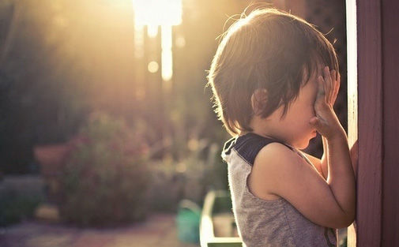
逃离火山岛
---融合主位推进之平行性原则与交叉性原则进行铺排叙事

Slide 3
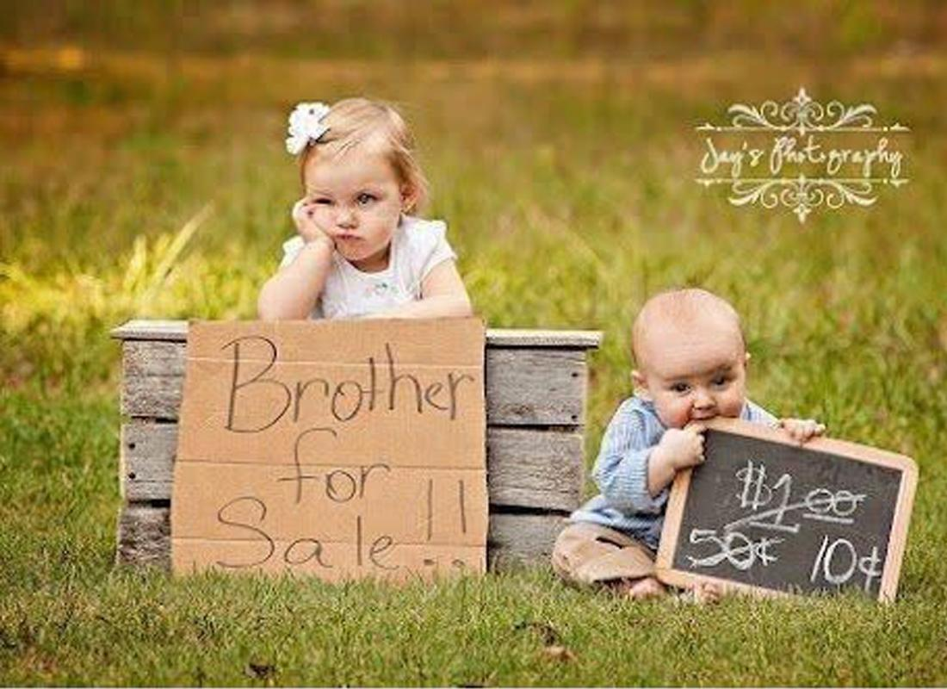

Slide 4
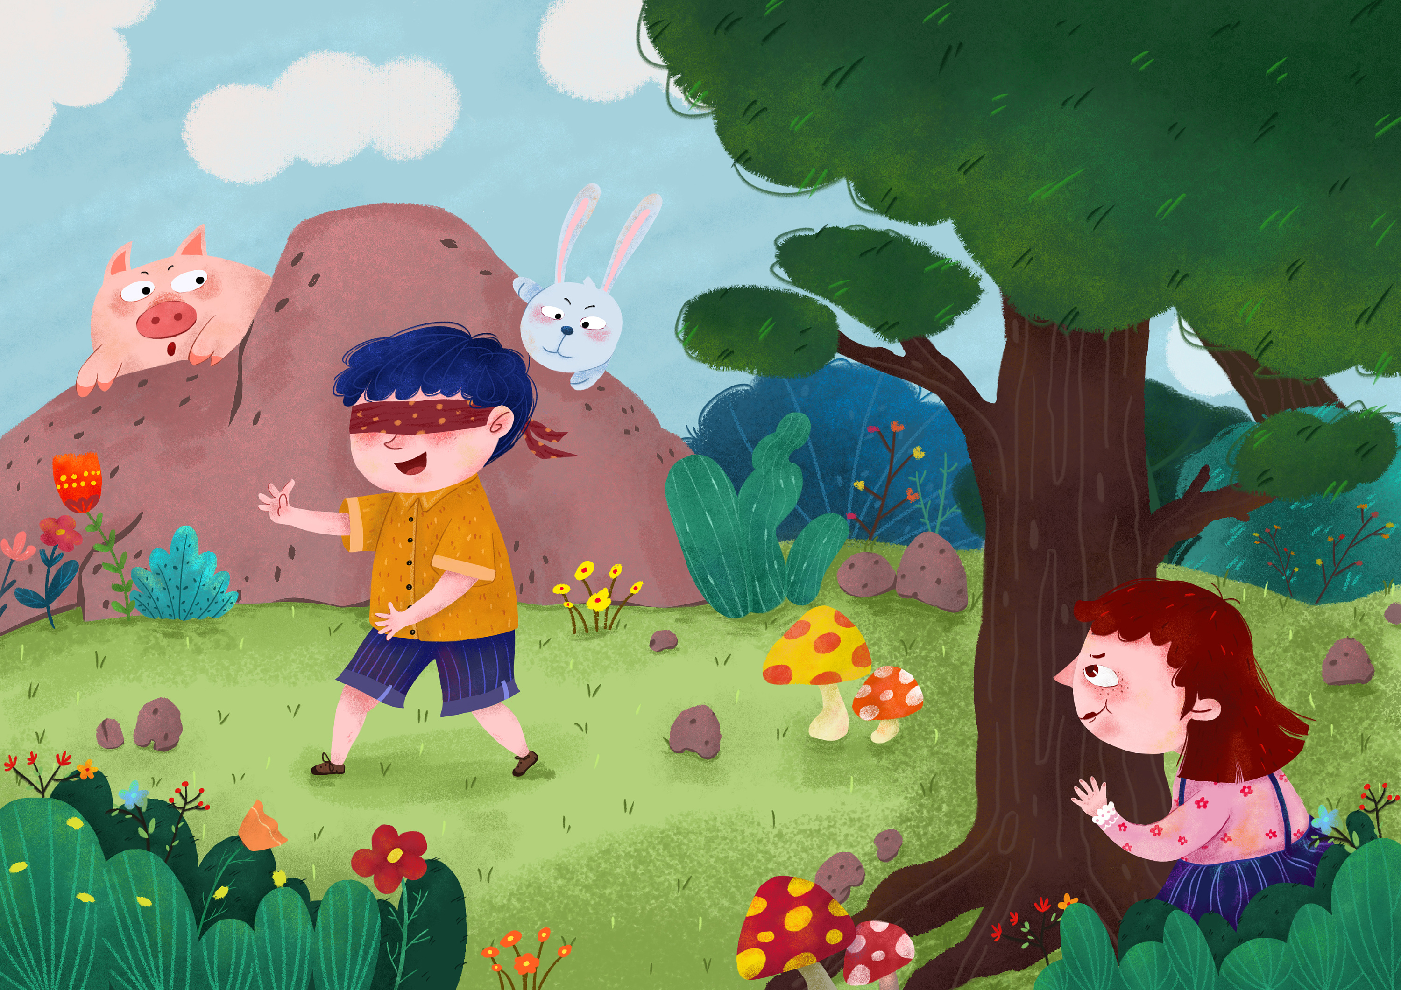
原文本
Rising to reach for the book on the desk in the living room, Gudrun fell over her little brother, who had crawled out from underneath her chair. “Arnar! Why do you always have to be right under me?”
The five-year-old giggled. “I was hiding,” he said, “and you found me.”
“I'm not playing,” Gudrun scolded. “I'm knitting. And it's time for you to go to bed.” Her parents had gone out for the evening, leaving Gudrun in charge.
“Let me hide once more,” Arnar begged. “Then I'll go to sleep, I promise.”
Gudrun couldn't help smiling. “Oh, all right.” She turned back to her knitting. “I'll look for you when I've finished this row.”
“Here's a clue,” Arnar called as he skipped away. “Look for me where I always am.”
But Gudrun was already absorbed in her work.
Gudrun wasn't sure what had awakened her in the middle of the night. Was it the urgency in Mamma's voice or the frightening and low rumble that rolled through her room? Gudrun found herself suddenly wide awake, drawn to the window by a strange and unfamiliar brilliance outside. “An eruption,” Mamma said as she began to gather Gudrun's clothes. “Maybe Helga fell, maybe a new volcano. We must leave the island quickly.”
“Tonight? How?” Gudrun asked, her heart pounding. “Where will we go?”
“We're lucky. The fishing boats will take us to the mainland.” Mamma turned to face Gudrun. “Pabbi has already gone to the harbor. I'm going to help Margret.” Their elderly neighbor lived alone. Mamma proceeded, “can you dress Arnar and take him to the harbor by yourself?”
“Of course,” she declared. Everyone would help tonight. Icelanders had always worked together to survive in a land ruled by volcanoes, glaciers, and ocean.
Gudrun dressed and ran to her brother's room. “Arnar!” she cried, “Wake up!” Hearing no response, Gudrun hurried to the bed and pulled back her brother's thick cover.

Slide 5
Read for plot
Rising to reach for the book on the desk in the living room, Gudrun fell over her little brother, who had crawled out from underneath her chair. “Arnar! Why do you always have to be right under me?”
The five-year-old giggled. “I was hiding,” he said, “and you found me.”
Q1： What was Arnar doing? Where did he always hide?

Slide 6
“I'm not playing,” Gudrun scolded. “I'm knitting. And it's time for you to go to bed.” Her parents had gone out for the evening, leaving Gudrun in charge.
“Let me hide once more,” Arnar begged. “Then I'll go to sleep, I promise.”
Gudrun couldn't help smiling. “Oh, all right.” She turned back to her knitting. “I'll look for you when I've finished this row.”
“Here's a clue,” Arnar called as he skipped away. “Look for me where I always am.”
But Gudrun was already absorbed in her work.
Q2: What was Gudrun doing?
Q3:Who looked after Arnar that evening?

Slide 7
Gudrun wasn't sure what had awakened her in the middle of the night. Was it the urgency in Mamma's voice or the frightening and low rumble that rolled through her room? Gudrun found herself suddenly wide awake, drawn to the window by a strange and unfamiliar brilliance outside. “An eruption,” Mamma said as she began to gather Gudrun's clothes. “Maybe Helga fell, maybe a new volcano. We must leave the island quickly.”
Q4: What happened ?
Q5: What must they do?

Slide 8
“Tonight? How?” Gudrun asked, her heart pounding. “Where will we go?”
“We're lucky. The fishing boats will take us to the mainland.” Mamma turned to face Gudrun. “Pabbi has already gone to the harbor. I'm going to help Margret.” Their elderly neighbor lived alone. Mamma proceeded, “can you dress Arnar and take him to the harbor by yourself?”
“Of course,” she declared. Everyone would help tonight. Icelanders had always worked together to survive in a land ruled by volcanoes, glaciers, and ocean.
Q6: Where would they go? How?
Q7: What would their mother do next?

Slide 9
Gudrun dressed and ran to her brother's room. “Arnar!” she cried, “Wake up!” Hearing no response, Gudrun hurried to the bed and pulled back her brother's thick cover.
Para1: Arnar wasn’t there!
Para2: There, curled around a worn stuffed bear, was Arnar, sound asleep.
Q8: Was Arnar in his room?
Q9: Can you tell the difference between “there” in Para1 and “there” in Para2?

Slide 10
Read for clues and echoes
Rising to reach for the book on the desk in the living room, Gudrun fell over her little brother, who had crawled out from underneath her chair. “Arnar! Why do you always have to be right under me?” The five-year-old giggled. “I was hiding,” he said, “and you found me.” .
clues
echoes
1. Arnar hid under Gudrun’s chair again or under Gudrun’s bed .
2. Arnar was found by his sister no matter where he hid.

Slide 11
Read for clues and echoes
“Here's a clue,” Arnar called as he skipped away. “Look for me where I always am.” But Gudrun was already absorbed in her work..
clues
echoes
3. How much Gudrun regretted being absorbed in knitting instead of looking for her adorable brother.
4. “What was the Clue?” Gudrun exclaimed. All of a sudden, “Look for me where always am” rang in her ears.

Slide 12
Read for clues and echoes
“An eruption,” Mamma said as she began to gather Gudrun's clothes. “Maybe Helga fell, maybe a new volcano. We must leave the island quickly.”
clues
echoes
5. No sooner had the family hopped onto their Pabbi’s boat than Helga fell.
6. A new volcano erupted, with red hot lava shooting high in the night starry sky.

Slide 13
Read for clues and echoes
“Pabbi has already gone to the harbor. I'm going to help Margret.” Their elderly neighbor lived alone. Mamma proceeded, “can you dress Arnar and take him to the harbor by yourself?”
clues
echoes
7. Their anxious parents were waiting for the brother and sister , constantly looking up in the distance , with worry
Written on their faces.

Slide 14
Read for clues and echoes
Everyone would help tonight. Icelanders had always worked together to survive in a land ruled by volcanoes, glaciers, and ocean.
clues
echoes
8. Red hot lava swallowed their houses in a split second. Tears streaming down their faces, they bid farewell to their homeland, setting for mainland.

Slide 15
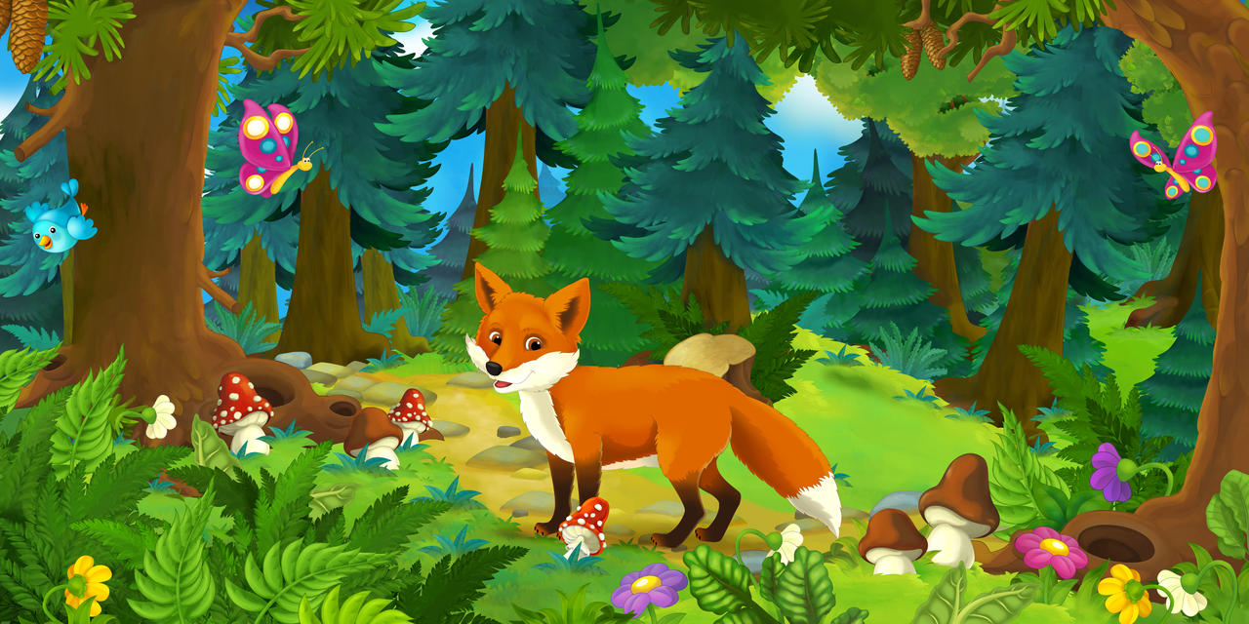
who
where
When
The cause
The process
The result
Six elements
Six detailed elements of the text
Gudrun, Arnar, parents; Margret; Icelanders
at home , the harbour
midnight
A volcano erupted.
Gudrun couldn’t find her brother Arnar.
Where was Arnar?

Slide 16
处理衔接处：
Gudrun dressed and ran to her brother's room. “Arnar!” she cried, “Wake up!” Hearing no response, Gudrun hurried to the bed and pulled back her brother's thick cover.
Para1: Arnar wasn’t there!
Para2: There, curled around a worn stuffed bear, was Arnar, sound asleep.
首段衔接1：A: （主语 Arnar平行叙述：他去哪里拉呀？） Arnar disappeared from his room!
首段衔接1： B: （结合尾段叙事主语 Gudrun,进行交叉叙事，描述弟弟不见了，姐姐的情感体验：Seized by an enormous wave of shock, Gudrun couldn’t believe what she saw under the thick cover!

Slide 17
Gudrun dressed and ran to her brother's room. “Arnar!” she cried, “Wake up!” Hearing no response, Gudrun hurried to the bed and pulled back her brother's thick cover.
Para1: Arnar wasn’t there!
Para2: There, curled around a worn stuffed bear, was Arnar, sound asleep.
首段尾句衔接2：A: （根据Para2主语 Arnar进行平行叙述：Arnar 又躲在了她的椅子下） Arnar hid himself again under her chair. As Gudrun was dedicated to her knitting, she took no notice of what Arnar did at all.
首段尾句衔接2： B: （躲藏的地方，只要是家里，还可以是床底下）Never in Gudrun’s wildest dream had she imagined that her clever adorable brother hid himself under her bed.

Slide 18
Para1: Arnar wasn’t there!
Para2: There, curled around a worn stuffed bear, was Arnar, sound asleep.
二段首句衔接3：A: （根据原文新火山喷发，说明Gudrun 要行动迅速，分秒必争） Gudrun pulled/ dragged her brother out from under the bed and woke up him immediately . “ We have to race against time. We are in danger. And we have to run to the harbor, where our parents and our neighbor Margret are waiting for us.”
二段首句衔接3： B: （找到了弟弟，姐姐可以松一口气了。但是轰鸣声越来越响。）Seeing his brother sleeping soundly, Gudrun breathed a sigh of relief. But she had only a little time for an escape, with the volcano rumbling outside like thunders. She cupped her hands over Arnar and soothed him gently.

Slide 19
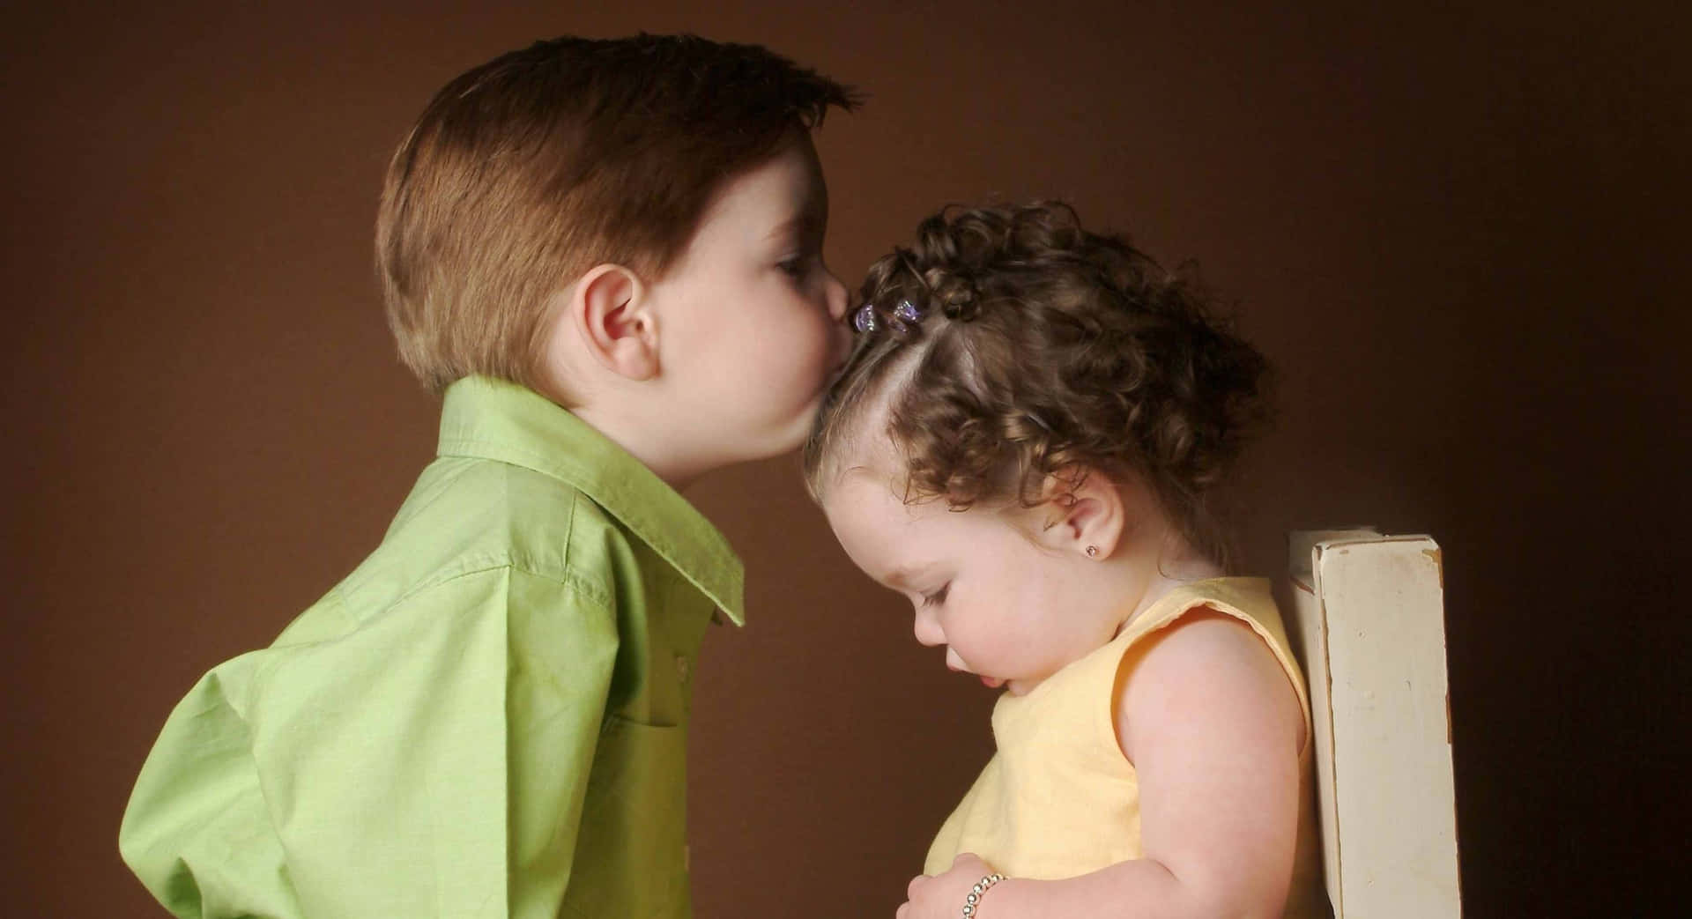
习作句式及逻辑拆解 主语切换 方便行文
Para1: Arnar wasn’t there!
(Done 短语，sb did sth: Gudrun 很吃惊，无法相信被子地下看见的情景） Seized by an enormous wave of shock, Gudrun couldn’t believe what she saw under the thick cover!
（平行主语 Gudrun 的细腻心理活动） “ Where did Arnar go? What did he do before I went to bed?” Gudrun thought to herself.
平行主语Gudrun：表达当初织毛衣时没好好照看弟弟。）How（感叹句： Gudrun regretted being absorbed in knitting instead of looking after her adorable brother！
( 无灵主语句： 弟弟说过的话在耳畔回响）Then suddenly Arnar’s words echoed in her ear—”Here's a clue. Look for me where I always am.”

Slide 20
习作句式及逻辑拆解 主语切换 方便行文
5. （无灵主语句： 忽然灵感闪现） An inspiration flashed across her mind.
6. （ 承接上句：猜测 躲藏的地方：主语切换到Arnar）Arnar must have hidden under something.
7. （并列句：Gudrun 开始寻找；主语切换回到Gudrun)Gudrun kicked off her search by looking down Arnar’s bed but no luck.
8. （时间状语从句+无灵主语句： 平行主语 Gudrun的眼睛落到了椅子上） ；As she went back to the living room, her eyes fell onto the chair.

Slide 21
习作句式及逻辑拆解 主语切换 方便行文
Para2: There, curled around a worn stuffed bear, was Arnar, sound asleep.
（主语切换到寻找弟弟的Gudrun 如释重负） Gudrun breathed a sigh of relief.
（ with 结构+ 平行主语Gudrun 火山喷发的声音，姐姐自己也很惊慌) With the volcano rumbling outside like thunders, Gudrun felt her heart almost beating out of her chest.
3. ( Doing sth, sb did sth : 平行主语 Gudrun 安抚弟弟） Noticing Arnar in great panic, Gudrun cupped her hands over Arnar’s ears and soothed him gently. “
4. （夸张的写作手法：姐姐不告诉弟弟险情，用躲猫猫的方法来解决去港口）“We will hide in a boat in the harbor. Arnar, let’s run !” After what seemed like centuries, the sibling made it to the harbor.

Slide 22
习作句式及逻辑拆解 主语切换 方便行文
5. （ with 结构+sb did sth, doing 短语：切换主语到焦急的父母） Their anxious parents were waiting for them, looking up in the distance, with worry on their face.
6. （ 倒装句：切换主语到船上的家人邻居等：刚上船，滚烫的岩浆吞噬了美丽家园）No sooner had the family and neighbors hopped onto the boat than red hot lava swallowed their beautiful homes.
7. （ 独立主格 结构+ 切换主语到船上的冰岛人：告别故土，对未来充满希望） Tears streaming down their faces, they bid farewell to their homeland, setting for mainland. They, persistent Icelanders, would work together again to build a brand new hometown!

Slide 23
习作欣赏
Para1: Arnar wasn’t there! Seized by an enormous wave of shock, Gudrun couldn’t believe what she saw under the thick cover! “ Where did Arnar go? What did he do before I went to bed?” Gudrun thought to herself. How Gudrun regretted being absorbed in knitting instead of looking after her adorable brother. Then suddenly Arnar’s words echoed in her ear—”Here's a clue. Look for me where I always am.” An inspiration flashed across her mind. Arnar must have hidden under something. Gudrun kicked off her search by looking down Arnar’s bed but no luck. As she went back to the living room, her eyes fell onto the chair.

Slide 24
Para2: There, curled around a worn stuffed bear, was Arnar, sound asleep. Gudrun breathed a sigh of relief. With the volcano rumbling outside like thunders, Gudrun felt her heart almost beating out of her chest. Noticing Arnar in great panic, Gudrun cupped her hands over Arnar‘s ears and soothed him gently. “We will hide in a boat in the harbor. Arnar, let’s run !” After what seemed like centuries, the sibling made it to the harbor. Their anxious parents were waiting for them, looking up in the distance, with worry on their face. No sooner had the family and neighbors hopped onto the boat than red hot lava swallowed their beautiful homes. Tears streaming down their faces, they bid farewell to their homeland, setting for mainland. They, persistent Icelanders， would work together again to build a brand new hometown!

Slide 25
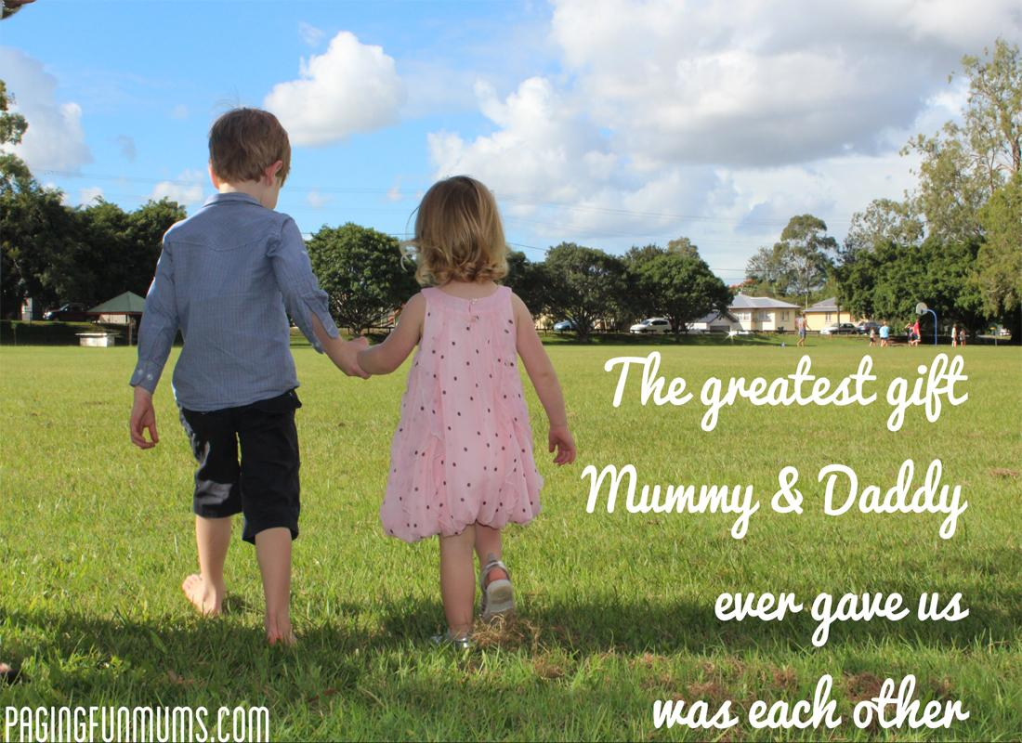
本篇文章看似描述姐弟情，但实则讲述的是姐弟俩在火山喷发的那个夜晚，一起逃离火山。文中有一句：Everyone would help tonight. Icelanders had always worked together to survive in a land ruled by volcanoes, glaciers, and ocean. 说明本文的续写可以有较高的立意。

