Slide 1

感恩遇见，相互成就，本课件资料仅供您个人参考、教学使用，严禁自行在网络传播，违者依知识产权法追究法律责任。
更多教学资源请关注
公众号：溯恩高中英语
知识产权声明

Slide 2

How to describe a dog?
狗是人类的好朋友·也是读后续写的好题材
—— 吴俊峰 张立春——

Slide 3
1.
Lead in - how do you describe man's best friend?
It's hard to sum up man's best friend using words alone. Countless authors have written on what it is that makes dogs so amazing. There are many quotes about dogs and sayings. There are beautiful stories of dogs who have rescued their owners just as much as their owners have rescued them. And then there are the beautiful moments where dogs make a human's life so much better. So how do you describe man's best friend? What is it about dogs that makes our lives better, that makes us love these animals as members of our families?
While describing man's best friend accurately is a challenge, the quotes and photos in this video do it beautifully. Take a look at this touching video.
仅用语言很难概括人类最好的朋友。无数作家都曾写过关于狗之所以如此神奇的原因。有许多关于狗的名言和格言。有很多关于狗的美丽故事，它们救了主人，就像主人救了它们一样。还有一些美好的时刻，狗让人类的生活变得更好。那么你如何描述人类最好的朋友呢? 是什么让我们的生活更美好，是什么让我们像爱家人一样爱这些动物?
虽然准确地描述人类最好的朋友是一个挑战，但这段视频中的引用和照片做到了这一点。看看这个感人的视频。

Slide 4
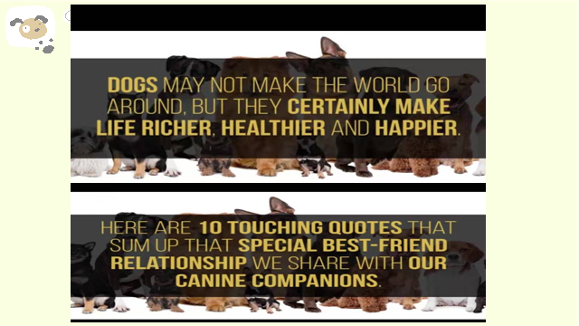
1.
Lead in - Play the video
Dogs may not make the world go around, but they certainly make life richer, healthier and happier. Here are 10 touching quotes that sum up that special best-friend relationship we share with our canine companions. canine /ˈkeɪnaɪn/ adj. 犬的；犬齿的；犬科的；似犬的

Slide 5
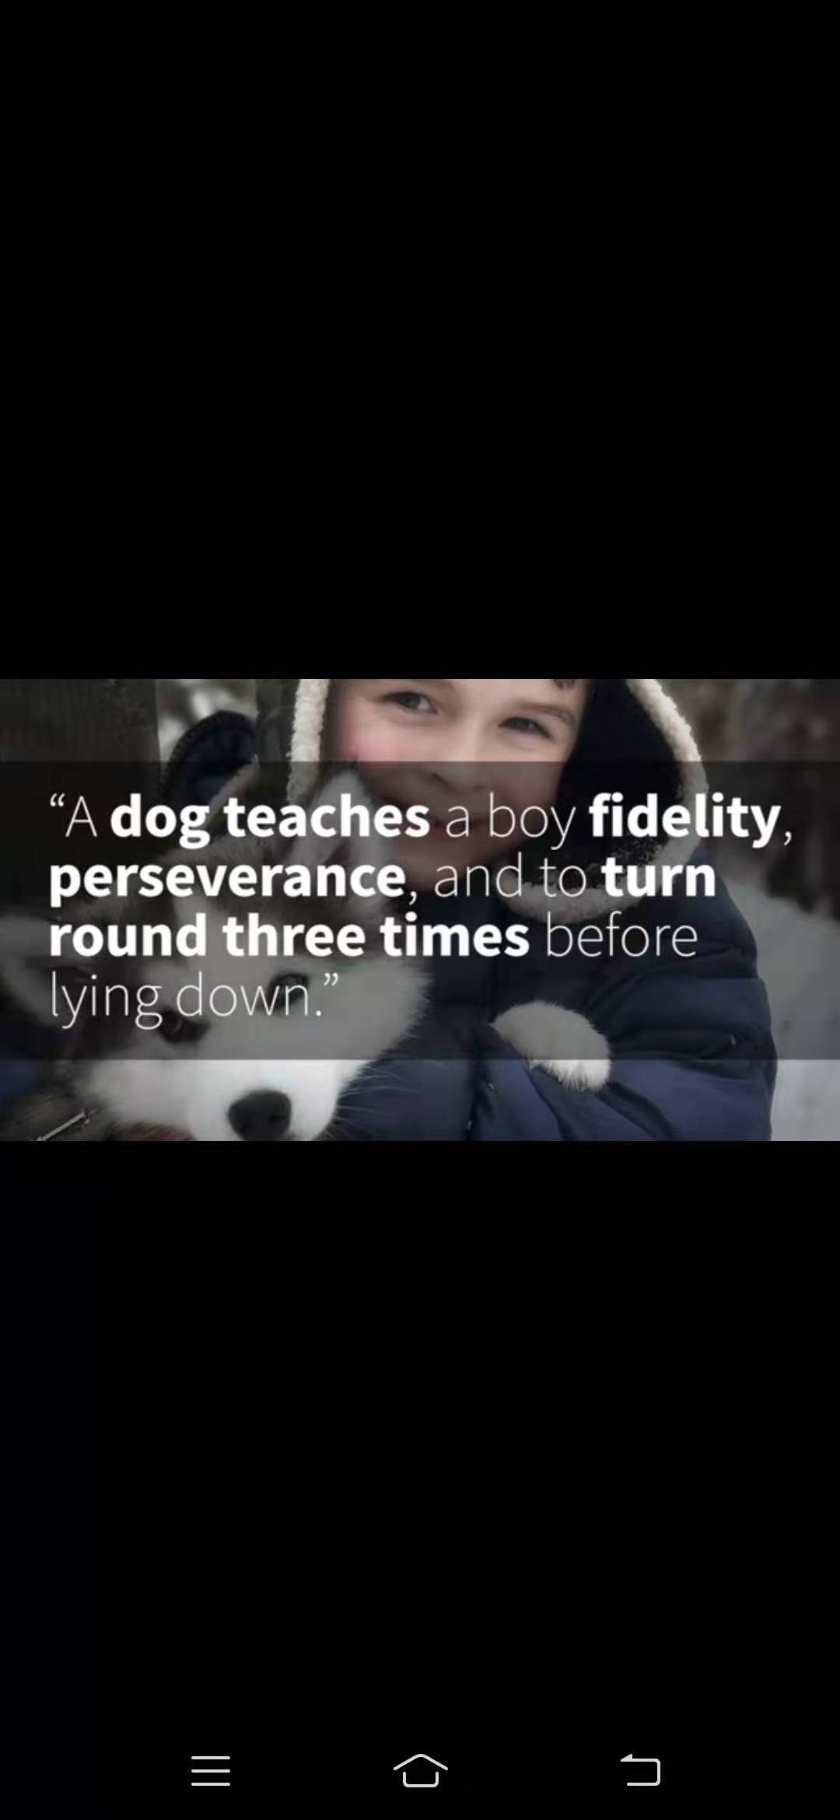
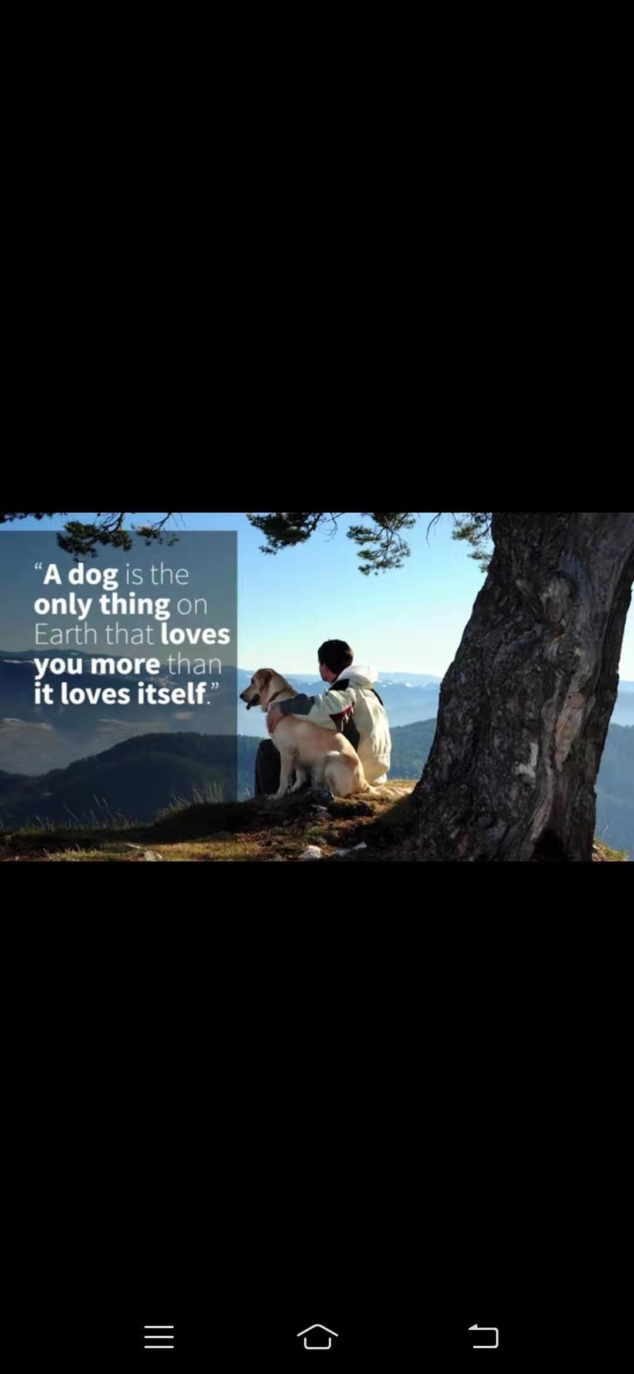
1.
10 touching quotes describing human-dog relationship
A dog is the only thing on Earth that loves you more than it loves itself.
狗是世界上唯一爱你胜过爱自己的动物。
A dog teaches a boy fidelty, perseverance, and to turn around three times before lying down.
狗教会一个男孩忠诚，坚韧，在倒下之前还要奋力一搏。
fidelity /fɪˈdeləti/ n. 保真度；忠诚；精确；尽责

Slide 6
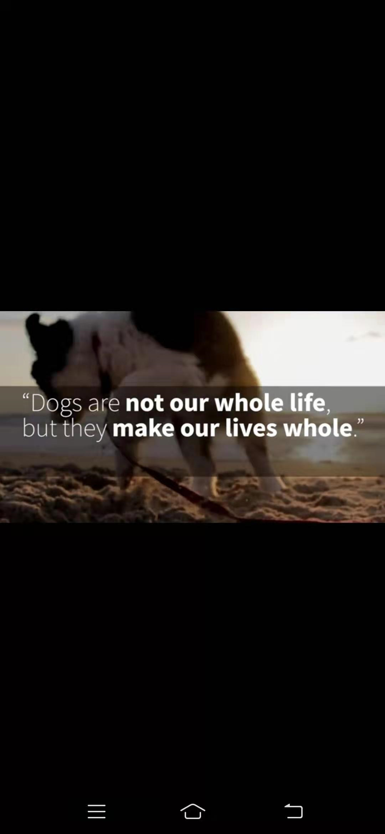
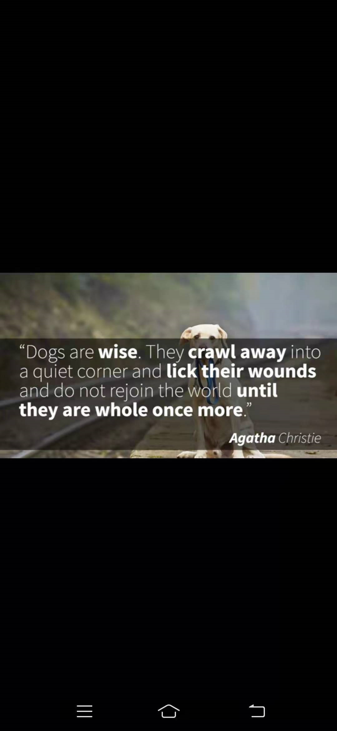
1.
10 touching quotes describing human-dog relationship
Dogs are wise. They crawl away into a quite corner and lick their wounds and do not rejoin the world until they are whole once more.
狗是明智的。他们爬到一个安静的角落，舔着伤口，直到他们再次调整好，才重新回到这个世界。
crawl /krɔːl/ v. 爬行
Dog are not our whole life, but they make our lives whole.
狗不是我们生活的全部，但它们使我们的生活完整。

Slide 7


1.
10 touching quotes describing human-dog relationship
The better I get to known men, the more I find myself loving dogs.
我越了解人，就越喜欢狗。。
The world would be a nicer place if everyone had the ability to love as unconditionally as a dog.
如果每个人都能像狗一样无条件地去爱，世界会变得更美好。
unconditionally /ˌʌnkənˈdɪʃənəli/ adv. 无条件地

Slide 8
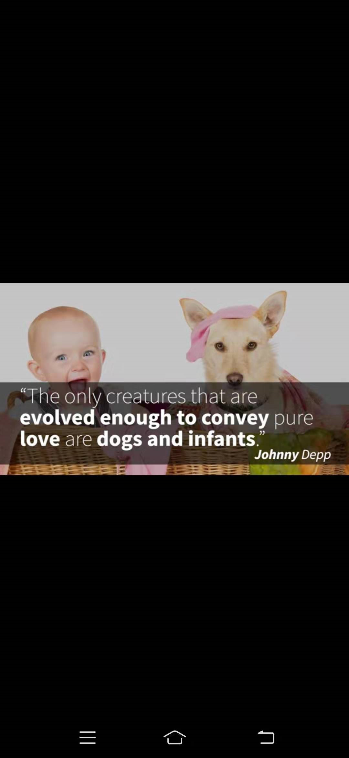
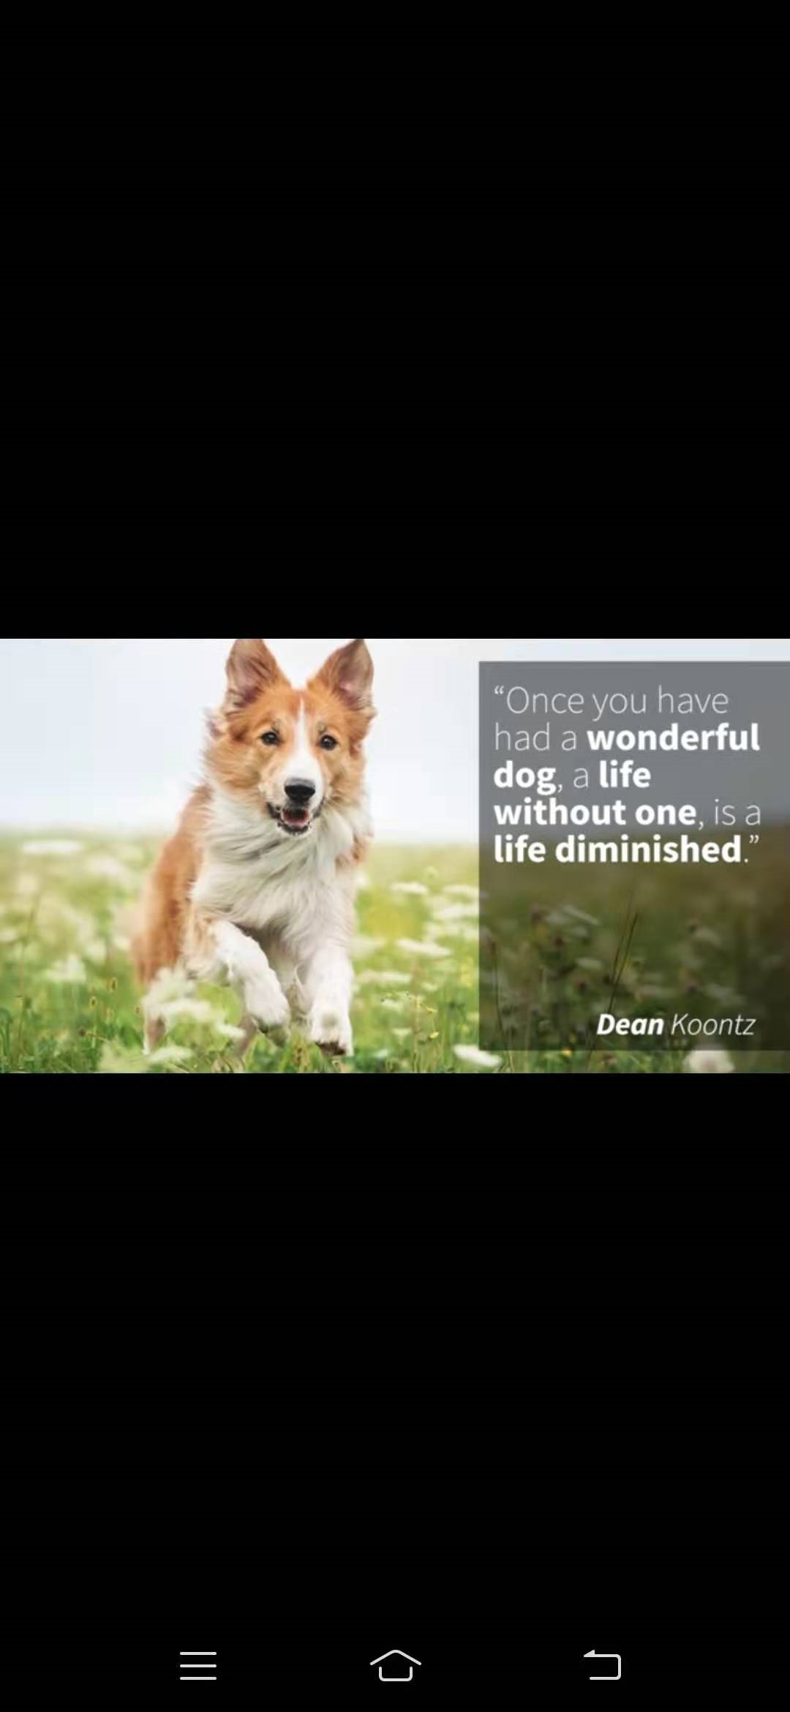
1.
10 touching quotes describing human-dog relationship
Once you had a wonderful dog, a life without one, is a life diminished.
一旦你有了一只好狗，没有它的生活，就是打了折扣的生活。
diminish /dɪˈmɪnɪʃ/ v. 减少，缩小；变小
The only creature that are evolved enough to convey pure love are dogs and infants.
狗和婴儿是唯一进化到可以产生纯洁感情的生物。
evolve /ɪˈvɒlv/ vi. 发展，进展；进化；逐步形成
infant /ˈɪnfənt/ n. 婴儿；幼儿；未成年人

Slide 9

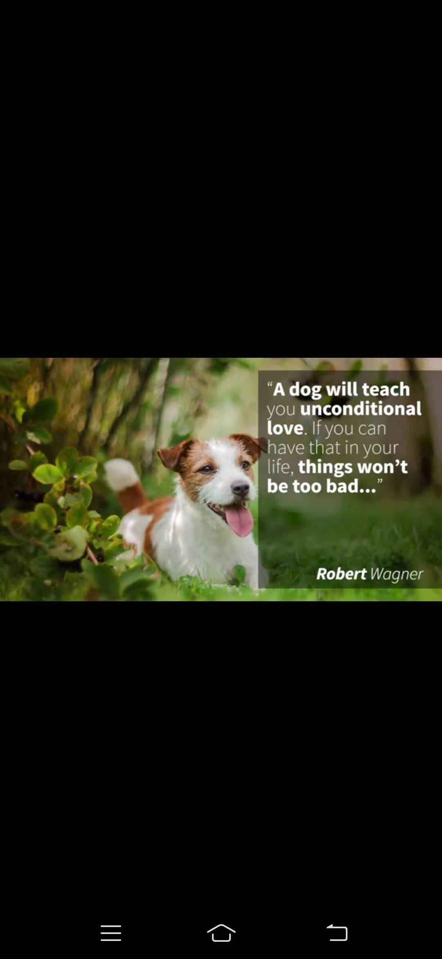
1.
10 touching quotes describing human-dog relationship
A dog will teach you unconditional love. If you can have that in your life, things won't be too bad...
狗狗会教你无条件的爱。如果你能在生活中拥有它，事情就不会太糟糕……
I care not for a man's religion whose dog and cat are not the better for it.
我不关心一个人的宗教，因为他的猫狗是最好的宗教。

Slide 10
1.
Lead in - you might just find your next best friend
If you're lucky enough to share your life with a dog, then you know how awesome dogs are. They make us laugh, they drive us a bit crazy, and they're always up for a good cuddle. Dogs give us company, reassurance, and love. cuddle /ˈkʌdl/ v. 拥抱；偎依；亲热地搂住 n. 搂抱，拥抱
reassurance / ˌriːəˈʃʊərəns/安慰；慰藉
Don't have a dog in your life just yet? There are countless reasons why you might want to consider getting one. Dogs encourage us to get some exercise, and they can be great guardians. Dogs can help to relieve stress and can even help people to better cope with depression.
If you're thinking that it might be time to bring home a dog, head to your local shelter or rescue and see what dogs are in need of homes. You never know - you might just find your next best friend.
如果你足够幸运能和狗狗共度一生，你就会知道狗狗有多棒。它们让我们欢笑，让我们有些疯狂，它们总是让我们拥抱。狗给了我们陪伴、安慰和爱。你还没有养狗吗? 你可能会有无数的理由去考虑买一个。狗鼓励我们做一些运动，它们可以是很好的监护人。狗可以帮助缓解压力，甚至可以帮助人们更好地应对抑郁。如果你觉得是时候把狗带回家了，那就去当地的收容所或救助站看看狗狗们需要什么样的家。你永远不会知道——你可能会找到下一个最好的朋友。

Slide 11
1.单身·狗
2.狗·狗
3.狗狗·人类
4.狗·读后续写

Slide 12
单身·狗

Slide 13
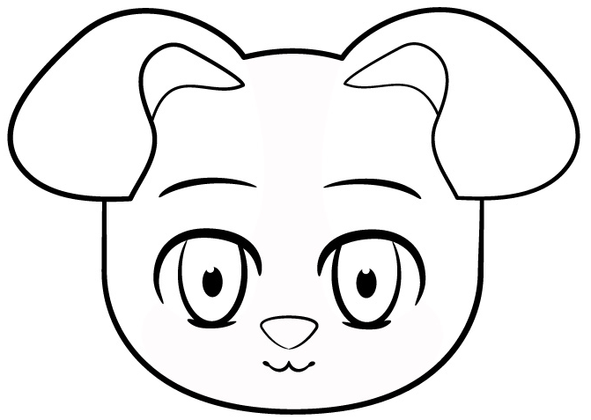
2.
Dog profile
New research is revealing ever more intricate connections between human and dog. Without that initial starting phase of dog domestication, civilisation just would not have been possible.
We have an extraordinary relationship with dogs. We love them like no other animal on the planet. What makes our relationship so special, is perhaps the dog's ability to be able to read our emotions so effectively. We've got over 400 breeds across the world and every one of them has something special about them. What do you know about the dogs?
intricate /ˈɪntrɪkət/ adj. 复杂的；错综的
initial /ɪˈnɪʃl/ adj. 最初的
domestication /dəˌmestɪˈkeɪʃn/ n. 驯养；教化
一项新的研究让我们对人与狗之间的复杂沟通关系有了新的认识，如果没有完成对狗的驯化，人类也就不可能进入文明社会。
我们与狗狗存在着非常特殊的关系。我们爱它们胜过地球上其他任何动物，可能是因为狗狗懂得分辨我们的情绪，这使得它们与我们的关系变得特别。全世界范围有超过400种狗狗，其中的每一种都有其特别之处。 你了解多少？

Slide 14
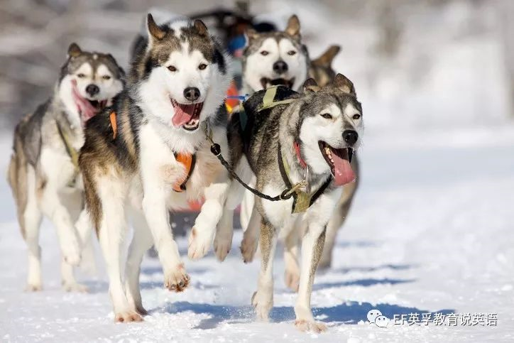
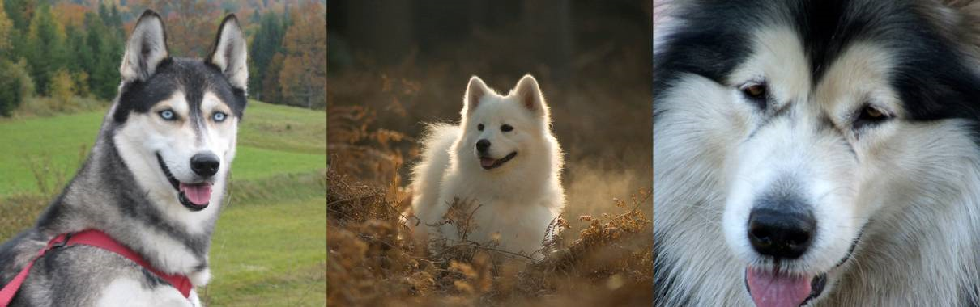
2.
Dog profile
Husky /ˈhʌski/ 哈士奇
friendly 友好
gentle 温和
dignified /ˈdɪɡnɪfaɪd/ 高贵的
alert, but not aggressive /əˈlɜːt/ 警觉的但没有侵略性
adorkable 呆萌=dorky /ˈdɔːki/ 呆傻+adorable /əˈdɔːrəbl/可爱
New owners should be prepared to provide an outlet for daily exercise.
对于哈士奇新手应该有些心理准备，需要为二哈们准备一个每天可以锻炼的途径哦。

Slide 15
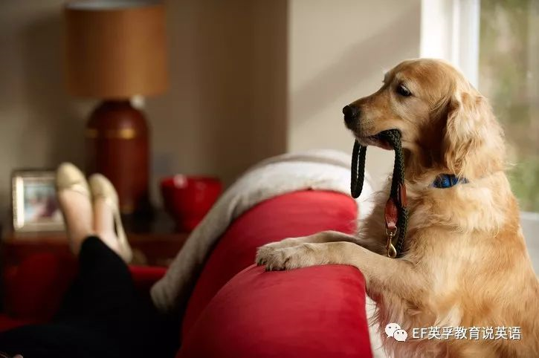
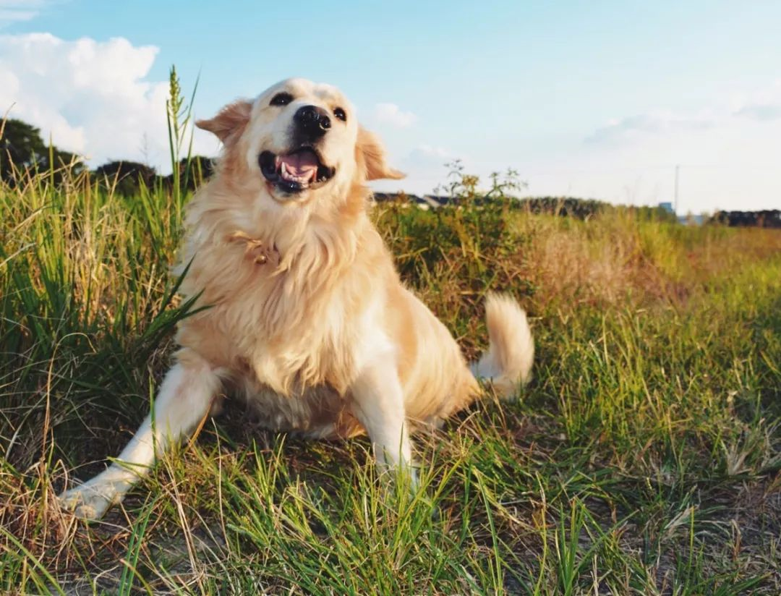
2.
Dog profile
Golden retriever /rɪˈtriːvə(r)/ 金毛，动词 retrieve“找回猎物”； retriever“寻回犬”
intelligent 有才智的
friendly 友好的
devoted 忠诚的
This dog is active and energetic, and needs daily exercise.
这种狗非常活泼且精力充沛，需要每天锻炼。

Slide 16
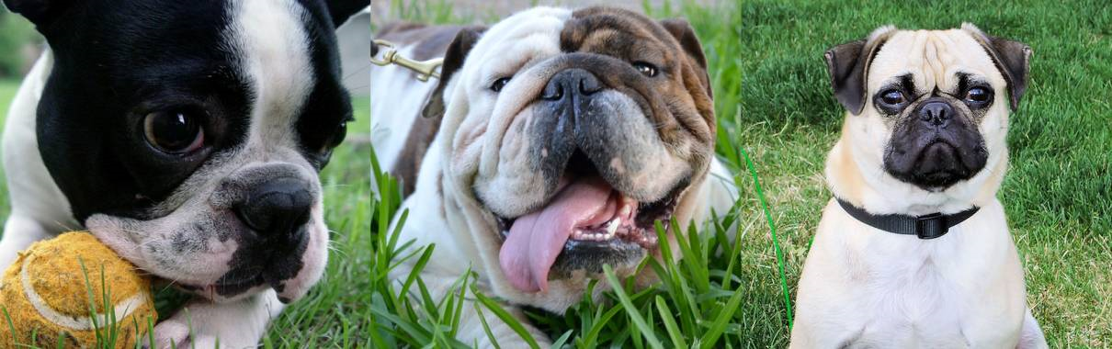
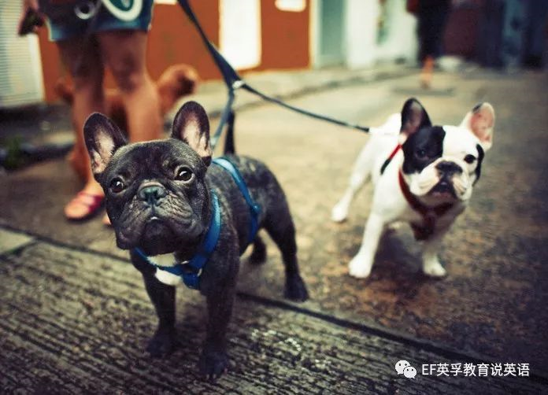
2.
Dog profile
French bulldog / frenchie 法国斗牛犬
playful 好玩的
smart 聪明的
adaptable 适应性强
completely irresistible /ˌɪrɪˈzɪstəbl/
完全不可抵抗的
Frenchies are easygoing, not terribly athletic; brisk walks will keep them trim.
法斗脾气随和，并不是那种可怕的运动员体质。轻快的散步可以让它们保持身形。
brisk /brɪsk/adj. 敏锐的，活泼的 trim /trɪm/ adj. 整齐的；身材苗条的

Slide 17
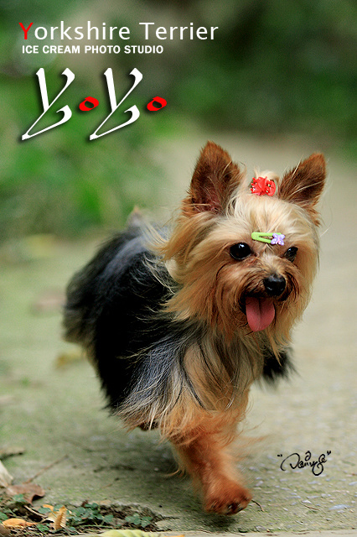
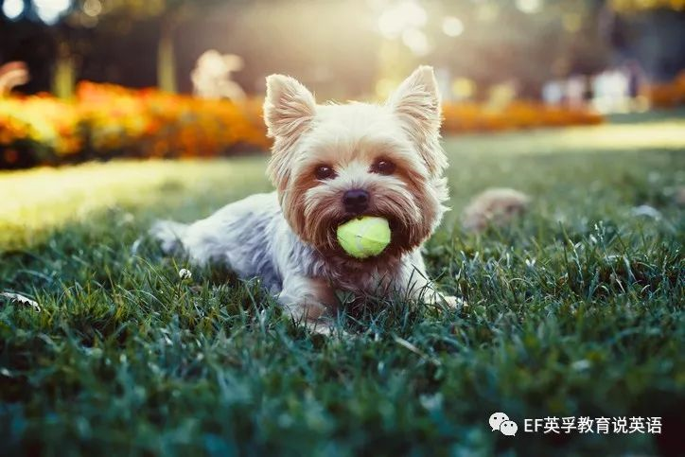
2.
Dog profile
Yorkshire Terrier (Yorkie)约克夏梗
sprightly /ˈspraɪtli/ 活泼的
tomboyish /'tɑm,bɔɪɪʃ/ 顽皮的
affectionate /əˈfekʃənət/ 深情的
Yorkies are moderately active and will be happy with a daily satisfying walk.
约克夏梗通常是适度活泼的，如果可以给它们每天一次令它满意的步行，它们会非常高兴的！ moderately /ˈmɒdərətli/ adv. 适度地；中庸地；有节制地

Slide 18
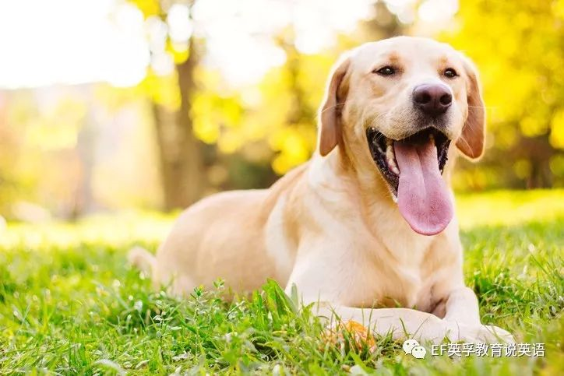
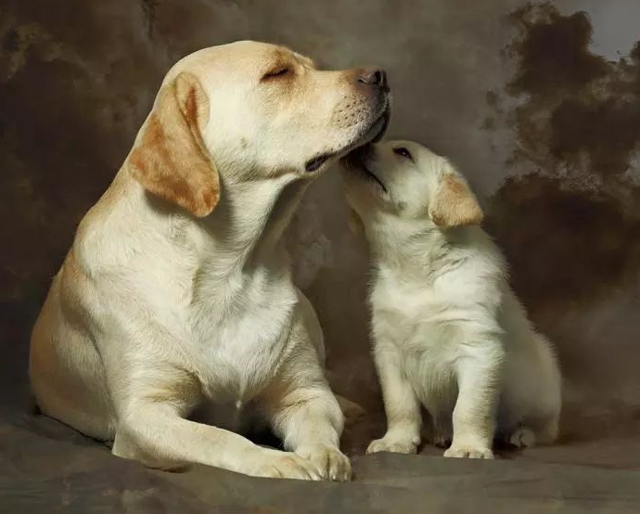
2.
Dog profile
Labrador /ˈlæbrədɔː(r)/ retriever 拉布拉多
friendly and outgoing
友好且开朗的
play well with others
和其他狗狗玩得很好，狗中社交高手
Labs are high-spirited and not afraid to show it.
拉布拉多非常生气勃勃，并且很乐于展现自己的活力。

Slide 19
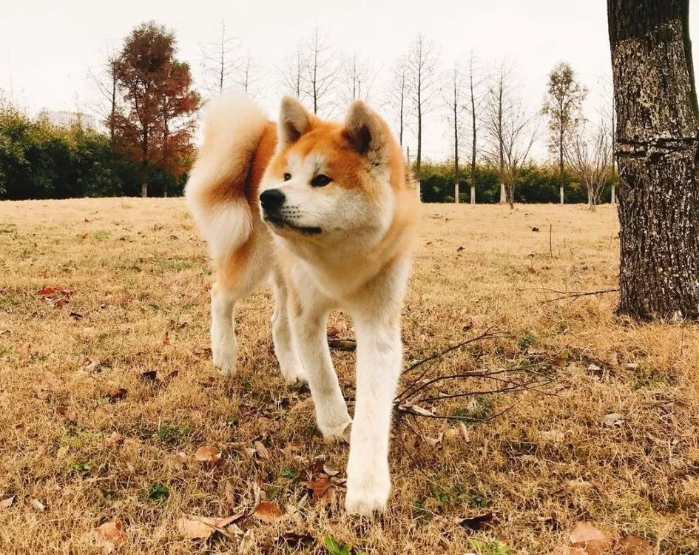
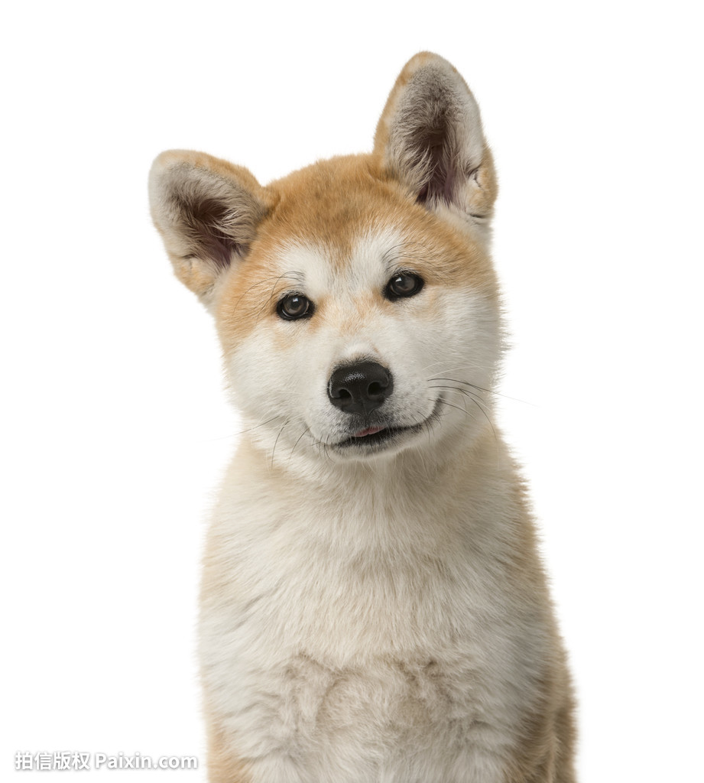
2.
Dog profile
Akita /əˈkiːtə/ 日本秋田
dignified 高贵的
courageous 有胆识的
profoundly loyal to their humans
/prəˈfaʊndli/ adv. 深刻地；深深地；极度地
对主人拥有深沉的忠诚度
Not a hyper breed, but these big guys enjoy regular exercise.
秋田不算一个会超级亢奋的品种，但这些大家伙很享受它们的常规训练。
hyper /ˈhaɪpə(r)/ adj. 亢奋的；高度紧张的
breed /briːd/ n. 品种；（人或物的）类型

Slide 20
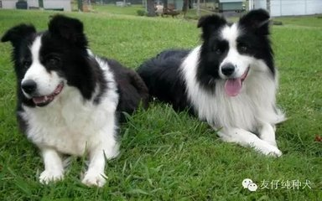
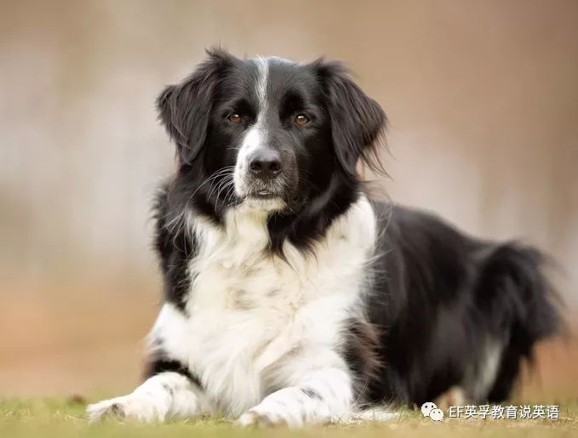
2.
Dog profile
Border Collie边境牧羊犬
remarkably smart 非常聪明
workaholics /ˌwɜːkəˈhɒlɪk/ 工作狂
keen, intelligent and alert 敏锐，聪明而且警惕
not averse to a good cuddle 对拥抱并不反感
/əˈvɜːs/ adj. 反对的；不愿意的
/ˈkʌdl/ v. 拥抱；偎依；亲热地搂住 n. 搂抱，拥抱
The uncanny intelligence, athleticism and trainability of Border Collies have a perfect outlet in agility work. 通过良好的驯化，边牧犬便可表现出不可思议的智慧、活力和可塑性。 uncanny /ʌnˈkæni/ adj. 神秘的；离奇的；可怕的
athleticism /æθˈletɪsɪzəm/ n. 运动能力 trainability 可训练性
outlet（感情、思想、精力发泄的）出路；表现机会 agility /əˈdʒɪləti/ n. 敏捷；灵活；机敏

Slide 21
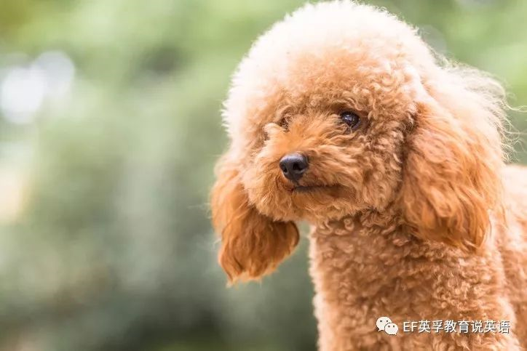
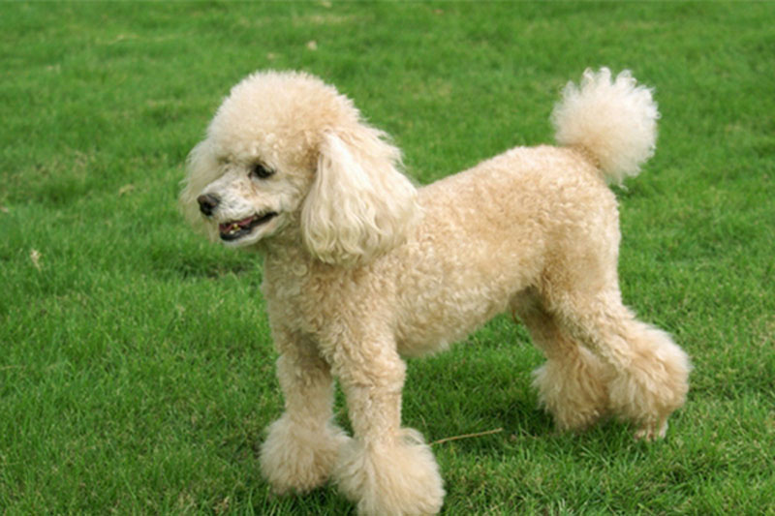
2.
Dog profile
poodle /ˈpuːdəl/ /Teddy dog贵宾犬
“泰迪”并不是犬的品种，而是贵宾犬的一种毛发造型方式。
proud 骄傲的
active 活跃的
very smart 非常聪明
Poodles are enthusiastic walkers, runners and swimmers. They're eager for all kinds of activity, and they enjoy keeping busy. 贵宾犬是非常狂热的步行者、奔跑者和游泳健将。它们非常渴望各种类型的活动，并且它们很享受保持着忙碌。

Slide 22
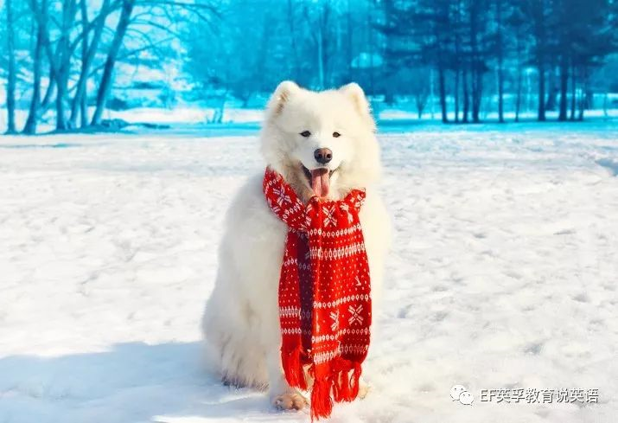
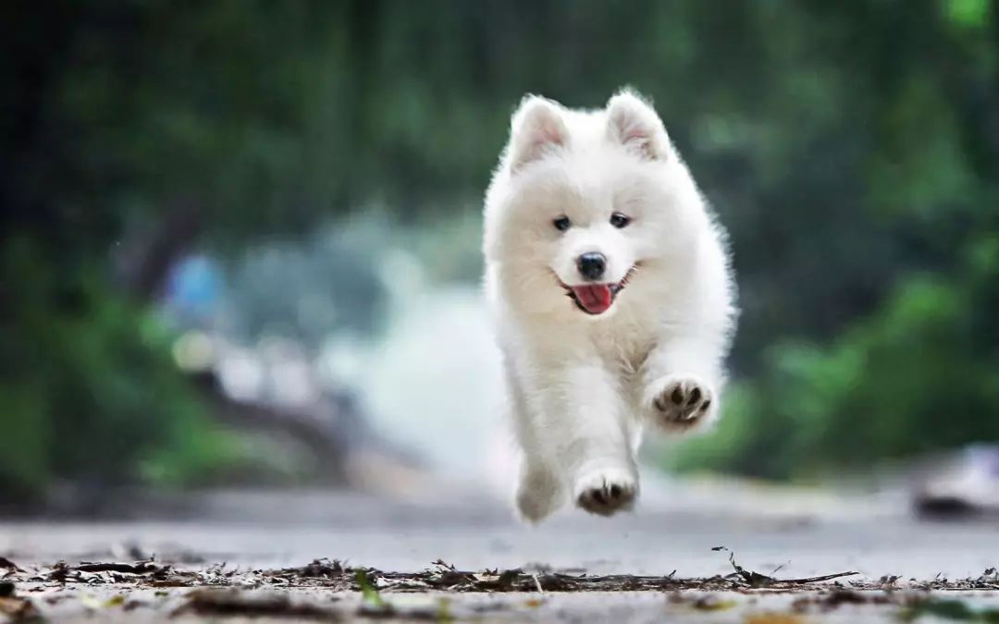
2.
Dog profile
Samoyed /ˈsæməjɛd/ 萨摩耶
gentle 温和的
adaptable 实用性强
friendly 友好的
conservative but never shy 有些保守但从来不害羞
/kənˈsɜːvətɪv/ adj. 保守的
Sammies are energetic, curious and independent; a fenced-in exercise room is a must. 萨摩耶充满能量，好奇心重也很独立；给它们提供一个围起来的训练室是很必须的。

Slide 23
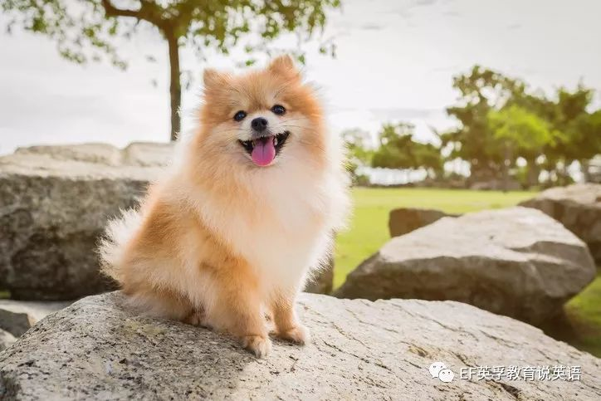
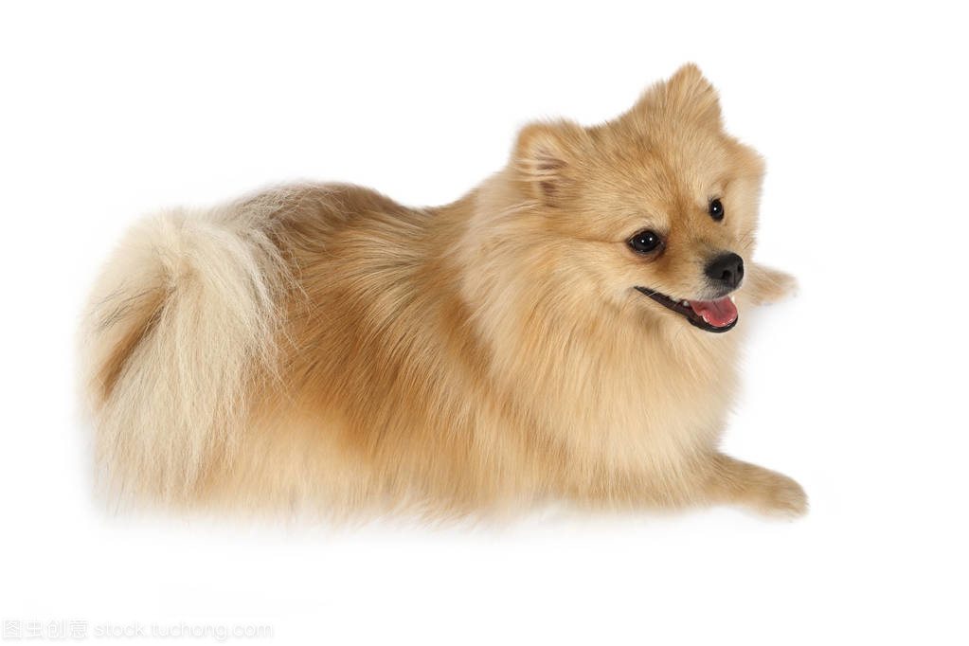
2.
Dog profile
Pomeranian dog博美犬
/,pɔmə'reiniən/
lively 活泼的
bold /bəʊld/ 大胆的
inquisitive /ɪnˈkwɪzətɪv/ 好奇的
Pomeranians are playful and vivacious, but also love to be lapdogs.
博美犬喜爱嬉戏并且充满生气，但也喜欢被当做供观赏用的小狗
vivacious /vɪˈveɪʃəs/ adj. 活泼的；快活的；有生气的

Slide 24
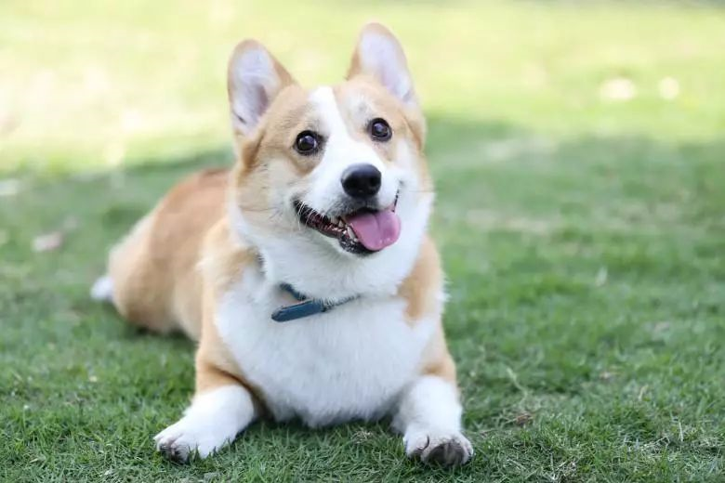
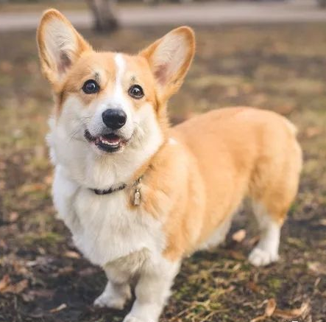
2.
Dog profile
Welsh Corgi /ˈkɔːɡi/ 威尔士柯基
loyal 忠诚的（所以成英国女王的最爱）
affectionate 深情的
smart 聪明
even-tempered, never shy 性情平和的，从不害羞
These rugged herders have a love for the outdoors. Corgis thrive on mental and physical activity. 这种顽强的牧羊犬热爱户外，通过心智和体育活动柯基可以得到成长。 rugged /ˈrʌɡɪd/ adj. 崎岖的；坚固的
thrive /θraɪv/ vi. 繁荣，兴旺；茁壮成长

Slide 25
2.
Describing a Dog
Describing a dog can be a very fun writing exercise. There are 3 different levels to describe our canine friends . Level 1 is in Basic English and it goes up to Level 3 which is Intermediate English.
LEVEL 3
A Labrador
LEVEL 2
LEVEL 1
A handbag dog
A puppy

Slide 26
2.
Describing a Dog （LEVEL-1）-A puppy
childlike /ˈtʃaɪldlaɪk/ adj. 天真烂漫的；孩子似的
innocent /ˈɪnəsnt/ adj. 无辜的；无罪的 n. 天真的人
jade-green /'dʒeidgri:n/ adj. 绿玉色的；浅绿色的
velvety /ˈvelvəti/ adj.
天鹅绒般柔软的；醇和的，可口的
hedgehog /ˈhedʒhɒɡ/ n. 刺猬；刺猬状
racoon /rəˈkuːn/ n. 浣熊
wag /wæɡ/ v. (狗) 摇摆 (尾巴)
adorable /əˈdɔːrəbl/ adj. 可爱的；可敬重的
arrow tips 箭头
yip /jɪp/ n. 叫喊声 vi. 犬吠；尖叫
yelp /jelp/ v. / n.
（因兴奋、疼痛等）尖叫，大叫；狗吠
cuddly /ˈkʌdli/ adj.
令人想拥抱的；喜欢搂搂抱抱的；逗人喜爱的
messy /ˈmesi/ adj. 凌乱的；不整洁的
wobbly /ˈwɒbli/ adj. 不稳定的；摆动的；歪斜的
wobbly on his feet 摇摇晃晃地站着
Level-1 A puppy
Face | childlike; innocent
Eyes | jade-green; jewel-green
Fur | silky; velvety
Paws | hedgehog paw；racoon paws
Tail | wagging; cute
Personality | playful; adorable
Teeth | like arrow tips; like needles
Bark | yipping; yelping
Body Shape | tiny; cuddly
Other Features | messy; wobbly on his feet

Slide 27
2.
Describing a Dog （LEVEL-1）- A puppy
Level-1 A puppy
Face | childlike; innocent
Eyes | jade-green; jewel-green
Fur | silky; velvety
Paws | hedgehog paw；racoon paws
Tail | wagging; cute
Personality | playful; adorable
Teeth | like arrow tips; like needles
Bark | yipping; yelping
Body Shape | tiny; cuddly
Other Features | messy; wobbly on his feet
1. My puppy has a very childlike face.
2. He has beautiful, jade-green eyes.
3. His fur is silky and smooth.
4. He has tiny, hedgehog paws.
5. Wagging his tail is his favourite activity!
6. He is very playful and a joy to be around.
7. His teeth are as sharp as needles.
8. He is always yelping at the cat.
9. I love him because he is so cuddly.
10. Sometimes he can be very wobbly on his feet.

Slide 28
2.
Describing a Dog （LEVEL-1）- A puppy
It was the dearest little waddling thing, and so smooth and soft and velvety, and had such cunning little awkward paws, and such affectionate eyes, and such a sweet and innocent face; and it made me so proud to see how the children and their mother adored it, and fondled it, and exclaimed over every little wonderful thing it did.
cunning /ˈkʌnɪŋ/ adj. 狡猾的；巧妙的；可爱的
fondle /ˈfɒndl/ vt. 爱抚；抚弄
它是最可爱的蹒跚的小东西，那么光滑、柔软，长着那么灵巧的小脚爪，那么深情的眼睛，那么可爱而天真的脸。我看到孩子们和他们的母亲都那么喜欢它，那么喜欢它所做的每一件奇妙的小事。
Level-1 A puppy
Face | childlike; innocent
Eyes | jade-green; jewel-green
Fur | silky; velvety
Paws | hedgehog paw；racoon paws
Tail | wagging; cute
Personality | playful; adorable
Teeth | like arrow tips; like needles
Bark | yipping; yelping
Body Shape | tiny; cuddly
Other Features | messy; wobbly on his feet

Slide 29
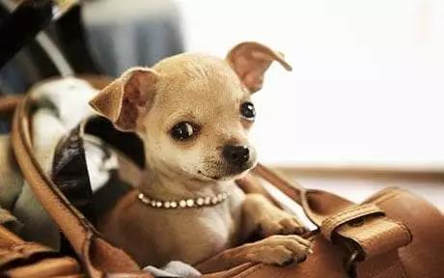
2.
Describing a Dog （LEVEL-1）- A handbag dog (吉娃娃)
Level-2 A handbag dog
Face | friendly; intelligent
Eyes | molten-brown; mocha-brown
Fur | polished; glossy
Paws | long claws; manicured
Tail | pom-pom tail; marshmallow
Personality | friendly; ladylike
Teeth | sharp teeth; cutting
Bark | yapping; playful
Body Shape | lean; whip-thin
Other Features | flea collar; begging for food
molten /ˈməʊltən/ adj. 熔化的；铸造的；炽热的
mocha /ˈmɒkə/ adj. 深咖啡色的
polished /ˈpɒlɪʃt/ adj. 擦亮的；优美的；圆滑的
glossy /ˈɡlɒsi/ adj. 光滑的；有光泽的
manicured /ˈmænɪkjʊəd/ adj. 整修的；修剪整齐的
pom-pom /ˈpɒm pɒm/ n. 机关炮
marshmallow /ˌmɑːʃˈmæləʊ/n. 棉花糖
yap /jæp/ v. （小狗）狂吠，乱叫
lean /liːn/ adj. 瘦且健康的；脂肪少的
whip /wɪp/ n. 鞭子
flea /fliː/ n. 跳蚤
flea collar 灭蚤颈圈

Slide 30
2.
Describing a Dog （LEVEL-2）-A handbag dog (吉娃娃)
We own a handbag dog. That at least is what my mother calls her, probably because she takes him shopping in her handbag. She is a miniature Yorkshire terrier and she is a delight. Her most attractive quality is that she is friendly to everyone, especially children. They love her molten-brown eyes and her glossy fur. She also has the cutest little paws. They are like a fox's paws and she loves to dig up the garden with them. She also has a small,
marshmallow tail. It is soft and white so we just call it the marshmallow.
miniature /ˈmɪnətʃə(r)/ adj. 微型的，小规模的
cutest（cute的最高级）漂亮的; 有吸引力的
Level-2 A handbag dog
Face | friendly; intelligent
Eyes | molten-brown; mocha-brown
Fur | polished; glossy
Paws | long claws; manicured
Tail | pom-pom tail; marshmallow
Personality | friendly; ladylike
Teeth | sharp teeth; cutting
Bark | yapping; playful
Body Shape | lean; whip-thin
Other Features | flea collar; begging for food

Slide 31
2.
Describing a Dog （LEVEL-2）- A handbag dog (吉娃娃)
She can be very ladylike and fussy about her food at times. She turns her nose up at dog food but would snap your hand off for a chocolate digestive. Her small, sharp teeth make short work of any treats we give her. She is always playful and that is why we adore her. Her whip-thin body is very energetic. Although she can be as temperamental as a human child, we wouldn't swop her for anything.
fussy /ˈfʌsi/ adj. 爱挑剔的，难取悦的
snap /snæp/ v. 猛咬
digestive /daɪˈdʒestɪv; dɪˈdʒestɪv/
adj. 消化的；助消化的 n. 助消化药
temperamental /ˌtemprəˈmentl/
adj. 喜怒无常的；性情的；易兴奋的
swop /swɒp/ vt. 交换；替换
Level-2 A handbag dog
Face | friendly; intelligent
Eyes | molten-brown; mocha-brown
Fur | polished; glossy
Paws | long claws; manicured
Tail | pom-pom tail; marshmallow
Personality | friendly; ladylike
Teeth | sharp teeth; cutting
Bark | yapping; playful
Body Shape | lean; whip-thin
Other Features | flea collar; begging for food

Slide 32
2.
Describing a Dog （LEVEL-3）- A Labrador
Level-3 A Labrador
Face | playful; friendly
Eyes | human eyes; lagoon-blue
Fur | burnished; lustrous
Paws | soft pads; fur covered
Tail | tufty; streamlined
Personality | energetic; hyperactive
Teeth | pointy; canines ivory-white
Bark | a woof deep rumble
Body Shape | lithe; graceful
Other Features | floppy ears; wet nose
lagoon /ləˈɡuːn/ n. 环礁湖
burnish /ˈbɜːnɪʃ/ v. 擦亮; 打磨光亮
burnished /ˈbɜːnɪʃt/ adj. 铮亮的；光洁的
lustrous /ˈlʌstrəs/ adj. 有光泽的；光辉的
soft pads 软垫
tufty /'tʌfti/ adj. 分成束（或簇）的；呈簇状的
streamlined /'striːmlaɪnd/ adj. 流线型的
hyperactive /ˌhaɪpərˈæktɪv/ adj. 极度活跃的
ivory-white /'aivəriwait/ adj. 乳白色的
a woof deep rumble n. 低沉的隆隆声
rumble /ˈrʌmbl/ n. 隆隆声；抱怨声
lithe /laɪð/ adj. 轻盈的（等于lithesome）；柔软的
graceful /ˈɡreɪsfʊl/adj. 优雅的；优美的
floppy /ˈflɒpi/ adj. 松软的；叭嗒叭嗒响的

Slide 33
2.
Describing a Dog （LEVEL-3）-A Labrador
Labradors are such a contrary bunch.
My guy (Elvis is his name) will be lying by the fire on a winter's night dreaming his doggy dreams when, suddenly, out of nowhere, he will emit a blood-curdling growl, with his teeth bared and the hackles rising on his neck. I often wonder if he is chasing an imaginary rabbit or a burglar when he's dreaming. But he's never exhibited aggression towards me.
拉布拉多是一群非常叛逆的家伙。
我的朋友(埃尔维斯是他的名字)会在一个冬天的夜晚躺在火炉旁做他的狗狗梦，突然，不知从什么地方，他会发出一声令人毛骨悚然的咆哮，露出牙齿，脖子上的颈毛也会竖起来。我常常在想，他是在做梦中追逐一只想象中的兔子，或是在追逐一个窃贼。但他从来没有对我表现出攻击性。
bunch /bʌntʃ/ n. 群；串；伙
emit /iˈmɪt/ vt. 发出(声音或噪音)，放射；发行；发表
blood-curdling /ˈblʌd kɜːrdlɪŋ/ 令人毛骨悚然的
growl /ɡraʊl/ v. /n. （动物，尤指狗）发出低吠声；低声咆哮着说；（事物）发隆隆声
hackles /ˈhæklz/ n. 颈背部毛；颈羽；狗颈部的毛；发怒，勃然大怒
burglar /ˈbɜːɡlə(r)/ n. 夜贼，窃贼

Slide 34
2.
Describing a Dog （LEVEL-3）-A Labrador
When he switches back to Labrador mode, he is quite the character. His eyes become mellow and warm again and they glow with a lagoon-blue sheen. He has great physical qualities too. His fur is burnished, almost coppery, and he bounces along with energy on those soft pads of his. Blessed with a streamlined tail for balance, he is the most hyperactive and agile dog I've ever befriended.
当他切换回拉布拉多模式时，他完全是一个角色。他的眼睛又变得圆润和温暖，发出泻湖蓝色的光泽。他的身体素质也很好。它的毛很光亮，几乎是铜色的，那些的软垫能让它充满活力地跳跃。它的尾巴呈流线型，能保持身体平衡，是我结交过的最活跃、最敏捷的狗。
mellow /ˈmeləʊ/ adj. 圆润的，柔和的；成熟的；芳醇的
sheen /ʃiːn/ n. 光辉，光彩 adj. 光辉的；有光泽的；华丽的 vi. 闪耀；发光
coppery /ˈkɒpəri/ adj. 含铜的；铜制的；紫铜色的
bounce /baʊns/ v. 弹起；反弹；蹦跳；蹦蹦跳跳
bless /bles/ vt. 祝福；保佑；赞美
be blessed with 赋有…的；享有…的；有幸得到
agile /ˈædʒaɪl/ adj. 敏捷的；机敏的；活泼的
befriend /bɪˈfrend/ v. 做……的朋友，和……交朋友；友善对待，以朋友态度对待

Slide 35
2.
Describing a Dog （LEVEL-3）-A Labrador
He is an athlete, or thinks he is, when we take him to the park. His speciality is the discus (known as the Frisbee to us). It doesn't seem to matter what angle you throw it to him. He will contort his body in all manner of impossible ways just to jump up and pluck it out of the air. My own opinion is that we should have a doggie Olympics to celebrate these wonderful specimens of the animal world.
当我们带他去公园时，他是一个运动员，或者自认为是。他的专长是铁饼(我们称之为飞盘)。不管你从哪个角度扔给他都没关系。他会用各种不可能的方式扭曲他的身体，只是为了跳起来，把它从空中拽起来。我个人的观点是，我们应该举办一届狗狗奥运会来庆祝这些动物世界的奇妙物种。
speciality /ˌspeʃiˈæləti/ n. 专业，专长；特性
contort /kənˈtɔːt/ v. 扭曲; 扭歪; 曲解; 歪曲
pluck /plʌk/ v. 采摘；解救；抢夺；鼓起勇气
specimen /ˈspesɪmən/ n. 样品，样本；标本； （尤指动植物的）单一实例

Slide 36
2.
Describing a Dog （LEVEL-3）-A Labrador
There is no doubt in my mind that they would, if given the choice, prefer it to being pawed by a bunch of strangers. It must be so humiliating to be voted Best Dog in the World. Dogs don't want ivory–white teeth and manicured nails. They want to let out deep, throaty rumbles and a gold medal celebrating their 1st position as the apex predator.
在我看来，毫无疑问，如果让他们选择，他们会更喜欢这样，而不是被一群陌生人抓来抓去。被选为世界上最好的狗狗，这一定很丢脸，狗狗不想要象牙白的牙齿和修剪整齐的指甲。他们想要发出低沉、沙哑的隆隆声，并获得一枚金牌，以此来庆祝自己作为顶级捕食者的第一个位置。
paw /pɔː/ v. 抓，扒；触；刨；粗鲁地抚摸；用爪子抓；翻找
humiliating /hjuːˈmɪlieɪtɪŋ/ adj. 丢脸的；羞辱性的
manicure /ˈmænɪkjʊə(r)/ v. 修剪，美甲，护理指甲
throaty /ˈθrəʊti/ adj. 喉音的；嘶哑的；低沉洪亮的
apex /ˈeɪpeks/ n. 顶点；尖端
predator /ˈpredətə(r)/ n. [动] 捕食者；[动] 食肉动物；掠夺者

Slide 37
狗·狗

Slide 38
3.
Describing Dogs
I heard a rush under the hedge and a great dog ran by, whose black and white coat was clearly to be seen. It was a lionlike creature with long hair and a huge head.
我听见树篱下唰地一声_{动作}，一条大狗窜了过去，黑白相间的毛色_{外貌}清晰可见。它一副狮子模样，毛很长，头很大_{外貌}。
The dog was noisy and silly, running round after nothing at all.
那条狗傻呼呼地吠个不停_{神态}，毫无目的地乱跑乱窜_{动作}。
The dog hovers around me while I am fixing their dinner.
hover /ˈhɒvə(r)/ （鸟、昆虫、直升机等 ) 翱翔；盘旋；. (人) 徘徊
我给狗儿们弄吃的时候它们围著我转_{动作}。
The dog perked its ears at the noise.
perk/pɜːk/v. 振作起来；昂首
一听到噪声，狗就竖起了耳朵_{动作}

Slide 39
3.
Describing Dogs
As I neared her property, I heard the whimpering^{①} of what sounded like a small dog. Then I saw the puppy, a very cute little brown- and black-speckled^{②} basset^{③} hound^{④}. Delighted to see the small animal, I called, "Hi, puppy!" Suddenly, not just one puppy but a whole litter^{⑤} of little spotted basset hounds came loping^{⑥} to the wire gate to view the passerby, tripping^{⑦} over one another's long floppy^{⑧} ears as each clamored^{⑨} to get there first.
① whimper/ˈwɪmpə(r)/ v. 呜咽 n. 呜咽声 ② speckle /ˈspekl/ n. 斑点，色斑 v. 用斑点做标记
③ basset/ˈbæsɪt/ n. 矮脚长耳猎犬 ④ hound /haʊnd/ n. 猎犬；探长v. 追猎
⑤ litter/ˈlɪtə(r)/ n. 一窝（动物的幼崽） ⑥ lope /ləʊp/ v. 大步慢跑 n. 大步慢跑，大步踏走
⑦ trip /trɪp/ vi. 绊倒，跌倒；轻快地走（或跑、跳舞） ⑧ floppy /ˈflɒpi/adj. 松软的；叭嗒叭嗒的
⑨ clamor /'klæmə/ n. 喧闹，叫嚷；大声的要求 vi. 喧嚷
当我走近她的住所时，我听到了一只小狗的呜咽声_{声音}。然后我看到了小狗，一只非常可爱的棕色和黑色斑点_{外貌}的巴吉特猎犬。看到这只小动物我很高兴，我叫道:“嗨，小狗!”_{语言}突然间，不仅仅是一只小狗，而是一窝_{量词}带斑点的巴吉特猎犬，它们奔向_{动作}铁栅栏门口，想要看到这个过路人，它们互相绊倒在对方耷拉着的长耳朵上_{动作}，争先恐后地_{神态}想要抢先到达那里。

Slide 40
3.
Describing Dogs
Seeing me, they yipped^{①} and moaned^{②} in anticipation^{③}, frantically^{④} wagging^{⑤} their little tails. Unable to resist a closer look at the puppies, I hurried over. The puppies struggled to get closer to me, pouncing^{⑥} and tumbling^{⑦} over each other.
① yip /jɪp/n. 叫喊声vi. 犬吠；尖叫
② moan /məʊn/vi. 抱怨；呻吟 n. 呻吟声
③ anticipation /ænˌtɪsɪˈpeɪʃn/ n. 预料；盼望
④ frantically /ˈfræntɪkli/ adv. 疯狂似地；狂暴地
⑤ wag /wæɡ/ v. （动物尾巴）来回摇摆
⑥ pounce /paʊns/ v. 突袭，猛扑
⑦ tumble /ˈtʌmbl/ v. 摔倒；打滚；滚翻
看到我，他们又叫又叫_{动作}，期待着_{神态}，疯狂地_{神态}摇着他们的小尾巴_{动作}。我忍不住要仔细看看那些小狗，赶紧走了过去。小狗们挣扎着_{动作}向我靠近，扑过来又滚过来_{动作}。

Slide 41
3.
Describing Dogs
The ones in front were now standing on their hind^{①} legs, their plump^{②} little bodies leaned taunt^{③} against the wire gate so as to be as close to me as possible. Like the pup who greeted me, the others looked to be about one or two months old. As I stood with my fingers poked^{④} through the wire fence to enjoy their affectionate^{⑤} licks^{⑥}, I was startled^{⑦} by a woman's voice.
① hind /haɪnd/ adj. 后部的
② plump /plʌmp/ adj. 饱满的；胖乎乎的 v. （使）饱满而柔软；重重地放下
③ taunt /tɔːnt/ adj. 很高的 v. 奚落，逗弄
④ poke /pəʊk/ vi. 刺，捅；戳；伸出
⑤ affectionate /əˈfekʃənət/ adj. 深情的；充满爱的；
⑥ lick /lɪk/ v. 舔；卷过；轻轻拍打
⑦ startle /ˈstɑːtl/ v. 使吓一跳；惊跳；使惊奇 n. 惊愕；惊恐
前面的小狗现在都用后腿站着_{动作}，他们胖胖的小身体_{外貌}尽可能高地伸展着靠在铁门上，尽量靠近我。和跟我打招呼_{动作}的小狗一样，其他的看起来也有一两个月大。我站在那里，手指从铁丝栅栏里伸出来，享受着它们深情的舔舐_{动作}，我被一个女人的声音吓了一跳_{动作}。

Slide 42
3.
Describing Dogs
She had the warmest brown eyes, which could melt ^{①}even the hardest heart. She had long, pointed^{②} ears that seemed to be oversized compared to her little head. When I watched her playing in the yard, all I could see were ears, eyes, and legs. Like all puppies, she was full of energy, inquisitiveness^{③}, and wonder.
① melt /melt/ v. 熔化，溶解；软化；使感动
② pointed /ˈpɔɪntɪd/ adj. 尖的；突出的；锐利的；率直的
③ inquisitiveness /ɪnˈkwɪzətɪvnəs/好奇；求知欲；好奇心
她有一双最温暖的棕色眼睛_{外貌}，即使是最坚硬的心也会被它融化_{比喻}。她有一对又长又尖的耳朵，和她的小脑袋相比，耳朵似乎太大了_{外貌}。当我看着她在院子里玩耍时，我所能看到的只有耳朵、眼睛和腿_{神态}。像所有的小狗一样，她充满活力、求知欲和好奇心_{神态}。

Slide 43
3.
Describing Dogs
There were four puppies and four visitors; the man handed each of us a dog. Three of the puppies looked up at us with large, curious eyes. The fourth one, who I was holding, began to wiggle^{①} excitedly and kiss my face. The dogs raced around joyfully, tagging^{②} each other and wrestling^{③} with the giftwrap.
①wiggle /ˈwɪɡl/ v. /n. 摆动，扭动
②tag /tæɡ/ v. 尾随，紧随 n. 标签；结束语
③wrestle /ˈresl/ v. 摔跤；扭打
有四只小狗和四位访客;那个人给了我们每人一条狗。三只小狗用好奇的大眼睛_{神态}看着我们。第四个，我抱着的那个，开始兴奋地扭动，亲吻我的脸_{动作}。狗儿们欢快地跑来跑去，互相追逐打闹，还拼命地扯着礼物包装缎带_{动作}。

Slide 44
3.
Describing Dogs
Everything about her was exciting — her little bark^{①}; the way she half-waddled ^{②}, half-scampered^{③} down the gravel^{④} driveway; the way she got startled^{⑤} by bicycle horns^{⑥}; the way she turned up her nose at wet grass and refused to walk through it. _{the way排比}
① bark /bɑːk/ vt./n. 犬吠；狗叫
② waddle /ˈwɒdl/ v. 摇摇摆摆地走，蹒跚而行 n. 蹒跚，摇摆的步子
③ scamper /ˈskæmpə(r)/ vi. 蹦蹦跳跳；奔跑，惊惶奔跑 n. 蹦跳；奔跑
④ gravel /ˈɡrævl/ n. 碎石；砂砾 vt. 用碎石铺
⑤ startle /ˈstɑːtl/ v. 使吓一跳；惊跳；使惊奇 n. 惊愕；惊恐
⑥ horn /hɔːn/ n. 喇叭，号角
她身上的一切都令人兴奋——她的小吠声_{声音};她半摇摇摆摆，半蹦蹦跳跳地_{神态}走在铺满碎石的车道上;她被自行车的喇叭声吓了一跳_{动作};她对湿漉漉的草地嗤之以鼻，拒绝穿过_{动作}。

Slide 45
3.
Describing Dogs
As the sun sank lower toward the greying^{①} silhouettes^{②} of the woodland trees, the dogs moved wolfishly^{③} in a pack^{④}. Their brindled^{⑤} coats merged^{⑥} with the fading dappled^{⑦} shadows and they hunkered^{⑧} low to the ground.
① greying /'ɡreiiŋ/ adj. 石墨化的；发灰色的人；老时鬓发疏落变白发灰色的；头发花白
② silhouette /ˌsɪluˈet/ n. 轮廓，剪影 vt. 使…照出影子来；使…仅仅显出轮廓
③ wolfishly /ˈwʊlfɪʃli/ adv. 残忍地；贪婪地；似狼地
④ in a pack 成群; 一包; 一群
⑤ brindle /ˈbrɪndl/ n. 斑纹；有斑纹的动物 adj. 有斑纹的
⑥ merge /mɜːdʒ/ v. 合并；吞没; 融合
⑦ dapple /'dæp(ə)l/ n. 斑纹；花马 adj. 有斑纹的 vt. 使有斑点 vi. 起斑纹
⑧ hunker /ˈhʌŋkə(r)/ vi. 蹲下，盘坐 n. 守旧者
当太阳渐渐西沉，渐渐隐没在森林树木灰色的剪影里时_{环境}，狗群开始成群结队地四处觅食_{动作}。他们的斑驳的外衣_{外貌}和逐渐消失的斑驳的影子融合在一起_{环境}，他们蹲在地上_{动作}。

Slide 46
3.
Rescue between Dogs
Curiously, Spotty showed up at Brownie’s house alone, jumping and whining loudly. …The determined dog, however, kept barking, which made Brownie’s owner Ted tired of him…. Spotty refused to take “no” for an answer. He followed Ted, Brownie’s owner, everywhere he went. He barked, then rushed towards a nearby empty lot and back, as if to say, “Follow me! It's urgent!” …Spotty had been visiting Brownie every day. He had stayed with Brownie to protect him, snuggling with him at night to keep him warm and nuzzling him to keep his spirits up. …. For many years afterward, the two families watched the faithful friends frolicking and chasing each other down that well-worn path between their houses.
whine [waɪn] v. 发牢骚；哭诉；嘎嘎响；发呜呜声n. 抱怨；牢骚；哀鸣
snug [snʌg] adj. 舒适的；温暖的 v. 偎依；舒适地蜷伏n. 舒适温暖的地方
nuzzle ['nʌzl] v. 用鼻紧挨，用鼻爱抚；紧贴某人
frolic ['frɒlɪk] adj. 嬉戏的n. /vi.嬉闹，嬉戏 ( frolicked/ frolicking)
chase [tʃeɪs] v. /n. 追逐；追捕；奔跑
奇怪的是，斯多斯独自出现在布朗尼的房子里，边跳边大声地发出呜呜声。然而，这只倔强的狗不停地叫，这使得布朗尼的主人厌倦了它……斯多斯拒绝接受“不”的回答_{拟人}。无论走到哪里，它都跟着特德，布朗尼的主人。它叫着，然后冲到附近的空地上，好像说：“跟我来！紧急! ”_{语言}……斯多斯每天都来看望布朗尼。它陪着布朗尼，保护它，晚上依偎着让它温暖，用鼻子爱抚使它继续振作精神。....多年之后,两家邻居不时会看到这一对忠实的朋友嬉戏玩耍, 相互追逐在两家房子之间的老路上。

Slide 47
狗狗·人类

Slide 48
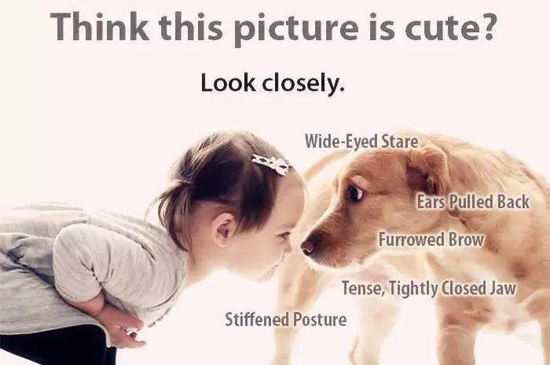
4.
Do You Learn Dog's Body Language and Emotion?

Slide 49

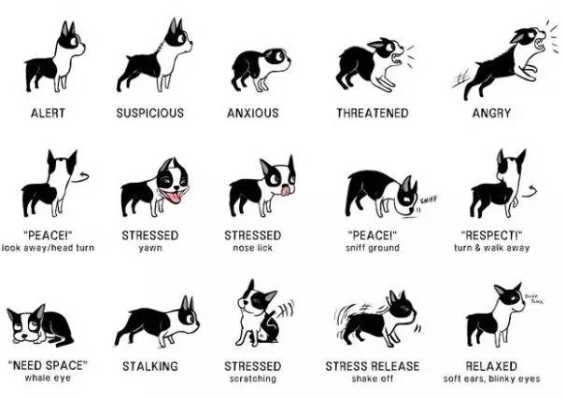

Slide 50
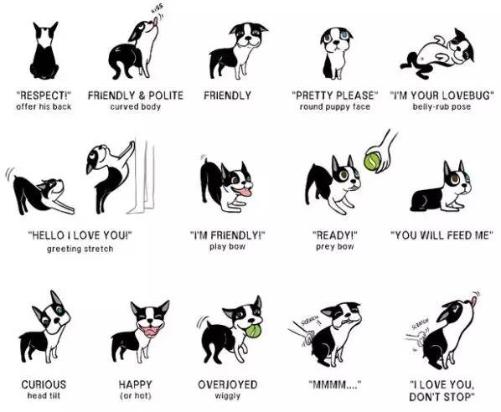

Slide 51
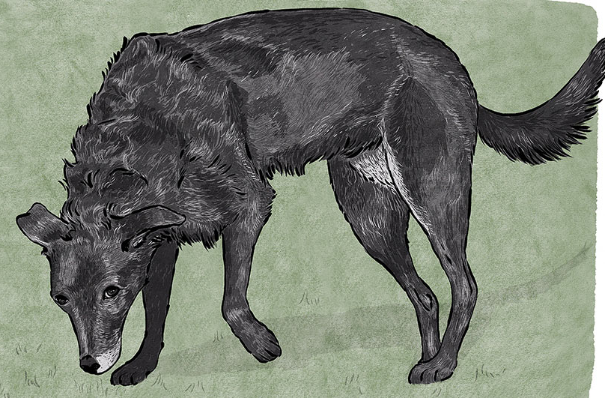
4.
Learn Dog's Body Language – Sniffing the ground
Dogs may sniff the environment often to investigate scents, and sniffing is part of dog communication. Sniffing can be used as a calming signal when an interaction is too intense.
Sniffing can be used as negotiation as two dogs approach each other; a deliberate slower approach is polite when greeting.
In other contexts, sniffing could also be interpreted as displacement behaviour or a stress response. A dog may feel conflicted about something he sees ahead of him; he may slow down and stop to sniff the environment. Sniffing may help displace the anxiety, and it gives the opportunity to assess things further from a safe distance by stalling the approach.
狗狗经常会用嗅闻气味的方式探查周围环境，嗅闻是狗狗沟通方式的一部分。嗅闻往往是狗狗们在过于强烈互动时表现出的安定信号。
嗅闻也是两只狗狗遭遇时谈判协商的方式；一种见面时谨慎礼貌缓慢靠近的方法。嗅闻地面通常是狗狗们开始接近时呈现出的身体语言的一部分。
在另一些场景里，嗅闻可以被解释为转移行为或压力反应。狗狗或许对眼前出现的事物感到困扰和冲突；他开始缓慢停下来嗅闻环境。嗅闻能够缓解焦虑，让双方有机会重新评估相互接近的安全距离。

Slide 52
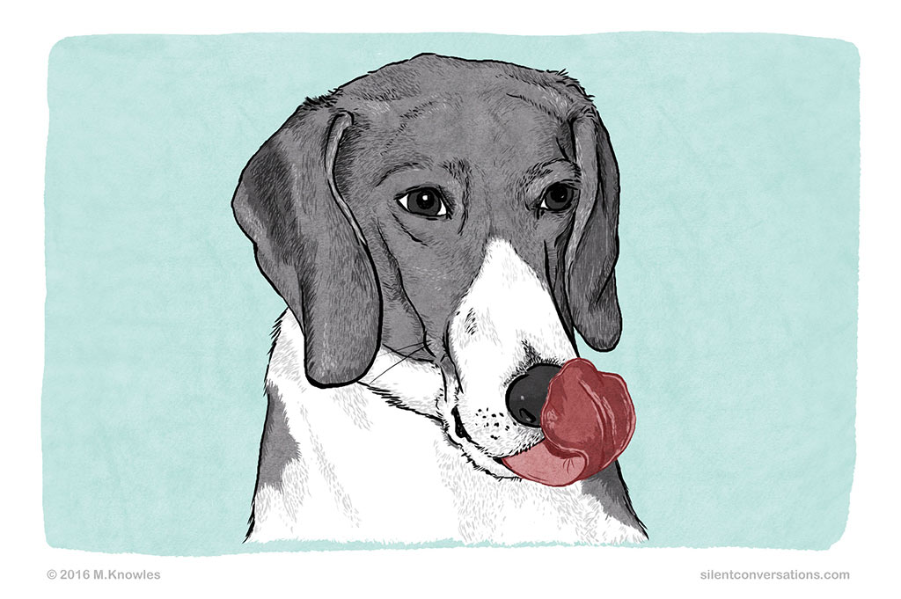
4.
Learn Dog's Body Language – Lip Lick
A lip lick can often be seen as a quick tongue flick. From a dog body language perspective, the lip lick could be a calming signal or a sign of stress, depending on the situation. Here are a few examples of situations where a dog may offer a lip lick:
A person comes home to be greeted by an excited dog whose whole body is wagging; the dog's eyes are squinty, its ears are back, it is sneezing and there are also some lip licks. In this case, the combination of body language and the lip lick might be due to the dog's excitement.
A dog is walking in a new environment; the dog's body movements get faster and more jittery; he scans the environment and starts doing more lip licks. This could mean the dog is a bit unsure and does not feel comfortable in this new environment.
舔舌通常是指舌头的快速轻弹。就狗狗的身体语言而言，舔舌是安定信号或压力信号的一种，具体情况要根据当时的场景分析。
主人归家时和兴奋不已，全身剧烈摇摆的狗狗打招呼；狗狗眯着眼睛，耳朵后背，可能打喷嚏以及舔舌。这种情况下狗狗出现的一连串身体语言，包括舔舌，或许是由于他太过兴奋了。
狗狗到全新环境散步；身体移动的方式快速而紧张；探查环境并开始舔舌。这可能表示狗狗对这个新环境感到些许不确定及不舒服。

Slide 53
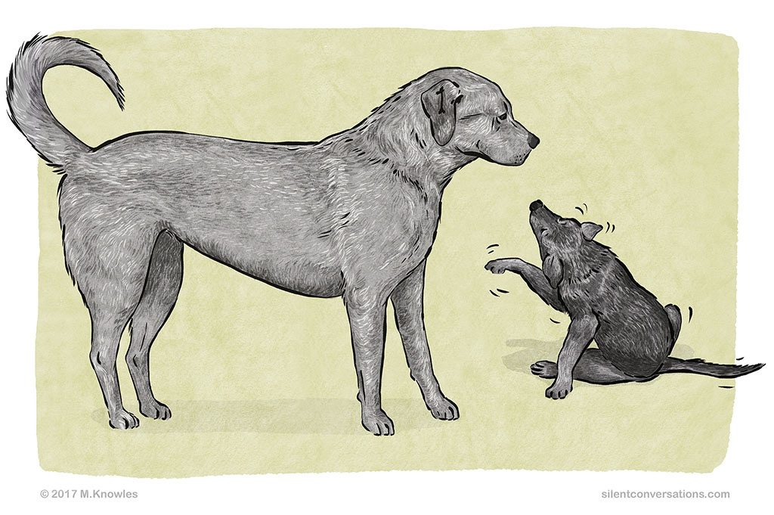
4.
Learn Dog's Body Language – Freezing or Stillness
Freezing or stillness in dog body language terms is a very clear signal that speaks loudly. If a dog is feeling the need to freeze or be still, it means that they are experiencing a high level of unease. Freezing may be part of a warning, and the situation is quite likely to escalate.
Freezing should always be respected, taken seriously, and treated with caution. Even if it does not escalate to a bite, it is a very clear loud signal that the dog is not comfortable and needs more space.
“僵住”或“不动”是狗狗明确表达立场的身体语言。如果一只狗狗感到有必要“僵住”或“不动”，这意味着他正经历着高强度的困境。“僵住”可能是警告的一部分，而这种情形非常容易恶化。
“僵住”的行为应该被尊重，严肃对待，并引起警示。即便情况不会恶化至咬，这也是狗狗不适，需要更多空间的明确信号。

Slide 54
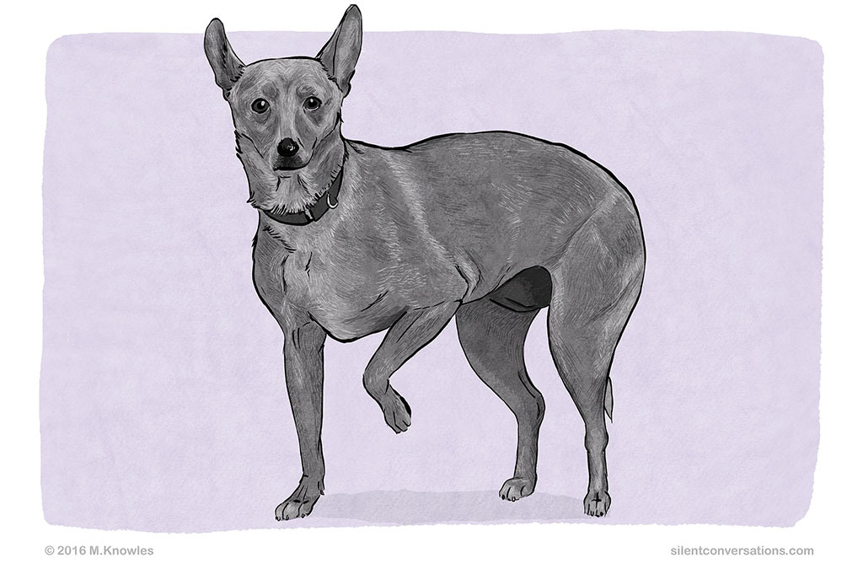
4.
Learn Dog's Body Language – Paw lift
A paw lift is when one paw is lifted ever so slightly off the ground. It is different to a paw lift when stalking or hunting, which can be quite rigid; this paw lift can seem a bit more tentative.
Depending on the rest of the dog’s body language and context, it is generally used when the dog may be feeling conflicted, anxious or anticipating something.
For example, there is a loud, sudden noise. The dog freezes, his eyes widen, his ears go up and are alert, and he does a paw lift. The sudden noise was unsettling; he shows his discomfort by doing a paw lift whilst he tries to figure out what the sound was.
这里讨论的狗狗抬爪子，是指狗的一只前爪稍稍抬离地面。这和狗狗捕猎或前进时爪子的抬起是有区别的，会显得十分突兀；这种抬前爪表现得有些犹豫不决。
根据伴随此现象出现的其他身体语言以及前后状况，一般抬前爪是狗狗感觉冲突、焦虑或期待某事的反应。
比如，突然一声巨响。狗狗瞬间僵住，眼睛圆睁，耳朵直竖警觉，前爪抬起。是突然的噪声令他无法安顿下来；抬前爪表现出狗狗的不舒服以及试图找出究竟发生了什么。

Slide 55
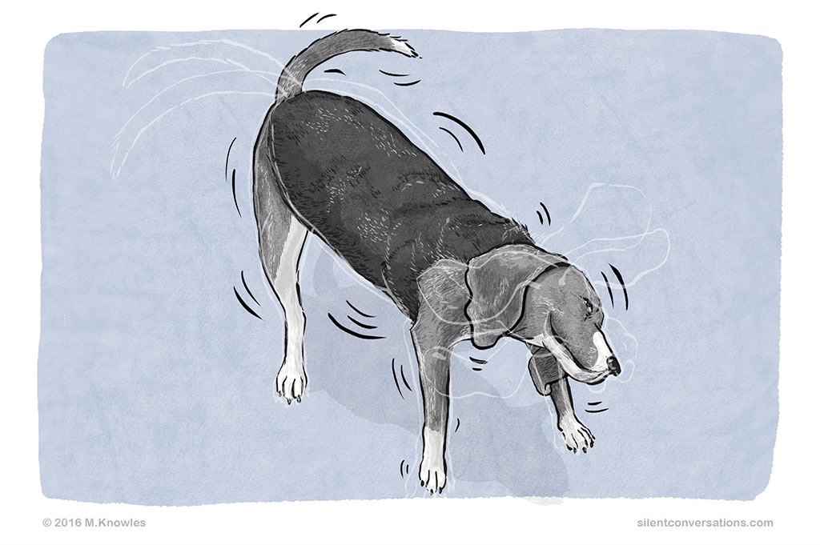
4.
Learn Dog's Body Language – Shake Off
A shake off is when the dog shakes as if he is wet and shaking water off his body, but as he is completely dry, the shake off may seem out of context. In this instance it is part of dog body language. You may notice the shake off after an event that may have been taxing or stressful* for the dog. It is almost as if it signifies a break from whatever had just occurred, allowing the dog to reframe the event, pause and move on from it.
A dog may be hugged by a person. The dog communicates with some body language, such as whale eye, lip lick, head turn and yawn to communicate she would prefer not to be hugged and did not enjoy her space being invaded. After the person lets go of her, she walks away and does a shake off.
所谓狗狗抖毛，就是他像身上有水时那样抖动身体，但其实狗狗身上的毛是干的，这种抖毛需要结合前后情况来看。这种抖毛是狗狗身体语言的一部分。你或许会注意到狗狗在有压力或遭受指责的时候抖毛。这似乎是狗狗从当前状况中摆脱出来的征兆，抖毛让他重新面对眼前的场景，暂停并从情景中逃离。
比如，狗狗被人拥抱。他用一些身体语言和人类沟通，比如鲸鱼眼，舔舌，转头，打哈欠，这些都表示狗狗不喜欢被拥抱，不享受这种私狗空间被侵犯的状况。在人放开狗狗的时候，他走开并开始抖毛。

Slide 56
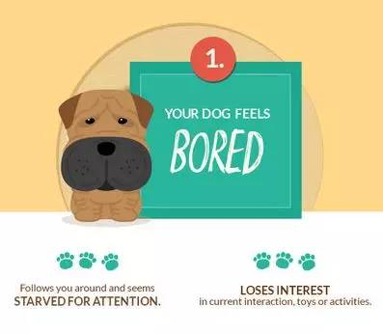
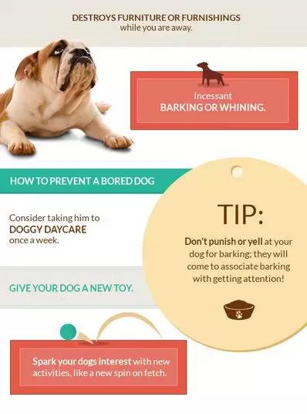
4.
Learn Dog's Emotion – Bored
Follow you around and starved for attention
Lose interest in current interaction, toys or activities
Destroy furniture or furnishings when you are away
Incessant barking and whinning

Slide 57
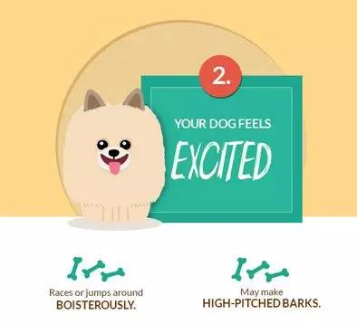
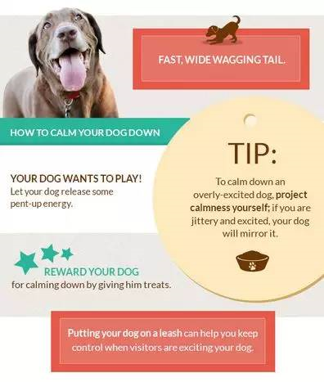
4.
Learn Dog's Emotion – Excited
Race or jump around boisterously
May make high-pitched barks
Fast, wild wagging tail

Slide 58
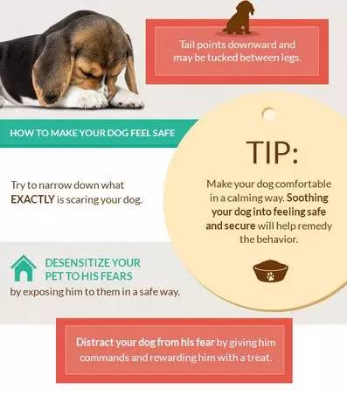
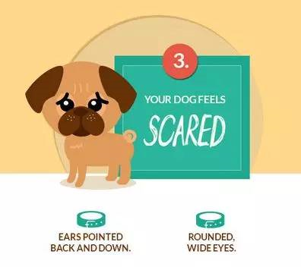
4.
Learn Dog's Emotion – Scared
Ears pointed back and down
Round, wide eyes
Tail points downward and may be tucked between legs

Slide 59
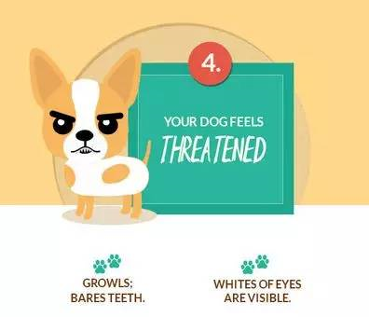
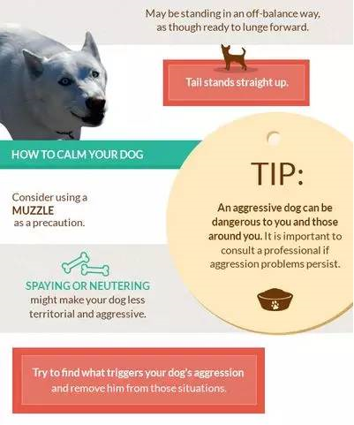
4.
Learn Dog's Emotion – Threatened
Growl; bare teeth
Whites of eyes are visible
May be standing in an off-balance way, as though ready to lunge forward
Tail stands straight up

Slide 60
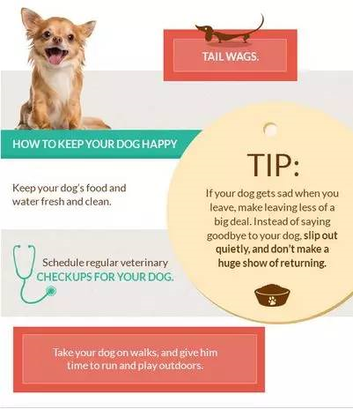
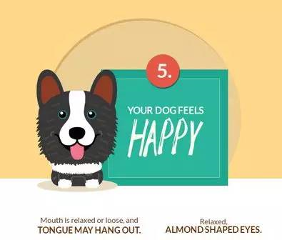
4.
Learn Dog's Emotion – Threatened
Mouth is related or loose, and tongue may hang out
Relaxed; almond shaped eyes
Tail wags

Slide 61






4.
Learn Dog's training command
④
stay
待着别过来
①
sit
坐下
②
come
过来
Fetch
取回来
⑤
③
⑥
heel
不快不慢贴着脚跟走
leave it.
别碰那些东西

Slide 62
4.
Describing human-dog relationship
Quickly, she and I developed something very similar to a Vulcan mind meld^{①}. She'd look at me with those sad brown eyes of hers, beam^{②} her need, and then wait, trusting I would understand---which, strangely, I almost always did. In no time, she became my fifth appendage^{③}, snoring^{④} on my stomach as I watched television.
① mind meld 心灵融合; 心电感应 meld /meld/ 结合；融合
② beam /biːm/ n. 横梁；光线；电波 v. 发送；照射；流露
③ appendage /əˈpendɪdʒ/ n. 附加物；下属
④ snore /snɔː(r)/ v. 打鼾 n. 打鼾（声）
很快，我和她就形成了一种非常类似于瓦肯人的心灵融合 _{心理}。她会用她那忧郁的褐色眼睛看着我_{神态}，流露出她的需要_{动作}，然后等待着，相信我会理解_{心理}——奇怪的是，我几乎总是会理解。没过多久，她就成了我的第五肢_{比喻}，当我看电视时，她就在我的肚子上打鼾_{动作}。

Slide 63
4.
Describing human-dog relationship
Being torn as to whether to risk everyone's safety to save the dog out, he suddenly thought that the dog might be the best friend and comfort to the boys in the war. A ripple of excitement ran through his body, “Come and grab my hand!” he ordered.
在纠结是否要冒着危及大家安全的风险把狗救出来时_{心理}，他突然想到_{心理}狗可能是战争中孩子们最好的朋友和安慰。一阵兴奋的涟漪掠过他的全身_{心理}，“过来抓住我的手!””他命令。
So exhausted was Old Tin Hat that he collapsed on the ground. Whining gently, Raf, the dog, snuggled with him, nuzzled him and licked his hand to keep his spirits up.
“老钢盔”累得瘫倒在地上_{神态}。拉夫轻轻地呜咽着 _{动作}，依偎着他 _{动作}，用鼻子蹭他 _{动作}，舔他的手 _{动作}，让他振作起来。
——溯恩英语“2020年1月高考临门一脚：读后续写考前提升指导”

Slide 64
4.
Describing human-dog relationship
Soon his paws are planted upon your knees and he looks up into your face beseechingly^{①}. He wags his tail and tries to smile, suggesting that you laugh it off. Then he jumps down and runs about the room to attract your attention by his funny pranks^{②}, or perhaps he even barks once in a deprecating^{③} way, but he is soon back again licking your face.
① beseechingly /bɪˈsiːtʃɪŋli/ adv. 恳求地
② prank /præŋk/ n. 恶作剧，开玩笑；戏谑 vt. 装饰；打扮 vi. 炫耀自己；胡闹
③ deprecating /ˈdeprəkeɪtɪŋ/ adj. 不以为然的；不赞成的 v. 对…表示不赞成；轻视（deprecate的ing形式）
很快，它的爪子就搭在你的膝盖上_{动作}，它抬起头来，乞求地望着你的脸_{神态}。他摇着尾巴，试图微笑_{动作}，暗示你一笑了之 _{心理}。然后他跳下来，在房间里跑来跑去_{动作}，用他有趣的恶作剧来吸引你的注意力_{神态}，或者他甚至以一种不以为然的方式_{神态}叫了一声，但他很快又回来舔你的脸_{动作}。

Slide 65
4.
Describing human-dog relationship
A man's dog stands by him in prosperity and poverty, in health and in sickness. He will sleep on the cold ground, when the wintry winds blow and the snow drives fiercely, if only he may be near his master's side. He will kiss the hand that has no food to offer, he will lick the wounds and sores that come in encounter with the roughness of the world. He guards the sleep of his pauper master as if he were a prince.
prosperity /prɒˈsperəti/ n. 繁荣，成功
poverty /ˈpɒvəti/ n. 贫困；困难
wintry /ˈwɪntri/ adj. 寒冷的，冬天的；冷淡的
sore /sɔː(r)/ adj. 疼痛的，痛心的；剧烈的，极度的 n. 溃疡，痛处；伤心事
encounter with 遭遇，遇到
pauper /ˈpɔːpə(r)/ n. 乞丐；穷人；靠救济度日者 adj. 贫民的
一个人的狗不管他是富贵还是贫穷，是健康还是疾病，都会守在他身边。当寒风凛冽，大雪纷飞的时候，只要能靠近主人，它会睡在冰冷的地上。他会亲吻没有食物的手，他会舔舐在这个粗糙的世界中所受的创伤。即使主人是乞丐，他也像守护王子一样守护他。

Slide 66
4.
Describing human-dog relationship
As a dog lover, our canine companions always fill me with joy. Whether pedigree or mongrel, tame or stray, whenever I see one, I smile. After all, their loyalty is indisputable, their companionship is always welcome, they fetch for us, guard for us and even work for us when required.
Well, not content with just warming the cockles of your heart, it seems that our four-legged-friends actually lower the risk of cardiovascular disease, according to a 2017 scientific study.
pedigree /ˈpedɪɡriː/ n. 血统；家谱 adj. 纯种的
mongrel /ˈmʌŋɡrəl/ n. 杂种；混血儿；杂种动物 adj. 杂种的；混血儿的
tame /teɪm/ adj. 驯服的；平淡的；乏味的；顺从的v. 驯养；使变得平淡；制服
stray /streɪ/ v. 迷路，走失 adj. 走失的 n. 走失宠物，无主家畜；走散者
indisputable /ˌɪndɪˈspjuːtəbl/ adj. 不容置疑的，无可争辩的
cockles n. 波纹，起皱; 小贝肉; 牡蛎
cardiovascular /ˌkɑːdiəʊˈvæskjələ(r)/ adj. [解剖] 心血管的
作为一个爱狗者，我们的狗伙伴总是让我充满欢乐。无论是纯种的还是杂种的，无论是驯养的还是流浪的，只要我看到一只，我就会微笑。毕竟，他们的忠诚是无可争辩的，他们的友谊总是受欢迎的，他们为我们争取，为我们守护，甚至在需要的时候为我们工作。
2017年的一项科学研究结果显示，我们的“四腿朋友”不仅满足于让我们暖心，似乎还能降低心血管疾病的风险。

Slide 67
狗狗·读后续写

Slide 68
外形特点，活动情况，生活习性
本物
观察仔细，细微特点，准确传神
精准的动作描写，老舍先生“唯有动作描写, 人物才能立起来。”
内容要充实
故事要感人
语言要准确
情感要真实
情节要合理
故事
Describe animals
尊重
平等
交流，心灵融合
和谐
情感

Slide 69
5.
Continuation Writing--2020.1浙江卷
①“I’m going to miss you so much, Poppy,” said the tall, thin teenager. He bent down to hug his old friend goodbye. He stood up, hugged his parents, and smiled, trying not to let his emotions (情绪) get the better of him.
②His parents were not quite able to keep theirs under control. They had driven their son several hours out of town to the university where he would soon be living and studying. It was time to say goodbye for now at least. The family hugged and smiled through misty eyes and then laughed.
③The boy lifted the last bag onto his shoulder, and flashed a bright smile. “I guess this is it,” he said. “I’ll see you back home in a month, okay?” His parents nodded, and they watched as he walked out of sight into the crowds of hundreds of students and parents. The boy’s mother turned to the dog, “Okay, Poppy, time to go back home.”
④The house seemed quiet as a tomb without the boy living there. All that week, Poppy didn’t seem interested in her dinner, her favorite toy, or even in her daily walk. Her owners were sad too, but they knew their son would be back to visit. Poppy didn’t.
⑤They offered the dog some of her favorite peanut butter treats. They even let her sit on the sofa, but the old girl just wasn’t her usual cheerful self. Her owners started to get worried. “What should we do to cheer Poppy up?” asked Dad. “We’ve tried everything.”
⑥“I have an idea, but it might be a little crazy.” smiled Mom. “Without anybody left in the house but us, this place could use a bit of fun. Let’s get a little dog for Poppy.”
⑦It didn’t take long before they walked through the front door carrying a big box. Poppy welcomed them home as usual, but when she saw the box, she stopped. She put her nose on it. Her tail began wagging (摆动) ever so slowly, then faster as she caught the smell.
Para.1 Dad opened the box and a sweet little dog appeared.
Para.2 A few weeks later, the boy arrived home from the university.

Slide 70
5.
Continuation Writing--2020.1浙江卷--外教下水作文
Dad opened the box and a sweet little dog appeared. The two dogs sniffed each other for a few moments. Then, suddenly, the little dog leaped towards Poppy, who stepped back a little. After a moment's pause, Poppy licked the little dog's nose! They decide to call her Lucky, since they were lucky to have such a sweet pet. As the days went by, Poppy and Lucky became best friends. They loved to play together and, at night, would go to sleep in the same bed. The parents were relieved that Poppy was cheerful again.
A few weeks later, the boy arrived home from the university. “I'm back! Poppy, where are you?” the boy called out. Two dogs came galloping down the hallway. “What is this?” he cried out in surprise as he hugged both dogs tightly. His parents laughed as they explained how sad Poppy had been and their clever plan for cheering her up. During his stay, the boy spent many hours playing with the two dogs. He returned to university happy that Poppy was no longer lonely!
描写生动具体真实，观察细致，两只狗的初次见面的场景活灵活现。
情节发展围绕 “怎样解决Poppy的孤独和郁闷”这一主线展开，层层推进，内容生动，详略得当，行文流畅。
呼应首段，逻辑严密，整个故事浑然一体。与原文的写作思路契合、融洽度高。
——本文来自溯恩英语，作者：20年教龄的加拿大本部英语老师Liz

Slide 71
5.
Continuation Writing--2020.1浙江卷--外教下水作文
Dad opened the box and a sweet little dog appeared. The fluffy little creature examined her new surroundings curiously, and then quickly fixed her gaze at Poppy, who was nudging her nose toward the new dog and wagging her tail vigorously. Poppy seemed puzzled at first, but in no time, the two dogs were chasing each other around the living room, as if Poppy was showing her little guest around her new home. Her parents watched them playing around and smiled with relief – Poppy was back to her old cheerful self!
A few weeks later, the boy arrived home from the university. To his great surprise, it was not just Poppy, but two dogs, that dashed out of the house as the doorbell rang. “Meet Pipan, Poppy's new playmate,” exclaimed Dad. “Poppy has been gloomy ever since you left for university, we thought Pipan might cheer her up”. The boy beamed while patting both dogs: “I don't know if I should feel thrilled for having a new puppy or sad because Poppy has found a new best friend!”.
准确地使用动词，大量描写狗外貌神态动作。运用比喻和拟人的修辞手法，形象生动，贴切自然。对狗狗的喜爱之情，跃然纸上。
“冲突-危机-解决模式”是读后续写常见的叙事结构，在本文中得到了很好的体现。
结尾收笔有力，感情表达真实 ，对男孩子来说“Poppy找到新朋友是喜是忧”，反映内心的触动和成长。
——本文来自溯恩英语，作者：毕业于加拿大名校UBC的英语老师Coco

Slide 72
5.
Homework-1
My husband, BJ, and I knew our cat, Willow, was beautiful, but we didn't realize she had attracted a friend until the day there was an orange cat sitting on our patio staring in. He just sat there and was satisfied to watch Willow walking in the house and playing with us.
Day by day, he was there. Then one day, BJ and I decided that it was time to have a talk with the orange gentleman. He opened the patio door and the cat walked into the house naturally as if he knew we allowed him to get in. Then he played with Willow in the house. Both of them had a happy time.
How could he wait patiently on our patio for such a long time? We were surprised by his courage and patience. Every day, the cat would show up, spend the day with us, and then meow by the door to be let out at night. We had a responsibility to help him open the door and let him go—after all, he wasn't our cat. He was nobody's cat as far as we could tell. He had no collar or tag. I didn't remember how long we had waited before we admitted to ourselves that he was our cat. Then we bought him a collar, tagged him as Buster and added our phone number and address. However, a few days later, we received a call from our neighbor. We weren't home so she left a message.
“Hi, Darlene. I think you have my daughter's cat. Call me when you get the message. “ I was very surprised when I heard the message. I didn't even know that her daughter had a cat. I only saw her walk dogs before. BJ and I were very upset.
Para 1:When I called her back, the story of the cat was so funny that I forgot how upset I was.
Para 2:The next day, the neighbor's young daughter came over to collect her cat.

Slide 73
5.
Homework-1 -A possible version
When I called her back, the story of the cat was so funny that I forgot how upset I was. It turned out that the cat used to be very naughty and lively, running freely in the house and playing with my neighbor's daughter. However, everything changed with the arrival of the dogs. After the cat failed to win an obvious advantage when having conflict with the dogs, he chose to stay in his room, turning a blind eye to what happened outside. The daughter was concerned about her cat but had no idea about what she could do to cheer him up.
The next day, the neighbor's young daughter came over to collect her cat. Seeing her cat playing freely with Willow surprised her a lot. After a silent while, she seemed to gather up her courage and approached my husband and me, “If it doesn't bother you, I expect you to do me a favor to leave Buster here in your house.” said the girl in a low voice. Hearing her words, we patted her and nodded excitedly, adding that she would always be welcome here.

Slide 74
5.
Homework-2
Brady was a recently retired search and rescue dog. He was not happy and missed his owner Al because Al had gone out on a rescue mission without him. Al's nephew Steve took Brady along when he and his friend Zach went on a overnight hike. But suddenly Steve and Zach smelled something burning and they realized that lightning had set the woods on fire. Wind-blown flame had leaped from the top of one tree to another. The long dry summer had turned the forest into a tinderbox(火绒箱) and the thunderstorm wasn't helping much. It had more wind and lightning than rain. Zach pulled Steve's arm.“Let's go! We can make it back to the river we crossed today.”Steve pulled Brady's leash（皮带） and their heads down against the strong fire-wind, they hurried down the path they had followed earlier. The air was full of smoke，and pine branches broke from burning trees with a crisp sound. Steve kept his eyes on the route. All they had to do was to make it down to the river…
Brady barked a sharp warning. Ahead of them lay a dense curtain of smoke across the path. They'd never make it through that. They would have to find another escape route. The dog was pulling at his leash trying to draw them away from the smoke. This was what Brady was trained to do, and yet Steve was uneasy. It seemed to him they were moving away from the river.
Brady lifted his head and smelled the smoky wind. Suddenly, the dog ran away and disappeared. The boys yelled and shouted for him，but he didn't come back.
They had no choice but to leave him behind. Heartsick, Steve and Zach went up a slope（斜坡）. He couldn't blame Brady for panicking and escaping. He himself wanted to run even though he didn't have a clue which way. They hadn't gone far when there was a familiar bark, and Brady came running toward him.
Para1：“Where've you been？”Steve cried.
Para 2： Brady led them back down the slope and into the trees.

Slide 75
5.
Homework-2 -A possible version
“Where've you been?”Steve cried. Brady stopped directly in front of him and started pushing him back toward the slope they'd just climbed. When Steve still didn't get it, Brady grabbed the boy's jeans and pulled harder. The message was clear, but Steve hesitated. Of course he remembered what his uncle had said about Brady saving his life, but that had been a long time ago. Was he still sharp enough to get them through this? Brady pulled again, urgently. “OK, big guy,” Steve decided.
Brady led them back down the slope and into the trees. Several times the big dog stopped to get his escape route. Often he changed direction. How long they'd walked Steve had no idea. He just held onto Brady's leash with one hand and kept putting one foot in front of the other. He was almost numb when he heard the wonderful sound of rushing water. The river! With a yell the boys ran unsteadily forward until they jumped in cool, running water. “Brady, you did it !”

Slide 76

5.
Homework-3-After-class Reading
Read the supplementary reading materials just as you like.

Slide 77
Thank you!

