Slide 1
感恩遇见，相互成就，本课件资料仅供您个人参考、教学使用，严禁自行在网络传播，违者依知识产权法追究法律责任。
更多教学资源请关注
公众号：溯恩高中英语
知识产权声明

Slide 2
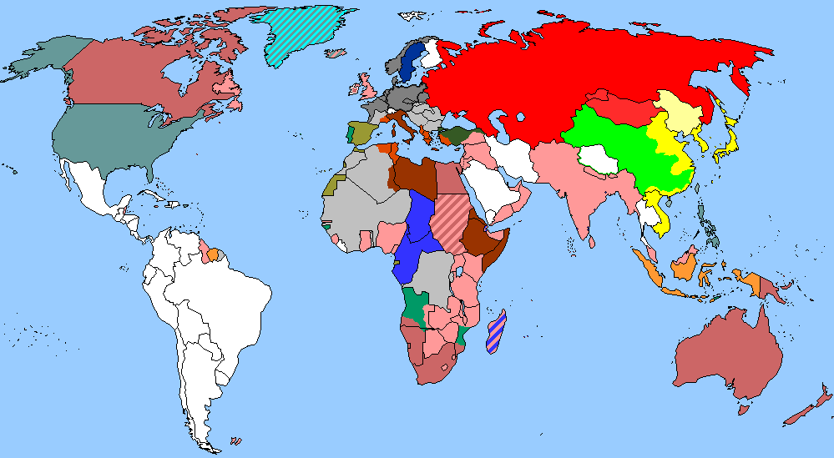
The World
November 1st-15th, 2023

Slide 3
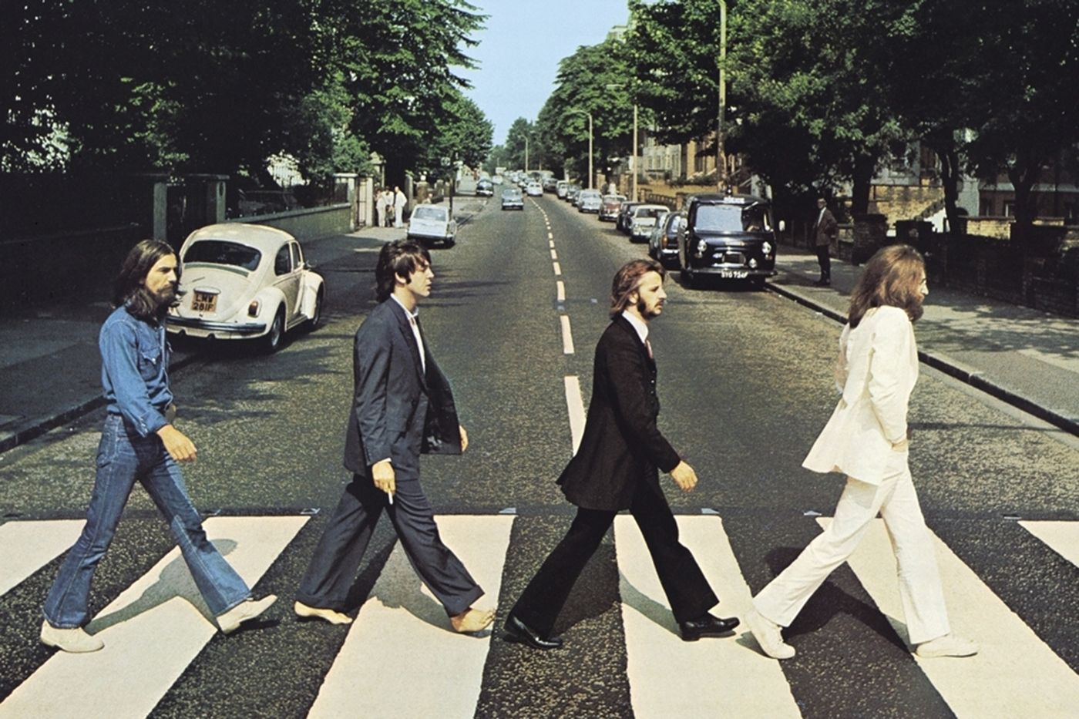
1. AI brings John Lennon’s vocals to new Beatles’ song
人工智能复活约翰·列侬的声音

Slide 4
Text Completion
New Scientist (4th November 2023 Page 9)
what
The Beatles have released _____ is said to be their last ever song, pieced together from recordings spanning more than four decades, in a feat that was possible due to artificial intelligence. On 2 November, the ______ (icon )band released Now and Then, a song edited from a recording of the late John Lennon playing piano and singing at home in 1979. Al was used to extract usable sections from that noisy tape. These _____________ (combine) with guitar tracks from the late George Harrison, recorded in 1995 when efforts were made to finish the song. __________(report), the endeavour was initially called off due to poor sound quality, ___ issue solved by Al. Finally, new recordings made earlier this year by Paul McCartney and Ringo Starr were added. McCartney has teased the song in interviews for months and said in a _________ (state): “There it was, John’s voice, crystal clear. It’s quite emotional. And we all play on it, it’s a genuine Beatles recording”.
Film director Peter Jackson’s production company WingNut Films is credited ___ “source separation”. When _______ (create) Now and Then, engineers at WingNut worked on 60 hours of recording captured by a single microphone that picked up the musicians’ instruments in a noisy jumble. The microphone also caught background chatter, making much of the recording unusable. The team used Al to separate the dialogue from other noises, also isolating the sound of each instrument ___________ (play). Jess Aslan at Goldsmiths, University of London, says The Beatles’ track was done with the blessing of the living members of the band, ____ adds that Al also presents risks to artists.
iconic
were combined
Reportedly
an
statement
for
creating
being played
but

Slide 5
Vocabulary
1. extract: to remove or obtain a substance from sth, for example by using an industrial or a chemical process 提取；提炼
They used to extract iron ore from this site. 他们过去常从这里开采铁矿石。
2. endeavour: an accident in which two vehicles or people crash into each other （尤指新的或艰苦的）努力，尝试
In spite of our best endeavours, it has proven impossible to contact her. 尽管我们尽了最大的努力，还是无法与她取得联系。
Translation
从橄榄中提取的油被用于烹饪。
The oil which is extracted from olives is used for cooking.
Translation
该公司的创新尝试蓬勃兴旺。
The company’s creative endeavours are thriving.

Slide 6
Translation
The Beatles have released what is said to be their last ever song, pieced together from recordings spanning more than four decades, in a feat that was possible due to artificial intelligence.
披头士乐队发行了据称是他们最后一首歌曲，这首歌是他们从40多年的录音中拼凑而成的，这一壮举可能要归功于人工智能。
McCartney has teased the song in interviews for months and said in a statement: “There it was, John’s voice, crystal clear. It’s quite emotional. And we all play on it, it’s a genuine Beatles recording”.
麦卡特尼几个月来一直在采访中打趣这首歌，并在一份声明中说:“约翰的声音就在那里，清晰无比。这是相当情绪化的。我们都在歌中演奏了，这是真正的披头士唱片。”

Slide 7
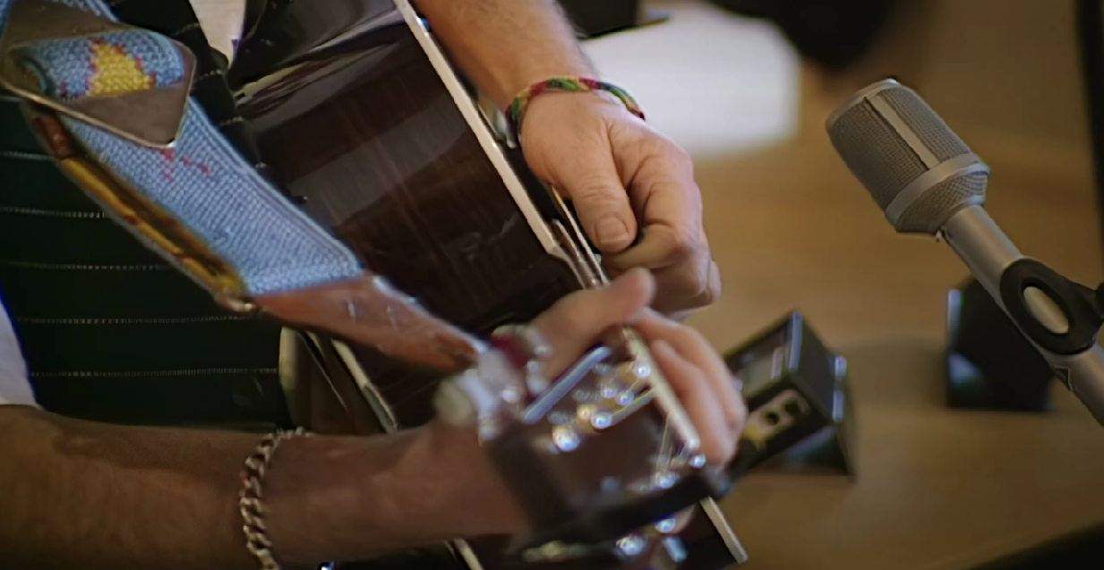
Now and Then

Slide 8
2. How dust destroyed the dinosaurs
尘埃是如何毁灭恐龙
Dust could have
blocked out the sun

Slide 9
Text Completion
The Week Junior (11th November 2023 Page 14）
You might have heard the theory that a meteor wiped out most life on Earth, including many dinosaurs, 66 million years ago. ________, scientists have come up with a reason why this caused so many species to go extinct.
Previously, scientists had argued that the meteor strike caused wildfires, earthquakes and tsunamis, ______ destroyed habitats all over the planet and made it impossible for many creatures to survive. However, the new report suggests that more attention should ________ (give) to another effect of the meteor-the trillions of tonnes of dust that were sent flying into the atmosphere.
This dust would have swirled around in dark clouds, blocking out the Sun and ________ (cause) temperatures around the world to drop ___________ (dramatic). The researchers devised their theory by running computer simulations of the aftermath of the meteor strike. These simulations took ____ account real measurements of dust caused by the meteor impact, _____ (take) from a site in North Dakota, US. The simulations suggested that the dust could have stayed in the atmosphere for up to 15 years after being thrown into the sky. Philippe Claeys, co-author of the new research, said that although the meteor strike was _________ (disaster) for the dinosaurs, it probably helped humans of the future. “Dinosaurs dominated the Earth and were doing just fine ______ the meteorite hit,” he said. “________the impact, my guess is that mammals-including us - had little chance to become the dominant organisms on this planet.”
However
which
be given
causing
dramatically
into
taken
disastrous
when
Without

Slide 10
Vocabulary
1. swirl: to move around quickly in a circle; to make sth do this （使）打旋，旋动，起旋涡
The water swirled down the drain. 水打着旋流进了下水道。
2. devise: to invent sth new or a new way of doing sth 发明；设计；想出
A new system has been devised to control traffic in the city. 控制城市交通的新系统已经设计出来。
Translation
她微笑了，旋动着玻璃杯里的葡萄酒。
She smiled, swirling the wine in her glass.
Translation
我们想出了一个计划来帮助他。
We devised a scheme to help him.

Slide 11
Translation
You might have heard the theory that a meteor wiped out most life on Earth, including many dinosaurs, 66 million years ago. However, scientists have come up with a reason why this caused so many species to go extinct.
你可能听说过这样一个理论：6600万年前，一颗流星消灭了地球上的大部分生命，包括许多恐龙。然而，科学家们已经找到了导致如此多物种灭绝的原因。
This dust would have swirled around in dark clouds, blocking out the Sun and causing temperatures around the world to drop dramatically. The researchers devised their theory by running computer simulations of the aftermath of the meteor strike.
这些尘埃会在乌云中旋转，挡住太阳，导致世界各地的温度急剧下降。研究人员通过运行计算机模拟流星撞击的后果来设计他们的理论。

Slide 12
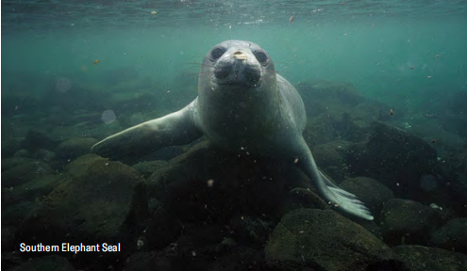
3. Seal Team 海豹突击队

Slide 13
Text Completion
Scientific American (November 2023 Page 17)
Humans have sailed the oceans’ surfaces for millennia but their depths remain ________ (effective) uncharted.Only about a quarter of the seafloor ________________ (map) at high resolution. Maps of most regions display only approximate depths _____ often miss entire underwater mountains or canyons.
So a group of researchers has recruited some deep-diving ________ (expert): Elephant Seals and Weddell Seals. Scientists have been placing trackers on these blubbery marine mammals around Antarctica for years __________ (gather) data on ocean temperature and salinity. For a new study the researchers compared these dives location and depth data with some of the less detailed seafloor maps. They spotted places _______ the seals dove deeper than should have been possible according to the maps meaning the existing depth estimates were __________ (accurate).
In eastern Antarctica’s Vincennes Bay the diving seals ______ (help) the scientists find a large, hidden underwater canyon plunging to depths of more than a mile. ___ Australian research ship called the RSV Nuyina later measured the canyon’s exact depth using sonar, and the researchers have proposed naming their find the Mirounga-Nuyina Canyon honoring both the ship and the _________ (involve) Elephant Seals.
effectively
has been mapped
and
experts
gathering
where
inaccurate
helped
An
involved

Slide 14
Vocabulary
1. resolution: the power of a computer screen, printer, etc. to give a clear image, depending on the size of the dots that make up the image 清晰度；析像；分辨率
It has high resolution graphics and large smooth spinning reels.
它具有高解析度的图形和大型顺利纺纱卷轴。
2. plunge: to move or make sb/sth move suddenly forwards and/or downwards 使突然前冲（或下落）
Japan's banks are in trouble because of bad loans and the stock market plunge.
日本各家银行处于困境，缘于不良贷款以及股市的暴跌。
Translation
卓越的高分辨率卡通图形。
Brilliant high resolution cartoon graphics.
Translation
他的体重开始骤然下降。
His weight began to plunge.

Slide 15
Translation
Scientists have been placing trackers on these blubbery marine mammals around Antarctica for years gathering data on ocean temperature and salinity.
多年来，科学家们一直在南极洲周围的这些肥胖的海洋哺乳动物身上放置追踪器，收集海洋温度和盐度的数据。
An Australian research ship called the RSV Nuyina later measured the canyon’s exact depth using sonar, and the researchers have proposed naming their find the Mirounga-Nuyina Canyon honoring both the ship and the involved Elephant Seals, genus Mirounga.
一艘名为RSV Nuyina的澳大利亚研究船后来使用声纳测量了峡谷的确切深度，研究人员提议将他们的发现命名为米隆加-努伊纳峡谷，以纪念这艘船和涉及的象海豹。

Slide 16
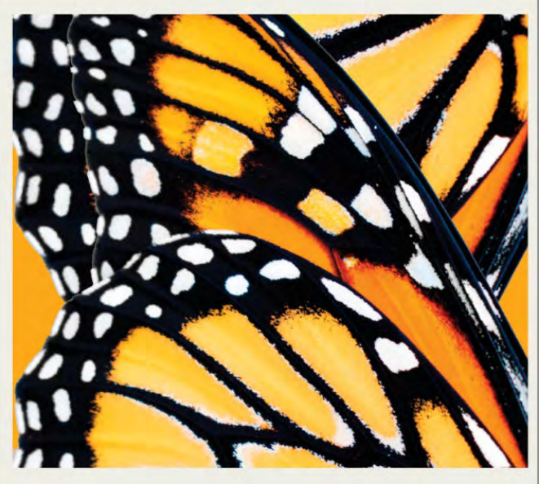
4. Spotting an Advantage 黑脉金斑蝶的翅膀斑点

Slide 17
Text Completion
National Geographic (November 2023 BREAKTHROUGHS)
Some monarchs fly thousands of miles each year from southern Canada all the way to the mountains outside of Mexico City. _____ do they do it? A new study says monarchs that make ___ to the Mexico wintering grounds have white wing spots 3 percent _____ (large) than those of monarchs ________ (sample) from other parts of the North American migration. This may mean that the black-and-white _______ (pattern) on monarch wings create micro-vortices of warm and cool air that in turn reduce drag while the insects soar in the sun. Three percent may not seem like much—____ for animals that weigh as little as a kernel of corn and have to fly across a continent, tiny changes could yield real benefits, the scientists say. Similar drag-reduction properties _______________ (find) in the wing patterns of seabirds and one day could lead ___ more efficient airborne devices. “If you want to develop drones that are flying for longer time and harnessing energy from sunlight, this is the best thing ____ we can look at,” says study co-author Mostafa Hassanalian, ___ associate professor of mechanical engineering at New Mexico Tech.
How
it
larger
sampled
patterns
but
have been found
to
that
an

Slide 18
Vocabulary
1. drag: the force of the air that acts against the movement of an aircraft or other vehicle （作用于飞机或其他运载工具的）空气阻力
The drag of those extra air molecules brought the satellite crashing to Earth.
额外的空气分子阻力使得卫星坠毁到了地球上。
2. airborne: (of a plane or passengers) in the air （飞机或乘客）升空
Do not leave your seat until the plane is airborne.
飞机升空时不要离开座位。
Translation
工程师们在设计新飞机时总是在寻找最小化阻力的方法。
Engineers are always looking for ways to reduce drag when they design new planes.
Translation
飞行员的确设法使飞机升空了。
The pilot did manage to get airborne.

Slide 19
Translation
A new study says monarchs that make it to the Mexico wintering grounds have white wing spots 3 percent larger than those of monarchs sampled from other parts of the North American migration.
一项新的研究表明，到达墨西哥越冬地的黑脉金斑蝶翅膀上的白色斑点比到达北美其他地区的黑脉金斑蝶翅膀上的白色斑点大3%。
This may mean that the black-and-white patterns on monarch wings create micro-vortices of warm and cool air that in turn reduce drag while the insects soar in the sun. Three percent may not seem like much—but for animals that weigh as little as a kernel of corn and have to fly across a continent, tiny changes could yield real benefits, the scientists say.
这可能意味着，当黑脉金斑蝶在阳光下翱翔时，翅膀上黑白相间的图案会产生暖空气和冷空气的微涡流，从而减少阻力。科学家说，百分之三可能看起来不多，但对于体重只有玉米粒那么轻，而且必须飞越大陆的动物来说，微小的变化可能会产生真正的好处。

Slide 20
5. CNN News 11/04/2023

Slide 21
Dictation
听力填空
We start today with an ______ out of Mexico, where residents are dealing with devastating damage caused by Wednesday’s category 5 storm Hurricane Otis. Trees were uprooted, buildings smashed, roadways were ________ under several feet of water. Thankfully, Mexican President Andres Manuel Lopez Obrador said there were as of Thursday morning no ________ reported. The local power utility says nearly 500,000 homes and businesses lost power though. And communication lines are down, making it hard for authorities and rescue operations to get a handle on the true __________________. Video we have shows widespread destruction with a big impact to the local ________.
Acapulco, located on the southwestern coast of Mexico, was once considered the Pearl of the Pacific in the 1940s and 50s. It was a major American _________________ for tourists and celebrities alike like Rita Hayworth. But it diminished slowly over time due to ____________ and crime. However, its tourism industry has been on an upswing _______ Mexican and European travelers recently. To protect this city, residents and authorities laid major ___________ ahead of the storm. But as we mentioned in yesterday’s show, the storm quickly turned ______, very, very quickly and even caught meteorologists off guard.
update
blanketed
casualties
extent of the damage
economy
vacation destination
overcrowding
hosting
preparations
brutal

Slide 22
Vocabulary
1. utility: a service provided for the public, for example an electricity, water or gas supply 公共事业
Funding will be sent to the household’s utility company to help cover bills.
资金将被送到家庭公用事业公司，以帮助支付账单。
2. catch... off guard: If someone catches you off guard, they surprise you by doing something you do not expect. If something catches you off guard, it surprises you by happening when you are not expecting it. 乘（人）不备；使猝不及防
The lawyer’s apparently innocent question was designed to catch the witness off guard. 律师看似不经意的问题是为了使证人措手不及。
Translation
公用事业包括煤气、电和电话等。
Public utilities include gas, electricity and phones.
Translation
收到这份邀请让我颇感意外。
The invitation caught me off guard.

Slide 23
Translation
The local power utility says nearly 500,000 homes and businesses lost power though. And communication lines are down, making it hard for authorities and rescue operations to get a handle on the true extent of the damage. Video we have shows widespread destruction with a big impact to the local economy.
当地电力公司表示，近50万户家庭和企业停电。通讯线路中断，使当局和救援行动难以掌握损失的真实程度。我们手头的视频显示，大范围的破坏对当地经济造成了巨大影响。
To protect this city, residents and authorities laid major preparations ahead of the storm. But as we mentioned in yesterday’s show, the storm quickly turned brutal, very, very quickly and even caught meteorologists off guard.
为了保护这座城市，居民和当局在风暴来临前做好了重大准备。但正如我们在昨天的节目中提到的，这场风暴很快就变得严重起来，甚至让气象学家措手不及。

