Slide 1



感恩遇见，相互成就，本课件资料仅供您个人参考、教学使用，严禁自行在网络传播，违者依知识产权法追究法律责任。
更多教学资源请关注
公众号：溯恩英语
知识产权声明

Slide 2
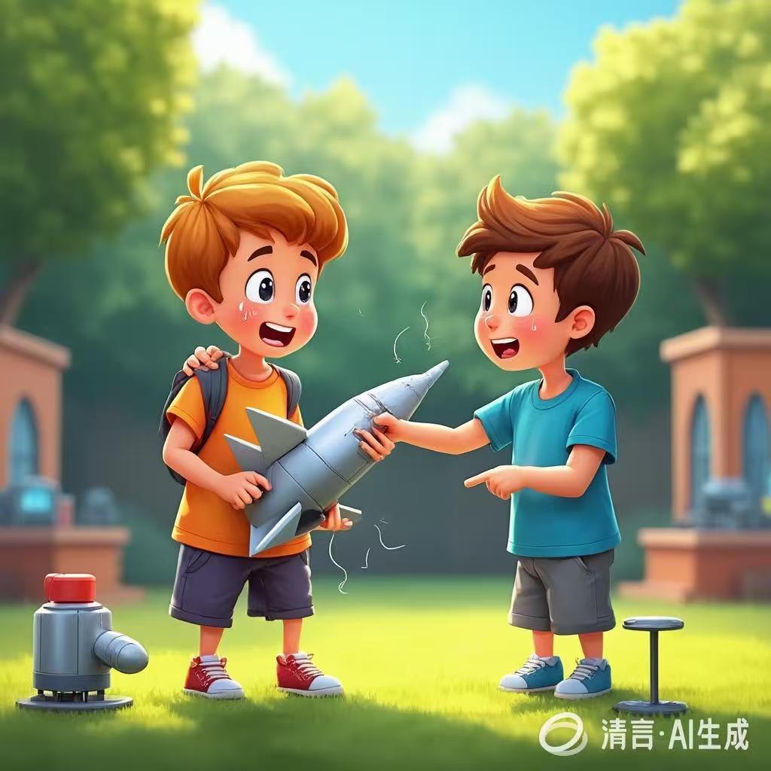
The True Winner
OF The Rocket Competition
---人与自我之个人成长
2025-8-22 Z20 名校联盟
郑素红

Slide 3
读原文:
Tom Perry concentrated hard. The rocket competition would begin shortly. He had never lost a contest, but that didn't calm him. Being on top counted, and he pushed himself to remain there.
The other kids, however, rarely came over to him. No way was he going to let them ignore that he'd win again. Still, he often wondered: why didn't winning make people like him better?
He opened his tool box and began assembling(组装)his launch pad. Then he checked his rocket again. It looked perfect- especially compared to the others.
But one caught his eye. A thin boy named Ed lifted it carefully. Its paint shone in the sunlight, and its parts fit perfectly. His critical eye detected that this rocket could beat his.
"Nice rocket," said the boy nervously.
"Thanks," Tom replied flatly, and then regretted it.
"Where do you usually launch it? I've never seen you here."
"In the field behind my house."
"You don't care for these contests?"
"I never really thought about them. I keep pretty much to myself."

Slide 4
The announcer explained the competition. Tom barely listened, his gaze constantly drifting to Ed's rocket. Suddenly his heart did a leap — as Ed lifted the rocket to place it on the launch pad , his fin ( 翼) had caught against something, pulling it away from the fuselage (机身)— not enough to break it off, just enough to loosen it.
But Ed hadn't noticed. He glanced back at Tom and gave a thumbs-up. Tom felt a surge of guilt but decided he wasn't going to say anything. Anyway, it was up to Ed to keep checking his rocket.
Then the competition began. Most rockets gained respectable heights, while a few shot wildly. Tom watched, but the knowledge he had about what was wrong with their rockets soured within him. It was like something he had stolen.
"Ed Malovich will be our next contestant," the announcer said, interrupting Tom's daydream.
Immediately Ed lifted his rocket and headed to the launch area.
注意:
( 1)续写词数应为150左右;
(2)请按如下格式在答题卡的相应位置作答。
Paragraph 1: Without thinking, words flowed from Tom's mouth, surprising even himself.
Paragraph 2: Minutes later, Ed’s rocket blasted skyward, shooting up as if unstoppable.

Slide 5

Read for information
Major roles: Tom
Minor roles : Ed ( the judge, the crowd, other contestants)
2. narrative perspective: third-person
3. time： unknown
place： unknown
event: A rocket competition helped Tom win respect from his rivals , show true sportsmanship and eventually win friendship.

Slide 6
Analysis
Tom Perry concentrated hard. The rocket competition would begin shortly. He had never lost a contest, but that didn't calm him. Being on top counted, and he pushed himself to remain there.
The other kids, however, rarely came over to him. No way was he going to let them ignore that he'd win again. Still, he often wondered: why didn't winning make people like him better?
He opened his tool box and began assembling(组装)his launch pad. Then he checked his rocket again. It looked perfect- especially compared to the others.
But one caught his eye. A thin boy named Ed lifted it carefully. Its paint shone in the sunlight, and its parts fit perfectly. His critical eye detected that this rocket could beat his.
"Nice rocket," said the boy nervously.
"Thanks," Tom replied flatly, and then regretted it.
"Where do you usually launch it? I've never seen you here."
"In the field behind my house."
"You don't care for these contests?"
"I never really thought about them. I keep pretty much to myself."
Tom was skilled and hard-working.
Tom was eager for victory and friendship.
Tom was confident with his perfect rocket.
Ed was Tom’s competitive rival.
Ed was sincere.
Tom was not so good at socializing with Ed( others) .

Slide 7
The announcer explained the competition. Tom barely listened, his gaze constantly drifting to Ed's rocket. Suddenly his heart did a leap — as Ed lifted the rocket to place it on the launch pad , his fin ( 翼) had caught against something, pulling it away from the fuselage (机身)— not enough to break it off, just enough to loosen it.
But Ed hadn't noticed. He glanced back at Tom and gave a thumbs-up. Tom felt a surge of guilt but decided he wasn't going to say anything. Anyway, it was up to Ed to keep checking his rocket.
Then the competition began. Most rockets gained respectable heights, while a few shot wildly. Tom watched, but the knowledge he had about what was wrong with their rockets soured within him. It was like something he had stolen.
"Ed Malovich will be our next contestant," the announcer said, interrupting Tom's daydream.
Immediately Ed lifted his rocket and headed to the launch area.
Paragraph 1: Without thinking, words flowed from Tom's mouth, surprising even himself.
Paragraph 2: Minutes later, Ed’s rocket blasted skyward, shooting up as if unstoppable.
Tom was upset by Ed’s rocket and noticed Ed’s loose fin.
Innocent Ed showed genuine admiration for Tom.
Tom began felt guilty but still chose not to say anything.
Tom became more and more uneasy.

Slide 8

5.
story
line
Now it was announced that it was soon Ed’s turn to launch the rocket. Guilt tortured Tom. Should he tell Ed the truth?
Climax
Then the competition began but the fin of Ed’s rocket got loose but Tom didn’t tell Ed immediately out of envy.
Para1: Without thinking, words flowed from Tom's mouth, surprising even himself.
Tom had a small chat with Ed , found Ed’s rocket perfect and even predicted that Ed would win the game.
Para2: Minutes later, Ed’s rocket blasted skyward, shooting up as if unstoppable.
Tom ‘s always being on top in the rocket competition didn’t make him liked by many people.
background
Ending
Beginning

Slide 9
Read for clues and echoes
hidden clues | echoes
Tom Perry concentrated hard. The rocket competition would begin shortly. He had never lost a contest, but that didn't calm him. Being on top counted, and he pushed himself to remain there. The other kids, however, rarely came over to him. No way was he going to let them ignore that he'd win again. Still, he often wondered: why didn't winning make people like him better? | 1. For the first time, Tom realized that being top didn’t count/ matter and winning didn’t make people like him better but doing the right thing did.

Slide 10
hidden clues | echoes
He opened his tool box and began assembling(组装)his launch pad. Then he checked his rocket again. It looked perfect- especially compared to the others. But one caught his eye. A thin boy named Ed lifted it carefully. Its paint shone in the sunlight, and its parts fit perfectly. His critical eye detected that this rocket could beat his. | 2. Tom rummaged through his tool box, rushed over to Ed and comforted Ed, “ Let’s handle it together.” Ed holding the fin in place, Tom applied his quick-dry glue to the loose part. 3. As the announcer declared Ed the winner of the competition, Tom felt pure joy and pride for Ed instead of envy. 4. After what seemed like an eternity, // Thanks to Tom’s timely help, Ed’s rocket was in perfect condition with the fin fit tightly, ready to be launched.

Slide 11
Read for clues and echoes
hidden clues | echoes
But Ed hadn't noticed. He glanced back at Tom and gave a thumbs-up. Tom felt a surge of guilt but decided he wasn't going to say anything. Anyway, it was up to Ed to keep checking his rocket. | 4. When the rocket eventually landed, Ed rushed over to Tom, eyes sparkling with excitement. “ I couldn’t have made it without you! Thank you, my friend!” Ed exclaimed, giving Tom a high-five. // giving Tom a thumbs-up.

Slide 12
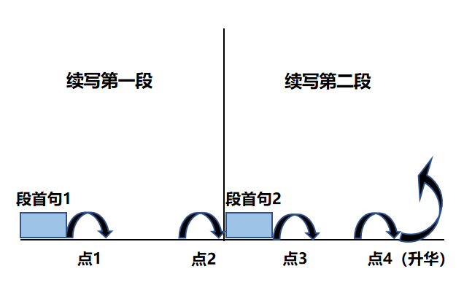
Plot Continuation
点1：位于续写第一段段首，流畅衔接前面的故事（常与原文最后一段呼应）和第一段段首语；
点2：位于续写第一段段尾，流畅衔接第二段段首句；
点3：位于续写第二段段首，续写衔接第二段段首语；
点4：文章结尾升华，给予读者正能量，揭示和强调主题。

Slide 13
Plot the continuation story
Para1: Without thinking, words flowed from Tom's mouth, surprising even himself.
Para2: Minutes later, Ed’s rocket blasted skyward, shooting up as if unstoppable.
Link1: What did Tom say? How did he feel now?
Body: How did Ed react to Tom’s words? What did they do ?
Link2: What was Ed’s rocket like now?
Link3: Seeing the blasting rocket, how did Ed / the crowd feel?
Body: How did the rocket perform then? What was the result of this rocket competition?
Ending: ① What did Tom learn from the competition?
② What do you think of Tom?

Slide 14

心理描写
神态描写
动作描写
外貌描写
环境描写
对话描写
语言
无灵主语
动作链
分词作状语
With 复合结构
独立主格
从句
倒装句
虚拟语气
强调句
长短句结合
考生构思情节的同时，要考虑合适的语言句式以及修辞

Slide 15
Design link1
Para1: Without thinking, words flowed from Tom's mouth, surprising even himself.
Link1A: (呼应所给首句words flowed以及提醒的代价是可能输掉比赛，故而心隐隐作痛 ） “ Wait a second! Your rocket’s fin is loose!” Tom blurted out, heart aching.
Link1B: （也可以从围观的观众角度来写）“ Wait, Ed! Something is wrong with your rocket. ” The crowd gasped at Tom’s words.

Slide 16
Design link2
Para1: Without thinking, words flowed from Tom's mouth, surprising even himself.
Para2： Anita studied the drawing carefully.
Link2 A: (呼应第二段所给句首句，暗示首段结尾Ed’s rocket 修复如故，准备发射) After what seemed like an eternity, // Thanks to Tom’s timely help, Ed’s rocket was in perfect condition with the fin fit tightly, ready to be launched.
Link2 B: (呼应原文第一段的争强好胜的Toｍ这次的做法让其他参赛的孩子刮目相看） The other kids stared at Tom in disbelief. This wasn’t the Tom they knew who always aimed to win at all costs. With joint efforts from Tom and other contestants, Ed eventually placed the perfect rocket on the launch pad.

Slide 17
Design link3
Para2: Minutes later, Ed’s rocket blasted skyward, shooting up as if unstoppable.
Link3A: (呼应叙事对象 Ed’s rocket 进一步描述火箭一飞冲天，远超出其他火箭） It reached an incredible height, far higher than any of the previous rockets including Tom’s.
Link3B: (回扣原文比赛的场景，描述观众的反响） The crowd erupted into cheers as Ed’s shining rocket reached an astonishing height.

Slide 18
Design ending
Para2: Minutes later, Ed’s rocket blasted skyward, shooting up as if unstoppable.
Ending A: (呼应Ed‘s rocket would beat his 以及原文提到的 Winning didn’t make people like him better) Holding the trophy, Ed waved at Tom, exclaiming “ Thank you for your selfless and generous help.” For the first time, Tom realized that being on top didn’t count and winning never made people like him but doing the right thing did.
Ending B: (情景式结尾,得到他人肯定后的愉悦) Despite the competition being over, more and more other contestants approached Tom and congratulated Tom on the sportsmanship he had shown during the event. Tom beamed, a current of warmth surging inside, which he had never experienced after winning.

Slide 19
习作 version 1
Para1: Without thinking, words flowed from Tom's mouth, surprising even himself. “ Wait a second! Your rocket’s fin is loose!” Tom blurted out, heart aching. Hearing of the unexpected disaster, Ed froze //was in total shock, mumbling in a trembling voice, “ I…I didn’t notice that at all.” Tears welling up his eyes, Ed was completely at a loss what to do. Tom rummaged through his tool box, rushed over to Ed and comforted Ed, “ Let’s handle it together.” Ed holding the fin in place, Tom applied his quick-dry glue to the loose part. Fingers moving faster than ever, Tom focused on making sure Ed’s rocket would get a fair shot instead of winning. After what seemed like an eternity, // Thanks to Tom’s timely help, Ed’s rocket was in perfect condition with the fin fit tightly, ready to be launched. (114)

Slide 20
Para2: Minutes later, Ed’s rocket blasted skyward, shooting up as if unstoppable.
It reached an incredible height, far higher than any of the previous rockets including Tom’s. A radiant smile cracked across Tom’s face, eyes focused on Ed’s shining rocket. His initial guilt gave way to relief and pure joy. No sooner had Ed’s rocket landed than the judge announced excitedly that Ed was the winner of the rocket competition. Shooting Ed an approving look, Tom gave him a thumbs-up. Holding the trophy, Ed waved at Tom, exclaiming “ Thank you for your selfless and generous help.” For the first time, Tom realized that being on top didn’t count and winning never made people like him better but doing the right thing did. (110)

Slide 21
习作 version 1
Para1: Without thinking, words flowed from Tom's mouth, surprising even himself. “ Wait a second! Your rocket’s fin is loose!” Tom’s words came as a bolt from the blue. All the surrounding contestants fell silent, wondering how to address the critical problem. Seeing Ed’s pale face, Tom apologized, “ Ed, I’m sorry. I should have told you about it earlier.” “ Thank you for reminding me. I would mess it up if you didn’t tell me.” Ed said, his voice filled with gratitude. Exchanging a look with Ed, Tom, retrieved his toolkit and fixed the fin with a tool. The rocket being in perfect condition again, Tom felt an overwhelming sense of relief. After giving Tom a big bear hug, Ed dashed to the launching area, holding the rocket tightly and cautiously. (121)

Slide 22
Para2: Minutes later, Ed’s rocket blasted skyward, shooting up as if unstoppable.
The crowd erupted into cheers as Ed’s shining rocket reached an astonishing height. Tom watched intently, a radiant smile cracking across his face. When the rocket eventually landed, Ed rushed over to Tom, eyes sparkling with excitement. “ I couldn’t have made it without you! Thank you, my friend!” Ed exclaimed, giving Tom a high-five. // giving Tom a thumbs-up. “ Friend?” Tom’s jaw almost dropped. As the announcer declared Ed the winner of the competition, Tom felt pure joy and pride for Ed instead of envy. Despite the competition being over, more and more other contestants approached Tom and congratulated Tom on the sportsmanship he had shown during the event. Tom beamed, a current of warmth surging inside, which he had never experienced after winning. (121)

Slide 23
人与自我
该主题语境重在叙述个人、家庭、社区以及学校生活，描述的是亲情，友情，邻里关系，师生情，同学情等。续写原文本中所描述的矛盾或冲突最终得到圆满的解决，人际之间竞争或合作，社区服务中个人付出和收获。个人的道德与利益的冲突。故事角色会在沟通和理解的基础上建立更紧密的社会关系与人际关系，并获得个人成长。有些文本会与人与社会主题语境糅杂交错。考生要梳理原文中人物所对面的矛盾或冲突并以此为突破口，合理构思故事情节。

Slide 24
比赛类语料：
Admiring David for his persistence, the crowd erupted into cheers. Deafening cheers exploded. (观众）
Eventually the competition came to an end and as expected, Ed was announced to be the winner of the rocket competition. （比赛结果揭晓）
Witnessing the great victory of Ed, Tom grinned from ear to ear . （胜者或见证胜利的亲朋好友的喜悦）
Casting/ Shooting an approving look at Ed, Tom gave him a thumbs-up. （好友夸奖）
Their joint efforts paid off. Ed’s rocket was in perfect condition with the fin fit tightly, ready to be launched. （共同合作）

