Slide 1



感恩遇见，相互成就，本课件资料仅供您个人参考、教学使用，严禁自行在网络传播，违者依知识产权法追究法律责任。
更多教学资源请关注
公众号：溯恩英语
知识产权声明

Slide 2
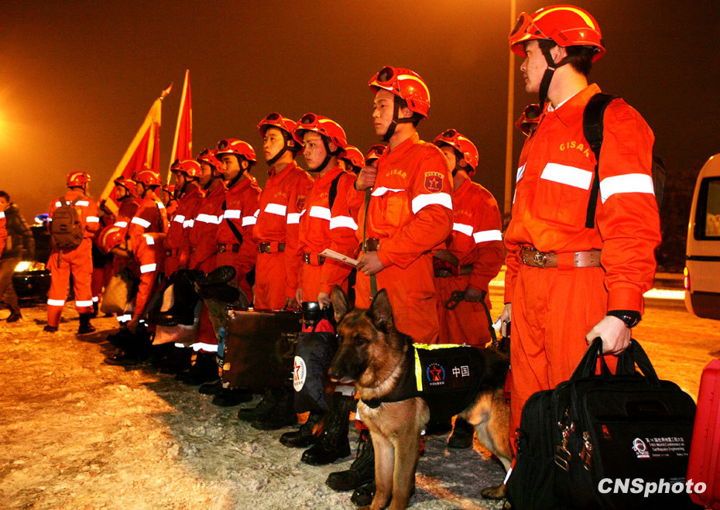
China to the rescue !
Shirley
Notes:
国外的挑一张。。。。Who are they? What are they going to do? Can you see the words on their clothes? The armband Dogs... What will they do？ To rescue others
When was the team set up? (time)
What did CISAR do? (mission)
Why was it set up? (reason;significance)
Who can be a menber of the team? (requirement)

Slide 3
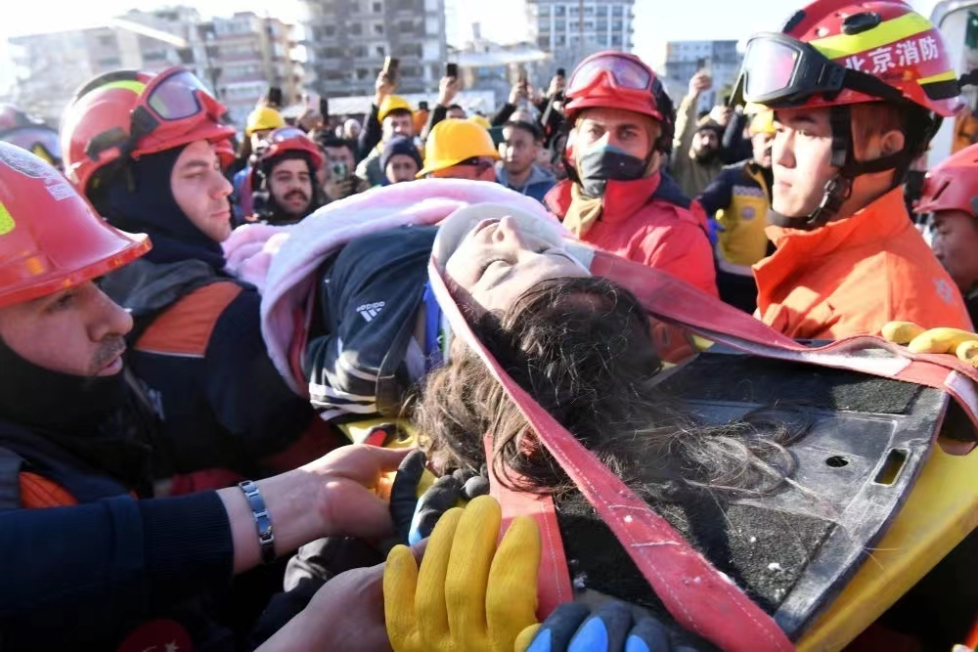
What are they doing?
Where are they?
Notes:
rescue someone... Abroad Why do we rescue foreingers?

Slide 4

CISAR The China International Search and Rescue Team
China to the rescue !
sniffer dogs
Notes:
国外的挑一张。。。。Who are they? What are they going to do? Can you see the words on their clothes? The armband Dogs... What will they do？ To rescue others
When was the team set up? (time)
What did CISAR do? (mission)
Why was it set up? (reason;significance)
Who can be a menber of the team? (requirement)

Slide 5
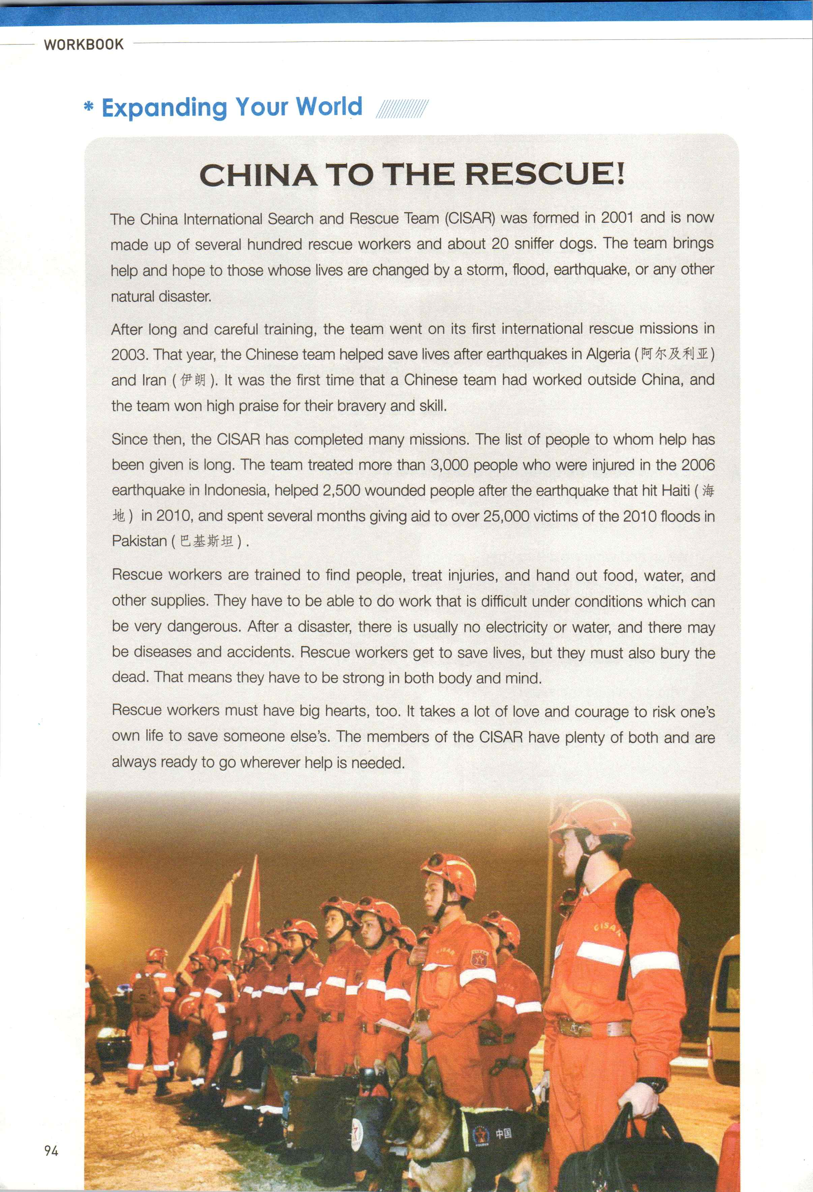
If you have a chance to ask them a question, what would you like to ask?
When
Who
Where
What
Why
How...
①
②
eg. When was CISAR set up?
③
④
⑤
Read the whole text and try to find out the anwers to the questions.
CISAR The China International Search and Rescue Team
Notes:
When was it set up? /What was it set up for?(why)(Para,1) / When and where did you go to rescue others? / Who did you rescue?/What did you do?(Para.2-3)
How to set up your team?( Who can be a member of your team?) Para.4-5

Slide 6

Para.1
The China International Search and Rescue Team ( CISAR ) was formed in 2001 and is now made up of several hundred rescue workers and about 20 sniffer dogs. The team brings help and hope to those whose lives are changed by a storm, flood, earthquake, or any other natural disaster.
was fromed in 2001
Form
& Aim
brings help and hope to those whose lives are changed by natural disasters.
CISAR

Slide 7
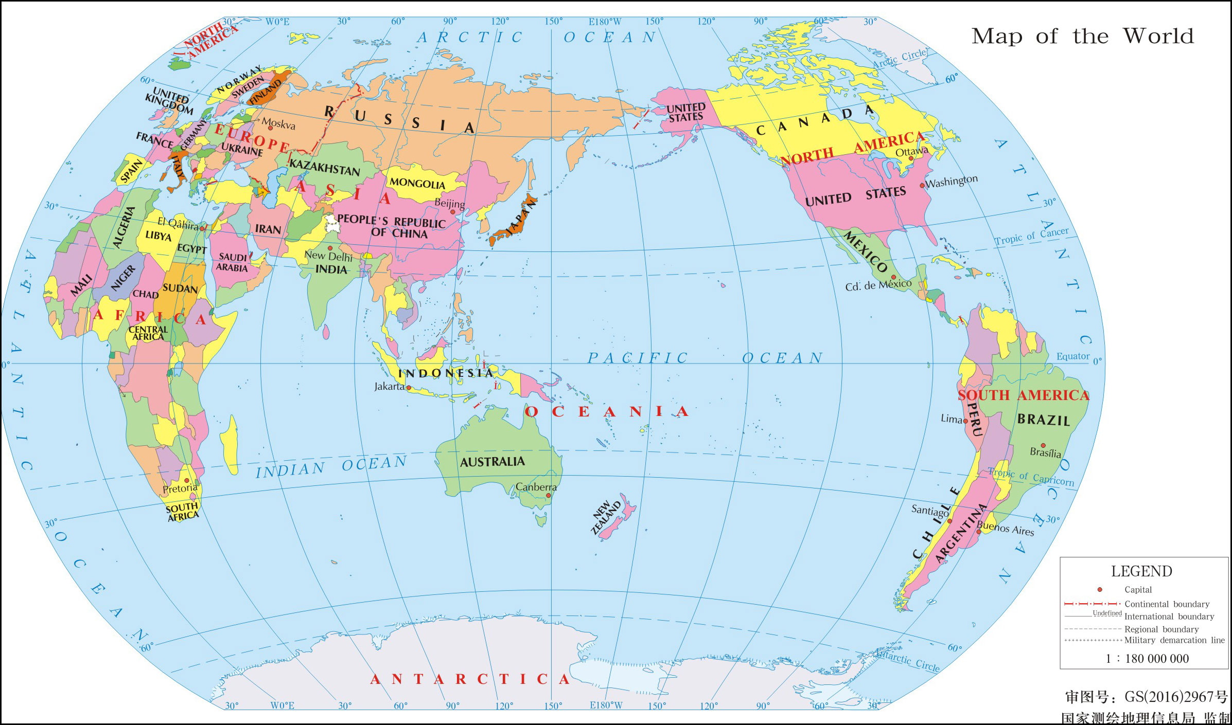

in 2010
Pakistan
in 2003
in 2010
Algeria & Iran
Haiti
in 2006
Indonesia

Slide 8

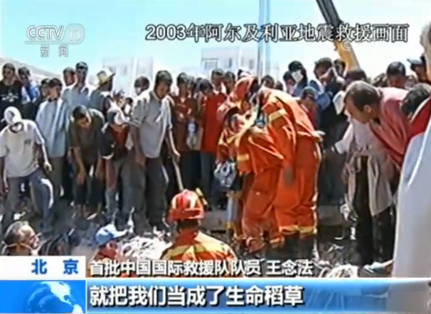
The list of people to whom help has been given is long.
What do the numbers show?
Numbers speak louder than words!
helped 2500 wounded people...(earthquake) Haiti
treated more than 3,000 people who were injured in the
earthquake
helped saved lives after the earthquake
spent several months giving aid to over 25,000 victims (floods) Pakistan
formed
in 2001
in 2003
in 2006
in 2010
China
Algeria & Iran
Indonesia
Haiti & Pakistan
severe/terrible/serious/…
By using numbers, the writer wants to show how _________________________ the natural disasters were and how___________the CISAR’s missions are.
important
Notes:
When was your time formed? What did you do? Where did you go?
Who can be a member of the team?

Slide 9
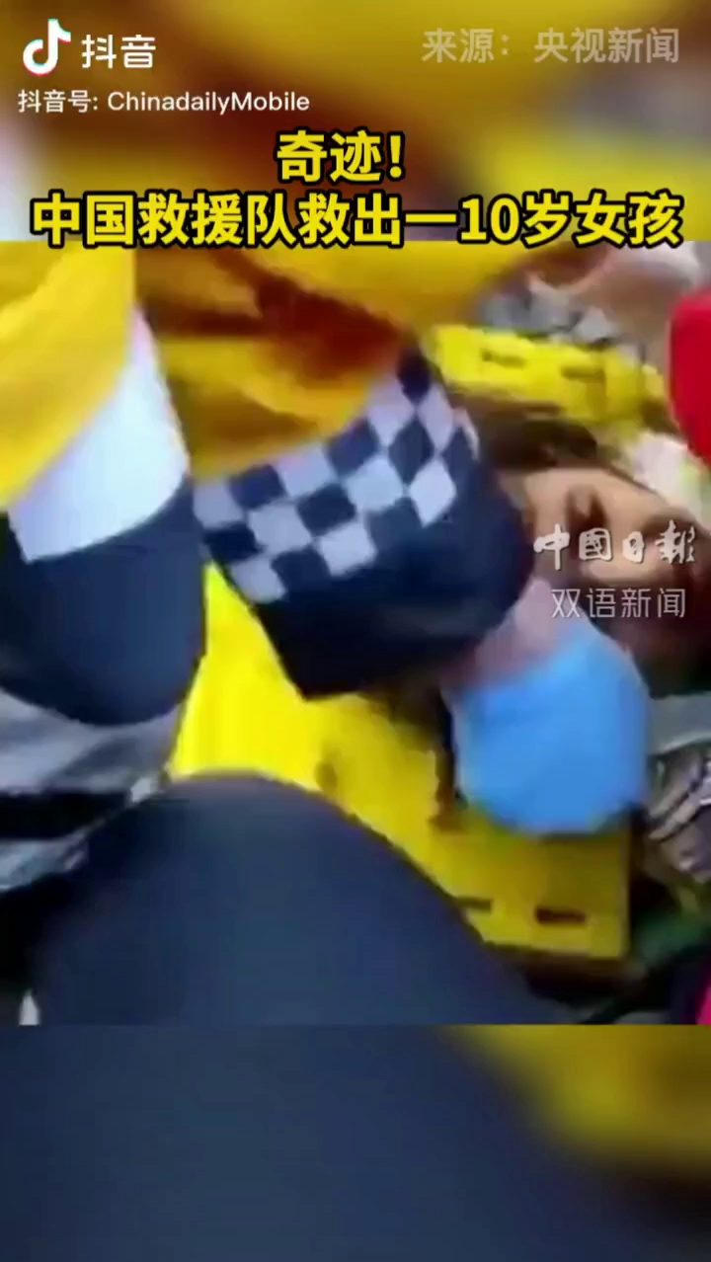
Para.4-5
Rescue workers are trained to find people, treat injuries, and hand out food, water, and other supplies. They have to be able to do work that is difficult under conditions which can be very dangerous. After a disaster, there is usually no electricity or water, and there may be diseases and accidents. Rescue workers get to save lives, but they must also bury the dead. That means they have to be strong in both body and mind.
Form
& Aim
Missions
Work
CISAR

Slide 10
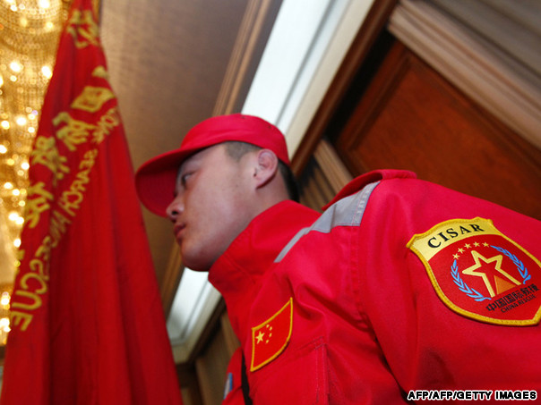
Rescue workers are trained to find people, treat injuries, and hand out food, water, and other supplies. They have to be able to do work that is difficult under conditions which can be very dangerous. After a disaster, there is usually no electricity or water, and there may be diseases and accidents. Rescue workers get to save lives, but they must also bury the dead. That means they have to be strong in both body and mind.
Rescue workers must have big hearts, too. It takes a lot of love and courage to risk one's own life to save someone else's. The members of the CISAR have plenty of both and are always ready to go wherever help is needed.
Strong body and mind
Why does it take a lot of love and courage?
What kind of work will they do?
Love and courage
Requirements
Notes:
学习能力强；

Slide 11
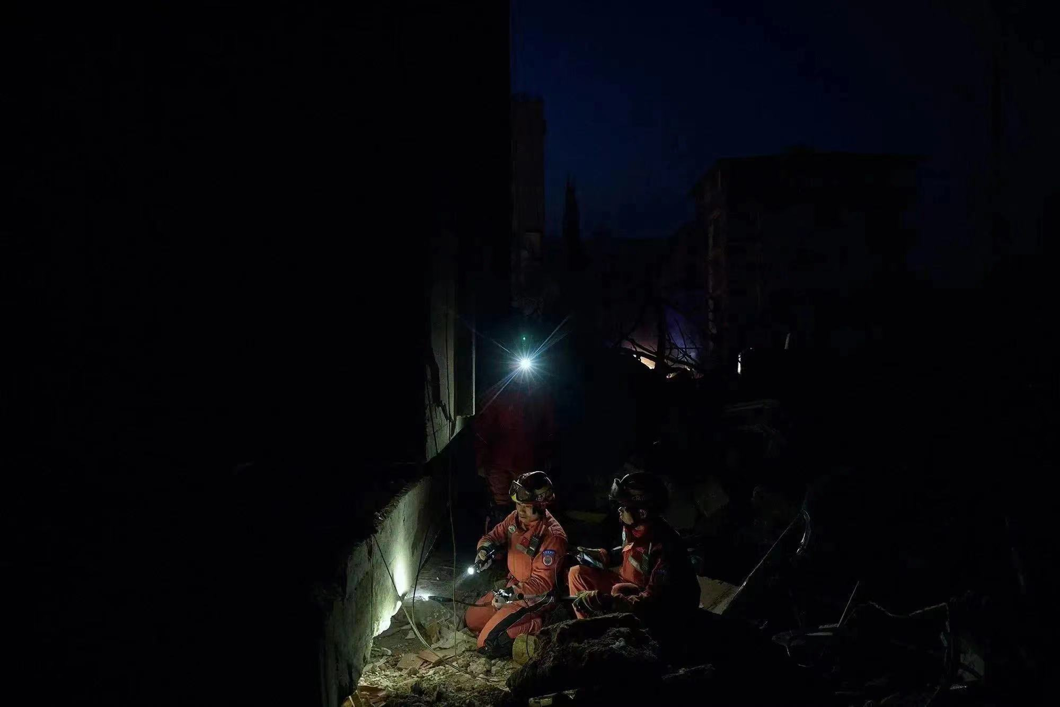
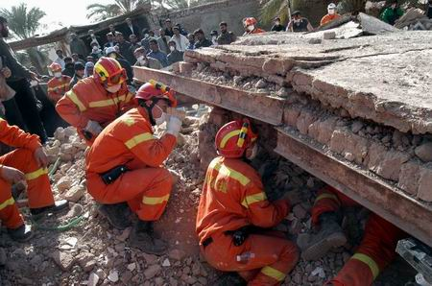
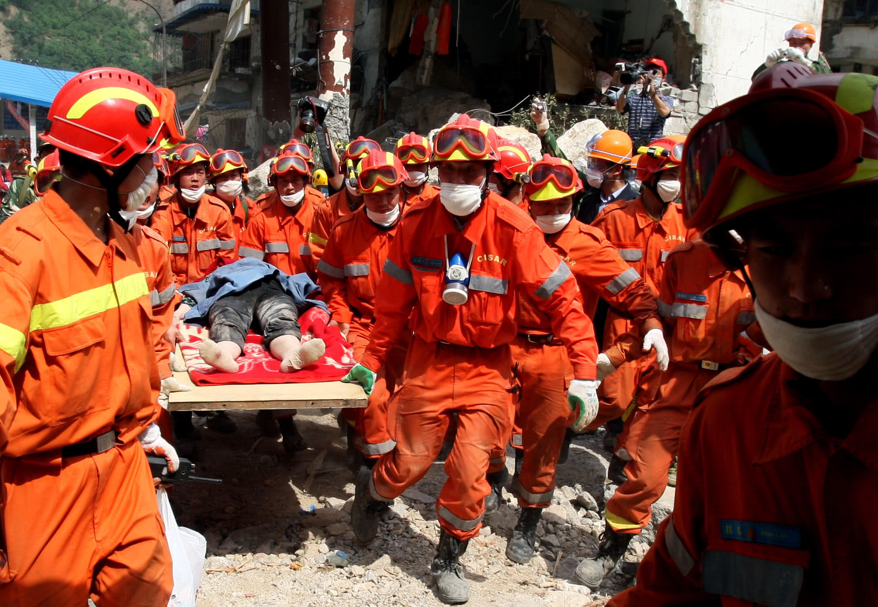
dangerous conditions
difficult work
Rescue workers are trained to find people, treat injuries, and hand out food, water, and other supplies. They have to be able to do work that is difficult under conditions which can be very dangerous. After a disaster, there is usually no electricity or water, and there may be diseases and accidents. Rescue workers get to save lives, but they must also bury the dead. That means they have to be strong in both body and mind.
Rescue workers must have big hearts, too. It takes a lot of love and courage to risk one's own life to save someone else's. The members of the CISAR have plenty of both and are always ready to go wherever help is needed.
no
electricity
water
diseases
accidents
People were in shock—and then,later that afternoon, another big quake shook Tangshan again. Even more buildings fell down. Water, food, and electricity were hard to get. People began to wonder how long the disaster would last.
from The Night the Earth Didn’t Sleep
Notes:
This is what their work is! It is dangerous/ important/ it takes a lot of responsiblity. reflect their unique role / significance = carrying out important tasks.

Slide 12

Rescue workers must have big hearts, too. It takes a lot of love and courage to risk one's own life to save someone else's. The members of the CISAR have plenty of both and are always ready to go wherever help is needed.
Courage & love
C
I
S
A
R
...
Discussion:
What is in their big hearts?
（Hints: qualities）
Industriousness（勤奋）
Selflessness & team spirit
Adaptability
Responsibility
Notes:
CISAR Courage Love Selfess Arduousness Resonsible

Slide 13
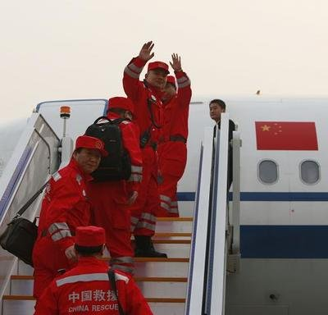
China to the rescue!
Discussion:
Is it necessary to risk their life to save the people from other countries?
What do you think of the work that CISAR had done?
...The members of the CISAR have plenty of both and are always ready to go wherever help is needed.

Slide 14

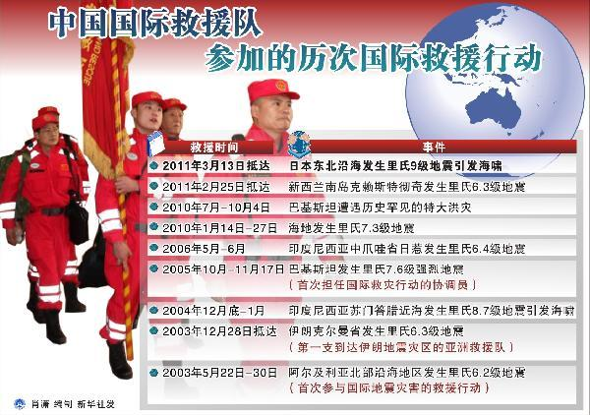
Form
& Aim
China to the rescue !
Missions
attitude!
Work
CISAR
Requirements
Courage & love
shows China's sense of responsibility for the international community
Industriousness
Selflessness & team spirit
reflects the idea of building a community of a shared future for mankind
(人类命运共同体）
Adaptability
Responsibility
Notes:
China’s role in playing with...、 It a dangerous job. Is it necessary to rescue people from other countries? 你觉得有必要么？ 我们也会遇到困难，别人的态度！！！

Slide 15
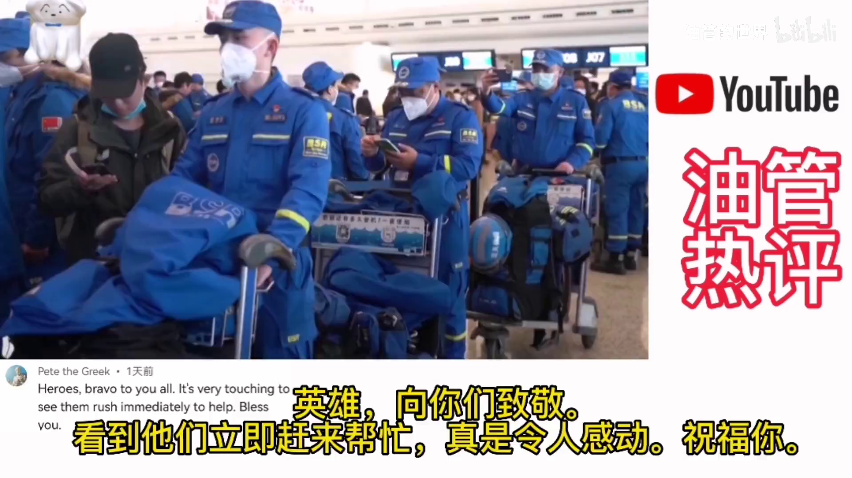

Slide 16
Assignment
1. Write a passage about “What I have learnt from CISAR?”
2. Search the Internet to learn more about rescue teams.

