Slide 1
扫码关注
回复：hello sun
获取课件制作、录课等实用工具包
知识产权声明
感恩遇见，相互成就，本课件资料仅供您个人参考、教学使用，严禁自行在网络传播，违者依知识产权法追究法律责任。
更多教学资源请关注
订阅号：溯恩英语

Slide 2
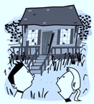
The Beach House
———Focusing on detailed description
Taizhou No. 1 High School Albert Tong

Slide 3
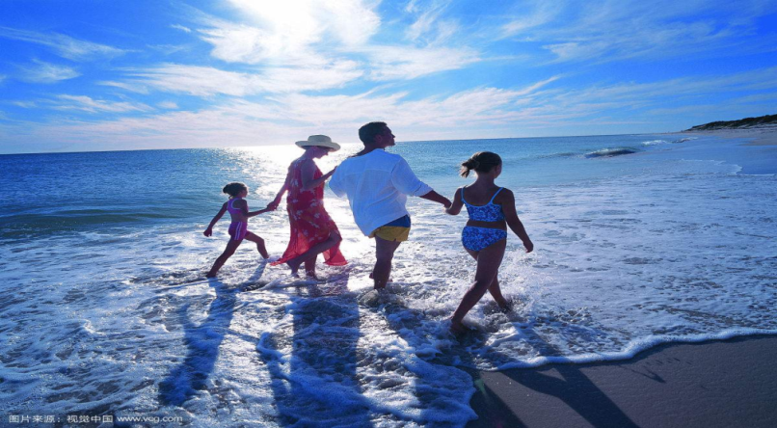
The story
a perfect family summer seaside holiday
how
who
when
where
what

Slide 4
Organization
scared
Inside
curious
relieved
Into
Out of
relaxed
---
Outside
outside

Slide 5
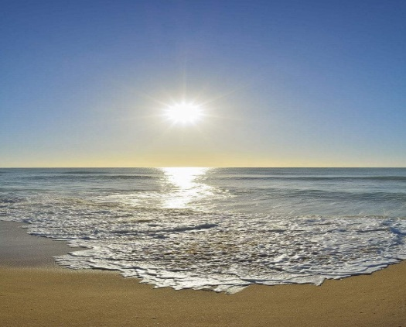
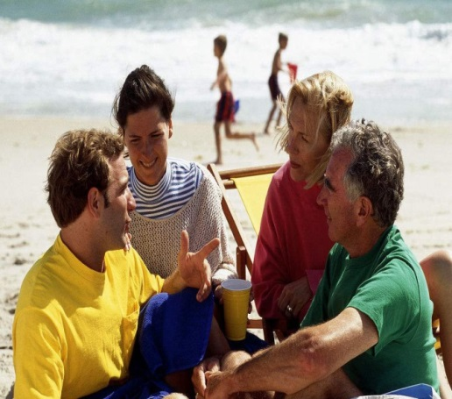
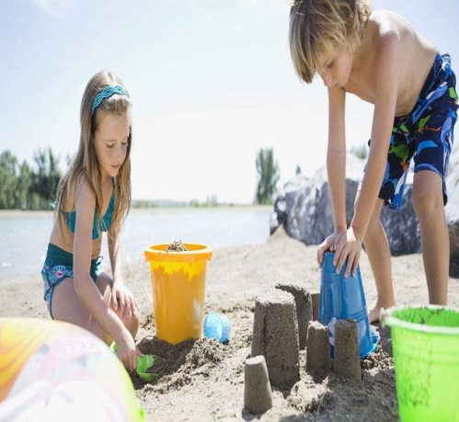
Outside the House (Para 1-2)
floating clouds
glistering water
scattered seashells
How does the author show they were having a perfect and relaxing holiday?
To give detailed description of the surroundings and what people do.

Slide 6
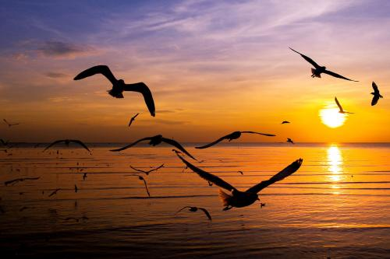
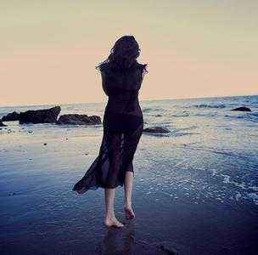
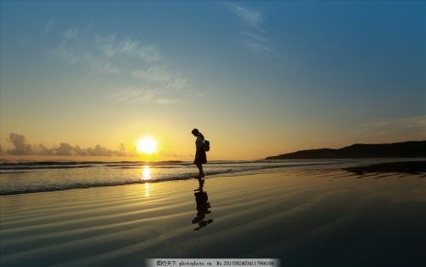
Detailed description of surroundings
A soft breeze gently kissed her hair. The golden red sun was setting. She was spellbound by its color, softly fading into yellow. She could hear nothing but the waves and the seagulls flying up above. The last sunshine gradually cast her shadow on the beach, leaving a long and charming figure in sight.

Slide 7
Into the House (Para 3-4)
The front steps to the doorway of the house creaked as they carefully climbed up them, so did the porch when they stepped onto it. The dusty windows and porch railing were badly weathered and broken. The front door was half open so they squeezed through and cautiously entered. The place was in a total mess, covered with dust, sand, dead leaves, and overturned furniture. They’d taken but a few steps when the door unexpectedly slammed shut behind them.
How does the author show they were curious and cautious?
To use specific vivid verbs and adverbs to describe actions.

Slide 8
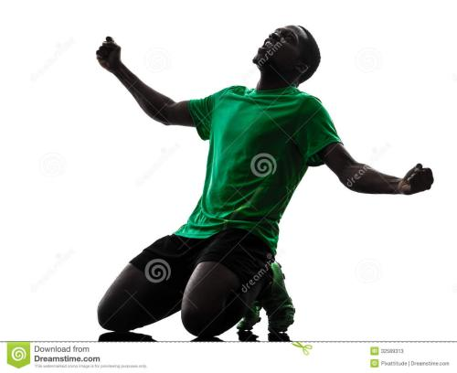
Detailed description of actions
动作细节描写：
Kevin 是一个短跑运动员，在一次全国运动会上，他获得了第一名。请设计一个情节，详细描述他在获胜后的动作，重点突出他激动的心情。
——————————————————————————————————————————————————————————————————————————————————————————————————————————————————————————————————————————————————————————————————————————————————————————————————————————————————————————————————————————————————————————————————————————————

Slide 9
Detailed description of actions
Crossing the finishing line, Kevin let out a roar. He won! After years of hard training, he won! He knelt down, kissing the dear track. Then he ran to his coach and held him tightly in his arms. His coach hugged him, tears of pleasure blurring his vision. Quite a while later, Kevin left his coach and walked to the inner track and waved to the audience, appreciating their support.

Slide 10
Inside the House (Para 5-6)
Frozen with fear, Paula was too scared to move an inch.
Seized by a huge surge of panic, she remained motionless.
Her face turned pale and palms were sweating.
He pointed to the door, with his fingers trembling.
She was so scared that her mouth went dry.
Instantly a sense of terror crept upon him rippling across his while body. He felt every single hair stood on end.
To include details of people’s physical and mental response.
How can you show they were scared? What detailed descriptions can be included to continue the story?

Slide 11
Inside the House (Para 5-6)
----“let’s get out of here, Paula!” screamed Krin.
----“But---ho---how can we make it?” stuttered Paula with a worried look.
----“Hey, bro, look over there in the back bedroom, the window is open.” whispered Paula.
----“Yeah, hurry up, let’s jump out of it.” nodded Krin.
To properly and naturally use dialogues.
.

Slide 12
Inside the House (Para 5-6)
At that critical moment, the survival skills learned at school flashed across his mind. “Yeah, that’s a good idea,” his face lit up.
Desperate and hopeless, they felt as if the world came crashing down. Then suddenly Mom’s encouraging words echoed in her brain, a ray of hope flickering in her eyes. ”I shouldn’t give up easily,” she murmured.
To include mental activities.

Slide 13
Inside the House (Para 5-6)
Without the slightest hesitation, Krin grabbed his sister’s hand and dashed into the back room.
They opened the window, jumped out of it and ran as fast as their legs could carry.
Hand in hand, they cautiously tiptoed to the back room. Unluckily, Krin tripped and fell before they got out of the haunted house.
To include detailed description of actions.

Slide 14
Reflecting on detailed description
To describe the surroundings and what people do.
To use specific vivid verbs and adverbs to describe actions.
To include people’s physical and mental response
by using sensory language.
To properly and naturally use dialogues.
To include mental activities.
---
How to give a detailed description?

Slide 15
Application of detailed description
杰克和妈妈争吵之后离家出走。独自在街道上游荡，身无分文，饥饿难耐。偶遇一位热心老板，免费给他一碗面条。感激之情，难以言表。而老板说，“最应该感谢的是你的妈妈。”杰克意识到自己的错误，决定回家向妈妈道歉。请运用环境描写、动作描写和心理描写等设计一段杰克在见到妈妈之前的描写，首句已给出。
Darkness increased and Jack made his way towards the house.________________________________________________________________________________________________________________________________________________

Slide 16
Application of detailed description
Darkness increased and he made his way towards the house. Heart beating wildly and mind racing swiftly, he cautiously inched closer and hesitantly knocked on the door with a trembling hand. No answer. “Where could Mom have gone?” wondered Jack, confused. Then the seller’s words flashed across his mind again. Countless harsh winter dawns had witnessed mom rising early cooking breakfast for him. But never once had he said a single Thank You to her. With eyes glistening and throat tightening, he resolved to apologize to her. Then he felt a touch on his head---
By Albert and his students

Slide 17
Continuation writing tips
Read more
Accumulate more
Imitate more
Acquire more

Slide 18
Thank You!

Slide 19
扫码关注
回复：hello sun
获取课件制作、录课等实用工具包
知识产权声明
感恩遇见，相互成就，本课件资料仅供您个人参考、教学使用，严禁自行在网络传播，违者依知识产权法追究法律责任。
更多教学资源请关注
订阅号：溯恩英语

