Slide 1
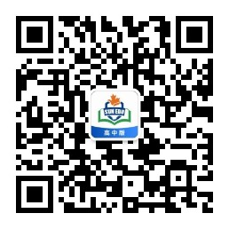
感恩遇见，相互成就，本课件资料仅供您个人参考、教学使用，严禁自行在网络传播，违者依知识产权法追究法律责任。
更多教学资源请关注
公众号：溯恩高中英语
知识产权声明

Slide 2
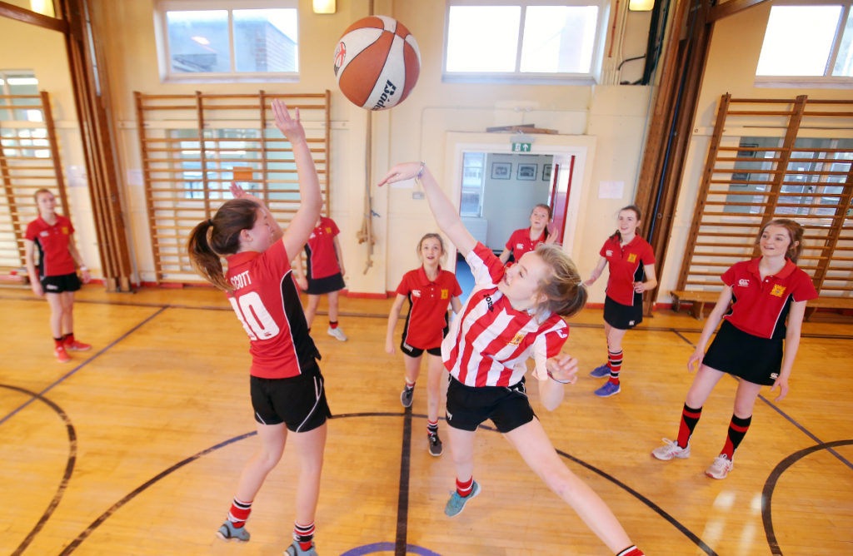

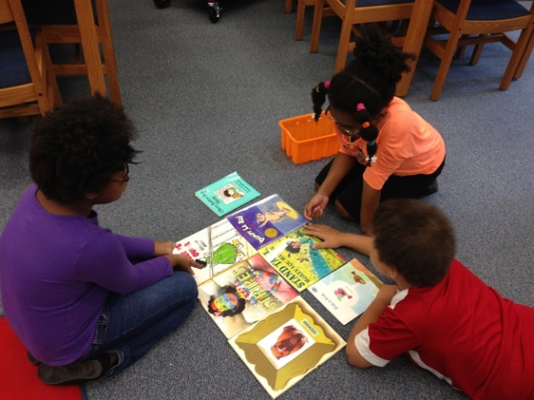

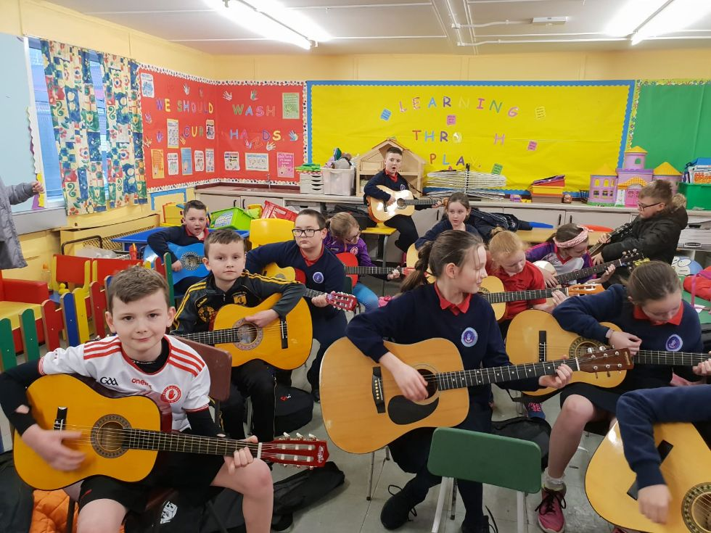
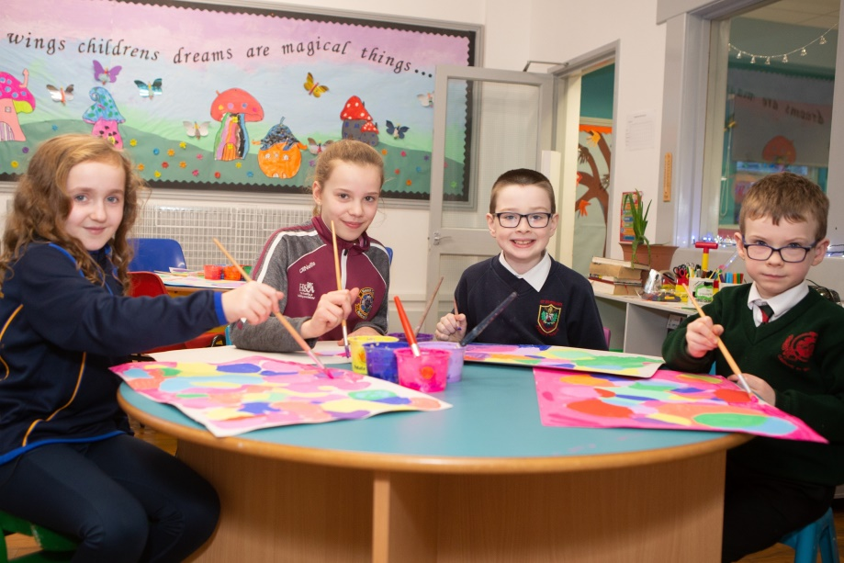
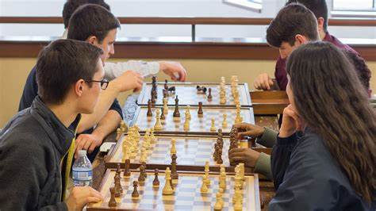
推荐信——俱乐部

Slide 3

推荐信、建议信
类型
时态
人称
要点
假定你是李华，某国际学校学生。新学期学校开设了文学、科技和摄影三个社团，你校新西兰交换生Biff不知如何选择，写信向你求助。请你给他回信，内容包括：
1.推荐某一社团；
2.简介该社团；
3.告知申请方式。
参考词汇：
文学社 the literature club
科技社 the science club
摄影社 the photography club
注意:1.词数80左右；
2.可适当增加细节，以使行文连贯。
一般现在时
审题
第一人称+第二人称+第三人称
why 1（有需求）+what
Why 2（有好处）+how
P1 写作目的——推荐
P2 推荐理由
P3 希望推荐能解决问题
+告知申请方式
主题一以贯之

Slide 4
满足主题（提供建议、推荐）的开头结尾：
Beginning:
Knowing from your last letter that you have difficulty/ are stuck in choosing the club, I am writing to give my recommendation-/ highly recommend …club.
Ending:
Hope my recommendation will be of some benefit to you.
Don’t hesitate to join in… club and embark on (开启)/ open up new avenues of (开辟新路)/ enjoy your fascinating literary/ scientific/ aesthetic journey!
You can’t miss such a good chance to explore the… world.

Slide 5
为何推荐：
文学社 the literature club 科技社 the science club 摄影社 the photography club
1. Which one is more persuasive?
perspectives of a bystander
personal experience in the club
objective--outsider
providing authentic evidence--insider
2. In what order can you recommend the club?
general+ specific
总——分
This club has an edge/ advantage over the other two for the following reasons.
Nothing beats the … club if you want to…
eg: Nothing beats the science club if you want to explore the thrill/ glamour/ charm/ mystery of the unknown world/ universe.
分——总
The club experience will give you the edge as a writer/ scientist/ professional photographer. / will lay a solid foundation for your future career or further exploration of this field.
It provides an outlet to explore… skills and develop new skills.

Slide 6




3. From what aspects can you recommend?
为什么要参加俱乐部？
兴趣满足+相关技能提升+交友交流+其他
需要根据俱乐部的什么信息来挑选？
+ 人气/名气好
丰富性、趣味性、实效性
+ 活动
 | literature club | science club | photography club
good reputation | This … club enjoys wide popularity among us students. This … club is our favorite and earns our highest rating as the best … club you can join. First funded in…, it has already attracted over 200 … lovers/ enthusiasts. 爱好者 bookworm/ shutterbug/ technophile
added bonuses | Club members can access all online courses for FREE! get extra credits (学分) necessary for graduation.

Slide 7
兴趣满足+相关技能提升+交友交流
activities
丰富性、趣味性、实效性
+ 活动
time
place
forms
competitions/ contests
salons/ seminars/ letures
workshops/ tutorials
sessions/ discussions
presentations
curate/ exhibit/ display/ promote the best works on social media account/ platform/ club website
benefits
A. 满足兴趣
quench one’s thirst for…
satisfy one’s interest in…
B. 提升技能
reinforce/ enhance/ strengthen/ promote/ update one’s skills in…
C. 交友交流
strike up/ forge friendships with people sharing the interest
bounce around your ideas with like-minded people
与志趣相投之人进行思想的碰撞

Slide 8

the literature club
reading groups/ circles/ salons/ sessions
book parties (图书签售会)
The club holds monthly reading sessions in the school library where there are thousands of reads/ best-sellers out there for you to read, including mysteries, sci-fi, history, action, or fantasy books.
By offering a customized selection of hand-picked books (that fit your taste) based on your reading preference, this club is a way into opening the box of reading delights.
In each reading group, you will find the pleasure of reading multiplied when we share our ideas, explore differences of opinion and find common interests.
Writing and sharing book reviews in the weekly reading circle can up your reading experience.
Our club is well-suited/ perfect for avid (热爱的) readers looking to feed their imagination because during the reading sessions, members can participate in mindmap drawing, character silhouettes (剪影、轮廓) creation and literary games.

Slide 9
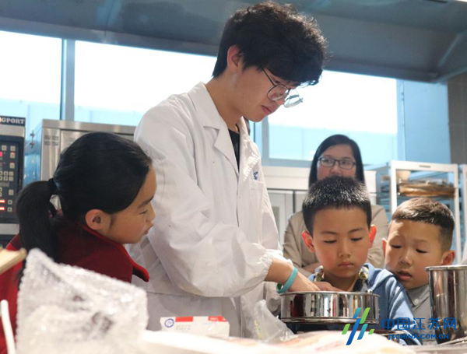
the science club
experiments, researches and investigations
field trips (实地考察)
heated discussions with/ lectures given by mentors/ experts
It provides plentiful/ abundant scientific resources for you to experiment with and try out your innovative/ creative ideas.
It engages each group in authentic science practices, presentation of research findings, and guided discussion with prominent professionals, / This club brings experienced mentors (导师) together with science-loving students to conduct fun and engaging scientific investigations, which are a great way to break down barriers between the cutting-edge technology and students.
Each session involves hands-on activities that explore different science
fields every month, including biology, chemistry, engineering,
environmental science, physics, robotics and more, from which you can
gain an understanding of concepts beyond the classroom/ which can
help you explore the unknown secrets about the universe.

Slide 10

the photography club
hold Photoshop tutorials (教程、学习指南) and workshops (工作坊)
The clubs evening post-processing workshops are a great place for you to update your photography skills.
Many experienced members will offer critiques (评论) from which you can pick up quite a few technical tips.

Slide 11
A possible Version
the literature club
Dear Biff,
Knowing from your last letter that you are stuck in choosing the club, I’m writing to give my recommendation- the literature club.
Rated as one of the Best Clubs of Year 2022, it features a diversity of healing and inspirational activities. To connect to great literary giants/ great minds/ To unplug and detox from modern technology and rejuvenate, the cozy and tranquil club reading room provides different reading sections for you to enjoy world-famous literary masterpieces (and works from new authors), such as detective stories, fairy tales, and poems. After finishing a particular book for each monthly reading session, a reading circle will be held to share members’ book reviews and critiques, during which you can bounce around your ideas with each other.
Just fill in the application form in the Students Union office before October 23rd and begin your literary journey. Have fun!
Yours,
Li Hua
(127 words)
地位+ 总
分——活动内容1+好处
活动内容2+好处

Slide 12
A possible Version
the science club
Dear Biff,
Knowing from your last letter that you are having trouble in choosing the club to join, I think the science club has the edge over the other two since you are such a technophile.
With plentiful scientific resources and professional tutors, this club has attracted over 200 students each year. By conducting hands-on experiments and field trips, you can explore a wide range of science fields—biology, chemistry, physics, robotics, and etc., which can reinforce your practical skills and lay a solid foundation for further investigations. Besides, having a talk with leading figures in scientific fields makes the most advanced technologies accessible to you and thus helps you locate what your real interest is.
You just can’t miss the chance to join the science club. Fill in the application form attached and submit it to thescienceclub@163.com before October 23rd. Good luck!
Yours,
Li Hua
(146 words)
总
分——活动内容1+好处
活动内容2+好处

