Slide 1

感恩遇见，相互成就，本课件资料仅供您个人参考、教学使用，严禁自行在网络传播，违者依知识产权法追究法律责任。
更多教学资源请关注
公众号：溯恩高中英语
知识产权声明

Slide 2

2020年7月高考全国二卷英语精听
语音分析
佳诚高级中学
焦海滨老师

Slide 3


影响听力的因素
心理因素学生在进行听力练习或考试时往往表现为听音时感到紧张、焦虑因而导致无法正常听音。
缺乏背景知识由于没有语言环境，学生很少了解听力材料中的背景知识，无法做出正确的判断、推理、猜测。
学生缺乏听力解题技巧研究发现，很多情况下由于听者未能掌握相关的听力技巧，因而不能很好地理解听力材料。
词汇储备不足一个学生的听、说、读、写要达到一定的水平，必须拥有相应数量的必备词汇。

Slide 4

语音知识对听力的影响
在听力理解的过程中，语音是第一位的，听者首先接受的是语音信息，大脑接受了因素，音节，中音等因素构成的单词，短语和句子后使他们在自己的语言图式中“对号入座”，根据已有的知识结构( 图式 ),开始对该信息进行建构，以理解其意义。

Slide 5
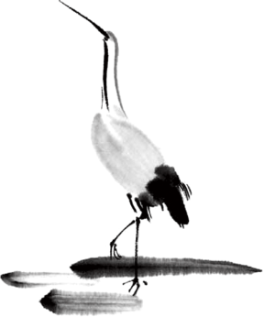
语速的加快主要有一下三种原因
壹
贰
叁
连读
（ 以下用红色标记 )
省音
（ 以下用蓝色标记 ）
音变
（以下用黄色标记 ）

Slide 6



一，连读 （ 以下用红色标记 )
1，“辅音+元音”型连读（异性相吸）
如：I’d like another bowl of rice.
2、“辅音+半元音”型连读英语语音中的/j/和/w/是半元音，如果前一个词是以辅音结尾，后一个词是以半元音，特别是/j/开头，此时也要连读。Thank you .

Slide 7

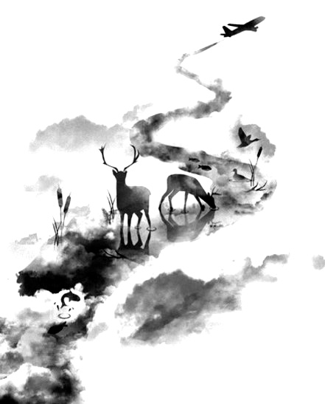

二，省音 （以下用蓝色标记）
01
壹
一、爆破音/b/ /p/ /d/ /t/ /g/ /k/
1.以上任何一个爆破音后面如果紧接着是一个辅音或者半元音，那么这个爆破音将不再发音，仅空半拍就行。如：Good morning!可以发为/gu_'mɔ:niŋ/。
2.以上任何一个爆破音在句尾时，这个爆破音不再发音。如：Good night!最后的/t/音便不再发，整句话可读作/gu_nai_/。

Slide 8
省音 （以下用蓝色标记）
01
二、不完全爆破
① 爆破音中的任何两个爆破音相邻时，前一爆破音失去爆破。如：a big car等。
② 爆破音中的任何一个后接摩擦音f,h,x,sh,s,r时，前面的爆破音失去爆破。
如：I didn't say so.
③ 爆破音后接/t/， /d/， /tr/， /dr /时，前面的爆破音失去爆破。如：a great change等。
④ 爆破音后接/m/, /n/, /l/, /s/时，前面的爆破音失去爆破。如：a bit more expensive等。

Slide 9
省音 （以下用蓝色标记）
01
三、/s/-/z/ /ts/-/dz/ /∫/-/ ʒ / /t∫/-/ dʒ / /θ/-/ ð / ds发/dz以上任何两个音相遇，只读后面的那个音，而前面的音则省略不发。
如：Who is Stone?可把前面一个/z/省掉，只读作/hu i stəun /。

Slide 10
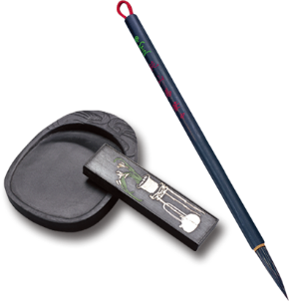
音的变化也是一种连读现象，两个词之间非常平滑的
过渡，导致一个音受临音影响而变化。
主要是以下两种方式：
1、 辅音[d]与[j]相邻时，被同化为[dʒ]：
Would you....?
2、 辅音[t]与[j]相邻时，被同化为[t∫]：
Can’t you？
另外，Do ,to ,from ,what ,can, must ,of , but , would ,for
在非 重读的时候，其中的元音都发央音
三，音变
（以下用黄色标记 ）

Slide 11
听力试音材料
M:Hello ! International Friends Club , can I help you ?
W: Oh , hello ! I read about your club in the paper today . And I thought I’d phone to find out a bit more .
M:Yes , certainly . well , we’re a sort of social club for people from different countries . It’s quite a new club .we have about 50 members at the moment but we’re growing all the time .

Slide 12
听力试音材料
W: That sounds interesting .I’m British actually ,and I came to Washington about three months ago ,I’m looking for ways to meet people . . Er ,what kinds of events do you organize ?
M: well , we have social get-togethers ,and sports events ,and we also have language evenings
W: Could you tell me something about the language evenings ?

Slide 13
听力试音材料
M: Yes , every day except Thursday , we have a language evening. People can come and practice their languages .you know , over a drink or something .we have different languages on different evenings . Monday -Spanish; Tuesday- Italian ;Wednesday- German and Friday- French .On Thursday we usually have a meal in a restaurant for everyone who wants to come .

Slide 14
听力试音材料
W:well,that sounds Great , I really need to practice my French .
M: Ok , well if you can just give me your name and address I’ll send you the form and some more
and 的d省掉之后，字母n和后面的字母a连读了。Name and address其实是这样拆分的（ na mea na ddress )
information .If you join now ,you can have first month free .

Slide 15


例题
M:Excuse me ,can you tell me how much the shirt is ?
W：Yes, it’s nine-fifteen.
例：How much is the shirt?
A. ￡19.15. B. ￡9.18. C. ￡9.15.

Slide 16


Text 1 问路；24词
M: Excuse me, 1.how can I get to the nearest supermarket?
W: It’s on Penny’s Road. Go past the post office, and it’s on your left.
1. Where does the conversation probably take place?
A. In a supermarket. B. In the post office. C. In the street.

Slide 17

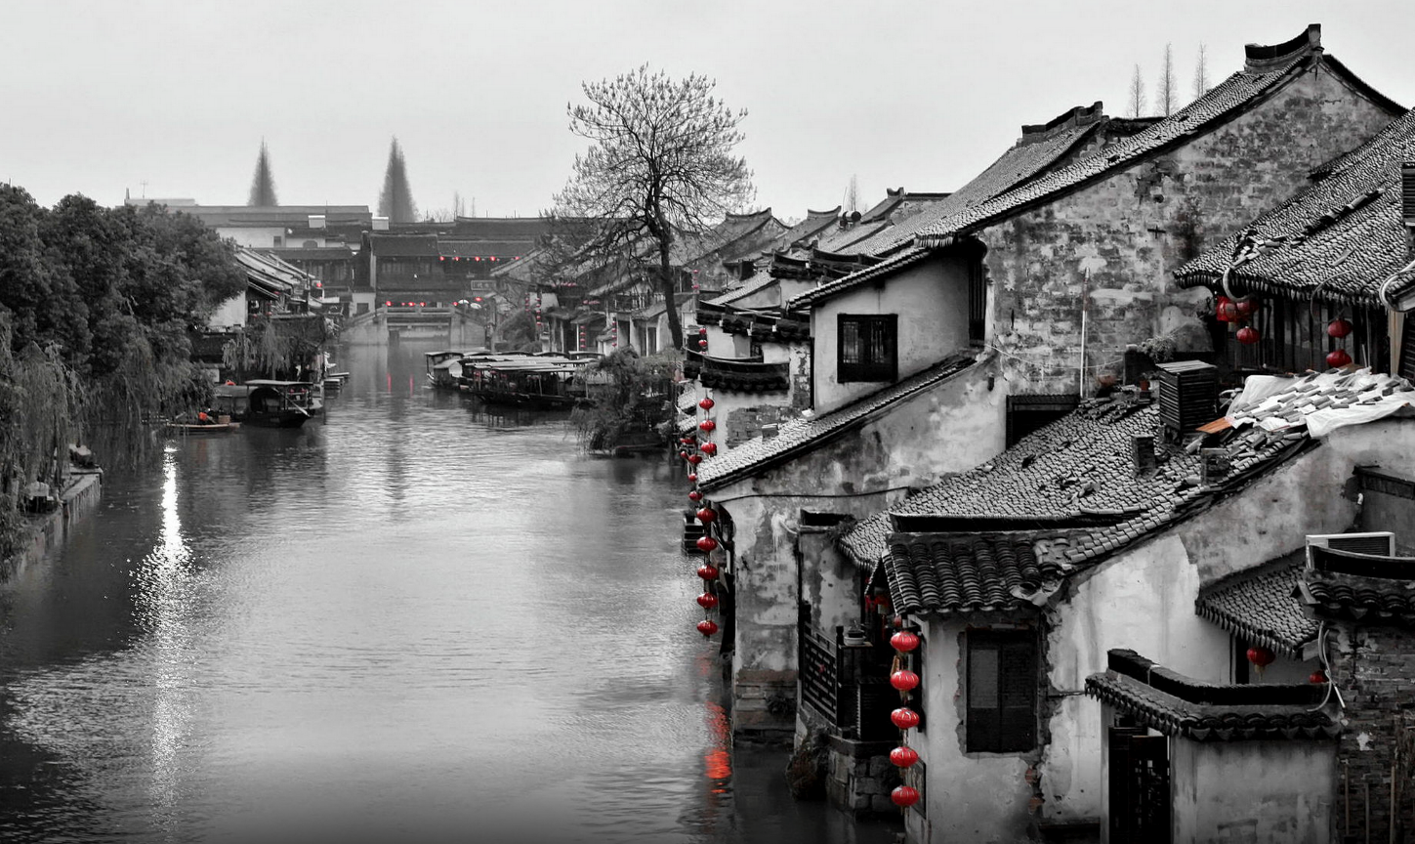
Text 2 修理电视机；36词
——————————
W: I don’t know how you did it, Carl. But the TV works beautifully now. You should get a medal for your work.
M: It wasn’t hard at all. It was much easier than preparing for the test.
2. What did Carl do?
A. He designed a medal.
B. He fixed a TV set.
C. He took a test

Slide 18
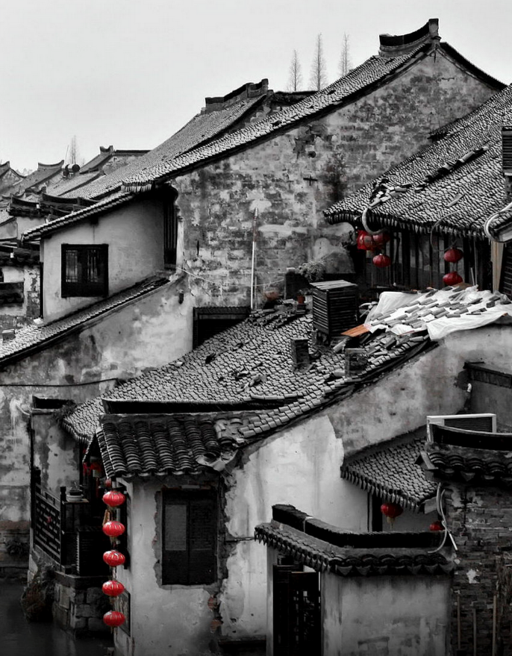
Text 3 裁剪衣服；36词
M: Good morning, madam. What can I do for you?
W: Well, the sleeves of this jacket are too long. Can you make them shorter?
M: Let me take a look. OK. I can do it for 20 dollars.
3. What does the man do?
A. He’s a tailor.
B. He’s a waiter.
C. He’s a shop assistant.
天人合一
天 下 皆 知 美 之 为 美 ， 斯 恶 已
皆 知 善 之 为 善 ， 斯 不 善 已
有 无 相 生 ， 难 易 相 成 ， 长 短 相 形
高 下 相 盈 ， 音 声 相 和 ， 前 后 相 随
恒 也

Slide 19

Text 4 航班延误；36词
W: Excuse me！ Could you tell me what time Flight AF35 gets in?
M: Well, it’s due in at 6:20 pm, but the announcement said just now that it has a 30-minute delay because of the bad weather.
4. When will the flight arrive?
A. At 18:20. B. At 18:35. C. At 18:50.

Slide 20
Text 5 请教老师；45词
M: Miss Miller, could you tell me how I can improve this article? I got B+.
W: It’s quite good actually. The language use is good and the main point is covered. 5.There’s just too much repetition. You could have said everything within two pages.
5. How can the man improve his article?
A. By deleting unnecessary words.
B. By adding a couple of points.
C. By correcting grammar mistakes.

Slide 21
Text 6 谈论周末生活；64词
W: So, Bill, what do you usually do on the weekend?
M: 6.I often go to movies with friends on Friday night. How about you, Sarah?
W: Well,7 I love seeing musical plays on Broadway with my friends. Have you been to many?
M: Not really. I saw one when I moved to New York and another when my parents came to visit, but none ever since.
听第6段材料，回答第6、7题。
6. What does Bill often do on Friday night?
A. Visit his parents.
B. Go to the movies.
C. Walk along Broadway.
7. Who watches musical plays most often?
A. Bill. B. Sarah. C. Bill’s parents.

Slide 22
Text 7 打电话留言取消会议；59词
W: Hello, Helen Smith speaking. Can I help you?
M: Hello, this is David. Could I speak to Mike, please?
W: I’m afraid he’s not available at the moment. Would you leave a
message?
（ 此处字母h被击穿，没有发音。字母d和e直接连读）
M: Yes, 8.I’m calling to cancel the meeting we scheduled for
this afternoon.
W: OK. Let me take this down.9. Could I have your name again?
M: Certainly. It’s David Stone.

Slide 23
——————————
听第7段材料，回答第8、9题。
8. Why does David want to speak to Mike?
A. To invite him to a party.
B. To discuss a schedule.
C. To call off a meeting.
9. What do we know about the speakers?
A. They are colleagues.
B. They are close friends.
C. They’ve never met before.

Slide 24
Text 8 购买摄影机；155词
W: Can I help you, sir?
M: I’d like to buy a camera.
W: Right. We have ordinary cameras, movie cameras and video cameras. They are all digital.
（ 字母t位于两个元音之母之间，且不是重读音节，此处t 发d的音）
M: Well, 10.I’m thinking of a video camera.
W: Let’s see. How much do you want to spend, sir?
M: Oh, I am not really sure. What is the price?
W: Well, that depends on the model and anything else you want to have with it.
M: I see.

Slide 25
W: How about this one? It has one of the new memory discs and a protected case for filming underwater, so you can take it when you go diving.
M: It doesn’t have auto-focus.
W: No, it doesn’t.
M: That’s OK.11. The underwater filming is important for me actually.
How much is this?
W: It costs 650 euros.
M: Oh, that’s a bit expensive for me. Have you got anything similar but less expensive?
W: Well, here is the sale of the week. It’s excellent for the price, only 170 euros and it includes...

Slide 26

听第8段材料，回答第10至12题。
10. What kind of camera does the man want?
A TV camera.
B. A video camera.
C. A movie camera.
11. Which function is the man most interested in?
Underwater filming.
B. A large memory.
C. Auto-focus.
12. How much would the man pay for the second camera?
950 euros.
B. 650 euros.
C. 470 euros.

Slide 27
Text 9 采访著名插画家；229词
W: A big dog celebrates a big birthday this year. 13.Clifford the Big Red Dog, first appeared 50 years ago along with Emily Elizabeth, a little girl who loves him. （ 同理，此处h被击穿没有发音）Today we have Norman Bridwell to talk with NBR’s Reporter on his dog’s 50th birthday. So, Norman, tell us how it all started.
M: Well, it was 1962, and I was a struggling, not very successful artist in New York. 14.My wife suggested that I try my hand in painting for children’s books. So I did ten paintings and took them to publishers. I was turned down everywhere except one publisher 15.where a young woman told me I wasn’t very good. So if I want to paint for a book, I need to write one on my own.

Slide 28
W: So you did?
M: Oh, the woman pointed to a painting I had done—a little girl with a big red dog, and she said maybe that is a story, and I went home and over that weekend I wrote the story—Clifford the Big Red Dog, and I was shocked it was accepted for publication, because I never wrote anything before.
W: I see. How wonderful!
M: Yes, it was. My wife was also in shock when she did realize it wasn’t a dream, but it was just luck.
W: But that luck turned into 90 Clifford books that have sold 126 million copies in thirteen languages.

Slide 29
——————————
听第9段材料，回答第13至16题。
13. Who is Clifford?
A. A little girl. B. The man’s pet. C. A fictional character.
14. Who suggested that Norman paint for children’s books?
A. His wife. B. Elizabeth. C. A publisher.
15. What is Norman’s story based on?
A. A book. B. A painting. C. A young woman.
16. What is it that shocked Norman?
A. His unexpected success.
B. His efforts made in vain.
C. His editor’s disagreement.

Slide 30
Text 10 关于陌生人之间寒暄的演讲；180词
M: Hello, everyone. Today I’m going to talk about small talk. That is short conversations 17.people often have with strangers they meet. Such strangers occur at bus stops, on buses, while waiting in line almost anywhere that strangers gather close together. As a matter of fact, these short conversations are a good way for people 18.to say hello and express friendliness. Such conversations usually cover a wild range of topics.19. The topics may include weather, customer service, movies, TV shows, local sports or the latest news. But you should always keep it in your mind that private questions about salaries, family life, religious belief and politics should be avoided during these conversations.

Slide 31
20.Besides, it’s better to ask open-ended questions. If you ask visitors, “Do you like our city?” They may say simply “Yes!” On the other hand, if you ask, “What do you think of our city?”, they would have more freedom in answering. This type of question also shows that you’re interested in them. If you appear interested in what people are saying, they’d feel more comfortable talking with you.

Slide 32
听第10段材料，回答第17至20题。
17. Who would like to make small talk according to the speaker?
A. Relatives. B. Strangers. C. Visitors.
18. Why do people have small talk?
A. To express opinions.
B. To avoid arguments.
C. To show friendliness.
19. Which of the following is a frequent topic in small talk?
A. Politics. B. Movies. C. Salaries.
20. What does the speaker recommend at the end of his lecture?
A. Asking open-ended questions.
B. Feeling free to change topics.
C. Making small talk interesting.

Slide 33
欢迎指导
祝各位考生金榜题名！

