Slide 1

感恩遇见，相互成就，本课件资料仅供您个人参考、教学使用，严禁自行在网络传播，违者依知识产权法追究法律责任。
更多教学资源请关注
公众号：溯恩高中英语
知识产权声明

Slide 2
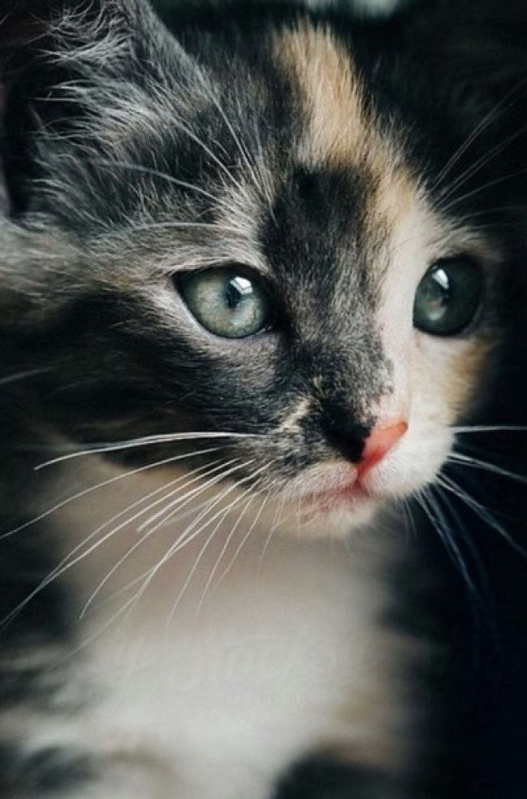
读后续写讲评
Angelica the Rescuer

Slide 3
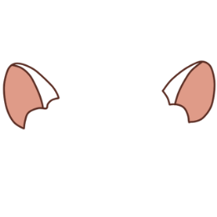

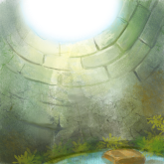
When and how did Angelica come to our family?
❶The Christmas holidays were fast approaching, and we had ordered many gifts online. So, when the doorbell rang, I was sure some of the packages had arrived. I ran to the door and swung it open, but no one was there. I sensed something and looked down, only to find a beautiful calico kitten (杂色猫) sitting there, looking up at me with big, intelligent eyes. There was no way that she could have rung the doorbell by herself, was there?
❷We figured that someone had found the kitten somewhere and left her there, and then rang the doorbell and ran away. They accurately guessed we would welcome an additional family member and take care of her.
❸My husband called her our little angel, so we named her accordingly. She had a calm aura (气质) about her as she walked straight into our home and hearts, fitting in perfectly. It seemed as if she was always meant to be in this big house with us. She was an old soul and turned out to be the perfect companion. Always by my side, she was more like a puppy than a kitten. Wise beyond her years, she enjoyed wandering through the tunnels and mysterious rooms as much as I did, but with much less fear. Angelica the calico was courageous.
❹So, I took a page from her book and decided to be brave, too. There was an underground stone cellar (地窖) I had been eager to explore. The only way in was down a rickety (摇晃的) ladder to its murky depths. I guessed it was an old root cellar, probably twelve feet deep.
❺I had promised my husband that I wouldn't explore dangerous areas unless he or someone else was around. Though I knew I was stretching it, I figured that Angelica would count as my companion. I was ready to explore this cellar, and so was she.
❻I equipped myself with a good flashlight and warm clothes, and carefully started down the rickety ladder while Angelica was looking down at me from above. Faint crack and sudden crash were what I could remember.
an additional family member
Characters
Setting
Plot-theme
POV
Language
our little angel
Characteristics of the cat: calm, adaptable, mature, wise/ intelligent, loyal/ faithful, adventurous, fearless/ brave/ courageous;
a good companion
walked straight into our home and hearts
was always meant to be in this big house with us
took a page from her book and decided to be brave, too
What was the cellar like?
My adventure down the cellar (purpose, preparation, result)

Slide 4
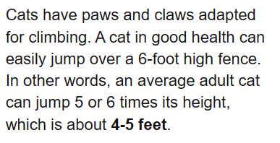
Some ridiculous mistakes you’ve made that conflict with the story or the common sense:
The cat stayed with me down in the cellar and jumped out to call for help.
The cat dragged along a rope and pulled me out of the cellar.
The cat carried another ladder to help me up to the ground.
The cat eyed me with encouragement and inspired me to go climbing up to the ground.
The cat came down to the cellar and dug a hole for us to get out.
Despite the pain, I took the chance to adventure deep to the cellar.
“… an old root cellar, probably twelve feet deep”
“…while Angelica was looking down at me from above”
“The only way in was down a rickety ladder to its murky depths.”

Slide 5


Characters
Setting
Plot-theme
POV
Language
trapped in an old underground stone root cellar
looking down at me from above
Angelica exploited her intelligence to rescue me.
Human and animals– Animals can be a good companion or even a rescuer for human beings.
1st person limited
Rhetorical device: personification—she; Angelica the calico
Contrast & comparison
I ran to…, but no one was there.
I sensed…, only to find…
She was more like a puppy than a kitten.
Specific Words or expressions: swung it open; murky depths; stretch; equipped myself with…

Slide 6

…Faint crack and sudden crash were what I could remember.
The ladder was broken. I fell off the ladder and fainted.
There was no way out of the cellar.
Paragraph1
I woke up with pieces of the rotting, broken ladder lying around me on the stone cellar floor.
Paragraph2
It seemed my companion, Angelica, was my last hope.
How was my physical condition?
How did I feel about the circumstances?
What did I do?
Several failed attempts
scream/ wave the flashlight/ …
Whose rescue work should be highlighted in this part? Angelica’s, my husband’s, other people’s or mine?
How did I ask Angelica to help me?
How did Angelica help me?
How was I rescued?
How did I and Angelica interact with each other after the rescue?

Slide 7


It was clear/ evident/ obvious that I had toppled off (从高处落下) the broken ladder and fallen back first to the cellar ground.
Apparently, the 5th rung of the rickety ladder was splintered (分裂成碎片) , so I figured that’s how I fell.
There was no way that I could get out of this cellar, was there?
My whole body was aching badly and my left leg was even bleeding due to the crush against the broken/ scattered (散落一地的) ladder pieces.
A surge of dizziness came over me when I recalled what had happened.

Slide 8
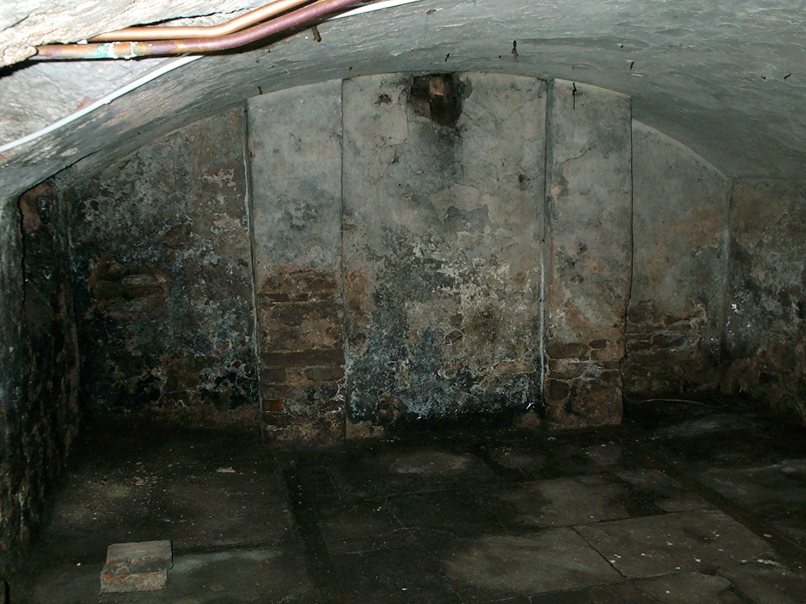

What can you see, touch, hear, taste in here?
How would you feel when trapped in a stone cellar like this?
Describe five senses to show the authenticity

Slide 9
In the depths of total darkness, the air was thick with rot (腐烂) and mildew (霉味)/ musty dampness, and I could even hear my breaths echoing through the narrow space/ and the only sounds that could be heard were the constant drips of water from a leaky pipe somewhere in the darkness/ were the frantic beating of my heart.
Thinking that I had no way out, I felt an overwhelming sense of despair washing/ sweeping over me.
My eyes strained to (竭力做……) adjust to the lack of light, but all I could see was a void of blackness (一片漆黑) that seemed to swallow any light or hope. I could barely make out my own hand in front of my face, let alone find a way out.

Slide 10
The longer I stayed down there, the more intense my fear became. It was as if the darkness had taken on a life of its own, suffocating (令人窒息的；使人呼吸困难的) and oppressive (让人难以忍受的). Time seemed to lose all meaning, and I was left alone in my terror, unsure if I would ever find my way out.
I reached out my hands, but they found nothing but cold, damp walls, which made my skin crawl (让人毛骨悚然).
A sense of terror soon took hold of me, making my heart race wildly. My hands frantically searched for a way out, but all I could feel were cold, rough stone walls.

Slide 11
How to show your regret?
虚拟语气：
How I wished I had kept the promise to my husband!
If only I hadn’t come down from that rickety ladder!
强调句：
How silly I was to take such an adventure without much thought!
否定+比较级表示最高级意义：
I couldn’t be more regretful to make such a decision!

Slide 12


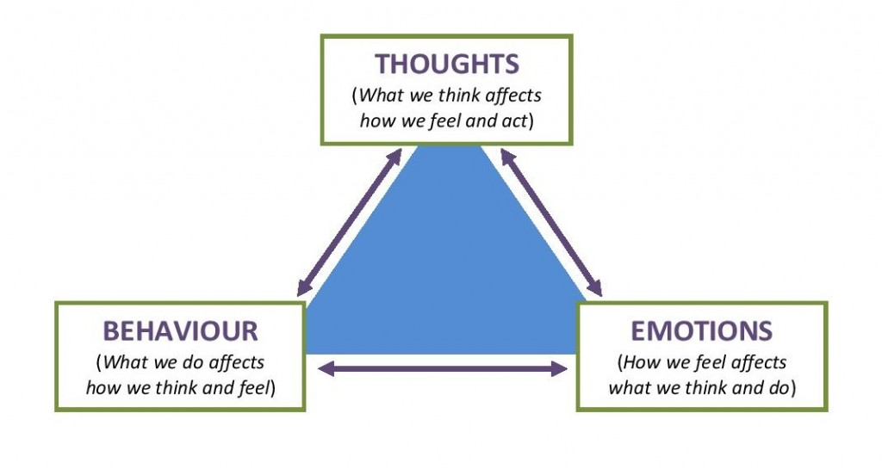

Desperate for help, I began to scream, hoping that someone would hear and came to my rescue. The high-pitched voice echoed off the walls, growing weaker with each cry. But no one responded. I cried more urgently, but still, no one came. As time passed, my voice grew hoarse (嘶哑的), and the screams turned into sobs. I curled/ huddled up (蜷缩) on the ground, my body wracking (痛苦不堪) with fear, despair and pain. The belief/ fear that I may never escape set in, and I was totally consumed by
a feeling of hopelessness.
Desperation gnawed at (啃；咬) me as I tried to think of another way out. I screamed, hoping someone above would hear me, but the only thing greeting me was dead silence.
I kept screaming for help, only to be greeted by the echoing of my own voice.

Slide 13

As I fumble through my backpack, my fingers felt something hard. It was the flashlight! Hope instantly flared (发光) within my heart. As I switched it on, a beam of light pierced (穿透；刺破) the gloom (n. 昏暗；黑暗).
I was searching my pocket for anything that could help me escape when I felt/ sensed the flashlight. After turning it on, I shone the torch up to the entrance in an attempt to attract/ capture/ draw the attention of people on the ground.

Slide 14

With no other options left/ no alternatives, I sank/ slumped to the ground and huddled (蜷缩) in a corner, trying hard to block out the terror of my situation.
At that moment, I realized that I was truly alone, trapped in a world of shadows and uncertainty.
All my self-saving attempts had failed, and the hopelessness of my current situation was almost too much to bear.

Slide 15

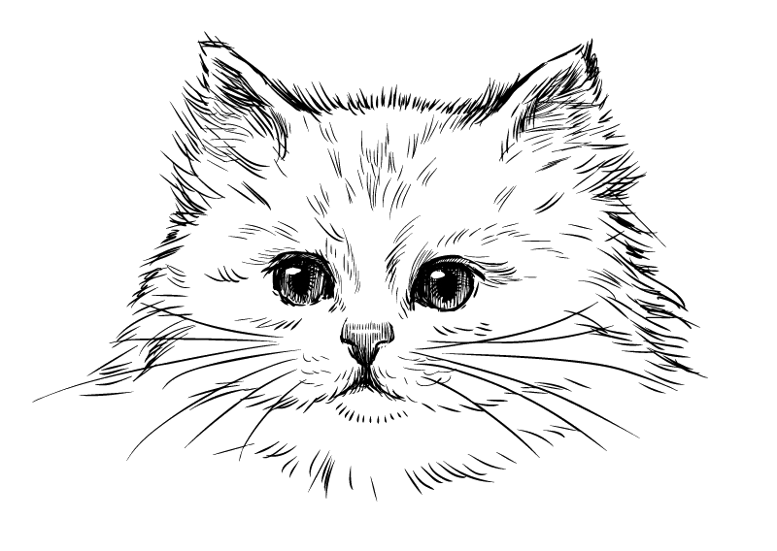
Before I was rescued:
Through the light of the torch, Angelica was seen to poke/ peep/ stick her tiny head out with great concern, seeming to check on whether I was fine or not.
The petite creature meowed softly and blinked eyes of calmness, as if comforting me and asking if there was anything she could do to help.

Slide 16
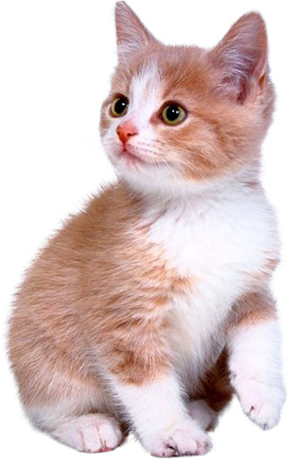
Her help:
It soon disappeared from sight. But moments later, I could hear scratching sound and approaching footsteps.
My husband told me it was Angelica who kept meowing and pawing at the door to get his attention. Once inside, she alerted him by rubbing his foot constantly and then brought/ navigated him to where I was.

Slide 17
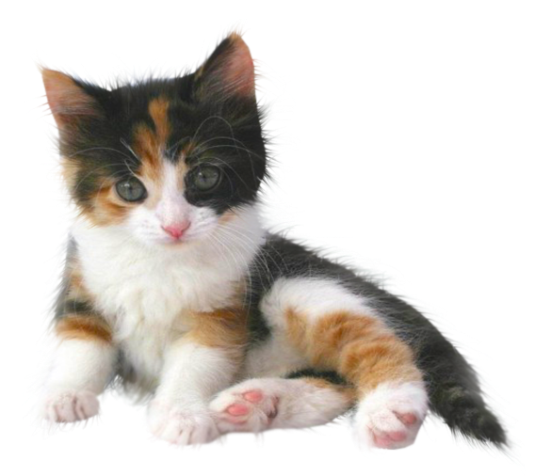
After I was rescued:
I turned to thank my dear Angelica, but she had already scampered (蹦蹦跳跳) away, confident and proud of her feat (功绩).
At the sight of me, she leapt to my arms and rubbed against my chin as a sign of reassurance and comfort.

Slide 18

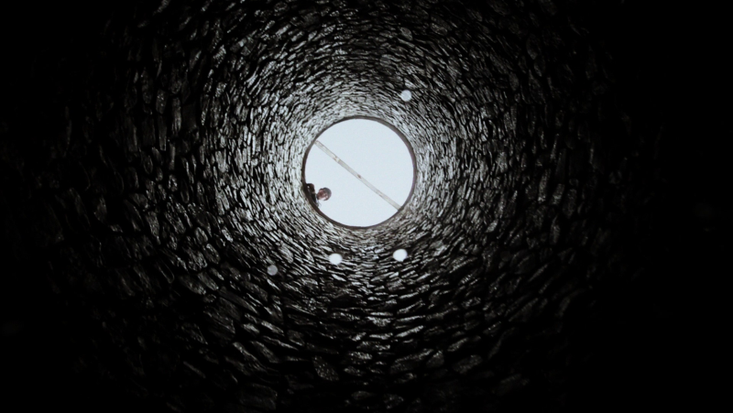
Time dragged on and there was no sign of my “savior”. Just when I thought all hope was lost, a beam of light suddenly pierced through the gloom. The sound of footsteps hurrying closer echoed through the darkness as a figure slowly came into my sight against the bright light. It was my husband!
By clutching the sturdy (结实的) rope brought along by my husband, I felt a surge of hope mounting/ accumulating inside as I was slowly raised up towards the light. When I emerged from the
cellar, the world suddenly seemed brighter.
Overwhelmed with emotion, I slumped to the
arms of my husband and cried tears of relief
and gratitude in his comforting embrace.

Slide 19

I couldn’t help but feel grateful for the intelligent calico kitten that had come to our home unexpectedly and saved me from being trapped alone. Maybe this tiny angel was destined (命中注定的) for great things, and I would always remember the role it played in my rescue and cherish the miraculous encounter.
This little rescuer, both intelligent and loyal, turned out a good companion and was meant to be our family.

Slide 20
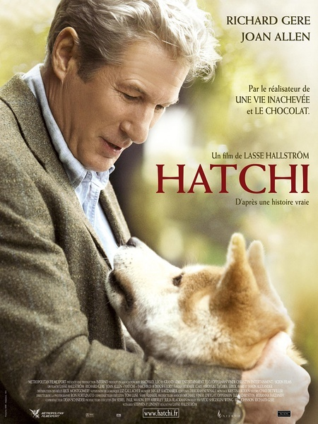
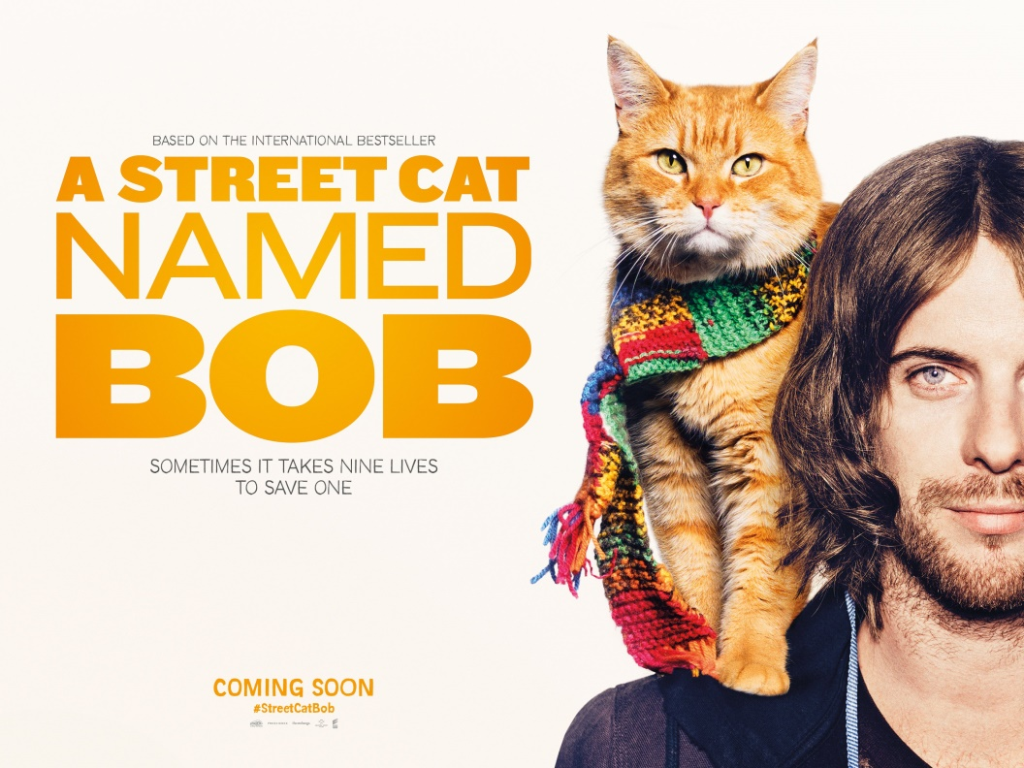
Relate to movies with a similar theme
https://www.iqiyi.com/v_19rqt2cko4.html
https://www.bilibili.com/video/BV1U4411S7L2/

Slide 21

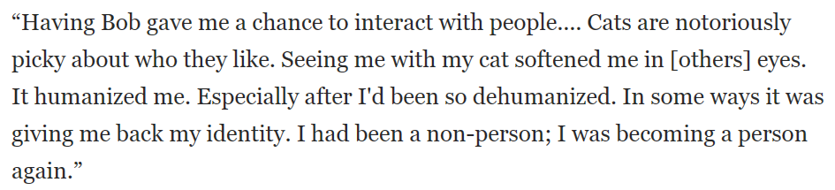
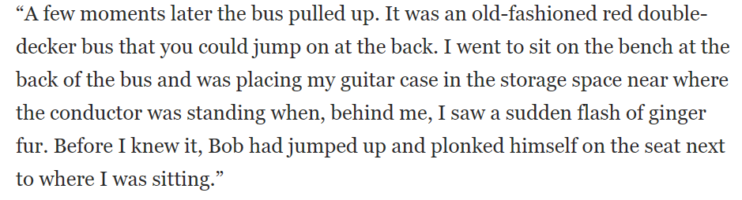
Having Angelica gave me a chance to learn what courage really means.
Before I knew it, a sudden flash of calico-colored fur disappeared from my sight.
I wondered whether Angelica was a gift of life to rescue me from such a plight (困境).

Slide 22
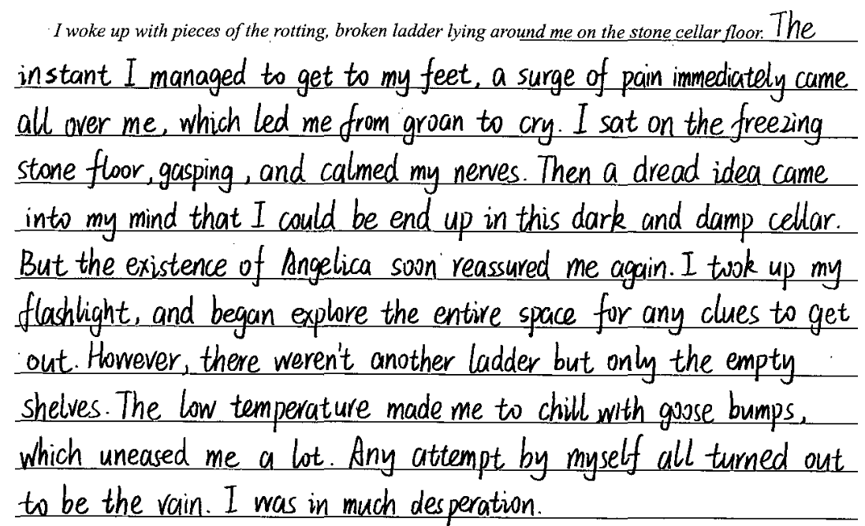
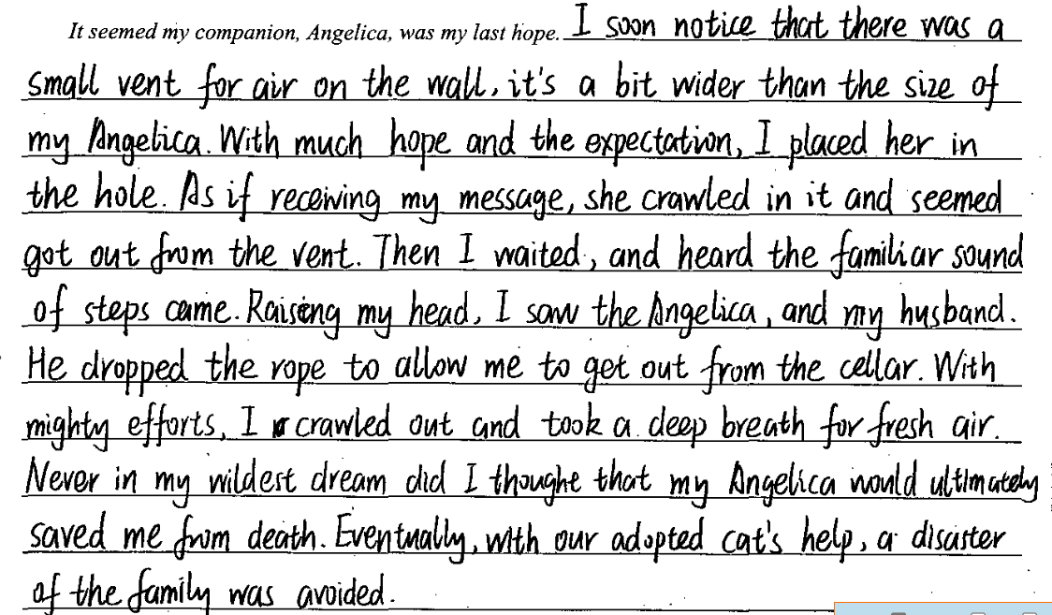
Grade this student’s writing based on the following aspects:
人设
情节
主题
逻辑
语言
Group Work: Polishing it by achieving all-rounded synergy

Slide 23
下水作文：
I woke up with pieces of the rotting, broken ladder lying around me on the stone cellar floor. Dizziness swept over me as I figured out that I had toppled off the ladder and fallen back first to the cellar ground. My right foot felt numb and every part of my body ached badly. Things got worse when the old root cellar floated its musty dampness to my nose. Was it my doomsday? Trying hard to get rid of this thought, I used all my might to scream out loud “Help! Help!”. No luck! Feeling freezing cold both physically and mentally, I fumbled for my clothes and accidentally felt the flashlight, which again flared my faith to go out. However, it failed me as always—the flashlight didn’t work due to the hard crash against the ground. In desperation, I decided to give in to my fate when there came a faint purr.
It seemed my companion, Angelica, was my last hope. Just for a glimmer of hope, I looked up to the vent of the cellar, delighted to find my dear Angelica stood still alertly, poking her head out and staring at me from above. “Angelica, go find Jack!” At my request, the calico-colored fur soon disappeared from my sight. It wasn’t long before I heard the hurried approaching footsteps. Eventually, I was rescued! According to Jack, it was Angelica who kept pawing at the door to get his attention and navigated him to where I was. Spontaneously, I pulled her closer to my chest, extremely grateful for this special Christmas gift who was destined to be our companion and family member.

Slide 24
参考范文：
I woke up with pieces of the rotting, broken ladder lying around me on the stone cellar floor. My head was pounding, and I couldn’t seem to focus on my thoughts. I had lost my footing/ missed a step on the third rung (第三级阶梯), and the ladder had given away, sending me crashing to the ground. The pain in my arm was intense, and I knew it was broken. I was trapped, alone, in the dark cellar with no way to climb out. I called out for help, but my voice echoed back to me, hollow and empty. Despair was about to swallow me when there came a faint but familiar mew.
It seemed my companion, Angelica, was my last hope. I prayed that she would realize something was wrong and come to my rescue. Her fearless nature and loyalty gave me a glimmer of hope. Lying in the darkness, I tried to calm my breathing and listened for any other sound from above. Time stood still till hurried footsteps broke the dead silence. It was Angelica and my husband! She had seemingly sensed my situation and led my husband here by pulling his pant with unremitting efforts. Stroking her soft fur, I was convinced that the angel was indeed right by my side.

