Slide 1

感恩遇见，相互成就，本课件资料仅供您个人参考、教学使用，严禁自行在网络传播，违者依知识产权法追究法律责任。
更多教学资源请关注
公众号：溯恩高中英语
知识产权声明

Slide 2


英语应用文-申请求职信(1)
Application Letters（1）
杭州二中 许丽君

Slide 3

To learn about the structure and contents of letters;
To recognize what a good Application letter is like
To write appropriate Application letters, especially pay attention to the tone and language.
Objectives

Slide 4

Lead in：
When do you need to write Application letters?
apply for a job/part-time job
apply for a visa
apply for a scholarship
apply for admission to schools
apply for admission to colleges
apply for admission to university
apply for a job/part-time job

Slide 5
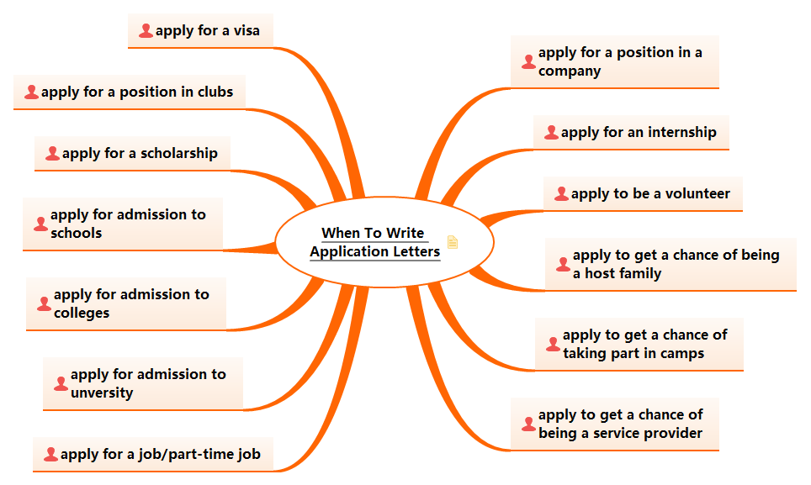

Slide 6

Send Application letters to
camps/clubs/organizations
school/colleges/university
internships
volunteer organizations

Slide 7

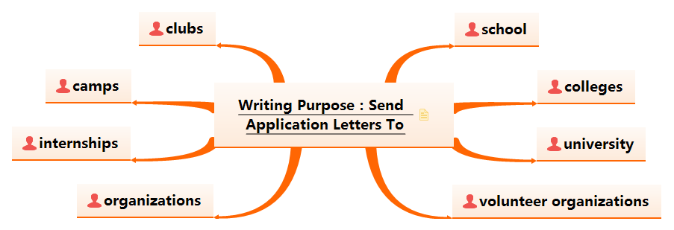

Slide 8
Application letters
  内容齐全content
  结构清楚Format
  语言准确language
  交际得体tone
  交际得体tone
  结构清楚Format
4
3
1
2
  语言准确language
  内容齐全content

Slide 9
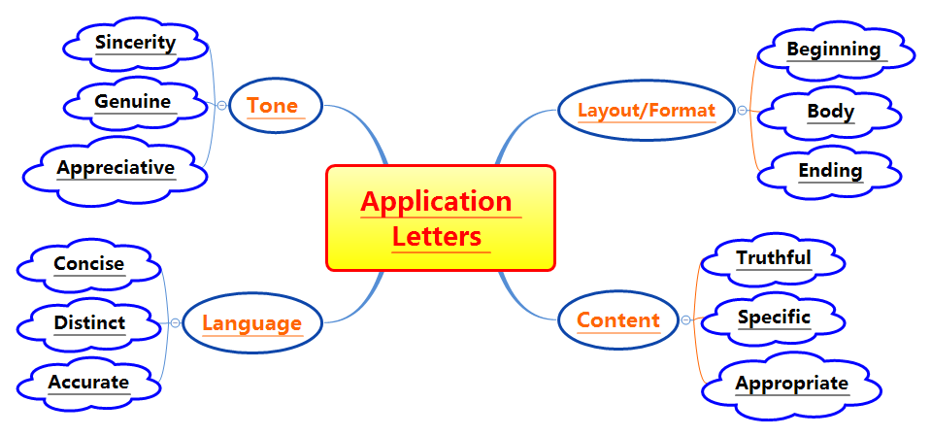

Slide 10

Application Letters -Readers-based
Format申请求职信写作框架
3
Part 3:
Ending
2
1
Part2:
Body Arrangements
Part 1:
Beginning Purpose of writing the letter

Slide 11

Structure
申请求职信：在申请工作职位、入学资格、奖学金、签证或参加活动的机会时，向校方或聘方发出的信件，信件需写明申请的理由、职位和具体内容，概述个人情况。信文语言表达要准确，言简意赅，语气应诚恳，措辞要得体。
三段式结构Structure:
第一段：自我介绍（收信人非熟人），交代消息来源和写信的目的；
第二段：详细描述申请的理由，具体的职位，阐述个人优势，对这一职位的设想，告知联系方式（必要时）；
第三段：表达希望得到对方的回复并致谢。

Slide 12
Format
What should be included in an application letter?
Dear ______,
Beginning --- Introduction and purpose
Why are you writing the letter?
Body--- describing your viewpoint on why you feel you are qualified for the job
--- describing how you think they will fit the position you are applying for
Why do you feel you are qualified for the job?
Ending --- About your wishes for response and your gratitude.
Yours faithfully
***

Slide 13
Writing Preparations:
Part1：Purpose of writing the letter
（1）开篇常用句式：自我介绍（收信人非熟人），交代消息来源和写信的目的；
I want to apply for admission into your university.
I am writing to apply to participate in the activity.
I am very glad to get the information that you need a…
I am writing to apply for the summer camp in your school.
Having read your terms, I believe that I’m qualified for the job.

Slide 14

Writing Preparations:
Part 2：Body Arrangements
Part 2: Body Arrangements
（2）篇中介绍能胜任申请的个人特长：知识、经验、性格等
be good at/ do well in / be familiar with/ be skilled in
I have learnt English for 8 years and I am good at spoken English…
be fit for/ be equal to/ have the qualification for / be qualified for
have a good knowledge of / have a good command of spoken English
What’s more important is that I am familiar with the local conditions.

Slide 15
Writing Preparations:
Part 2：Body Arrangements
Part 2: Body Arrangements
（2）篇中介绍能胜任申请的个人特长：知识、经验、性格等
I am easy-going and helpful and I am sure to get along well with my partners.
I have a talent for English and I have won the first prize in an English speech contest.
I sincerely hope that my family can have the honor to be a host family of an exchange student from…
If I had the opportunity to be accepted as a member of your summer camp, I would be quite appreciated.

Slide 16

Writing Preparations:
Part 3：Ending
Part 3: Ending
（3）篇尾表达对申请结果的期待
Looking forward to your early reply.
Thanks for your favorable consideration.
Your prompt reply will be highly appreciated.
I will appreciate it if I am offered the opportunity.
I will be much obliged if you offer me the opportunity.

Slide 17
Useful
words
And
expressions
navigated
notified
objectives
opportunity
optimistic
persuasive
practical
project
professional
promoted
enclosed
fostered
fashioned
goals
heightened
illustrated
imaginative
loyal
launched
motivated

Slide 18
Useful
words
And
expressions
proposal
purchased
qualified
ranked
reliable
recommended
responsible
summarize
self-confident
scheduled
sponsored
stimulated
summarize
terms
tended
tutored
trustworthy
urged
updated
volunteered
widened
well-organized

Slide 19
Writing help: Useful phrases
apply for the position of
for further information
believe I could contribute
ten years’ experience with
skills that would be useful to
experience that qualifies me for
qualities that would be useful in
considered an enthusiastic worker
in response to your advertisement
if you need additional information
interested in pursuing a career with
fit in with others= get on well with others
would enjoy attending/working/belonging

Slide 20
Writing help: sentences
1. I am a skilled ...
2. I have three years’ experience in…
3. I am applying for the position of...
4. I believe I am well qualified to apply for...
5. I am interested in your part-time position for...
SILVER STYLE

Slide 21
Writing help: sentences
6. I was pleased to learn that there is an opening.
7. I am seeking a position in this area because of...
8. According to this morning’s paper, you are seeking...
9. I am writing to request an interview for the position in...
10. I will call you Thursday to discuss setting up interview.
SILVER STYLE

Slide 22

申请求职信写作模板1
Dear ____,
Writing Purpose：
① I am Li Hua, a student from ______ (自我介绍). I am writing to apply for _____ (写信目的), for I believe that _____(申请的主要原因).
Body--- describing your viewpoint on why you feel you are qualified for the job
--- describing how you think they will fit the position you are applying for
Why do you feel you are qualified for the job?
② I am sure I am qualified for the post of ______(申请的职位). For one thing, I have learnt ____for___ years and I have a good command of _____. For another, I once worked as ______for ____ years, so I have much experience in _____. Moreover, I am outgoing and easygoing and can get along well with my partners.
Ending ---About your wishes for response and your gratitude.
③ I would appreciate it if you could give me the opportunity. Looking forward to your early reply.
Yours Sincerely / Faithfully/ Truly,
Li Hua

Slide 23
Assessment
Work in groups of four. Each student read the article and others comment on your partner’s work. Then select the best one out to show in the class. When you are discussing, you can pay attention to the following hints.
Purpose | Have you made the purpose obvious?
Format | Does the format conform to the requirements?
Language | Are the sentences correct? Have you used the proper punctuation, words, sentence and paragraphs to convey yourself?
Content | Have you included all the points of view?
Are the details suitable?

Slide 24
应用文写作—申请求职信
三、参考范文
范文1: （2011年6月辽宁高考真题）(加思维导图)
假定你是李华，将于今年七月从新星外语学校毕业。你从报纸上得知 B&B 公司要招聘一名英文秘书，你很感兴趣。请写一封求职信，要求包括下列内容：
1．年龄：18；
2. 学习情况：班级前5，英语口语好；
3. 兴趣和特长：打字快，喜欢阅读，听音乐；
4. 性格特点：积极向上。
注意：1．词数80左右；
2．可适当增加细节，以使行为连贯。

Slide 25
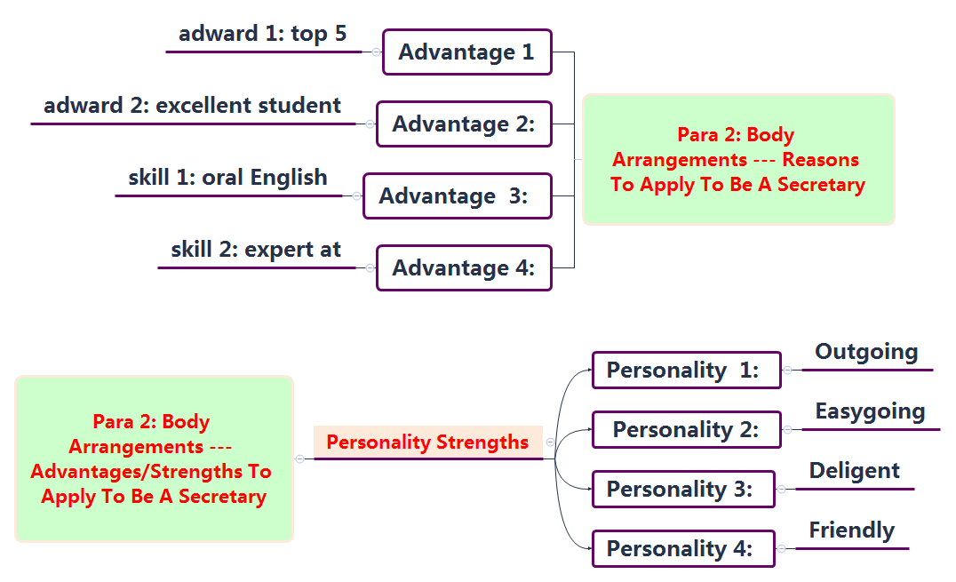

Slide 26
Writing Sample：
Dear Sir/Madam,
Knowing that an English secretary is needed in your company from the newspaper，I would like to apply for it.
I’m an-18 year-old boy and will graduate from Xinxing Foreign Language School this July. I’m an excellent student among the top 5 in my class. I’m expert at English, especially oral English. I enjoy reading and appreciate music and can type very fast. What’s more, I’m outgoing and diligent and like to make friends.
It would be greatly appreciated if you could give me the opportunity. Looking forward to your earliest reply.
Sincerely yours, Li Hua

Slide 27
范文2：(加思维导图)
假如你是中国留学生李华，你在芝加哥大学求学，请你根据以下提示，用英语向校方提交奖学金申请。
自我介绍（包括英语能力）；
奖学金申请的优势；
希望获准。

Slide 28
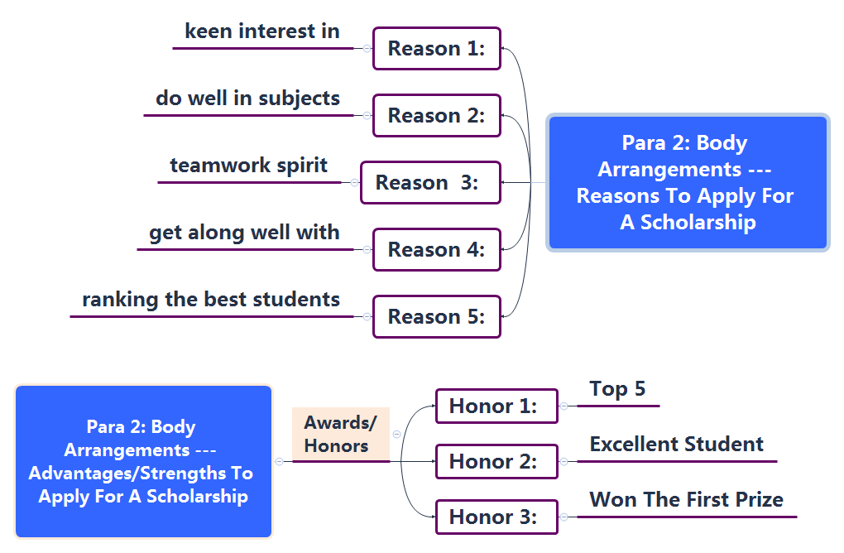

Slide 29
Writing Sample：
Dear sir,
I am Li Hua, a student from China, I’m writing to apply for a scholarship for an oversea student.
Having read your terms on school website, I think I’m qualified for your requirements to win scholarship. I have a keen interest in study and do well in all my subjects, ranking among the best students in our class. Once I got the first prize in the English Writing Competition. In addition, I have teamwork spirit and can get along well with others.
It would be extremely appreciated if you could take my application into account. Looking forward to your earliest reply.
Sincerely yours,
Li Hua

Slide 30
THANK YOU

