Slide 1

感恩遇见，相互成就，本课件资料仅供您个人参考、教学使用，严禁自行在网络传播，违者依知识产权法追究法律责任。
更多教学资源请关注
公众号：溯恩高中英语
知识产权声明

Slide 2
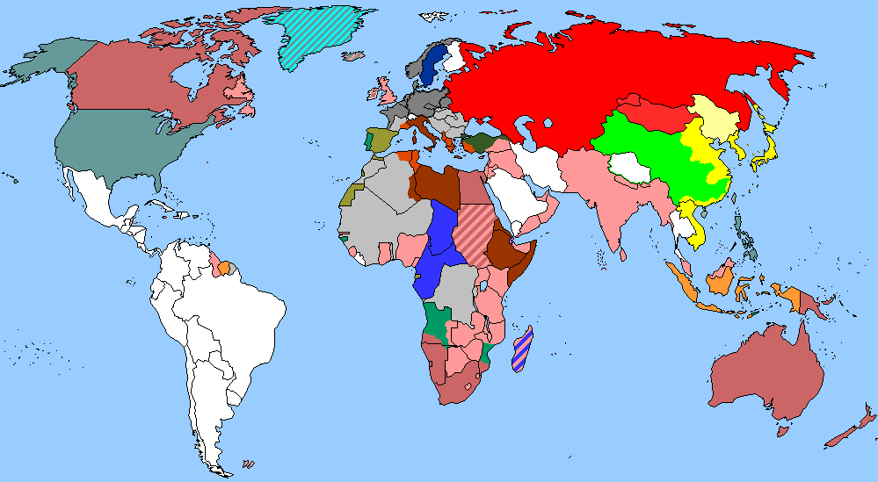
The Week
Dec 11th-17th, 2021

Slide 3
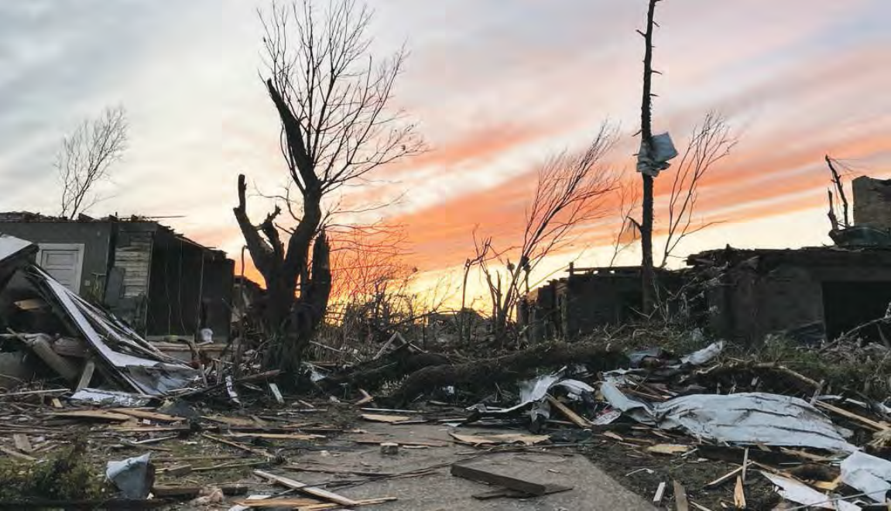
1. Deadly Tornadoes Tear Through Midwest 龙卷风横扫美国中西部
Parts of Mayfield, Ky., were destroyed. Even the buildings that were left standing had their windows blown out and their window frames left dangling.

Slide 4
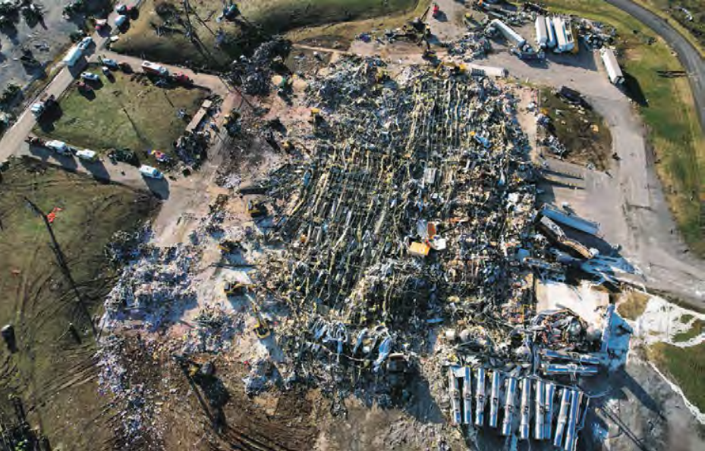
An aerial view of the damage to a candle factory in Mayfield, Ky., on Saturday. More than 100 people were inside Friday night when a tornado flattened the building.

Slide 5
语篇填空
（《华盛顿邮报》2021年12月12日 A1&A17版面）
More than 30 separate tornadoes moved with devastating power and speed through ____ area stretching from Mississippi in the south ____ Illinois in the north. As they swept through the region over several hours, the twisters killed _______ (dozen).
The tornadoes that ______ (sweep) through parts of the Midwest and Tennessee River Valley on Friday night and into early Saturday likely may be recorded ____ the worst on record in the United States during December. Peak tornado season in the region is _______ (usual) late spring through early summer. The tornadoes ______________ (trigger) by a powerful low-pressure system, _______ lifted from the Southern Great Plains into the Great Lakes. The low-pressure intensified as the polar jet stream (急流) plunged into the central United States ahead of a blast of record-setting warm air. The unusual ____________ (combine) — the polar cold ________ (meet) the unseasonably hot—created unstable air over Arkansas Friday evening that generated numerous thunderstorms. Those rotating storm systems eventually evolved into tornadoes.
an
to
dozens
swept
as
usually
were triggered
which
combination
meeting

Slide 6
词语讲解
1. devastate: to completely destroy a place or an area 彻底破坏；摧毁；毁灭
A few days before, a fire had devastated large parts of Windsor Castle.
几天前，一场大火烧毁了温莎城堡的大部分。
这颗炸弹炸毁了城市的一大片地方。
______________________________
2. intensify: to increase in degree or strength; to make sth increase in degree of strength （使）加强，增强，加剧
Britain is intensifying its efforts to secure the release of the hostages.
英国正加紧努力确保人质的获释。
他们加强了对敌人的攻击。
_________________________________________
翻译句子
The bomb devastated much of the city.
翻译句子
They has intensified their attacks on their enemy.

Slide 7
翻译句子
More than 30 separate tornadoes moved with devastating power and speed through an area stretching from Mississippi in the south to Illinois in the north.
超过30场独立的龙卷风以毁灭性的力量和速度穿过从南部的密西西比州到北部的伊利诺伊州的地区。
The tornadoes that swept through parts of the Midwest and Tennessee River Valley on Friday night and into early Saturday likely may be recorded as the worst on record in the United States during December.
周五晚上和周六早些时候席卷中西部和田纳西河谷部分地区的龙卷风可能会成为美国有记录以来12月份最严重的龙卷风。
The unusual combination—the polar cold meeting the unseasonably hot—created unstable air over Arkansas Friday evening that generated numerous thunderstorms.
这种不寻常的组合——极地寒冷与不合时宜的炎热相遇——于周五晚上在阿肯色州上空造成了不稳定的空气，从而产生了无数的雷暴。

Slide 8
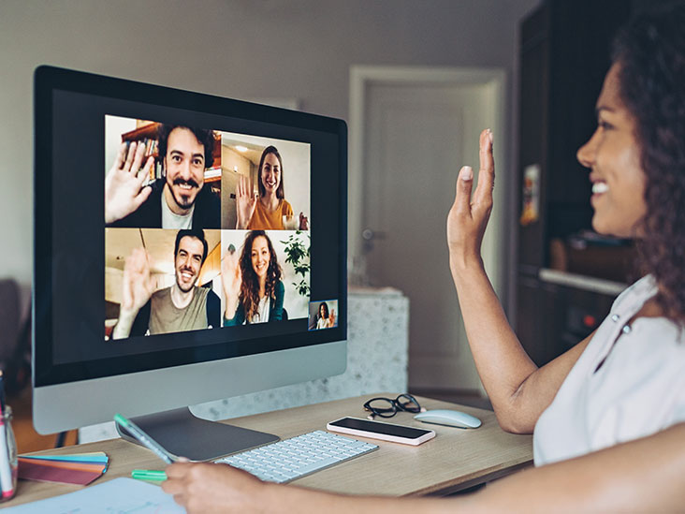
2. Video Calls Bad for Your Mental Health
视频通话不利于心理健康?

Slide 9
语篇填空
（《泰晤士报》2021年12月13日 14页）
an
They may have kept us afloat in lockdown but ____ international study has concluded that video calls have been bad for our wellbeing over the pandemic.
Research __________ (conduct) during the first wave of lockdowns worldwide found that video calls and messaging ______(app) had a bad effect on mental health when we were unable to meet ____ person. This was __________ (particular) the case for younger people.
The study, by two universities, wanted to find ____________ digital contact could replace face-to-face interactions and foster the same feeling of meaningful social connection. However, the research, _______ analysed the responses of 6,675 people across 115 countries, ___________ (determine) that text messages are no match for real-life meetings.
“We are a ______ (society) species,” Dr Martha Newson, a cognitive anthropologist said. “We don’t groom each other any more but we laugh and we joke and we hug. While we try and do these things online, nothing trumps face to face contact.” The results _______________ (publish) in the journal New Media & Society.
conducted
apps
in
particularly
whether / if
which
determined
social
were published

Slide 10
熟词生义讲解
1. determine: to discover the facts about sth; to calculate sth exactly 查明；测定；准确算出
An inquiry was set up to determine the cause of the accident.
已展开调查以确定事故原因。
我们着手查明那天晚上发生的事情。
______________________________________________
2. trump: to beat sth. by saying or doing something else that seems better. (因说或做得更好而) 胜过
The Republicans tried to trump this election campaign with their slogan.
共和党人试图用他们的口号来胜出竞选。
李磊通过他精湛的表演在本次比赛中胜出。
__________________________________________________
翻译句子
We set out to determine exactly what happened that night.
翻译句子
Li Lei has trumped the contest with his superb performance.

Slide 11
长难句分析
Research conducted during the first wave of lockdowns worldwide found that video calls and messaging apps had a bad effect on mental health when we were unable to meet in person.
分析：本句是一个宾语从句加一个时间状语从句，谓语动词分别是_____，_____和_____，“Research”后“conducted during... worldwide”是过去分词结构作______________；“found”后“that video calls ... person”是________，“when... person”是when引导____________。
found
had
were
后置定语表被动
宾语从句
时间状语从句
翻译
在全球第一波封锁期间进行的研究发现，当我们无法亲自见面时，视频通话和消息传递应用程序会对心理健康产生不良影响。
仿写
美国有线电视新闻网(CNN)报道说，当观众没有秩序拥挤到舞台前面时，在休斯敦举行的音乐节成为了一个严重的事故。
CNN reported that the music festival held in Houston became a serious accident when the audience was crowded to the front of the stage in disorder.

Slide 12
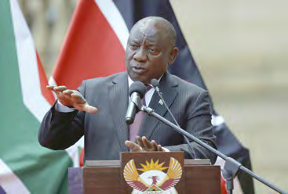
3. South Africa’s Leader is Infected 南非总统感染新冠
Cyril Ramaphosa

Slide 13
语篇填空
（《洛杉矶时报》2021年12月14日 A3版面）
President Cyril Ramaphosa of South Africa is receiving ________ (treat) for mild COVID-19 _________ (symptom) after testing positive for the disease Sunday. He’s self-isolating (自我隔离) in Cape Town and is being monitored by the South African Military Health Service, __statement from the president’s office announced. He has delegated all responsibilities to Deputy President David Mabuza for the next week.
Ramaphosa, 69, is ____ (full) vaccinated. The statement didn’t say __________ he had been infected with the Omicron variant of the coronavirus, which was first _______ (detect) in South Africa. In the statement, Ramaphosa said his infection serves ___ a caution to all people in South Africa to be vaccinated.
South Africa is battling a rapid coronavirus resurgence (复苏) ______ (drive) by Omicron. The country confirmed more than 18, 000 new cases Sunday night. More than 70% of the cases are estimated to be Omicron. So far, the majority of cases _________ (be) relatively mild, and the percentage of severe cases ______ patients require oxygen has been low.
treatment
symptoms
a
fully
whether / if
detected
as
driven
have been
where

Slide 14
词语讲解
1. delegate: to give part of your work, power or authority to sb in a lower position than you 委托；授权
Some managers find it difficult to delegate. 有些经理认为难以做到知人善任。
2. estimate: to judge the value, size, speed, cost etc of something, without calculating it exactly 估价；估算；估计
The deal is estimated to be worth $1.5 million. 这笔交易估计价值150万元。
翻译句子
这工作得委托给助手负责。
The job had to be delegated to an assistant.
翻译句子
有多少人患有这种疾病是不容易估计的。
It is not easy to estimate how many people have the disease.

Slide 15


新冠疫情相关词汇
COVID-19 2019冠状病毒病
novel coronavirus 新型冠状病毒
epidemic n.流行病
transmission n.传播
virus carrier 病毒携带者
close contact 密切接触者
confirmed/suspected case 确诊/疑似病例
mild/severe case 轻/重症
test positive/negative 检测呈阳性/阴性
vaccine n.疫苗
vaccinate v.给……接种疫苗
vaccination n. 接种疫苗
Δ
Omicron variant 奥密克戎变种
Ο
Delta variant 奥密克戎变种

Slide 16
长难句分析
The statement didn’t say whether he had been infected with the Omicron variant of the coronavirus, which first was detected in South Africa.
分析：本句是一个复合句，整体是一个_____ 从句，该从句中又包含一个_____________从句。
宾语
非限制性定语
该声明没有说明他是否感染了冠状病毒的奥密克戎变种，这种病毒最早是在南非被发现的。
翻译
仿写
他说他去年参观了一座寺庙，这座寺庙可以追溯到唐朝。
He said he visited a temple last year, which dates back to Tang Dynasty.

Slide 17

4. The U.N.’s Recent Summit Focused on Fossil Fuel as a Driver for Climate Change
联合国气候变化公约第26次缔约方大会将化石燃料作为气候变化的驱动因素
26th UN Climate Change Conference of the Parties

Slide 18
语篇填空
（《新闻周刊》2021年12月17日 10页）
Human activity is causing the earth's atmosphere to heat up much more quickly than any changes __________ might happen naturally, leaving many ecosystems at their ________ (break) points.
November's United Nations COP26 climate summit in Glasgow was the first time a global climate deal clearly _________ (identify) fossil fuel consumption as a major driver of climate change. While climate experts regarded that as a step forward, many also warned the Glasgow _________ (attend) have not done enough to limit mean global warming to "well below"2 degrees Celsius ________ (compare) to pre-industrial levels—a key goal of the 2015 Paris Agreement.
Climate Action Tracker is ____ international group of nonprofit institutes founded in 2009 that studies climate change science and ______ (track) the goals and policies of the 40 countries that produce 85 percent of global greenhouse gas emissions. ___ a statement, Bill Hare, CEO of Climate Analytics, said, "It's all well for leaders to claim they have a net zero target, but if they have no plans as to _____ to get there, and _______ (frank), these net zero targets are just lip service to real climate action."
which / that
breaking
identified
attendees
compared
an
tracks
In
how
frankly

Slide 19
选词填空
用以下词的适当形式完成句子。
1. The company _______ to have a 40% worldwide market.
2. China is playing a greater role in _______ affairs.
3. _________ of these “greenhouse” gases contributes to global warming.
4. The new technique has been used _________ the faces of suspects.
5. He likes reading newspapers every day to keep _____ of current events.
6. The bullets missed their intended _______.
7. The ___________ in the meeting was getting more and more tense.
8. Our children _____________ the same school in the past three years.
atmosphere global identify attend track emission target claim
claims
global
Emission
to identify
track
target(s)
atmosphere
have attended

Slide 20
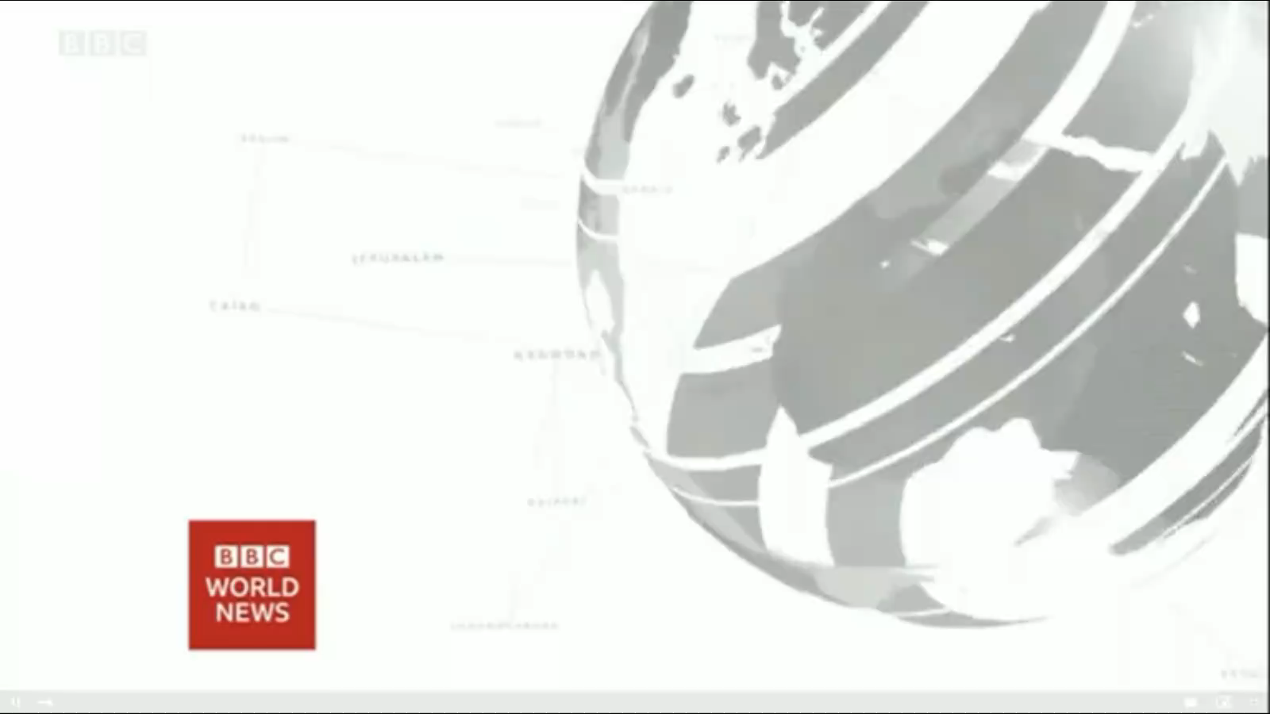
5. BBC一分钟新闻听写填空 One-minute World 12/15/21

Slide 21

听写
听写
This is BBC world news, the headlines.
A U.S congressional committee has voted to hold Donald Trump’s _______ White House Chief of Staff Mark Meadows in contempt (藐视法庭) for _______ to testify about the assault on the Capitol in January.
Hundreds of U.S National Guard Troops have joined the search for _________ of the devastating tornadoes as Kentucky's governor says 100 people are _______ there. President Biden will head there on Wednesday to see the _______ of the disaster.
Scientists are ________ that one of the biggest glaciers in Antarctica could shatter like a windscreen within 10 years due to _____________. Thwaites glacier is ________ 50 billion tons of ice into the ocean each year.
former
refusing
survivors
missing
impact
warning
climate change
dumping

Slide 22
译文
A U.S congressional committee has voted to hold Donald Trump's former White House Chief of Staff Mark Meadows in contempt for refusing to testify about the assault on the Capitol in January.
美国国会一个委员会投票认定唐纳德·特朗普的前白宫办公厅主任马克·梅多斯蔑视法庭，因其拒绝就 1 月国会大厦袭击事件作证。
Hundreds of U.S National Guard Troops have joined the search for survivors of the devastating tornadoes as Kentucky's governor says 100 people are missing there. President Biden will head there on Wednesday to see the impact of the disaster.
数百名美国国民警卫队人员加入了搜寻毁灭性龙卷风幸存者的行列，肯塔基州州长表示那里有 100 人失踪。 拜登总统将于周三前往查看这场灾难的影响。
Scientists are warning that one of the biggest glaciers in Antarctica could shatter like a windscreen within 10 years due to climate change. Thwaites glacier is dumping 50 billion tons of ice into the ocean each year.
科学家警告说，由于气候变化，南极洲最大的冰川之一可能会在 10 年内像挡风玻璃一样破碎。思韦茨冰川每年向海洋倾倒 500 亿吨冰。

