Slide 1


感恩遇见，相互成就，本课件资料仅供您个人参考、教学使用，严禁自行在网络传播，违者依知识产权法追究法律责任。
更多教学资源请关注
公众号：溯恩高中英语
知识产权声明

Slide 2
The New Term
Begins
The First Lesson

Slide 3
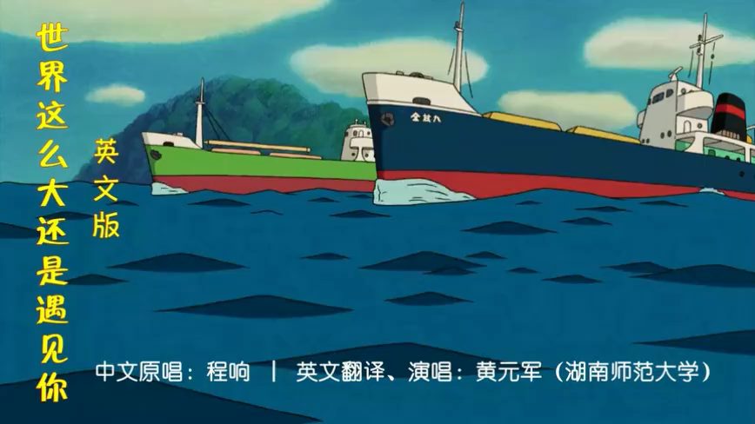
For relaxation
The world is
so large and
I here meet
you.
It must be fate!

Slide 4
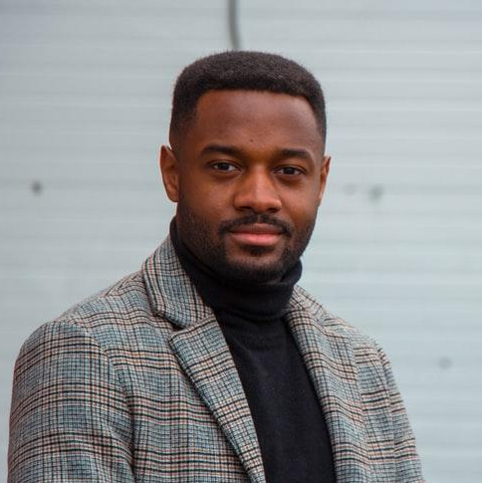
Ice-breaking 1 破冰 guessing what ?
3
15
15
2016
I am Rebecca
Numbers related to me！

Slide 5

Ice-breaking 2破冰——Two truths and a lie
I have ever been to UK twice for my further study.
I have been teaching English here since I graduated from universitpy.
I have one kid who is a boy.

Slide 6
♣Hello everyone.
♣Good morning / afternoon / evening, my teacher(s)
and classmates.
♣I'm very happy to introduce myself here.
♣I'm glad to be here for self-introduction.
♣Please allow me to introduce myself.
♣It's a great honor to introduce myself to you here.
♣It's a pleasure for me to be here to present myself.
Self-
introduction
greetings

Slide 7
basic
personal
information
name
My name is ...
I'm ...
I'm named/called...
You can call me ...
age
I'm ... years old.
I'm a ... year old boy / girl.
native place
I'm/come from ...
I live in ...
My hometown is ...
I was born in...
caring 、 considerate、 courageous、reliable 、 emotional 、shy 、extroverted 、responsible 、 introverted 、kind-hearted 、 straightforward 、confident cooperative、creative 、easy-going 、energetic 、friendly 、 humorous 、honest 、 optimistic 、 sincere 、
personality
I'm a ... person.
I'm a person who
is...

Slide 8
I like / love/enjoy ...
I'm fond of ...
I'm into ...
I'm interested in ...
I have a strong passion for ...
hobby
Why？
dream
My dream is ...
I want to ... in the future.
I hope I can ... in the future.
My ideal job is to ...

Slide 9
ending
表达期待：
I hope we can be good friends soon.
I hope we can make progress together.
表达谢意：
Thank you very much.
Thanks for your listening.
Thank you for your time .

Slide 10
Use proper linking Words (承接词)!
Good morning, my teacher and classmates. Please allow me to introduce myself. I'm Peter, a 15-year-old boy, and I'm from Beijing. I'm a very easy-going and dependable person. My hobby is reading. Reading can not only kill the time, but also broaden my horizons. My dream is to travel all around the world. I am always fond of experiencing different cultures. Thanks for your listening. I hope we can be good friends soon.

Slide 11

Why do we learn English?
The world's English mania(狂热)
Why English? In a single word: __________. __________ for a better life, a job, to be able to pay for school, or put better food on the table.
Imagine a student taking a giant test(大考) for three(2) full days. Her score on this one test literally(完全地) determines(决定) her future. She studies 12 hours a day for three years to prepare. 25% of her grade is based on _______. It's called the _________.
Opportunity
Opportunity
English
Gaokao

Slide 12
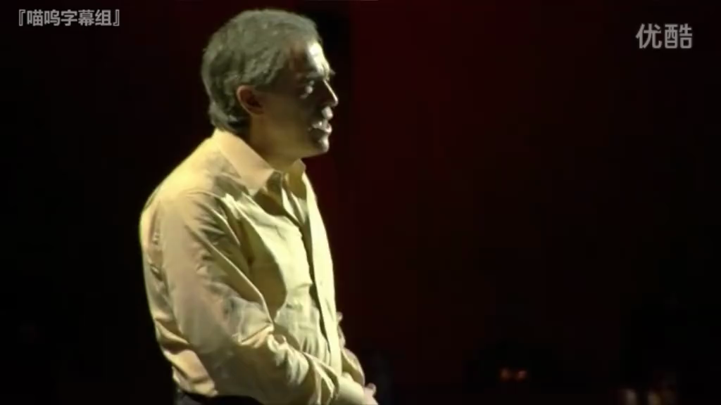
The world's English mania(狂热)
English is the world's ________ language. With English you can become part of a _______ conversation(对话). A ________ conversation about ________ problems. Like climate change or poverty. Or hunger or disease. Now English is becoming the language of problem solving.
English represents(代表；体现) hope for a _______ future. A future where the world has a _________ language to solve its ______ problems.
second
wider
global
global
better
common
common

Slide 13


Is learning English a hot potato？ Or a piece of cake?
Actually, English study is easy and fun!

Slide 14

English in our daily life

Slide 15
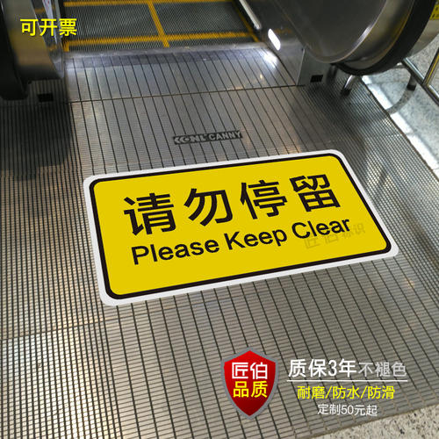

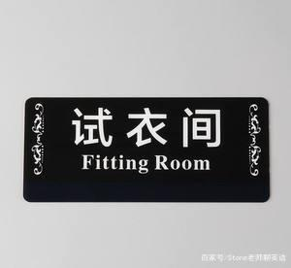

Slide 16



Brand
puma
美洲狮
rejoice vt.使喜悦；使感到高兴
safeguard
vt.保护;维护;防护

Slide 17

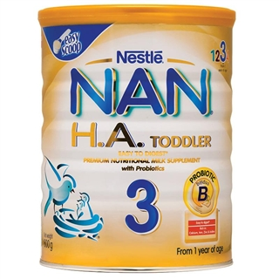
peak n.山峰;顶点;顶峰;尖顶
nestle vi.舒服地躺下,安居;依偎

Slide 18
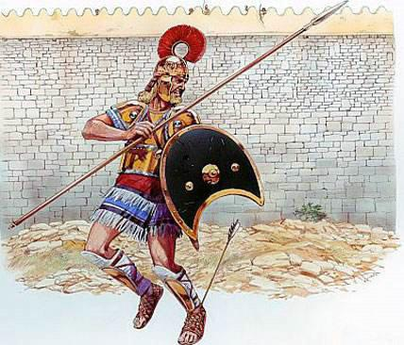
English itself has great Charm!
Vocabulary
Achilles heel
Peter should have a chance of winning, but his Archilles heel is his carelessness.

Slide 19
Puzzle
Pun 双关
1. Who is closer to you， your mom or your dad？
2. Which can run faster, heat or cold?
Mom is closer，because Dad is farther !
Heat. Because everyone can catch a cold.

Slide 20
Tongue twister
If one doctor doctors another doctor, does the doctor (who doctors the doctor) doctor the doctor the way (the doctor he is doctoring doctors)? Or does the doctor doctor the way (the doctor who doctors doctors)?
如果一位医生医治另一位医生,他是像被治疗的医生那样看病？ 还是像专门治疗医生的医生那样去看病？

Slide 21
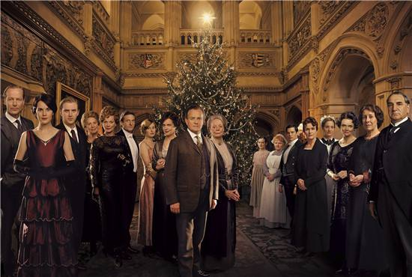
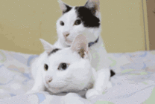
Movie
There is more than
one way to skin a cat.
Don't be so stubborn about this
problem because there is more
than one way to skin a cat.
Downton Abbey

Slide 22

Lyric（歌词）
If I were the only girl in the world
and you were the only boy!
Nothing else would matter in the world today
we could go on loving in the same old way!
A garden of Eden just made for two
with nothing to mar（破坏） our joy
I would say such wonderful things to you
there would be such wonderful things to do
If I were the only girl in the world
And you were the only boy!

Slide 23
English is great fun!
All things are difficult
before they are easy.
How?

Slide 24
English in Senior high school
初中：2000词汇
高中：3200词汇
A
Large vocabulary
B
Complicated(复杂的) phrases
Characteristics
特点
C
Long sentences & passages
D
Advanced(高级) grammar
E
Writing of high standard

Slide 25
150分
English in College Entrance Exam?
（一）听力 30分（20个单选题）
（二）笔试
I. 阅读理解 50分 （4篇+ 1篇七选五 每题2.5分 ）
II. 完形填空 15分 （15空）
III. 语法填空 15分 （10空）
IV. 书面表达：作文40分（应用文写作+读后续写/概要写作）

Slide 26
教材结构structure of the textbook
《英语》（新标准）高中阶段
必修教材— 必修模块1—3
选择性必修—4---7
选修教材— 选修模块8--10

Slide 27
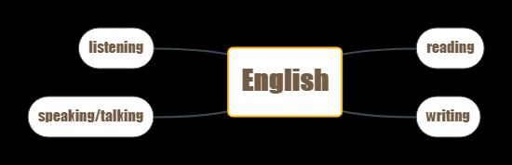
课上精听+午读专项专练/套题训练+泛听
participant
or
onlooker
每单元两个“说”的版块+各种课型的话题讨论
课文+习题中的文章+课外拓展阅读
日常句型操练+单元话题作文写作+高考作文
题型的研究和练习+美文背诵

Slide 28
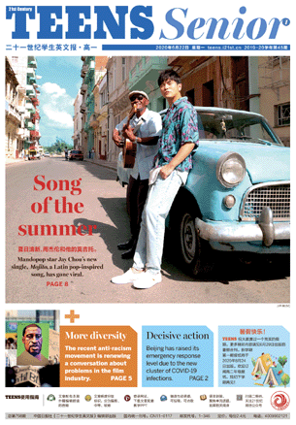







Slide 29
requirements
Time for English
morning reading :
6:35 – 7:10 am every Tue. Thu. and Sat.
Listening training:
13:50 – 14:10 pm every Mon. Wed. and Fri.
3. Homework time: 45 minutes every day
4. Be well prepared two minutes before class.
提早两分钟做准备，准时就位。

Slide 30
Requirements for homework
Do your homework in a black pen
黑笔书写
Correct it in red
红笔订正（打对错）
For the wrong item, refer to the explanation or the dictionary and take notes
查看错误题的解析，把知识点写在旁边

Slide 31
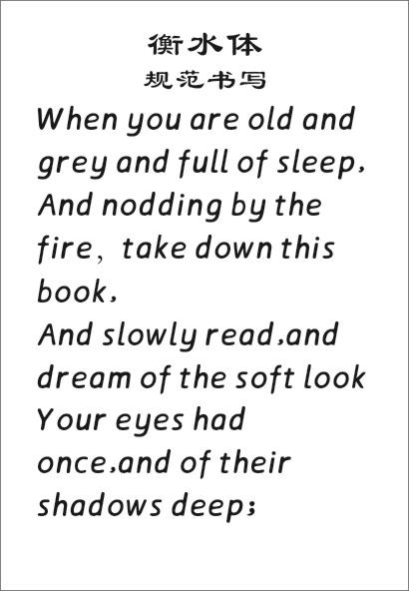

一本作业本
一本听写本
一本笔记本/积累本/改错本
一本书写练习本
一本字典
学习要求五个一

Slide 32
从小事做起
From little things，big things grow！
中考满分: | 高考满分：
我的分数: | 目标分数：
遗憾： | 我要怎样去做：
签名：__________
时间：__________
签名：__________
时间：__________

Slide 33
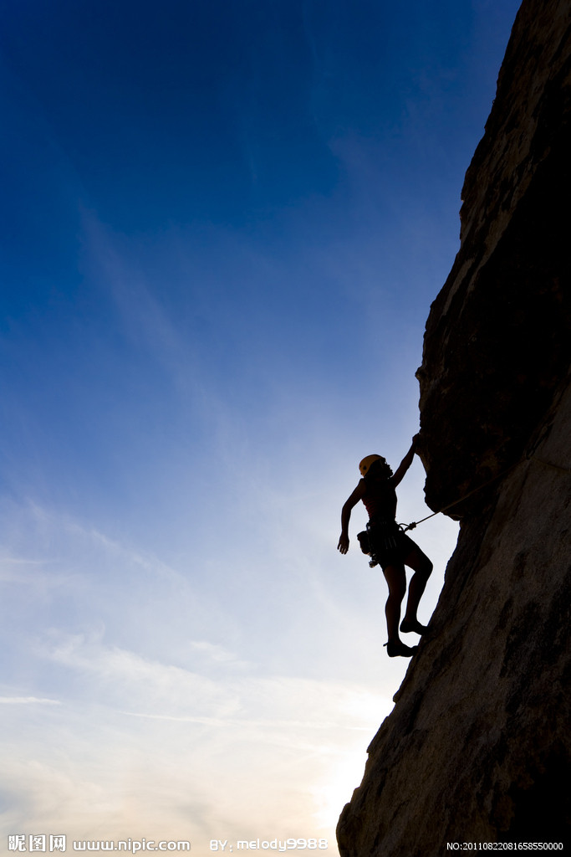
Dream big,
climb high
Attention+
Attitude+
Action+
Perseverance

