Slide 1
感恩遇见，相互成就，本课件资料仅供您个人参考、教学使用，严禁自行在网络传播，违者依知识产权法追究法律责任。
更多教学资源请关注
公众号：溯恩英语
知识产权声明

Slide 2
2025年3月金丽衢十二校应用文写作 AI And Our Study
浅析分析类应用文写作要点
海 亮 实 验 中 学 陈 虹

Slide 3
Analytical Expository Essays
01

Slide 4
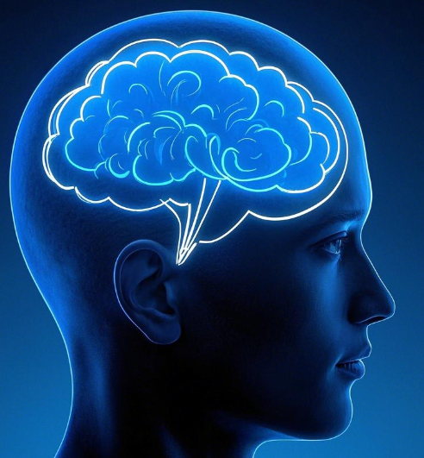
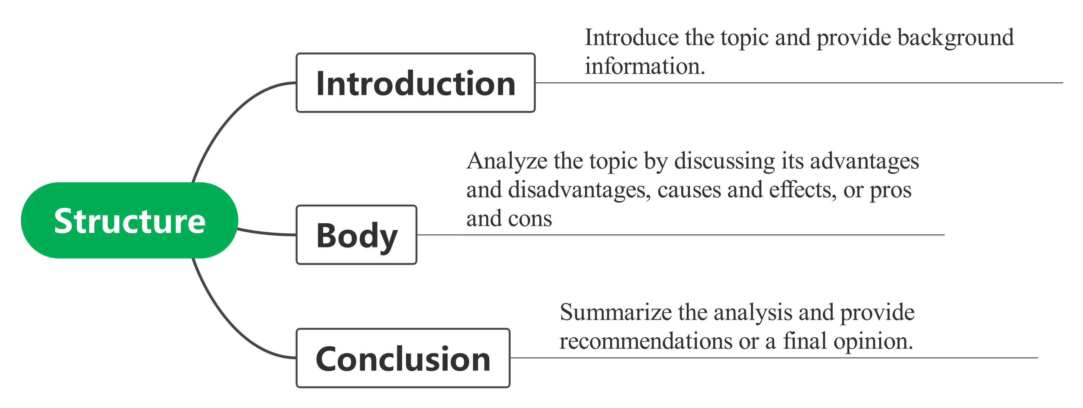
Key points
Focus
not just describe it
breaking down the topic
Balance
present both sides
in a fair and objective manner
practical
provide actionable recommendations

Slide 5
历年真题
2021年全国乙卷：
你校将举办英语演讲比赛。请你以"Be smart online learners"为题写一篇发言稿参赛，内容包括：
分析优势与不足；
提出学习建议。
2022年全国甲卷：你校将以六月八日世界海洋日为主题，举办英语征文比赛。请你写一篇短文投稿，内容包括：
海洋的重要性；
保护海洋的倡议
主要围绕活动分享、问题分析、建议提出等主题展开，考查考生的语言表达能力和逻辑思维能力
2023年浙江高考英语首考
上周末你参加了校学生会组织的“认识我们身边的植物”活动。请为校英文报写一篇报道，内容包括：
活动的过程；
收获与感想。
2024年高考英语全国甲卷
你校将举办英语演讲比赛。请根据以下图片内容，以“中国交通发展”为题写一篇发言稿参赛，内容包括：
发展现状；意义；启示。

Slide 6
Case Analysis
02

Slide 7
(2025年3月金丽衢十二校)假如你是李华，你们学校的校报英语论坛（English Forum）正在组织一次讨论活动。主题是“AI And Our Study”。请你写一篇英语文章投稿。 内容包括：1. AI用于学习的现状； 2. 你的看法或建议。 注意： 1. 写作词数应为80个左右； 2. 请在答题卡的相应位置作答。
审题
文体：稿件
时态：一般现在时
人称：第一人称
要点：现状+看法/建议
主题：AI and our study
Background information
discussion about... ?
current situation is about...?
Which is the key point?
current situation ?
your opinions or suggestions ?

Slide 8
结构
Para 1
The beginning 背景信息（现状描述）
Para 2
The body 看法&建议
Para 3
The ending 总结

Slide 9
语言
Para 1 Beginning
文体
内容形式
稿件类
分析类应用文

Slide 10
“开门见山”式
稿件类开头
例：Most people say that money is more important thantime.But I don't think so.First,when money is used up,you can earn it back, but....
对于叙事类的文章，可以在开头把事情交代清楚。对于论述性的文章，可以在开头处先阐明自己的观点，接着展开进一步的论述
回忆性开头
例：I will never forget my first trip to Huangshan/It was really an unforgettable experience I had。
在描述事件或游记类的文章中，采用回忆性的开头往往更能吸引人的眼球。
疑问性开头
在叙事类或论述性的文章中，都可采用疑问型开头，这样既可以吸引阅卷者的注意又容易抓住中心
例：Have you ever planted trees?Don't you think planting trees is..
倒叙式开头
例：I lay in bed in the hospital.I smiled at my friends even though my legs hurt.Do you want to know what happened to me?Let me tell you.It's a...story.
特别是叙事类的文章中，可以采用倒叙的写作手法，先写出事件的结果，再陈述过程。

Slide 11
分析类文章开头特点：简洁明了，直接引入主题，并为后续的分析做好铺垫
例：With the rapid development of technology, AIhas become an important part of our daily lives, especially in education. From personalized learning to instant feedback, AI is changing the way we study.
背景引入法
通过描述与主题相关的背景信息，引出讨论的核心内容。
例：In recent years, AI-powered tools like smart tutors and learning apps have gained popularity among students. These tools are not only making learning more efficient but also raising questions about their impact on traditional education.
现象描述法
直接描述与主题相关的现象或趋势，吸引读者注意。
例：Have you ever wondered how AI is shaping the future of education? As more students turn to AI for help with their studies, it is important to explore both its benefits and challenges.
提问引入法
通过提出问题，引发读者思考，并自然过渡到文章的主题。
例：AI is revolutionizing education, but it is not without its drawbacks. While it offers personalized learning experiences, it may also lead to over-reliance on technology.
观点引入法
直接提出一个观点或看法，作为文章讨论的起点。

Slide 12
语言
Para 2 Body 看法或建议
第二段通常是核心，需要对主题进行深入分析
利弊分析法
举例分析法
具体例子说明AI在学习中的应用及其影响
分析AI在学习中的优点和缺点，展现全面的思考
因果分析法
常见写作方式
分析AI在学习中产生的影响及其原因
个人观点法
对比分析法
问题解决法
直接表达个人观点，并加以论证
对比AI与传统学习方式的异同，突出AI的特点
提出AI在学习中可能带来的问题，并探讨解决方案

Slide 13
利弊分析法
例：On the one hand, AI offers many benefits. It provides personalized learning experiences, helping students focus on their weaknesses. It also saves time by offering instant feedback and access to a wide range of resources. On the other hand, over-reliance on AI may reduce students' critical thinking skills and creativity. For example, some students might use AI tools to complete assignments without truly understanding the content.
例：AI has been widely used in education. For instance, language learning apps like Oxfordtree use AI to adapt lessons to each student's level, making learning more efficient. Similarly, AI-powered tools like Grammarly help students improve their writing skills. However, these tools can also make students dependent on technology, reducing their ability to think independently.
举例分析法
例：The use of AI in education has led to significant changes in how students learn. Because AI can analyze data quickly, it provides personalized study plans and instant feedback, which improves learning efficiency. However, this convenience might also lead to laziness, as students may rely too much on AI instead of developing their own problem-solving skills.
例：Compared to traditional learning methods, AI offers more flexibility and efficiency. For example, while teachers can only address the needs of a group, AI can provide one-on-one support tailored to each student's needs. However, traditional methods encourage face-to-face interaction and teamwork, which are essential for developing social skills. AI, on the other hand, might isolate students and reduce their ability to communicate effectively.
因果分析法
逻辑清晰 论据充分 语言简洁
例：While AI has many advantages, it also brings challenges. One major problem is that students might become too dependent on AI tools, losing the ability to think critically. To address this, schools should teach students how to use AI responsibly. For example, students can use AI for practice and research but should complete assignments and exams without AI assistance.
对比分析法
问题解决法
例：In my opinion, AI is a powerful tool that can greatly enhance learning, but it should not replace traditional methods. AI can help students understand difficult concepts and save time, but it cannot teach creativity or critical thinking. Therefore, we should use AI as a supplement to traditional learning, not a replacement.
个人观点法

Slide 14
Para 3 Ending 总结
对前文的分析进行总结，并提出建议或展望未来
总结观点
例：In conclusion, AI has both advantages and disadvantages in education. Therefore, we should use AI as a tool to assist, not replace, traditional learning methods.
提出建议
例：To make the best use of AI, I suggest that students use it as a supplement rather than a complete solution，and schools should also teach students how to use AI responsibly to avoid over-reliance.
展望未来
例：Looking ahead, AI will likely play an even bigger role in education. However, it is important to ensure that it is used in a way that enhances students' learning. By balancing AI with traditional methods, we can create a more effective and well-rounded education system.
呼吁行动
例：It is time for us to rethink how we use AI in education. Let us embrace technology wisely and continue to develop our critical thinking and creativity

Slide 15
Versions
03

Slide 16
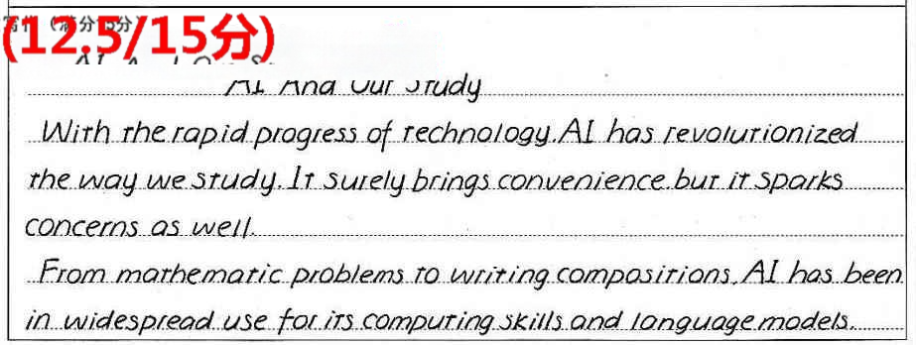
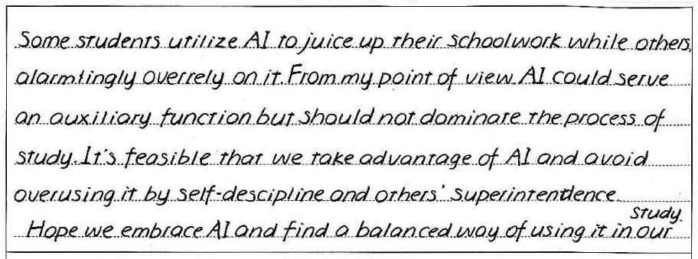
学生优秀范文

Slide 17
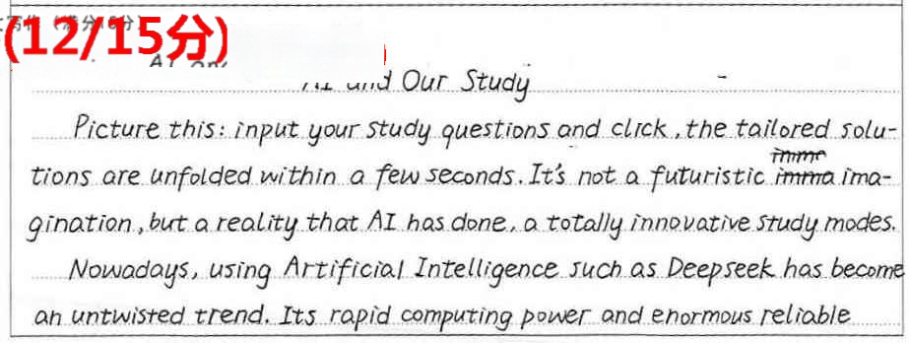
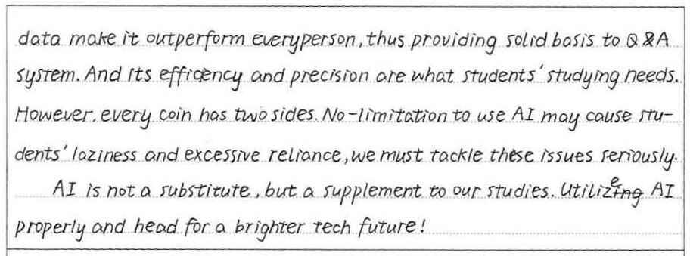
学生优秀范文

Slide 18
范文
Version1 分析现状（包括我使用的情况）+我的建议
AI and Our Study
Nowadays, AI has become an inseparable part of study, reshaping how students learn and interact with knowledge. Many students rely on ChatGPT, Deepseek to solve math problems, practice languages, or organize study schedules. However, this convenience comes with challenges, such as over-dependence and ethical concerns about originality in work.
In my daily study routine, I use AI tools wisely. I rely on apps to improve writing accuracy and brainstorm essay ideas. However, I avoid over-dependence by cross-checking AI suggestions with textbooks or teacher feedback. My advice? Embrace AI as a supporter, not a replacement. Balance technology with critical thinking, and always prioritize understanding over shortcuts. AI can lighten the load, but true learning still requires your effort and curiosity.
Only by blending AI’s efficiency with human creativity can we unlock greater academic potential.

Slide 19
范文
Version2 分析现状（客观环境）+我的观点+建议
AI and Our Study
As a high school student, I have noticed that AI is increasingly being used in our study. Many online learning platforms now incorporate AI to provide personalized study plans and real-time feedback.
In my opinion, the use of AI in study has both advantages and challenges. On one hand, it can adapt to our individual learning styles and paces, making learning more efficient. It can also offer immediate help and explanations when we encounter difficulties. However, there are also concerns. For example, over-reliance on AI might reduce our ability to think independently.
To make the best of AI in our study, we should use it as a tool to assist us, but not rely on it completely. We still need to develop our own critical thinking and problem-solving skills. I believe that with the right approach, AI can greatly enhance our learning experience and help us achieve better academic results.

Slide 20
范文
Version3 分析现状（大家还不怎么会用）+我的建议
AI And Our Study
In our school, AI is not yet a part of our daily study. Although it’s widely discussed, most students, including me, haven’t used it in learning, mainly because we lack the know-how.
However, I believe AI can bring huge benefits to our study. For instance, AI-powered language learning apps can offer instant translations and grammar checks, helping us improve language skills. Also, intelligent study planners can arrange personalized study schedules according to our weaknesses.
To make the most of AI, I suggest the school organize training sessions to teach us how to use AI tools safely and effectively. This way, we can leverage AI to enhance our learning efficiency.

Slide 21
谢 谢

