Slide 1

感恩遇见，相互成就，本课件资料仅供您个人参考、教学使用，严禁自行在网络传播，违者依知识产权法追究法律责任。
更多教学资源请关注
公众号：溯恩高中英语
知识产权声明

Slide 2
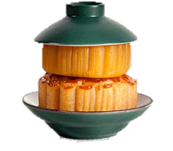
Using Language
Order food together with a foreign friend
常山县第一中学 张玉

Slide 3
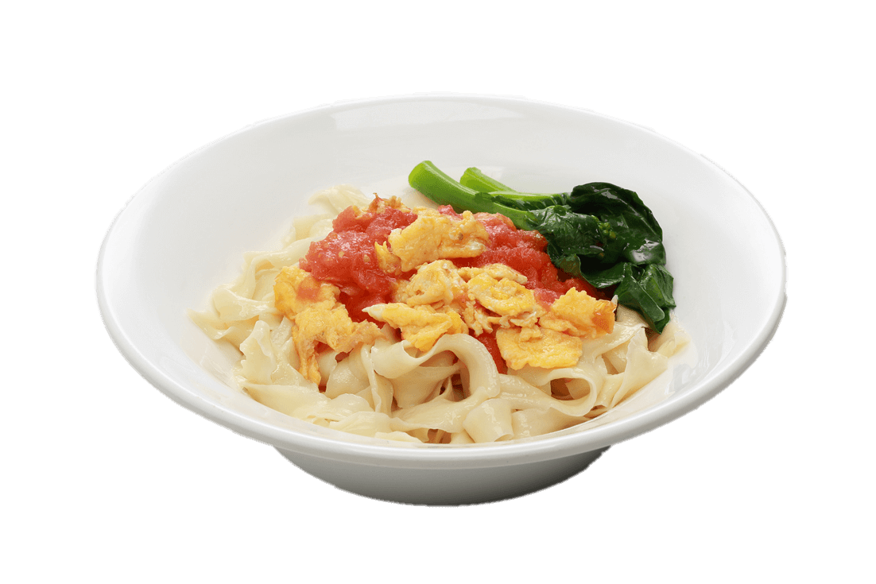
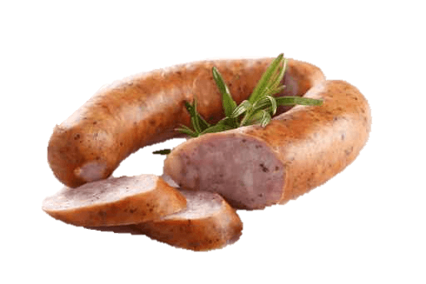
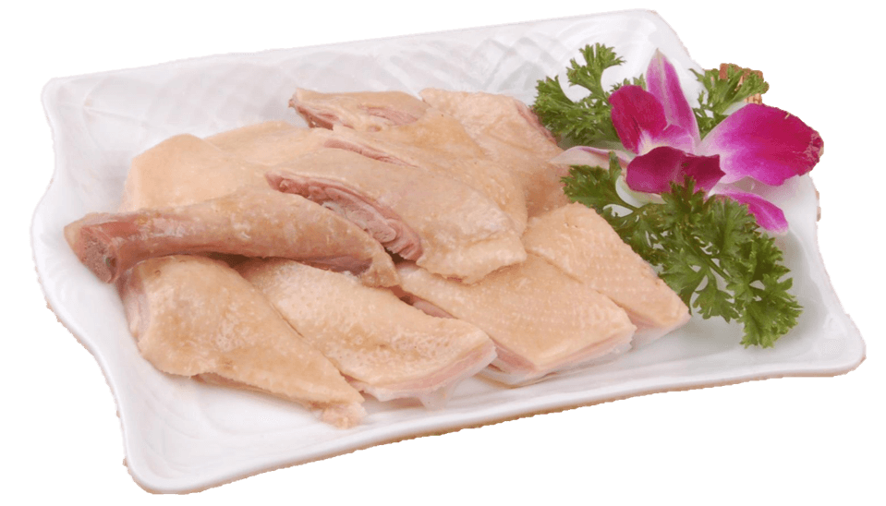
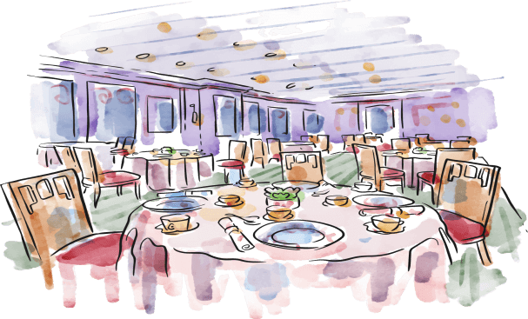
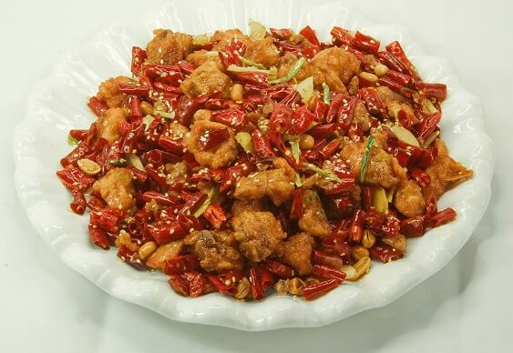
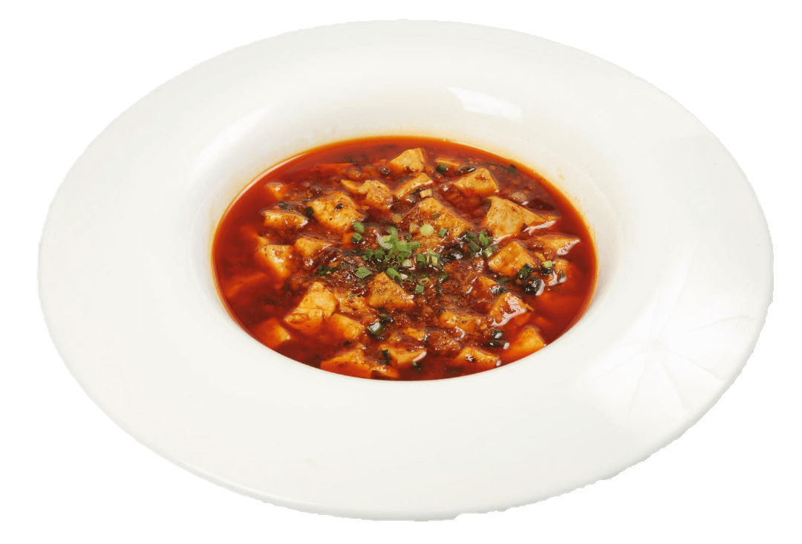
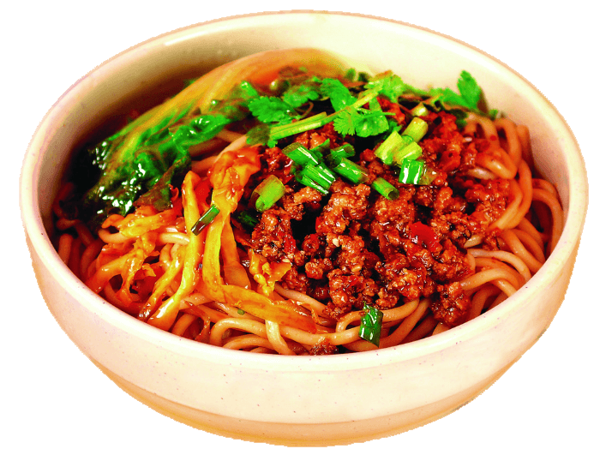
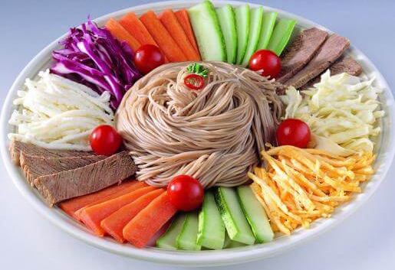

Pre-listening
_______________________(topic)
_____________________________(where)
Tip
Listening is often combined with some sort of picture or text. If you preview the picture or text before you listen, it will help you better understand what you hear.
Chinese food
Chinese restaurant

Slide 4
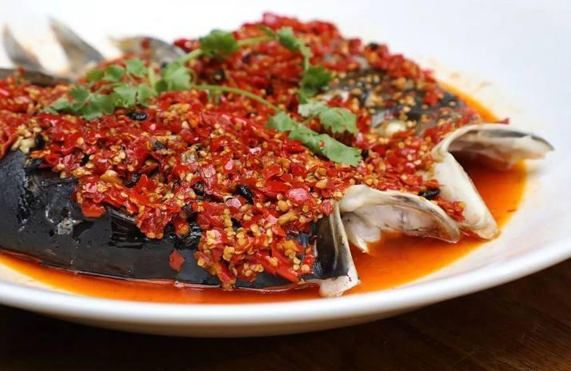
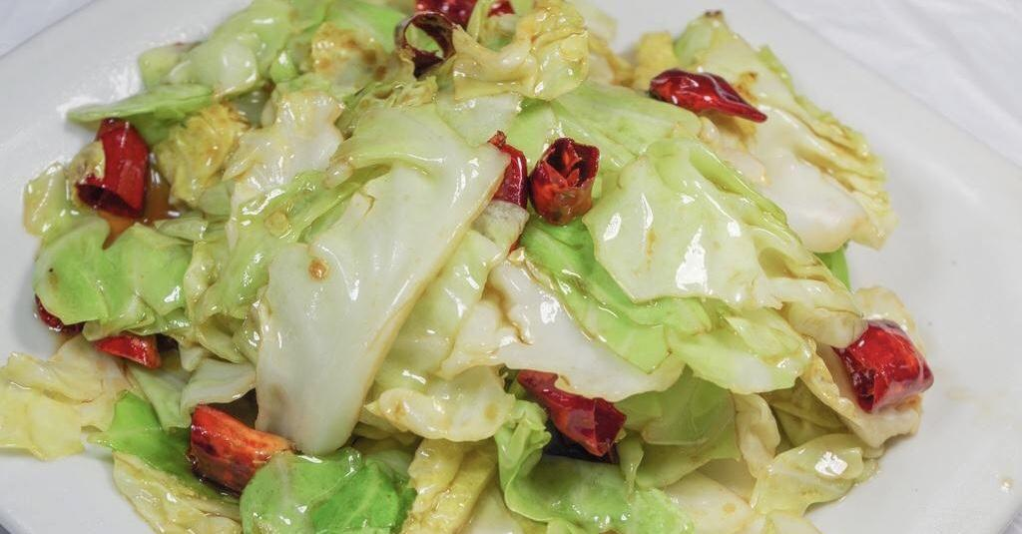
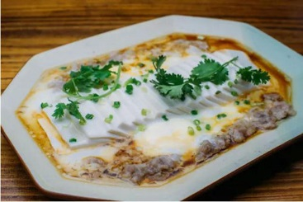
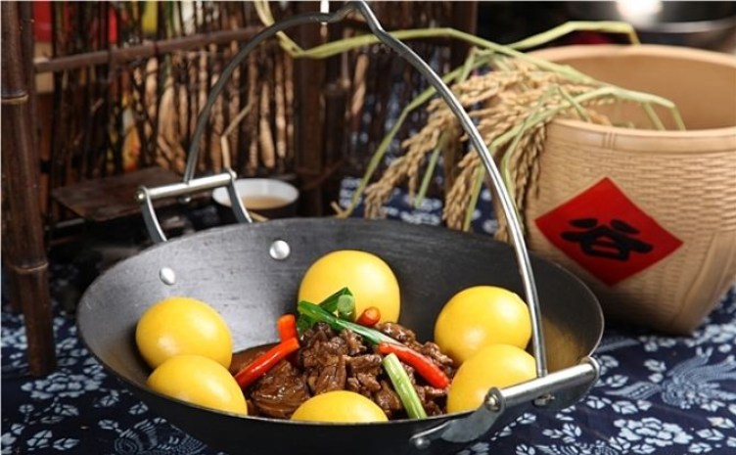
Picture | Name | Type of cuisine | Description
steamed fish head covered with chillies
spicy,
tender texture
Hunan cuisine
hand-torn
cabbage
crisp, fresh, sour, spicy,
typical Hunan cuisine
Hunan cuisine
smooth,
cheese-like texture,
high nutritional value
bridge tofu
Hunan cuisine
dry pot duck with
golden buns
tender, fresh,
juicy
Sichuan cuisine

Slide 5
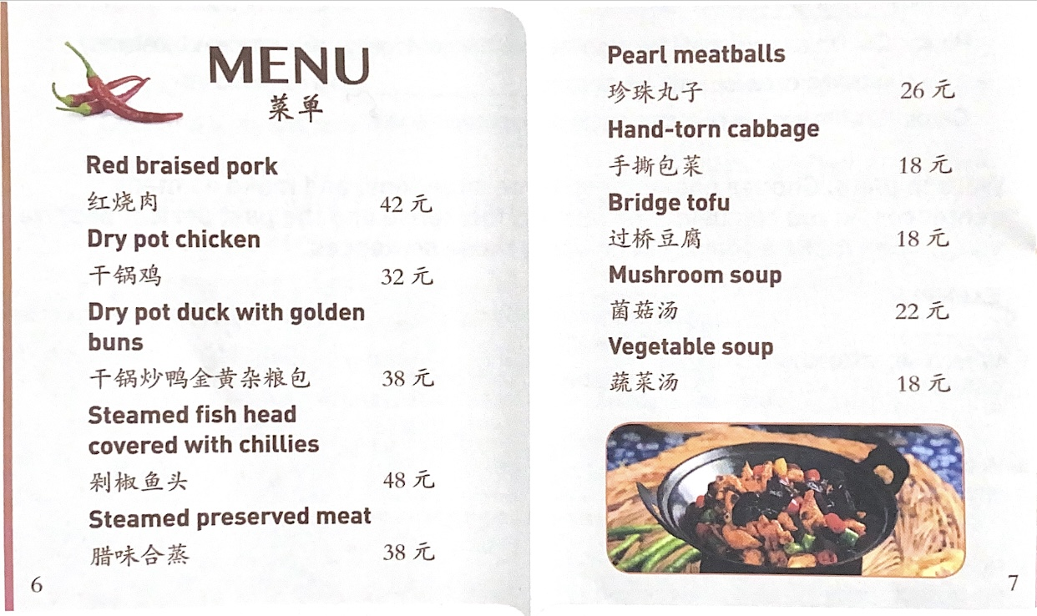
Discussion
Hunan restaurant
What will you pay attention to when you read the menu?
What kind of restaurant is it and what kinds of food are served?
Which food will you recommend to a foreigner? Why?
dish, price, picture...
Spicy food.

Slide 6


While-listening
Tingting, Anna, and Lisa are at the Hunan Restaurant. Listen to their conversation and tick the dishes that they order in the menu above.
√
√
√

Slide 7
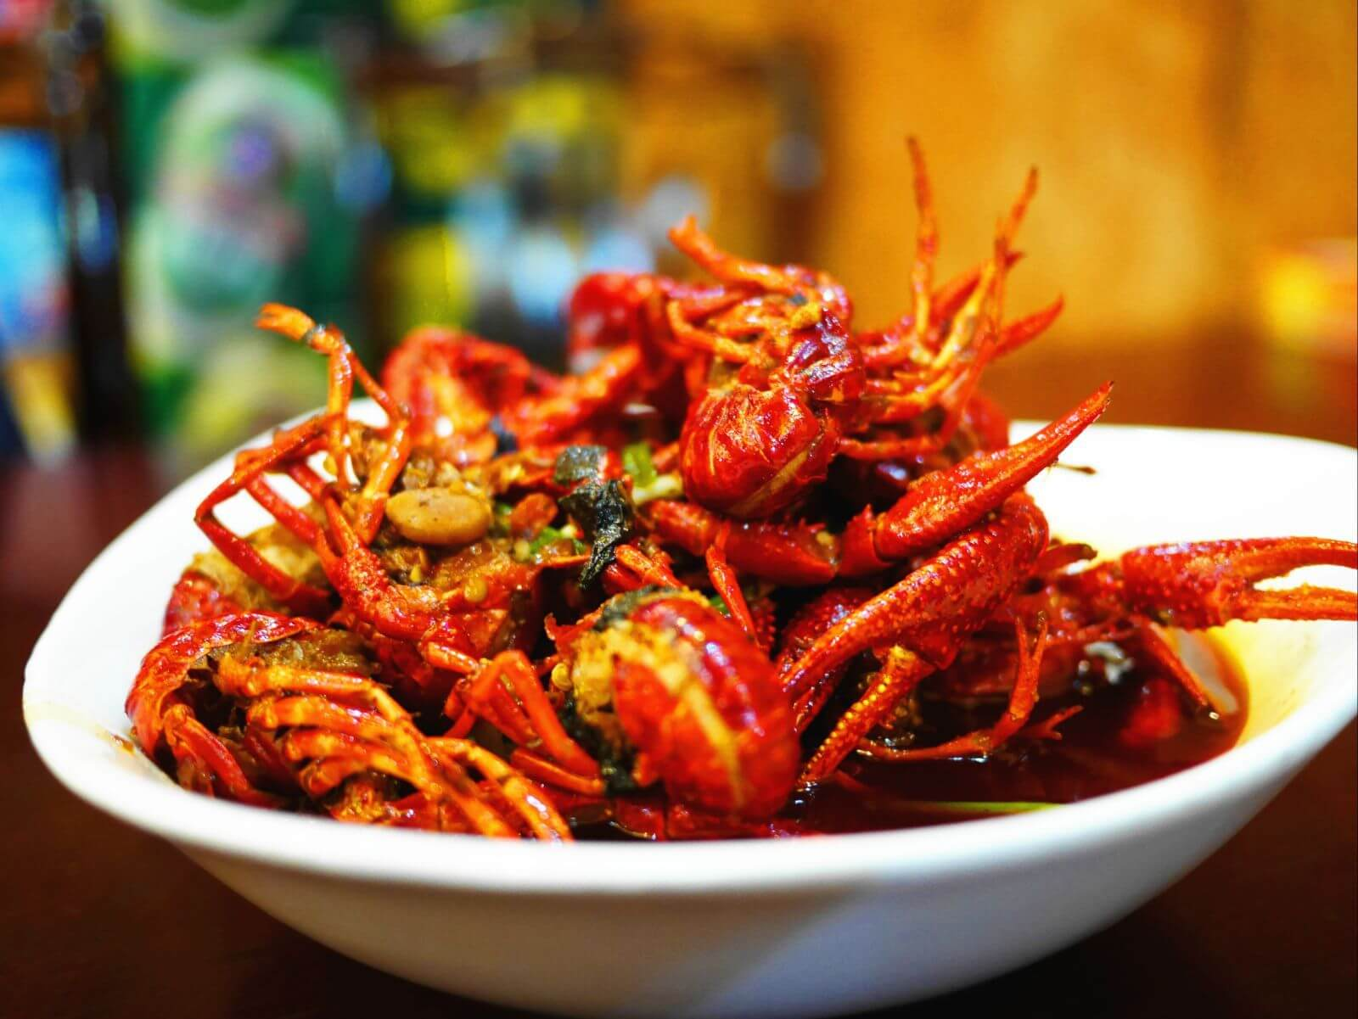
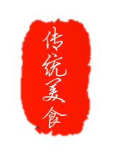
Listen again and answer the questions.
1. How is Hunan cuisine somewhat different from Sichuan cuisine?
2. What are the reasons why Hunan people like spicy food?
3. Why do so many people love steamed fish head covered with chilies?
4. Why does Tingting recommend bridge tofu instead of dry pot duck with golden buns?
5. Why is red braised pork the most famous dish?
1. How is Hunan cuisine somewhat different from Sichuan cuisine?
2. What are the reasons why Hunan people like spicy food?
3. Why do so many people love steamed fish head covered with chilies?
4. Why does Tingting recommend bridge tofu instead of dry pot duck with golden buns?
5. Why is red braised pork the most famous dish?

Slide 8
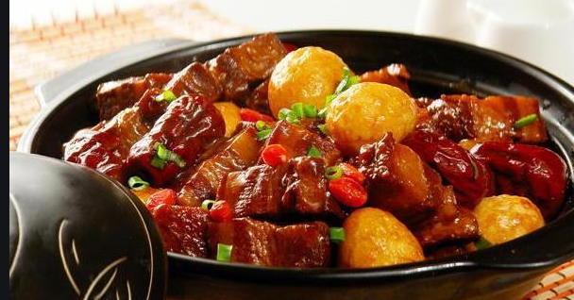
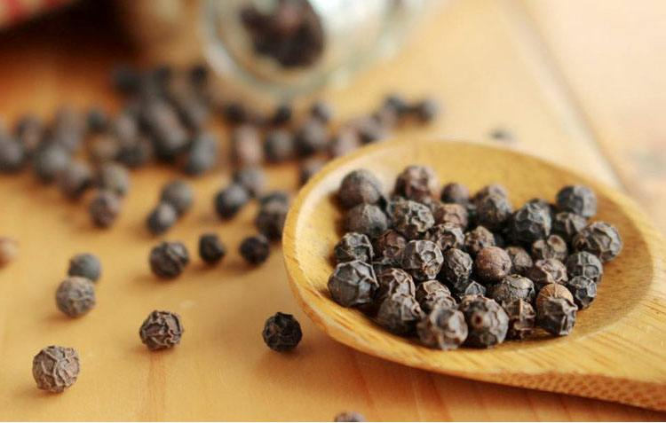
1.What are the reasons why Hunan people like spicy food??
The heat in Sichuan cuisine comes from and . Human cuisine is often and the heat comes from just chillies.
chillies
Sichuan peppercorns
hotter

Slide 9
2.What are the reasons why Hunan people like spicy food?
Hunan people will tell you that they like
because they are a bold people. But many Chinese people think that hot food helps them overcome the
.
bold flavours
effects of rainy or wet weather

Slide 10
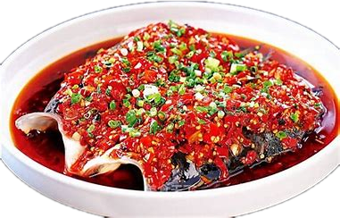
3. Why do so many people love steamed fish head covered with chilies?
People love it because the meat is
and there are
.
quite tender
very few small bones

Slide 11
4. Why does Tingting recommend bridge tofu instead of dry pot duck with golden buns?
Because bridge tofu has a lighter taste.

Slide 12
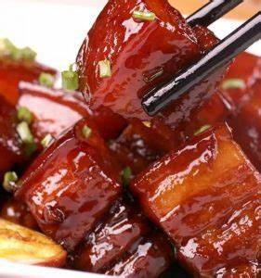
5. Why is red braised pork the most famous dish?
Because Chairman Mao was from Hunan, and this was his favorite food.

Slide 13
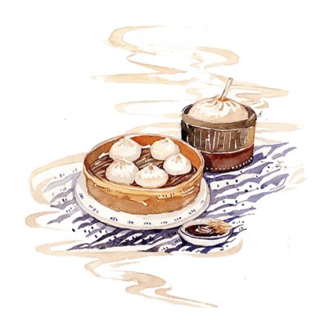
Listen for expressions
Q1: What language did they use to order food?
Q2: What language did they use to introduce food?
Tingting: Welcome to my favourite Hunan Restaurant! I hope you enjoy it!
Anna: Thanks, Tingting. I’m very excited. I had never even heard of Hunan
cuisine until you invited us.
Lisa: But what kind of food is Hunan cuisine exactly? Is it spicy like Sichuan food?
Tingting: It’s even spicier, Lisa! But the flavour is somewhat different from Sichuan cuisine. The heat in Sichuan cuisine comes from chillies and Sichuan peppercorns. Human cuisine is often hotter and the heat comes from just chillies.
Anna: But why do Hunan people prefer such spicy food?

Slide 14
Listen for expressions
Tingting: Well, Hunan people will tell you that they like bold flavours because they are a bold people. But many Chinese people think that hot food helps them overcome the effects of rainy or wet whether, and it is often wet in Hunan as well as in other places in the south, such as Sichuan and Chongqing.
Lisa: So what shall we order?
Tingting: I recommend the steamed fish head covered with chillies. I know fish head may sound strange, but the meat is quite tender and there are very few small bones, so everyone loves it.
Lisa: OK. And what’s this here: dry pot duck with golden buns?

Slide 15
Listen for expressions
Tingting: It’s duck stir-fried with garlic, ginger, and black bean paste, and it has some bread with it. It’s quite good, but I suggest the bridge tofu instead, as it has a lighter taste.
Lisa: Yes, let’s order that.
Tingting: Now, what else would you like to eat?
Lisa: I’m really hungry for some pork.
Tingting: Well, then you should have the read braised pork. It’s the most famous Hunan dish.
Anna: Why is that?
Tingting: Well, Chairman Mao was from Hunan, and this was his favourite food.
Anna: Oh, that’s interesting. Let’s have that then.
Tingting: So, we are ready to order? Waitress!

Slide 16

Order food together with a foreign friend

Slide 17
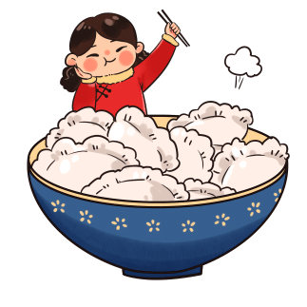
Order food together with a foreign friend
ordering food | introducing food | paying the bill
Waiter:
Can I help you?
Are you ready to order, sir/madam?
What would you like ...?
How about ordering ...?
This restaurant has the best ...
I'll take your order in a minute.
Enjoy your meal!
Customer:
What should I order?
What would you suggest/recommend?
Do you have ...?
Waiter:
Here’s your bill./ Here you are.
How will you pay?
Here’s your change. Thank you for your coming. Goodbye.
Customer:
Can I have the bill, please?
Do you accept credit cards?
I’ll pay in cash/through my mobile phone/by credit card.
Flavour:
spicy, sour, sweet, tender texture, smooth,
It will cool you down/warm you up.
Way of cooking:
stir-fry(炒), braise(烧), steam(蒸), simmer/stew(炖/煨), smoke(熏), roast(烤)
Ingredients:
oinion, garlic, chilly, ginger...

Slide 18
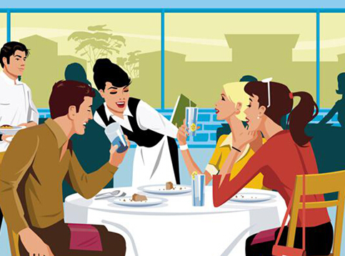
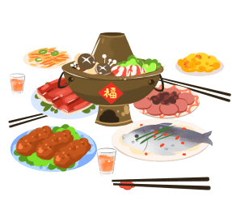
Talking
In groups of three, take turns role-playing taking your foreign guest to the restaurant you have chosen. One of you should act as the foreign guest, one as the Chinese host, and one as the waiter or waitress. You may start like this:
EXAMPLE
A: l really love spicy food, so what dish would you recommend?
B: I suggest Mapo tofu.
A: Really ? what's that?
…
B: waiter!
C: May l take your order?

Slide 19
EXAMPLE
A: I ready love spicy food, so what dish would you recommend?
B:I suggest Mapo tofu.
A: Really? What's that?
B: It's tofu served in a spicy bean and chilli sauce with beef or pork. It's quite hot.
A:That sounds OK, except that I don't really like tofu. what else do you recommend?
B: You know, this restaurant has the best hot pot. You'll like it because it is really spicy and you decide what you want to put in it. That sounds great! But then we should order some cold drink as well.

Slide 20
EXAMPLE
A: Why?
B: Well, the food is so spicy that we'll need something to cool us down.
A: That sounds good.
B: Waiter!
C: May I take your order?
B:We'd like hot pot for two with a good selection of meat and vegetables.
C: So that's hot pot for two.
B:Oh, and do you have iced tea?
C: Yes, we do.
B:Then we'd like two glasses to go with our meal.
C:Thank you very much. I'll have your order to you in just a moment.

Slide 21
Thinking
Is it a good idea to bring your foreign friend to a Chinese restaurant to have a taste of the Chinese food?
Voice your opinion and state your reasons by examples.

Slide 22
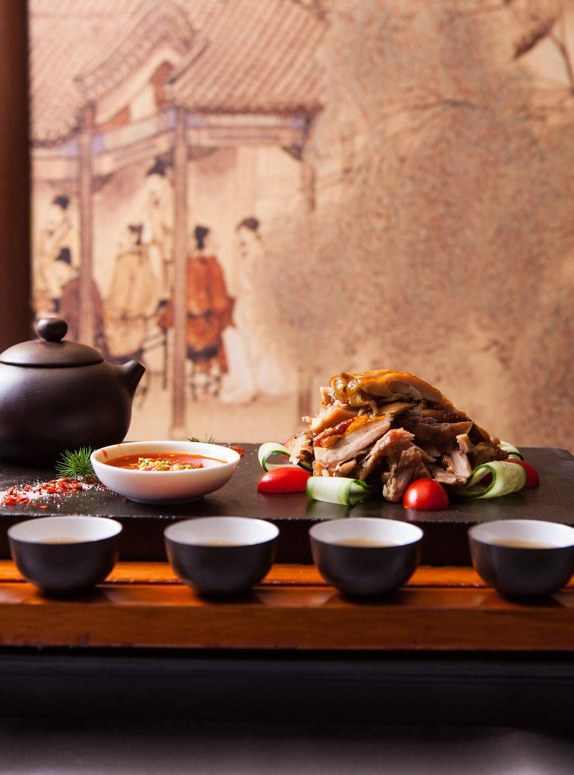
Enjoy cuisine,
Spread culture!
Thank you!

