Slide 1


感恩遇见，相互成就，本课件资料仅供您个人参考、教学使用，严禁自行在网络传播，违者依知识产权法追究法律责任。
更多教学资源请关注
公众号：溯恩英语
知识产权声明

Slide 2


Why do we celebrate festivals?
Reading and Thinking

Slide 3
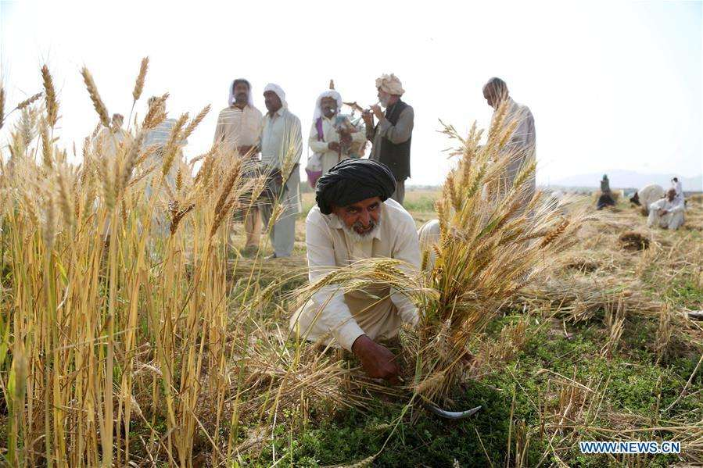
Language study

Slide 4
Listening and speaking
1. dress up _______ carnival costumes
in
dress (sb). up (in…)
to wear clothes that are more formal than those you usually wear 穿上盛装；穿上正装
dress (sb.) up as…to put on special clothes, especially to pretend to be somebody/something different装扮；乔装打扮
The boys were all dressed up as pirates. /ˈpaɪrət/
这些男孩子都装扮成了海盗。
costume 服装
custom 风俗
consume /kənˈsjuːm/ 消费

Slide 5
Congratulations
2. ______________ (congratulate) ______ becoming an adult!
on
3. Can you tell me what’s written on the piece of paper? Are they wishes?
表示感谢，问候，祝愿，祝贺的名词一般都用复数形式：
greetings, wishes, regards, thanks, congratulations

Slide 6
Reading and thinking
a wide range of origins
2. different customs and unique charms
3. famous figures
4. harvest festival
5. gather in
6. the year’s supply of food
7. a great feast
8. admire the shining moon
9. enjoy delicious mooncakes
1.多种多样的由来
2.不同的风俗和独特的魅力
3.著名人物
4. 丰收节
5. 收割
6. 一年收获的食物
7. 丰盛的宴席
8. 观赏明月
9. 品尝美味的月饼

Slide 7
10. play a significant role in…
11. change over time
12. With the development of modern society and the spread of new ideas
13. light firecrackers
drive away the evil spirits
avoid air pollution
in spite of religious origins
take advantage of celebrations
one’s loved ones
public happiness
the increase of spending
attitudes toward life
have a lot in common
10. 扮演重要角色
11. 随时间而变化
12. 随着现代社会的发展和新思想的传播
13. 燃放鞭炮
14. 驱鬼神
15. 避免空气污染
16. 尽管起源于宗教
17. 利用庆祝活动
18. 至亲至爱的人
19. 公众幸福感
20. 消费增长
21. 对生活的态度
22. 有很多共同之处

Slide 8
Reading and thinking
Para 1
1. They have _____ wide range of origins, such as the seasons of the year, religious, famous figures, and…
a
a great number of different origins, many kinds of origins
range:
1) n. a variety of things of a particular type 一系列
a wide/broad/full range of..
a narrow/limited range of ..
2) the limits between which something varies
（变动或浮动的）范围，界限，区间
在…的范围内
in/within range of…
超出…的范围
beyond/out of range of…

Slide 9
range v.
to vary between two particular amounts, sizes, etc., including others between them
（在一定的范围内）变化，变动
ranging
The show has a large audience, ________ (range) from children ______ grandparents.
to
range from…to…
range between… and….

Slide 10
figure n.
1) He was a well-known figure in London at that time.
2) Every woman wants a slim figure these days.
3) Her salary is now in six figures.
4）A shadowy figure can be seen through the window.
5) A triangle is a three-sided figure.
6) Figure skating is one of the ice sports.
人物，人士
体型，身材
位数，数字
人影，远处人的轮廓
图形，图表
花样滑冰

Slide 11
figure v.
1) to be part of a process, situation, etc. especially an important part 是重要部分；是…的部分
我对这个问题的意见似乎根本无足轻重。
My feelings about the matter didn't seem to figure at all.
2) think or guess 认为 估计
从他的举止来看，我认为他喝醉了。
From the way he behaved, I figured that he was drunk.
3) calculate 计算= figure out
我在计算我的开销。
I am just figuring my expense.
4) figure out : to think about somebody/something until you understand them/it弄懂；弄清楚；弄明白
I can't figure out how to do it.

Slide 12
Para 2
for
1. people celebrate to show that they are g_______ ______ the year's supply of food.
rateful
be grateful to sb for sth.
gratitude n.
I owe you a great debt of gratitude.
(= feel extremely grateful). 我对你感激不尽。
thank sb for sth.
appreciate sth.
十分感谢你的支持。
Your support is greatly appreciated.
假如你支付现金的话，我会不胜感激。
I would appreciate it if you paid in cash.
（请付现金。）

Slide 13
2. It featured a parade and a great feast with music, dancing and sports.
feature v. 1. to include a particular person or thing as a special feature以…为特色；是…的特征
1) The film features Cary Grant as a professor.
这部电影由卡里 · 格兰特饰演一位教授。
2) The actress was featured on the cover of time magazine last month .
这位女演员上个月登上了《时代》杂志的封面。
2) to have an important part in sth
占重要位置，起重要作用
鱼在日本人的饮食中占重要地位。
Fish features in the Japanese diet.

Slide 14
2023年1月高考短文填空：
No. 60
The large siheyuan of these high-ranking officials and wealthy businessmen often 60. featured
beautifully carved and painted roof beams and pillars (柱子).
v. to include a particular person or thing as a special feature以…为特色；是…的特征

Slide 15
feature n.
1) 特征
2） part of somebody’s face such as their nose, mouth and eyes 面容的一部分（如鼻、口、眼）
她五官中眼睛最好看。
Her eyes are her best feature.
3） 特写，专题节目
a special feature 专栏

Slide 16
Para 3
1. Customs play a significant role _____ festivals.
in
play a(n) significant/important role in...
play a(n) significant/important part in..
起着很重要的作用，扮演很重要的角色
significance n.
她的父母都非常重视教育。
Both her parents attach much significance to education.
very significant =of great significance
The exchange program was _______ great significance.
of

Slide 17
2. ..some traditions may fade away and others may be established.
to make people accept a belief, claim, custom
使…获得接受；使…得到认可
fade away
1) to disappear gradually逐渐消逝；逐渐消失
The laughter faded away.
笑声逐渐消逝。
fade out: become clearer or louder/less clear or quieter（画面）淡入／淡出，渐显／渐隐；（声音）渐强／渐弱
The music faded out at the end of the scene.

Slide 18
3. Another example is Halloween, which slowly became an exciting festival for children, ____________ its religious origins.
in spite of
in spite of+n =despite +n.
尽管年事已高，他依然过着一种忙碌的生活。
1) In spite of his age, he leads an active life.
2) Despite his age, he leads an active life.
3) Although/Though he is old, he leads an active life.
4) No matter how old he is, he leads an active life.
________________________ they may seem, all over the world, the spirit of sharing … is common in all festivals
No matter how different
无论遇到什么困难，他们都没有放弃。
No matter what difficulties they met, they didn’t give up.

Slide 19
Para 4
1. Festivals are becoming more and more commercial, with businesses ___________________ （利用）the celebrations.
taking advantage of
advantage 优势
advance 前进
adventure 冒险
take advantage of
to make use of something well; to make use of an opportunity利用；利用（机会）
她趁孩子们不在时收拾了他们的房间。
She took advantage of the children's absence to tidy their rooms.
2) to make use of somebody/something in a way that is unfair or dishonest 欺骗；占…的便宜
He took advantage of my generosity.
(= for example, by taking more than I had intended to give).他利用我的慷慨占了便宜。

Slide 20
Para 5
wishes beliefs faiths
They reflect people’s _______, _______, _______ and
attitudes towards life.
roofs
chiefs
gulfs
breaths
baths
paths
clothes
reflect
v. 映出
他的脸映照在镜子里。
His face was reflected in the mirror.
2）反射（声、光、热等）
窗户反射着午后明媚的阳光。
The windows reflected the bright afternoon sunlight.
3）reflect upon/on … to think carefully and deeply about something认真思考；沉思

Slide 21
2.They are occasions that allow us to relax and enjoy life ,and…
occasion n. a particular time when something happens
某次；…的时候
1)在这种场合
on this occasion
2) 我见过他几次。
I have met him on several occasions.
3) 我能有一天时间陪孩子们的时候都非常少。
1) Occasions __________ I have the time to spend a day with my kids are quite rare.
when
when
Occasions are quite rare __________ I have the time to spend a day with my kids.
分隔式定语从句

Slide 22
Assignment
假如你是Li Hua, 你的美国朋友Jim对中国传统节日端午节很感兴趣，来信询问相关情况，请你给他写e-mail回复，包括以下主要内容：
节日的时间和历史起源
主要庆祝活动
你对节日意义的评价
注意：
1.词数120左右
2. 增加适当的细节使之连贯
参考词汇： 农历the lunar month

Slide 23
Dear Jim,
I am glad to tell you something about the Chinese Dragon Boat Festival, which takes place on the fifth of the fifth lunar month, dates from over 2000 years ago. It was created in honor of a patriotic poet Qu Yuan, who drowned himself to prove his love to his motherland after being unfarily treated. It was said that people raced boats to save him and threw zongzi into river to feed the fish so that they won't harm the body of Qu Yuan.
Today It is a public holiday and people will have a day off to celebrate the festival nationwide with the traditional customs of eating Zongzi as well as racing dragon boats. It is also a family time and people share joy together.
Celebrating the festival is a wise way to pass down the valuable tradtional culture and history. Not only can we taste the delicous Zongzi but we can experience the warm atmosphere of the fesitival.
Yours,
Li Hua

