Slide 1


感恩遇见，相互成就，本课件资料仅供您个人参考、教学使用，严禁自行在网络传播，违者依知识产权法追究法律责任。
更多教学资源请关注
公众号：溯恩高中英语
知识产权声明

Slide 2
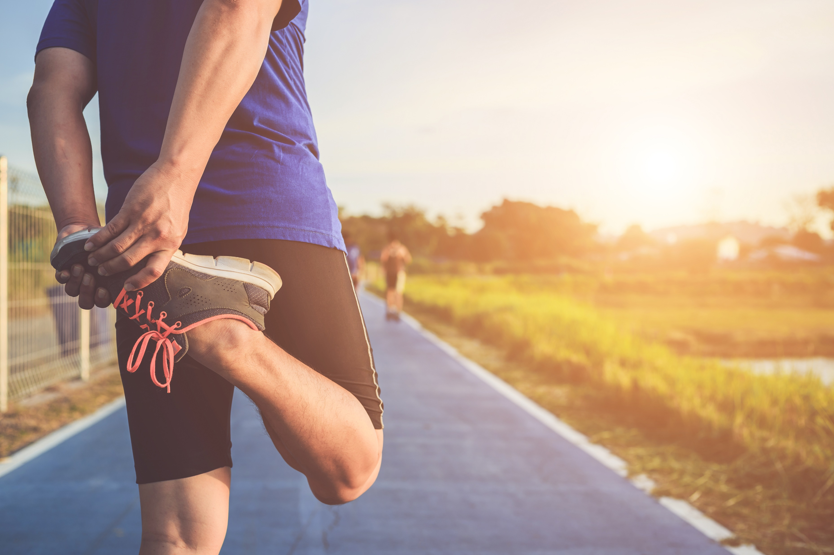

续写之环湖赛跑
续写中的学、思、辨、达
202109浙江名校协作体

Slide 3
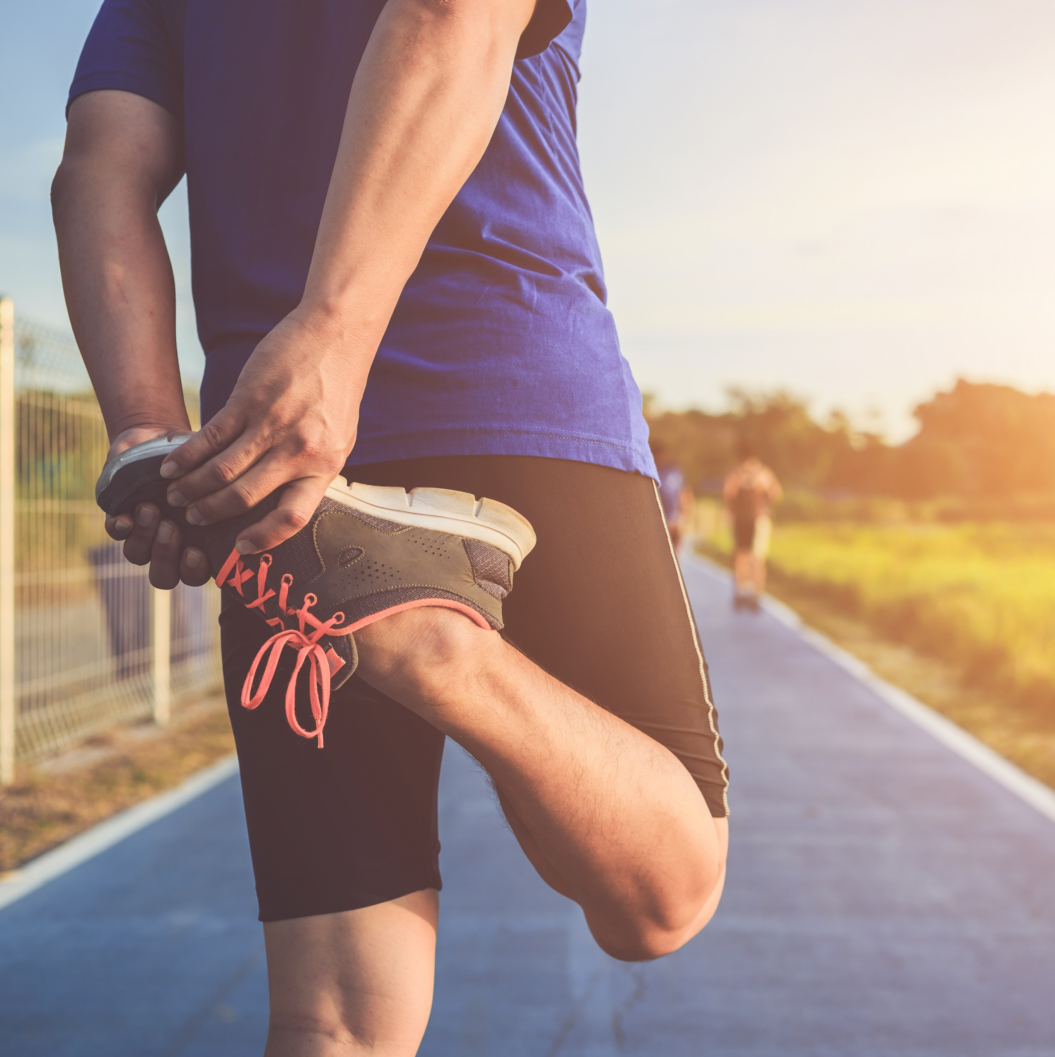
PART 01
01
读原文，学内容和语言

Slide 4
1. For me, it was normal to feel lost at the inter-camp track. Four camps of kids were ready to lead their teams to a blue ribbon and win the day. Not me. I was too little to be the leader and too skinny to be an athlete. I knew this by the time I was twelve, because my camp counselors（辅导员）and the other kids reminded me of it every chance they got. So when our camp needed a fourth runner in the two-mile race around the lake, I knew I was no one’s first choice. 2. I hid in the shade of a maple tree as they called the names of the runners, my body tensed as I heard a counselor call, “Fred! Where is Fred! He is in this race!” It was Barry. He spotted me under the tree. “Fred! We need a 12-year-old who hasn’t been in other events to run the two-mile!” 3. He gave me a push towards the starting line. Having no confidence and trying to save myself from the shame of taking the last place as four camps watched, I pleaded with him. 4. “But I don’t know the way around the lake!” 5. “You’re in. Just follow Bill!” Barry smiled. 6. Bill was my friend and the fastest runner in our camp. And then Barry said, “When you make it to the last stretch（最后一程）on the field, just throw your head back and run.” 7.At the starting line, I stood next to Bill and trembled. 8. “On your mark… Get set...” The gun cracked and sixteen of us took off. I stayed close on Bill’s heels, a little too close for Bill, I guess. He shouted at me, “Back off!” 9. I did. Two guys passed me, but I kept my eyes on Bill. 10. It was tiring. The distance was widening between Bill and me. We made the turn from the dusty road onto the muddy, wooded trail that would go around the lake back to the field. Through the trees, I saw Bill trip over a tree root and fall. A runner from another camp passed him. Paragraph 1 In a moment, Bill was up again and running. ____________________________________________ Paragraph 2 I didn’t know when I crossed the finish line. _____________________________________________

Slide 5
A. 学内容 (Get the main idea)
When
time
Barry asked me to participate in the two-mile race around the lake with Bill. The race began but unfortunately, we were behind and Bill tripped over a tree root..
place
at camp
Fred(I), Barry(counselor), Bill (best friend)
people
the two-mile race around the lake
event

Slide 6
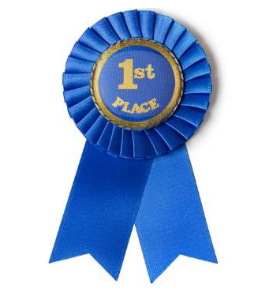


B. 学语言(learn the language)
1. For me, it was normal to feel lost at the inter-camp track. Four camps of kids were ready to lead their teams to a blue ribbon and win the day. Not me. I was too little to be the leader and too skinny to be an athlete. I knew this by the time I was twelve, because my camp counselors(辅导员)and the other kids reminded me of it every chance they got. So when our camp needed a fourth runner in the two-mile race around the lake, I knew I was no one’s first choice. 2. I hid in the shade of a maple tree as they called the names of the runners, my body tensed as I heard a counselor call, “Fred! Where is Fred! He is in this race!” It was Barry. He spotted me under the tree. “Fred! We need a 12-year-old who hasn’t been in other events to run the two-mile!”
a blue ribbon
优秀
win the day
获胜
tense v.
(limbs) become tight and stiff紧绷
定语从句

Slide 7
B. 学语言(learn the language)
3. He gave me a push towards the starting line. Having no confidence and trying to save myself from the shame of taking the last place as four camps watched, I pleaded with him.
4. “But I don’t know the way around the lake!” 5. “You’re in. Just follow Bill!” Barry smiled. 6. Bill was my friend and the fastest runner in our camp. And then Barry said, “When you make it to the last stretch（最后一程）on the field, just throw your head back and run.” 7.At the starting line, I stood next to Bill and trembled.
8. “On your mark… Get set...” The gun cracked and sixteen of us took off. I stayed close on Bill’s heels, a little too close for Bill, I guess. He shouted at me, “Back off!”
give sb a push
非谓语
推了某人一把
the starting line
起跑线
plead v.
乞求
throw one’s head back
身体向前倾
the gun cracked.
枪响了
stay close on one’s heels
跟紧某人的脚步

Slide 8
B. 学语言(learn the language)
wooded trail
9. I did. Two guys passed me, but I kept my eyes on Bill. 10. It was tiring. The distance was widening between Bill and me. We made the turn from the dusty road onto the muddy, wooded trail that would go around the lake back to the field. Through the trees, I saw Bill trip over a tree root and fall. A runner from another camp passed him.
trail covered with trees树木繁茂的小路
trip over
(tripped tripped)
绊倒

Slide 9
PART 02
02
读原文、首句、画线词，思情节和情感

Slide 10
A. Bill got up and restarted.
B. I crossed the finish line.
C. Barry asked me to join the runners and follow Bill.
D. The race started but Bill tripped over.
E. A two-mile race around the lake was to be held.
F. Our camp needed a fourth runner.
During the game:
I felt _________
clues____________________________________
climax
A
5. ______
tired
stayed close on Bill’s heels; kept
my eyes on Bill; passed; tiring; widening;
D
4. ______
C
3. ______
B
Before the game:
I felt _________
clues____________________________________
6. ______
After the game:
I felt _______________
clues_______________
unconfident
F
?
2. ______
Not me; too little to...too skinny to...; no one’s first choice; hid; tensed;trembled
?
ending
E
1. ______
beginning

Slide 11
PART 03
03
读情节、情感变化， 辨主题、续文方向

Slide 12


love
friendship
change of my attitude
fierce competition
theme
After the game
confident
How?
During the game
Before the game
tired
unconfident

Slide 13
PART 04
04
构思语言，传情达意

Slide 14
Para.1 In a moment, Bill was up again and running. | Para.2 I didn’t know when I crossed the finish line.
What did I do and how did I feel after reaching the finish line?
What did Barry and Bill say?
What did I think of the experience?
（我)到达--(别人)祝贺--(我)感悟
How was his condition?
How did I feel at the sight of Bill’s persistence?
What did I do?
Bill带伤跑步--我受到激励--我奋起直追

Slide 15

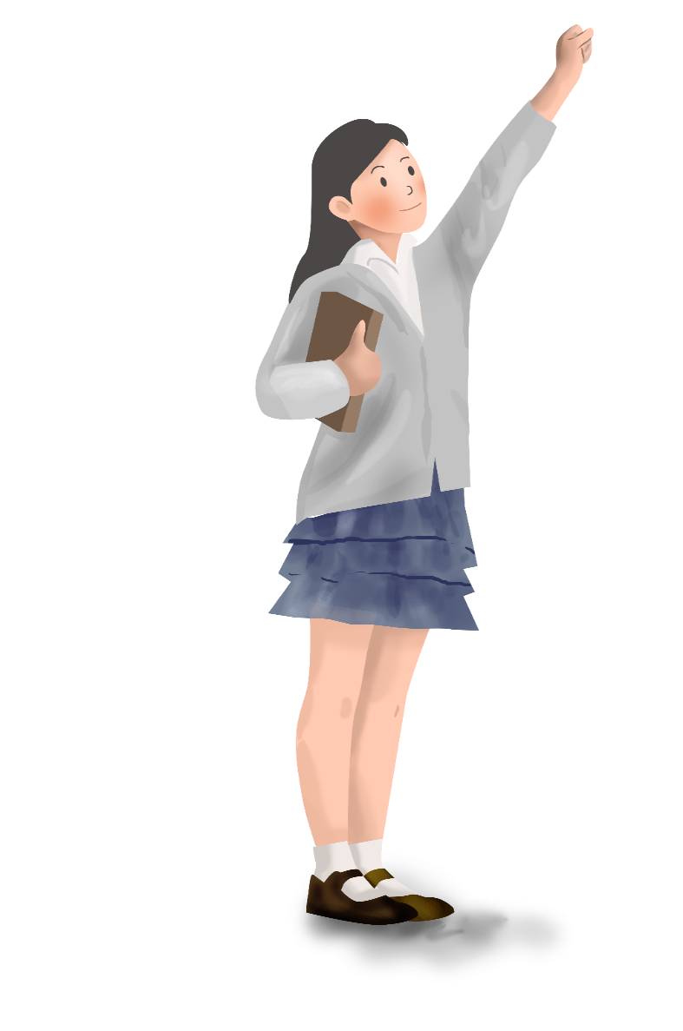
比赛中受激励
l 来自比尔的感动
1. 一看到比尔跌跌撞撞地前行着，膝盖仍在流血，我无比动容。
（on +doing 一...就...）
______________________________________________________________________________________________________________________________
2. Despite the huge pain I could tell from his extremely pale face, Bill didn’t stop. __________________________________________
___________________________________________________
(正是他钢铁般的坚持和坚定的决心给了我额外的能量。强调句)
On seeing Bill stumble forward with his knees still bleeding, I was deeply moved.
It was his iron persistence and resolute determination that gave me an extra burst of energy.

Slide 16
比赛中受激励
l 来自巴里的提醒、激励
我突然想起巴里的话。
Then Barry’s words______________________.(闪过我脑袋)
_______________________.(在我脑袋回响)
flashed into my head.
echoed in my head.

Slide 17
比赛中坚持和努力
Ø 加速
1. 快速跑 v. _________________
eg. I darted towards the
finish line.飞奔
eg. I zoomed passed Bill.
快速移动
dart
zoom
eg. I rushed forward.
迅速移动
rush
whiz
eg. Barry cheered as I
whizzed by.
嗖嗖地快 速移动
race
eg. I raced forward.
快速移动

Slide 18
比赛中坚持和努力
Ø 加速
1. 快速跑 v. _________________
eg. I sprinted for the
finishing line. 冲刺
I took a deep breath and shot forward.冲
shoot
sprint
eg. I zipped across
the wooded trail.
呼啸而过
charge
zip
eg. I charged off, heading straight for the finish line. 猛冲

Slide 19
比赛中坚持和努力
Ø 加速
2. 加速 ____________( vt)
____________(短语)
3. 我全速往前冲。
I dashed forward ___________________.
4. 我以惊人的速度向终点冲去。
I charged towards the finish line ________________.
5. 我以闪电般的速度向终点冲去。(比喻)
I darted toward the finish line ___________________. I ...________________(像箭般)
I..._________________(像正在加速的火车般)
6. I ran as fast as my legs could carry me.
__________________________________
accelerate
speed up/ pick up speed
at top/full speed
at an amazing speed
in lightning speed
like an arrow
a speeding train
我飞快地跑着。

Slide 20
比赛中坚持和努力
Ø 坚持与努力
1. 咬紧牙关 ___________________(短语)
2. 拼尽全力 ___________________(短语)
3. 鼓起勇气 ___________________(短语)
4. 不遗余力做__________________(短语)
5. My throat was dry, chest was burning, and I was ____________
(喘气) but I didn't stop.
6. Tough __________________(气喘吁吁), I pushed on.(非谓语)
7. The last few miles was a blur. But ____________(倒装)
最后几公里我感觉一片模糊，但我一直跑着。
8. 我深吸一口气，大喊一声，往前冲去。(三连动)
I ______________, _____________ and _______________.
grit one’s teeth (-tt)
with all one’s might
work up my courage/ summon up my courage
/pluck up my courage/muster up my courage
spare no effort to do sth
gasping for breath
puffing and panting
on I ran
took a deep breath let out a shout sprinted forward

Slide 21
比赛中坚持和努力
9. 环境+身体的阻力也没使我放弃
The scorching sun (炙热的太阳) _________ my face, and beads of sweats __________ my vision, I was nearly _______________, yet I ploughed on.
plough on: to continue doing sth that is difficult or boring.坚持做某事；苦撑
baking
blurred
suffocated

Slide 22
比赛后的如释重负
1.我如释重负地舒了一口气。
_______________________________________
I let out a deep sigh./I heaved a sigh of relief.
/I felt relieved and sighed.
heave: to make a sound slowly 缓慢发出(声音)
A great sense of relief flooded over me.
welled up inside me.
_______________________________________ （无灵主语）

Slide 23
比赛后的喜悦
鼓掌 v. __________ n. __________
拍肩膀_____________________(短语)
The whole team was _____________(非常高兴) , especially Bill.
The whole place __________________ .
(爆发出掌声和欢呼声 )
The field _____________________________.
(爆发出难以置信的欢呼)
Then came Bill, who slightly quivered ____________ (高兴地), took unsteady steps forward and ______________________(热情地拥抱我)
clap (-pp)/applaud
applause (U)
pat one’s shoulder (-tt)
wild with joy
burst out clapping and cheering
exploded with yells of disbelief
in excitement
hugged me warmly/gave me a warm hug

Slide 24
比赛后内心反思
没有想到
______________________________________ did I ever expect
myself to complete the whole race as a runner.
要不是比尔我不可能完成两公里的绕湖赛并且找到我的勇气的。(虚拟语气)
_____________________________________________________________
_____________________________________________________________
突然意识到
_________________________________that there is always strength and confidence inside us, and as long as we persevere, maintain hope and push forward, we can finally reach them.
Never in my wildest imagination
Hadn’t it been for Bill/But for Bill, I wouldn’t have made the two-mile race around the lake and found my confidence.
=it occurred to/struck/hit sb
It suddenly dawned on me
=It was exactly at that moment that I came into the enlightenment that ...

Slide 25
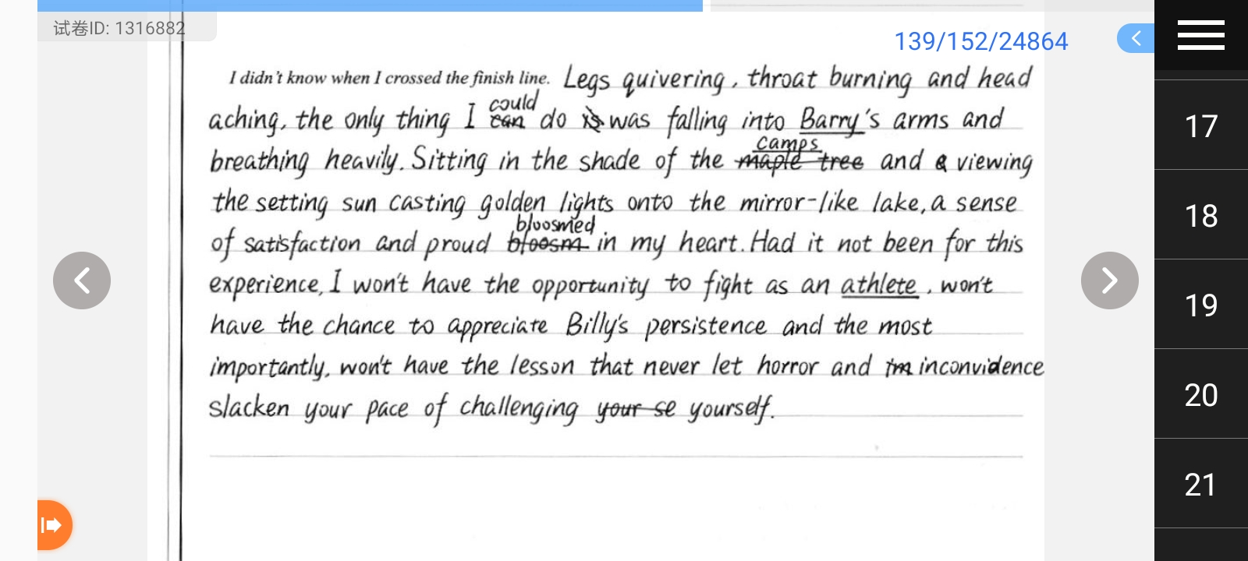
用虚拟语气引出感悟：

Slide 26

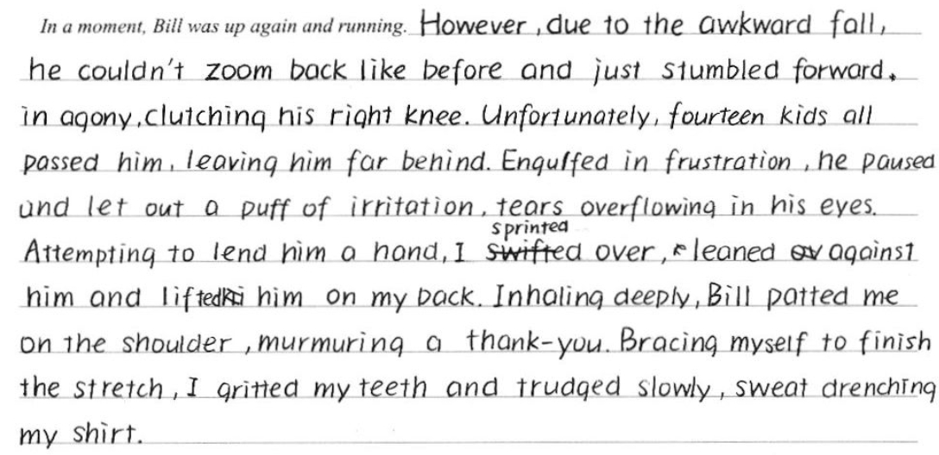
学生作品1
生动的小词
engulf: to surround/cover sb/sth completely 包围/吞没(+by/in)
brace sb for sth: to prepare sb for sth difficult 为困难做好准备

Slide 27
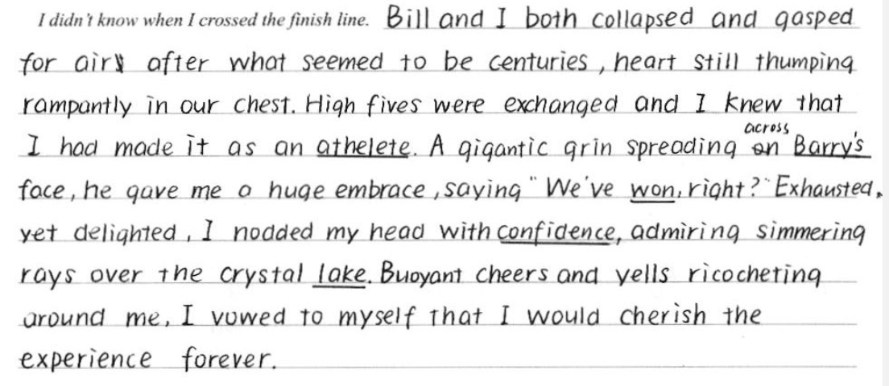

Slide 28
One possible version
In a moment, he was up again and running. He yelled to me, “Watch the roots!” Struggling to keep my legs moving, I looked down and saw the tree root. I puffed over it. Two hundred metres later, I scrambled up the hill, ready to see the rest of the pack crossing the finish line when I saw not the fifteen guys, but three. The crowd was roaring, but I could hear Barry over the rest of them, yelling “Run!” I threw my head back and told my legs to go and I knew I was winning.
I didn't know when I crossed the finish line. Barry caught me and I collapsed. “You flew! You flew, man! Second! You passed two guys!” There was a crowd of kids around me, patting me on the back, giving me high fives. I had come in second. Bill had finished first. With that and all the high fives and the cheers of the day, the best prize that I walked away with (轻易赢得)was my confidence. That year I discovered I could do a lot of things if I put my energy into them.

Slide 29
比赛话题练习
2020暨阳联考
Mike licked the last of the mint chocolate chip ice cream. It was almost time to leave. He jumped into the car with his parents and headed off to the Olympic-sized pool for the big swim meet.
When his race came up, Mike was confident. He was strong and swift. Mike climbed out the pool, smiling. He had just won first place, making him the fastest boy in his age group.
" Congratulations, son, "his father said. His mom gave him a hug, even though he was soaking wet.
A week later, it was time for another swim meet. Like before, Mike decided to enjoy his favorite ice cream flavor. Mike remembered that the last time he had won a race, he also ate mint chocolate chip ice cream first. Maybe he'd win again.
He’s taken first place again in his race. Mike was feeling pretty good. As it turned out, Mike decided to have some mint chocolate chip Ice cream before every one of the next few swim meets. He began to think of it as his lucky charm. After several months of placing in the top positions of every race he swam, Mike was feeling unbeatable. And he wouldn’t admit it, but all that ice cream was adding a few pounds to his athletic swimmer's build.
It didn’t take long after that for Mike to start coming in second place-and then third-and then last place in his races. The lucky mint chocolate chip ice cream had lost its magic.
On the day of his next swim meet, his mother sat down at the table with him. “Mike, we all love ice cream, but it's not healthy for your body to eat so much of it. Maybe it's time to quit the sweet treats for a while, especially before you go swimming.
Mike unwillingly agreed. He went to the swim meet, and didn’t perform well. His father offered to go running with him a few days a week to help him feel better and strengthen his muscles. The extra weight soon disappeared, and Mike found himself breathing easier at swim practices.
Paragraph 1: It was the last meet of the season, and Mike wasn't sure what to expect.________________________
Paragraph 2: Finally came the end of the race. _______________________________________

Slide 30
梦
想
脚
下
始
从
开
SPORTS HEALTH GENERAL PPT TEMPLATE

Slide 31
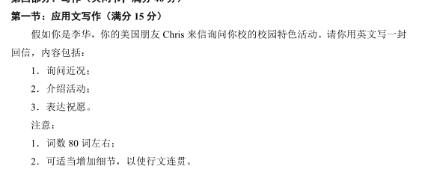
2021届一模应用文

