Slide 1
感恩遇见，相互成就，本课件资料仅供您个人参考、教学使用，严禁自行在网络传播，违者依知识产权法追究法律责任。
更多教学资源请关注
公众号：溯恩高中英语
知识产权声明

Slide 2
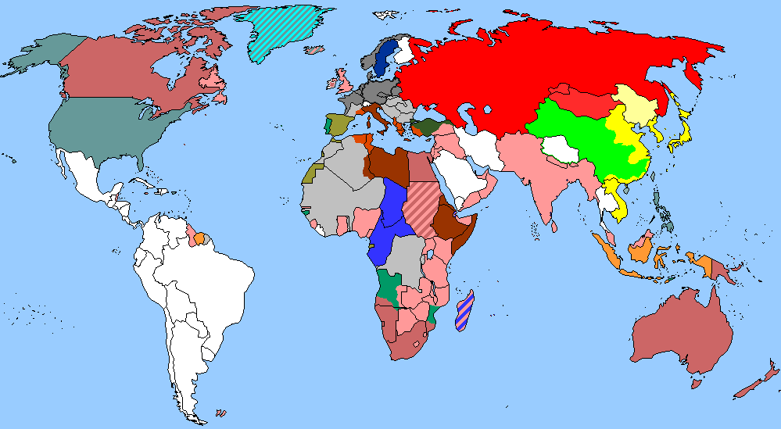
The World
July 1st-15th, 2022

Slide 3
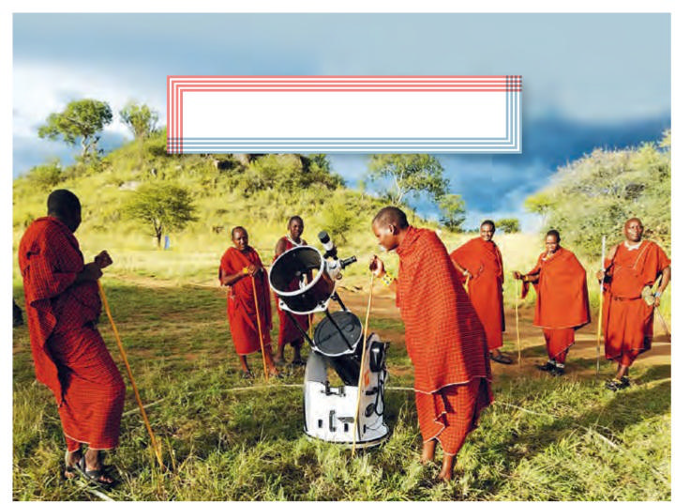
1. Bringing Stars To The Eyes Of Students
让孩子的眼中充满星光
NEWS WORTH SHARING

Slide 4
语篇填空
（《读者文摘》澳大利亚版 2022年6月刊 10页）
As a child growing up in Nairobi, Kenya, looking up at the stars wasn’t something school children _______________ (encourage) to do. For Susan Murabana, that changed in her early 20s when she encountered her first telescope and spotted Saturn. “______ (see) something I had only read about in a textbook made me realise how small we ______ (real) are,” says Murabana, who is now ___ astronomer.
In 2014, Murabana’s husband was so inspired ___ how studying space had opened up Murabana’s life that the couple decided to give kids this experience by creating an __________ (education) programme called “The Travelling Telescope”. They criss-cross Kenya bringing astronomy education and a portable planetarium to schools and ____________ (community). So far, they ________ (meet) with more than 300,000 children. Kids can’t resist the lure of the telescope and the opportunity it offers to see the moon up close, as well as stars and planets, says Murabana.
In January 2021, pop royalty Madonna visited Kenya and booked a private telescope session for ____ (she) family. Murabana watched the pop star’s face light up with the same sense of wonder as the kids. “It reminds people about the universe ___________ sits just above their heads,”she says.
were encouraged
Seeing
really
an
by
educational
communities
have met
her
which / that

Slide 5
词汇讲解
1. encounter: to meet sb, or discover or experience sth, especially sb/sth new, unusual or unexpected 偶然碰到；意外地遇见；与…邂逅
She was the most remarkable woman he had ever encountered. 她是他所见到过的最出色的女性。
2. lure: the attractive qualities of sth 吸引力；诱惑力；魅力
Few can resist the lure of adventure. 很少有人能抵御历险的诱惑力。
翻译句子
我们在第一周遇到了一些困难。
We encountered a number of difficulties in the first week.
翻译句子
他还不够成熟，无法抵抗酒精和毒品的诱惑。
He wasn’t mature enough to resist the lure of drink and drugs.

Slide 6
句子翻译
Kids can’t resist the lure of the telescope and the opportunity it offers to see the moon up close, as well as stars and planets, says Murabana.
孩子们无法抗拒望远镜的诱惑，它提供了近距离观察月球以及恒星和行星的机会，Murabana说。
翻译
Murabana watched the pop star’s face light up with the same sense of wonder as the kids. “It reminds people about the universe that sits just above their heads,” she says.
Murabana看到这位流行歌手的脸上绽放出和孩子们一样的惊奇。 “它提醒人们，宇宙就在他们头顶上，” 她说。
翻译

Slide 7
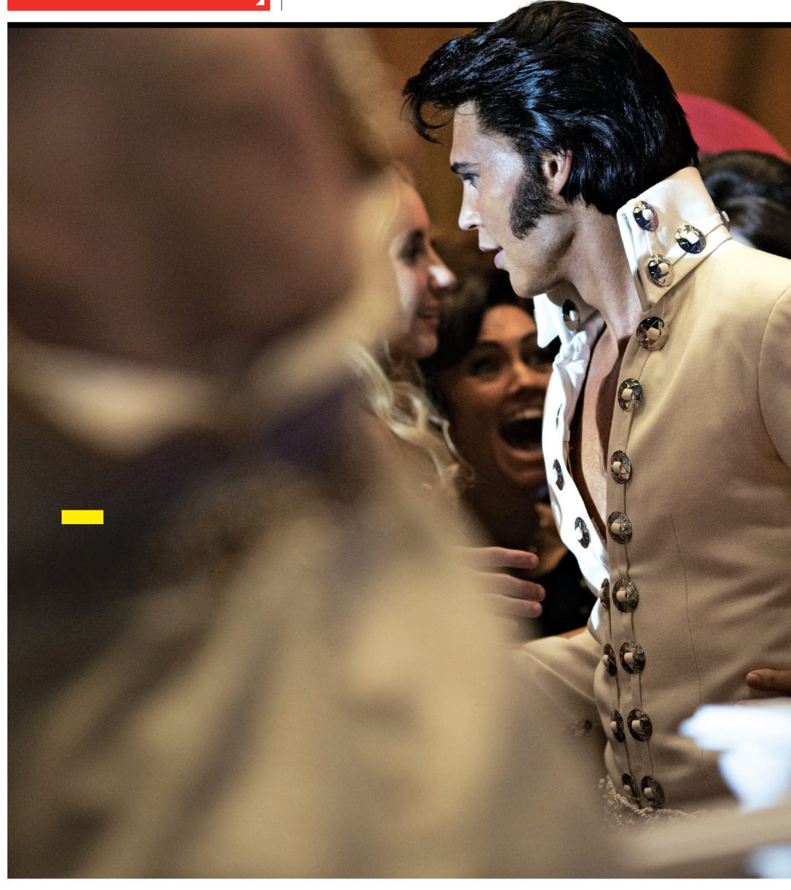
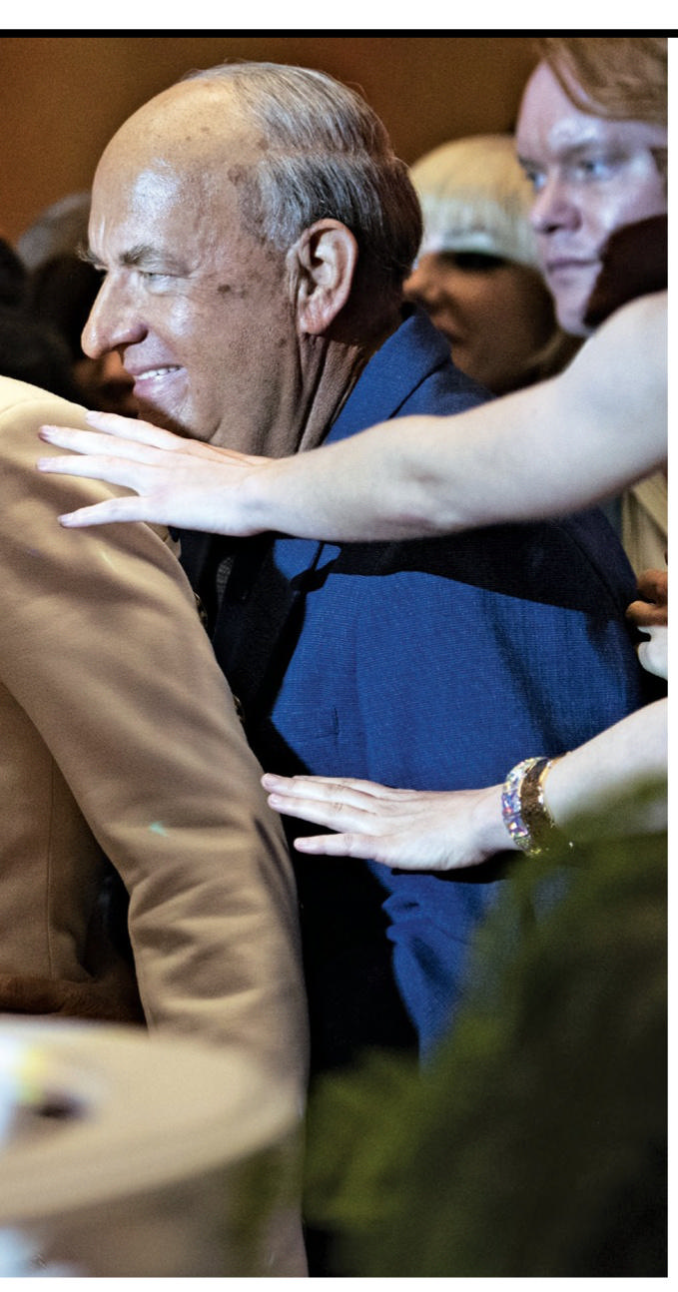
2. A Good Guy Movie Star Steps Into the Shadows
汤姆·汉克斯出演猫王经纪人
As the King’s manager in the biopic Elvis, Tom Hanks says he tried to take audiences someplace new.

Slide 8
语篇填空
（《新闻周刊》 2022年7月1日刊 61页）
choice
Even Tom Hanks thought he was an odd ______ (choose) to play Elvis Presley’s manager Colonel Tom Parker in director Baz Luhrmann’s Elvis. “When Baz came in and first talked about Elvis, I couldn’t figure out ____ in the world he would come to see me,” Hanks recalls.
For one thing, Hanks had little interest __ Elvis. For another, the actor specializes in decent all-American Everymen and Parker was a _________ (mystery )wheeler-dealer who managed (some say exploited) the King throughout his singular career while _________ (remain) almost anonymous himself. Hanks remembers thinking, “I don’t know what the man _____ (look) like. I’ve never heard his voice.”
Still, Hanks says he was intrigued and only got more interested as he started researching Parker. _____ he found was a “devious mix of self-serving and moxie of genius somehow.”
“There was not ___ artistic bone in Colonel Tom Parker,” he says, “he didn’t care about the music, he didn’t care about the movies. He cared about the _____ (deal). He cared about making sure that his boy didn’t just have a million dollars worth of talent, but _______ (actual) had a million dollars.”
why
in
mysterious
remaining
looks
What
an
deals
actually

Slide 9
词汇讲解
1. intrigued: very interested in sth/sb and wanting to know more about it/them 着迷；很感兴趣；好奇
I'm intrigued to know what you thought of the movie. 我很想知道你对这部电影的看法。
2. devious: behaving in a dishonest or indirect way, or tricking people, in order to get sth 不诚实的；不直率的；欺诈的
He got rich by devious means. 他不择手段大发横财。
翻译句子
我对倾听别人的看法会感兴趣的。
I would be intrigued to hear others’ views.
翻译句子
他也许狡猾，但并非没有原则。
He might be devious, but he was not without principles.

Slide 10
句子翻译
For one thing, Hanks had little interest in Elvis. For another, the actor specializes in decent all-American Everymen and Parker was a mysterious wheeler-dealer who managed (some say exploited) the King throughout his singular career while remaining almost anonymous himself.
一方面，汉克斯对猫王没什么兴趣。 另一方面，这位演员擅长演正派的典型美国普通人，而帕克是一个神秘的精明商人，在猫王非凡的职业生涯中管理(有人说利用)猫王，而他自己几乎默默无闻。
翻译
Still, Hanks says he was intrigued and only got more interested as he started researching Parker. What he found was a “devious mix of self-serving and moxie of genius somehow.”
尽管如此，汉克斯说他很感兴趣，而且随着他开始研究帕克，他的兴趣越来越大。 他发现的是一种“自私自利和天才勇气的巧妙结合”。
翻译

Slide 11
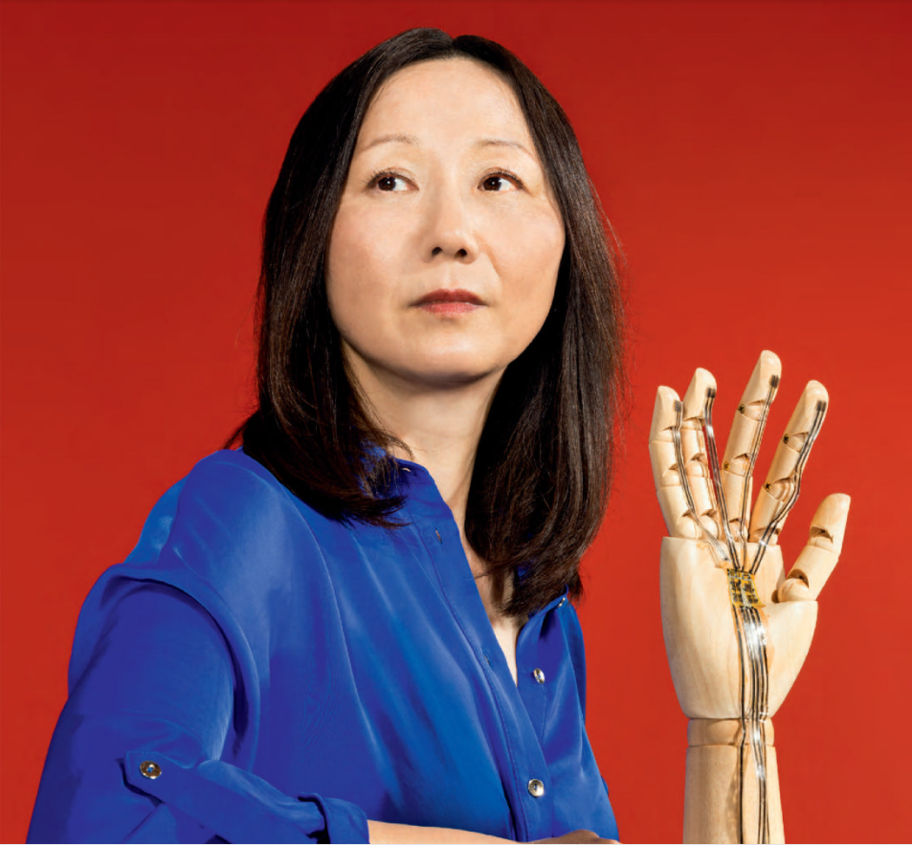
3. ELECTRIC SKIN: THE ULTIMATE WEARABLE TECH
电子皮肤: 终极可穿戴技术

Slide 12
语篇填空
（《连线》2022年7月1日 23页）
The skin is the body’s largest organ, and also its most complex. Peer at it under a micro-scope and you’ll see thousands of nerve endings that keep the brain ________ (connect) to the outside world and allow us to feel touch,pressure and pain. But Zhenan Bao sees something else.
For Bao, a chemical engineer, the skin is not only a sensory organ, but a flexible, _______ (stretch), self-healing and biodegradable material. Bao works in the _________ (emerge) field of electronic skin, and has made it her mission __________ (recreate) the many functions of human skin for use in prosthetics and robotics. For those who wear artificial limbs, a sense of touch would immeasurably improve their quality of life.
When Bao joined Stanford University in 2004, few researchers were working on flexible sensors. By 2010, Bao and her colleagues _____________ (develope) a flexible sensor so sensitive that it could detect the touch of an alighting butterfly.
In addition ___ robotics and prostheses, Bao sees potential ___________ (application)for electronic skin, or e-skin, in the field of wearables. Imagine a device that _______ (worn) on the body like a second skin and uses sensors to __________ (accurately) measure blood pressure, temperature, or glucose and oxygen levels in real time. There are many potential applications for e-skin, says Bao, ____ the road to commercialization is long.
connected
stretchable
emerging
to recreate
had developed
to
applications
is worn
accurately
but

Slide 13
词汇讲解1
1. peer: look keenly or with difficulty at someone or something 凝视，盯着看，费力地看
I had been peering at a computer print-out that made no sense at all.
我一直在费力地看一份不知所云的电脑打印稿。
2. biodegradable: Something breaks down or decays naturally without any special scientific treatment. 能进行生物降解的
The car materials are recyclable and biodegradable.
全车材质都是可循环可降解的。
翻译句子
在立交桥上，我俯视着桥下如棋盘般的铁皮屋顶。
On the flyover, I peer down at a chessboard of tin roofs.
翻译句子
太空垃圾是不能生物降解的。
Space waste is not biodegradable.

Slide 14
词汇讲解2
3. prosthetics: artificial parts of the body 假体（人造的身体部分）；义肢
It can also enhance the quality of life for disabled persons through advanced prosthetics.
科技还能通过先进的肢体修复技术提高残疾人的生活品质。
4. alighting: to land in or on sth after flying to it 降落；飞落
The birds couldn't alight on the MATS and his head simultaneously.
鸟儿不可能同时停在垫子和他身上。
翻译句子
许多研究都专注于将解读大脑作为操作假肢的一种方法。
Much research focused on reading the mind as a way to operate prosthetics.
翻译句子
一只画眉落在这棵松树的一根树枝上。
A thrush alighted on a branch of the pine tree.

Slide 15
句子翻译
Bao works in the emerging field of electronic skin, and has made it her mission to recreate the many functions of human skin for use in prosthetics and robotics.
翻译
鲍女士的工作领域是新兴的电子皮肤领域，她的使命是重现人类皮肤的许多功能，用于假肢和机器人技术。
Imagine a device that is worn on the body like a second skin and uses sensors to accurately measure blood pressure, temperature, or glucose and oxygen levels in real time.
翻译
想象一下，有一种装置可以像第二层皮肤一样戴在身上，它使用传感器实时准确地测量血压、温度、血糖和氧气水平。

Slide 16
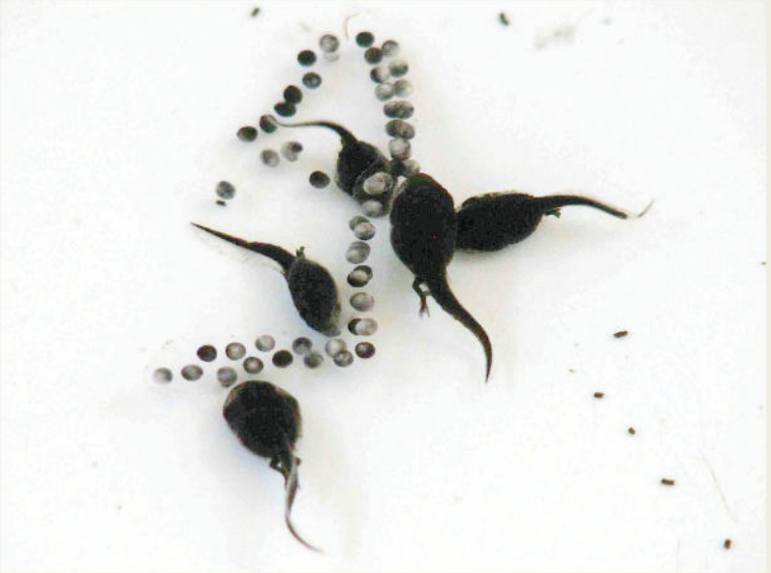
4. Too Many Mouths? 蟾蜍的自相残杀

Slide 17
语篇填空
（《国家地理》2022年7月刊 19页）
Known as the marine toad, giant toad, and cane toad, Rhinella marina feasts on insects in ___ (it) native South America. So in 1935, 101 toads ___________ (bring) to Australia in hopes of ridding sugarcane plantations ___ beetles. The poisonous amphibians did little to curb the beetle population and quickly became _____ (pest), multiplying rapidly and taking a toll on native species. Today the more than 200 million cane toads in Australia are far too many for anyone’s liking—including the toads’, ______ intraspecies competition for resources has evolved a gruesome new behavior: cannibalism. In a study _________ (publish) in the journal Ecology and Evolution, scientists found that after cane toad tadpoles in Australia detect a toxin in eggs of their own species—____ same toxin that makes the toads poisonous to predators—the tadpoles become ravenous and eat the eggs and hatchlings. This behavior is virtually ________ (know) in cane toads in their native range; it’s thought to have arisen _______ (recent) among those in Australia as a way to reduce competition. “They’re definitely their own _____ (bad) enemy in Australia,” says study co-author Michael Crossland of the University of Sydney.
its
were brought
of
pests
whose
published
the
unknown
recently
worst

Slide 18
词汇讲解
1. gruesome: very unpleasant and filling you with horror, usually because it is connected with death or injury 令人厌恶的；恐怖的；可怕的
(humorous) We spent a week in a grusesome apartment in Miami.
（幽默用法）我们在迈阿密一套糟糕的公寓里住了一个星期。
2. ravenous: (of a person or an animal) extremely hungry 及其饥饿的
Amy realized that she had eaten nothing since leaving Bruton Street, and she was ravenous.
埃米意识到自己从离开布鲁顿大街之后什么东西都没吃，她饿极了。
翻译句子
在首都发生了一连串让人毛骨悚然的谋杀案。
There has been a series of gruesome murders in the capital.
翻译句子
午饭吃什么？我饿死了。
What’s for lunch? I’m absolutely ravenous.

Slide 19
长难句分析
In a study published in the journal Ecology and Evolution, scientists found that after cane toad tadpoles in Australia detect a toxin in eggs of their own species—the same toxin that makes the toads poisonous to predators—the tadpoles become ravenous and eat the eggs and hatchlings.
分析：整句是一个____从句,其中，“after cane toad tadpoles ... own species”是_____________；“the same toxin”是_______，并且是“that makes the toads poisonous to predators”这个_________的_______ “published in the journal Ecology and Evolution”是过去分词短语作
_________修饰“study”。
宾语
时间状语从句
同位语
定语从句
先行词
后置定语
翻译
在发表于《生态与进化》杂志上的一项研究中，科学家们发现，澳大利亚的蔗蟾蝌蚪在它们自己物种的卵中检测到一种毒素后——这种毒素能毒死蟾蜍的捕食者——它们变得贪婪并吃掉卵和幼体。

Slide 20
句子翻译
The poisonous amphibians did little to curb the beetle population and quickly became pests, multiplying rapidly and taking a toll on native species.
翻译
这种有毒的两栖动物几乎没有遏制甲虫的数量，很快就变成了害虫，迅速繁殖并对本地物种造成了伤害。
Today the more than 200 million cane toads in Australia are far too many for anyone’s liking—including the toads’, whose intraspecies competition for resources has evolved a gruesome new behavior: cannibalism.
翻译
如今，澳大利亚数量超过 2 亿只的蔗蟾另任何人都无法接受——包括
蔗蟾，它们的种内资源竞争已经演变成一种可怕的新行为：自相残杀。

Slide 21
5. BBC新闻听写填空 07/01/22

Slide 22
听力填空
Talks are expected to start in Qatar today in a renewed effort to revive the international deal on Iran’s ______________. Discussions in Vienna on the 2015 Agreement have been stored since March. The latest _______ talks follow an __________ visit by the European foreign policy chief Josep Borrell to Iran on Saturday.
Sri Lanka’s government has announced that it will allow firms from oil-producing countries to _____________ fuel in Sri Lanka. It’s the latest attempt to tackle the worst economic crisis in the country’s history since ____________. The energy minister said the companies would be chosen on the basis of their ability to operate without _______ any foreign exchange in their central bank, which is nearly _________ foreign currency reserves.
The supreme court in the Philippines has _______ an attempt to stop the inauguration of Ferdinand Marcos Jr. as the country’s next president. Petitioners ______ that Mr Marcos shouldn’t have been allowed to run because of his conviction for ______ to file tax returns for four years. This took place in the 1980s.
nuclear program
indirect
unexpected
import and sell
independence
seeking
run out of
rejected
argued
failing

Slide 23
词汇讲解
1. revive: to make sth start being used or done again 重新使用；使重做
She has been trying to revive the debate over equal pay.
她一直在设法再次展开同工同酬的辩论。
2. tackle: to make a determined effort to deal with a difficult problem or situation
应付，处理，解决（难题或局面）
The first reason to tackle these problems is to save children’s lives.
果断处理这些问题的首要原因是为了挽救孩子们的生命。
翻译句子
应该恢复这一独特的风俗。
This unique custom should be revived.
翻译句子
消防队员们后来扑灭了这场大火。
Firemen later tackled the big fire.

Slide 24
句子翻译
The energy minister said the companies would be chosen on the basis of their ability to operate without seeking any foreign exchange in their central bank, which is nearly run out of foreign currency reserves.
翻译
能源部长表示，将根据这些公司不在央行寻求任何外汇储备情况下的运营能力选择，而央行的外汇储备几乎已耗尽。
The supreme court in the Philippines has rejected an attempt to stop the inauguration of Ferdinand Marcos Jr. as the country’s next president.
翻译
菲律宾最高法院驳回了阻止小费迪南德·马科斯就任该国下一任总统的尝试。

