Slide 1


感恩遇见，相互成就，本课件资料仅供您个人参考、教学使用，严禁自行在网络传播，违者依知识产权法追究法律责任。
更多教学资源请关注
公众号：溯恩高中英语
知识产权声明

Slide 2

高中英语应用文写作---投诉信 Letters of Complaint
杭州二中许丽君

Slide 3
学习目标： Learning Goals
After learning this lesson, students will
learn about the structure and contents of letters of Complaint;
01
5. write an appropriate letter of Complaint, especially pay attention to the tone and language.
2. write the points completely and clearly.
02
05
03
3. use advanced expressions and sentence patterns to write a letter of Complaint.
04
4. know what a good letter of Complaint is like.

Slide 4

Lead in:
When do you need to write letters of Complaint?
complain about the poor quality of goods
complain about service attitude
complain about rude behavior
complain about waste
complain about ordering errors
complain about damage
complain about noisy parties
complain about hotel service

Slide 5
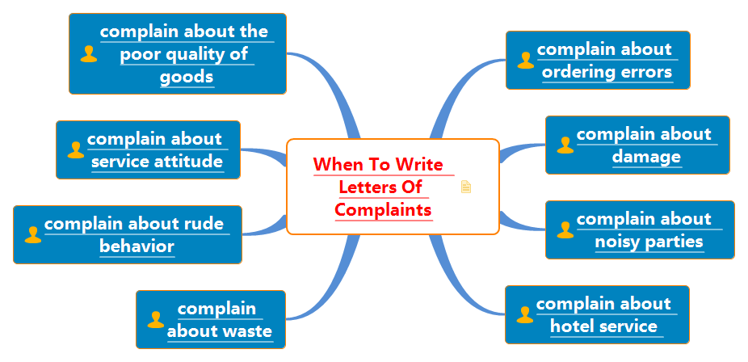
Lead in:
When do you need to write letters of Complaint?

Slide 6

写投诉信给谁: (the receiver)
 Write Letters of Complaint to ➔Who is the recipient（receiver）?- To someone it may concern
shops
sales clerk
headmaster
person in charge
canteen manager

Slide 7
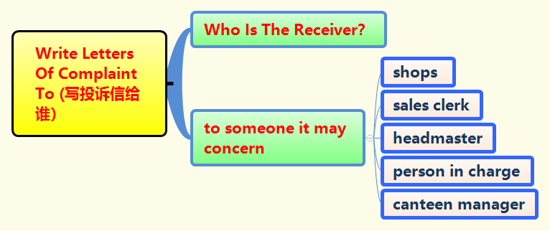
写投诉信给谁: (the receiver)

Slide 8

Writing preparations投诉信文体概述
投诉信是人们在遇到一些不文明现象、所购商品质量差、售后服务不满意等情况下解决问题的一个方法。在语言方面，要注意把握分寸，要公平、公正。投诉信应包括六个方面的内容：
首先说明投诉者身份；
表明写信目的，投诉的内容；
3. 投诉的具体事实与原因；
4. 提出你的要求，说出具体的解决方法；
5. 具体的诉求，希望得到的结果；
6. 最后写出期待答复的句子，答复期限要求。

Slide 9

投诉信写作步骤：
1
2
3
第一步：表明自己的身份，说明写信的目的，因何事投诉何人和机构；
第二步：具体阐述投诉的内容与投诉的理由；
第三步：提出解决建议并期望尽快解决，表示感谢。

Slide 10
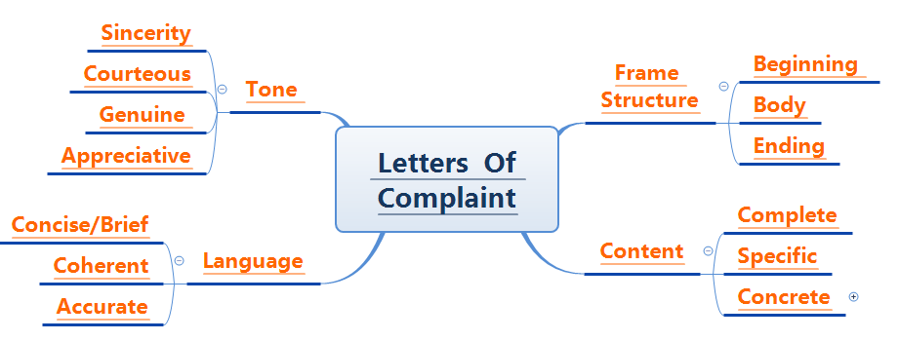
 投诉信的四项评判标准

Slide 11

Structure of the letter of complaint
Beginning --- Purpose of writing the letter【写信意图-投诉不当行为➔说明身份+表明写作的目的】
Body Arrangements---【主体段落➔投诉的内容+投诉的具体原因（诉求的条理要清晰）➔呈现所有要点+描述事件的经过】
Ending --- 【希望得到的结果+期待对方调查整改➔总结全文，再次点题】

Slide 12
 如何写投诉信的开头
Part 1: Beginning【首段-引人入胜开头句】
Purpose of writing the letter【写信意图➔投诉不当行为➔表明写作的目的】
篇首介绍自己，说明身份，投诉不当行为。
➢ I am writing to you to complain about…我写信是投诉关于……
➢ I am most reluctant to complain, but...
我最不想抱怨，但是...
➢ I’m writing to express my dissatisfaction about the coat which I bought last month in your store.
我写信向你投诉有关上个月我在你家店买的衣服的问题。
➢ I am one of your customers. I’m writing to complain about one of your waiters’ improper and rude behaviors.
我是你的一个顾客。我想投诉你店里一个服务员的不礼貌且粗鲁的行为。
➢ I have been content /satisfied with your service for years but I am writing to express my dissatisfaction about…
这几年我对你们的服务都很满意，但是我写信是表达关于……的不满。
➢ I’m LiHua. I feel sorry to trouble you but I’m afraid that I have to make a complaint about your restaurant. 我是李华，我不想给你添麻烦。但是，恐怕我不得不对你们餐馆进行投诉。

Slide 13

 如何写投诉信的正文
Part 2: Body Arrangements: (正文部分的衔接词)
Natural transitions
to begin with, as for, In addition , Therefore, as well, to be frank, what’s more, meanwhile, undoubtedly…

Slide 14
Part 2: Body Arrangements【主体段落➔画龙点睛篇中句】
（2）篇中说明投诉的内容+投诉的具体原因+呈现所有要点+描述事件的经过；
1. I think it necessary for you to do something /take some measures to solve the problem.
我认为您有必要采取措施解决问题。
2. There are some main reasons why I am not content with… At first, … What’s worse, … Eventually, …
我对……不满意有一些主要原因。首先，……更糟糕的是，……最后，……
3. There are some problems that I wish to bring to your attention. For one thing, … For another thing…
有一些问题希望能引起你的注意：首先… 其次…
4. In the first place, the food is too salty and the water isn’t served in time. In addition, the music you broadcast is too noisy.
首先， 食物太咸，水没有及时端上来。而且，你们播放的音乐太吵了。
5．Under these circumstances, I find it hard to sit here having dinner quietly.
在这样的环境下， 我很难安静地坐在这里吃饭。
6. It is a great pity that your goods and service have the following unacceptable/unbearable problems/faults.很遗憾的是你们的产品和服务竟然有以下这些令人难以接受的问题。
7. While I was on vacation in HongKong about a week ago, I bought a green shirt for 300 HK dollars in your shop, but there seems to be something wrong with it.
大概一周前我在香港度假的时候，我在你们店里花300港元买了一件绿色衬衫，但看上去有些问题。

Slide 15
如何写投诉信的结尾
Part 3: Ending【言简意赅篇尾句】
篇尾写希望得到的结果➔期待对方调查整改➔总结全文，再次点题
I do hope that the problems can be solved as soon as possible.
我希望问题可以得到尽早解决。
 I believe you will take my complaint seriously.
我相信你会认真考虑我的投诉。
 I sincerely hope that you will look into the matter seriously and proper measures should be taken to prevent such an incident happening again.
我真诚地希望你能认真调查这件事情，以及采取恰当的措施防止类似事件再次发生。
I would appreciate it very much if you could take measures to solve the problem as soon as possible.
你若能尽快采取措施处理这个问题，我将感激不尽。
 I would like to have this matter settled by the end of this month.
我希望这个问题能在这个月底之前得以解决。
 We trust that you will consider this matter seriously and make an effort to prevent the recurrence of this kind.
我相信您能认真考虑这件事情，并且尽力阻止这类事情的发生。
 I am waiting for a reasonable explanation and expecting an early reply.
我在等待一个合理的解释，并期待及早回复。

Slide 16



常用语块Writing help: Useful phrases and expressions
1. 抱怨 complain about
2. 希望解决这个问题hope to resolve this problem
3. 忍受 put up with/bear
4. 不愉快的事件unpleasant incident
5. 糟糕的服务poor service
6. 修正你的记录correct your records
7. 解决问题 deal with/solve the problem
8. 我想提醒你I would like to alert you to
9. 调查此次事件investigate/look into the matter/incident
10. 我敢肯定你想知道I feel certain that you would want to know that
11. 向……道歉 make an apology to…/apologize to…
12. 以粗鲁的方式 in a rude manner
13. 不用说 needless to say

Slide 17
Writing help: Useful sentences
I believe that an apology is due us.
I expect an adjustment to be made as soon as possible.
I know you will want to see that such an incident does not occur again.
I like your product but I object strongly to your advertising.
I’m confident that we can resolve this matter to our satisfaction.
I regret/am sorry to inform you of the following unpleasant situation.

Slide 18
【投诉信模板1】：
Dear ____, (对象)
Part 1:Beginning-Purpose of writing the letter
➢Why are you writing the letter of Complaint?
① I am . (自我介绍) ② I feel bad to trouble you but I am afraid that I have to make a complaint about . (写作意图，投诉事件)
Part 2: Body Arrangements：
What’s your complaint?
Make a list of your complaints.
③The reason for my dissatisfaction is . (介绍不满意的原因) ④ In the first place, . （抱怨的第一个方面）⑤ In addition, . （抱怨的第二个方面）⑥ Under these circumstances, I find it . （感觉）to ___________ (描述给你带来的后果)
Part 3: Ending
⑦ I’d appreciate it very much if you could , (提出建议和请求) , preferably ,（进一步要求），and I would like to have this matter settled by (设定解决事情的最后期限)
⑧ Thank you for your consideration and I will be looking forward to your reply. (表示感谢和期待问题解决的愿望)
Yours Sincerely / Faithfully/ Truly,
________________

Slide 19

【投诉信模板2】：
Dear ____, (对象)
My name is ____________. (自我介绍) I am ____________. （告知身份）I am writing to you for ________. (写作意图)Firstly, _______. （抱怨的第一个方面）Secondly, _________. （抱怨的第二个方面） Thirdly, _________. Therefore, I require that you send me a new one of the same model within a month. (你的要求)
To be honest/Honestly speaking, _______. Therefore, I do require/hope ________. （你的希望和建议）
Thank you for your consideration.
Sincerely yours,
Li Hua

Slide 20
Evaluation:
Work in groups of four. Each student read the article and others comment on others’ article. Then choose the best one to present in the class. When you are discussing, you can pay attention to the following hints.
Teaching Goal | Have you made the purpose clear?
Frame/ structure | Does the structure conform to the requirements?
Language | Are the sentences concise and accurate?
Main points | Have you included all the points of view?
Proper details | Are the details suitable?
three Criteria of complaint Letters | Does the letter meet three Criteria of complaint Letters-To be appropriate/concise/To get to the point?

Slide 21

应用文写作— 投诉信
题型训练实战演练参考范文

Slide 22
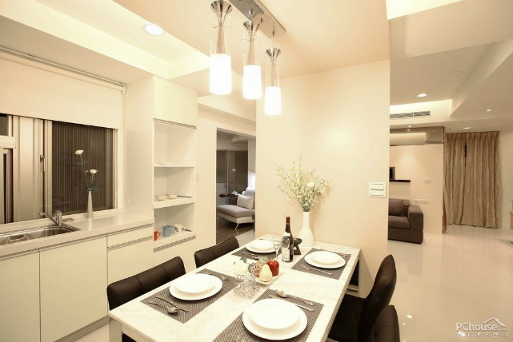
【投诉信题型训练1-投诉学生餐厅食品和服务质量不佳】
第一节:应用文写作（满分15分）
假定你是来自新华高中的李华，你对学校学生餐厅的食品和服务质量不满意。请你给校长写一封投诉信反映情况。要点如下：
1. 问题：食品质量差，价格高；餐厅服务不佳。
2. 你的建议和要求。
注意：1. 词数80左右。
2. 可以适当增加细节，以使行文连贯。
3. 开头语和结束语已为你写好。

Slide 23
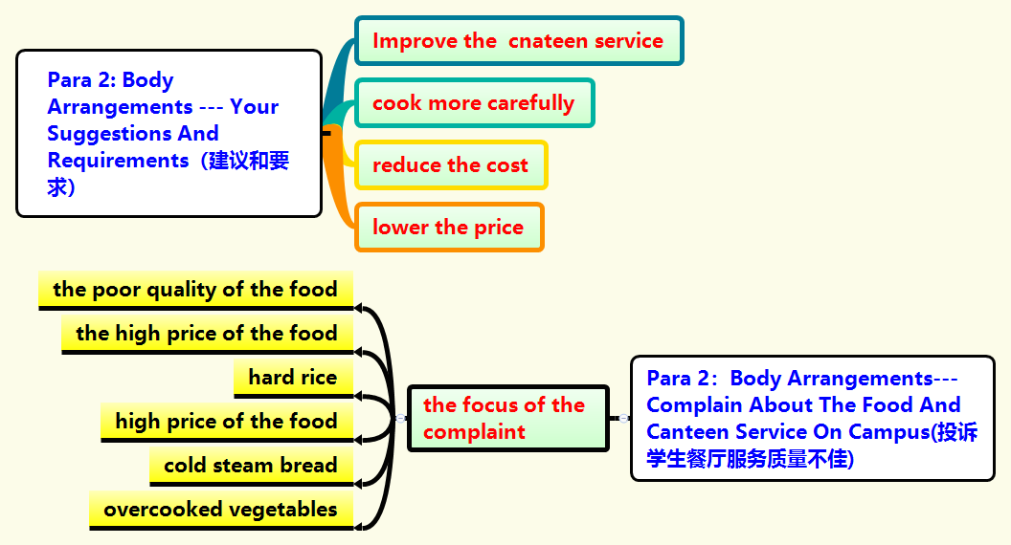
【投诉信1思维导图-投诉学生餐厅食品和服务质量不佳】

Slide 24

【投诉信1-投诉学生餐厅食品和服务质量不佳】
参考范文
A Letter to the President about the Canteen Service on Campus.
Dear Mr. President,
My name is LiHua, I am a student from Xinhua High School. I want to write you a letter about the canteen service on campus.
The focus of the complaint is the poor quality and high price of the food. For one thing, the rice is so hard, the price of the food is so high that many of us go out to dine. For another, the steam bread too cold，and vegetables overcooked. Honestly speaking, the canteen service is a little better than before. But the cooking staff need to do the cooking more carefully. Besides, the cost needs to be reduced to lower the price. All in all, there is still much room for improvement.
I do hope the service will be much improved very soon. Thank you for your time and kind consideration.
Sincerely yours
LiHua

Slide 25

投诉信题型训练2【投诉网购英文小说质量问题】
第一节:应用文写作（满分15分）(浙江金丽衢三市一模)
假如你是李华,一周前在某购物网站订购了一套英文小说,昨天收到货,发现少了几本,并且书本纸张粗糙,有异味。请你就此事给该网站客服写一封投诉邮件。内容包括:
1.投诉的原因:少货、质量差。
2.你的要求。
注意：1. 词数80左右。
2. 可以适当增加细节，以使行文连贯。
3. 开头语和结束语已为你写好。

Slide 26

投诉信2【投诉网购英文小说质量问题】
【写作提示】
1.投诉信是比较特殊的应用文,写作时要注意其特殊的表达语气。
2.投诉要涉及过去购买东西的经历以及现在的状况和未来的要求等多种语境,因此注意时态的多样性。

Slide 27
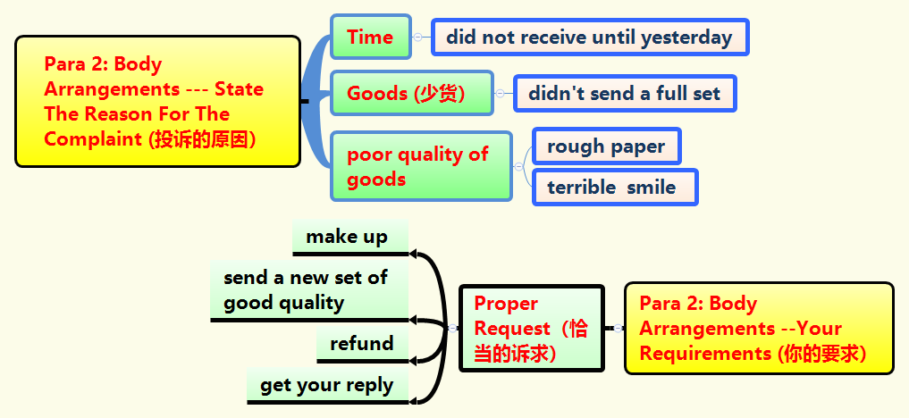
投诉信2思维导图【投诉网购英文小说质量问题】

Slide 28
投诉信2范文【投诉网购英文小说质量问题】
【Writing Sample：】One possible version:
To whom it may concern,
I am writing to complain about the English novels I bought on your website a week ago. When I received the package yesterday, I found you didn’t send me a full set. Worse still, the rough paper and the terrible smell from the books make me sick. I am really disappointed about it. I’d like you to make it up by sending me a full new set of good quality. If this requirement can’t be met, the refund is acceptable to me. I hope to get your reply as soon as possible.
Sincerely yours
LiHua

Slide 29
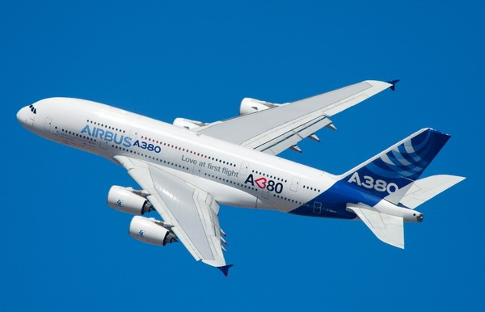
投诉信题型训练3【投诉航班糟糕的服务】
第一节:应用文写作（满分15分）
假定你是李华，昨天你乘飞机去伦敦，经历了一次不愉快的旅途，对航空公司的服务非常不满意。请你给航空公司写一封投诉信。要点如下：
1. 反映的问题：行李箱丢失，航班延误，航空食品差，服务员态度粗鲁。
2. 要求：改进并妥善解决。
注意：1. 词数80左右。
2. 可以适当增加细节，以使行文连贯。
3. 开头语和结束语已为你写好。

Slide 30
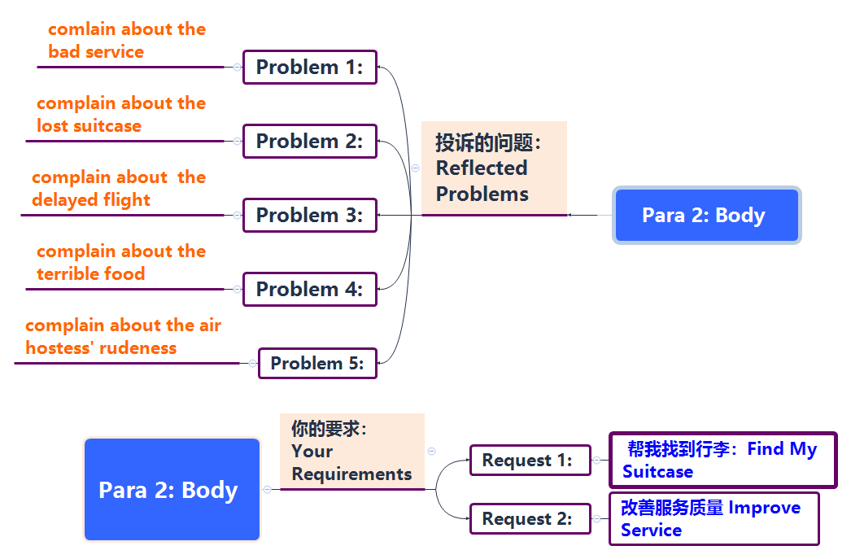
投诉信3思维导图【投诉航班糟糕的服务】

Slide 31
投诉信3范文【投诉航班糟糕的服务】
【Writing Sample：】One possible version:
Dear Manager,
My name is Li Hua. I’m writing to complain about the bad service on one of your flights.
Yesterday, I took a plane to London and I have to say that I’m very unhappy about the line. First of all, your airline lost one of my suitcases in which there is an important contract. Second, the plane was delayed for an hour. As a result, I was late for an important meeting. Third, the food on the plane was terrible. What’s most unacceptable is that the air hostesses on the plane were quite unfriendly and impolite. Frankly speaking, this is the worst experience I have ever had on the plane. I hope you can help me find my suitcase and improve your service.
Thank you very much.
Yours sincerely,
Li Hua

Slide 32

投诉信题型训练4【投诉商品劣质营业员态度粗暴】
第一节:应用文写作（满分15分）
假定你是李华， 你在一家商店购得劣质商品，遂与营业员交涉。但营业员对你态度粗暴，不予受理，为此你向经理写封投诉信反映情况，希望得到解决。
注意：1. 词数80左右。
2. 可以适当增加细节，以使行文连贯。
3. 开头语和结束语已为你写好。

Slide 33
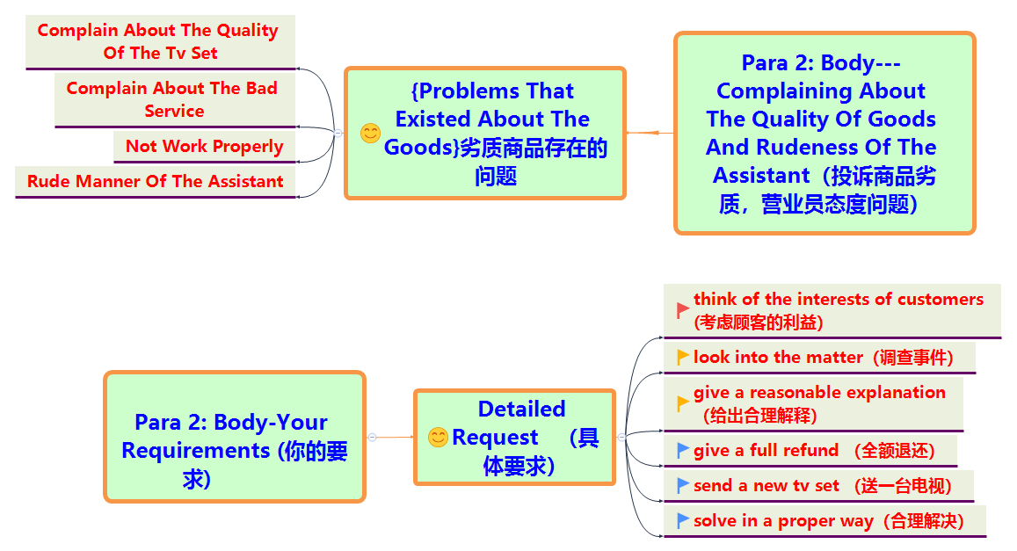
投诉信4思维导图【投诉商品劣质营业员态度粗暴】

Slide 34
投诉信4范文【投诉商品劣质营业员态度粗暴】---Possible version 1:
Dear Sir/ Madam,
Now I am writing to make a complaint about the TV set bought from your shop.
Several days ago, I bought a TV set in your shop, but when I brought it home and turned it on, I found it didn’t work properly. So I took it back to the shop and told the assistant what had happened. To my surprise, your assistant didn’t help me to solve the problem. On the contrary, he shouted at me rudely and refused to examine it. I know your shop enjoys a high reputation but, I am sorry to find that such poor service should have happened in your shop and your assistant didn’t seriously think of the interests of customers.
I do hope that you can look into this matter and give me a reasonable explanation by either giving me a full refund or sending me a new TV set. Thank you for your consideration and I am expecting an early reply.
Sincerely yours
LiHua

Slide 35
投诉信4范文【投诉商品劣质营业员态度粗暴】--Possible version 2:
Dear manager，
I feel bad to trouble you but I am afraid I have to make a complaint about your bad service.
I bought a TV set from your shop several days ago. A few days later, I found it didn’t work properly. To my shock, when I took it back to the shop, your assistant didn’t solve the problem but shouted at me rudely. Honestly speaking, I am sorry to find that such service should have happened in your shop.
It’s my sincere hope that the problem will be solved in an appropriate way. Looking forward to your reply.
Sincerely yours
LiHua

Slide 36

投诉信题型训练5【投诉新华书店买的英文词典质量问题】
第一节: 应用文写作（满分15分）
假如你是李华, 上周末你在重庆新华书店买了一本英文词典，发现有印刷错误、漏页等质量问题，后与书店交涉，要去调换，但营业员却拒绝你的要求。因此你给一家英语报社编辑写一封投诉信，信中必须包括以下内容：
事情的起因；
与书店交涉的经过；
呼吁服务行业(service trade)必须提高服务质量。
注意：1. 词数80左右。
2. 可以适当增加细节，以使行文连贯。
3. 开头语和结束语已为你写好。

Slide 37
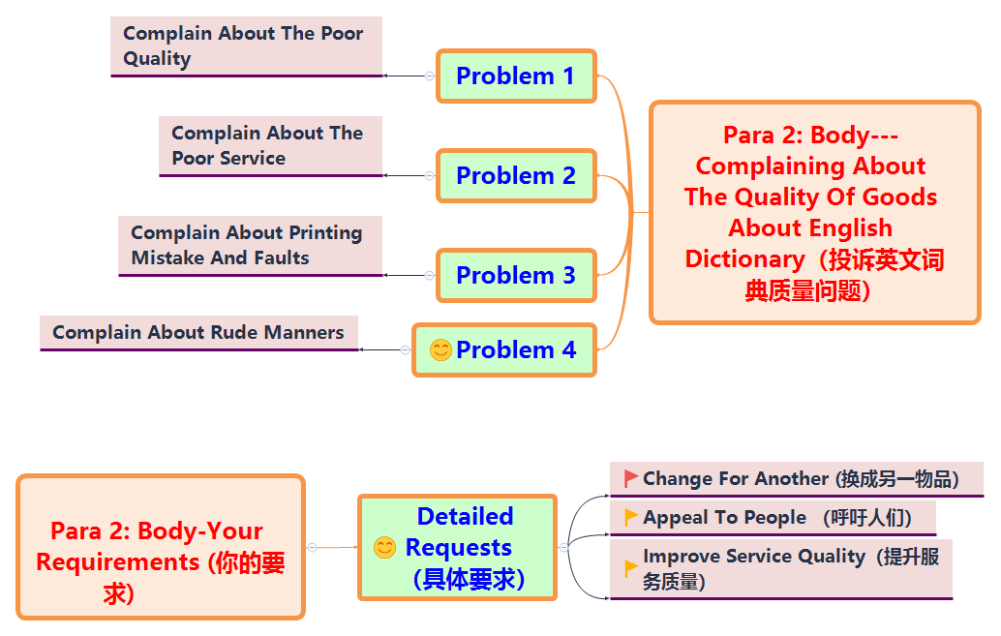
投诉信5思维导图【投诉新华书店买的英文词典质量问题】

Slide 38
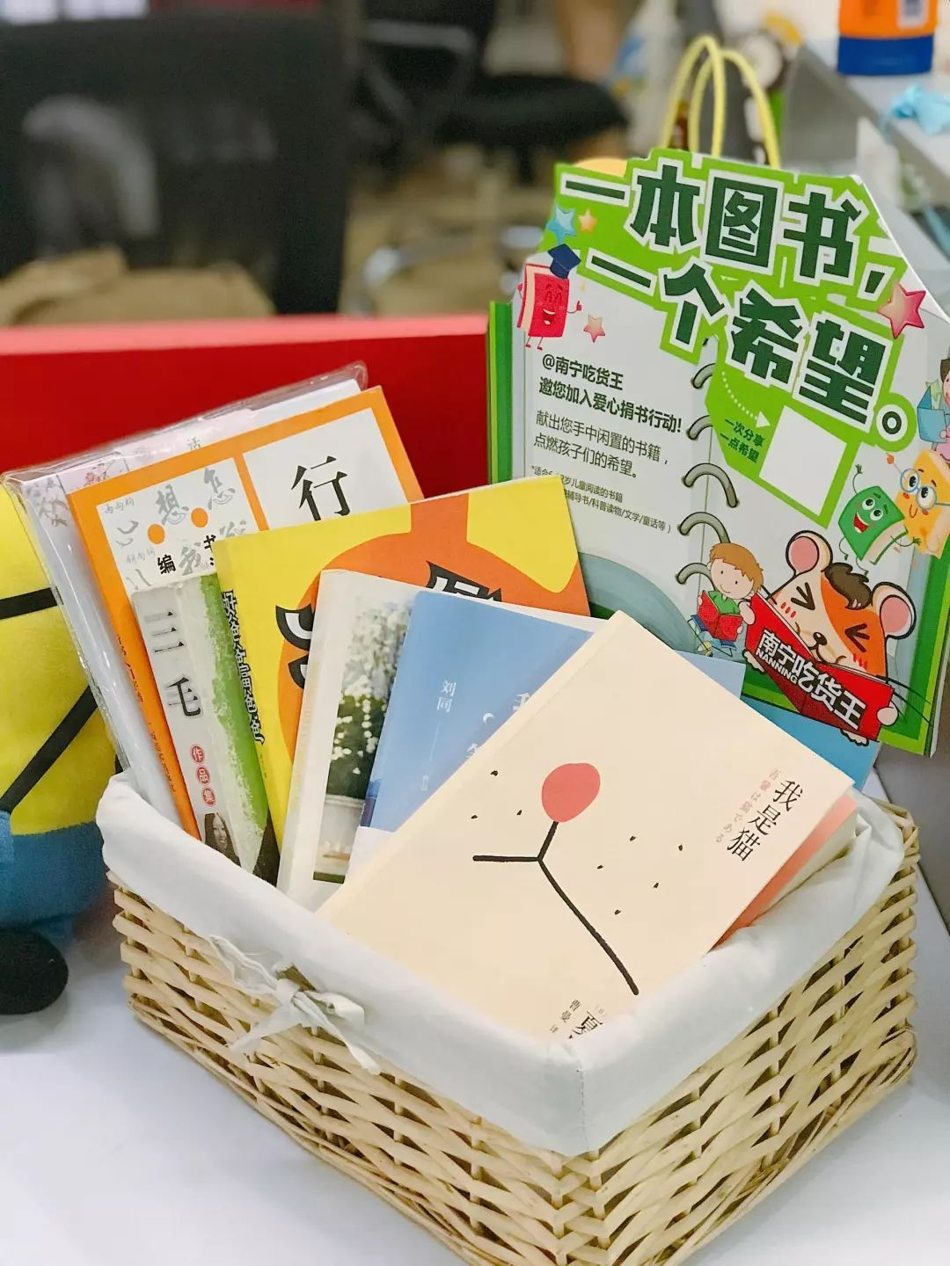
投诉信5范文【投诉新华书店买的英文词典质量问题】
【Writing Sample：】One possible Version:
Dear Editor,
My name is LiHua. I am a middle school student. I have some complaints to make about the poor service of Xinhua bookstore.
I went to the bookstore last weekend and bought an English dictionary. Unfortunately, I noticed some printing mistakes and faults in the dictionary and found it poor in quality, too. So I decided to change it for another one. As I discussed this matter with a clerk, she refused my request which made me very sad and angry. I think she was a bit rude to her customer.
My purpose of writing the letter is to appeal to people in the service trade to improve service quality. Only in this way can customers really have the feeling of being treated as “God”.
Best regards!
Sincerely yours
LiHua

Slide 39

投诉信题型训练6【投诉网购笔记本电脑及英文小说存在的问题】
第一节:应用文写作（满分15分）
假定你是李华，半月前你从国外网站上订购了一台笔记本电脑和一套英文小说，昨天才到货，且电脑不是你订购的型号，小说也有缺页现象。请就此向网店客服写邮件投诉，要点如下：
1. 介绍购物情况
2. 反映存在问题
3. 提出解决方案
注意：1. 词数80左右。
2. 可以适当增加细节，以使行文连贯。
3. 开头语和结束语已为你写好。

Slide 40
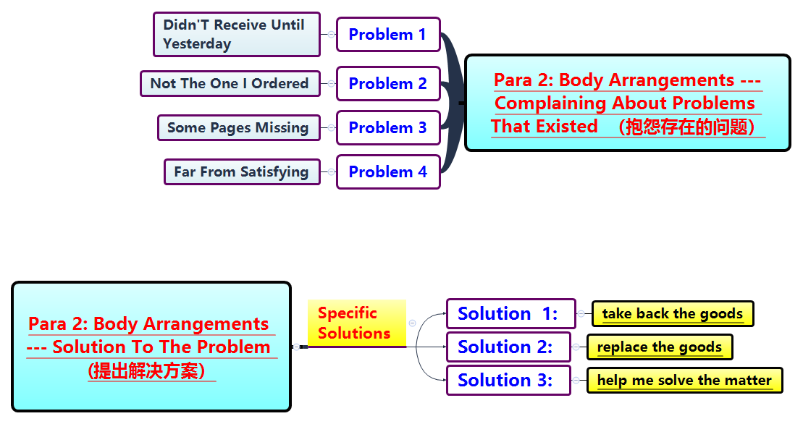
投诉信6思维导图【投诉网购笔记本电脑及英文小说存在的问题】

Slide 41

投诉信6范文【投诉网购笔记本电脑及英文小说存在的问题】
【Writing Sample：】One possible Version:
Dear Sir or Madam,
I am one of your customers. I am writing to make a complaint about your goods.
(介绍购物情况)To begin with, I ordered a notebook computer and a set of English novels on your website two weeks ago, but I didn’t receive them until yesterday. （反映存在问题）To my disappointment, the computer I received isn’t the one I ordered. To make matters worse, the books are far from satisfying, as I found some pages missing. （提出解决方法）Therefore， I hope you can solve the matter for me. I wonder if you can take back those you sent out and replace them. I would appreciate it if you could give due attention to this matter.
Looking forward to your reply.
Sincerely yours
LiHua

Slide 42
Thanks for attention！

