Slide 1
感恩遇见，相互成就，本课件资料仅供您个人参考、教学使用，严禁自行在网络传播，违者依知识产权法追究法律责任。
更多教学资源请关注
公众号：溯恩英语
知识产权声明

Slide 2
250410 衢丽湖联考客观题讲评
11/04/25
黄思渊

Slide 3
听力 1-5 CABAB
6-10 CCBBA
11-15 CABBA
16-20 ACCAC
阅读： A: DCA
B: CDBB
C: BAAD
D: DABC
七选五：DBEAF
完型： 41-45 BCDBC
46-50 DAACB
51-55 ACDBD
语法
featured
whose
have become
safer
to take
61. flying
62. on
63. the
64. As
65. influential

Slide 4
A篇主旨：介绍Mount Seymour Provincial Park的自然景观、活动项目及游客需遵守的规则，强调生态保护与安全意识。 Mount Seymour Provincial Park features 3,508 hectares and offers viewpoints overlooking Burrard Inlet, the city of Vancouver. The park has an extensive trail network, and many of the trails lead to notable park features and spectacular lookouts. Here are things to do and see while you are visiting.
Hiking
Mt Seymour has 14 hiking trails of varying difficulty and length, offering excellent wildlife viewing opportunities. Obey posted signs and stay on designated marked trails to decrease erosion and trail deterioration, so walking around freely is not allowed. Boardwalks may be slippery.
Mountain Biking
Mountain biking is permitted only on designated trails within the park boundary. Trail maps are available online and on kiosks (亭子) at each day-use area. Riders can enjoy the natural scenery along the trail, and it is the responsibility of the riders to know whether the trail they are riding is legal.
Fishing
Elasy Lake, accessed by trail only, can be fished but is not stocked. Sitting by the lake, the beautiful scenery is right in front of you. And anyone fishing or angling must have an appropriate license and anyone fishing overnight is encouraged to post emergency contact information but fires are not permitted anytime within the park.
Winter Recreation
Winter recreation opportunities include ski touring, downhill skiing and snowboarding. Park visitors interested in sightseeing or recreating in the Controlled Recreation Area managed by Mt Seymour must purchase a pass.
Mountain weather can change quickly. If you become lost or disoriented, stay where you are until the weather clears or you are found. Never leave the trail! Leave a trip plan with a friend in advance. Enjoy your time at Mount Seymour Provincial Park and help us preserve this beautiful natural space for future generations.
22. Who is advised to leave emergency contact information?
A. Anyone who fishes by the Elasy Lake.
B. Anyone who has an appropriate permit.
C. Anyone who fishes for the whole night.
D. Anyone who makes a fire and cooks there.

Slide 5
Language Bank
viewpoint 观景点
overlook 俯瞰
trail 路径；步道
notable 显要的
spectacular lookouts 令人惊叹的瞭望台
slippery 湿滑的
stocked 充足的
appropriate license 合法许可证
recreation 娱乐
disoriented 迷失方向的
in advance 提前
长句理解：
Park visitors interested in sightseeing or recreating in the Controlled Recreation Area managed by Mt Seymour must purchase a pass.
主句： "Park visitors... must purchase a pass"
后置定语：分词短语 interested in sightseeing or recreating... 修饰 visitors；过去分词短语 managed by Mt Seymour 修饰 Area。
想在由Mt Seymour管理的管控娱乐区内观光或游玩的游客必须购买通行证。

Slide 6
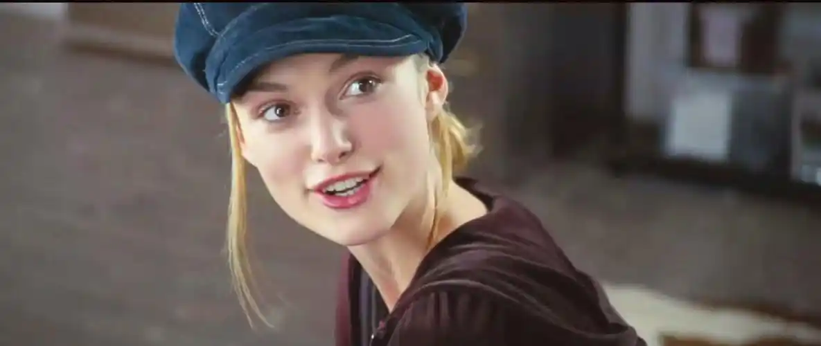
B篇主旨：通过凯拉·奈特莉的职业生涯与个人反思，探讨“过早成名对青少年的负面影响”这一社会议题。
Keira Knightley, a British actress, has undoubtedly left an indelible mark on the film industry. With her strikingly delicate yet expressive features, she is famed for roles in films like Pirates of the Caribbean series and Atonement, starting her acting career at a young age and achieving significant success in the film industry. But she may have gotten her start in Hollywood too early.
At age 16, the London-born actress appeared in the unexpected 2002 box-office hit Bend It Like Beckham. She soon found herself in near-constant demand, in both the U. K. and the U. S. “I had a five-year period between the ages of 17 and 21-ish, and I’m never going to have that kind of success again,” says Knightley, now 39. Knightley admits that this period of intense success is unlikely to happen again.(24题) She also expresses her sadness about the loss of privacy during her teenage years. “It’s very cruel to have your privacy taken away in your teenage years.”
para1:简要介绍凯拉·奈特莉的演艺生涯成就，并引出“过早进入好莱坞可能带来的问题”这一核心话题。
para2:以《我爱贝克汉姆》为例，描述凯拉·奈特莉青少年时期的爆红及其对隐私丧失的遗憾。

Slide 7
Reflecting on her role in 2003’s Love Actually, she considers it inappropriate for her age. In one scene, her newly married character opens the front door to her husband’s best friend, played by Andrew Lincoln, then 30, who conveys his love to her with a series of cue cards. Moved as she is, in the end, she rejects his love. While filming the scene, director Richard Curtis told her to stop reacting as if the gesture was inappropriate. “And I’m like, ‘but it is quite strange.’ Also, I knew I was 17. It only seems like a few years ago that everybody else realized I was 17.”
Having started acting professionally at 6, Knightley is hesitant to let her daughters, aged 9 and 5, follow the same path. Interestingly, they haven’t shown an inclination either. “One wants to be a sweet-shop owner,” she says. “The other one a bear. I don’t think that’s going to work, but personally speaking, premature fame is not necessarily a good thing.”
para3:通过《真爱至上》的角色反思年龄与表演内容的冲突，强调角色与演员真实年龄的不匹配。
para4:凯拉·奈特莉对子女职业选择的态度，明确反对过早成名，并借子女的愿望表达对童星现象的反思。
实际年龄与角色设定的冲突、剧情的伦理争议以及个人价值观与职业要求的撕裂，让Keira Knightley感到不适，故选D。
25. Why did Knightley feel uncomfortable in her scene in Love Actually?
A. It misrepresented young love. B. It didn’t match her acting age.
C. It stressed the age gap with the actor. D. It was a bit mature for her young age.
What made Knightley unwilling for her daughters to be actresses?
A. The same repetitive life. B. Her first-hand experience. 她的亲身经历
C. Their lack of acting skills. D. The competitive film industry.

Slide 8
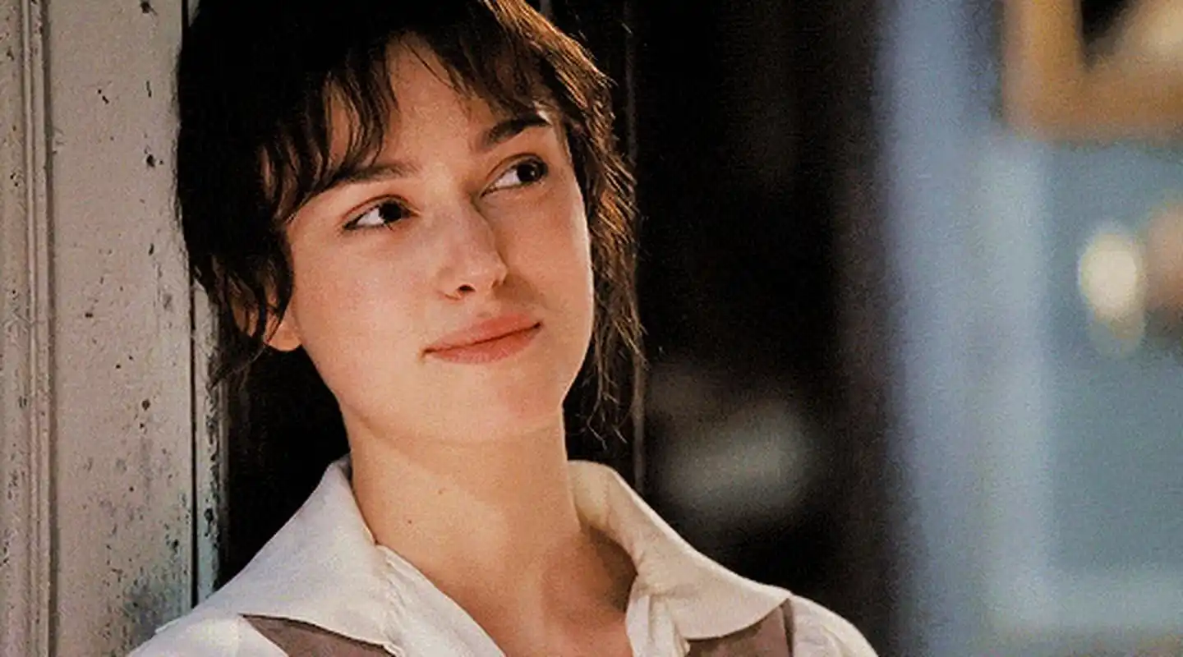
Language bank
cruel 残忍的
inclination 倾向
premature 过早的
27题：
a drama script 话剧剧本
autobiography 自传
（biography 传记）
indelible 不可磨灭的
be famed for 因…而闻名
box-office hit 票房大片
near-constant 几乎不停的
intense success 很大的成功
loss of privacy 隐私的丧失
长句理解：
With her strikingly delicate yet expressive features, she is famed for roles in films like Pirates of the Caribbean series and Atonement, starting her acting career at a young age and achieving significant success in the film industry.
凭借精致而富有表现力的面容，她因出演《加勒比海盗》系列和《赎罪》等影片闻名，自幼开启演艺生涯并在电影界取得巨大成功。
In one scene, her newly married character opens the front door to her husband’s best friend, played by Andrew Lincoln, then 30, who conveys his love to her with a series of cue cards.
主句："her character opens the door..."；"played by..." 修饰 friend；同位语 "then 30" 补充年龄；
在一场戏中，她饰演的新婚妻子为丈夫的挚友（时年30岁的安德鲁·林肯饰）开门，对方用纸板写下情话示爱。

Slide 9
C篇 通过CDC研究揭示H5N1禽流感可能未被充分监测的传播风险，结合专家观点探讨其科学意义与社会警示。说明文。
As the proverb says, a straw shows which way the wind blows. A new study published by the U.S. Centers for Disease Control and Prevention (CDC) shows that the H5N1 bird flu virus is probably circulating undetected in domestic animals in many parts of the country and may be infecting unaware vets (兽医).
In the health agency’s Morbidity and Mortality Weekly Report, a group of researchers from the CDC, the Ohio Department of Health and the American Association of Bovine Practitioners reported the results of analysis they conducted on 150 cow vets from 46 states and Canada. They found that three of them had antibodies for the H5N1 bird flu virus in their blood. However, none of the infected vets recalled having any symptoms, including conjunctivitis, or pink eye, the most commonly reported symptom in human cases. （29题）
Seema Lakdawala, a virologist at Emory University in Atlanta, who was not involved in the research, said she was surprised that only 2% of the vets surveyed tested positive for the antibodies, considering another CDC study showed that 17% of dairy workers sampled had been infected. But she said she was even more surprised that none of them had known they were infected or that they had worked with infected animals.
para1 :通过谚语引出主题，指出美国CDC最新研究表明H5N1禽流感病毒可能在未被察觉的情况下传播，并可能感染未察觉的兽医。
para2:详细描述CDC的研究方法、样本范围及结果（3名兽医携带H5N1抗体但无症状）
para3:引用专家观点，表达对低感染率与无症状现象的惊讶，对比其他研究数据。
30. What surprised Seema Lakdawala the most?
A. The infected vets’ unawareness of the issue. B. The 17% infection rate among dairy workers.
C. The high number of positive test results in vets. D. The risk of unrecognized infections in cows and vets

Slide 10
para4:专家强调血清检测的重要性，并提出加强兽医防护措施的建议。
para5:另一专家评价研究结果的双面性（疫情可能被低估但感染未广泛扩散）。
para6:科学家指出当前研究的局限性，呼吁后续跟进研究。
“These surprising results indicate that serum surveillance (血清检测) studies are important to inform risk of infections that are going unnoticed,” she said. “Vets are on the front line of the outbreak, and increased biosafety practices like respiratory and eye protection should reduce their exposure risk.”
Jennifer Nuzzo, director of the Pandemic Center at Brown University, described the study as “good and bad news study.” “On the one hand, we see concerning evidence that there may be more H5N1 outbreaks on farms than being reported,” she said. “On the other hand, I’m reassured that there isn’t evidence that infections among vets have been widespread.”
However, John Korslund, a U.S. Department of Agriculture scientist, said that finding H5N1 antibodies in the blood of vets was an “interesting but very imprecise way to measure state cattle incidence, so we need follow-up study.”
31. What aspect should be improved in the follow-up study?
A. The size of the tested group.
B. The individual samples.
C. The data analysis procedure.
D. The measuring method.

Slide 11
Language bank
on the front line 在前线
outbreak 爆发
reassured 放心的
imprecise 不精确的
circulate 传播；循环
undetected 未被发现的
domestic 家养的；国内的
1. Seema Lakdawala, a virologist at Emory University in Atlanta, who was not involved in the research, said she was surprised that only 2% of the vets surveyed tested positive for the antibodies, considering another CDC study showed that 17% of dairy workers sampled had been infected.
主句："Seema Lakdawala... said..."（含同位语 a virologist... 和定语从句 who was...）；宾语从句："she was surprised that..."；原因状语："considering..."（引导对比数据，含宾语从句 showed that...）。
未参与此项研究的亚特兰大埃默里大学病毒学家Seema Lakdawala表示，考虑到另一项CDC研究显示17%的抽样奶农被感染，仅有2%的受调查兽医抗体检测呈阳性让她感到惊讶。
2. John Korslund, a U.S. Department of Agriculture scientist, said that finding H5N1 antibodies in the blood of vets was an “interesting but very imprecise way to measure state cattle incidence, so we need follow-up study.”
主句："John Korslund... said that..."（含同位语 a... scientist）; 宾语从句："finding... was a way..."（动名词作主语）；结果状语从句："so we need..."。
美国农业部科学家John Korslun表示，发现兽医血液中的H5N1抗体是“一种有趣但极不精确的测量每个州牛群感染率的方式，因此需要后续研究”。

Slide 12
D篇 说明文。 解析OpenAI架构重组背后的商业逻辑与行业影响，探讨非营利与营利模式在科技领域的平衡。
OpenAI, the company behind the artificial intelligence tool ChatGPT, has set out restructuring plans 重组计划 to make it easier for it to raise money and remove restrictions made by its non-profit parent (母公司).
OpenAI reveals its for-profit 以盈利为目的的 unit would become a public benefit corporation, a company required to consider the interests of society as well as shareholder (股东) value (32题). The non-profit parent would have “a significant interest” in the public benefit corporation, OpenAI said in a blog-post, adding that it would be one of the “best resourced non-profits in history.”
OpenAI has been looking to make changes to its rules to make it easier for investors to profit when they inject new investment into the firm. OpenAI was founded in 2015 as a research-focused non-profit but created a for-profit unit four years later to secure funding for the high costs of AI development. Its unusual structure gave control of the for-profit unit to the non-profit.
para1:总述OpenAI重组计划的目标（简化融资、解除母公司限制）。
para2:说明营利部门转型为"公益公司"的具体架构调整。
para3:回溯OpenAI从非营利到营利架构转变的历史背景。
[解决35题时要充分理解本段所说的重组目标]

Slide 13
para4:回溯OpenAI从非营利到营利架构转变的历史背景。
para5:引用OpenAI声明，解释架构改革的必要性。
para6:分析师评价与竞争对手动态。
A $6.6 billion fundraising by OpenAI, which valued it at $157 billion, was conditional on it being able to remove a profit limit and move towards being a more conventional company.
“We again need to raise more money than we’d imagined. Investors want to back us but they need conventional equity (股东权益) and a less unique structure,” OpenAI said. “The hundreds of billions of dollars that companies are investing into AI show what it will take for OpenAI to continue pursuing the mission.”
“This is the critical step the company needs in order to continue fundraising,” said Gil Luria, analyst with DA Davidson & Co. The key to the announcement, he said, was that the non-profit side of OpenAI “will run and control OpenAI’s operations and business.” For its AI competition, it’s a different matter. Musk, an OpenAI co-founder, is trying to preclude (阻止) the plan, as is Meta Platforms, which is developing a competitor against ChatGPT named Meta AI.
33. Why does OpenAI believe it needs to restructure its operations in paragraph 5?
A. To attract more investors and simplify the structure.
B. To push forward its development goals on AI safety.
C. To settle conflicts with its non-profit parent organization.
D. To prevent competitors from taking control of its operations.
34. What does the underlined word “preclude” in paragraph 6 mean?
A. Design. B. Prevent. C. Back. D. Follow.

Slide 14
Language bank
restructuring plans 重组计划
raise money 融资
restrictions 限制
secure funding 获得资金
conventional company 传统公司
critical step 关键步骤
1. OpenAI, the company behind the artificial intelligence tool ChatGPT, has set out restructuring plans to make it easier for it to raise money and remove restrictions made by its non-profit parent (母公司).
主句："OpenAI... has set out restructuring plans"（主语含同位语 the company... ChatGPT）；目的状语："to make it easier... and remove restrictions"（不定式短语表目标）；后置定语："made by its non-profit parent"（过去分词短语修饰 restrictions）。
ChatGPT的开发者OpenAI公司公布了重组计划，旨在简化融资流程并解除其非营利母公司制定的限制。
2. Musk, an OpenAI co-founder, is trying to preclude the plan, as is Meta Platforms, which is developing a competitor against ChatGPT named Meta AI.
主句："Musk... is trying to preclude..."（含同位语 co-founder）；类比倒装结构："as is Meta Platforms"（表“同样地”）；定语从句："which is developing..."（修饰Meta，说明竞争产品）。
OpenAI联合创始人马斯克正试图阻止该计划，Meta Platforms也持相同立场——后者正在开发名为Meta AI的ChatGPT竞品。

Slide 15
Ugh! You swear you had your keys a second ago, and now they’re just gone! Before you panic, take a deep breath. 36 Losing things is a part of life, but finding them doesn’t have to be a nerve-wracking rush. In this article, we’ll teach you where you can look and how you can retrace your steps to find lost objects.
Identify what makes your missing object stand out in its environment. Is it big, color, texture or shape. 37 It will make the process faster and more efficient. Instead of looking at everything in a space, this approach helps you focus your attention only with that distinction.
Look in places where you’ve lost this item before. Do you tend to lose your keys or student cards often? If so, it may have ended up in a similar place as before. Think about where your common lost objects tend to be lost. For example, maybe you have a habit of leaving your keys in the lock or your bag in the car. 38
D
七选五
B
Language bank
swear 发誓
take a deep breath 深呼吸
nerve-wracking 伤脑筋的
rush 匆忙；情绪迸发
retrace 追溯
stand out 突出；显眼
distinction 特点
end up 最终落得
E
A. Or sit where you were standing.
B. Then search based on that unique feature.
C. Look in the messiest areas of your living space.
D. Everyone misplaces things every now and again 有时候；间或.
E. Check those places before extending your search.
F. The best thing you can do to avoid losing things is be organized.
G. Thinking about the last time you saw it helps you retrace your steps.

Slide 16
Try looking at the room from a new angle. If you’ve retraced your steps, gone through all the motions, and still haven’t found anything, change your perspective. Crawl instead of walking down the hall. 39 Seeing things from a different point of view can help you notice details you may have missed before.
40 Scattered and crowded areas make it easier to lose objects, as things can fall under other things or get buried beneath piles. Regularly clean and tidy up living spaces, so you won’t have to spend more time looking for things later on.
Language bank
motion 移动；动作
change your perspective
改变角度
crawl 爬行
scattered 零散的
get buried beneath piles
被埋在一大堆东西之下
organized 有条理的
A
F
A. Or sit where you were standing.
B. Then search based on that unique feature.
C. Look in the messiest areas of your living space.
D. Everyone misplaces things every now and again.
E. Check those places before extending your search.
F. The best thing you can do to avoid losing things is be organized.
G. Thinking about the last time you saw it helps you retrace your steps.

Slide 17
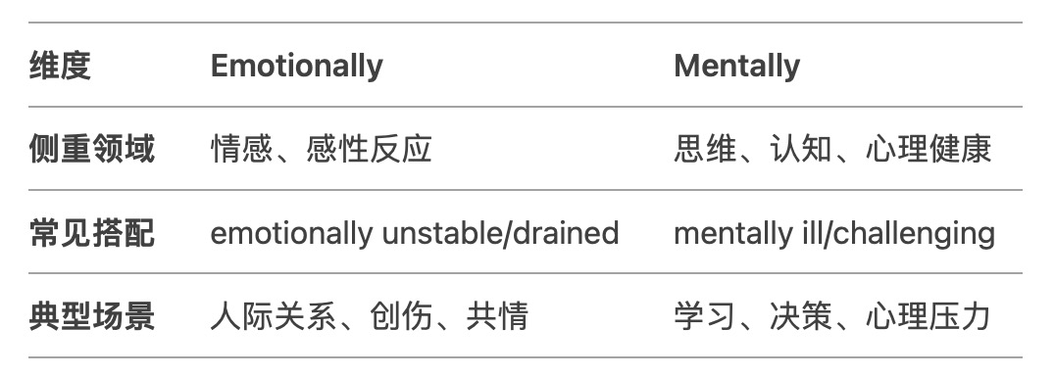
完形填空
George White, 77, may look like an ordinary grandfather at a family reunion—until you learn he calls 200 people his “children.” “They’re not biologically my kids, but 41 White told the local news outlet.
That is how 42 he became and still is to the students who 43 his school bus, a job he held for 27 years before he retired. Yet, driving a bus was never his 44 plan. In 1990, he fell off a roof while working outdoors. After that, he intended to 45 a job closer to the ground. However, he said no job has ever 46 him higher. “It’s the children.” White said. “And being in a position where you can love kids every single day is a 47 position to be in.”
A. personally B. emotionally C. mentally D. socially
A. exposed暴露的 B. committed尽心的 C. attached 热爱…的 D. accustomed习惯的
A. drove B. missed C. repaired D. rode （ride the bus 乘坐大巴）
A. realistic B. original C. subsequent D. previous
A. offer B. perform C. seek D. quit
A. held B. pushed C. promoted D. lifted
A. lovely B. tricky C. suitable D. challenging

Slide 18
根据后文提到former students回来重聚可知，他的付出是得到了学生的回应的
The positive feeling was 48 by so many of the kids on his bus over the years. One of his former students, Kaitlyn Hare, cited that he just made everybody feel safe, loved and cared for. It is a 49 so strong that even though George retired years ago, former students 50 recently for one last ride. “They’re finding their 51 that they had 20 years ago.” White said. “And now even their children are sitting on their laps. And that kind of feeling is a wonderful thing.”
What was White’s secret to developing this 52? “He only had two 53 on the bus,” another former student, Louis Castellano, said. “Show everyone love, and show respect.” It’s a lesson many of them now 54 with them.
“I’m convinced that when you love and respect people, that’s what you’re going to get back.” White said. That is how one man’s unexpected path became 200 lives’ 55.
48. A. returned B. inspired C. judged D. hidden
49. A. symbol B. character C. bond 纽带，联系 D. tone
50. A. graduated B. gathered C. communicated D. developed
51. A. seats B. wallets C. puzzles D. jobs
52. A. strategy B. skill C. affection D. curiosity
53. A. bans B. options C. records D. rules
54. A. turn to B. carry through 贯彻；坚持到底 C. keep up 跟上；保持联系 D. search for
55. A. career B. dream C. position D. compass 指南针；罗盘

Slide 19
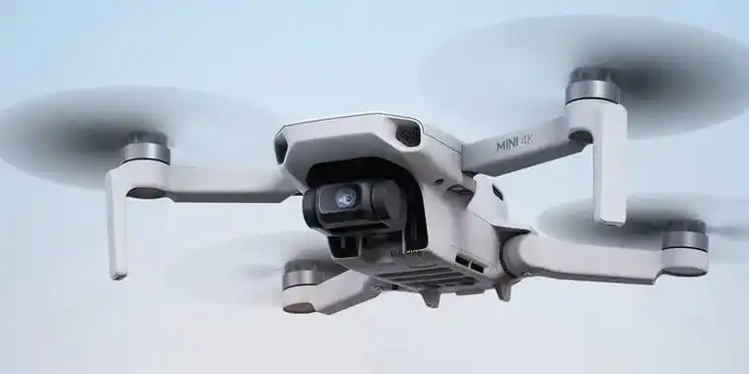
语法填空 文章主要介绍了无人机表演在娱乐领域的应用及其发展趋势。
On January 28, 3,000 drones (无人机) performed a stunning light show in Chongqing during the Spring Festival Gala. The show, organized by Damao Intelligent Control Technology, 56 (feature) patterns of famous landmarks and flowers across the night sky.
Despite challenges such as unpredictable weather and signal interference, the team, 57 average age is 27, delivered a flawless performance. Most of the team members specialize in drone technology, while others are enthusiasts recruited by the company.
In recent years, drone performances 58 (become) a major trend in entertainment. Compared to traditional fireworks, drones are 59 (safe) and less polluting. Advancements in technology have made larger-scale performances possible. Damao’s third-generation drones are designed 60 (take) off from a compact box, saving space, while the fourth-generation models charge automatically. In 2023, the company set two Guinness World Records by 61 (fly) 10,197 drones simultaneously.
featured
主句
whose
have become
safer
to take
flying

Slide 20
put emphasis on
Competition is shifting from technology to creativity, as the industry grows, with a greater emphasis 62 storytelling and cultural elements. Beyond entertainment, drones are also fueling 63 low-altitude economy, with widespread use in logistics, agriculture, and emergency rescue.
64 is expected by industry experts, drone shows are going to become even more spectacular, with continuous technological progress. China’s drone industry continues to grow globally, setting new standards and reinforcing its 65 (influence) position in aerial technology.
on
the
低空经济（Low-altitude Economy）是一种新型的综合性经济形态。它以低空飞行活动为核心，以有人或无人驾驶飞行、低空智联网等技术组成的新质生产力与空域、市场等要素相互作用，带动低空基础设施等发展。
正如行业专家所预料的那样，随着技术的不断进步，无人机表演将变得更加壮观。
Language Bank
a stunning light show 令人震撼的灯光秀
flawless 完美无瑕的
enthusiast 爱好者
recruit 招募
fuel 刺激
As
influential
As 作关系代词
引导非限制性定语从句（As is expected by...），指代整个主句的内容（即"无人机表演将更壮观"这一事实）。
在从句中充当主语。
表达主句内容符合某种预期或共识，类似中文的"正如……"。

Slide 21
Thanks!

