Slide 1
感恩遇见，相互成就，本课件资料仅供您个人参考、教学使用，严禁自行在网络传播，违者依知识产权法追究法律责任。
更多教学资源请关注
公众号：溯恩高中英语
知识产权声明

Slide 2
M3U1
Festivals around the world
New Words and Expressions

Slide 3
重点单词
religious
1. ________ adj. 宗教上的;信奉宗教的;虔诚的
2. ________ n. 信任;信心;信仰
3. ________ n. 诡计;恶作剧;窍门 vt. 欺骗;诈骗
4. ________ vt.获得;得到
5. ________ vt. & vi. & n. 搜集;集合;聚集
6. ________ n. 奖;奖品 vt. 授予;判定
7. ________ vt.赞美;钦佩;羡慕
8. ________ n. 许可;允许
9. ________ vi. 道歉;辩白
10.________ adj. 明显的;显而易见的
11. ________ vt. 提醒;使想起
12.________ n. & vt. & vi. 收获;收割
belief
trick
gain
gather
award
admire
permission
apologize
obvious
remind
harvest

Slide 4
重点单词
starve
13. ________ vi. & vt. (使)饿死;饿得要死
14. ________ n. 起源;由来;起因
15. ________ n. 独立;自主
16. ________ adj.充满活力的;精力充沛的;积极的
17. ________ vt. 擦;揩;擦去
18. ________ vi. (______, _____) 哭泣;流泪
19. ________ vt. (________, _______) 原谅;饶恕
20. ________ n. 悲哀, 悲伤
21. ________ n. 基督徒;信徒 adj. 基督教的;信基督教的
22.________ n. 衣服
23. ________ n. 农业;农艺;农学
24.________ n. 到来;到达;到达者
origin
independence
energetic
wipe
weep
wept
wept
forgive
forgave
forgiven
sadness
Christian
clothing
agriculture
arrival

Slide 5
派生单词
1. _________ n. 起源;由来;起因 _________ adj. 原来的；起初的
2. _________ adj. 宗教上的;信奉宗教的 _________ n. 宗教；宗教信仰
3. _________ n. 信任;信心;信仰 _________ v. 相信；认定
4. _________ n. 到来;到达;到达者 _________ v. 到达
5. _________ n. 农业;农艺;农学 _________ adj. 农业的;农艺的
6. _________ vt. 赞美;钦佩;羡慕 _________ adj. 值得赞赏的
7. _________ adj.充满活力的;精力充沛的 _________ n. 能源；能量；精力
8. _________ n. 许可;允许 _________ v. 允许；准许
9. _________ vi. 道歉;辩白 _________ n. 道歉；辩护
10.________ adj. 明显的;显而易见的 _________ adv. 显然；明显地
origin
original
religious
religion
belief
believe
arrival
arrive
agriculture
agricultural
admire
admirable
energetic
energy
permission
permit
apologize
apology
obvious
obviously

Slide 6
重点短语
take place
1. ________________ 发生
2. ________________ 纪念;追念
3. ________________ 盛装;打扮;装饰
4. ________________ 搞恶作剧;诈骗;开玩笑
5. ________________ 期望;期待;盼望
6. ________________ 日夜;昼夜;整天
7. _______________ 好像
8. _______________ 玩得开心
9. _______________ 停车场
10._______________ 出现;到场
11._______________ 守信用;履行诺言
12._______________ 屏息;屏气
13._______________ 使……想起……
in memory of
dress up
play a trick on
look forward to
day and night
as though
have fun with
parking lot
turn up
keep one’s word
hold one’s breath
remind ... of ...

Slide 7
词义释义
____________ clothes, especially a particular type of clothes
____________ to suffer or die because you do not have enough food to eat
____________ based on or believing the teachings of Jesus Christ
____________ a large or special meal, especially for a lot of people and to celebrate something
____________ the act of allowing somebody to do something, especially when this is done by somebody in a position of authority
____________ the act of cutting and gathering crops
____________ the science or practice of farming
clothing
starve
Christian
feast
permission
harvest
agriculture

Slide 8
话题词汇
Obon, Columbus Day, Halloween, carnival, Easter, Valentine’s Day
Names of festivals
celebration, harvest, feast, dress up, play a trick on, award, produce, parade, custom, incense, grave, have fun with, custom
How festivals are celebrated
How festivals began
in memory of, independence, origin

Slide 9
美句赏析
Gather
______ the flowers, but spare the buds. ---Andrew Marvell
Believe that life is worth living and your ______ will help create the fact.
---William James
You don't _____ by falling into water. You only _____ if you stay there. ---Zig Ziglar
Fear not for the future, _____ not for the past. ---Percy Bysshe Shelley
When you ______, you in no way change the past - but you sure do change the future. ---Bernard Meltzer
belief
drown
drown
weep
forgive

Slide 10
遣词造句
Group 1: celebration; in memory of; ancestors
Group 2: belief; gain; independent
Group 3: gather; admire; parade
Group 4: as though; have fun with; dress up
Group 5: apologize; keep one's word; turn up
A lot of celebrations are in memory of ancestors, some of whom made a great contribution to the society.
It is his belief that one can gain nothing if he is not independent.
We gather here to admire the most amazing parade in the world.
They dressed up and had fun with each other as though they were old friends for years. .
He apologized to her for not keeping his word and not turning up on time.

Slide 11
核心词汇
1. trick
n. & v.
将例句中trick相关表达与右侧相应的意思匹配
She was tricked out of her life savings.
The girls were playing tricks on their teacher.
He didn't really lose his wallet - that's just a trick.
He tricked me into lending him $ 100.
花招，骗局，诡计
从某人处骗走某物
搞恶作剧
诱使某人做某事

Slide 12
Quiz
翻译
1. 孩子们经常耍些花招戏弄老师.
The kids are always playing tricks on their teacher.
2. 他的家人骗他去了美国。
His family tricked him into going to America.
3. 她被骗了20万美元。
She was tricked out of $200,000.

Slide 13
核心词汇
2. gather
v.
猜测不同例句中gather可能的意思。
A crowd soon gathered.
聚集，聚合
Police have spent months gathering evidence.
收集
I gather from your letter that you are not enjoying your job.
猜测；认为
The truck gathered speed.
增加（速度、力量等）

Slide 14
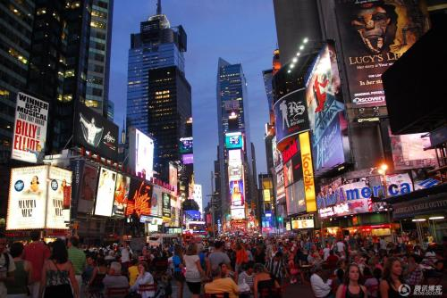
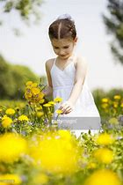
Quiz
根据图片写句子
A lot of people gathered in Times Square to count down to the new year.
The girl is gathering flowers.

Slide 15
核心词汇
3. apologize
v.
根据例句推出apologize的短语
I think you should apologize to your brother.
He later apologized for his behaviour.
I apologized for losing my temper.
apologize to sb;
apologize for sth/doing sth
派生词
apology n. 道歉

Slide 16
Quiz
改错
我为迟到感到歉意。
I apologize to be late.
I apologize for being late.

Slide 17
核心词汇
4. remind
v.
利用例句找出remind可能的用法
remind sb to do sth
提醒某人做某事
Remind me to buy some milk tonight.
Mrs Welland reminded her son that they still had several people to see.
That song always reminds me of our first date.
remind sb that 提醒某人...
remind sb of 使某人想起

Slide 18
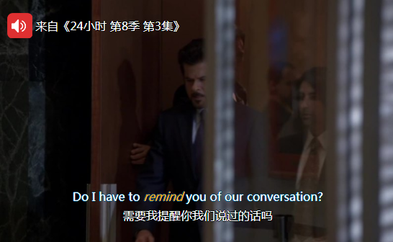
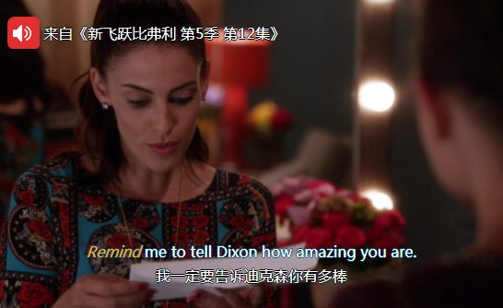
Quiz
台词翻译

Slide 19
核心词汇
5. gain
v.
翻译gain相关的短语
The country gained its independence ten years ago.
I've gained weight recently.
We are hoping to gain a better understanding of the process.
My watch gains two minutes every 24 hours.
His books have gained in popularity in recent years.
获得独立
体重增加
对...有更多了解
快两分钟
越来越受欢迎

Slide 20
Quiz
名言翻译
一个人也许知道如何取得胜利，但是不知道如何去使用。
One may know how to gain a victory, and know not how to use it. (by Pedro Calderon de la Barca)
人生有两种悲剧，一种是失去了心中想要的东西；另一种是得到了心中想要的东西。
There are two tragedies in life. One is to lose your heart's desire. The other is to gain it. (by George Bernard Shaw)

Slide 21
即学即用
April Fools’ Day, which falls on April 1st, has been _________ for several centuries by different cultures. On this day, people do not need to __________ like they do on Halloween, nor do they need to parade on the street ___________. It is a day when people ____________ each other and they need not _________ for it. The simplest jokes may involve children who tell each other that their shoelaces are undone and then cry out “April Fool!”. The _____ of April Fools’ Day probably points to the introduction of the Gregorian calendar in the 16th century. People who forgot about the change or followed the old rules were ______ by others. Through centuries, people have ______ a lot of fun from the day.
celebrated
dress up
day and night
play a trick on
apologize
origin
fooled
gained

Slide 23
The End
右键点击结束放映

Slide 24
The End
右键点击结束放映

Slide 25
感恩遇见，相互成就，本课件资料仅供您个人参考、教学使用，严禁自行在网络传播，违者依知识产权法追究法律责任。
更多教学资源请关注
公众号：溯恩高中英语
知识产权声明

