Slide 1



2025年6月高考备考
靶向高考，应用文雷霆一击
浙江省常山一中
吴俊峰

Slide 2

语篇的外貌：
格式正确，拼写无误
—— 较多的低水平失误将导致一键式评分（9分以下）
表意清楚，语法无误，句型正确，地道自然
语篇的价值意蕴、情感策略及优化措施
1
Part

Slide 3
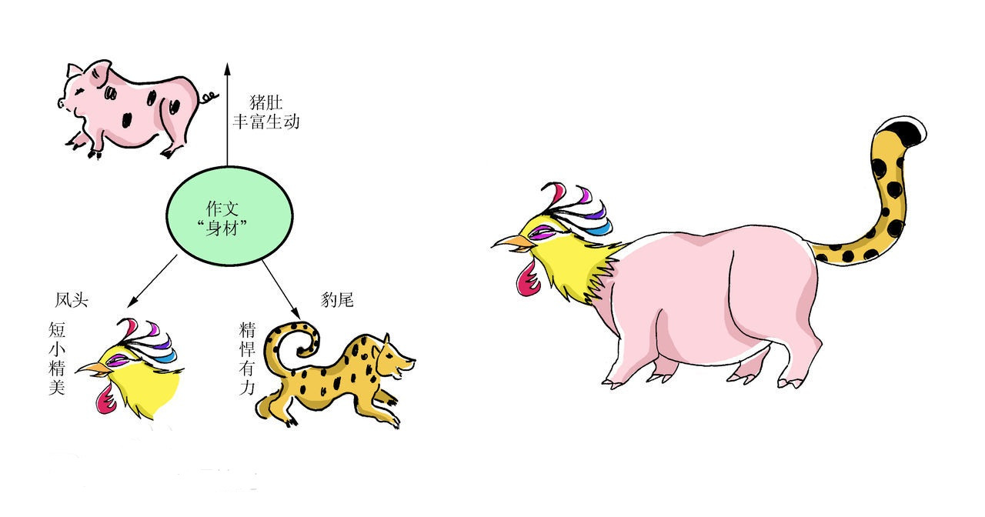
应用文写作中首尾段的价值意蕴、情感策略及优化措施
在应用文写作中，“首尾段”是保障文章完整性的重要部分。开头段是评卷者细读信息的源头，是考生给评卷者留下第一印象的“咽喉要地”。尾段能满足阅卷老师的期待。
高考中的应用文写作属于竞技色彩浓郁的“生存性写作”，“评卷者之反应”是决定一篇应用文得分的关键因素。因此，从“评卷者”视角来分析，应用文写作中的首尾段的好坏决定第二印象，不容出现低级错误，且较好地体现交际效应（既有客套语句，又有真实情感交流）。
虎头、豹尾、猪肚
Notes:
联系 系统 真实挑战
应用 迁移
大概念不是法则，从左到右，先算个位后算十位，从低位到高位。 乘除法规则运算：先分后合
最核心的是什么？
基于知识技能 高于知识技能 的思想 理念 认识 准则
自主学习能力
选择不同的工具进行测量，能够准确表示。高楼 大树 不能测量可以选择参照物估测。
真实的 挑战性
教室的高 楼房的高
大概念可以是各种形式的体现：一个词、一个短语、一个句子或者一个问题
站位很高，长远的目标，指向学生核心素养，抓住大概念，抓住基本问题，实现预期结果和目标

Slide 4

应用文写作中首尾段的价值意蕴、情感策略及优化措施
Notes:
词汇与结构知识
正式语篇结构知识
内容/世界背景知识
自动识别技能
综合与评价策略
元认知知识与技能监控

Slide 5
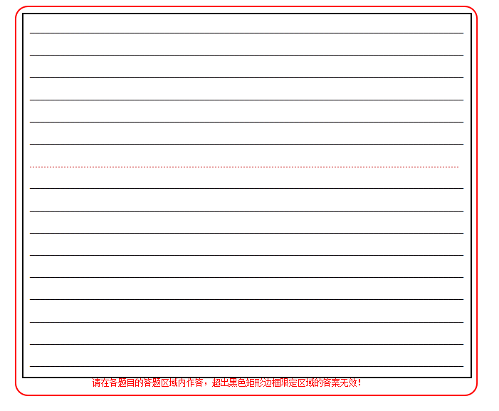
应用文写作中语篇的价值意蕴、情感策略及优化措施
每行约11-12词
分为三段
1. 写信背景和目的+拉近情感（求共情）
（3行）
2. 主要内容
（一般三个要点）
（7-8行）
3. 套路结语+祝愿鼓励（画大饼）
（2-3行）
共计13-14行
应用文正反面，7+9共16行。如果是信件，16-3，学生可写13行。
虎头、豹尾、猪肚：
第一段：交代写作背景和写作目的
+拉近情感（求共情）
第二段：要点齐全
逻辑清晰
语义连贯
渗透目的
第三段：套路结语
+祝愿鼓励（画大饼）
文章主旨
Notes:
联系 系统 真实挑战
应用 迁移
大概念不是法则，从左到右，先算个位后算十位，从低位到高位。 乘除法规则运算：先分后合
最核心的是什么？
基于知识技能 高于知识技能 的思想 理念 认识 准则
自主学习能力
选择不同的工具进行测量，能够准确表示。高楼 大树 不能测量可以选择参照物估测。
真实的 挑战性
教室的高 楼房的高
大概念可以是各种形式的体现：一个词、一个短语、一个句子或者一个问题
站位很高，长远的目标，指向学生核心素养，抓住大概念，抓住基本问题，实现预期结果和目标

Slide 6
2
回归高考真题：
学以致用，创新思维
—— 打破语篇定势，打乱语言框架
突显立德树人，体现核心素养
Part

Slide 7

2024年1月浙江首考新课标I卷应用文真题
试题呈现 Unique presentation | 观点有理有据 Clear levels | 语言准确丰富 Complete points | 语篇合理建构 Logic bridges | 交际真实得体 Authentic emotions
请你写一篇短文向校英文报“Sports and Health”栏目投稿，向同学们推荐一项适合课间开展的运动，内容包括: 1.介绍这项运动; 2.说明推荐理由。 | Stand Up and Exercise, Everybody! Nowadays,we students are pressed with mounting academic demands.As a result, we experience prolonged sedentary periods and less exercise time, I hereby encourage everyone who is reading this passage stand up and start jogging. Jogging, an aerobic exercise that trains all parts of your body, is both inexpensive to do and very flexible.You can easily fit jogging sessions into your tight study schedule, and all you need are some comfortable clothes and a pair of trainers of your preference. Besides, jogging has several scientifically proved mental benefits, such as boosting your cognition and mental clarity. With all those physical and mental benefits, jogging is such an excellent exercise for us students. So,let's stand up and hit the trail today.

Slide 8

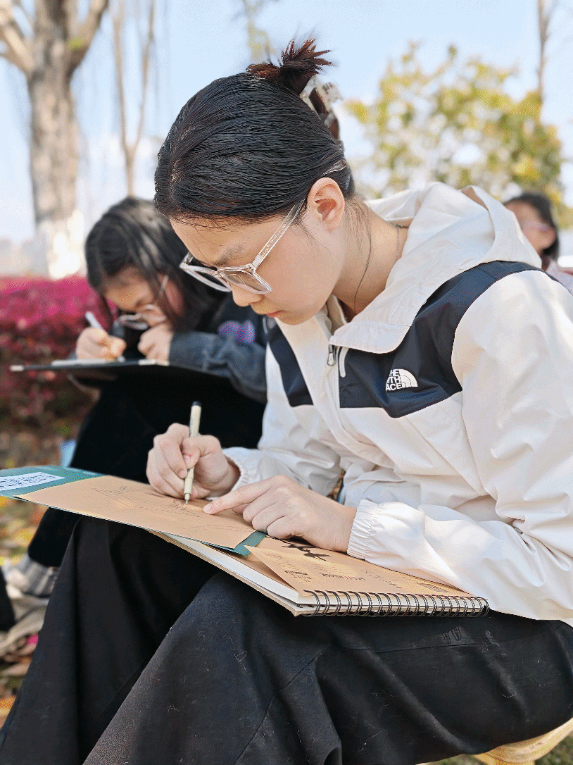
2024年6月全国新课标I卷应用文真题
试题呈现 Unique presentation | 观点有理有据 Clear levels | 语言准确丰富 Complete points | 语篇合理建构 Logic bridges | 交际真实得体 Authentic emotions
假定你是李华，你们班上周五在公园上了一节美术课，请给英国好友Chris写一封邮件分享你的经历，内容包括： 1. 你的作品内容 2. 你的感想 | Dear Chris， I'm writing to share with you an art class in a park last Friday. Never had I ever come across so many forms of artistic expression!
I'm writing to share with you an art class in a park last Friday. Never had I ever come across such nature-based form of artistic expression!
因果构建

Slide 9

2024年6月全国新课标I卷应用文真题
试题呈现 Unique presentation | 观点有理有据 Clear levels | 语言准确丰富 Complete points | 语篇合理建构 Logic bridges | 交际真实得体 Authentic emotions
假定你是李华，你们班上周五在公园上了一节美术课，请给英国好友Chris写一封邮件分享你的经历，内容包括： 1. 你的作品内容 2. 你的感想 | Dear Chris， I'm writing to share with you an art class in a park last Friday. Never had I ever comNot only did this unique experience improve my artistic skills ,but I also deepened my connection with nature, making me appreciate its beauty even more. Have you been working on any artwork lately? Please let me know. e across so many forms of artistic expression!
I'm writing to share with you an art class in a park last Friday. Never had I ever come across such nature-based form of artistic expression!
Not only did this unique experience improve my artistic skills , but I also deepened my connection with nature, making me appreciate its beauty even more. Have you been working on any artwork lately? Please let me know.
交际共情能力

Slide 10
2024年6月全国新课标I卷应用文真题 _{（样卷14分）}
试题呈现 Unique presentation | 观点有理有据 Clear levels | 语言准确丰富 Complete points | 语篇合理建构 Logic bridges | 交际真实得体 Authentic emotions
假定你是李华，你们班上周五在公园上了一节美术课，请给英国好友Chris写一封邮件分享你的经历，内容包括： 1. 你的作品内容 2. 你的感想 | Dear Chris， I'm writing to share with you an art class in a park last Friday. Never had I ever comNot only did this unique experience improve my artistic skills ,but I also deepened my connection with nature, making me appreciate its beauty even more. Have you been working on any artwork lately? Please let me know. e across so many forms of artistic expression!
I'm writing to share with you an art class in a park last Friday. Guess what? I drew an oil painting! I think I’ve done myself proud.
I painted it on the bank of a babbling stream. On the canvas, the sky is rendered in bright bule with fluffy clouds floating above, and the skyline of the distant mountain is sketched out in silhouette with grey shades. Below flows the river, with tall willows dipping their branches into the surface and nifty birds skimming over the lotus, causing the ripples which disturbs the peaceful reflection of the sky. I suppose it has to be the best work I’ve ever made. The photo of my painting is attached below, just see for yourself!
Besides the satisfaction of creating my own pieces, I learned a lot from the art class in nature. I’ve never thought before that art has it root it Mother Nature and that we create art pieces to remember and applaud for “her”. As humans, we should never be alienated from our “root” where we come from: Nature.
So how do you think of it? Tell me as soon as possible.
Best wishes! (180)

Slide 11

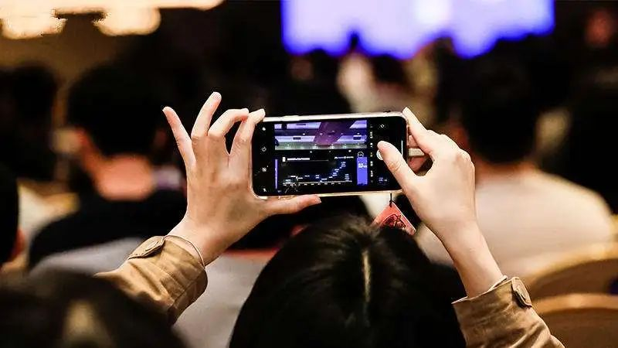
2025年1月浙江首考新课标I卷应用文真题 _{（样卷13分）}
试题呈现 Unique presentation | 观点有理有据 Clear levels | 语言准确丰富 Complete points | 语篇合理建构 Logic bridges | 交际真实得体 Authentic emotions
你将参加英语课上的“一分钟演讲”活动。请你针对部分同学在校园内用手机拍摄短视频的现象写一篇演讲稿，内容包括： 1.陈述看法； 2.提出建议。 | My views on Filming Short Videos on Campusever had I ever comNot only did this unique experience improve my artistic skills ,but I also deepened my connection with nature, making me appreciate its beauty even more. Have you been working on any artwork lately? Please let me know. e across so many forms of artistic expression!
Hello, everyone! Recent days have witnessed some of students harnessing their mobile phones to film short videos on campus. From my perspective，the prevalent act itself does no harm, yet regulations are demanded.
Admittedly, short videos are capable for capturing meaningful moments and transforming them into lifelong memories. Nevertheless, addiction to streaming platforms might cage students’ attention，thus hindering their academic excellence. To maximize the pros while minimizing the cons, it’s feasible for the school to set certain periods for the utilization of phones, so as to guarantee learning proficiency and efficiency. As for we students, it’s strongly suggested that we ensure the contents of our short videos are of high quality.
Hopefully, we’ll be the master of devices, rather than the slaves of them. Thanks for your listening!

Slide 12
3
2025年高考预测：
五育并举，综合考查
—— “实践类学习+, 劳动教育+，高科技+”的综合话题
Part

Slide 13



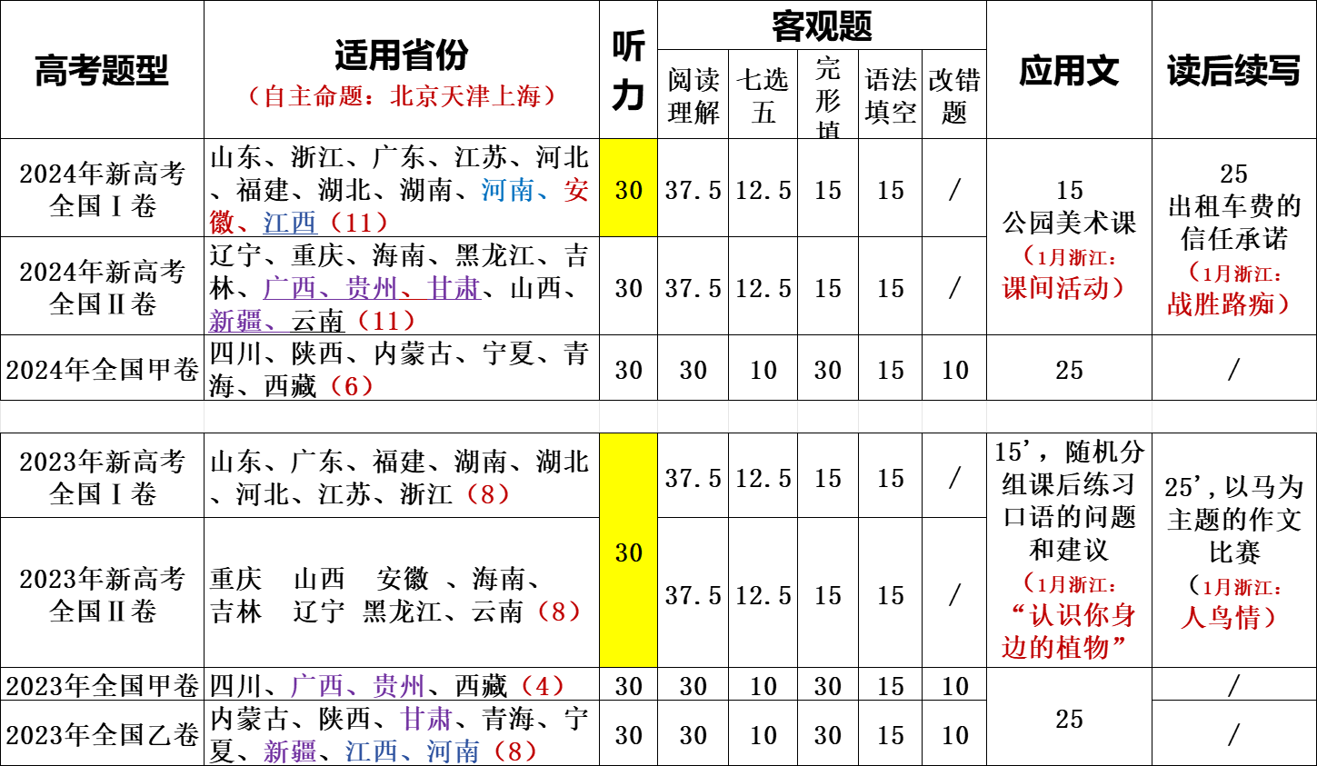
2025年高考预测 ——“实践类学习+, 劳动教育+, 高科技+”的综合话题
话题分类（夯实-融会）
临门一脚（融会-贯通）
2025年高考应用文考前话题分类突破：
1.课外研究性学习/拓展性学习；
2.劳动教育；
3.体育；
4.美育；
5.文化交流/英语学习；
6.社会公益；
7.社会进步（人工智能、科技）
8.健康生活/环境友好；
9.中华传统文化
“一分钟演讲”+校园内用手机拍摄短视频 2025年6月？ | 勇敢男孩+真假小偷 2025年6月？
应用文重点关注：“劳动教育+，实践类学习+, 高科技+”的综合话题，融合贴近时代、贴近社会、贴近生活的问题，加强和引导学生运用知识、能力和素养解决实际问题的能力。
Notes:
词汇与结构知识
正式语篇结构知识
内容/世界背景知识
自动识别技能
综合与评价策略
元认知知识与技能监控

Slide 14
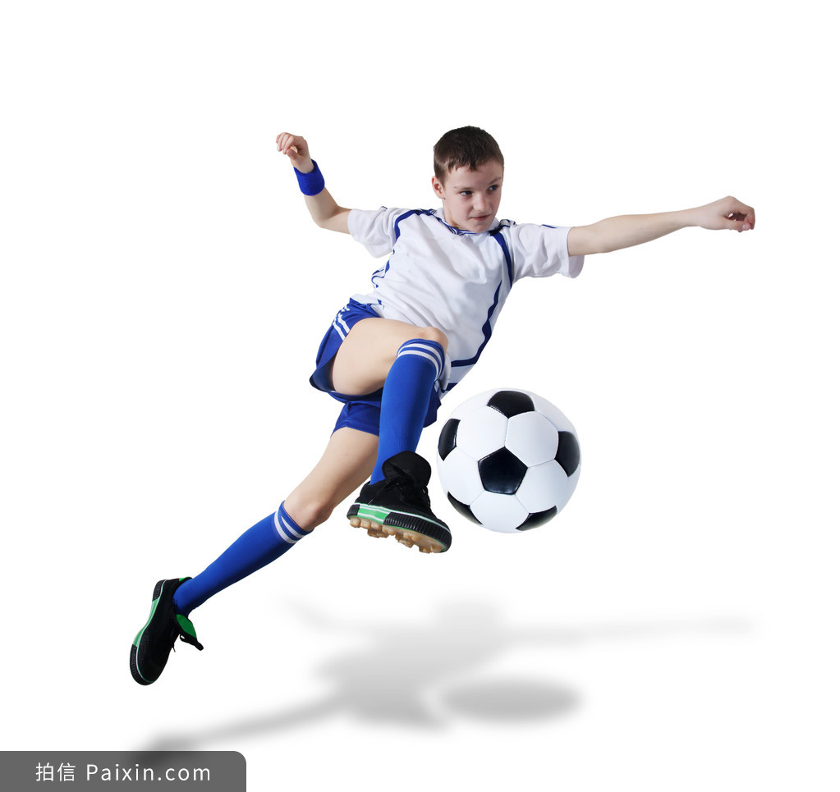


2025年6月高考备考
奇迹总在拼搏之后；
成功蕴于进取之中。

