Slide 1


感恩遇见，相互成就，本课件资料仅供您个人参考、教学使用，严禁自行在网络传播，违者依知识产权法追究法律责任。
更多教学资源请关注
公众号：溯恩英语
知识产权声明

Slide 2
4.10衢丽湖联考
作文讲评
黄思渊

Slide 3
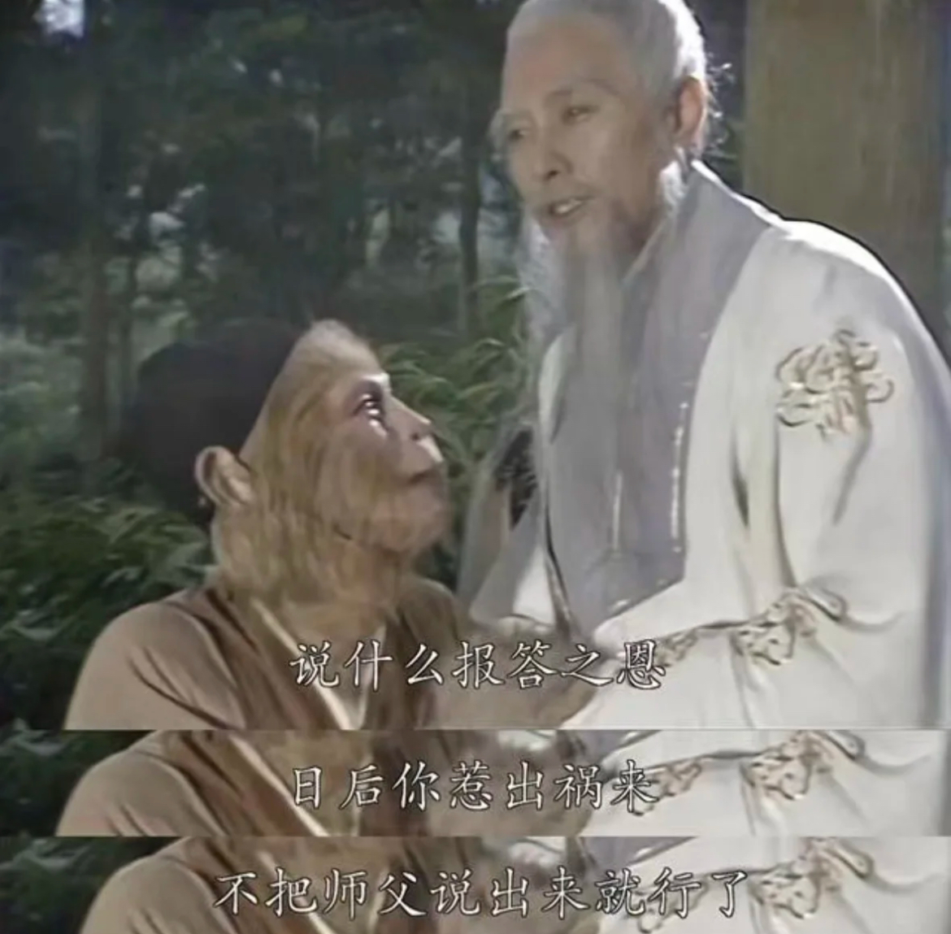
应用文
假定你是李华，你校有些学生把老师的照片制作成表情包(meme)并在社交媒体上传播，针对这一现象，请给校英语报 Letters 专栏投稿，内容包括：
(1) 陈述观点； (2) 提出建议。
一、文体分析
本文属于议论文性质的书信投稿，需符合以下特点：
语言得体，符合校园报纸正式程度
观点明确，逻辑清晰
建议具体可行

Slide 4

二、结构解析
Paragraph 1 引言段
概述现象
亮明核心观点
语言提示：
Recently, the trend of... has aroused heated discussions
While creative, this phenomenon requires cautious handling
Paragraph 2 主体段
1. 指出潜在问题：
  侵犯教师肖像权
  可能造成误解
  损害师生关系
  2. 建议措施 :
  制定网络行为规范
开展数字素养教育
建立师生沟通渠道
Paragraph 3 结尾段
重申观点 ；2. 呼吁行动
语言提示：Only through... can we...； Let‘s work together to...

Slide 5
题目中的隐藏要求
辩证思维
  题目要求"陈述观点"，但需注意：现象本身具有 两面性（创意表达 vs 负面影响），需体现 balanced view（平衡观点），而非全盘否定或完全支持。
  得分关键：使用 让步状语从句（While.../Although...）或 先扬后抑 结构（如：肯定创意→转折指出问题）。
建议的可行性
  建议需体现 多方责任主体（学生、学校、教师），避免仅单方面要求学生改正。
  用 分点建议或 角色分工（Students should..., Schools ought to...）。
身份意识
  作者身份是学生（李华），需用 得体语气：避免过度指责同龄人（如：用"We should reflect"而非"You are wrong"），同时体现对教师的尊重。

Slide 6

题目中的潜在陷阱
文体混淆
  ❌ 陷阱：误写成 投诉信（纯批判）或 说明文（仅描述现象）。
  ✅ 正确：保持 议论文 核心（观点+论据+建议），结合 书信格式（称呼、结尾、署名）。
法律常识缺失
  ❌ 陷阱：忽视"肖像权（portrait rights）"和"网络隐私（cyber privacy）"等概念。
  ✅ 正确：需提及 consent（许可）、misuse of personal images（滥用肖像） 等关键词。
建议空洞化
  ❌ 陷阱：仅泛泛要求"加强管理"或"提高意识"，缺乏具体措施。
  ✅ 正确：用 动词短语 明确行动（如：establish social media guidelines, organize workshops on digital ethics）。
例证不当
  ❌ 陷阱：虚构极端例子（如：老师被开除），削弱说服力。
  ✅ 正确：用 合理假设（如：A meme mocking a teacher's strictness might be misunderstood by parents）。

Slide 7
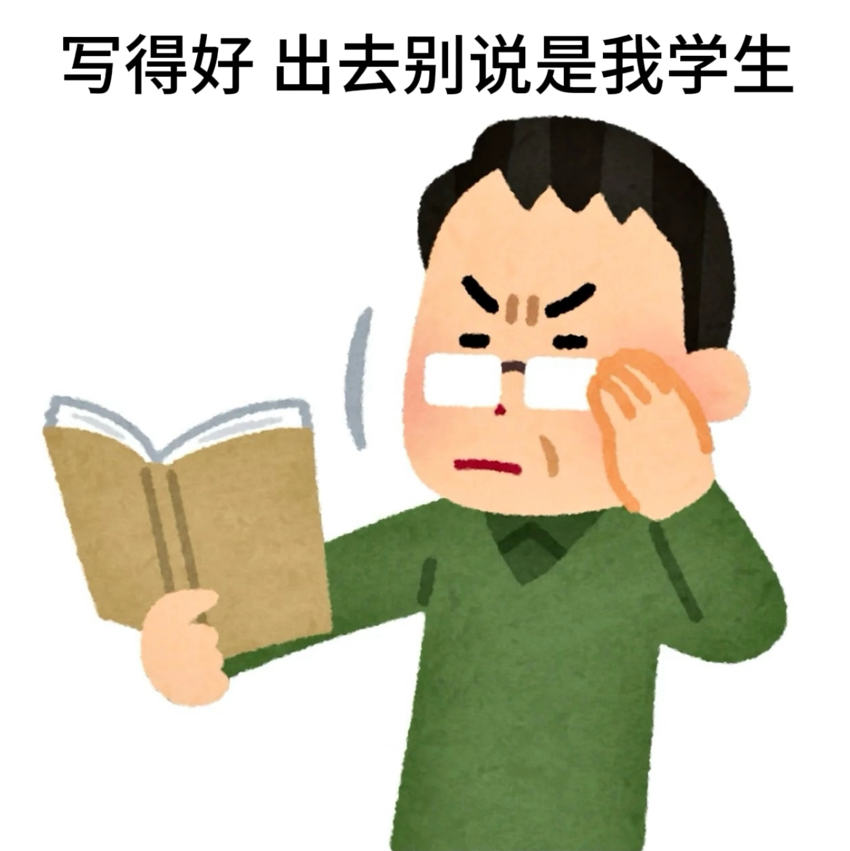
不恰当表达自查
不恰当表达 | 错误示例 | 优化方案
观点绝对化 | "Making memes is totally wrong" | "While humorous, memes may have unintended consequences"
建议缺乏主体 | "We must stop this trend" | "Schools should collaborate with students to create clear guidelines"
忽略传播范围 | 未提及社交媒体的公开性 | 加入"public platforms"或"circulate beyond campus"
结尾无升华 | 简单重复观点 | 呼吁行动 + 价值升华（如："Let humor coexist with respect"）

Slide 8
技巧指导
观点句模板：
  "While [现象] demonstrates [积极面], it could potentially [消极影响] if not properly addressed."
  "Creativity should never come at the expense of [核心价值]."
建议句模板：
  "It would be advisable for [主体] to [具体行动], thereby [预期结果]."
  "By [措施], we can ensure [积极结果] while avoiding [负面后果]."
升华句模板：
  "True humor lies not in [负面行为], but in [正面行为]."
  "Let us strive to create a campus culture where [价值A] and [价值B] coexist harmoniously."

Slide 9
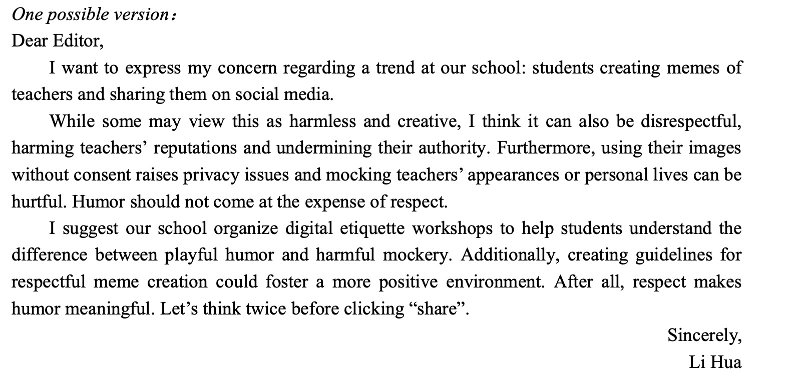
官方范文

Slide 10
possible version
Dear Editor,
Recently, some students have been creating humorous memes using teachers‘ photos and sharing them on social media. While this trend reflects young people’s creativity and sense of humor, I firmly believe it raises ethical concerns that demand immediate attention. (现象+观点)
The primary issue lies in unauthorized use of personal images. Even with playful intentions, editing teachers' portraits without consent violates their right to privacy. Moreover, exaggerated expressions or captions in memes might distort educators' professional image. For example, a meme mocking a teacher's strictness could be misinterpreted as disrespect by parents or the public, potentially harming the teacher's reputation.
To address this, I suggest students delete existing memes and apologize sincerely. Meanwhile, schools should establish clear social media guidelines through open discussions, and organize workshops about digital responsibility. Only by balancing humor with respect can we maintain healthy teacher-student relationships.
Yours sincerely,
Li Hua
建议的实施：多方责任主体

Slide 11
语料积累
一、现象描述类
英文表达 | 中文释义 | 例句应用场景
create/spread memes | 制作/传播表情包 | "Some students create memes using teachers' photos."
humorous adaptations | 幽默改编 | "These humorous adaptations spread rapidly online."
viral on social media | 在社交媒体疯传 | "The memes went viral on social media platforms."
digital creativity | 数字创意 | "This trend reflects students' digital creativity."
youth culture phenomenon | 青年文化现象 | "It has become a youth culture phenomenon."

Slide 12
二、观点表达类
英文表达 | 中文释义 | 例句应用场景
a double-edged sword | 双刃剑 | "Internet memes are a double-edged sword."
raise ethical concerns | 引发道德担忧 | "This behavior raises ethical concerns."
cross boundaries | 跨越界限 | "Humor should not cross boundaries of respect."
balance A with B | 平衡A与B | "We must balance creativity with respect."
spark heated debates | 引发激烈讨论 | "The issue has sparked heated debates on campus."

Slide 13
三、建议措施类
英文表达 | 中文释义 | 例句应用场景
establish clear guidelines | 制定明确准则 | "Schools should establish clear guidelines for online behavior."
promote digital citizenship | 推广数字公民素养 | "Workshops on promoting digital citizenship are essential."
seek prior consent | 事先征得同意 | "Students must seek prior consent before using personal images."
organize awareness campaigns | 组织宣传活动 | "Organizing awareness campaigns can educate students."
foster a respectful environment | 营造尊重的环境 | "We should foster a respectful online environment."

Slide 14

替换词
基础表达 | 词汇替换
bad | inappropriate/irresponsible
harm | undermine
spread | circulate
rules | guidelines/regulations
right | entitlement

Slide 15

Tim had always struggled with his weight. He loved food, but at school, he often found himself the target of cruel jokes and teasing. His classmates would call him names like “Big Tim” and make fun of his size, and though Tim tried to ignore it, it still hurt. Every day, he wished he could be like the athletic kids, running fast and playing sports with ease, but that always seemed out of reach.
One day, a group of his classmates—three boys who were notorious (恶作剧) decided to play a trick on him. They knew Tim wasn’t athletic, and they thought it would be funny to sign him up for the upcoming school’s long-distance race. They figured he’d panic when he found out and that it would be fun to watch him fail. Without telling Tim, they registered his name for the race.
读后续写
阅读原文，
找出文中的伏笔

Slide 16
On race day, as Tim walked across the track trying to join his classmates in the stands, he saw some of them holding giant posters of his face with slogans like “The Big Runner” and “Go Tim!” He froze. He realized what had happened—the boys had tricked him into racing. His face turned red with embarrassment, but the crowd was already watching, and he felt trapped.
The starting gun fired, and to everyone’s surprise, Tim began to jog. It wasn’t fast, and he could barely keep up with the other names, but he kept moving. His legs burned with each step, and his breath came in sharp gasps, but he didn’t stop. His classmates’ laughter echoed in his ears, but he ignored it.
As the race went on, something shifted. A few students who weren’t part of the prank started cheering for him. “Come on, Tim! You can do it!” they yelled. Their encouragement made Tim feel lighter, and his pace picked up just a little. It wasn’t about winning anymore; it was about proving to himself that he could finish.

Slide 17
一、伏笔分析
原文伏笔 | 续写呼应方式 | 作用
“Big Tim”的嘲笑 | 比如标语被改为“Brave Tim” | 角色成长，主题升华
被迫报名参赛的陷阱 | 恶作剧者道歉，承认“没想到你真能坚持” | 解决核心冲突，体现反讽
非恶作剧同学的初期支持 | 全场加入欢呼，甚至老师鼓掌 | 强化集体善意压倒恶意的主题
Tim对运动健将的渴望 | 比赛后被邀请加入跑步俱乐部 | 闭合人物弧光，实现最初愿望的“升级版”

Slide 18
二、主题分析
1：对抗欺凌与自我救赎
具体内容：
故事通过Tim被同学恶意嘲笑和捉弄的经历，展现了一个自卑少年在逆境中通过坚持完成看似不可能的任务，最终赢得尊重、实现自我救赎的过程。
文本依据：
  欺凌的伤害：
  "His classmates would call him names like ‘Big Tim’... it still hurt."
  自我救赎的转折：
  "It wasn’t about winning anymore; it was about proving to himself that he could finish."
2：善意的力量与群体觉醒
具体内容：
故事中少数同学的鼓励逐渐演变为全场的支持，暗示集体善意可以扭转恶意，推动社会态度的积极转变。
文本依据：
  群体态度的变化：
  "A few students... started cheering for him. Their encouragement made Tim feel lighter."（从个别支持到全场掌声，体现善意的扩散）
  反讽性结局：
  "The posters once mocking him now waved proudly... their sarcastic slogans overshadowed by genuine admiration."（恶意符号被善意重新定义）

Slide 19
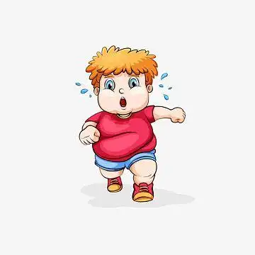
3：对“胜利”的重新定义
具体内容：
打破“以速度论英雄”的传统观念，强调坚持和勇气本身即是胜利。
文本依据：
  Tim的自我认知：
  "He wished he could be like the athletic kids... but that always seemed out of reach."（最初认为只有体能优秀才算成功）
  主题句升华：
  "Tim realized winning wasn’t about speed—it was about refusing to quit."（直接点明主题）

Slide 20

三、故事冲突分析
1. 外部冲突：欺凌与反抗
具体内容：
Tim与恶作剧同学之间的对立：同学通过羞辱和陷阱施加伤害，而Tim用坚持完成比赛作为无声反抗。
文本依据：
"They thought it would be funny to sign him up for the race... watch him fail."（恶作剧者的动机）
"He kept moving... ignored the laughter."（Tim的反抗方式）
2. 内部冲突：自卑与成长
具体内容：
Tim内心对自身价值的怀疑（因体型被嘲笑）与逐渐觉醒的自我认同（通过坚持赢得尊重）之间的矛盾。
文本依据：
"He felt trapped... but he didn’t stop."（被迫参赛的屈辱感与坚持的挣扎）
"His old insecurities melting like morning frost."（最终克服自卑）
3. 社会性冲突：恶意与善意的对抗
具体内容：
少数人的欺凌行为与逐渐扩大的支持力量之间的较量，反映社会环境中善恶力量的动态平衡。
文本依据：
"The jeers of his tormentors had faded, replaced by... supportive shouts."（群体态度的逆转）
"The three pranksters standing awkwardly... their smirks replaced by uneasy silence."（恶意者被善意压制）

Slide 21
冲突类型 | 推动的主题发展 | 文本例证
外部冲突（欺凌） | 引出自我救赎的必要性 | 恶作剧迫使Tim直面挑战
内部冲突（自卑） | 强化“坚持即胜利”的主题 | Tim从“想放弃”到“咬牙完成”的心理变化
社会冲突（善恶意） | 深化集体觉醒对个人成长的影响 | 全场掌声促使恶作剧者道歉
主题与冲突的互动关系

Slide 22
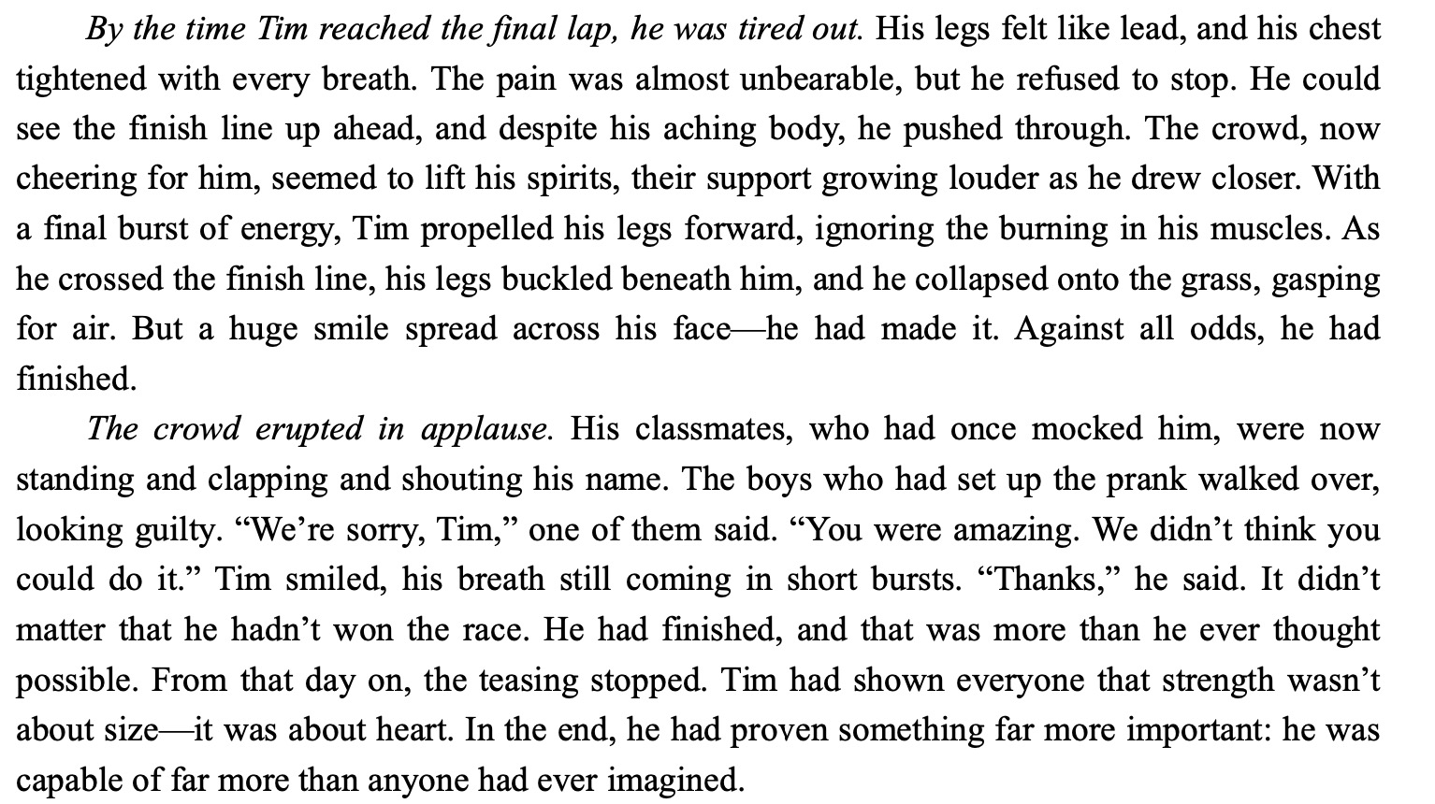
官方范文

Slide 23
Possible Version
By the time Tim reached the final lap, he was tired out. His uniform clung to his sweat-drenched back, and each breath felt like fire. The mocking posters of “Big Tim” now blurred into streaks of color as he passed, but the crowd’s chants grew louder—“Tim! Tim! Tim!” Even the three boys who had tricked him stood frozen, their earlier smirks replaced by uneasy glances. One of them mumbled, “He’s actually doing it…” Tim’s mind flashed to the years of taunts, but now, the insults felt distant. A teacher jogged alongside the track, shouting, “Focus on your rhythm!” Tim gritted his teeth. Though his legs trembled, he forced himself forward, one heavy step after another. The finish line loomed ahead, not as a threat, but a promise.
The crowd erupted in applause. Tim collapsed just past the line, his chest heaving, but the world around him buzzed with energy. Students rushed to help him up, their earlier sneers transformed into awed whispers. The three boys lingered at the edge of the crowd; one awkwardly handed Tim a water bottle, muttering, “Didn’t think you’d make it… sorry.” The posters now read “Our Hero Tim”—someone had torn off the word “Big.” A PE teacher patted his shoulder, “That’s real grit. The running club needs fighters like you.” Tim smiled weakly, his old shame dissolving. He hadn’t outrun his bullies, but he’d outlasted them. For the first time, “Big Tim” didn’t feel like a joke—it felt like a badge of honor.

Slide 24
语料积累
情感与态度转变类词汇
1. 负面情感（欺凌/痛苦）
词汇：
taunts（嘲笑） / sneers（讥笑） / mocking posters（嘲讽海报） / uneasy glances（不安的眼神） / blurred into streaks of color（模糊成色块，暗示视线不清）
2. 积极转变（支持/成长）
词汇：
buzzed with energy（充满活力） / a badge of honor（荣誉徽章） / dissolving shame（消散的羞耻） / awed whispers（敬佩的低语）
运动与体力极限描写
1. 身体反应
词汇：
sweat-drenched back（汗湿的后背） / legs trembled（双腿颤抖） / chest heaving（胸膛起伏） / breath came in sharp gasps（急促喘息）
2. 坚持与毅力
词汇：
gritted his teeth（咬紧牙关） / forced himself forward（强迫自己前进） / outlasted（坚持到底） / real grit（真正的毅力）

Slide 25
象征与隐喻类表达
1. 环境象征
finish line loomed as a promise（终点线如同承诺般显现） / melting like morning frost（如晨霜般消融）
E.g. "The finish line loomed ahead, not as a threat, but a promise."
"His old shame dissolving... like morning frost."
2. 物品象征
posters transformed（海报被改变） / water bottle as peace offering（水瓶作为和解象征）
E.g. "The posters now read ‘Our Hero Tim’—someone had torn off the word ‘Big.’"
"One boy awkwardly handed Tim a water bottle..."
高级语法结构
1. 分词结构（画面感增强）
例句：
"Students rushed to help him up, their earlier sneers transformed into awed whispers." （独立主格结构）
"His uniform clung to his sweat-drenched back, each breath feeling like fire." （现在分词短语）
2. 比喻与感官描写
例句：
"The crowd’s chants grew louder—‘Tim! Tim! Tim!’—like waves crashing on shore." （明喻）
"His legs felt like lead, but his mind burned with determination." （隐喻+感官对比）

Slide 26
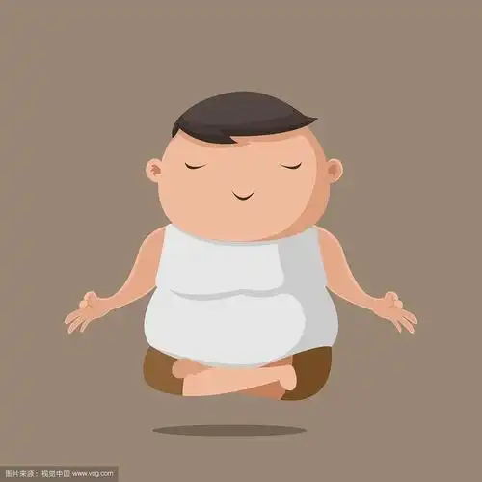
主题升华
主题 | 例句
自我救赎 | "He hadn’t outrun his bullies, but he’d outlasted them." （对比+双关）
集体善意 | "The jeers had faded, replaced by a chorus of hope." （象征转变）
重新定义胜利 | "Winning wasn’t about speed—it was about refusing to quit." （金句）

Slide 27
Thanks!

