Slide 1
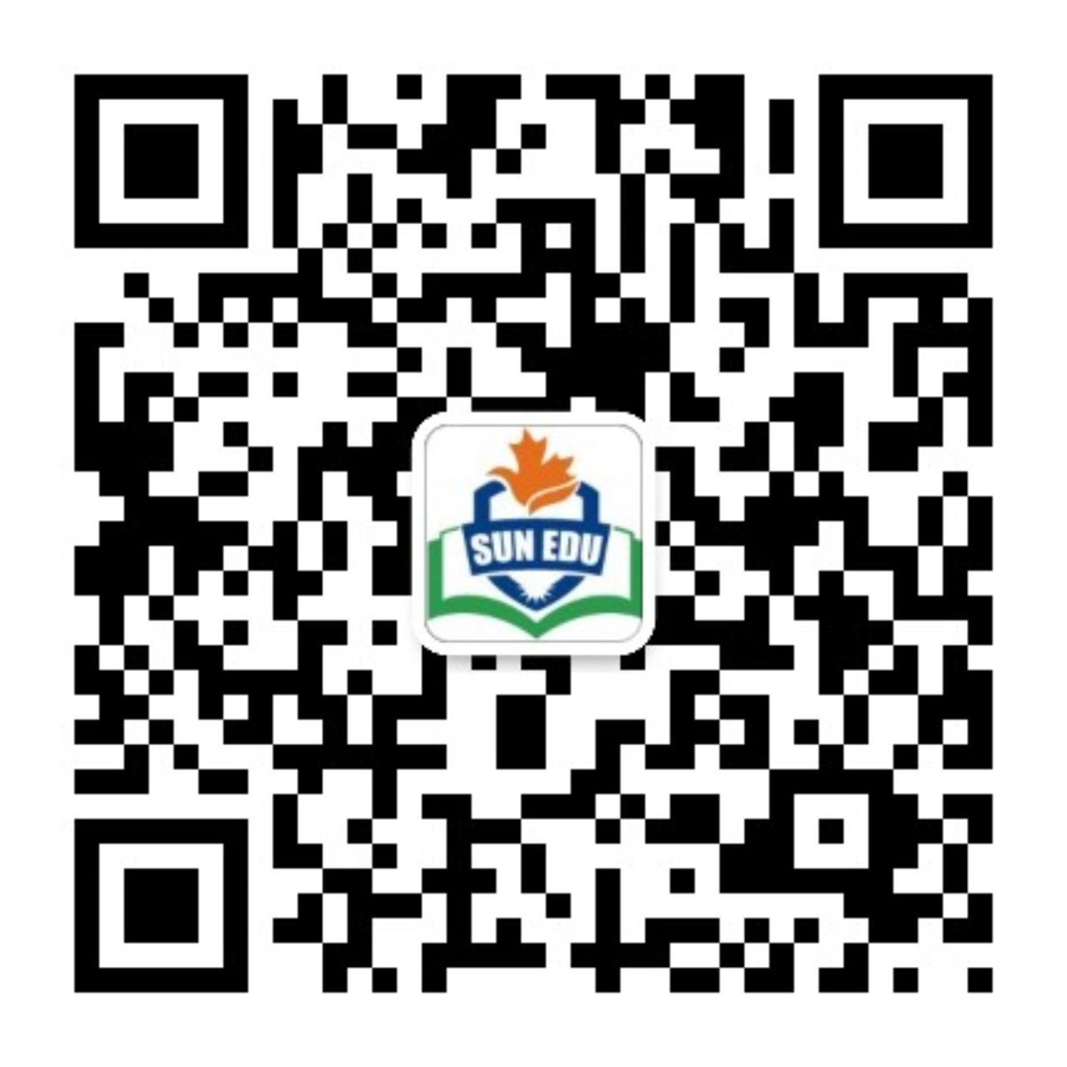
感恩遇见，相互成就，本课件资料仅供您个人参考、教学使用，严禁自行在网络传播，违者依知识产权法追究法律责任。
更多教学资源请关注
公众号：溯恩英语
知识产权声明

Slide 2
Should Community Service be a Requirement for Graduation?
—温州二模应用文英语报投稿
社区服务是否该列入毕业条件

Slide 3
What’s most challenging for you in this writing assignment?
Lead in
Possible difficulties:
1.unfamiliar with community service
2.unknown of the specific advantages of
community service for senior school students
3.unknown of the specific disadvantages of community service for senior school students
4.unknown of the impacts of community service being a requirement for graduation...

Slide 4
Analyze
Receiver: editor of school English newspaper
假定你是高中生李华，你校英语报正在开展关于“社区服务是否该列入毕业条件”的讨论，请你写一篇文章投稿，内容包括：
1.你的观点
2.你的理由。
debate/discussion
Contribution
Argumentation
Short Essay
Views
Reasons/Supporting details
Topic/Title : Should CommunityService be a Requirement for Graduation?
What’s the genre of this writing?
What do the underlined parts tell us?
In this article, what should be included in each part ?

Slide 5
Construct
Briefly introduce the debate over the topic./Backgound
Introduction
State your view clearly.
Short
Essay
Reasons/ supporting details
Advantages
Disadvantages
logical
multi-dimension
Conclusion
Summarize/Emphasize/Highlight your thoughts

Slide 6
Practice and Accumulate
Briefly introduce the debate over the topic./Backgound
P1 Introduction
State your view clearly.
In terms of whether students should be required to complete community service to graduate, I’m convinced that it is of great significance.直接引出话题+直接表达肯定（从句）
Beneficial and rewarding as it is, it would be unwise to make community service a compulsory graduation requirement.对比引出话题+委婉表达否定（让步状从）
Recently, a heated debate has been sparked by “Should Community Service be a Requirement for Graduation?” From my perspective/standpoint/As for me, the answer is yes/no. The reasons are as follows.客观陈述背景+直接表达观点+引起下文（从句）

Slide 7
Brainstorm
Arguments in Favor of Community Service
as a Graduation Requirement
Society
Uncover inner potential
01
Understand Self-value
02
Social Responsibility
Nurture/foster Civic Responsibility
03
Community Bonds
Build/strengthen social connections
All-round Development
Enhance Holistic Development
04
Skill Development
Develop Practical Skills,
such as communication, teamwork, and leadership
05
Individual

Slide 8
Logic
Arguments in Favor of Community Service
as a Graduation Requirement
Values
enhance our worldview
elevate our life philosophy
strengthen our values‌
deepen/develop/foster/build a sense of responsibility and belonging
Emotion
Ability
hone/ empower/equip us with collaborative abilities
cultivate future-ready teamwork capabilities

Slide 9
Brainstorm
Arguments Against Community Service as a Graduation Requirement
Academic Pressure
Voluntary Nature
students may be unwilling/reluctant to engage in the voluntary work
cause mental or physical strain
generate distraction from academic learning
04
03
Risk of Formalization
Individual Differences
02
01
fail to yield the expected results
bear little fruit
lead to fruitless outcome
backfire with self-defeating consequences
individual differences need to be considered
Individual
Event

Slide 10
Logic
Arguments Against Community Service as a Graduation Requirement
fail to yield the anticipated results
bear little fruit
lead to/trigger fruitless outcome
backfire with self-defeating consequences
Present
future
cause mental or physical strain
generate distraction from academic learning

Slide 11
Conclusion
Summarize+anticipate/appeal/highlight
To sum up, making community service a graduation requirement is a must. Not only does it nurture our emotional well-being and personal growth, but it also contributes to building a harmonious society .（强调观点+展望未来not only倒装）
Therefore, instead of forcing students to get involved in community service, schools are supposed to motivate them to participate in the events actively and willingly. Only in this way will students achieve holistic personal growth, making community service fruitful .（正向呼吁学校+展望未来only倒装）
"Education is not preparation for life; education is life itself," as John Dewey said. Since community service bridges the gap between classroom learning and society, why not weave it into the fabric of graduation?（名人名言+教育本质+反问结尾+比喻why not...?）

Slide 12
Sample Writing One
Should Community Service be a Requirement for Graduation?
In terms of whether students should be required to complete community service to graduate, I’m convinced that it is of great significance.
To begin with, engaging in community activities cultivates our ‌practical problem-solving skills‌, which are indispensable in preparing us for real-world challenges. Besides, it not just ‌enhances our teamwork capabilities‌ but ‌alleviates our academic stress‌ through meaningful social interaction. Most importantly‌, helping others, such as tutoring migrant children or visiting nursing homes, awakens our social responsibility, making us feel truly connected to our community.
To sum up, making community service a graduation requirement is a must. Not only does it nurture our emotional well-being and personal growth, but it also contributes to building a harmonious society .

Slide 13
Sample Writing Two
Should Community Service be a Requirement for Graduation?
Beneficial and rewarding as it is, it would be unwise to make community service a compulsory graduation requirement.
Compulsory community service, which adds to students' already heavy academic workload, may lead to burnout and reduced performance in core subjects. Moreover, with different personal circumstances, such as family responsibilities or health issues, students may find it unfair to be judged by the same service standards. Lastly, forced service often results in unwilling participation, failing to achieve its educational purpose.
Therefore, instead of forcing students to get involved in community service, schools are supposed to motivate them to participate the events actively and willingly. Only in this way will students achieve holistic personal growth, making community service fruitful.

Slide 14
Sample Writing Three
Should Community Service be a Requirement for Graduation?
Recently, a heated debate has been sparked by “Should Community Service be a Requirement for Graduation?” As for me, the answer is YES. The reasons are as follows.
Admittedly, assisting others in tackling real-life challenges enables us to enhance our interpersonal communication and teamwork skills, which are vital for personal growth. Plus, by engaging in community activities, a sense of responsibility and belonging can be fostered and deepened at the bottom of our heart. Also, not only these experiences can shape our outlook on life, values, and worldview but also motivate us to meet a better self through meaningful interactions and shared goals.
"Education is not preparation for life; education is life itself," as John Dewey put it. Since community service bridges the gap between classroom learning and society, why not weave it into the fabric of graduation?

Slide 15
Word Bank
1. 支持社区服务作为毕业要求的理由 (Arguments For Community Service as a Requirement)
1 | uncover inner potential | 发掘内在潜能
2 | nurture/foster civic responsibility | 培养/促进公民责任感
3 | build/strengthen social connections | 建立/加强社会关系
4 | enhance holistic development | 促进全面发展
5 | develop practical skills, such as communication, teamwork, and leadership | 培养实践技能（如沟通、团队合作、领导力）
6 | hone/empower/equip us with collaborative abilities | 磨练/赋予/配备协作能力
7 | cultivate future-ready teamwork capabilities | 培养面向未来的团队协作能力
8 | deepen/develop/foster/build a sense of responsibility and belonging | 深化/培养/促进/建立责任感和归属感
9 | enhance our worldview | 拓宽世界观
10 | elevate our life philosophy | 提升人生理念

Slide 16
Word Bank
2. 反对社区服务作为毕业要求的理由 (Arguments Against Community Service as a Requirement)
1 | cause mental or physical strain | 导致身心压力
2 | generate distraction from academic learning | 分散学术学习的注意力
3 | individual differences need to be considered | 需考虑个体差异
4 | students may be unwilling/reluctant to engage in the voluntary work | 学生可能不愿/勉强参与志愿活动
5 | fail to yield the expected results | 未能达到预期效果
6 | bear little fruit | 收效甚微
7 | lead to fruitless outcome | 导致徒劳无果
8 | backfire with self-defeating consequences | 适得其反，造成自我挫败的后果

Slide 17
Word Bank
3. 句型与高级表达 (Sentence Structures and Advanced Expressions)
1 | When it comes to/In terms of... | 谈到/就...而言
2 | I’m convinced that it is of great significance | 我坚信此举意义重大
3 | Beneficial and rewarding as it is, it would be unwise to ... | 尽管初衷良好，但我认为...并非明智之举
4 | Recently, a heated debate has been sparked by... | 最近，关于...的讨论引发了热议
5 | As for me, the answer is YES/NO. The reasons are as follows. | 在我看来，答案是。具体原因如下
6 | To sum up, ...is a must | 总之，必须...
7 | ...help/motivate/allow students to | 帮助学生/激励学生/允许学生
8 | enable/prompt/motivate/inspire/help students to | 使学生能够/促使学生/激励学生/启发学生
9 | engage/participate in community service | 参与社区服务

Slide 18
Thank you!

