Slide 1
感恩遇见，相互成就，本课件资料仅供您个人参考、教学使用，严禁自行在网络传播，违者依知识产权法追究法律责任。
更多教学资源请关注
公众号：溯恩高中英语
知识产权声明

Slide 2
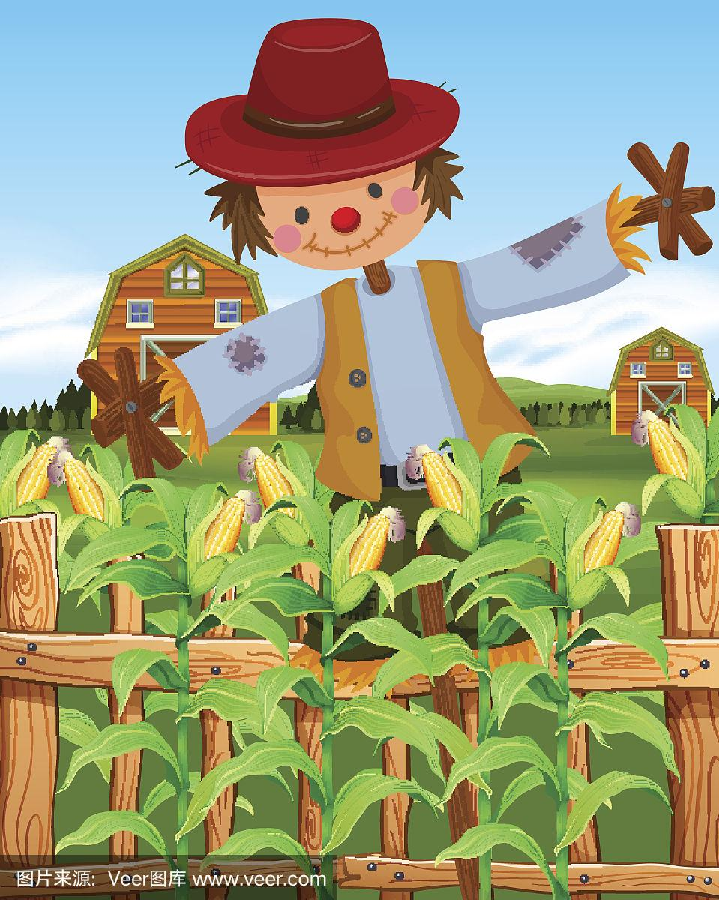
The Scarecrow in the Cornfield
浙江金华汤溪高级中学 郑素红

Slide 3
My mother believed in using things up. Last year, our cornfield had a bad harvest because birds feasted on the crops. It was probably then that Mom's frugality(节俭) became even more extraordinary. She began keeping everything that seemed useless in the attic (阁楼)— worn-out clothes, old sheets, broken umbrellas, and some other old items. Mom's favorite saying was "waste not, want not". My brother Josh and I weren't sure what that meant until the“Affair of the Scarecrow(稻草人)",which, as it later became known, left a lasting impression on us.
What happened to our cornfield last year?
2. Why?
What was kept in the attic?
4. Why did mom do so?
5. How did mom influence us?

Slide 4
The story began with a pretty hat that Mom received as a gift to protect her from the sun. However, Josh and I could see that Mom's frugal nature and fashion sense were in battle. Mom really didn't want to get rid of the hat---it was new and had a lot of use left in it--- but neither could she stand wearing it. She tried to take off the fancy decorations, but they were stuck on tight. She'd have to find some other solution.
What did mom do with her hat?
Why did the author mention mom’s hat?

Slide 5
Josh and I watched as Mom headed upstairs to the attic with the hat. "Waste not, want not," she called back down. We heard boxes being moved around. Moments later, Mom leaned out, holding a flour bag full of straw, and with a mysterious smile, she placed the hat on it.
What did mom do with the flour bad full of straw? Can you make a guess?

Slide 6
"What is that for?" I asked, confused. "A scarecrow!" Mom exclaimed. "But not a good one yet. It needs a strong body to stand firm in the field, she said with a frown." And it doesn't look scary enough," Josh remarked. I had to admit that Josh, though younger than I was, could sometimes be more imaginative. Josh and I turned to each other, searching for a good idea. Soon enough, Josh's eyes lit up with inspiration.
1. What ‘s the problem with mom’s scarecrow?
2. Can you make a guess about Josh’s inspiration?

Slide 7
伏笔
原文伏笔 | 续写回扣
Last year, our cornfield had a bad harvest because birds feasted on the crops. | How was this year’s harvest?
She began keeping everything that seemed useless in the attic (阁楼)— worn-out clothes, old sheets, broken umbrellas, and some other old items. | How did Josh and I use these seemingly useless stuff?
Mom's favorite saying was "waste not, want not". | Can mom’s saying be used as the theme of the continuation writing?
"But not a good one yet. It needs a strong body to stand firm in the field, she said with a frown." And it doesn't look scary enough," Josh remarked. | Can Josh and I make an ideal scarecrow? How ?

Slide 8
"What is that for?" I asked, confused. "A scarecrow!“ Mom exclaimed. "But not a good one yet. It needs a strong body to stand firm in the field, she said with a frown." And it doesn't look scary enough," Josh remarked. I had to admit that Josh, though younger than I was, could sometimes be more imaginative. Josh and I turned to each other, searching for a good idea. Soon enough, Josh's eyes lit up with inspiration.
首段首句（句群）： 根据 come with me ；首句应该写 “I” ， 我应该是好奇为什么要我跟着他。然后Josh 要向我解释。 接着我们一起来到阁楼，开始寻宝。
Para 1: “Come with me!” Josh called out.
Overwhelmed with an enormous sense of excitement and curiosity, I followed Josh. Looking into my eyes, Josh exclaimed excitedly ,“ We can find some useful stuff in the attic to make a strong and scary scarecrow.” No sooner had Josh entered the attic than he began to search every corner for some items/(“ treasures”) .

Slide 9
首段尾句：从所给句the scarecrow stood tall 可推知尾句应该是scarecrow 做成了; scarecrow 什么模样？什么作用？
After what seemed like centuries, a tall , strong and terrifying scarecrow was created. Staring at it, we breathed a sigh of relief, hoping that it would scare away the birds.
Para 2: In the days that followed, the scarecrow stood tall.

Slide 10
Para 1: "Come with me!" Josh called out.
After what seemed like centuries, a tall , strong and terrifying scarecrow was created. Staring at it, we breathed a sigh of relief, hoping that it would scare away the birds.
Para 2: In the days that followed, the scarecrow stood tall.
Never in my wildest dream had I imagined that it would prevent the birds from feasting on the corn. Seeing its terrible appearance, birds were scared to death, not daring to come to our corn field. Thanks to its hard work, this year, we had a great harvest. Our beloved mom gave us a thumbs-up for what we did, with her eyes sparkling with joy and delight. Our joint efforts eventually paid off and our hearts were overflowing with pride.
二段首句：描写 the scarecrow 实际作用；鸟儿如何反应？最终结果我们玉米丰收；妈妈开心，为我们点赞，我们很自豪

Slide 11
Para 2: In the days that followed, the scarecrow stood tall.
The Affair of the Scarecrow made a great / huge difference to Josh and me, which contributed to our understanding of Mom’s saying” Waste not, want not.”
Mom’s saying “ Waste not, want not.” would be engraved in my heart for ever, which transformed me into its firm believer and practitioner.
二段尾句：点一下主题

Slide 12
Para 1: “Come with me!” Josh called out.
1. （从come with me, 叙事对象为作者“ I” ，因作者没有得知弟弟的奇思妙想，应该会有好奇心理。）
Overwhelmed with an enormous sense of excitement and curiosity, I followed Josh.
2. (Josh 会回头跟我解释）
Turning around and looking into my eyes, Josh exclaimed excitedly ,“ We can find some useful stuff in the attic to make a strong and scary scarecrow.”

Slide 13
Para 1: “Come with me!” Josh called out.
3. (根据原文首段伏笔：Josh 应该去阁楼立马展开寻宝行动）
No sooner had Josh entered the attic than he began to search every corner for some “treasures”.
4. （我和弟弟Josh 拿了可以做稻草的东西，和妈妈会合，一起来到玉米地）
We took some worn-out clothes, an old sheet , a broken umbrella, joined mom and came to our corn field.

Slide 14
5. （妈妈一旁指导，弟弟和我开始制作稻草人）
Josh and I set out to do our job, with mom guiding us patiently.
6. （稻草人制作成功）
After what seemed like centuries, a tall , strong and terrifying scarecrow was created/made/ crafted (精心制作）.
7. （期待稻草人发挥作用）
Staring at it, we breathed a sigh of relief, hoping that it would scare away the birds.

Slide 15
Para 2: In the days that followed, the scarecrow stood tall.
1. （承接所写第一段结尾句稻草人的作用，展示稻草人真的把吃玉米的鸟儿吓跑了。）
Never in my wildest dream had I imagined that it could prevent the birds from feasting on the corn.
2. （从birds的角度，用拟人手法来写鸟儿们的反应）
Seeing its terrible appearance, birds were scared to death, not daring to come to our corn field.
3. （自然就呼应到原文本第一段今年玉米大获丰收）
Thanks to its hard work, this year, we had a great harvest.

Slide 16
4. （丰收，妈妈自然是心情喜悦，要为我们的付出点赞）
Our beloved mom gave us a thumbs-up for what we did, with her eyes sparkling with joy and delight.
5. （我们努力是有回报的。我们也很开心呀。）
Our joint efforts eventually paid off and our hearts were overflowing with pride.
6. (我们明白了可以变废为宝的道理。）
What we never expected was that seemingly useless things had magic power.

Slide 17
7. （ 回扣一下原文本第一段妈妈的生活信条 以及对我产生的影响。）
Mom’s saying “ Waste not, want not.” would be engraved in my heart for ever, which transformed me into its firm believer and practitioner.

Slide 18
下水作文：
Para 1: “Come with me!” Josh called out. Overwhelmed with an enormous sense of excitement and curiosity, I followed Josh. Turning around to me, Josh exclaimed excitedly ,“ We can find some useful stuff in the attic to make a strong and scary scarecrow.” No sooner had Josh entered the attic than he began to search every corner for some “treasures”. We took some worn-out clothes, an old sheet , a broken umbrella, joined mom and came to our corn field. Josh and I set out to do our job, with mom guiding us patiently. After what seemed like centuries, a tall , strong and terrifying scarecrow was created/made/ crafted (精心制作）. Staring at it, we breathed a sigh of relief, hoping that it would scare away the birds.

Slide 19
Para 2: In the days that followed, the scarecrow stood tall. Never in my wildest dream had I imagined that it would prevent the birds from feasting on the corn. Seeing its terrible appearance, birds were scared to death, not daring to come to our corn field. Thanks to its hard work, this year, we had a great harvest. Our beloved mom gave us a thumbs-up for what we did, with her eyes sparkling with joy and delight. Our joint efforts eventually paid off and our hearts were overflowing with pride. What we never expected was that seemingly useless things had magic power. Mom’s saying “ Waste not, want not.” would be engraved in my heart for ever, which transformed me into its firm believer and practitioner.

