Slide 1

感恩遇见，相互成就，本课件资料仅供您个人参考、教学使用，严禁自行在网络传播，违者依知识产权法追究法律责任。
更多教学资源请关注
公众号：溯恩高中英语
知识产权声明

Slide 2

A gift box
续写中的主题升华
2022.5.上虞二模试卷

Slide 3
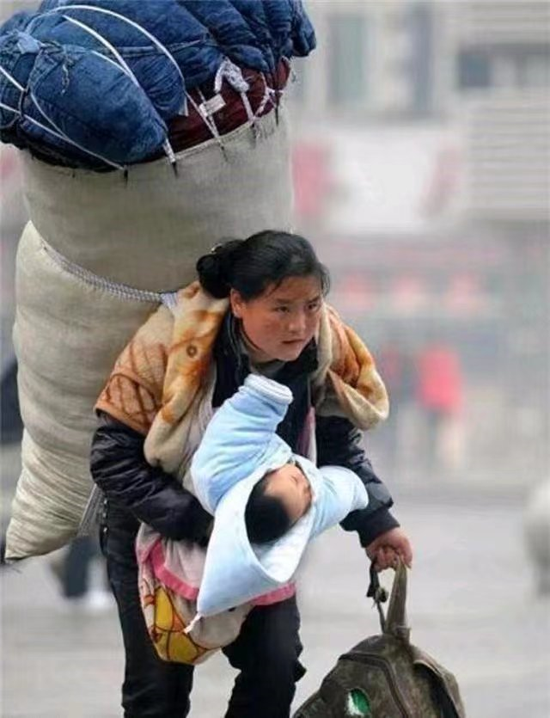
What can you read from the picture?
M
O
T
H
E
R
is for the things she gave me.
means she grows old.
is for the tears
is her heart.
is for eyes.
means right and right always be.
circle
Mother's love is like a __________.
It has no __________ and no ________.
beginning
ending

Slide 4
阅读下面短文，根据所给情节进行续写，使之构成一个完整的故事。
1. In the back of my closet is a small box that has followed me to every new address. It's the first thing I find a place for as the moving truck pulls away. The only remaining contents in it are dozens of notes in my mother's tidy writing.
2. My mother, who put her business degree to use running a small company with my father, while raising me, was always prepared and always gave me abundant love. By day the made marketing slogans and distribution strategies. By night: Hubble baths and bedtime stories. She and I had the same February birthday. Each year my parents arranged wonderful parties.
3. When I was 3, she learned she had advanced breast cancer and immediately began to prepare by researching every available treatment. Each day, she would sit for hours at our dining table, her straight dark hair tied back, surrounded by piles of paper, studying, technical paragraphs.
4.When I was 7, the materials on the dining table began to change. Wrapping(包装) paper and ribbons took the place of her highlighted pages. Scissors swished through gift wrap. Paper creased(折) under her fingers. Ribbon cut to length with one snip. Knots came together with a tiny creak. Swish, crease, snip, creak. She had begun assembling(装配)a gift box for me.
5.Inside, she packed presents and letters for the milestones of my life she would miss--graduation, wedding, and every birthday until the age of 30. My mother died 10 days before our shared birthday. That morning, when I turned 12 and she would have turned 49, I woke up early and opened the box as my mother had shown me.
6. Neat rows of brightly wrapped presents glowed like the spring tulips(郁金香) that were just coming up in the front yard. In the package marked "12th Birthday", I found a little ring with an amethyst(紫水晶) at its center.A white card curling around the present read:"I always wanted a birthstone ring when I was a little girl. I hope you like it, too. Happy birthday, darling girl! Love, your Mommy.”
para. 1 On the morning of my high school graduation, I walked to the box.___________________________
para. 2 Today Ihit 31, and I sat in my room, holding the nearly empty box.___________________________

Slide 5
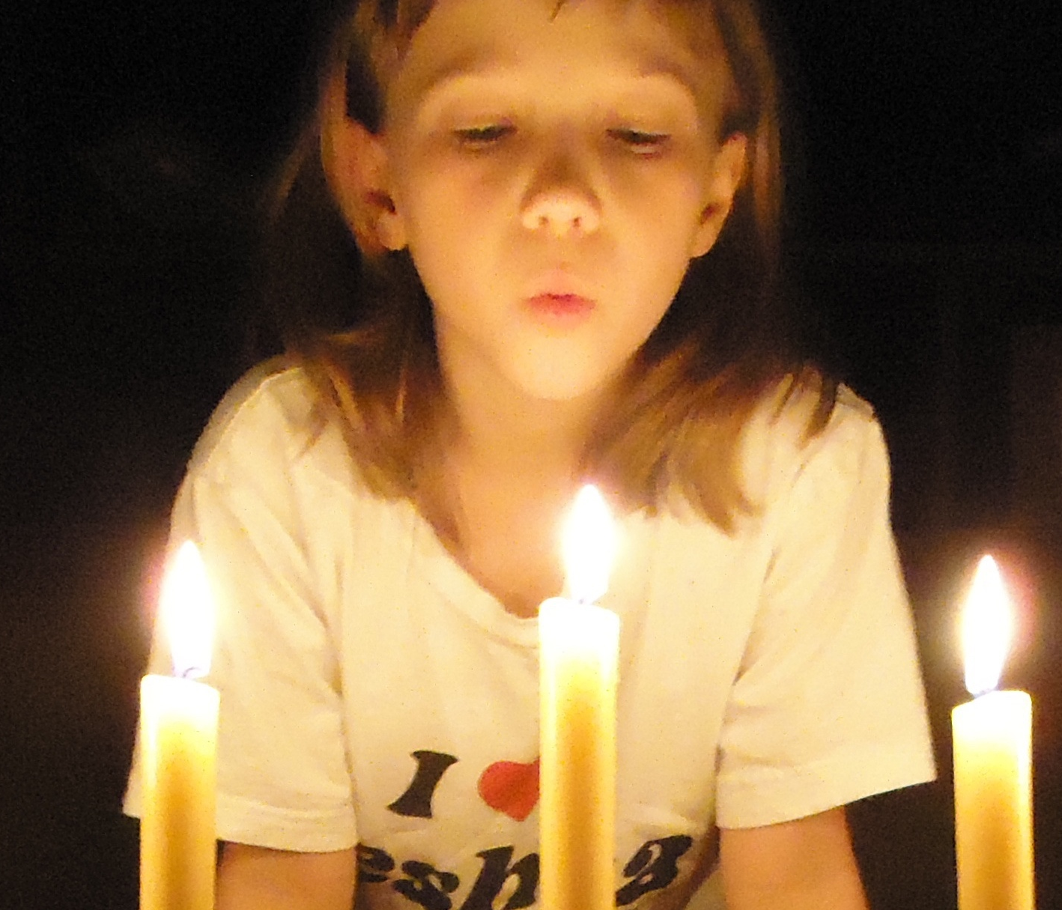
Read for background
Task1. Find out the main characters and setting.
Characters & setting
1. In the back of my closet is a small box that has followed me to every new address. It's the first thing I find a place for as the moving truck pulls away. The only remaining contents in it are dozens of notes in my mother's tidy writing.
2. My mother, who put her business degree to use running a small company with my father, while raising me, was always prepared and always gave me abundant love. By day the made marketing slogans and distribution strategies. By night: Hubble baths and bedtime stories. She and I had the same February birthday. Each year my parents arranged wonderful parties.
traits?
traits?
a small box
I
my mother
precious;
containing dozens of notes from my mother;
capable
gave me abundant love
Exposition: a loving mother & wonderful birthday parties

Slide 6
Read for plots
3. When I was 3. she learned she had advanced breast cancer and immediately began to prepare by researching every available treatment. Each day, she would sit for hours at our dining table, her straight dark hair tied back, surrounded by piles of paper, studying, technical paragraphs.
who wins
crisis
a battle against the cancer
Development:
?
Exposition: a loving mother & wonderful birthday parties

Slide 7
Read for plots
?
4.When I was 7, the materials on the dining table began to change. Wrapping(包装) paper and ribbons took the place of her highlighted pages. Scissors swished through gift wrap. Paper creased(折) under her fingers. Ribbon cut to length with one snip. Knots came together with a tiny creak. Swish, crease, snip, creak. She had begun assembling(装配)a gift box for me.
5.Inside, she packed presents and letters for the milestones of my life she would miss--graduation, wedding, and every birthday until the age of 30. My mother died 10 days before our shared birthday. That morning, when I turned 12 and she would have turned 49, I woke up early and opened the box as my mother had shown me.
6. Neat rows of brightly wrapped presents glowed like the spring tulips(郁金香) that were just coming up in the front yard. In the package marked "12th Birthday", I found a little ring with an amethyst(紫水晶) at its center.A white card curling around the present read:"I always wanted a birthstone ring when I was a little girl. I hope you like it, too. Happy birthday, darling girl! Love, your Mommy.”
Q: Why did my mother assemble a gift box for my milestones until the age of 30 before she died?
Climax
a lost battle
Development: a battle
against the cancer
It’s more than a gift box!
She did what she could to “walk” me through these important moments with her limited time.
Exposition: a loving mother & wonderful birthday parties

Slide 8
Read for prediction
para. 1 On the morning of my high school graduation, I walked to the box.
Q1. What gift did mother prepared for me?
Q2. What words did mother write on the note?
Q3. How did I feel at the sight of the gift and words?
Q4. How to connect para.2?
...
para. 2 Today I hit 31, and I sat in my room, holding the nearly empty box.
Q1. What did I think and feel looking at it?
Q2. How would I deal with it?
Q3. What did I learn from it?
...

Slide 9
How to convey the theme in continuation writing? (如何在续写中升华主题)
1. 基于事实，提炼感悟 (顿悟式)
I
It suddenly dawned on me that although she missed every highlight of my life which was supposed to be shared, her love was, indeed, never absent.

Slide 10
How to convey the theme in continuation writing? (如何在续写中升华主题)
1. 基于事实，提炼感悟 (反思式)
I
...I see it as more of a message from my mother, a reminder of not to lose faith towards life even if I have no idea what might be in store for me.

Slide 11
How to convey the theme in continuation writing? (如何在续写中升华主题)
1. 基于事实，提炼感悟 (颂扬式)
I
...through the fear and blows from life, my mother stayed strong; she persevered, maintained hope and never forgot to show love to me.

Slide 12
How to convey the theme in continuation writing? (如何在续写中升华主题)
2. 通过联想，类比象征(借物抒情式)
I
Empty as the box was, I still treasured it,
because mother’s abundant love packed
inside, just like the candlelight, would
continue to light up the road behind for me.

Slide 13
How to convey the theme in continuation writing? (如何在续写中升华主题)
2. 通过联想，类比象征(借景抒情式)
I
Sunlight flittered in, shining on the box as well as in my heart.
The tulips in the yard suddenly opened in bloom, with its fragrance perfuming the air, far and wide, which brought enormous happiness and rejoice to me.

Slide 14
How to convey the theme in continuation writing? (如何在续写中升华主题)
2. 通过联想，类比象征(温馨画面式)
I
I held the box tightly as if I were
embracing my mommy. Love you
forever, mommy.

Slide 15
One possible version
Para.1: On the morning of my high school graduation, I walked to the box. The box sat quietly at the foot of my bed, as if waiting for me. I opened it, found out the package labeled “graduation” and unwrapped it. A strand of (一串) pearls made a sound like a maraca (沙球) as I drew them from the box. Her note read, “There seemed to be a tradition in my family that when girls graduated from high school, they received a string of pearls. You must be shiny at the ceremony.” As I read, I wanted to fall through the white, lightly textured (质地不平的) page and into her arms. Wearing the pearls that afternoon, I accepted my diploma.
Para.2: Today I hit 31, and I sat in my room, holding the nearly empty box. For 20 years I have pulled mothering(母亲的呵护) from the box. When I was a child, opening the next package felt like a treasure hunt. As I grew older, it began to feel like something far more fundamental, her messages meeting me like guideposts(路牌) in a dark forest. There is no gifts left in the box now, but these letters are a constant reminder that I have already been given what every child, what every human, needs. I have been fiercely, extravagantly /ɪkˈstrævəɡəntli/ (过度地), wildly loved. The love is powerful enough to help me carve my life in the next 20 years, and my whole life.

Slide 16
下水作文
Para.1: On the morning of my high school graduation, I walked to the box. With great care, I opened it and found the well-packed gift marked “17th Birthday.” Gingerly, I unwrapped the small package and what came into my view was the dream present I had wanted for ages——a camera! Eyes moist, I noticed a note attached to it. I unfolded it, and written on it were the familiar words which read “To my dear girl! Here is the gift I was once craving for. Hope you like it and use it to record the highlights in your graduation ceremony. Tears stained my cheeks as I stroked the precious gift. In the following years, this box witnessed each sweet moment in my life.
Para.2: Today I hit 31, and I sat in my room, holding the nearly empty box. A mixture of emptiness and sadness swept over me. I closed my eyes, trying to capture the details when mom was elaborately preparing the gift box with her weathered hands. Despite immense sufferings from her illness, she never ceased showing her love to me. And the box she assembled was not just a gift box, but a means of remembrance and symbols of her love. She might blamed herself for her missing in those milestones of my life, but actually, her deathless love packed in the box, accompanied me, always and forever.

Slide 17
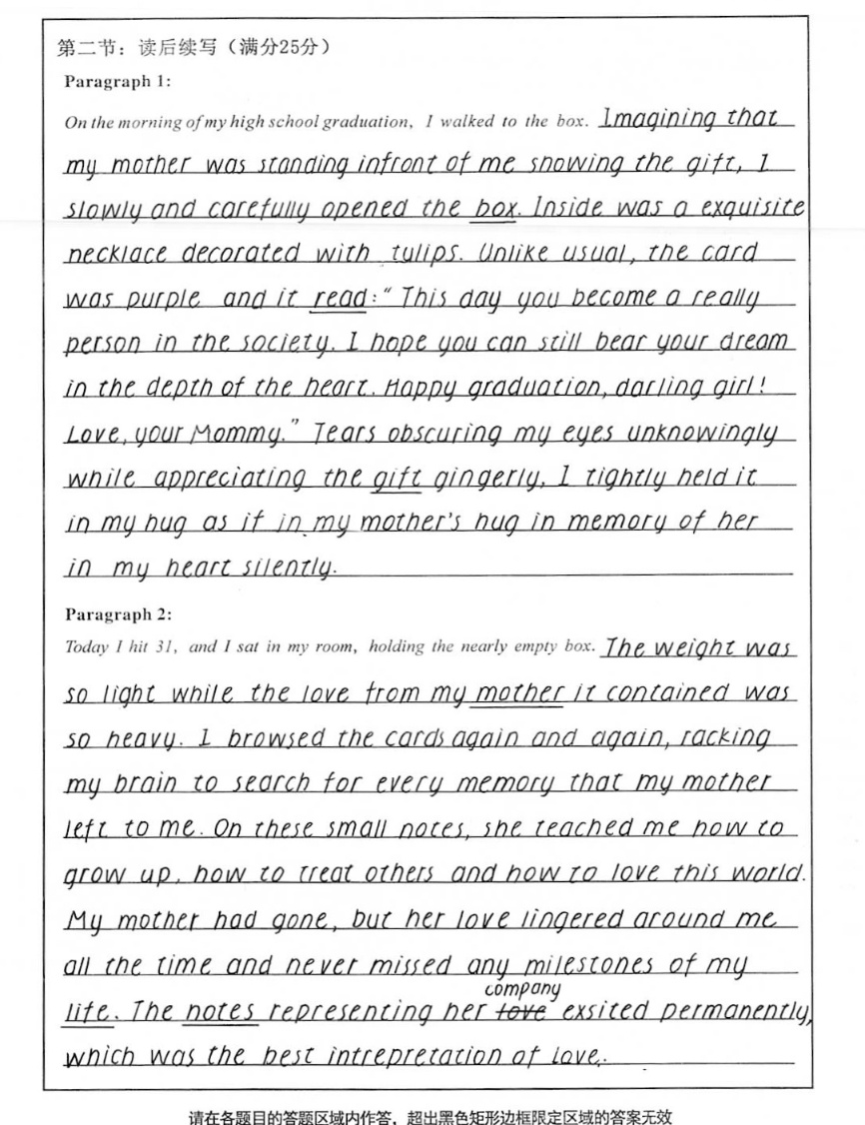
优秀作文
20.5
书写优美；
语言出彩：情感的表达真切自然（如Tears obscuring my eyes unknowingly）； 最后的反思升华了主题。

Slide 18
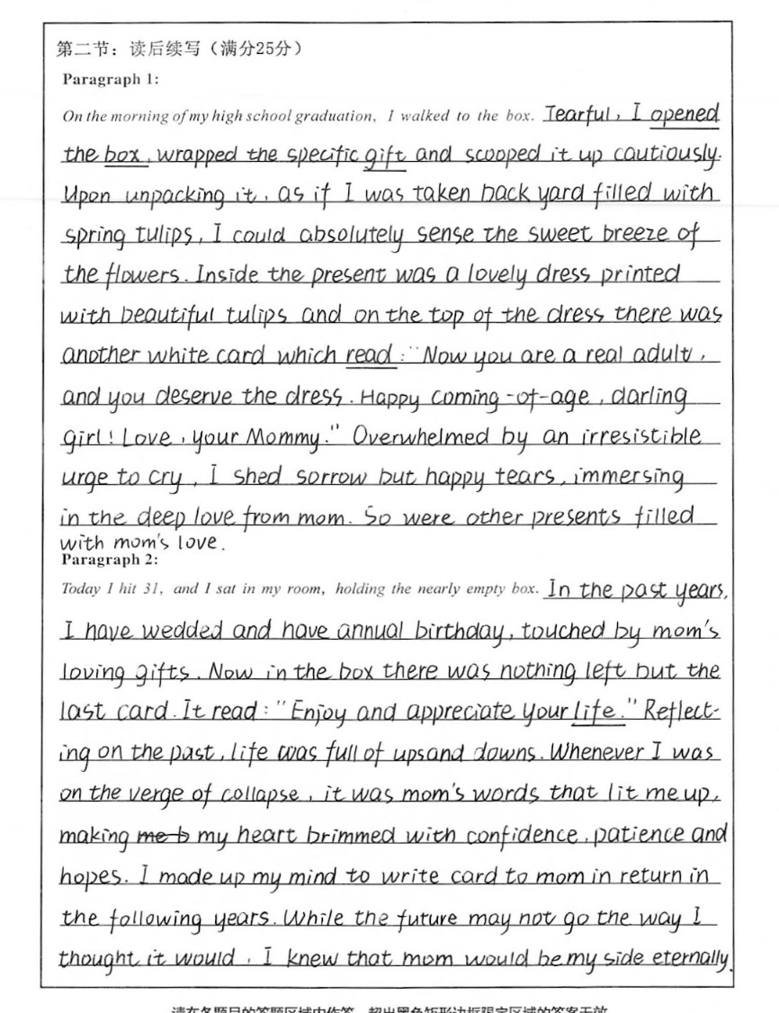
21.5
使用多处生动副词(如cautiously, absolutely, eternally)和形容词(如tearful) 使情感表达更加生动真实；
两段之间衔接自然；
结尾的感悟照应前文，通过心理活动由浅入深地展示了文章主题。

Slide 19
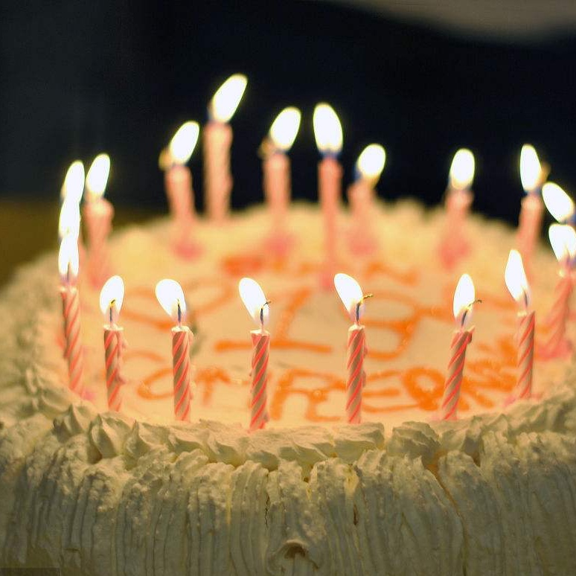
the end

