Slide 1
感恩遇见，相互成就，本课件资料仅供您个人参考、教学使用，严禁自行在网络传播，违者依知识产权法追究法律责任。
更多教学资源请关注
公众号：溯恩英语
知识产权声明

Slide 2
B2U5
Music
The Virtual Choir

Slide 3
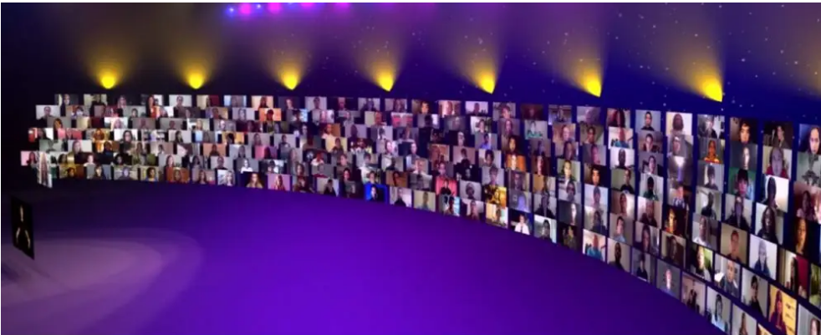
Language study

Slide 4
Listening and speaking
1. Country music __________ my heart.
touches
touch v.
1) to make somebody feel upset or emotional感动；触动；使同情
2) to put your hand or another part of your body onto somebody/something
触摸；碰
Don't touch that plate—it's hot!别碰那个盘子，烫手！
feel
She paid the driver and then, using her hands to ____ 1 ___ the seats, settled in one of them.
1. A. touch B. grab C. count D. feel
feel v. to deliberately move your fingers over something in order to find out what it is like触；摸

Slide 5
2. I like to listen to it when I exercise. It gives me energy.
energy
1)u. n. the strength, effort and enthusiasm required for physical or mental activity, work, etc.精力；活力；干劲
她总是充满活力。
She’s always full of energy.
I must concentrate my energies on decorating today.
energies: the physical and mental effort that you use to do something
精力；力量
concentrate /focus one’s energies on sth.
put one’s energies into sth.
apply/devote one’s energies to sth.
把精力投入到某事当中

Slide 6
合并成为一个视频
2. 志趣相投的私交
3. 参加当地合唱团
4. 证明是积极的影响
5. 获奖作曲家兼指挥
6. 痴迷于莫扎特的古典音乐
7. 获音乐创作硕士学位
8. 原创作品
9. 深受合唱团和歌手的欢迎
10. 风靡全球的现象
11. 同声歌唱
12. 在舞台上
1. be put together into one video
2. contacts who have the same interest
3. join a local choir
4. prove to be a positive influence on…
5. awarding-winning composer and conductor
6. fall in love with Mozart’s classical music
7. receive a master’s degree in musical composition
8. original compositions
Become quite popular among choirs and singers
a worldwide phenomenon
sing with one voice
on stage

Slide 7
Reading and thinking
1. virtual choir
virtual adj. 1) made to appear to exist by the use of computer software, for example on the internet（通过计算机软件，如在互联网上）模拟的，虚拟的
虚拟世界
虚拟现实
the virtual world
virtual reality =VR
He married a virtual stranger.
他娶了一个几乎素不相识的女子。
2) almost or very nearly the thing described, so that any slight difference is not important 很接近的；几乎…的；事实上的；实际上的；实质上的
The economy has come to a virtual standstill.

Slide 8
Para 1
having
1. Imagine _________ (have) the opportunity to sing together with hundreds of other people while you are at home alone.
imagine v. +doing
to form a picture in your mind of what something might be like
想象；设想
想想看，竟赚那么多的钱！
Imagine _________ (earn) that much money!
earning

Slide 9
2. Virtual choir members record themselves while they perform alone on video.
perform
to entertain an audience by playing a piece of music, acting in a play, etc.
演出；表演
2) to do something, such as a piece of work, task or duty做；履行；执行
perform an experiment
perform an operation
3) to work or function well or badly工作，运转（好／不好）
The engine is performing poorly.
He performed well in the test.
performance n.
academic performance 学业成绩

Slide 10
3. Many people do not have close friends or contacts who have the same interest in music.
contact
1) c. n a person that you know, especially somebody who can be helpful to you in your work 熟人；（尤指）社会关系
He has a contact at the White House.
2) u. n
the state of touching/meeting …
接触/遇见 …
目光接触
接触，与…有联系
失去联系
联系方式，联系信息
eye contact
(be/come) in/into contact with…
lose contact with…
contact information

Slide 11
contact v.
to communicate with somebody, for example by phone, letter or email联系，联络（如用电话或信件）
He can be contacted by phone on the number given below.
Please do not hesitate to contact me if you have any questions.

Slide 12
enable sb to do sth.
to make it possible for somebody/something to do something
使能够；使有机会
to add
those
3. A virtual choir enables them __________ (add) their voices to ________ of other individuals and become part of the global community.
替代词=the voices
This new programme will enable older people to study at college.

Slide 13
on
3. It ___________ (prove) to be a positive influence ______ the lives of many people.
has proved
prove 1) link. v. be 后来被发现是；最终显现为 强调结果，没有被动语态
The strategy has proved (to be) successful.
v. show something is true 证明，表示动作
He proved that the strategy was successful.
It was proved that the strategy was successful.

Slide 14
Para 2
1. The virtual choir was the idea of award-winning composer and conductor Eric Whitacre.
award n.
a prize such as money, etc. for something that somebody has done奖；奖品；奖金；奖状
Academy Award 奥斯卡金像奖
Grammy Awards 格莱美奖
award v.
award sb sth/ award sth to sb. 颁奖给某人
A Nobel Prize was awarded to Tu Youyou in 2015.

Slide 15
was moved
Moved
2. Because he _______________(move) by this music, he said, ..
过去分词作状语，表示原因

Slide 16
Para 3
=Because he was inspired
1. __________ (inspire), he asked his fans to make videos, ________ he then joined together into one performance.
Inspired
which
2. Since then, the virtual choir ___________ (become) a worldwide phenomenon.
has become
和现在完成时态连用

Slide 17
3. Altogether, 2,292 young people from 80 countries joined in to sing Whitacre’s song “What if”.
join (sb) in +n: to take part in an activity with other people
参加，加入（活动）
She listens but she never joins in.
她只是听，但从来不发表意见。
Will you join us in the discussion?
Do you mind if I join you?
我和你们在一起，可以吗？

Slide 18
2) Many others do not have the chance to join a local choir. (Para 1)
join v. to become a member of an organization, a company, a club, etc.
成为…的一员；参加；加入
3. Inspired, he asked his fans to make videos, which he then joined together into one performance.
join: become one 合二为一
join …together into one performance/video
=put…together into one performance/video

Slide 19
THANK YOU

