Slide 1
感恩遇见，相互成就，本课件资料仅供您个人参考、教学使用，严禁自行在网络传播，违者依知识产权法追究法律责任。
更多教学资源请关注
公众号：溯恩高中英语
知识产权声明

Slide 2
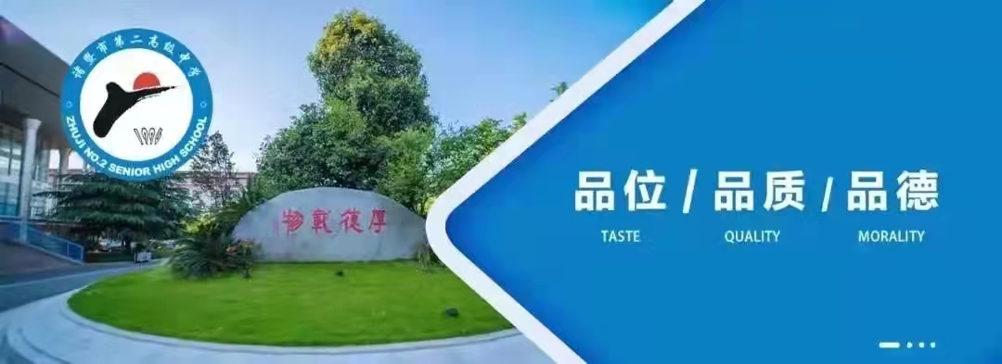
Welcome To My Class
Zhuji No.2 High School Luo ChunLi

Slide 3
Lead-- in

Slide 4
Climate change has a great impact on our oceans, our_________, our food sources and our ________. Ice sheets are melting. Extreme weather is caused such as major storms,_________, heavy _________, and longer___________. So growing crops becomes more difficult. Also, people's health is directly affected for exposure to higher levels of smog. while the dramatic weather change is mainly caused by ____________, humans are also the ones who can combat it.
weather
health
floods
snowfall
droughts
humans
How ?

Slide 5
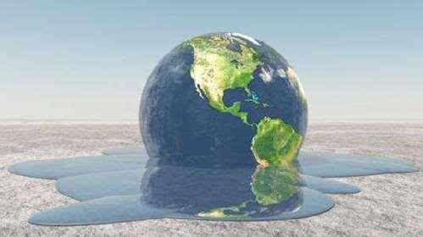
Explore the title and predict
Climate Change Requires The World’s Attention
Why
How
How
What
Exposition

Slide 6
Read main idea
Reading strategy
You can find main ideas by first taking a quick look at the title, pictures, key words and phrases, and topic sentences.
Para 1& para2
Main idea:
A _______________ of climate change.
problem
Main idea:
An exact _____ of climate change.
case

Slide 7
Para 3
Main idea:
The _______ of the increase in the global temperature.
causes

Slide 8
Para 4
Main idea:
___________________of the rise in temperature.
The consequences

Slide 9
Para 5
Main idea:
_______________ to reducing greenhouse gas emissions.
solutions

Slide 10
Read for structure
Para1 | A ________________ of climate change
Para2 | An exact _________________ of the climate change
Para3 | The _______________ of the increase in the global temperature
Para4 | The _______________ of the rise in global temperature
Part5 | The _______________ to reducing greenhouse gas emissions
problem
case
causes
Exposition
consequences
solutions

Slide 11
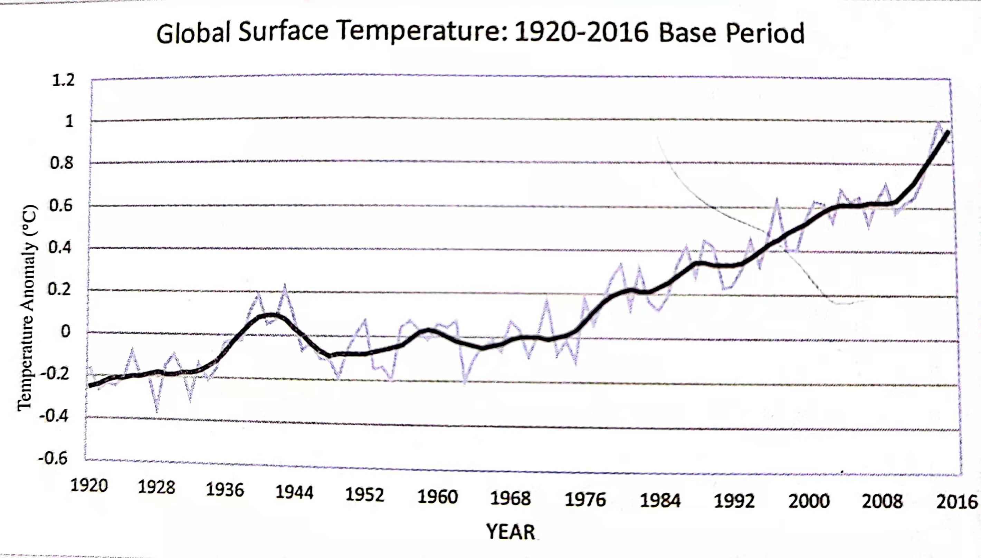
Read for details
A problem
what ?
Why ?
climate's getting warmer and warmer
evidence\cases
a warming ocean & atmosphere
melting ice
rising sea levels
a dead polar bear

Slide 12
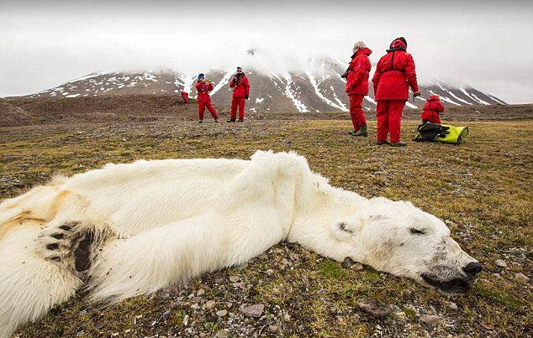
Climate change's influence on the polar bear's life
climate change
low sea-ice levels
led to
so
greater distance
had to
no seals
during the process
severe starvation
at last
dead body

Slide 13
Read for details
The causes
The greenhouse effect
types
the “natural” one
the “man-made”one
function
results
keep the earth's climate warm and habitable
cause the earth's surface to rise quickly

Slide 14
The greenhouse effect

Slide 15
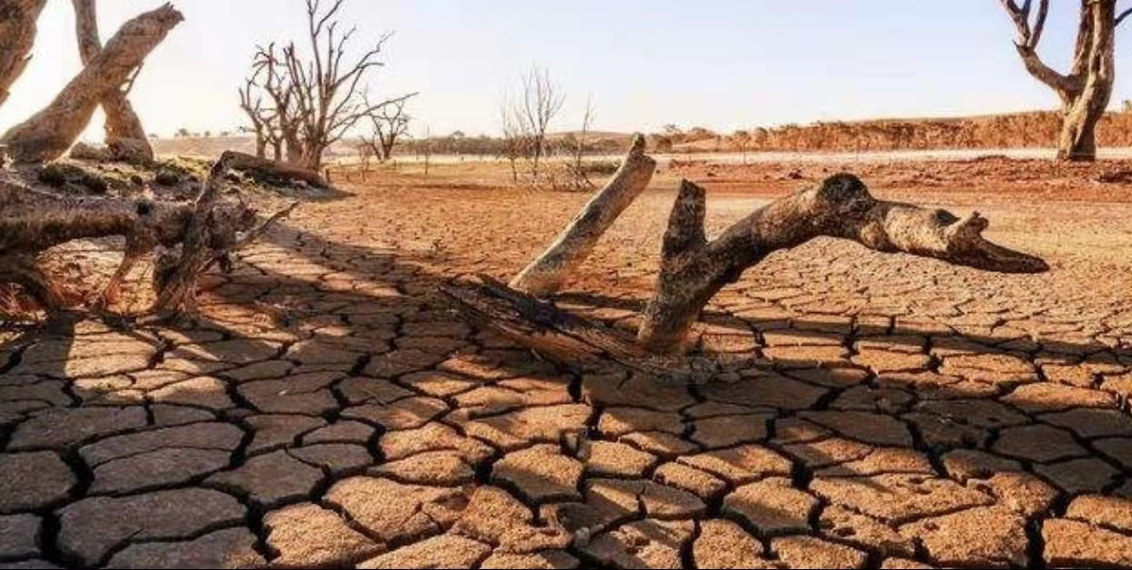
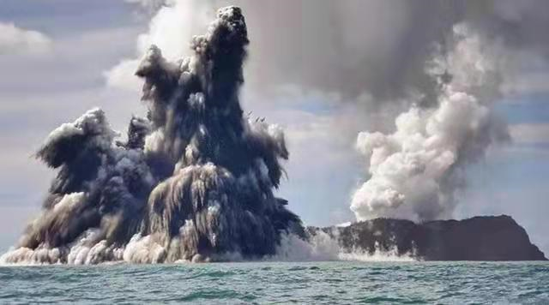
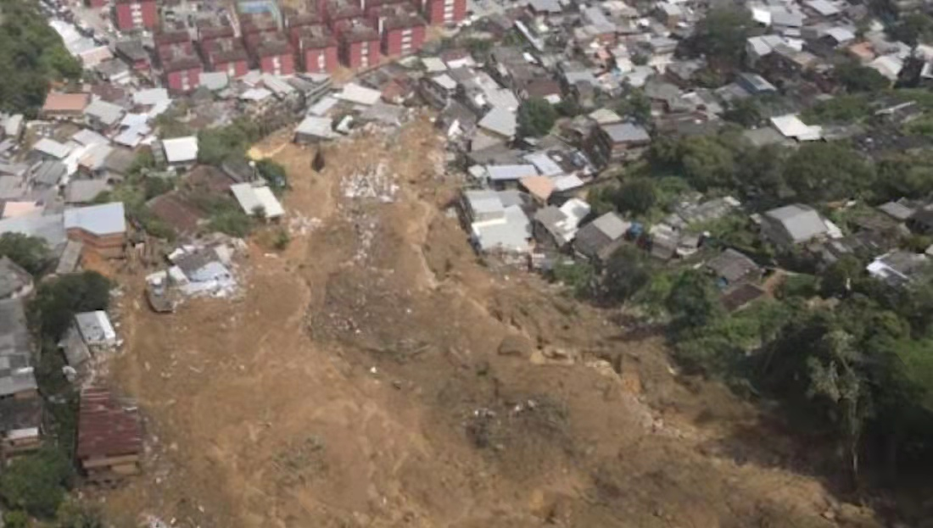
Read for details
climate scientists' warning ?
The consequences
more extreme weather &
natural disasters
serious damage & death
Because it needs to be brought to everyone’s attention
and it is essential that we take action .
Rainstorm in Rio de Janeiro，Brazilia in 2022
Drought in western US in 2021
Volcanoe ruption inTonga in 2022

Slide 16
Read for details
Who | Measures
Governments
make policies & take measures
to reduce greenhouse gas emissions
we individuals
reduce our “carbon footprint”
So what will you do to help ?
Why ?
To urge readers to take immediate measures

Slide 17
Draw a diagram
please draw a diagram to review what we've learned.

Slide 18
A problem
A case
The causes
climate's getting warmer and warmer
a dead polar bear
the natural greenhouse effect
the man-made one
The solutions
The consequences
governments
individuals
extreme weather
natural disaster

Slide 19
Read and think
What writing techniques does the author use ?
Notes:
各个方法请结合文本的具体体现

Slide 20
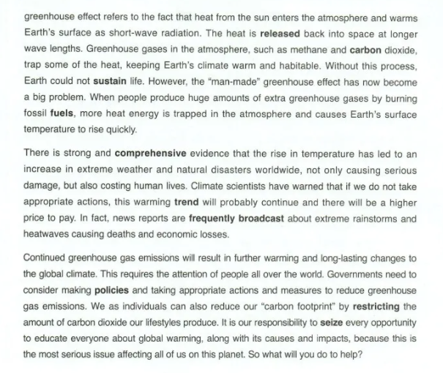
writing techniques
using a graph
using an example
asking a question
making an explanation
making a comparison
leaving a question

Slide 21
Read and think
What is the author's purpose of writing this text?
To inform us readers of the terrible consequences of climate change and urge us to do whatever we can to deal with the problem.

Slide 22
Discuss
As an individual, what can we do
to deal with the climate change?
Sort the garbage
Abate the use of plastic bags
Value our own role
End wasting resources
Encourage others to paticipate in it
Alter our lifestyle
Ride a bike or walk to school
Turn off all electric devices when not in use
Help inform those around the danger of global warming
...
Who is more likely to blame for climate ? Any reasons ?

Slide 23
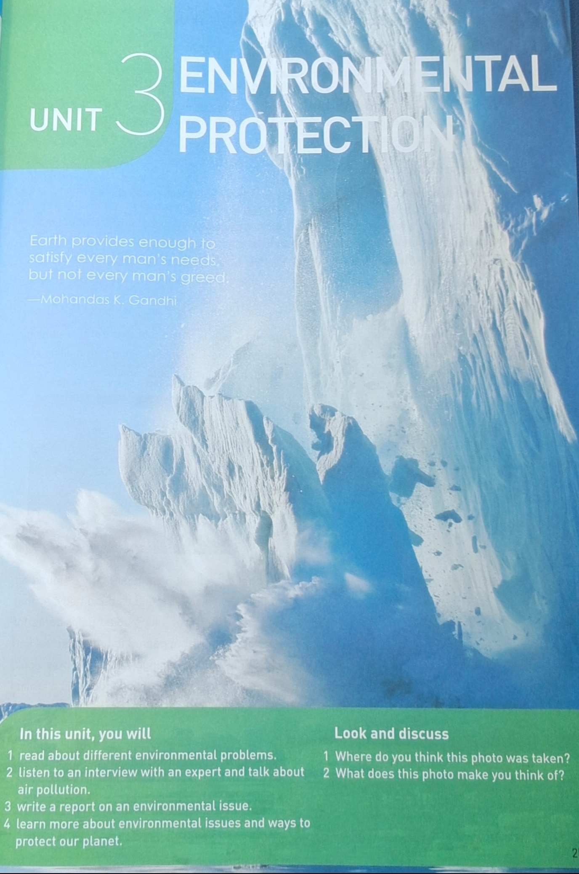
A Conclusion
Earth provides enough to satisfy every man's needs, but not every man's greed.
------Mohandas K.Gandhi

Slide 24
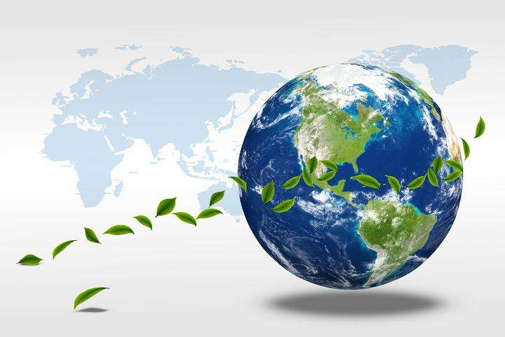
Together, let's return green to the earth !

Slide 25
Homework
你校为应对全球变暖，保护地球家园，特向全体学生们发出“低碳减排，绿色生活”的倡议。假如你是学生会主席李华，请你根据以下要点写一封英语倡议书，内容包括:
1. 发出倡议的目的;
2.“低碳减排，绿色生活”的几点建议;
3.呼吁大家采取行动。
注意：
1.词数80左右;
2.可适当增加细节，使行文连贯。

Slide 26
Possible version
Dear friends,
Nowadays, the weather is becoming warmer and warmer.Not only has it caused the increase of the extreme weather but also costed humans life. So it's time for us to do our part to reduce our “carbon footprint “.
I believe green travel can make a difference . Firstly，We should choose to walk or ride a bicycle if it's a short distance travel. Secondly, whenever possible, it's good to take public transportation rather than private cars so as to cut down gas emission. What's more, sorting garbage is also of great help.
Such measures can definitely make a marked improvement in drcreasing gas emission, so let's take action and live a low-carbon life from now.
Students Union

Slide 27
Thank you !

