Slide 1


感恩遇见，相互成就，本课件资料仅供您个人参考、教学使用，严禁自行在网络传播，违者依知识产权法追究法律责任。
更多教学资源请关注
公众号：溯恩高中英语
知识产权声明

Slide 2
人教版新教材选择性必修三 Unit4
Discover useful structures

Slide 3






Make a guess
parents
They have been looking after you since you were born. They have been providing you with whatever you want. They have been loving you deeply. Do you know who they are?

Slide 4

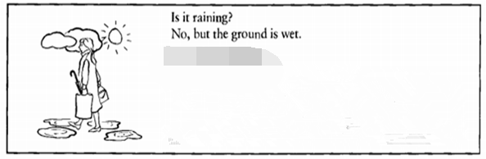
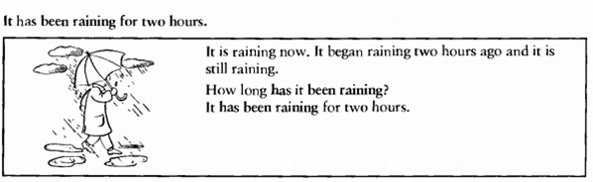

It rained last night, but it stopped this morning.
In meaning: the action is continuous from the past
The Present Perfect Continuous Tense
In form: have/has been doing
Now look for more sentences with the present perfect continuous tense in the reading passage, and summarise its use in your own words.

Slide 5
Observe and discover
1. This is the adventure that I have been dreaming of.
2. We are now camped on the rice and we have been managing to survive, but spring is coming, and the ice will soon begin to melt.
3. We have been struggling for days, but things on Elephant Island are going from bad to worse.
The present perfect continuous tense
现在完成进行时

Slide 6
DISCOVER
What kind of tense is used in the sentence?
We for days.
have been struggling
have /has done
be doing
present perfect tense
现在完成时
continuous tense
进行时
现在完成进行时
FORM:
have /has + been + doing

Slide 7
Task 1
Complete the conversation.
Put the verbs into the present perfect progressive.
Interviewer: Liu Fang, what___________________ (do) recently?
Liu Fang: Well, I _______________ (give) concerts in America.学
Interviewer: Have you ______________(play) any new pieces?
Liu Fang: Yes. I __________________ (play) some classical American tunes.
Interviewer: What else have you____________ (do)?
Liu Fang: I __________________(learn) how to play the konghou.
网
have you been doing
have been giving
been playing
have been playing
been doing
have been learning

Slide 8
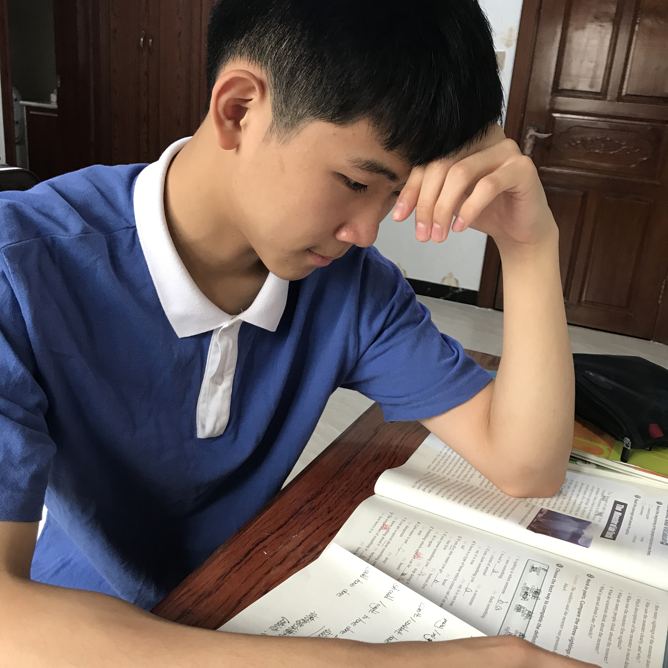
DISCOVER
has been reading
started
still
go on
reading
2 hours ago
now
Past
future

Slide 9

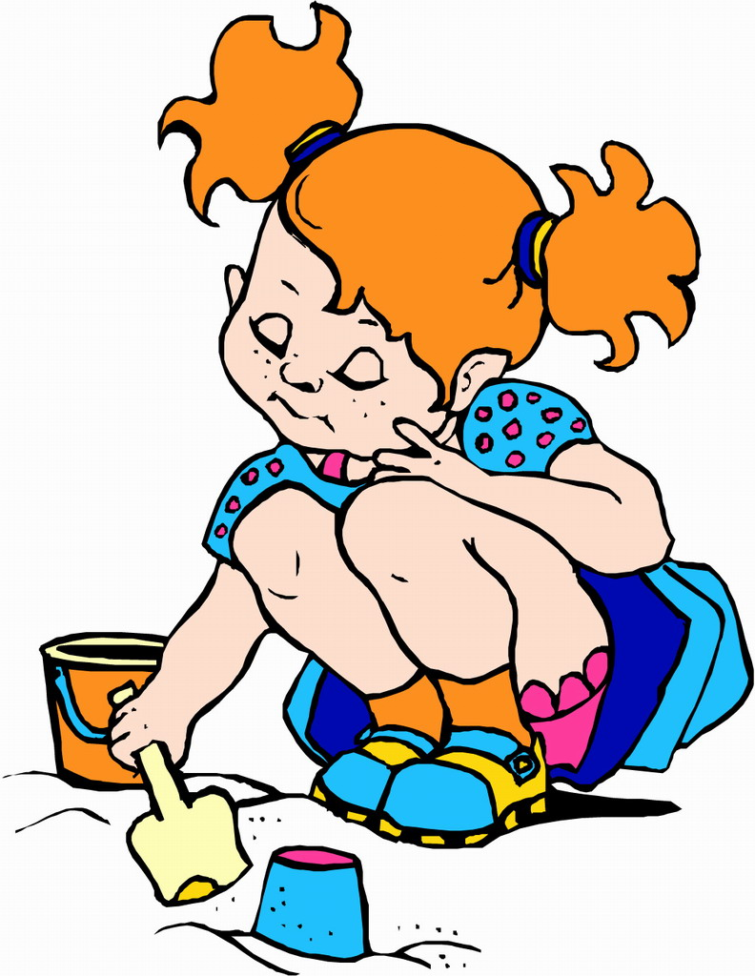
DISCOVER
Sorry. Have you been waiting long?
Lily
Cathy
I have been waiting for an hour.

Slide 10

DISCOVER
Lily
started
arrives
Cathy
has been waiting
waiting
One hour ago
now
Past
future

Slide 11
Conclude
We use the present perfect progressive tense to talk about non-stop actions that have just finished but are still connected to the present in some way.

Slide 12
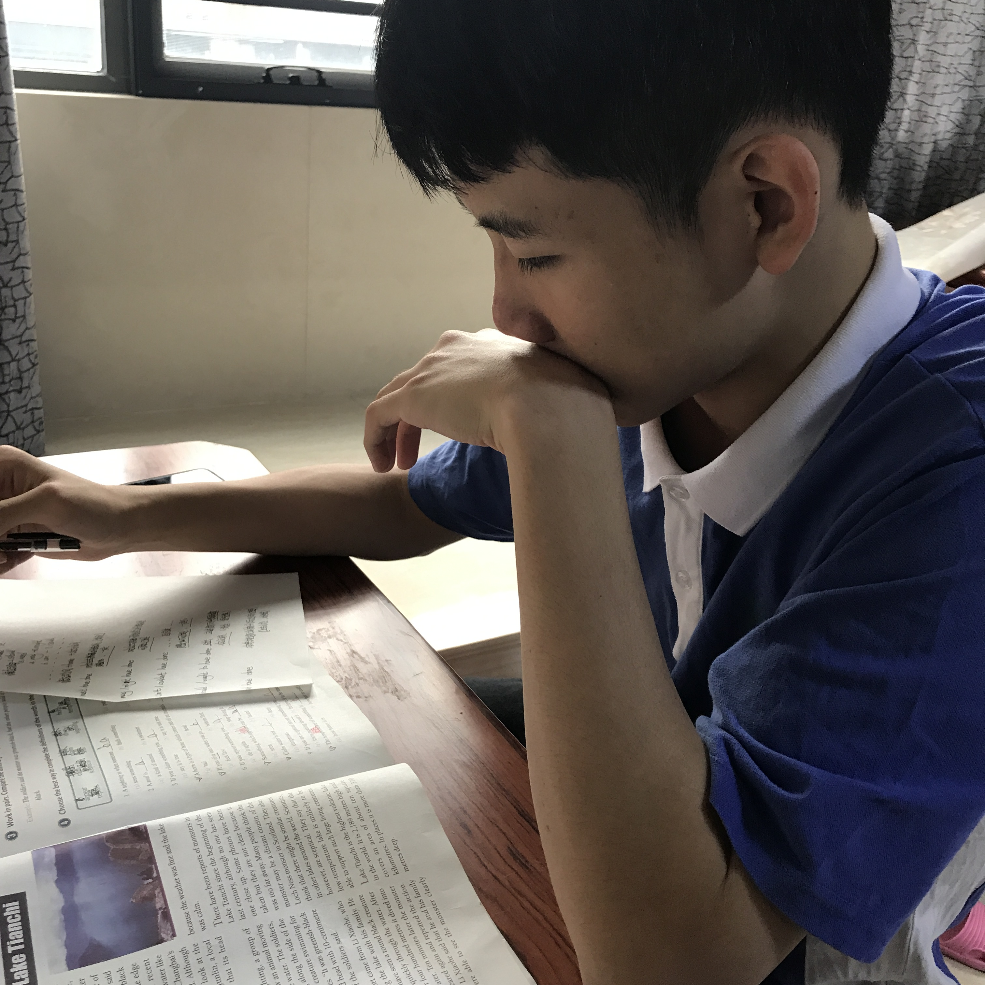
DISCOVER
He started learning English in 2010.
He is still learning English now.
He has been learning English for 6 years
/since 2010.

Slide 13
DISCOVER
started
still
go on
has been learning
learning
2010
now
Past
future

Slide 14
Conclude
We also use the present perfect progressive tense to talk about actions that started in the past and are still continuing.

Slide 15
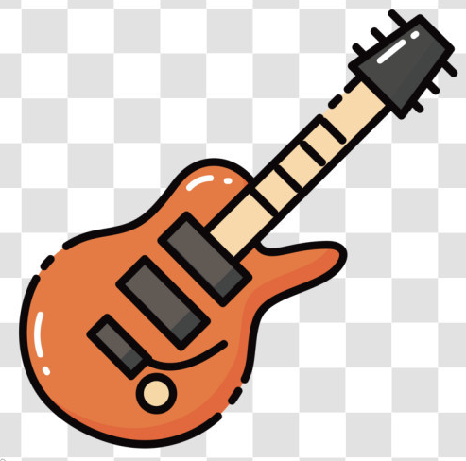


Summary 1
过去
表示动作从 开始一直持续到现在，这动作可能刚 也可能 .
停止
继续下去

Slide 16

PRACTICE
Understand the following situations and complete the sentences.
Pay attention to the time adverbials.

Slide 17
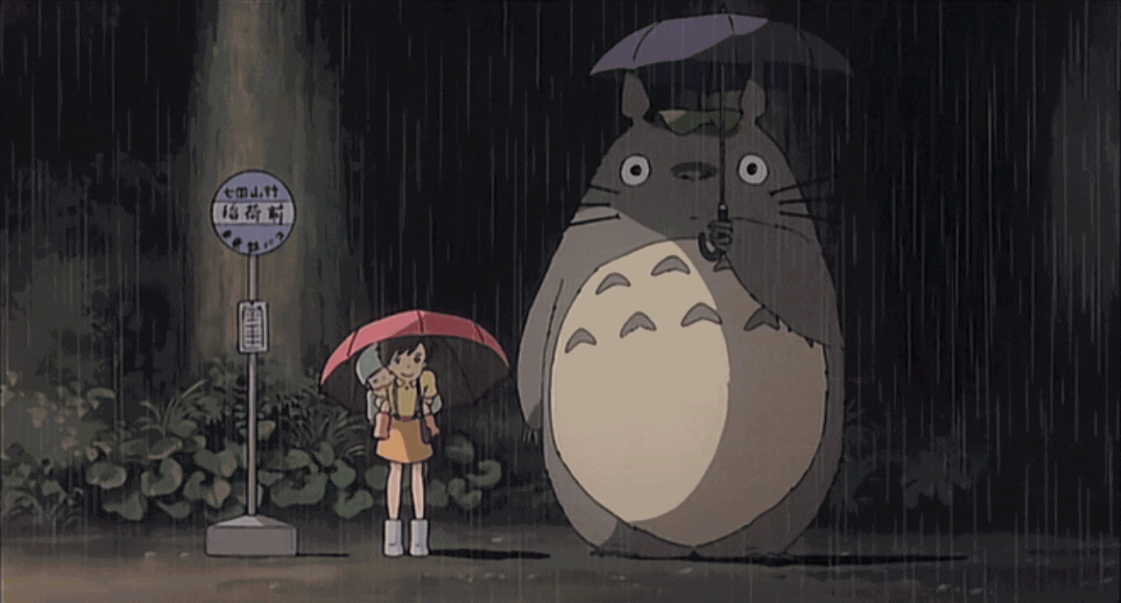
Practice 1
It began to rain this morning.
It is 6 pm now and it is still raining.
It__________________ all day. .
has been raining

Slide 18
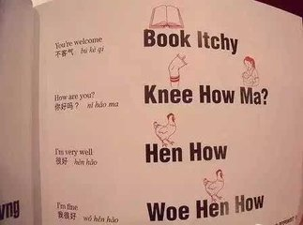
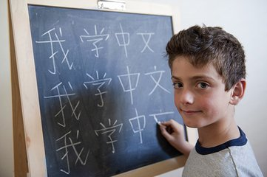
Practice 2
He is still learning Chinese now.
He_________________________ since December.
has been learning Chinese

Slide 19

Practice 3
Mike began looking for a job six months ago.
He is still looking now.
has been looking for a job
Mike________________________ for six months.

Slide 20
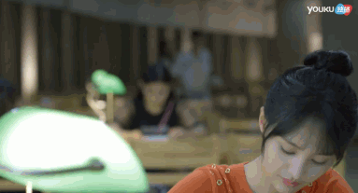
Practice 4
She _________________ (study) in the library every night over the last three months.
has been studying

Slide 21
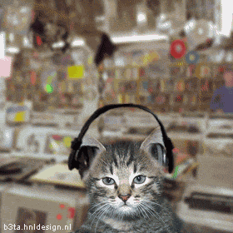
Practice 5
have been sitting
I _______________ (sit) here enjoying the music all the morning.

Slide 22
It has been raining all day.
He has been learning Chinese since December.
Mike has been looking for a job for six months.
She has been studying in the library
every night over the last three months.
I have been typing the whole morning.
I have been sitting here enjoying the music
all the morning.
all day
since December
for six months
every night over the last three months
all the morning
Common time adverbials

Slide 23
Common time adverbial
It has been raining all day.
He has been waiting for a car for 20 minutes.
He has been learning Chinese since December.
I have been typing the whole morning.
all day
for 20 minutes
since December
the whole morning

Slide 24

Summary 2
Summarize the time adverbial
for+时间段 /since+时间点
all day /all night /all the morning /all the time
this week /this month
recently最近

Slide 25
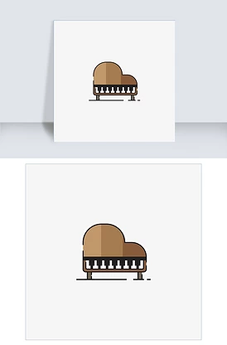
Extension
Spot the difference between the tenses.
have/has been doing VS. be(was/were) doing
have/has been doing VS. have/has done

Slide 26
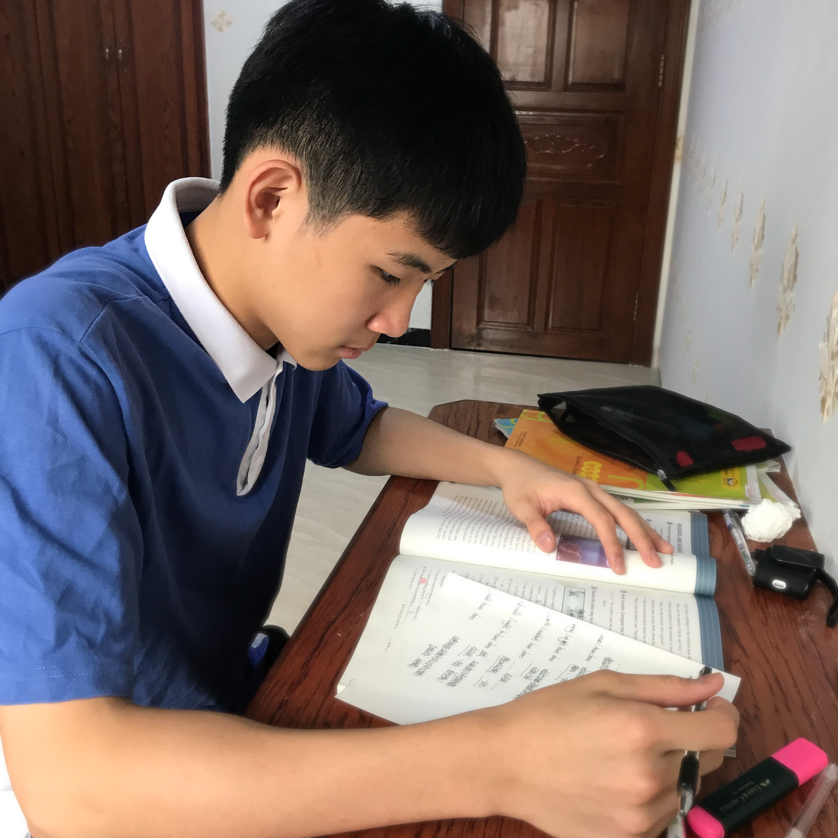
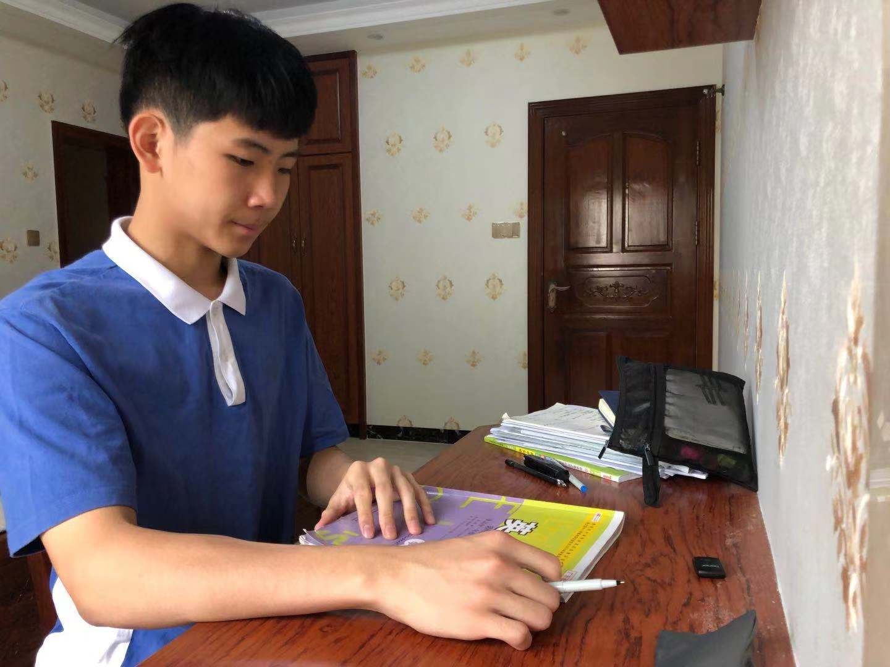
DISCOVER
Lin Zipeng has read the book.
Lin Zipeng was reading the book.
Lin Zipeng has been reading the book all the morning.
be reading
has read
has been reading

Slide 27
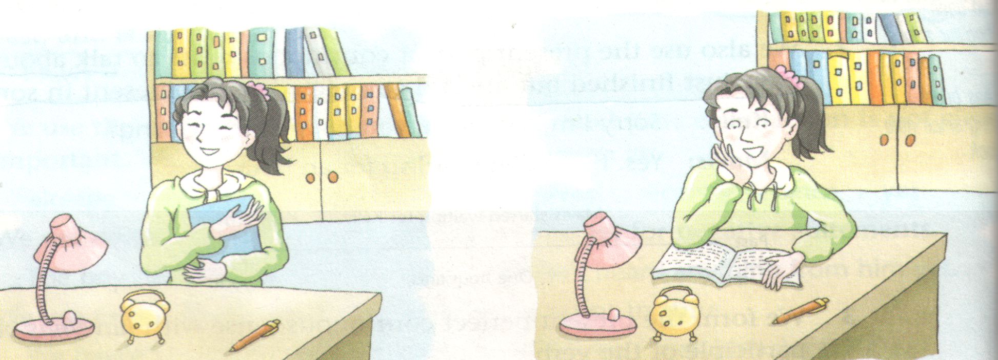
Spot the Difference
have been doing VS. have/has done
A
Li Jia has read a book. She likes it very much.
Li Jia has been reading a book.
She finished reading the book.
B
She is still reading the book.
A
B

Slide 28


The ceiling was white. Now it is green. Tom has painted the room.
B
He finished painting the room.
A
Tom’s clothes are covered with paint. He has been painting the room.
He is still painting the room.
A
B

Slide 29
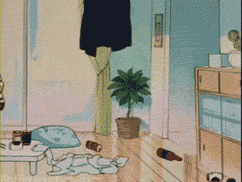
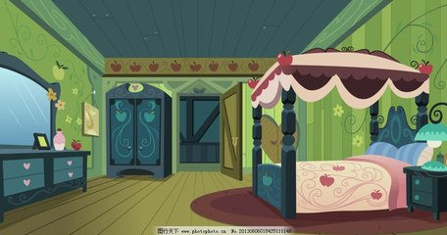
A
Mary is busy. She has been cleaning the room.
She is still cleaning the room.
B
The room is tidy. Mary has cleaned the room.
She finished cleaning the room.
A
B

Slide 30
Function
A. the present perfect tense 现在完成时
B. the present perfect progressive tense 现在完成进行时
1.________is used to talk about an action completed in the recent past but are connected with the present.
2. _______is used to talk about an action that started in the past and is still happening or a non-stop action or a repeated action until recently.
A
B

Slide 31
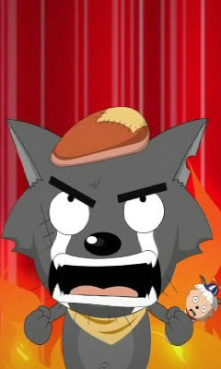
Practice
has been doing
---Mr. Wolf, what have you
been busy with these days?
---I ________________ (try)
to catch goats, but ______
never ________ (catch) a
single one so far.
past
present
future
have been trying
I will be back soon!
have
caught
has / have done

Slide 32

Summary 3
Difference
be(was/were) doing强调过去某时刻或某段时间正在进行的动作;
have/has done强调动作已经完成/结束, 行为结果在现在能感受到;
have/has been doing强调动作仍在持续，有时候带有感情色彩。
动作的结果
动作的延续性

Slide 33
Task 2
Complete the passage with the correct form of the verbs.
Last night, I___(went /have been) to see a concert by the Chinese- born Canadian artist Liu Fang. She was born in China and____(studied /has been studying) music in Shanghai, but she_____(lived /has been living) in Canada since 1996. She_____(played /has been playing) traditional Chinese music since she was very young. Last night, she____(performed /has performed) a series of classical Chinese pieces for the pipa and the guzheng. I____(bought /have bought) a CD of her music after the concert and I ___(listened /have been listening) to it all day today!

Slide 34


Interview your partner about something about he/she: hobbies, new habits, family, hometown and dream etc. The following questions might help you.
Do you have any hobbies or interests?
How long have you been learning / playing …?
What have you been doing recently?
REQUIREMENT: Use the present perfect continuous if possible.

Slide 35

A: Do you have any hobbies?
B: Sure. I have several hobbies such as table tennis, photography, and kite flying. But my favourite hobby is playing the guitar.
A: How long have you been learning the guitar?
B: I have been learning the guitar since I was eight years old. I saw a video of someone playing and I fell in love with it.
A: That’s great.

Slide 36

Show Time!

Slide 37

Enjoy a song and fill in the blanks.
I ________________ with a shadow overhead.
I __________________ with a cloud above my bed.
I ____________________ all my hopes and dreams away.
I ___________________ aside time.
I ___________________ but the stars refuse to shine.
I ___________________ but I just do not see the signs.
I ______________________ someone to shed some light.
have been living
have been sleeping
have been hiding
have been setting
have been watching
have been searching
have been looking for

Slide 38

Write a short report about something about your friend: hobbies, new habits, family, hometown and dream etc. according to your interview. Remember to use the present perfect continuous tense.

Slide 39

Writing
I have a friend, who is crazy about collecting snow globes. He has been collecting snow globes for seven years, and now he has 226 of them in total, but his mom said last weekend that he would have to stop , because they’ve run out of room to store them. Therefore his parents have been encouraging her to build up interests in another hobby. He has been learning the guitar since he was eight years old, when he saw a video of someone playing and fell in love with it. Luckily there will be a Singing Contest in our school to be held next month, so he has been practising because he is going to sing a song about my hometown with guitar accompaniment. I wish he would achieve success in the contest and realize his dream of being a singer one day.

Slide 40


