Slide 1



感恩遇见，相互成就，本课件资料仅供您个人参考、教学使用，严禁自行在网络传播，违者依知识产权法追究法律责任。
更多教学资源请关注
公众号：溯恩英语
知识产权声明

Slide 2
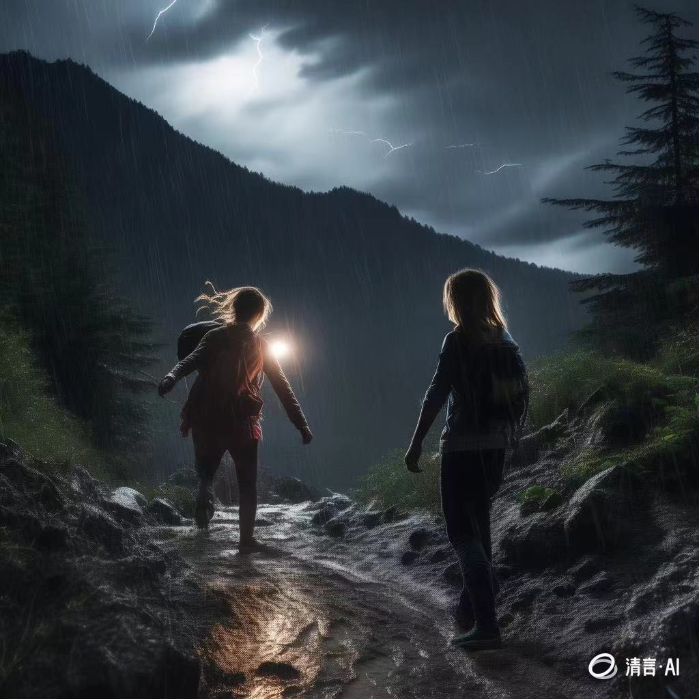
Magic Backpack Rescued Sisters Trapped in the Storm
---2024-10 强基联盟
人与自然之脱困篇
郑素红

Slide 3
读原文:
A high-pitched scream stopped Laura Douglas in her tracks. Spinning around on the narrow dirt path, she thought that her cousin Cassie was in danger. Instead, Cassie was knee-deep in flowers that covered the meadow (草地) like a quilt.
“Cassie! You scared me to death!” Laura scolded, her voice echoing through the meadow. “I am sorry,” Cassie, absorbed in her photography, didn’t notice the thick fog rolling in, consuming the nearby mountains. “Not again!” Laura complained, her eyes shifting to the approaching clouds. “We gotta go!”
Cassie’s focus remained on her camera, capturing the short-lived beauty of the moment. Laura tied a red scarf around her hair. “Let’s go back to the campsite.” The girls quickly ran down the winding path, the meadow now covered by a thick fog and a steady, cold rain. The road turned slippery, and they had to move slowly to avoid sliding down.

Slide 4
“It’s dangerous! We need shelter now!” Cassie screamed after a loud crack of thunder, the storm’s strength increasing rapidly. Laura’s keen eyes found a small cave in the rock face, partly hidden by overhanging branches. It wasn’t much, but it offered a chance to escape the rain.
“Cassie, over here!” Laura called out, her voice barely carrying over the wind.
Cassie, wet and shaking, stumbled towards the place of Laura’s voice. As she approached, she could see the shelter. It wasn’t perfect, but it was better than nothing.
“Smart thinking, Laura,” Cassie said, her teeth chattering (打颤) with cold as she pressed her backpack close to her chest. The backpack, a tough and waterproof (防水的) model, had been a gift from her father, an experienced hiker who had insisted on its numerous pockets and sections for emergency supplies. Little did they know, his advice would prove invaluable on this day.
Para1: “Check your backpack,” Laura instructed, her voice being hopeful.
Para2：As night fell, the storm finally began to die down.

Slide 5
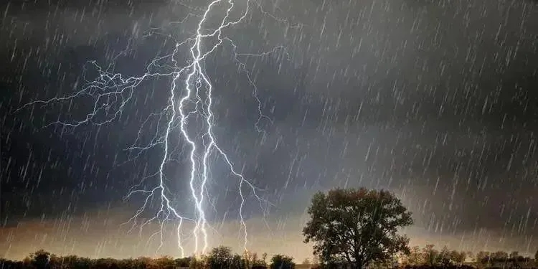
Read for elements
Major roles: Laura & Cassie
Minor roles : Cassie’s father
2. narrative perspective: third-person ( she ; they )
3. time： late afternoon --- night
place： in a mountain
event: The cousins were trapped in the storm.
6. Analyze
conflicts
Conflict : Laura and Cassie were trapped in a storm.
Solution: How did they survive the storm with the backpack?

Slide 6

5.
story
line
The backpack, a tough and waterproof (防水的) model, had been a gift from her father, an experienced hiker who had insisted on its numerous pockets and sections for emergency supplies.
Climax
Para1: “Check your backpack,” Laura instructed, her voice being hopeful.
Laura’s keen eyes found a small cave in the rock face, partly hidden by overhanging branches. It wasn’t much, but it offered a chance to escape the rain.
Laura tied a red scarf around her hair. “Let’s go back to the campsite.” The girls quickly ran down the winding path.
Para2：As night fell, the storm finally began to die down.
Cassie, absorbed in her photography, didn’t notice the thick fog rolling in, consuming the nearby mountains.
background
Ending
Beginning

Slide 7

Read for clues and echoes
hidden clues | echoes
A high-pitched scream stopped Laura Douglas in her tracks. Spinning around on the narrow dirt path, she thought that her cousin Cassie was in danger. Instead, Cassie was knee-deep in flowers that covered the meadow (草地) like a quilt. | 1. A fragrant scent from the meadow covered with a quilt of flowers filled their nostrils.

Slide 8
Read for clues and echoes
hidden clues | echoes
“Cassie! You scared me to death!” Laura scolded, her voice echoing through the meadow. | 2. After what seemed an eternity, a familiar voice echoed in the ears. “ There you are!” It was Cassie’s father.

Slide 9
Read for clues and echoes
hidden clues | echoes
…“Let’s go back to the campsite.” The girls quickly ran down the winding path, the meadow now covered by a thick fog and a steady, cold rain. The road turned slippery, and they had to move slowly to avoid sliding down. | 3. “ We’d better find our way back to the campsite.” Laura said firmly, holding Cassie’s hand tightly. 4. Leaving the temporary shelter, Laura and Cassie walked down the slippery winding path leading to their campsite, struggling to keep their balance to avoid sliding down.

Slide 10
Read for clues and echoes
hidden clues | echoes
“It’s dangerous! We need shelter now!” Cassie screamed after a loud crack of thunder, the storm’s strength increasing rapidly. Laura’s keen eyes found a small cave in the rock face, partly hidden by overhanging branches. It wasn’t much, but it offered a chance to escape the rain. | 5. Panicked by the blazing lightning and the rumbling thunder, Cassie hugged Laura tightly, trembling all over. 6. The storm strength/ power lessened gradually, with the weak crack of the rumbling thunder in the distant.

Slide 11
Read for clues and echoes
hidden clues | echoes
The backpack, a tough and waterproof (防水的) model, had been a gift from her father, an experienced hiker who had insisted on its numerous pockets and sections for emergency supplies. Little did they know, his advice would prove invaluable on this day. | 7. What astonished the cousins was that the magic backpack contained a wide variety of invaluable emergency supplies.

Slide 12
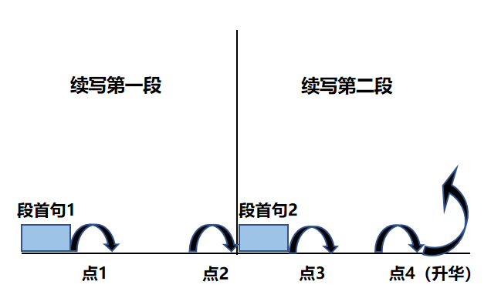
Plot Continuation
点1：位于续写第一段段首，流畅衔接前面的故事（常与原文最后一段呼应）和第一段段首语；
点2：位于续写第一段段尾，流畅衔接第二段段首句；
点3：位于续写第二段段首，续写衔接第二段段首语；
点4：文章结尾升华，给予读者正能量，揭示和强调主题。

Slide 13
Plot the continuation story
Para1: “Check your backpack,” Laura instructed, her voice being hopeful.
Para2：As night fell, the storm finally began to die down.
Link1: Who opened the backpack? What supplies were in it?
Body: What did they do with the supplies? How did they feel?
Link2: What was the situation in the cave now ?
Link3: What about the circumstances? What did they do?
Body: How did they get back to the campsite? How about their feeling?
Ending: What was the ending of the adventure?

Slide 14
心理描写
神态描写
动作描写
外貌描写
环境描写
对话描写
语言
无灵主语
动作链
分词作状语
With 复合结构
独立主格
从句
倒装句
虚拟语气
强调句
长短句结合
考生构思情节的同时，要考虑合适的语言句式以及修辞

Slide 15
Design link1
Para1: “Check your backpack,” Laura instructed, her voice being hopeful.
Link1A: (呼应原文最后一段backpack‘s relevant information） Cassie, still quivering with cold, unzipped the tough and waterproof backpack in the hope of finding something invaluable.
Link1B: （呼应原文的the cave & Laura’s sharp eyes） Thanks to Laura’s sharp eyes, they found a relatively ideal shelter and protected themselves against the terrible storm.

Slide 16
Design link2
Para1: “Check your backpack,” Laura instructed, her voice being hopeful.
Para2：As night fell, the storm finally began to die down.
Link2 A: (呼应第二段所给句 首句，暗示他们俩在山洞躲雨) Feeling refreshed, Cassie held her camera, focused intently and captured the short-lived beauty of the wild nature. Laura wrapped the blanket around Cassie’s shoulder, waiting for the storm to pass.

Slide 17
Design link2
Para1: “Check your backpack,” Laura instructed, her voice being hopeful.
Para2：As night fell, the storm finally began to die down.
Link2B: ( 呼应背包里的emergency supplies 以及俩人淋雨后感到冷) Wrapped in the warm soft blanket, the cousins huddled together, with the flashlight shining brightly and the rain pouring relentlessly. // … , praying for good luck.

Slide 18
Design link2
Para1: “Check your backpack,” Laura instructed, her voice being hopeful.
Para2：As night fell, the storm finally began to die down.
Link2B: ( 呼应背包里的emergency supplies 以及俩人淋雨后感到冷) To keep warm, they huddled together in the corner of the cave, covered with the blanket and praying for good luck.

Slide 19
Design link3
Para2：As night fell, the storm finally began to die down.
Link3A：(呼应 the storm finally began to die down.)
The storm strength/ power lessened gradually, with the weak crack of the rumbling thunder in the distant.
Link3B: (回扣原文的草地，在草地附近躲雨） A fragrant scent from the meadow covered with a quilt of flowers filled their nostrils.

Slide 20
Design ending
Para2：As night fell, the storm finally began to die down.
Ending A: (情景式结尾+半路与家人汇合) “ There you are!” It was Cassie’s father. Cassie threw herself into her father’s arms, wrapped her arms around him and pressed a kiss on his face, saying gratefully, “ Thank you for your priceless gift. ”

Slide 21
Design ending
Para2：As night fell, the storm finally began to die down.
Ending B: （情景式+ 感悟结尾）
No sooner had they made it to their campsite than they hugged each other tightly, tears of joy welling up in their eyes. It dawned on them that an invaluable backpack with emergency supplies did make all the difference to their lives.

Slide 22
习作: 基于各类描写+语法句型的句式拆解： para1:
( 动作描写+心理活动） Cassie, still quivering with cold, unzipped the tough and waterproof backpack in the hope of finding something invaluable. （ doing sth + 介词短语）
(环境描写）It was pouring cats and dogs ,the wind howling even more mercilessly. （ 无灵主语句+独立主格）
(神情描写+动作描写）Wearing a worried look on her face, Cassie rummaged through the bag. （ 非谓语作伴随状语）
（心理活动描写）What astonished the cousins was that the magic backpack contained a wide variety of invaluable emergency supplies. （主从 be 表从 ）

Slide 23
5. ( 动作描写） Cassie grabbed a flashlight, some chocolate bars and compressed biscuits and a blanket.
6. ( 心理活动+神情描写） Relief overwhelmed the cousins, their eyes sparkling with a glimmer of hope. （ 独立主格结构）
7. (神情描写+动作描写）Exhausted and hungry, they shared some chocolate and biscuits to boost their energy. （二连形）
8. （ 动作描写） To keep warm, they huddled together in the corner of the cave, covered with the blanket and praying for good luck. （ 非谓语）

Slide 24
习作: 基于各类描写+语法句型的句式拆解： para2:
( 环境描写+心理活动描写） Darkness swallowing the foggy mountain, the cousins’ panic gave way to hope . （独立主格）
( 动作描写） In the weak glow of the flashlight, they exchanged a determined look.
（对话描写+动作描写）“ We’d better go back our campsite.” Laura said firmly, holding Cassie’s hand tightly. （非谓语伴随动作）
( 动作描写+环境描写） Leaving the temporary shelter, Laura and Cassie walked down the slippery winding path leading to their campsite, struggling to keep their balance to avoid sliding down. （非谓语）

Slide 25
习作: 基于各类描写+语法句型的句式拆解： para1:
5. ( 环境描写） After what seemed an eternity, a familiar tent came into their vision. （夸张+ 无灵主语句）
6. ( 动作描写+神态描写） No sooner had they made it to their campsite than they hugged each other tightly, tears of joy welling up in their eyes. （非谓语+二连动+时间状语从句）
7. ( 心理活动描写）It dawned on them that a small backpack with emergency supplies did make all the difference to their lives. （it句型+ 强调谓语）

Slide 26
习作
Para1: “Check your backpack,” Laura instructed, her voice being hopeful. Cassie, still quivering with cold, unzipped the tough and waterproof backpack in the hope of finding something invaluable. It was pouring cats and dogs , the wind howling even more mercilessly. Wearing a worried look on her face, Cassie rummaged through the bag. What astonished the cousins was that the magic backpack contained a wide variety of invaluable emergency supplies. Cassie grabbed a flashlight, some chocolate bars and compressed biscuits and a blanket. Relief overwhelmed the cousins, their eyes sparkling with a glimmer of hope. Exhausted and hungry, they shared some chocolate and biscuits to boost their energy. To keep warm, they huddled together in the corner of the cave, covered with the blanket and praying for good luck. (119)

Slide 27
Para2：As night fell, the storm finally began to die down.
Darkness swallowing the foggy mountain, the cousins’ panic gave way to hope . In the weak glow of the flashlight, they exchanged a determined look. “ We’d better find our way back.” Laura said firmly, holding Cassie’s hand tightly. Leaving the temporary shelter, Laura and Cassie walked down the slippery winding path leading to their campsite, struggling to keep their balance to avoid sliding down. After what seemed an eternity, a familiar tent came into their vision. No sooner had they made it to their campsite than they hugged each other tightly, tears of joy welling up in their eyes. It dawned on them that a small backpack with emergency supplies did make all the difference to their lives. (118)

Slide 28
主题语境 | 主题语境主要内容 | 类别 | 故事模型
人 与 自 然 | 自然生态； 自然环境； 地理概况； 自然遗产； 自然研究； | 旅游： 体验自然 学校生活： ①科研考察 ② 做课题 ③搞科研 个人兴趣爱好：研究动物；植物 | 旅游见闻及经历
 | 环境保护： （人与环境； 人与动物； 人与植物； 人类生存； 动物生存； 社会发展与环境） | 人与动植物的关系 ： ①人保护环境，保护动植物； ②人与宠物互相陪伴； ③人与动物互助互救； ④人类与动物的冲突； | ①人与自然和谐相处 ：植树造林，保护生态；感悟保护环境的重要性 ②人与动物和谐相处：动物陪伴主人，与人类亲密接触，治愈身心，互相信赖，共度难关；（可爱温和的动物如 猫，狗，鸟 ，兔等） 人类救助动物：人类救助受困或受惊动物， 照顾收留流浪动物，动物报恩或动物救助人类，与人类建立亲密关系； ③ 人类与动物产生冲突：人类伤害动物或凶猛动物攻击人类（熊，狼，蛇，鲨鱼等）
 | 自然灾害 （安全与自我保护，基本逃生知识，急救常识） | 户外历险；险境求生；自然灾害造成的困境 | 迷路；落水；困于自然灾害（火灾，地震，飓风，暴风雨，暴雪冰雹等）；登山坠崖；坠马；遭遇凶猛动物袭击等。

Slide 29
脱困类叙事模型简析：
1. 从历险者角度叙事：①遭遇危险（恶劣环境&危险描写&情感描写）—出现转机（想到办法&历险者自救） ---自救脱险 （过程&情感描写）---感悟升华
②遭遇危险（恶劣环境&危险描写&情感描写）—出现转机（想到办法&呼救求助&他人救助） —救援脱险（救援描述&情感描写）—感悟升华 或对救援人员表达谢意并致敬；
2. 从救援者角度叙事 （如消防员，警察，专业救援人员等）
接到警情（恶劣环境&危险描写&情感描写）—抵达现场（评估险情&想办法实施救援）—救援脱险（救援描述&情感描写）—可以从职业角度感悟升华 ，体现救援工作的价值和崇高的职业精神。

Slide 30
脱困类语料：
一、环境描写（恶劣环境描写&困境危险描写）
1. The stars disappeared under a blanket of clouds. The wind whistled and bent the prairie grass. 星星消失在一层乌云之下。风呼啸着吹弯了草原上的草。 （雨夜前）
2. A flash of lightning lit up the whole sky, followed by a loud crack of thunder.
一道闪电照亮天空，接着一声巨雷。 (雷雨）
3. Minutes later, there came a downpour/It began to rain cats and dogs, violently beating against the window. 几分钟之后，大雨倾盆而下，大雨猛烈地打在窗户上。（暴雨）
4. The storm strength/ power lessened gradually, with the weak crack of the rumbling thunder in the distant. 暴风雨的强度逐渐减弱，远处传来微弱的轰隆雷声。
5. Black clouds gathered over our head in the sky and the sun hid behind them. A blaze of lightning flashed across the night sky, with deafening thunder roaring violently. It rained cats and dogs, which made visibility poor.天空中乌云聚集在我们头上，太阳躲在乌云后面。一道闪电划过夜空，伴随着震耳欲聋的雷鸣。雨下得很大，能见度很低。

Slide 31
脱困类语料：
一、环境描写（恶劣环境描写&困境危险描写）
6. The water kept rising, as if it would engulf me alive.
水不断上涨，仿佛要把我活活淹没。（洪水）
7. Flames consumed everything in the way like a monster, a thick burning smell filling the air. 火焰像个怪兽一样吞噬着一切，空气中弥漫着浓烈的烧焦的气味。 （火灾）
8. The house was flaming ， thick clouds of smoke shooting up into the air. （室外）
Thick smoke filled the room. （室内）房子着火了，浓烟直冲云霄。房间里充满了浓烟。
9. The wind was howling mercilessly/ relentlessly and the waves smacked repeatedly against her face. 风无情地呼啸着，海浪不停地拍打着她的脸。（风&海浪）
10. The wall caved in, deep cracks opened up in the roads and huge buildings collapsed, sending clouds of dust into the air. (地震）
墙塌了，道路上出现了深深的裂缝，巨大的建筑物倒塌了，空气中弥漫着灰尘。

