Slide 1
感恩遇见，相互成就，本课件资料仅供您个人参考、教学使用，严禁自行在网络传播，违者依知识产权法追究法律责任。
更多教学资源请关注
公众号：溯恩英语
知识产权声明

Slide 2
浙江杭州一模应用文讲评
2024年11月
介绍信——班级绿植活动

Slide 3
目录
01
审题分析
02
分段语料
03
例文提升
04
比对延伸

Slide 4
审题分析
01

Slide 5
原题呈现
假定你是李华，上学期你校发起了一项活动，倡议每个班级都养绿植(greenery)。请你给曾经的外教 Linda写一封邮件介绍相关情况，内容包括：
1.活动内容；
2.活动的效果和反响。
注意：
1. 写作词数应为80个左右；
2. 请按如下格式在答题卡的相应位置作答。

Slide 6
题干细节分析
Q1：题干中的“活动”用什么词最恰当？
Activity? Compaign? Or else?
假定你是李华，上学期你校发起了一项活动，倡议每个班级都养绿植(greenery)。请你给曾经的外教 Linda写一封邮件介绍相关情况，内容包括：
1.活动内容；
2.活动的效果和反响。
activity 不合适，compaign相对好一点，但在这个情境中，最恰当的英语单词是 "initiative"，因为这是一个由学校发起的、鼓励每个班级参与的主动行动，旨在推广环保和美化校园环境。
Q2：从篇幅角度，如何分配内容、效果和反响的比重？
建议多写活动内容，因为题干中的“介绍相关情况”，主要还是希望学生能多介绍活动本身的过程和内容，而非寥寥几句带过，效果和反响是包含在要点2里的，所以个人建议2-3个句子即可。

Slide 7
常规要求破解
文体体裁 | 介绍信
写作人 | 参与了绿植活动的学生李华
目标读者 | 曾经的外教Linda
写作背景 | Li Hua's school launched a greenery initiative last semester, where each class was encouraged to care for plants. Li Hua is writing to Linda, a former teacher, to share the details and outcomes of this environmental effort.
写作目的 | The purpose of the email is to inform Linda about the initiative, highlight its positive effects, and share the feedback from the school community, possibly seeking her input or suggestions.
人称时态 | 第二人称 |  | 一般过去时

Slide 8
框架形成
首段简述写信目的
01
首段表示寒暄，直入主题，分享关于学校发起的这个绿植倡议活动。
次段述主体
02
第二段是整篇帖子的核心部分，也就是所说的“主体”（body），在这段中，必须紧密围绕题干给出的要点进行写作，即围绕“活动内容”“活动效果与反响”展开，重点描述活动内容，即如何开展、活动的步骤、活动的事项……
活动效果可以从校园环境变化角度开展，活动反响则是师生反应。
03
总结or祝福
Looking forward to hearing from you soon!

Slide 9
分段语料
02

Slide 10
首段：寒暄+引入
Last semester, our school launched an initiative encouraging each class to grow greenery.
I’m delighted to share with you an exciting initiative we've launched at our school—Greenery in Every Classroom.
Which one is better?
How can we make this para better?
I hope this email finds you well. I’m delighted to share with you an exciting initiative we've launched at our school—Greenery in Every Classroom.
请你给曾经的外教 Linda写一封邮件介绍相关情况，

Slide 11
次段—活动内容
Each class was encouraged to cultivate greenery.
Example Ⅰ: We embarked on a journey of planting flowers and plants in our classrooms, taking turns to nurture them.
Example Ⅱ: We planted various plants in our classrooms, watered and cared for them daily.
都较为宽泛，缺乏细节
【Good Example】
The project kicked off with each class selecting a variety of plants to cultivate. We began with a special planting session where students enthusiastically potted seeds and saplings. The subsequent weeks were filled with a shared responsibility as we watered and nurtured our tiny green friends.

Slide 12
学生佳句
Classes were tasked with choosing a variety of plants, ranging from flowers to herbs, and were responsible for their daily care, including watering, pruning, and ensuring they received adequate sunlight.
Our greenery initiative involved a multi-step process that began with each class choosing a variety of indoor plants. During the execution phase, we organized a planting day where students and teachers worked together to pot the plants and place them around the classroom. We also established a rotation schedule for watering and caring for the plants, ensuring everyone’s participation.

Slide 13
次段：活动效果
The results have been fantastic/fabulous!
角度1：对学校环境来说：
The school corridors, once stark and silent, came alive with the vibrant colors and fragrances of the plants.
The greenery has not only freshened the air but also enhanced our learning environment.
角度2：对学生来说：
Not only did the greenery improve air quality, but it also boosted our mood and study efficiency.
It has created a more tranquil atmosphere, which benefited our mood and concentration.
The initiative not only enhanced the aesthetic appeal of our school but also served as a platform for students to learn and discuss about environmental issues.

Slide 14
enhance environmental awareness
improve atmosphere
boost morale and well-being
increase focus and productivity
strengthen the sense of community
witness aesthetic improvement
contribute to improved air quality
boost our understanding of environmental conservation
provide hands-on learning experiences about botany and ecology.

Slide 15
活动反响
Students embraced the opportunity to engage with nature and take an active role in their immediate environment.
The initiative has been widely applauded by both students and faculty, generating a sense of environmental responsibility among us.
receive a warm reception from everyone
receive an abundance of positive feedback
garner widespread praise from
show enthusiastic participation
get rave reviews for its positive impact
a buzz of excitement surrounding the campaign
instill a sense of pride
inspire other schools to consider implementing similar initiatives
become a viral success story
capture the attention of local media and beyond
可用
语块

Slide 16
例文欣赏
03

Slide 17
官方范文
Dear Linda,
I’m delighted to share with you an exciting initiative we've launched at our school—Greenery in Every Classroom.
The project kicked off with each class selecting a variety of plants to cultivate. We began with a special planting session where students enthusiastically potted seeds and saplings. The subsequent weeks were filled with a shared responsibility as we watered and nurtured our tiny green friends. This hands-on experience with nature has not only brightened our classrooms but also sparked a genuine interest in botany and environmental conservation. The initiative has been met with widespread enthusiasm and even made the headlines in the local newspaper.
文章从活动介绍到效果和反响，逻辑流畅。语料丰富，言之有物，细节处详细厚实。结构上使用了恰当的过渡语句，如“subsequent weeks”和“not only...but also”，使文章读起来连贯自然。

Slide 18
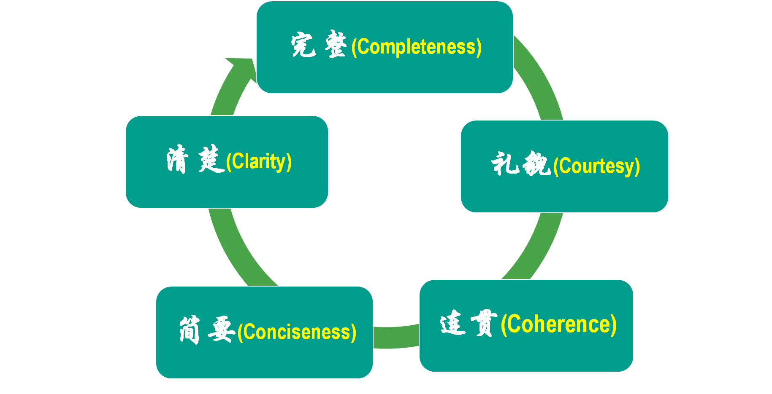
修改
After reading the excellent composition, please note down the materials that will be useful to your writing. Then revise and polish your own articles according to the following 5 aspects of reference.

Slide 19
比对延伸
04

Slide 20
广东省2025届8月八校联考
假定你是校英文报的记者李华，上周五你校学生会在操场举办了一场跳蚤市场（a flea market）活动。请你为此写一篇新闻报道，内容包括：
1．活动目的和过程；
2．活动反响和意义。
注意：
1．写作词数应为80左右；
2．请按如下格式在答题卡的相应位置作答。

Slide 21
参考范文
A Flea Market
Last Friday, the Students’ Union in our school organized a flea market on the playground, aiming to encourage resource recycling and meet individual needs.
The event featured students selling various items, from books to handmade crafts, creating a lively marketplace atmosphere. The flea market gained enthusiastic participation from both sellers and buyers. Many students took the opportunity to clear their possessions while earning some extra income. Buyers found unique treasures and eco-friendly alternatives to new products, contributing to a greener lifestyle among students.
Overall, the event was a success（定性词）, which not only provided a platform for students to exchange goods but also promoted a sense of environmental awareness.

Slide 22
如何写这篇的活动反响？
The flea market received an enthusiastic response from students, with many delighted by the unique finds and bargains they discovered.
The flea market was a hit, with students already looking forward to the next edition and discussing ideas for their future stalls.
Many students expressed their delight in finding treasures among the second-hand goods, while others appreciated the chance to clear out their belongings and give them a new life.

