Slide 1
感恩遇见，相互成就，本课件资料仅供您个人参考、教学使用，严禁自行在网络传播，违者依知识产权法追究法律责任。
更多教学资源请关注
公众号：溯恩高中英语
知识产权声明

Slide 2
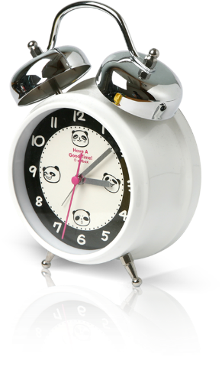
Using English roots to decipher the derivatives
溯词汇-2--curious-词根：cur
http://www.sunedu.com
02
浙江省常山一中 吴俊峰

Slide 3
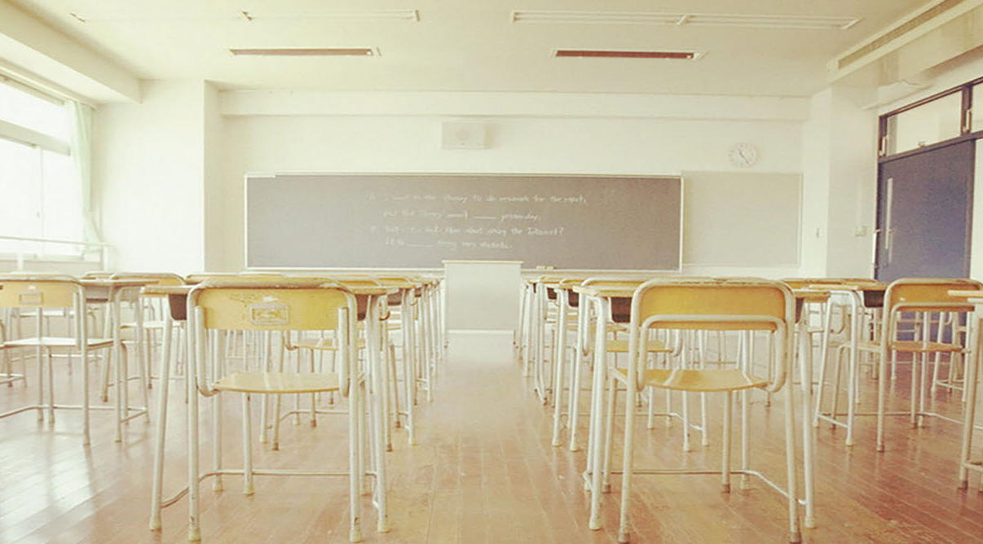
01
溯词源
cur
02
溯语用
巧记活用；用法归纳；链接高考；写作提能；词语辨析
目录
溯同源
CONTENTS
03
新课标词汇; 课标外词汇
3-1
溯新课标词汇
curious；cure；accurate；secure
3-2
溯课标外词汇
procure；curate ；curator
04
溯规律
词海垂钓; 由此及彼; 同义相连; 寻根问底

Slide 4
01
【溯词源】cur [L]= care 关心
〖词根探究〗在常用词cure, curious, accurate, secure 中含有词根cur，它来自拉丁名词cura，意思相当于care(关心，注意)。
这个词根与to run(跑)的词根cur(r) 形态相同。但是，在实际构词中，两者除了含义不同，发音与形状也不一样。例如，词根cur(r) 在recur，current, curriculum等派生词中，或者出现在重读尾音节，发[kɜː]的音，或以curr的形式添加后缀，发[ka:]或[kʌ]的音。本堂课要介绍的cur，一定要添加后缀构词，发音总是[ˈkjʊə]。
新课标词汇
curious；cure；accurate；secure
拉丁语 cura
关心，注意
课标外词汇
procure；curate ；curator

Slide 5
01
溯词源
cur
02
溯语用
巧记活用；用法归纳；链接高考；写作提能；词语辨析
目录
溯同源
CONTENTS
03
新课标词汇; 课标外词汇
3-1
溯新课标词汇
curious；cure；accurate；secure
3-2
溯课标外词汇
procure；curate ；curator
04
溯规律
词海垂钓; 由此及彼; 同义相连; 寻根问底

Slide 6
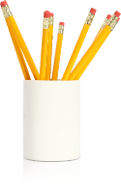
02
〖巧记活用〗curious /ˈkjʊəriəs/
〖构词巧记〗
[cur =care关心，注意；-i-；-ous =causing引起……的 →“causing one's care惹人注意的”→]
〖单词活用〗
① adj. having a strong desire to know about sth 求知欲强的；好奇的
Steve was intensely curious about the world I came from.
史蒂夫对我是从哪里来的有强烈的好奇心。
He is such a curious boy, always asking questions.
他这个孩子求知欲很强，总是爱提问。
② adj. strange and unusual 稀奇古怪；奇特；不寻常; 难以理解的
It was a curious feeling, as though we were floating on air.
那是一种奇特的感觉，我们仿佛在空中漂浮。
It is a curious paradox that professional comedians often have unhappy personal lives. /ˈpærədɒks/ n. 悖论；似是而非的论点；自相矛盾的人或事
这真是个奇怪的矛盾现象—职业喜剧演员的私人生活往往并不快乐。

Slide 7
02
〖巧记活用〗curious /ˈkjʊəriəs/
〖派生词汇〗
curiosity /ˌkjʊəriˈɒsəti/ n.好奇；好奇心；求知欲；奇物；珍品
curiously /ˈkjʊəriəsli/ adv. 好奇地
〖单词活用〗
I was bursting with curiosity.
我满怀好奇。
Sophie's curiosity was aroused by the mysterious phone call.
那个神秘的电话引起了索菲的好奇心。
His emotions swung between fear and curiosity.
他时而害怕，时而好奇。
The museum is full of historical curiosities.
这座博物馆有许多珍奇历史文物。
Rather curiously they both snapped out the same remark, "Shut up!"
奇怪的是，他们都厉声说出了同样的话：“闭嘴！”
The Welshman eyed him gravely, curiously--and presently said, "Yes, burglar's tools." /ˈɡreɪvli/ adv. 严重地；严肃地；严峻地；沉重地
威尔斯曼严肃而好奇地打量着他，过了一会儿，他说：“是的，窃贼的作案工具。”

Slide 8
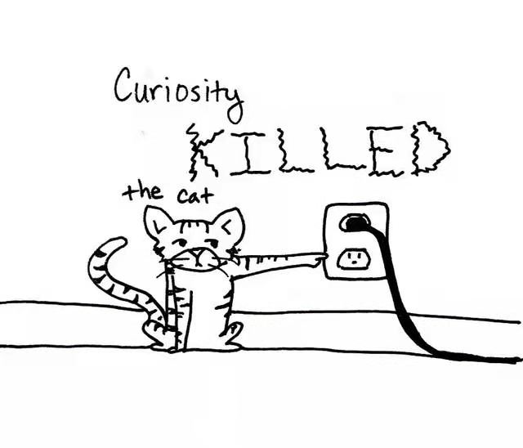
02
〖巧记活用〗curiosity /ˌkjʊəriˈɒsəti/
〖谚语学习〗 Curiosity Kills the Cat 好奇害死猫
This proverb is often used to stop someone from asking too many questions. Curiosity (when you’re excited and eager to know something) can lead you into dangerous situations. Cats, who are naturally curious, often end up in trouble. They get stuck up in trees or between walls.这句谚语常被用来阻止别人问太多的问题。好奇心（当你感到兴奋和渴望知道某件事的时候）会把你带入危险的境地。那些天生好奇的猫，往往会陷入麻烦。由于好奇，他们常被困在树上或两墙之间。
〖谚语活用〗
1）A cat has nine lives, but curiosity killed the cat.
猫有九条命，但好奇害死猫。有时我们需要约束一下自己的好奇心。
2）Remember curiosity killed the cat. You should just forget about it.
记住，好奇害死猫，你应该忘了它。

Slide 9
02
〖用法归纳〗curious / curiosity
(1)be curious about 对……感到好奇
be curious to do sth 渴望做某事
(2) out of curiosity 出于好奇
with curiosity＝curiously 好奇地
satisfy/ meet/ gratify one’s curiosity 满足某人的好奇心
fan/arouse one’s curiosity 激起某人的好奇心
(1)be curious about 对……感到好奇
be curious to do sth 渴望做某事
(2) out of curiosity 出于好奇
with curiosity＝curiously 好奇地
satisfy/ meet/ gratify one’s curiosity 满足某人的好奇心
fan/arouse one’s curiosity 激起某人的好奇心
〖链接高考〗 单句语法填空
①She was curious how the experts did it.(2020·天津7月卷阅读D)
②The little boy，out of (curious)，took the radio set apart.
③ (curious) enough，the same thing happened again a year later.
about
curiosity
Curiously
curiously enough 说来也奇怪

Slide 10
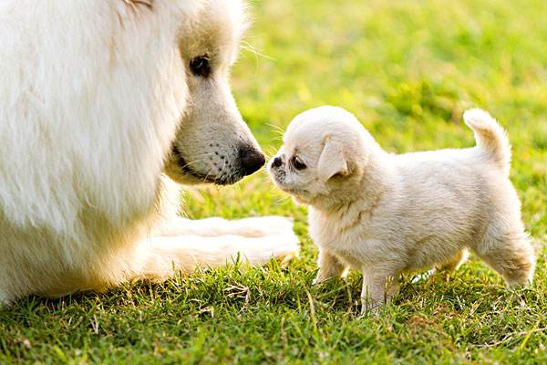
02
〖写作提能〗curious / curiosity
完成句子(2020·浙江1月卷读后续写第二段)
Dad opened the box and a sweet little dog appeared. .
1.波比一看到小狗就高兴地跳了起来。她低下头好奇地看着它。
2.它藏在箱子的一个角落里，眼睛里有一种好奇的神情。它摇着尾巴，想爬出箱子，但却摔倒了，站不起来。
3.波比盯着小狗，既惊讶又兴奋。她小心翼翼地靠近，吠叫着，然后开始舔他的脸。小狗从盒子里跳出来，摇着尾巴，好奇地叫着。
1.Poppy jumped with joy at the sight of the little dog. She lowered her head to watch it curiously /with curiosity.
2.It was hiding in one corner of the box, with a curious look in its eyes. Wagging its tail, it tried to climb out of the box, but it fell down back, unable to stand up.
3.Poppy stared at the puppy, surprised and excited. She approached cautiously, barked and then started to lick his face. The little dog jumped out of the box, wagged his tail and barked with curiosity.

Slide 11
02
〖写作提能〗curious / curiosity
完成句子(读后续写——描写“好奇”)
1.好奇地向某人看了一眼
2.我开始产生好奇心。
3.他好奇心顿起。
4.好奇心驱使王鹏走了进去。
5.他很想知道里面有什么，就蹑手蹑脚地走进黑暗的山洞。
6.在内心的好奇和困惑/怀疑的驱使下，我轻轻地推开门，走进了房间。好奇心驱使
1. throw a curious glance at
2. I feel a stirring of curiosity.
3. He was seized by curiosity.
4. Curiosity drove Wang Peng inside.
5. Curious to know what was inside, he tiptoed into the dark cave.
6. Driven by my inner curiosity and confusion， I gently pushed the door and entered the room.

Slide 12
01
溯词源
cur
02
溯语用
巧记活用；用法归纳；链接高考；写作提能；词语辨析
目录
溯同源
CONTENTS
03
新课标词汇; 课标外词汇
3-1
溯新课标词汇
curious；cure；accurate；secure
3-2
溯课标外词汇
procure；curate ；curator
04
溯规律
词海垂钓; 由此及彼; 同义相连; 寻根问底

Slide 13
01
溯词源
cur
02
溯语用
巧记活用；用法归纳；链接高考；写作提能；词语辨析
目录
溯同源
CONTENTS
03
新课标词汇; 课标外词汇
3-1
溯新课标词汇
curious；cure；accurate；secure
3-2
溯课标外词汇
procure；curate ；curator
04
溯规律
词海垂钓; 由此及彼; 同义相连; 寻根问底

Slide 14
03
〖新课标词汇-1〗cure /kjʊə/
〖构词巧记〗
[cur=care 关心；e→“care for the sick 对病人的关心”→]
〖单词活用〗
① n. 药物；疗法，治疗；治愈；对策；
Finding a cure requires considerable time and effort.
找到一种治愈方法需要相当的时间和努力。
Scientists around the world are working to discover a cure for AIDS.
全世界的科学家都在努力寻找治疗艾滋病的方法。
There is no easy cure for poverty.
贫困问题很难解决。
★用法点睛：
cure在表示不同意思时，需接不同的介词：
表示“医治〔治疗〕…的方法”时，此时用其本义，cure后常接介词for。
表示“纠正别人的错误或毛病”时，此时用其比喻义，cure后常接介词of。

Slide 15
03
〖新课标词汇-1〗cure /kjʊə/
② to make an illness go away 治好（疾病）
He needed surgery to cure a troublesome back injury.
他需要做手术来治好烦人的背伤。
The only way to cure backache is to rest.
治疗背痛的唯一办法是休息。
③ to make a person or an animal healthy again after an illness 治愈，治好（病人或动物）
Almost overnight I was cured.
几乎在一夜之间我被治愈了。
When I left the hospital I was completely cured.
出院时，我已经完全痊愈了。
Will you be able to cure him, Doctor?
医生，你能把他治好吗？

Slide 16
03
〖新课标词汇-1〗cure /kjʊə/
④ to deal with a problem successfully 解决，了结（问题）
I finally managed to cure the rattling noise in my car.
我最终设法解决了我汽车发出的格格响声。
⑤ ~ sb of sth to stop sb from behaving in a particular way矫正，改正（某人的不良行为）
He tried to cure his child of the habit.
他试着去矫正他孩子的那种习惯。
〖派生词汇〗
cureless /'kjʊrlɪs/ [cure n.; -less a.] a.无法治疗的
curable /ˈkjʊərəbl/ [cur(e) v.; -able a.] a.可治疗的
curative /ˈkjʊərətɪv/ [cur(e)v.;-ative a.] a.治疗的
★用法点睛：
cure在表示不同意思时，需接不同的介词：
表示“医治〔治疗〕…的方法”时，此时用其本义，cure后常接介词for。
表示“纠正别人的错误或毛病”时，此时用其比喻义，cure后常接介词of。

Slide 17
03
〖词语辨析〗cure / heal
cure ① 治愈内科疾病，使人完全恢复健康。②用于比喻，含义是纠正。
heal ①伤口愈合。②用于比喻，含义是 “弥补”, 表达弥合，和解。
This medicine should cure you of your cold.
这种药应该能治愈你的感冒
This wound will heal soon if you keep it clean.
如果你使伤口保持清洁，就会愈合得快。
He had never been really healed of the wound his father had given him.
他父亲给他造成的创伤从来就没有真正地愈合过。
That long talk healed many of our differences.
那次长谈消除了我们的许多分歧。
★用法点睛：
近代英语这两词有了分工，cure指表内科医生为病人治病；heal指外科医生治疗撞伤、伤口。

Slide 18
03
〖词语辨析+写作提能〗cure / heal
★用法点睛： cure 和heal用于比喻时也有明显的差异。
be cured of coming late to breakfast 不再迟到吃早饭
to cure mistrust 消除不信任 (mistrust表示不信任，属于态度，需要的是“纠正”，所以这里一般不用heal)
be healed of old regrets 消除过去的遗憾
to heal a breach between friends 弥合朋友间的不和 _{(breach表示裂痕，裂痕就需要弥合，不用cure)}
原文首段：Five years ago, I had a nine-to-five job, and I usually commuted_{(通勤)} to work by bus. Those long tiring hours of travelling were always annoying. But one day, it was healing.（2021年3月浙江省名校协作体 读后续写）
✍续写：The woman took some cheese bread to the old man and said "Don't worry. All is going well." It amazed me that what random actions of kindness could mean to the people who received it. From that day I was not annoyed at the long tiring hours of travelling home any more. I felt healed, enjoying every moment commute to work.
☝由此及彼，尽管捉襟见肘、左支右绌，遭遇偷窃，经历痛苦和挣扎，该妇女依然相信善良，相信世间温情，释放着温暖和善意，她也用这份温情完成了自我救赎，治愈healing世人（包括作者）。

Slide 19
03
〖新课标词汇-2〗accurate /ˈækjərət/
〖构词巧记〗
[ac-(ad-)=to对；cur=care关心，注意；-ate a.=having 有……的→“having much care to 对……极为注意的”→]
〖单词活用〗
① correct and true in every detail 正确无误的; 精确的；准确的
an accurate description/account/calculation
准确的描述╱叙述╱计算
accurate information/data
正确无误的情报╱资料
a highly accurate electronic compass
高度精确的电子罗盘仪
② an accurate throw, shot, weapon, etc. hits or reaches the thing that it was aimed at 准确的（掷、射、击等）
His throws were long, hard and accurate, as always.
像往常一样，他的投掷远、有力又精准。

Slide 20
03
〖新课标词汇-2〗accurate /ˈækjərət/
〖派生词汇〗
accuracy /ˈækjərəsi/ [ac-; cur-acy n.]n.精确；准确
accurately /ˈækjərətli/ adv. 精确地，准确地
〖单词活用〗
He hit the golf ball powerfully and accurately.
他有力而准确地击中了那个高尔夫球。
Your response is scored on your ability to speak clearly and coherently, and on your ability to accurately convey information about the text and the transcript.
根据你清晰和连贯的表达能力，以及准确传达文本和文字信息的能力来对你的回答
进行评分。
She hits the ball with great accuracy.
她击球十分准确。
Convinced of the accuracy of the data, they stuck to their opinion.
由于深信数据准确无误，他们坚持自己的意见。

Slide 21
03
〖词语辨析〗correct, right, accurate, exact, precise
correct, right, accurate, exact, precise
correct | ①为人稳妥，言行可靠，可以信赖 | Sedley's valet, (is) a most solemn and correct gentleman. 希德里的男仆，(是)一位非常庄重、非常稳妥的先生。 You cantrust him; he is a correct person 你可以信赖他，他是个稳妥的人。
 | ②正确无误，不出差错 | Big Ben has rarely gone wrong. Once, however, it failed to give the correct time. 大本钟很少出差错，然而有一次它报错了时间。 He was always able to make correct decisions. 他总是能够做出正确决定。
right | ①符合事实，符合真理 | Whatyou said before dinnerwas right. 你在吃饭前所说的话是正确的。
 | ②正确无误，没出差错 | Are we on the rightroad? 我们的路走得对吗？
进一步讨论correct和right的区别： 若要表达“他所说的话是对的”，只要翻译成He is right 就可以了，最好不要译成“What he said is right”。 而“他是对的”不要译成 He is correct，因为correct 指的是“他可靠，他行为端庄，可以托付”。

Slide 22
03
〖词语辨析〗correct, right, accurate, exact, precise
correct, right, accurate, exact, precise
accurate | 做事仔细， 准确无误 | His information was accurate. 他的情报是准确的。
 | 射击瞄准， 子弹中的 | Someonefireda shot through my office window. Accurate, don't you think? 有人向我的办公室窗子里打了一枪。打得很准，你不觉得吗？
exact 强调准确的严格性，不许有丝毫的差错 | ①记忆力准确 | His memory is very exact, he never makes mistakes. 他的记忆力非常准确，他从来不出差错。
 | ②信息准确 | He could not obtain any exact information as to where shewas. 至于她在什么地方，他不能够获得准确的信息。
 | ③重量准确 | The exact weight is 25. 68 kilograms. 准确的重量是25.68千克。
 | ④处理事务不出差错 | Reading makes a full man; conference a ready man; and writing an exact man. 读书使人充实；交谈使人机智；写作使人精确。
 | ⑤准确的时间 | I will shortly let you know when I start but still have no exact date. 很快我就会让你知道我什么时候出发，但现在还没有确切的日子。 At exactly the moment, the telephone rang. 不早不迟，电话铃正在那个时候响了。
进一步讨论accurate 和exact 的区别：an accurate memory 和 an exact memory 都是准确的记忆； accurate information 和exactinformation 都是准确的信息； accurate和exact 的细微差异是：射击准确多用an accurate shot，准确的日期多用an exact date。

Slide 23
03
〖词语辨析〗correct, right, accurate, exact, precise
correct, right, accurate, exact, precise
precise 强调要有严格的界线，划界线时非常审慎 | ①做事一丝不苟，有时指过于审慎、仔细 | He is precise in everything. 他在一切方面都太精细了。 He had precise ways of doing things and would not change. 他做事的方式一丝不苟，而且不会改变。
 | ②工作做得精确无误 | Such undertakings require the precise planning and foresight of military operation. 这种事情要求军事战役上的准确部署和预见。 A lawyer needs a precise mind. 律师需要精明的头脑。
 | ③数字精确。 | The precise sum was 34 1/2 cents. 准确地数目是三十四分五厘钱。
 | ④时间准确 | At that precise moment he entered the room. 恰恰在那个时刻他走进房了房间。
进一步讨论 precise 和exact 的区别： exact 和 precise的词义差异细微，前者强调“要做到准确，就要严格”，后者强调“要准确，仅仅严格还不够，还要有审慎的界定”。如：at the exact (or precise) moment, the exact (or precise) sum,the exact (or precise)date，在这样的短语中，虽然有细微的区别，就不必太考究其含义差别了。 但是，an exact plan强调的是要求严格的准确计划，而a precise plan强调的是经过审慎的考虑而制定的计划；an exact man和a precise man的区别较大，前者是褒义，指的是“做事准确的人”，后者略含贬义，指的是“做事过精细、过于仔细的人”。

Slide 24
03
〖新课标词汇-3〗secure /sɪˈkjʊə/
〖构词巧记〗
[se-=apart离开；cur=care关心；-e→“apart from the state of care离开挂念状态的”→]
〖派生词汇〗
security /sɪˈkjʊərəti/ [secur(e) a ; -ity n.]n. 安全；保护
securement /si'kjuəmənt/ [secure v; -ment n.]n. 把握；稳当性
〖单词活用〗
① adj. feeling happy and confident about yourself or a particular situation 安心的；有把握的
She felt secure to her own future.
她对未来感到放心。
Our objective must be to secure a peace settlement.
我们的目标必须是确保达成一个和平协议。

Slide 25
03
〖新课标词汇-3〗secure /sɪˈkjʊə/
〖单词活用〗
②adj. likely to continue or be successful for a long time (工作等) 稳定的;可靠的；牢靠的
a secure job/income
稳定的工作╱收入
demands for secure wages and employment.
对稳定的工资和就业的要求。
③ adj. that cannot be affected or harmed by sth 安全的；稳妥的
She felt secure and protected when she was with him.
她和他在一起的时候感到很安全。
How do you keep the data secure?
你如何确保数据安全？
Double-check that the ladder is secure.
再检查一下梯子是否安全。

Slide 26
03
〖新课标词汇-3〗secure /sɪˈkjʊə/
④ adj. guarded and/or made stronger so that it is difficult for people to enter or leave 严密把守的；牢固的；坚固的
We'll make sure our home is as secure as possible from now on.
我们将从现在起确保我们的家尽可能安全。
He locked the heavy door securely and kept the key in his pocket.
他锁牢了那扇重门把钥匙放在了他的口袋里。
⑤ vt. 保护；弄到；招致；缚住 vi. 获得安全
This is the only effectual way to secure our present and future happiness.
这是确保我们现在和未来幸福的唯一有效途径。
We have secured a first class cook.
我们已经请到了一位第一流的厨师。
She has secured a good job.
她已获得一份好的工作。

Slide 27
03
〖写作提能〗security-应用文写作
消防演习的通知
为了唤起大家远离火灾的意识，并教会大家一些逃生的技巧，我们学校将于周五下午3点举行一次有全校师生参加的消防演习。
消防演习路线如下。首先，你应该在课堂上集合。然后，跟着你的老师穿过走廊到体育场。最后，我们将在操场集合。
由于消防演习将密切模拟真实火灾的情况，请务必带上一块湿布或手帕来捂住口鼻。此外，请您密切、迅速、有秩序地跟随您的班主任，以免发生踩踏或拥挤事件。毕竟，安全是整个过程中最重要的。
To arouse your awareness of keeping away from fire and teach you some useful skills to escape from a big fire, our school will hold a fire drill, which involves all students and teachers on campus, at 3:00 p.m. on Friday afternoon.
The route of the fire drill is as follows. Firstly, you should gather in your class. Then, follow your teacher through the hallway to the stadium. Finally, we will converge at the playground.
As the fire drill will closely model the situation in a real fire, make sure you bring with you a wet cloth or handkerchief to cover your nose and mouth. Moreover, please follow your headteacher closely, swiftly and orderly to avoid any stamping or crowding incident. After all, security counts most throughout the process.

Slide 28
03
〖写作提能〗School Security 校园安全-应用文写作
学校安全是我们的首要任务。让我们按照这些提示，一起努力创造一个安全、和谐的校园环境:
1. 有序排队，间隔一米距离等候。检查体温，双手消毒，方可安静进入教室。
2. 教室外行走不奔跑，上下楼梯轻声慢步靠右行。
3. 不扎堆，不打闹，避免肢体接触，与同学保持安全距离。
School security is our top priority. Let's follow the tips and try to create a safe and harmonious campus environment together:
1. Line up and keep a one-meter distance. Check the temperature, disinfect your hands and then walk to the classroom quietly.
2. Always walk in the corridor. Walk slowly up and down stairs and keep to the right.
3. No gathering or fighting. Avoid physical contact, and keep a safe distance from other kids.

Slide 29
03
〖写作提能〗security-概要写作
如今，尽管医疗条件先进，人们的生命仍然受到机动车事故的巨大威胁。通常情况下，人们在开车时不能很好地控制自己的情绪。但是我们的社会仍然对他们的行为采取宽容的态度。因此，迫切需要建立一个更严格的政策体系来处理这一问题。总之，保障生命安全再强调也不过分。(201904嘉兴丽水衢州联考-概要写作）
Nowadays, despite advanced medical conditions, human life is still under great threat from motorcar accidents. (要点一) As is often the case, people fail to manage their emotions well when driving. （要点二）But our society still takes a tolerant attitude towards their behavior.(要点三)Therefore, it's urgent to establish a stricter policy system to handle this problem.（要点四）Anyhow, guaranteeing life security cannot be overstressed.(要点五)

Slide 30
01
溯词源
cur
02
溯语用
巧记活用；用法归纳；链接高考；写作提能；词语辨析
目录
溯同源
CONTENTS
03
新课标词汇; 课标外词汇
3-1
溯新课标词汇
curious；cure；accurate；secure
3-2
溯课标外词汇
procure；curate ；curator
04
溯规律
词海垂钓; 由此及彼; 同义相连; 寻根问底

Slide 31
03
〖课标外词汇-1〗procure /prəˈkjʊə(r)/
〖构词巧记〗
[pro-=for 为； cur =care关心；-e→“to give one's care for 为……而关心”→]
〖派生词汇〗
procurable /prəˈkjʊərəbl/ [procur(e);-able a.] a.可获得的；可实现的
procural [procur(e); -al n.] n.获得；取得
〖单词活用〗
adj. to obtain sth, especially with difficulty （设法）获得，取得 (尤指难以获得的东西)
She managed to procure a ticket for the concert.
她好不容易弄到一张音乐会入场券。
It remained very difficult to procure food, fuel, and other daily necessities.
当时仍然很难获得食品、燃料和其他日用必需品。

Slide 32
03
〖课标外词汇-2〗curate /ˈkjʊərət/
〖构词巧记〗
[cur=care关心；-ate n.=person人→“person in charge of the care of others 负责关心他人者”→]
〖单词活用〗
n. an assistant to a vicar (= a priest, who is in charge of the church or churches in a particular area) （某教区的）助理牧师(协助牧师关心人们灵魂的人)
“And the curate does not teach you to read and write then? ” I pursued.
“那么副牧师也不教你读书写字了吗？”我追问着。
A vicar with a large parish may have an assistant priest called a curate to help him.
一个大教区的牧师可能会有一个牧师助理协助他的工作。

Slide 33
03
〖课标外词汇-3〗curator /kjʊəˈreɪtə/
〖构词巧记〗
[cur=care关心，照料；-ator (-ate +-or) n.=person who acts 做……者→]
〖派生词汇〗
curatorship [curator;-ship n.]n.管理者或馆长的职位或身份
〖单词活用〗
①a person whose job is to be in charge of the objects or works of art in a museum or art gallery , etc. （博物馆或美术馆等的）馆长，负责人
He's curator at a gallery in New Haven.
他是纽黑文市一家美术馆的馆长。
As this virtual museum's digital curator, Dr Rosling's attention turned to the data underpinning his presentations.
作为这个虚拟博物馆的数字馆长，罗斯林将注意力转向了支撑其图像的数据。

Slide 34
01
溯词源
ced, ceed, cess
02
溯语用
巧记活用；用法归纳；链接高考；写作提能；词语辨析
目录
溯同源
CONTENTS
03
新课标词汇; 课标外词汇
3-1
溯新课标词汇
ancestor; proceed; procedure; process; succeed
3-2
溯课标外词汇
antecedent ; antecessor; accede; exceed; precede; recede; secede; concede
04
溯规律
词根辨异; 由此及彼; 同义相连;望文生义；寻根问底

Slide 35
04
【溯规律】
〖词根辨异〗指出下列单词的词根的含义是①care或 ②to run:
current curious curricle currency
secure curator incur incuriosity
recur procure concurrence occur
〖由此及彼〗根据已知单词的词义推断出其同根词的词义。
1. incurious a.不关心的→inaccurate a.
2. incuriosity n.不关心的→inaccuracy n.
〖同义相连〗将左栏的单词和右栏中相对应的词义连接起米。
① insecure a. faulty
② insecurity b. incorrectness
③ inaccurate c. unsafe
④ inaccuracy d. defencelessness
⑤ incuriority e. unconcern
①不精确的
②不精确

Slide 36
04
【溯规律】
〖望文生义〗根据已学的词根知识推测下列单词的词义。
① incurable a.
② incurability n.
〖寻根问底〗指出下列单词的词根并领会其词义的由来。
①curio n.古董，古玩；珍品
②curiosa n.[复]珍品；稀有的书
③procuration n.代理
④procurator n.代理人
⑤manicure n.修指甲
manicurist n.指甲修剪师(提示：man=hand)
⑥pedicure n.足医；修脚指甲(提示：ped=foot)
⑦sinecure n.挂名职务：闲职（提示.sine=without）
①不可治的
②无可救药

Slide 37
http://www.sunedu.com
Thank You!

