Slide 1


感恩遇见，相互成就，本课件资料仅供您个人参考、教学使用，严禁自行在网络传播，违者依知识产权法追究法律责任。
更多教学资源请关注
公众号：溯恩高中英语
知识产权声明

Slide 2


校园生活
道 歉 信
Apology Email for a Missed Appointment
Fay/ 2023.11.09

Slide 3


Apology email format
Apology email subject line
2.Apology email body copy
3.Apology email ending
Eg:"Regarding the Missed appointment - My Sincere Apologies"
Acknowledge your mistake/responsibility and apologize for it
Explain what you're doing to fix it
Outline next steps
sign off and move on.

Slide 4



Everyone screws up sometimes. When your decision or mistake hurts someone else or cause inconvenience, it's proper to offer an apology.
Apology email
body
文体类型 | 邮件/道歉信
目标受众 | 你的爱尔兰交换生朋友Philip
语言风格 | 遗憾惋惜，礼貌友善
篇章结构 | 开头+主体+结尾
内容要点 | 写信目的+理由与弥补措施+再次道歉
假定你是李华，你与爱尔兰交换生Philip 原定本周日上午一起修改英文讲稿，因故不能赴约。青给他写一封邮件，内容 包括：
1.表达歉意；
2.说明原因；
3.另约时间。
假定你是李华，你与爱尔兰交换生Philip 原定本周日上午一起修改英文讲稿，因故不能赴约。青给他写一封邮件，内容 包括：
1.表达歉意；
2.说明原因；
3.另约时间。
审 题
copy
时态 | 一般现在时/将来时
人称 | I ,you
理由 | 合理性:无法预测&推脱，非常重要&紧迫
弥补 | 合乎情理可接受度高，征求对方意见/方便对方

Slide 5
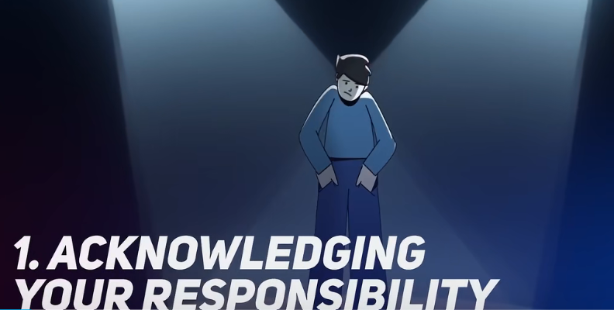
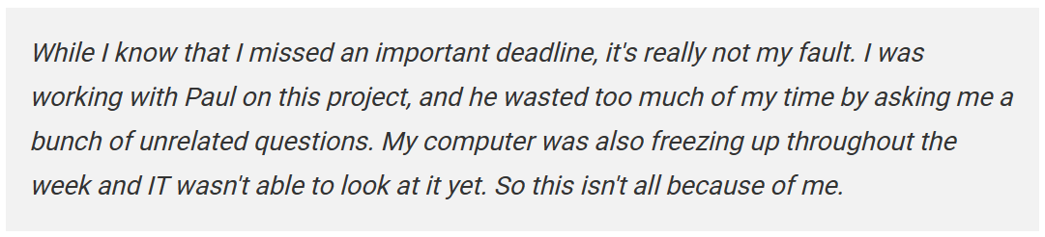

How to Open/close Your Apology Email
Here, you need to clearly identify the problem that happened. Own up to what you did; don't try to deflect the blame on someone else or make excuses for what happened.

Slide 6
Opening &closing
I'm awfully/indeed sorry to tell you that I won't be able to meet you this Sunday as planned to work on/make a modification of the English speech presentation/ draft /text /article/essay/content/script.
I'm awfully sorry for the sudden change of plan and feel it a great pity to miss the appointment with you this Sunday as scheduled to polish/revise/rewrite/modify/ change/amend the English speech draft.
I’m writing to extend/convey my deepest apology for not being able to polish the English speech draft with you this Sunday morning as planned.
I'm awfully sorry for the sudden change of plan and feel it a great pity to…
I'm awfully/indeed sorry to tell you that I won't be able to…
I apologize again for any inconvenience or trouble caused and appreciate your understanding.
I sincerely hope you can understand my situation and accept my apology.
Build apology emails that are honest, and emotional

Slide 7
Expressing empathy is an important soft skill that lends authenticity to your apology.
More for Opening
An example
I want to sincerely apologize that I didn't fulfill my obligations and complete the task you entrusted to me on time. There are no excuses for this failure. I don't like knowing that I let my group down, and feel terrible that this caused your inconvenience.
Build apology emails that are honest, and emotional

Slide 8


Expressing Remorse for What You Did and make up for it
Main body

Slide 9
Expressing remorse
acceptable
sincere
unpredictable
urgent
polite
Your actions
Your reasons
reasonable
practical
☻The reason is that my left foot was injured. I fell off my bike yesterday when I was on my way to school, and the doctor insisted that I should stay in bed for at least two weeks.
Can I suggest that we put it off until early August?
subjective factors
Keep in mind that the ultimate goal of an apology is to rebuild the broken trust.
Is it possible for us to rearrange the time to ….?
☻The reason why I didn't finish the book report on time is that I suddenly fell ill last Friday morning. My parents sent me to hospital and I had to stay there for the next three days. Therefore, there was not enough time for me to finish the homework
As a result, I have no choice but to break my promise. I hope the change will not cause you too much trouble. Shall we go on Saturday morning?
subjective factors
☺Here is the thing. I have just been informed that our class is going to hold an important meeting on Saturday afternoon---exactly the time we shall meet. What an awful coincidence! I feel so sorry about it.
objective factors
☺Here is the thing.I have just found that I have to attend an important class meeting that afternoon. So urgent is it that I have to get our plan changed
I would appreciate it if you allow me to rearrange …
objective factors

Slide 10
Sample 1
Dear Philip,
I’m really sorry for not being able to meet up with you this Sunday morning as planned to work on the English speech draft.
Recently, I was given an unexpected opportunity to interview runners as a reporter for the upcoming 2023 Hangzhou Marathon. It’s a great honor for me, and I believe it will be a valuable experience for my future career. However, the interview is scheduled for the same time as our meeting, and I cannot reschedule it. I would appreciate it if you allow me to rearrange our meeting to next Sunday morning. If you are available that time, please let me know.
I apologize for any inconvenience caused and appreciate your understanding. Looking forward to your reply.
Yours,
Li Hua
Acknowledge& apologize
concise
Explain & outline
reasonable
Apologize again
sincere

Slide 11
Sample 2
Dear Philip,
I sincerely apologize for not being able to meet with you on our planned date --next Sunday morning. I have just found that I have to attend an important class meeting that afternoon. So urgent is it that I have to get our plan changed.
I left you a message on your desk to apologize in person, but I also want to send you a quick email. Please kindly consider my heartfelt apologies for any inconvenience that it may have caused you.
I understand that just an apology isn’t enough to make up for my absence, but please know that skipping the appointment isn’t typical of me. Would you contact me as soon as you have a spare minute, and I will gladly rearrange our appointment at a mutually agreed time.
Please accept my heartfelt apologies, and I do hope to hear from you soon.
Yours,
Li Hua
Acknowledge& apologize
Make up& apologize
Express remorse&
outline
Apologize again

Slide 12
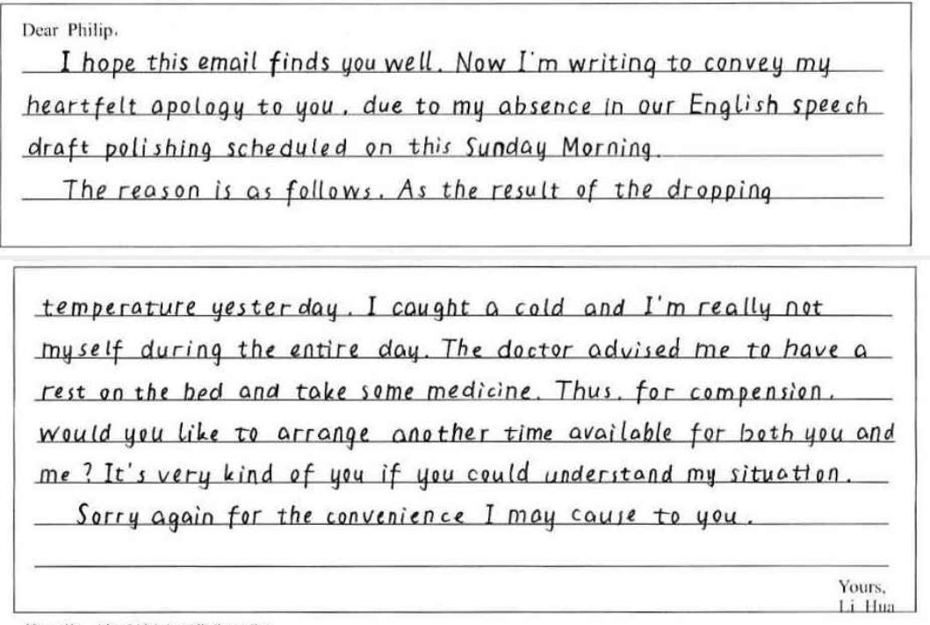
高分考场作文
Acknowledge& apologize
Explain & outline
Apologize again

Slide 13
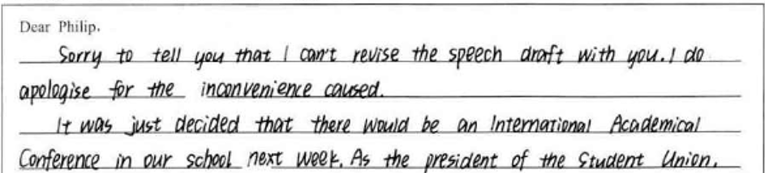
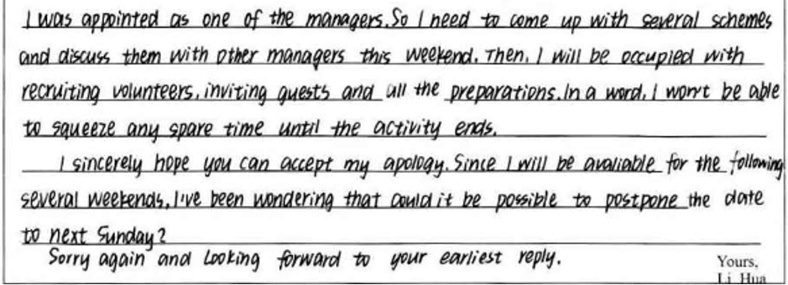
高分考场作文
Acknowledge& apologize
Explain & outline
Apologize again

Slide 14
真题回顾
（2021年英语高考北京卷）假设你是红星中学高三学生李华。你和英国好友Jim原定本周末一起外出，你因故不能赴约。请你用英文给他写一封电子邮件，
内容包括：
1.表达歉意并说明原因；
2.提出建议并给出理由。
注意：
词数100左右；
2. 开头和结尾已给出，不计入总词数。
Dear Jim，
I'm sorry that I won't be able to go hiking with you this Saturday.
I began to cough yesterday morning，so I went to see a doctor. She told me it was a bad cold，and I would have to stay at home for a few days．
I'd really like to spend some time with you．Is it OK with you if we take a trip to Zhangjiakou next Saturday？It's one of the host cities for the 2022 Winter Olympics．Please let me know what you think．
Again, I'm sorry about the inconvenience．
Hope to hear from you soon．
Yours，
Li Hua

Slide 15
真题回顾
（2016全国卷）
假如你是李华，与留学生朋友Bob约好一起去书店，因故不能赴约。请给她写一封邮件，内容包括：
1. 表示歉意；
2. 说明原因；
3. 另约时间。
注意：
词数80左右；
2. 开头和结尾已给出，不计入总词数。
Dear Bob,
I’m sorry to say that I cannot go to the bookstore with you on Friday afternoon. I have just found that I have to attend an important class meeting that afternoon. I hope the change won’t cause you too much trouble.
Shall we go on Saturday morning? We can set out early so that we’ll have more time to read and select books. If it’s convenient for you, let’s meet at 8:30 outside the school gate. If not, let me know what time suits you best. I should be available any time after school next week.
Looking forward to your early reply.
Yours，
Li Hua

Slide 16

Build apology emails that are honest, emotional and effective
highlight

Slide 17
Different causes
Running late for a class
Failing to keep the appointment
Missed a deadline
Accidentally left someone out of an invitation
Accidental incorrect data in a presentation
Misunderstanding or miscommunication
Accidentally sharing incorrect information
Delay in attending a birthday party of friends
Unintentionally offending someone during a conversation
Mistakenly deleting shared files or data
Mistakenly overstepping or misunderstanding boundaries
Homework
Pick one of the causes and try to practice an apology email

Slide 18


The best strategy is just to sincerely apologize and move on
Thank you!

