Slide 1
感恩遇见，相互成就，本课件资料仅供您个人参考、教学使用，严禁自行在网络传播，违者依知识产权法追究法律责任。
更多教学资源请关注
公众号：溯恩高中英语
知识产权声明

Slide 2
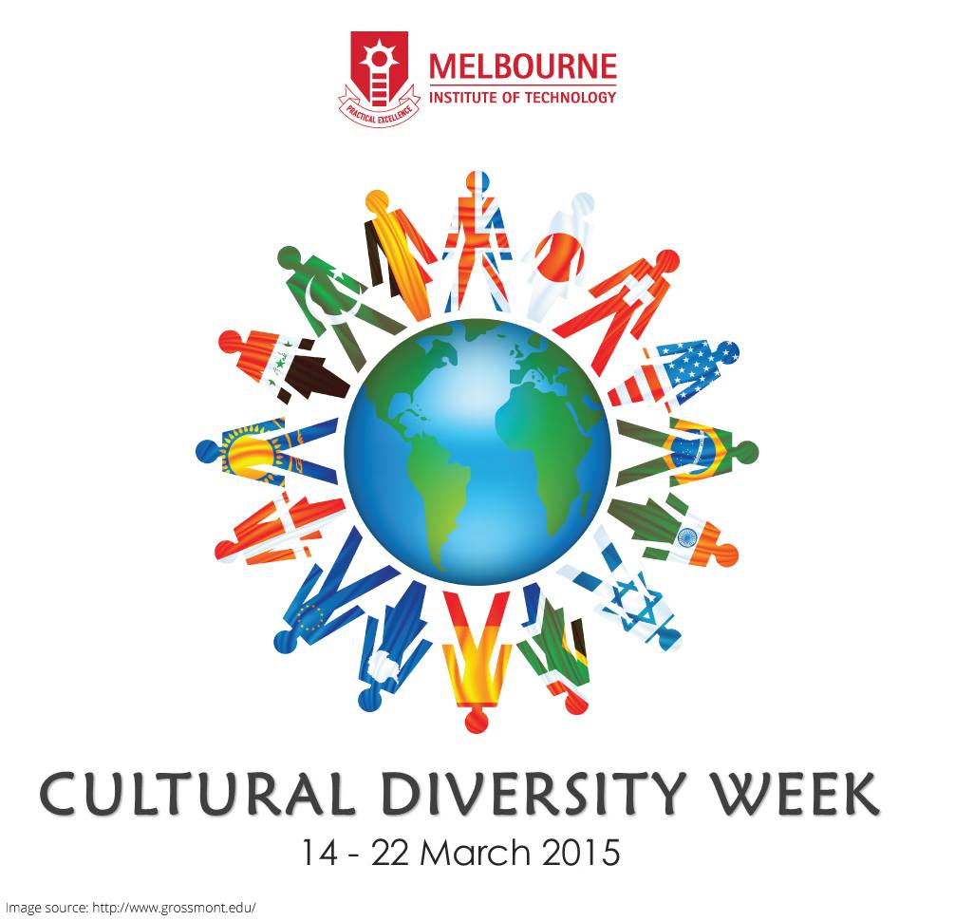
Book 3 UNIT 3 Diverse Cultures
Listening and Speaking
-- Thinker, Tiantai High School

Slide 3
Diverse Cultures 多元文化
Discussion: How do you understand diverse cultures or cultural diversity?
Culture is collection of characteristics and knowledge of many different aspects of life of a people, encompassing language, religion, cuisine, social habits, music and arts.
Culture exhibits itself differently in different peoples.
1.Culture comes in different aspects and forms.

Slide 4
Diverse Cultures 多元文化
We can explore the diverse cultures by various means.
experience, enjoy, explore
taste, get a taste of
take a taste of
get a clear picture of …
catch a glimpse of…
gain a deep insight into…
gain a new dimension in understanding...
take a deep dive into…
study tours
get actively involved in person
refer to related resources
...

Slide 5
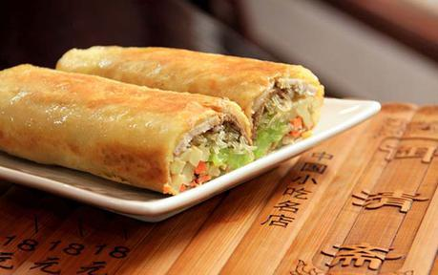
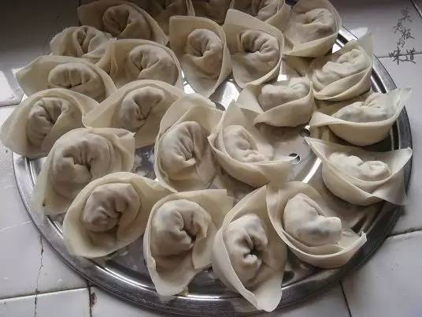
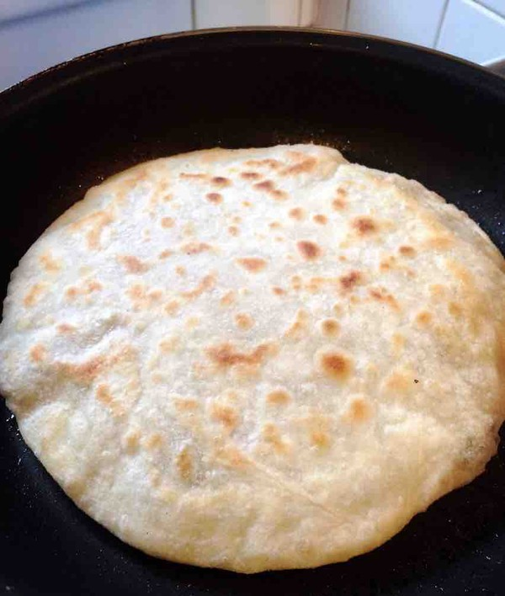
Diverse Cultures 多元文化
-- cuisine
How is it prepared?
What is it made of?
In what way is the food special?
How do you like it?
2.One man's meat is another man's poison.

Slide 6
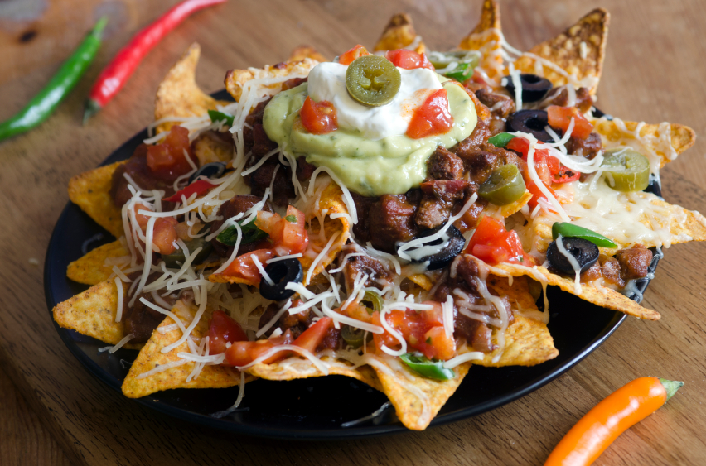
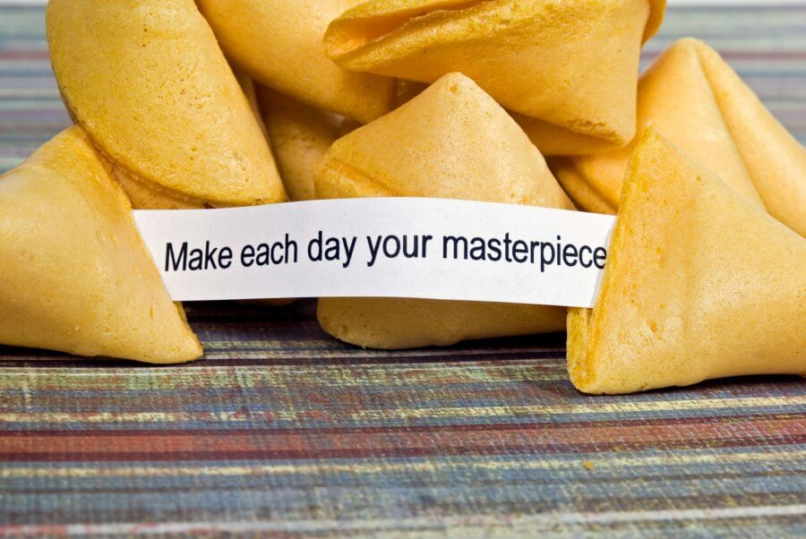
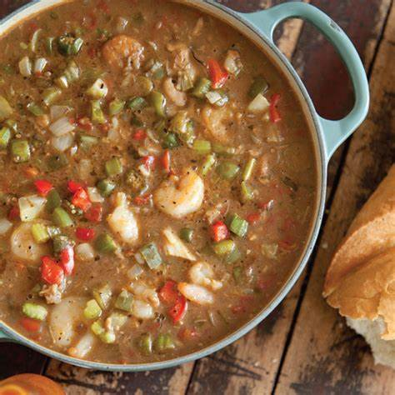
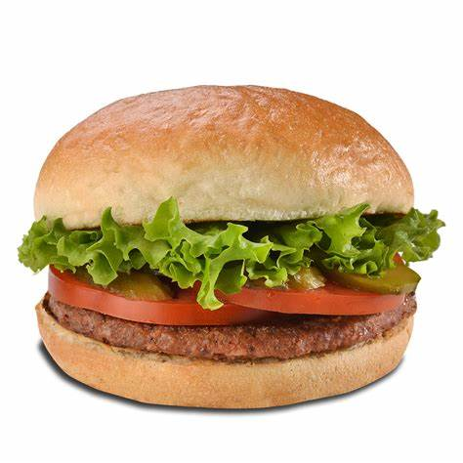
Diverse Cultures 多元文化
-- cuisine
hamburger
fortune cookie
gumbo秋葵汤
nachos墨西哥玉米片
a sandwich containing cooked meat and some other vegetables in a bread roll
a crisp hollow cookie containing piece of paper with a short message on it
a thick seafood soup, spicy stew辣炖
small pieces o thin crisp chips served with bean, cheese, spices, etc.

Slide 7
Listen and match-- cuisine
hamburger
fortune cookie
gumbo
nachos

Slide 8
Listen and decide True/False-- cuisine
1.No food was ever invented in America.
2.Hamburger was invented in Germany.
3.Nachos were invented for Americans by a foreigner.
4.Every Chinese restaurant in America has fortune cookies.
5.American cooking often mixes things from around the world to make something completely new.
That's not really true.
The recipe for the meat in a hamburger may have come from Germany but the final hamburger we know today was definitely crcated by Americans.
The recipe was actually invented by a Mexican cook for his American customers.
Language focus:
invent the telephone, invent an excuse, invent a
discover the truth

Slide 9
Listen and take notes-- cuisine
Tips: 1. Omit all articles;
2.Use abbreviations. ( yrs-years, LA, bc-because...)
Names of food | Notes
Hamburger | mix of _______ + ________ cultures
Nachos | ___________ chips covered in cheese made by ________ cook for _________________
Fortune cookie | invented in ____________ about _________yrs ago a piece of _________ with _______ on it inside cookie
Gumbo | spicy stew invented in N.O. about ______ yrs ago mixes ________, ______ ______________ + Spanish cooking
German American
Mexican corn
Mexican American customers
San Francisco
100
paper fortune
200
Frecnch African Native American

Slide 10
Interviewer: Today our guest is Steve Fox. He's here to talk about cultural influences on American food. Welcome, Steve!
Steve: Thank you. _________________.
Interviewer: _______________ American food, some say no food was ever __________ in America. What do you think?
Steve: Hmm... That's not really true. For example, some s the hamburger comes from Hamburg in Germany, but they're wrong. The recipe for the meat in a hamburger ______________ from Germany but the final hamburger we know today was definitely created by Americans.
Interviewer: You mean there was a mixing of cultures? Food from overseas changed when it arrived in the States.
Steve: Right. And there are many more examples of mixed-culture dishes, Like nachos, for example.
Interviewer: Oh, I just love nachos! Mexican corn chips _______________!
Steve: Yes, they're delicious, ____________________________. The recipe was actually invented by a Mexican cook for his American customers. Then there are fortune cookies...
It's nice to be here
When it comes to
invented
may have come
covered in cheese
but they re not traditional Mexican food

Slide 11
Interviewer: What do you mean?
Steve: They are not Chinese.
Interviewer: _____________! But every Chinese restaurant in America has them!
Steve: Yes, but they're unknown in China. About 100 years ago, someone in San Francisco put a piece of paper with a fortune on it inside a Japanese-style cookie, and the fortune cookie was born.
Interviewer: Wow! That's interesting! So they re like a mix of the Chinese, American, and Japanese cultures.
Steve: __________. And then we have gumbo, the spicy stew. It was invented in New Orleans over 200 years ago, and mixes French, African, Native American, and Spanish cooking.
Interviewer: So it's the food of many different cultures, _________________?
Steve: Exactly. American cooking often _______________________________________ ________________________.
You're kidding
You got it
all in one dish
mixes things from around the world to make something completely new

Slide 12
Interviewer: Today our guest is Steve Fox. He's here to talk about cultural influences on America food. Welcome, Steve!
Steve: Thank you. It's nice to be here.
Interviewer: When it comes to American food, some say no food was ever invented in America. What do you think?
Steve: Hmm... That's not really true. For example, some s the hamburger comes from Hamburg in Germany, but they're wrong. The recipe for the meat in a hamburger may have come from Germany but the final hamburger we know today was definitely created by Americans.
Interviewer: You mean there was a mixing of cultures? Food from overseas changed when it arrived in the States.
Steve: Right. And there are many more examples of mixed-culture dishes, Like nachos, for example.
Interviewer: Oh, I just love nachos! Mexican corn chips covered in cheese!
Steve: Yes, they're delicious, but they re not traditional Mexican food. The recipe was actually invented by a Mexican cook for his American customers. Then there are fortune cookies...
Interviewer: What do you mean?
Steve: They are not Chinese.
Interviewer: You're kidding! But every Chinese restaurant in America has them!
Steve: Yes, but they're unknown in China. About 100 years ago, someone in San Francisco put a piece of paper with a fortune on it inside a Japanese-style cookie, and the fortune cookie was born.
Interviewer: Wow! That's interesting! So they re like a mix of the Chinese, American, and Japanese cultures.
Steve: You got it. And then we have gumbo, the spicy stew. It was invented in New Orleans over 200 years ago, and mixes French, African, Native American, and Spanish cooking.
Interviewer: So it's the food of many different cultures, all in one dish?
Steve: Exactly. American cooking often mixes things from around the world to make something completely new.
A potluck dinner

Slide 13
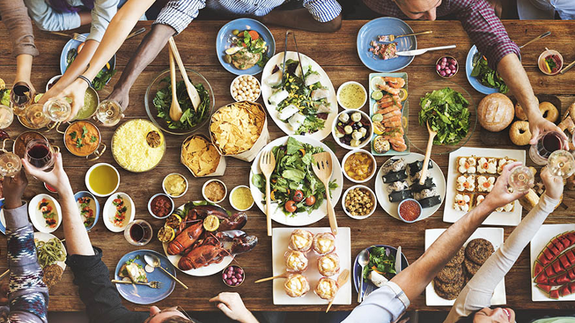
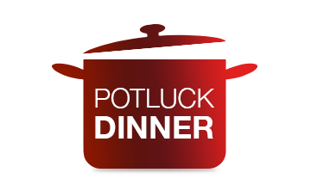
A potluck dinner is a meal to which each guest brings a dish of prepared food by the person, to be shared among the group.
A potluck dinner is a way to show diverse cultures in the world.
Discussion: Going to a potluck dinner
1.What food/snack from which area/ethnic group will you bring?
2.How is the food prepared and what is it made of?
3.In what way is the food special?

Slide 14
Going to a potluck dinner
A Sample:
A: What should I bring to the potluck dinner this weekend?
B: Why don't you make a dish from your home province?
A: You mean a Hunan dish?
B: Yeah, why not? I bet they'd love it!
A: Well, I guess I could make. It's delicious and really colorful.
B: Really? Canyou make that fish? How do you make it?
A: Easy! Slice open a fish head and cover it with a chilli and bean sauce. Then just steam it for 10 minutes.
B. Soundso easy! You could make it at your friend's house. That way it'll be fresh.
A: Great idea！I'll ask my friend.

Slide 15
Dialogue-making
This weekend, you are to invite David, an exchange student in your school, to your home for dinner. You are discussing with your mother what special food to prepare. These questions may help you.
1.What food/snack from which area/ethnic group will you bring?
2.How is the food prepared and what is it made of?
3.In what way is the food special?

Slide 16
Summary of the topic
3.Whether you like it or not, learn to respect and tolerate a different culture.
4.The beauty of the world lies in the diversity of its people. 世界之美源于人之多样。

Slide 17
