Slide 1

感恩遇见，相互成就，本课件资料仅供您个人参考、教学使用，严禁自行在网络传播，违者依知识产权法追究法律责任。
更多教学资源请关注
公众号：溯恩高中英语
知识产权声明

Slide 2
必修三Unit 1 Festivals And Celebrations
Period 2 Reading and Thinking

Slide 3

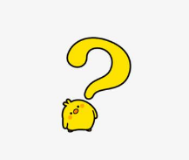


Lead-in
Listen and guess
Which festival is it?
Christmas Day
Thanksgiving Day
Halloween
Mid-Autumn Day
Spring Festival
Think: Why do people celebrate festivals?
Notes:
请从左上角第一个音乐开始播放。后续音乐点击“Page Down”键控制。

Slide 4


WHY DO WE
CELEBRATE FESTIVALS?
Notes:
www.515ppt.com

Slide 5
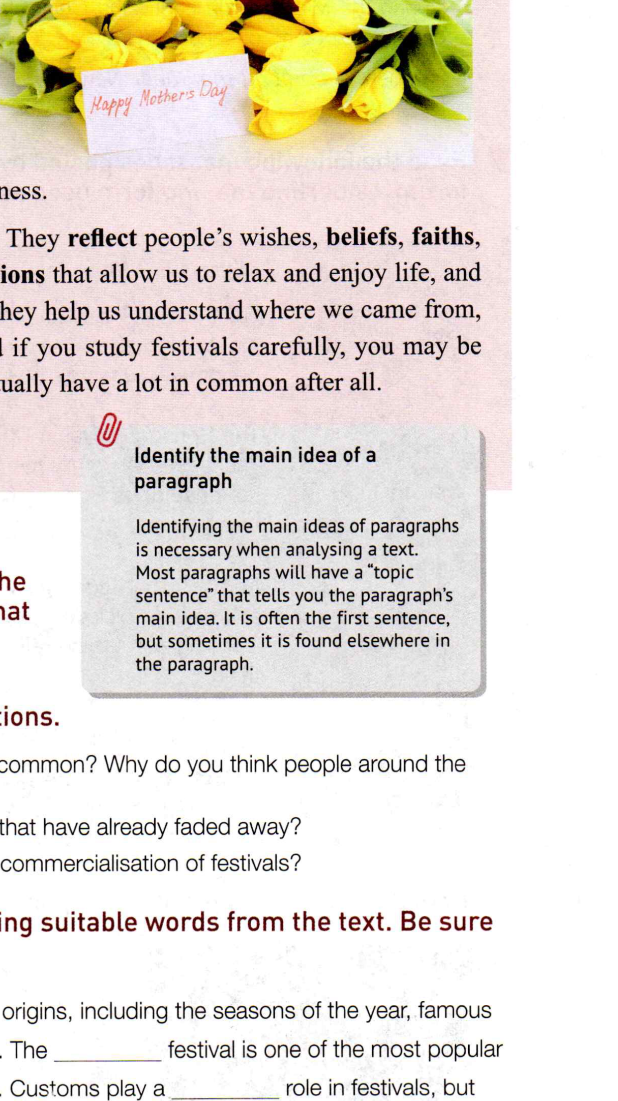
Skimming
Identify the topic sentence of each para.
Position
It may be in the middle of a paragraph or in the end of a paragraph

Slide 6
Topic sentences
Para1: Festivals are celebrated all around the world.
Para2: Of all the traditional festivals, the harvest festival
can be found in almost every culture.
Para3: Customs play a significant role in festivals, but
sometimes they can change over time.
Para4: Festivals are becoming more and more commercial,
with businesses taking advantage of the celebrations.
Para5: Festivals are an important part of society.

Slide 7
Read and understand
Careful reading
How do the rest part serve the topic sentence?
A topic sentence
Details
Support
Explain
illustrate…
general
specific
It is a good habit to place topic sentences at the beginning of paragraphs.

Slide 8
Read for Details—Para. 1
Festivals are celebrated all around the world. They have a wide range of origins, such as the seasons of the year, religions, famous figures, and important events. Every festival has its different customs and unique charms. However, no matter how different they may seem, all over the world, the spirit of sharing joy, gratitude, love, or peace is common in all festivals.
Para1
Festivals are celebrated all around the world.
different
common
seasons
religions
famous figures
important events
sharing joy,
gratitude, love, or peace
origins
customs
the spirit

Slide 9
Of all the traditional festivals, the harvest festival can be found in almost every culture.
Para2
springtime
1.Ancient Egypt
Time: __________
Features: ① ________
② _____________
_____________
The harvest
festival in every culture
a parade
great feast with music, dancing, and sports.
Features: ①___________________
___________
② get together to
__________________
decorate churches and town halls
Why
2.Europe
They are grateful for ___________
_____________.
celebrate over a meal
the year’s
Time: ___________________
Features: ①_____________________
②_____________________
Mid-Autumn Festival
supply of food
3.China
admire the shining moon
enjoy delicious mooncakes

Slide 10
Customs play a significant role in festivals, but sometimes they can change over time.
Para3
Q1: Why do some traditions possibly fade away?
Q2:How does the author support the topic sentence?
Because of the development of modern society and the spread of new ideas.
By giving examples.
The typical Chinese Spring Festival custom of lighting firecrackers is stopped.
Holloween

Slide 11
Example One
Why is setting off firecrackers stopped in Chinese Spring Festival?
A. To drive away evil spirits.
B. To avoid pollution.
C. To become an exciting festival for children.
D.To save money and spend more on gifts.
B.To avoid pollution.
Example Two
which
Another example is Halloween ,______ became an exciting festival for children, in spite of its _______ origins.
religious

Slide 12

Q1: Are there any different attitudes to the commercialization of festivals? If any,what are they?
Q2: What’s the writer’s attitude towards the commercialization of festivals.
Festivals are becoming more and more commercial,
with business taking advantage of the celebrations.
Para4
1.some
festivals shouldn’t be commercialised
Views
the increase in spending is good for the economy and public happiness.
2. others
What’s your opinion about the commercialisation of festivals?
D. Objective
A. Favorable B. Critical C. Doubtful D. Objective

Slide 13
Para5
Why are festivals important part of society?
reflect
people’s wishes,beliefs, faiths,and attitude to life.
us to relax and enjoy life, and to forget about our work for a little while.
allow
us to relax and enjoy life, and to forget about our work for a little while.
Significance
where
help
us understand we came from,
we are, and to appreciate.
us understand we came from,
we are, and to appreciate.
who
what

Slide 14
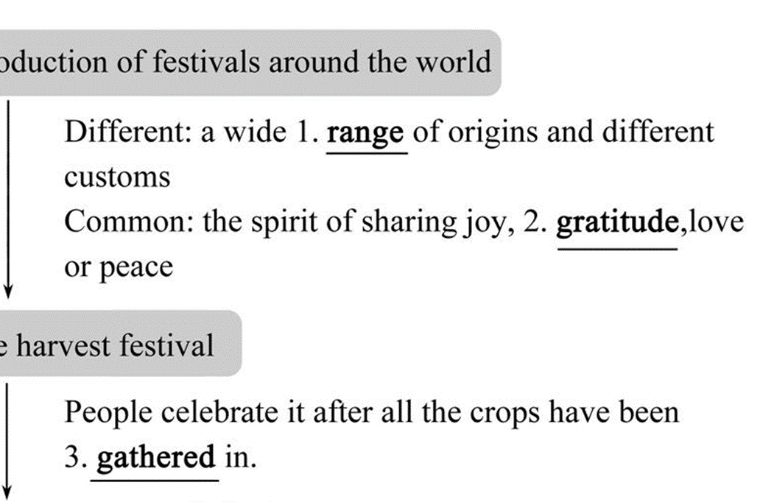
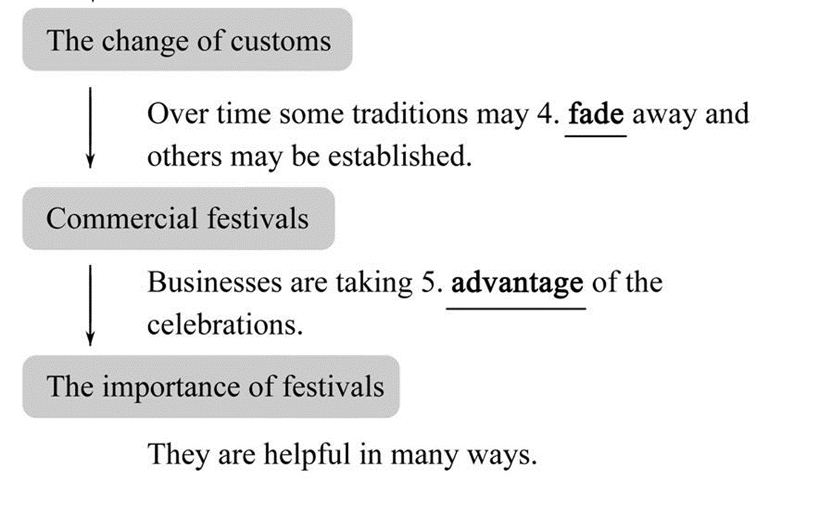
Summary
Retell the text according to the chart.
Introduction of festivals around the world
The change of customs
Commercial festivals
The harvest festival
The importance of festivals

Slide 15
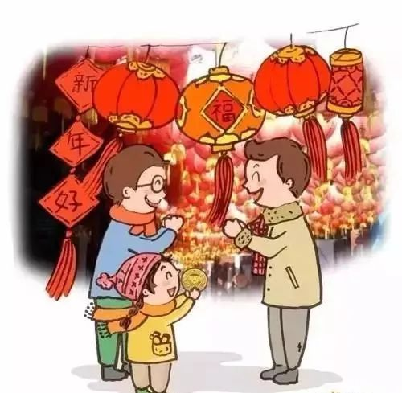
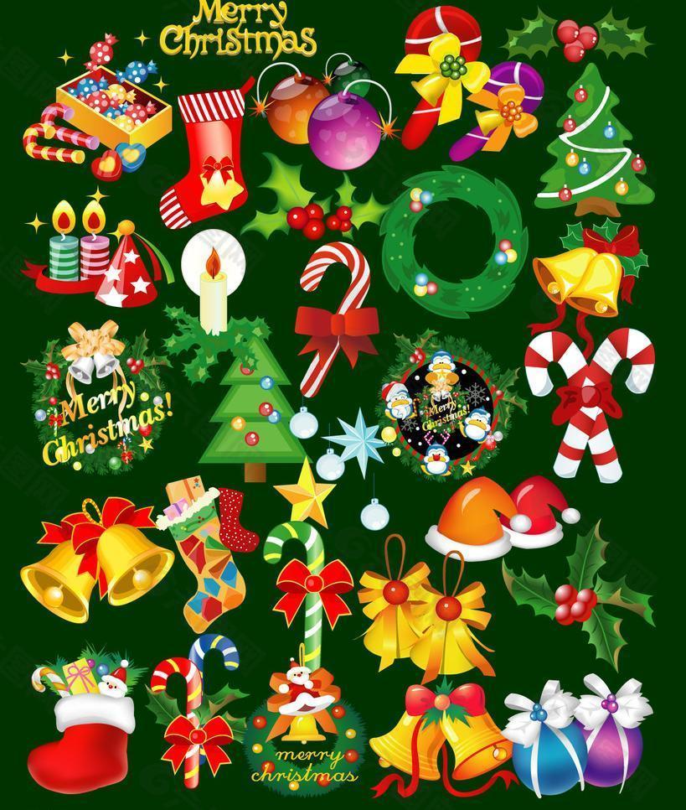
Deep thinking
Which do you prefer? The Spring Festival or Christmas?
In pairs, discuss “ Should we celebrate western festivals?”

Slide 16
East or west, holidays make us feel loved and happy.
As our world is becoming more and more like a village, it is normal to celebrate western festivals like Christmas.
Celebating western festivals does not mean we do not love our traditions and our motherland.
But we Chinese have the responsibility to carry forward(弘扬) our brilliant traditions and customs and to make them known to the outside world.
With 5000-year-long cilvilisation, China was, is and will always be our pride.

Slide 17
Homework
Homework
Write a small passage about how to carry
forward our traditional Chinese customs as a
student ( provide at least 3 practical advice).

Slide 18
Sample
Keep the Chinese tradition customs passed down method :
First: to bring Chinese culture to other countries, also let other countries understand China, understand chinese as well.
Second: deepen adolescents and people around of Chinese traditional culture so that they love our culture to accept it.
Third: often engage in some activity, whose main content is to publicize Chinese traditional customs, make them well spread and be carried forward, so that every Chinese and foreigners understand and love the traditional culture.

