Slide 1


感恩遇见，相互成就，本课件资料仅供您个人参考、教学使用，严禁自行在网络传播，违者依知识产权法追究法律责任。
更多教学资源请关注
公众号：溯恩英语
知识产权声明

Slide 2
2024广东一模应用文邀请信
简洁工作计划类模板

Slide 3
目录
/CONTENTS
1审题
2溯源
3建构
4评价
5迁移

Slide 4
审题
第一节（满分15分）
假定你是李华，你校将举办“经典文化探索展”，并通过网络进行直播。请你给外国笔友 Hans 写封邮件，邀请他在线观看。内容包括：
1. 活动介绍；
2. 观看时间、方式；
3. 你的期待。
注意：1.写作词数应为80左右；2． 请按如下格式在答题卡的相应位置作答。
Dear Hans,
Yours,
Li Hua

Slide 5
审题
体裁
作者身份
写信对象
人称
时态
写信语气
写信背景
写信目的
邀请信
学生
外国笔友 Hans
第一人称
第三人称
将来时
非正式
学校将举办一场“经典文化探索展”
我将邀请我的好友Hans进行在线观看，并告知他相关的活动信息，以此来增加吸引力。

Slide 6
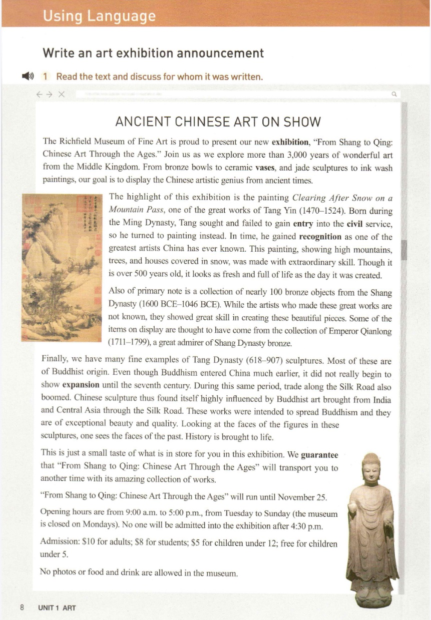
溯源
我们是否学过与“经典文化探索展”相关的文章呢？
人教版选择性必修三Unit1 Ancient Chinese Art on Show
语料整理：The Richfield Museum of Fine Art is proud to present our new exhibition, "From Shang to Qing: Chinese Art Through the Ages." Join us as we explore more than 3,000 years of wonderful art from the Middle Kingdom. From bronze bowls to ceramic vases, and jade sculptures to ink wash paintings, our goal is to display the Chinese artistic genius from ancient times. The highlight of this exhibition is the painting Clearing After Snow on a Mountain Pass, one of the great works of Tang Yin.

Slide 7
建构
段落
内容
1首段
问好+说明写信目的，就某事发出邀请
邀请信
2中段
介绍所邀请的活动细节
3尾端
期待接受，期盼回复

Slide 8
建构
假定你是李华，你校将举办“经典文化探索展”，并通过网络进行直播。请你给外国笔友 Hans 写封邮件，邀请他在线观看。
1首段句：
1.1寒暄语
Good news for you!
How is everything going?
How are things going these days?
I hope this letter finds you well!
1.2 如何用一句话传达背景信息和写作目的？Event+ Purpose

Slide 9
建构
1.2 如何用一句话传达背景信息和写作目的？Event+ Purpose
I'd like to invite you to attend our school's upcoming "Classic Culture Exploration Exhibition."
I’m excited to share that our school will be hosting a “Classic Culture Exploration Exhibition”, and I will be thrilled if you can join us for the online live streaming of the event.
v.在线收听（或收看）
Being more than happy to inform you of a “Classic Culture Exploration Exhibition” to be held in our school, I'm writing to invite you to join us online.
Knowing you are interested in the “Classic Culture Exploration Exhibition”, I’m writing to invite you to watch the online live streaming.

Slide 10
建构
2中段句：从哪些方面介绍所邀请的活动细节？
活动时间(when)、方式(how)、内容(what)、地点(where)、活动目的(why)和收获(what)等
The exhibition will kick off this Saturday at 2:00 PM and will be streamed live online.
when+how
The live streaming will take place at 9 AM Beijing next Friday, and you can join us through our school's official website as attached below.
when+how
The exhibition will be live-streamed online this Saturday, starting at 2:00 PM.
how+when

Slide 11
建构
2中段句：从哪些方面介绍所邀请的活动细节？
活动时间(when)、方式(how)、内容(what)、地点(where)、活动目的(why)和收获(what)等
The exhibition will showcase a diverse range of classic cultural artifacts, literature, and art, offering a fascinating exploration of our rich heritage.
what
深入探究
This event aims to delve into various classic cultures, including literature, art, history, and more.
why+what
This event promises an enriching journey through various facets of classic culture, including literature, art, and history.
what

Slide 12
建构
2中段句：从哪些方面介绍所邀请的活动细节？
活动时间(when)、方式(how)、内容(what)、地点(where)、活动目的(why)和收获(what)等
You can watch from the comfort of your own home, no need to venture out. Viewing is easy—simply click the link provided on our school's website.
how+where
By watching it, not only can we enjoy elegant artworks, but also we can have a better understanding of Chinese culture.
what
You can tune in via our school's website, where we'll provide a link to the live stream.
how+where

Slide 13
建构
2中段句：从哪些方面介绍所邀请的活动细节？
活动时间(when)、方式(how)、内容(what)、地点(where)、活动目的(why)和收获(what)等
You can watch from the comfort of your own home, no need to venture out. Viewing is easy—simply click the link provided on our school's website.
how+where
By watching it, not only can we enjoy elegant artworks, but also we can have a better understanding of Chinese culture.
what
You can tune in via our school's website, where we'll provide a link to the live stream.
how+where

Slide 14
建构
3尾段句：再次发出诚挚的邀请，并希望尽快得到回复，需注意用语的礼貌。
段落示范1
I sincerely hope you can join us and share in this cultural feast. I look forward to hearing your thoughts on the exhibition and having discussions afterward.
Looking forward to your reply!
段落示范2
I'm looking forward to having you virtually with us for this experience. Your participation will surely add to the enjoyment of the event.

Slide 15
建构
3尾段句：再次发出诚挚的邀请，并希望尽快得到回复，需注意用语的礼貌。
段落示范3
I genuinely hope you can join us for this enlightening experience. Your presence would add to the richness of our event, and I'm eager to hear your thoughts on the exploration of our classic culture.
Looking forward to your virtual presence!

Slide 16
评价
参考范文
I hope this email finds you well! I'm excited to share that our school will be hosting a "Classic Culture Exploration Exhibition", and I will be thrilled if you can join us for the online live streaming of the event.
The exhibition will showcase a diverse range of classic cultural artifacts, literature, and art, offering a fascinating exploration of our rich heritage. The live streaming will take place at 9 AM Beijing next Friday, and you can join us through our school's official website as attached below.
I'm looking forward to having you virtually with us for this experience. Your participation will surely add to the enjoyment of the event.
你觉得这篇范文怎样？
本文采用三段式，有效地介绍了本次“经典文化探索展”的活动内容、时间和方式，增加吸引力的同时，发出了真诚的邀请。

Slide 17
迁移
（2022年新高考全国I卷）
假定你是校广播站英语节目“Talk and Talk”的负责人李华，请给外教Caroline写邮件邀请她做一次访谈。
内容包括：
1. 节目介绍；
2. 访谈的时间和话题。
注意：1. 写作词数应为80左右；2. 请按如下格式在答题卡的相应位置作答。

Slide 18
迁移
范文语篇填空
Dear Caroline,
I hope this email finds you well. I‘m writing to _________________（发出邀请） for you to be a guest on our school radio program, "Talk and Talk."
“Talk and Talk” is a platform ________ we discuss various topics ranging from culture and education to personal experiences. We believe your insights would greatly _______（使丰富） our program.
We would like to s________ （安排）the interview at 6:00 AM this Friday. The topic of discussion will ________________（以……为中心）“Cultural Exchange and Language Learning.” Your perspective as a foreign language educator would be ________（极宝贵的）.
We look forward to hearing from you soon and hope you can join us for this insightful conversation.
extend an invitation
where
enrich
schedule
revolve around
invaluable

Slide 19
迁移
（2022年新高考全国I卷）
假定你是李华，正在组织主题力“My Career，My Lite”的生涯规划研讨会，得知你校外教 David 有相关工作经验，想邀请他来做一个主题讲座。请你给他写一封邮件，内容包括：
1. 讲座时间和地点；2. 讲座目的和内容。
注意：1.写作词数应为80左右；2. 可以适当增加细节，以使行文连贯。

Slide 20
迁移
参考范文
Dear David,
I'm Li Hua. We're organizing a career planning seminar entitled "My Career, My Life". Knowing that you have relevant work experience, I'm more than glad to invite you to give a keynote lecture for us.
You know we have been senior school students, facing the point of choosing our future college major and career. But we know nothing about it. So, would you like to give us some guidance and suggestions? We will hold the lecture at 7:00 pm this Friday in the hall of our school.
I will appreciate it if you can come. Looking forward to your arrival.
Yours,
Li Hua

Slide 21
谢谢观看
简洁工作计划类模板

