Slide 1

感恩遇见，相互成就，本课件资料仅供您个人参考、教学使用，严禁自行在网络传播，违者依知识产权法追究法律责任。
更多教学资源请关注
公众号：溯恩高中英语
知识产权声明

Slide 2
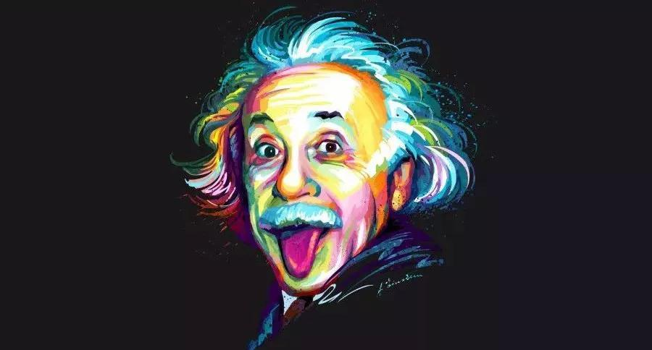
Unit 1 People of Achievement
-Using Language
The man who changed
our understanding of the universe
-by Lily 2021

Slide 3
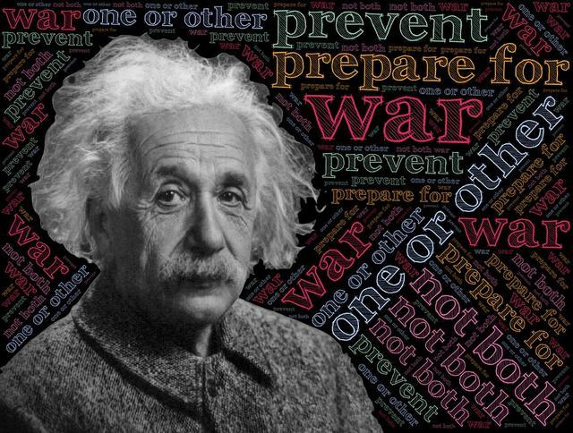
Some tags of Albert Einstein
a slightly odd looking but kind and funny man
a great scientist
a genius
the greatest scientist in physics
a courageous and kind figure
the smartest man
a gentle genius
Can you find more tags like this in the text?

Slide 4
What might be written to support these descriptive words?
achievements
appearance
attitude
the greatest scientist in physics
a courageous and kind figure
a slightly odd looking man
the smartest man
a kind and funny man
a genius
a gentle genius

Slide 5
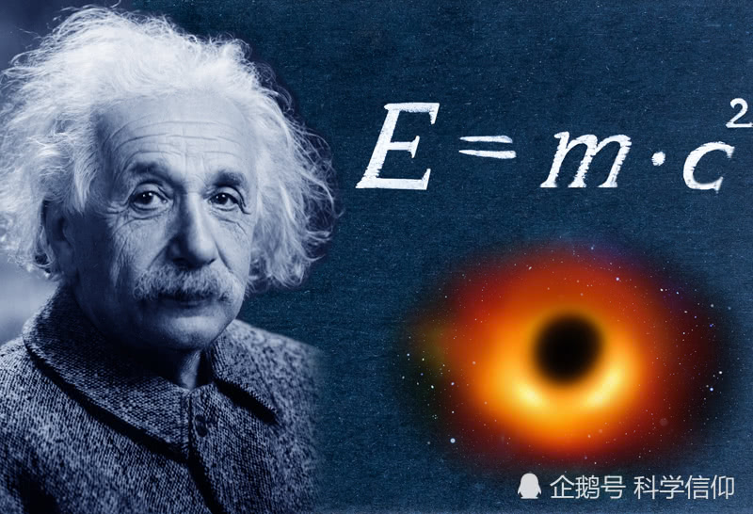
Read for the topics of each paragraph
paragraph | Topics
1
2
3
4
5
6
introduction (Einstein’s major achievements )
early life (education)
work experience
Einstein’s life
midlife
appearance and three anecdotes
death

Slide 6
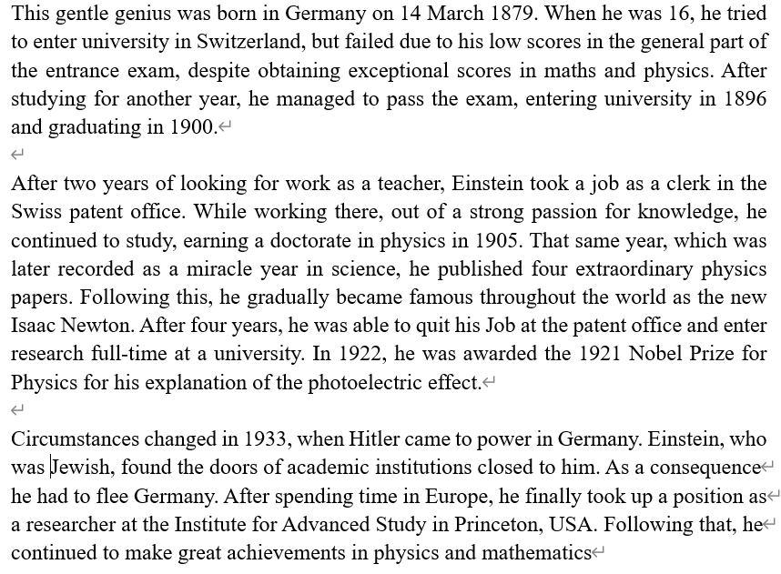
Einstein’s life
How does the writer introduce Einstein’s life?
It is in time order.

Slide 7

Make a timeline for Einstein’s life
turbulent midlife
Took a job
as a clerk in the Swiss patent office
(adj) 动乱的
a period when there are lots of changes
Entered research full-time at a university
Born in Germany
Entered university
Fled
Germany
1895
1900
1905
1922
1955
1902
1909
1879
1896
1933
Earned a doctorate in physics and published four extraordinary physics papers
Graduated from university
Awarded the Nobel Prize for Physics
Failed to enter university
Passed away
Circumstances changed in 1933…
the smartest man/genius

Slide 8
Find the descriptions of each part anf what these descriptions show.
content | language | skills | attitude/personal qualities
Achievement (para1)
Life (para2-4+6)
Appearance& Anecdotes (para5)
1) is often considered ….
2) He made numerous contributions to, the most well known being the …;
3) …became famous …as the new Isaac Newtown
List the major achievements;
Use analogy
the greatest scientist in physics
the smartest man
a genius

Slide 9
Find the descriptions of each part anf what these descriptions show.
content | language | skills | attitude/personal qualities
Life (para2-4+6)
After…
While working….
That same year…;
Following this…
In 1922…,
Circumstances changed…
As a consequence…; Following that…
1. Attitude to study:
1. in time order;
2. Using the crucial events in his life
passionate
committed
2. Attitude to life:
positive
courageous

Slide 10
Find the descriptions of each part anf what these descriptions show.
content | language | skills | attitude/personal qualities
Appearance& Anecdotes (para5)
slightly odd-looking
He had a thick moustache and long white hair, which sometimes stood on end as though he had just received an electric shock.
1. Using descriptive words to add details;
2. Using personification and simile;
peculiar
funny
forgetful
1. Forgot friends’ birthdays.
2. Helped a little girl with homework
3. Helped explain things and made an excuse
humorous
3. Using anecdotes to show personality
Attitude to people:
kind/gentle

Slide 11
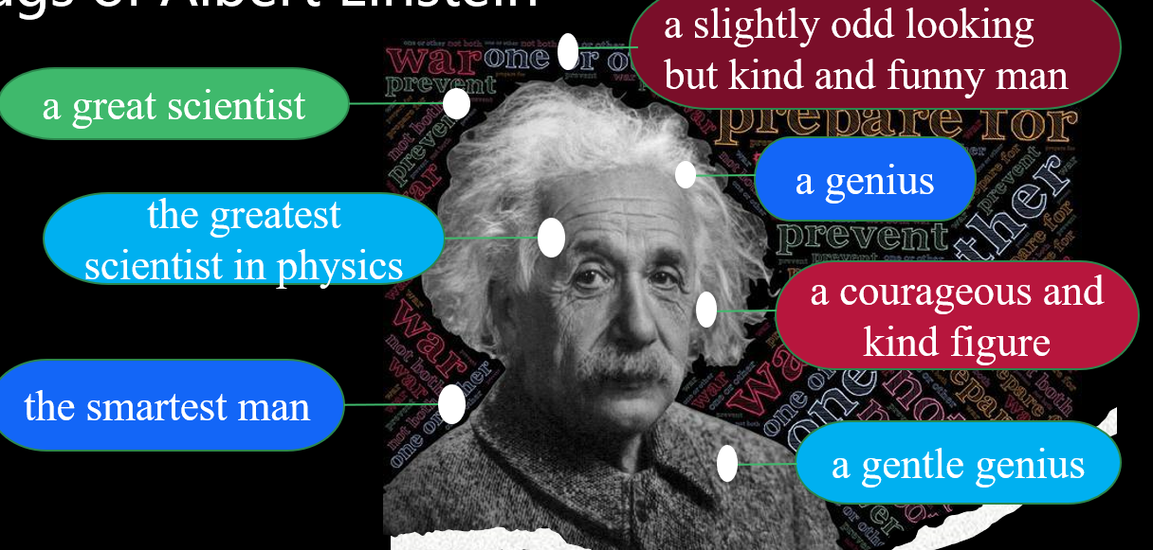
Q: How does the writer feel about Einstein?
Thinking
The writer respects and admires Einstein not only for his achievements but the charm of his personality and attitudes to study, life and people.
the title
The man who changed our understanding of the universe
descriptive words
the anecdotes he mentioned
On 18 April 1955, it was reported that Einstein had passed away, and the whole world mourned the great loss of a brilliant scientist. (Para6)
euphemism

Slide 12
Who is the person you admire?
(It can be a famous man or an ordinary person.
How to introduce a person you admire?
achievements
Life experience
Attitude & Personal qualities
appearance
How do you feel about this person?
anecdotes

Slide 13
Sample Writing
Zhong Nanshan, who is one of the greatest doctors in China, is often considered one of the modern national heroes for his great contributions to the fight against the virus. He is not only acknowledged as one of the most respectable and trusted figures during China’s battle against the Sars and COVID-19 but also a courageous and kind figure loved by many people.
Dr. Zhong Nanshan was born in October 1936 in Nanjing, Jiangsu Province. After graduating from Beijing Medical College in 1960, he stayed behind to teach. In 2003 , when the SARS epidemic broke out, Dr. Zhong acted as a leading pioneer in the battle against SARS. Although healthcare workers knew very little about the disease and there were no effective treatments or drugs available, Dr. Zhong and his team worked diligently and achieved remarkable results. Eventually, the SARS was successfully wiped out in August, 2003 in China. And in 2020 when the Covid-19 struck China, this 80-year-old man moved whole country again with his passion for his job and his commitment to the country.
Up to now, he has been working in the field of medicine for over 60 years and he insisted on exercising regularly. To the public, he is a brilliant doctor as well as a lovely man who always deserves people’s respect.

Slide 14

Checklist
 Does the writer describe the person’s appearance and personality?
 Does the writer tell an impressive story of the person’s life?
 Does the writer say why the person is great?
 Does the writer sum up how he/she feels about this person?

Slide 15
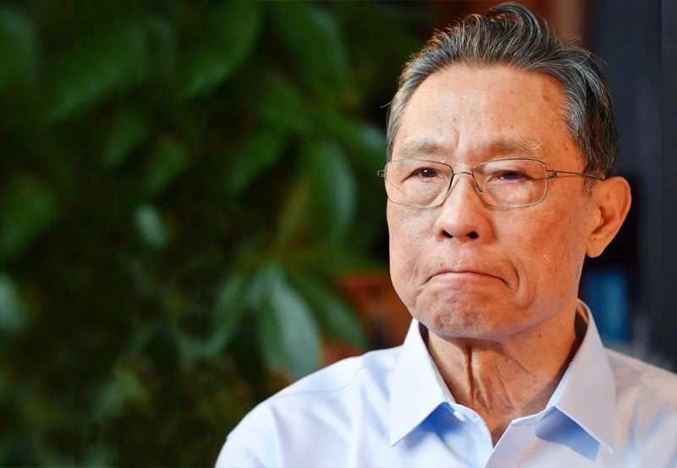
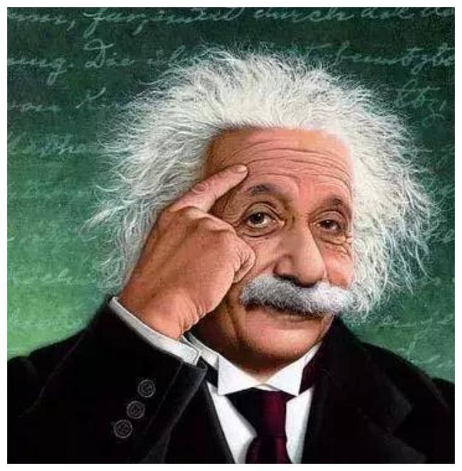
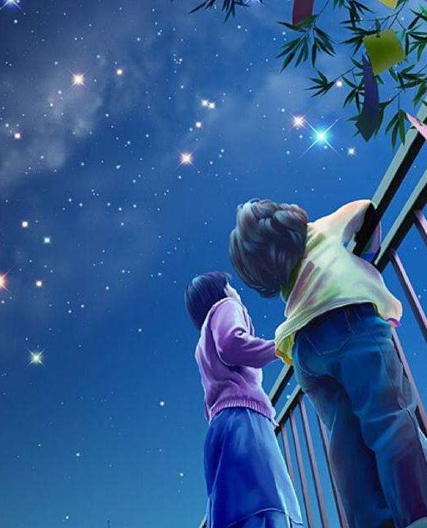
Thank You!
for all the great people
and all inspirations.

