Slide 1

感恩遇见，相互成就，本课件资料仅供您个人参考、教学使用，严禁自行在网络传播，违者依知识产权法追究法律责任。
更多教学资源请关注
公众号：溯恩高中英语
知识产权声明

Slide 2
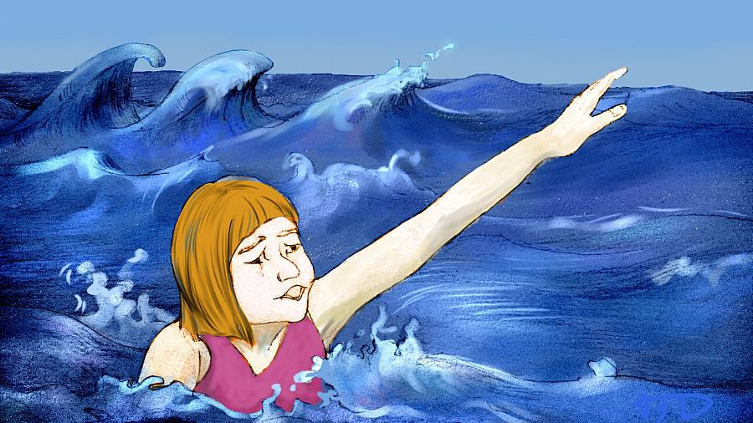
2019 稽阳联考读后续写

Slide 3

年份 | 体裁 | 主题 | 细节描写特点
2016.10 | 记叙文 | Jane 和丈夫在野营时吵架走散并迷路 | 侧重心理描写
2017.6 | 记叙文 | Mac 和朋友骑行途中偶遇恶狼 | 侧重动作描写
2017.7 | 记叙文 | “我”与健忘母亲的旅行趣事 | 侧重人物性格描写
2018.6 | 记叙文 | “我”与父亲去西部荒野度假时骑马迷路 | 侧重环境描写
年份 | 体裁 | 主题 | 细节描写特点
indirect characterization (间接人物塑造)
To reveal a character’s traits by describing his or her appearance, thoughts, words, actions, and other characters’ comments on him or her.

Slide 4



How to read a narrative story?
Read for plot
把握故事情节
Read for clues
寻找故事线索
Read for development
推测故事发展

Slide 5
Read for plot (把握故事情节)
Event
(what)
Plot
(how)
Time
(when)
A story
Characters
(who)
Place
(where)

Slide 6
阅读下面短文根据所给情节进行续写,使之构成个完整的故事
After study for hours. I went outside and up to the roof nearby for a break and watched people swimming in the sea. It was a sunny day-a blue, cloudless sky over a calm sea. But then, as I looked in the distance, I discovered a series of three or four big waves heading towards the shore. I'd seen these mini- tsunamis(小型海啸) many times before. They were heading at speed in the direction of the swimming area. Most people knew to look out for them, but from the screams that started coming from the beach, I could tell someone was in trouble.
Without thinking, I ran down into the street, holding my bodyboard (冲浪板)on the way and shouted at a stranger to call the coastguard(海岸整卫) My neighbor Tom had heard the screaming as well and was also outside with his bodyboard, so together we rushed to the steps that led down to the sea

Slide 7
Once we got closer, we discovered the waves had pulled a boy and a girl into the open sea. I know that the nearest boat would take at least 30 minutes to reach us. I wasn't used to this sort of emergency--I'd never been trained as a lifeguard--but I didn't think twice about trying to save them. I suppose in a way I wanted to impress everyone; at 19, a deal like that can seem like a good opportunity to show off
Tom and I dived into the water and it took us 10 minutes to get to them. When we finally reached them, they were almost lifeless with only their heads coming in and out of the water. We could tell they were still alive from their small breaths but it was clear they wouldn't have been able to stay there much longer. I held the boy and pulled him over my board. Tom then moved the girl onto his board.

Slide 8
Read for plot
time
place
characters
theme
on a sunny day
plot
a.We pulled kids onto our boards.
b.I shouted at a stranger to call the coastguard.
c. The kids were almost lifeless.
d. A boy and a girl were pulled into the sea.
e. I dived into the sea with Tom to save the kids.
f. I noted mini-tsunamis heading towards the
shore.
g. I went out for a break after hours of study.
at the seaside
a boy and a girl;
I;Tom;
coastguard
saving two kids
g
f
d
b
e
a
c

Slide 9


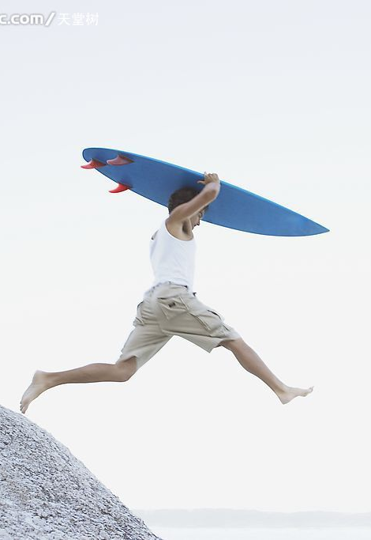
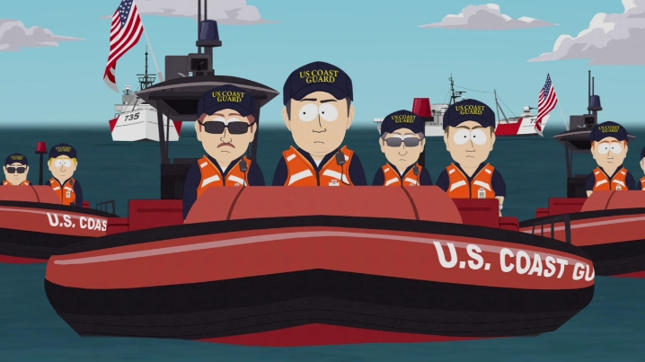
character traits: thoughtful/
considerate...
Read for clues
indirect characterization
...
Without thinking, I ran down into the street, holding my bodyboard on the way and shouted at a stranger to call the coastguard....
help
tool
Generally, a bodyboard is 1.5 to 2.7m in length and it weighs about 11 to 25 kg.

Slide 10
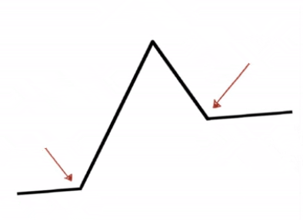
Read for development
We reached the boy and
girl but ___________
from the land
too far away
rushed
we ____ to the steps, led down to the sea
Climax
Falling action
Resolution
headed
Min-tsunamis ______
towards the shore.
______ started from beach
Rising action
Screams
inciting incident
Denouement
A ______ ________
sky over a _____ sea
blue cloudless
calm
setting

Slide 11
Read for development
划线词分类
人物类 | a boy and a girl; Tom
事物类 | waves; boat; opportunity; bodyboard
动作类 | swimming; save
距离 | in the distance
时间 | longer
划线词分类
人物类
事物类
动作类
距离
时间

Slide 12
Read for development
Para.1
We discussed pushing them back to the shore, but we were too far out.
Para 2. That night, word came from the hospital that the two kids were in
good condition.
The problems we met:
tiredness/ fierce waves/ dying kids...
The help we got:
the coastguard...
The gratefulness we received:
from the two kids' parents/ the media...
The lesson I learnt:
One simple act of kindness can really make a difference.
Where there is kindness, there is a miracle.
One good turn deserves another.
...

Slide 13
How to continue a narrative story?
Meaningful
Colourful
Beautiful
Mind your theme
注意主题
Mind your language
注意语言
Mind your handwriting
注意书写
indirect characterization

Slide 14
自然环境描写
——描写波涛汹涌
The coastline was hidden behind the _________ waves (汹涌澎湃的浪涛)with almost no one to be seen.
roaring
2. As I floated on, ______________ (一个巨浪) _________(呼啸而来)and approached us.
a huge wave
whistled
3. The big wind ____________________(在耳边咆哮), and we
were pushed away from the shore farther and farther.
roared through our ears
4. All my senses told me that a big wave ________________.(即
将来临)
was about to come
5. A_______________(看似猛烈的)wave was ________________.
(靠近我们)
powerful-looking
coming towards us
6. The fierce waves _________________________(没有消退的迹象).
showed no sign of dying down

Slide 15
人文环境描写
——描写声音传来
1. A distant sound _________________________.(传入耳朵)
reached our ears
2. A soft, reedy(似笛声的) sound ___________________________.
(漂浮在海上)
floated across the sea
echoed in our ears
3. The sound of the boat _______________________.(在我们耳内回响)
ripped the air
4. At that moment, a shrill whistle(笛汽声)______________ (划破天空).
5. When we were at a loss of what to do, there was a rasping (刺耳的)
shouts(喊叫声) ____________________ (从远处升起).
rising from the distance
6. A ship's ____________________ (喇叭声响起).
horn sounded

Slide 16
人物描写
——描写疲倦
1. Drown in the sea, I______________ (失去了平衡) but seized the
bodyboard tightly.
lost my balance
engulfed
2. Time passing us, tiredness _______________(包围了) us with my
feet __________ (僵硬/麻木)and shivering.
stiff/numb
3. ___________________ (尽管很累), we didn’t stop. Gritting out
teeth, we kept swimming.
Exhausted as we were
/fəˈtiːgd/
extremely fatigued
4. After what seemed a century, I felt _________________ (非常累)
while swimming hard to keep myself afloat(漂浮着的).
5. Casting a look at Tom, I could tell he was also ____________
_________________(明显地精 疲力尽了).
apparently
worn-out

Slide 17
人物描写
——描写害怕
1. I took a deep breath and_____________ (害怕地咽了口吐沫).
swallowed hard
2. Watching the shore in the distance, I felt _________ (无力的)
as if we were broken tiny boats at the mercy of strong wave.(simile)
powerless
3. Exhausted and cold, the thought that we might die here flashed
across my mind, which made me_____________________________
_______________________ (难以控制地发抖).
quiver with an uncontrollable terror/horror/fright
4. Looking at the vast sea, I felt a sense of fear ________________
______________.(在身体涌动)
surging through my
whole body
(creep)
5. As time ticked by, fear ___________________(爬上我心头)
and I could hardly tell how long I could _________(前行).
crept upon my heart
plough on

Slide 18
人物描写
——描写害怕
6. The thought of hopelessness _________________________(让
我后脊背发凉).
sent shivers down my spine
7. I was _________________________(被恐惧感淹没).
flooded with a sense of horror
8. Seeing this, I felt my fear ________________(剧增) inside.
growing/increasing
9. I felt ________________(一阵焦虑) _________________(袭来).
a wave of anxiety
swept over my body
sweep

Slide 19
人物描写
——描写挣扎努力
1. Tom looked ____________(若有所思)
thoughtfully
2. “We need to think out a way!” I muttered (喃喃自语), ___________
_________(绞尽脑汁)
scratching
my head
3. ...,We swam ____________(全力以赴地).
tooth and nail
4. We __________________(不遗余力地) to swim towards the shore.
spared no effort to
5. We _________________________(互换了坚定的神情) , then
ploughed on (继续前行) __________________(难以置信的速度).
exchanged a determined look
at an incredible speed

Slide 20
人物描写
——描写如释重负
1. Ensuring their safety, I __________________ .(感到一阵胜利的喜悦)
felt a surge of triumph
2. Hearing the comforting news, I __________________________
_________________.(情难自抑)
couldn't help to restraining my
excitement
3. _______________(听到...很高兴) to hear the good news.
It thrilled us
4. On hearing the good news, Tom and I _________________(如释重负地叹了口气), grinning merrily at each other.
sighed in great relief
5. ____________ (如释重负地微笑), I _________________(感到一阵自豪).
Smiling in relief
felt a rush of pride
6. _____________ (狂喜) to see a boat coming to our rescue, Tom and I ____________________ .(如释重负地松了口气)
Overjoyed
breathed a sigh of relief

Slide 21

natural setting
cultural setting
character's feelings/words/actions/monologues...
indirect characterization
A hero
A 19-year-old student
character traits: thoughtful/brave/
courageous/considerate
...

Slide 22
One possible version:
We discussed pushing them back to the shore, but we were too far out. We had to wait, trying to keep them on the bodyboards. Patting their faces to wake them up, we continuously told them to be strong. After what seemed a century, I felt extremely exhausted while swimming hard to keep myself afloat. Casting a look at Tom, I could tell he was also apparently worn-out. Looking at the vast sea, I felt a sense of surging through my whole body. Salt stinging(刺痛) my eyes, I could hardly tell how long I could hold on. But I still shouted in my head: focus. In sheer desperation(在绝望中), I finally caught sight of some boats with lifeguards on them heading towards us in the distance. Thank you, Lord. Quite soon, I felt strong arms pull me out of the sea onto the board, and the two kids were sent to the hospital without delay.

Slide 23
That night, word came from the hospital that the two kids were in good condition. Sighing in relief, I couldn’t stop thinking about the whole event. I knew they would have died if they had been in the sea for any longer. Obviously I had done a big deal which is surely a good opportunity to show off. I had expected to experience some sort of sense of wellbeing or greatness, but none of that came. Rather than feel like a hero, I believe anyone who could swim would have done the same thing.

Slide 24
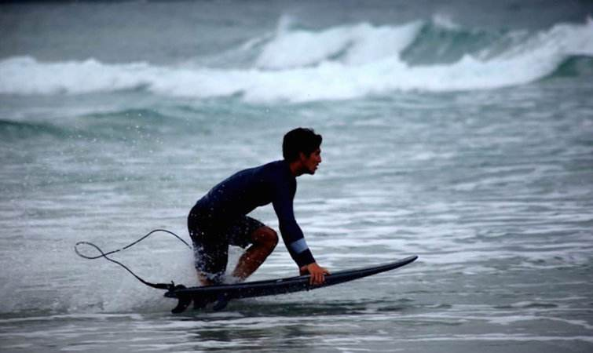
The end!

