Slide 1
感恩遇见，相互成就，本课件资料仅供您个人参考、教学使用，严禁自行在网络传播，违者依知识产权法追究法律责任。
更多教学资源请关注
公众号：溯恩高中英语
知识产权声明

Slide 2
Unit 2 Morals and Virtues Listening and Speaking
statements, informal, intimate

Slide 3
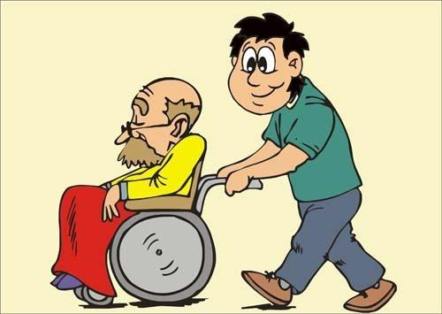
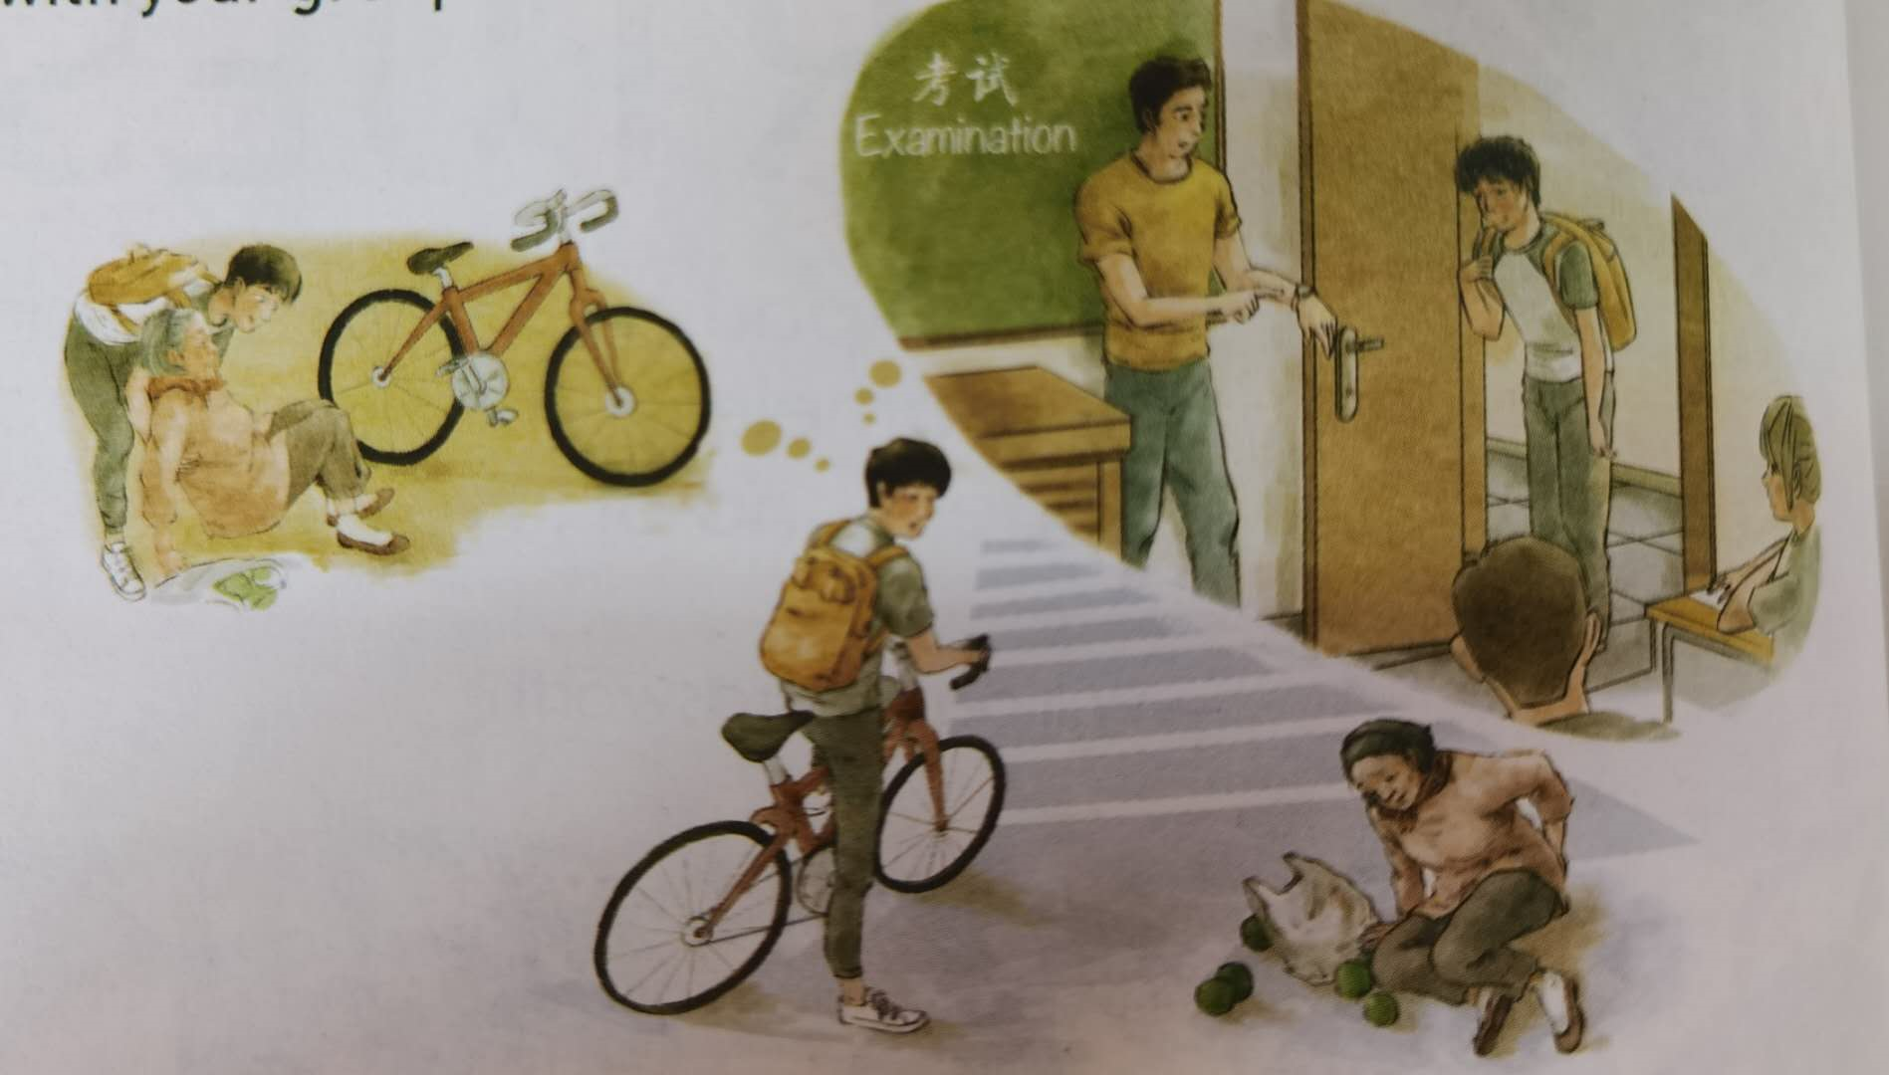
——Look and say
Lead-in
Moral Dilemma
A situation in which a difficult choice has to be made between two or more. If you choose one, you may get in trouble for not choosing the other(s).
If I were the boy faced with such a moral dilemma, I would choose to help her. This is because being hardwroking and kind is one of the significant traditional virtues in China.
What problem does is the boy faced with?
If I were the boy faced with such a moral dilemma, I would choose to help her/continue my way. This is because____________
The boy meets an old woman who fell to the ground.
and he has to make a choice whether to help her or
attend an examination.
—— Moral dilemma

Slide 4
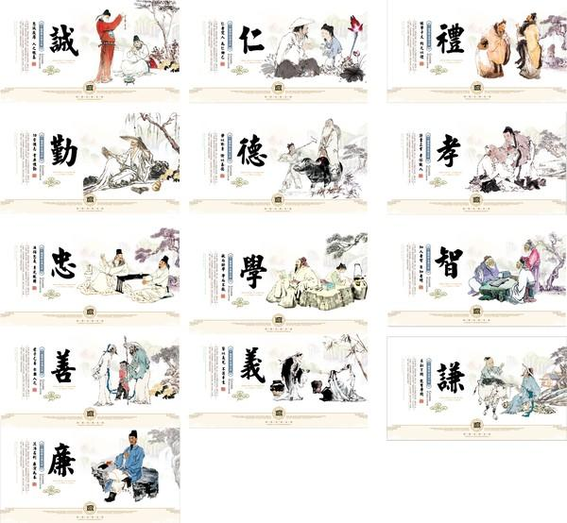
——Know more traditional virtues
Lead-in
a. be hardworking and kind
b. be modest and devoted
It’s our responsibility to spread Chinese traditional virtues.
c. be ready to help others
g. put the needs of the others first
d. offer to take on responsibility
e. respect our parents and teachers
f. care for/take care of the old

Slide 5
——Listen and fill in blanks
Listening
Situation | The girl is taking the entrance examination for ___________________ in Beijing. During the exam, the student next to her fainted.
Choices | She can ____________________ | or | She can __________________
Possible results | ________________________________________________________but__________________________________________________________________________________ |  | ____________________________________________________but_______________________________________________________________________
a medical university
finish the exam
stop and help the girl
She will get into the medical university
She can put the needs of others first
the girl may not get the help she need.
she have to give up her choice to get into the medical university
Tip: Before listening, you can make a prediction according to the key words in the questions

Slide 6
——Listen and decide
Listening
What do the red words have in common?
While listening, please take notes.
1. Jane is eager to share the magazine article with Luck.
2. Luck doubts that young people face moral dilemmas all the time.
3. Jane admires what the girl in the story did.
4. Luck doesn’t believe anybody would do what the girl in the story did.
5. Jane wonders how the girl became a doctor later.
T
Well. For example...
T
...don’t happen often...
Really? Like What?
T
T
can’t believe...
Who would do such a thing?
F
Tips:
1.pay attention to the words speakers use (passive or positive or objective)
2. pay attention to HOW the speakers is talking
be used to describe attitudes

Slide 7
——Listen and choose
Listening
1. The girl did all the following to help the student, except for?
A. carried her to a safe place
B. went to the hospital
C. called the teacher
2. What was the girl’s name? And what was she famous for?
A. Lin Qiaozhi, she always put the needs of the others first.
B. Lin Zhiqiao, her life was full of hard choice, but she always take care of others.
C. Lin Qiaozhi, she cared for tens of thousands of women and babies.
3. What kind of person is the girl can you infer from Jane’s words?
A. kind and devoted B. kind and modest C. devoted and modest
sister
Her life was full of hard choices, but she didn’t let them stop her from taking care of people who in need. She always cared for others more than for herself.

Slide 8
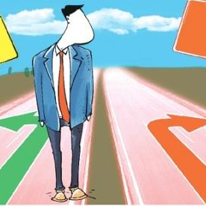
——Debate
Post-listening
There is no doubt that there are a wide range of moral dilemmas in our life, but whether should we help or not?
Choice
Opinion + Reason(s)
As for me/In my opinion/As far as I’m concerned, if we meet such a moral dilemma, we should choose to help/ ignore. The reason why I make such a choice is that...

