Slide 1


感恩遇见，相互成就，本课件资料仅供您个人参考、教学使用，严禁自行在网络传播，违者依知识产权法追究法律责任。
更多教学资源请关注
公众号：溯恩高中英语
知识产权声明

Slide 2
选择性必修二
U3 Using language(2)
Healthy
Eating

Slide 3
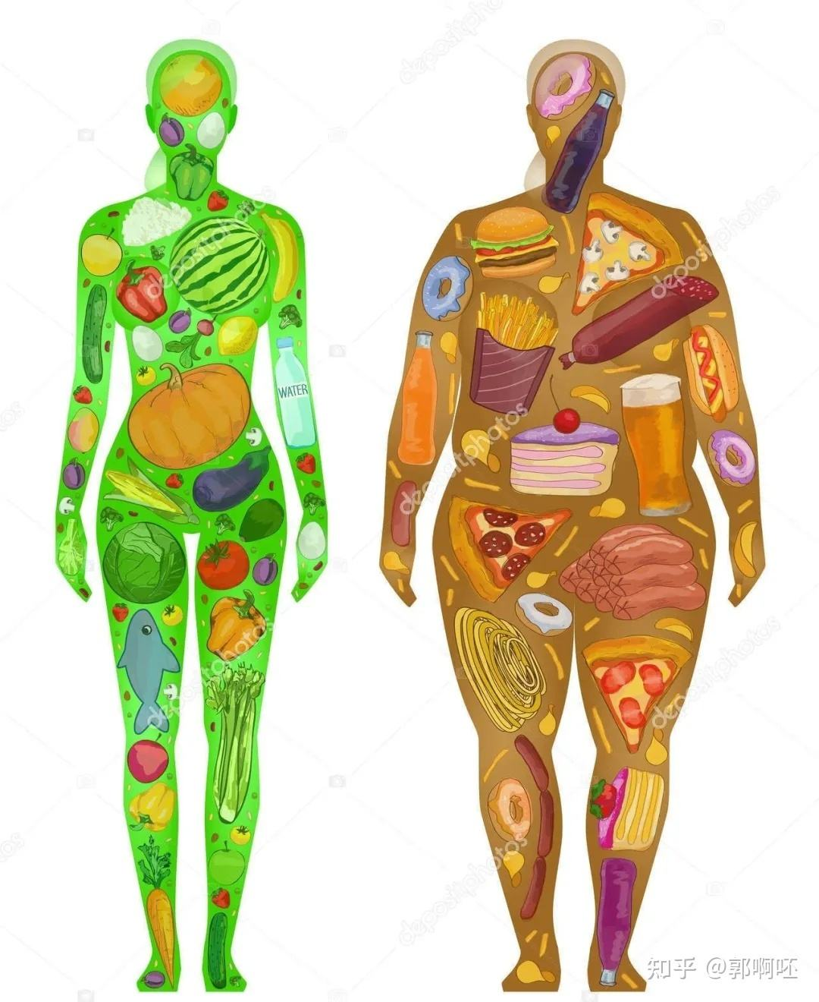
Lead-in
How do you understand the sentence?
You are what you eat.
人如其食

Slide 4
Brainstorm
What are the healthy eating habits?
01
Eat slowly.
02
Eat healthily.
03
Eat less.
...
04

Slide 5
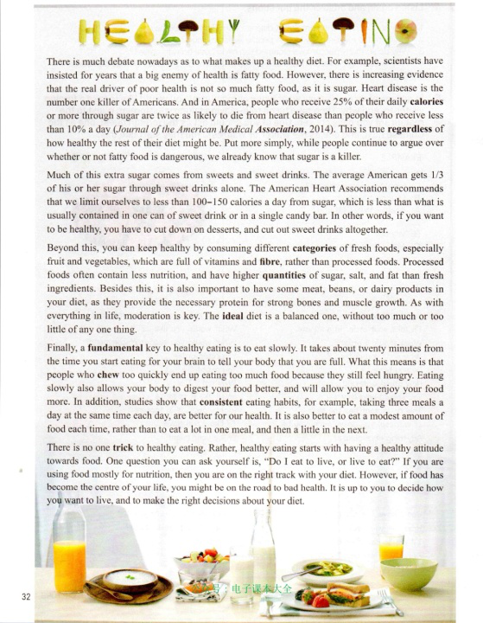

Pre-reading
Predict the main idea according to the title and the picture.
HEALTHY EATING
Some rules for healthy eating.

Slide 6
While-reading
Read for the structure of the text.
Specific
Part 1 (Para____)
Part 2 (Para____)
Part 3 (Para____)
1-2
3
4
Part 4 (Para____)
General
5

Slide 7
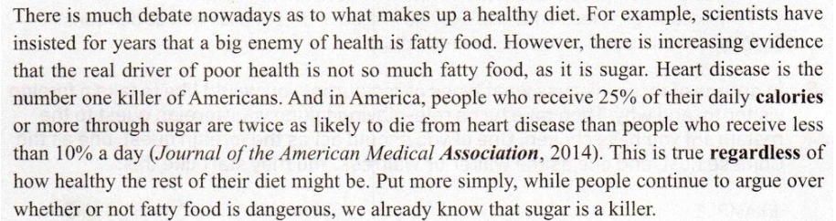
While-reading
  A paragraph
  topic sentence /key point
1. Explanation: explain and make the idea clear
2. Definition : give clear definition or concept
3. Examples: give examples to support the ideas
4. Quotation: use some facts、some findings or someone’s words to support the ideas
5. Conclusion/ Transition: Conclude again or introduce the next paragraph
  supporting details

Slide 8
While-reading
Read Para1 for the key point, the supporting details and the writing technique.
  topic sentence
  supporting details
example
explanation
quotation
conclusion
1. What is the topic sentence?
2. How does the writer support his topic sentence?

Slide 9
While-reading
Read Para1 for the key point, the supporting details and the writing technique.
contrasting ideas are being introduced
introduce another way of saying what was already mentioned
3. What writing technique does the writer use?
using linking words
using numbers

Slide 10
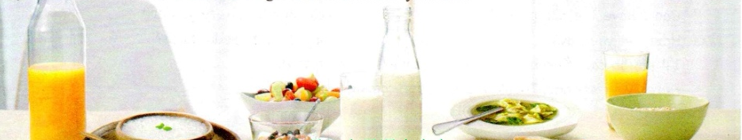
Group work
Discuss in groups of four and try to read Para2-4 for the key point, the supporting details and the writing technique in each paragraph.
1. What is the topic sentence/key point?
2. How does the writer support his point?
3. What writing technique does the writer use?

Slide 11
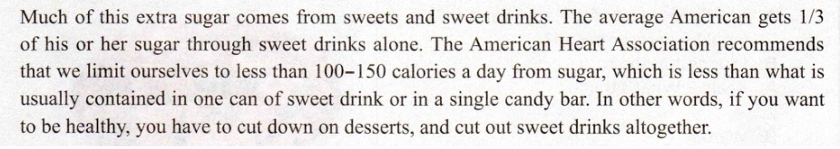
Para2
explanation
quotation
using numbers
1. What is the topic sentence?
2. How does the writer support his topic sentence?
3. What writing technique does the writer use?
using linking words

Slide 12
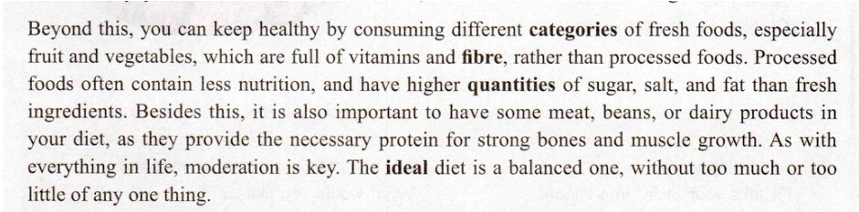
Para3
explanation
making a comparison
definition
1. What is the topic sentence?
2. What diet is a balanced one?
3. How does the writer support his topic sentence?

Slide 13
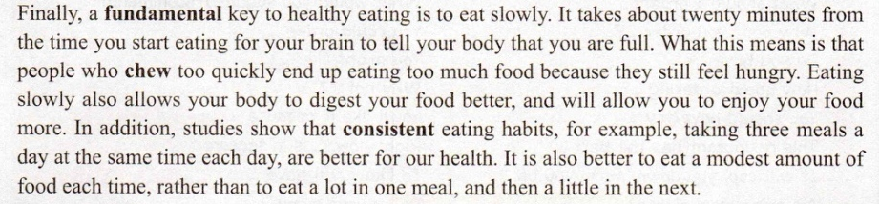
Para4
How does the writer support his key point?
explanation
examples
What’s the main idea?
Eat slowly, regularly and eat in moderation.

Slide 14
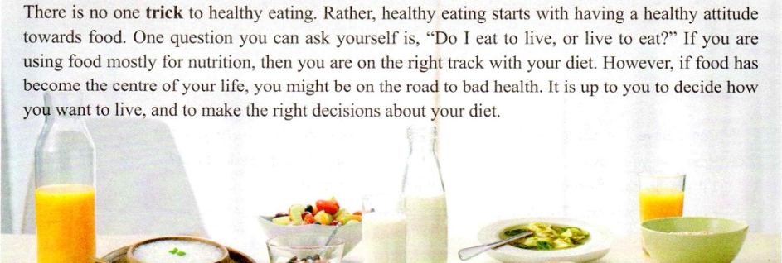
Para5
How do you understand it?

Slide 15
Conclusion
Some rules for healthy eating.
1. Cut down on dessert and cut out sweet drinks.
2. Consume fresh foods rather than processed foods.
3. Eat slowly and eat in moderation.
Have a healthy attitude towards food.

Slide 16
Post-reading
Writing
1. Compare your own eating habits with the rules written in the text.
1). Do you have healthy eating habits?
2). If not, what can you do to get rid of them?
2. Write about your own eating habits.
My eating habits
1. Use details to support your point.
2. Use linking words to tie your essay together.

Slide 17
Share and assess: Use this checklist to help you
revise the draft.
Do you use details to support each point?
Do you use proper linking words to tie the essay together?
Have you really thought about your diet carefully?

Slide 18
Healthy diet is a heated topic among people recently, for diet plays an important role in our daily life.
As for me, I have a healthy diet.Firstly, I rarely consume sweet foods, let alone junk food.Secondly, my diet contains quantities of green vegetables and fruits, which can supply/provide me with necessary vitamins.Thirdly, a modest amount of meat and rich dairy products are also included in my diet.Most fundamentally, I take three meals a day at the same time each day, regardless of holidays.
Personally, sticking to a healthy diet helps me stay in shape.Hope you can join me!
Sample
My eating habits
Healthy diet is a heated topic among people recently, for diet plays an important role in our daily life. As for me, I have a healthy diet. For example, I rarely consume sweet foods, let alone junk food. In addition, my diet contains quantities of green vegetables and fruits, which can supply/provide me with necessary vitamins. Besides this, a modest amount of meat and rich dairy products are also included in my diet. Personally, sticking to a healthy diet helps me stay in shape.

Slide 19
Homework
Polish your draft and exchange it with your classmates.

Slide 20
Thanks

