Slide 1
感恩遇见，相互成就，本课件资料仅供您个人参考、教学使用，严禁自行在网络传播，违者依知识产权法追究法律责任。
更多教学资源请关注
公众号：溯恩高中英语
知识产权声明

Slide 2
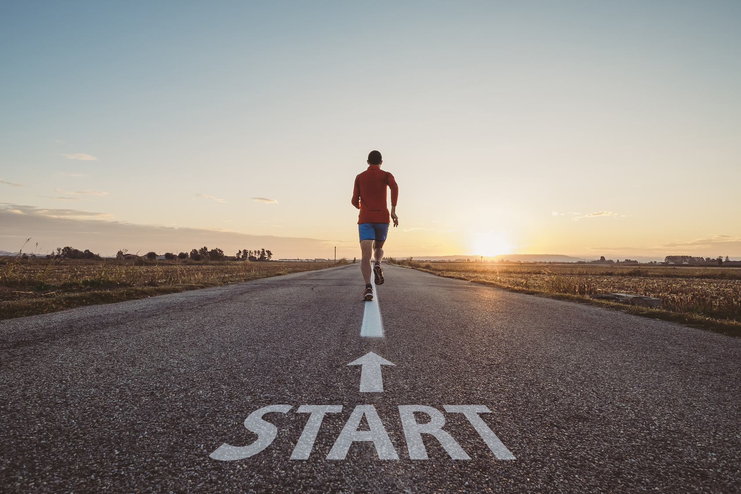
20220608全国I卷读后续写讲评 David’s Run
浙江省天台中学
陈星可

Slide 3
Text：文本呈现
It was the day of the big cross-country run. Students from seven different primary schools in and around the small town were warming up and walking the route (路线) through thick evergreen forest.
I looked around and finally spotted David, who was standing by himself off to the side by a fence. He was small for ten years old. His usual big toothy smile was absent today. I walked over and asked him why he wasn’t with the other children. He hesitated and then said he had decided not to run.
What was wrong? He had worked so hard for this event!
I quickly searched the crowd for the school’s coach and asked him what had happened. “I was afraid that kids from other schools would laugh at him,” he explained uncomfortably. “I gave him the choice to run or not, and let him decide.”
I bit back my frustration (懊恼). I knew the coach meant well - he
thought he was doing the right thing. After making sure that David

Slide 4
could run if he wanted, I turned to find him coming towards me, his small body rocking from side to side as he swung his feet forward.
David had a brain disease which prevented him from walking or running like other children, but at school his classmates thought of him as a regular kid. He always participated to the best of his ability in whatever they were doing. That was why none of the children thought it unusual that David had decided to join the cross-country team. It just took him longer — that’s all. David had not missed a single practice, and although he always finished his run long after the other children, he did always finish. As a special education teacher at the school, I was familiar with the challenges David faced and was proud of his strong determination.
We sat down next to each other, but David wouldn’t look at me.
I watched as David moved up to the starting line with the other
runners.

Slide 5
Learn the language
1.越野赛 2.小学 师范大学
3.强忍住（不说）
4.怀有好意，出于好心
5.晃动/摆动他的腿
6.一个普通的孩子
7.尽力地 8.对...熟悉 9.对...自豪/骄傲
满心骄傲 10.没有错过一次练习
11.起跑线 终点线
1.the cross-country race
2.primary school
normal university
3.bite back...
4.mean well
5.swing his feet -- swung--swung
6.a regular kid
7.to the best of one’s ability
8.be familiar with...
9.be proud of..., take pride in...
swell with pride
10.not miss a single practice
11.the starting line
the finishing line

Slide 6
Understand the story- Fill in the blanks:
David had a brain disease ______ prevented him from walking or running like other children, but he always participated ____ the best of his ability _____ whatever they were doing at school. And as a member of the cross-country team, he never missed a practice, for which his classmates considered him a regular kid and I was proud of his strong ____________.
On the day of the big cross-country run which ____________(attend) by seven primary schools, the coach, afraid that David would be laughed at, let David himself decide ________ to run or not, which made David feel very frustrated. He was alone by the fence, without his ususal big _______(tooth) smile. Learning about his decision and the reasons behind, I walked towards the boy...
which
to
in
determination
was attended
whether
toothy

Slide 7
Understand the story-Plot & Emotions:
3.Climax
David decided not to run
discouraged
4.Falling action
2.Rising action
We sat down next to each other, but David wouldn’t look at me.
Coach gave him the choice to run or not.
self-doubtful, nervous, upset
....
1.Beginning
5.Ending
Though with a brain disease, David always finished the practice, was thought a regular kid.
I watched as David moved up to the starting line with the other runners.
....
determined,optimistic
David’s Run

Slide 8
Understand the story- Foreshadowing
foreshadowing | 在读后续写中的运用
1.His usual big toothy smile was absent today.
2. I turned to find him coming towards me, his small body rocking from side to side as he swung his feet forward.
3.He always participated to the best of his ability in whatever they were doing.
4.As a special education teacher at the school, I was familiar with the challenges David faced and was proud of his strong determination.
到达终点线后，他又露出了big toothy smile.
描写David 在跑步过程中的样子，与后面的全力以赴形成对比。
与文本的主题determination形成呼应。.
determination是贯穿文本的主题，是主人公前后变化的主因，也是文章想要表达的message.

Slide 9
Design the plot- Question and Answer
Para 1. We sat down next to each other , but David wouldn’t look at me.
Q1:How did David appear? (神态+动作+体态语)
Q2: Faced with the situation, how did I react to it? (动作链+话语)
Q3:At what I did and said to him, Did David change his mind? (情绪+动作+话语)
Para 2.I watched as David moved up to the starting line with the other runners .
Q1:What was the challenge for David? How did he cope with it ? (环境描写+动作+神态)
Q2: Seeing David’s determination to make it to the finish line, what did the people watching do to him?(动作链)
Q3: Whats the result of the run? What did his mates and I do to celebrate his determination?(动作+情感+点题)
David changed his mind and decided to participate.

Slide 10
Design the plot- Question and Answer
Para 1. We sat down next to each other , but David wouldn’t look at me.
Q1:How did David appear? (神态+动作+体态语)
He simply looked down at the ground, biting his lips and saying nothing.
Obviously, he knew his quitting the race failed my expectation but by no means would he allow other kids to tease him for his funny gait.
He ducked his head silently, his hands crossed together.
He hung his head, trying to avoid eye contact with me.
Depressed and low-spirited, David sat silently with his head dropping. And from time to time, he stole a glance at me as if he had something to say.
He buried his face in his arms and began to sob.
Staring at his shoes stiffly, David sat silently with his one hand rubbing the other.

Slide 11
Design the plot- Question and Answer
Q2: Faced with the situation, how did I react to it? (动作链+话语)
Gently I turned him around, looking firmly into his eyes. I assured him that determination to participate in whatever he was doing to the best of his ability was what made other people admire him. “Cheer up and shine yourself,” I added.
Smile tugging at the corner of my mouth, I patted on his shoulder and
encouraged him to run.
I decided to infuse some courage into this tough boy.
Gently guiding him into my arms, I looked right into his eyes, where tears welled up.
Anyone who always participates to his best deserves to have a try for himself.”

Slide 12
Design the plot- Question and Answer
Q3:At what I did and said to him, Did David change his mind? (情绪+动作+话语)
Hearing my confirmation, David beamed with pleasure and stumbled towards the starting line.
At my inspiring words, the confidence in the run found its way back.
After what seemed to be ages, David lifted his head and cast me a determined look. All the frustration that had been built inside of me came to a complete stop.
Inspired, he took a deep breath, summoned up his courage. "I, I would like to give it a shot."
After hearing my encouragement, David looked up at me with a determined look saying,“I will run with all my effort!”
Hearing my inspiring words, David could see the silver lining in the cloud. His longing for success eventually overcame his fear.

Slide 13
Design the plot- Question and Answer
Para 2.I watched as David moved up to the starting line with the other runners .
Q1:What was the challenge for David? How did he cope with it ? (环境描写+动作+神态)
David was soon far behind others. Worse still, he somehow lost his balance and fell.Instead of giving up, the brave boy miraculously picked himself up and struggled on.
However, he spared no effort to catch up with the others, drops of sweat streaming down his cheeks, showing no sign of giving up.
Painful and a bit embarrassed as he was, he still dragged his feet to keep moving forward.
David stood firmly in his position, ignoring anything around. Pushing forward without balance, he was left behind. However, when he came into sight, the spectators burst into thunderous cheers and applause.

Slide 14
Design the plot- Question and Answer
Q2: Seeing David’s determination to make it to the finish line, what did the people watching do to him?(动作链)
At first, students from other schools whispered and pointed at him. But as time went by, they were overcome by his tough spirit.
Obviously impressed by David’s perseverance, all the audience unanimously shouted cheers for him, which in turn encouraged David. He kept on running with every ounce of his strength and finally made it across the finish line.
Thunderous applause burst out. Everyone was struck by his strong determination instead of laughing at him.
Only David was left far behind. However, he spared no effort to catch up with the others, drops of sweat streaming down his cheeks, showing no sign of giving up. Ten minutes later than the last runner, David reached the finishing line and all the students cheered up for him.

Slide 15
Design the plot- Question and Answer
Q3: What was the result of the run? What did his mates and I do to celebrate his determination?(动作+情感+点题)
Although David didn’t get the best title, he went beyond his limits, breaking his own record.
In the cheer and applause, David crossed the finish line finally, along with the most familiar but unforgettable thing- a usual big toothy smile on his sweaty face.
With all his might, he threw himself across the finish line.
He finally made it across the finishing line,with a camera freezing the moment when his big toothy smile reappeared on his face.
Such is the key to “success”---a little bit more efforts and determination will create a little bit more miracles.
For others, it was just a simple cross-country run. But for David, it was a symbol of strong determination and self-breakthrough.

Slide 16
Accumulate writing material: frustration/sadness
Upon/On hearing the bad news, she felt extremely sad.
At the bad news, her heart ached, tears streaming down her cheeks.
Upon hearing the bad news, she, numb with grief, had trouble speaking.
Hearing the bad news, she felt seized by a burst of sadness and couldn’t help crying bitterly.
All the frustration and stress began to build up inside of me.
Feelings of frustration overwhelmed me.

Slide 17
下水作文及 点评：
We sat down next to each other, but David wouldn't look at me. He simply looked down at the ground, biting his lips and saying nothing. ①Gently I turned him around, looking firmly into his eyes. I ②assured him that determination to participate in whatever he was doing to the best of his ability was what made other people admire him. I further ②convinced him that the students from other schools would never judge him by the way he ran but how he performed at the race. “Cheer up and shine yourself,” I ②added. ③Half doubtful and half encouraged, he looked up and the next moment, the hesitation on his face disappeared, totally replaced by the eagerness to give it his best shot and the confidence to overcome himself. 116
1.修饰性副词至于句首，赋予句子以感情，凸显我的关心和暖心。
2.Assured, convinced, added三个不同的“说”的动词的运用，增加了表达的丰富性；他们在不同的位置也使得句式更为多样化。
3.half doubtful and half encouraged, replaced by eagerness等情感词汇的变换使用，使得主人公的情感变化得以淋漓尽致地呈现出来。
4.高级词汇bite one’s lips, to the best of one’s ability, shine oneself, give it one’s best shot和较强的长句子驾驭能力都为文章增色不少。

Slide 18
下水作文及 点评：
I watched as David moved up to the starting line with the other runners. ①At the whistle signalling the start, all the athletes shot out except David. He was soon left far behind others. Worse still, he somehow lost his balance and fell. ②The whole world suddenly fell silent and all the eyes were on the boy. Instead of giving up, the brave boy miraculously picked himself up and struggled on. ③Obviously impressed by David’s perseverance, all the audience unanimously shouted cheers for him, which in turn encouraged David. He kept on running with every ounce of his strength and finally made it across the finish line. ③Surrounded by hugs of congratulations and words of admiration,④ the shy boy once again cracked his big toothy smile, indicating that he had made it. 115
1. 介词的灵活运用，给人耳目一新的感觉。
2.环境描写的运用，有效地反衬了主人公的determination.
3.两处过去分词的运用，实现了情节的有效过渡和表达的简练性。
4. his big toothy smile呼应了原文本的信息，同时也表达的主人公的determination。
5.高级表达shoot out, fall silent, pick himself up, in turn, with every ounce of his strength都显示了较扎实的语言功底。

Slide 19
Let’s get a head start together, running towards our dreams ahead!
Thinker英语工作室

