Slide 1
感恩遇见，相互成就，本课件资料仅供您个人参考、教学使用，严禁自行在网络传播，违者依知识产权法追究法律责任。
更多教学资源请关注
公众号：溯恩高中英语
知识产权声明

Slide 2
助力六月高考 为考生圆梦加油！
应用文写作：约稿信
The Letter for making an arrangement in advance with sb. for his contribution
杭州二中树兰高级中学 郭合英

Slide 3
Learning Goals
After learning this lesson, you will gain the skills
1. Cultivate the students’ ability to comprehend the question carefully.
2. Learn about the structure.
3. Apply the proper format of the letter.
4. Build up some appropriate expressions
5. Mind your tone in the letter.
6. Make your writing more coherent.
7. Know what a good letter is like.

Slide 4
What is the Letter for making an arrangement in advance with sb. for
his contribution?
约稿信是指报纸、杂志、文化专栏等媒体向其他的作者发出的邀请别人写稿的信件。约稿人需要在信中介绍该媒体的栏目特点和媒体的受众范围。在约稿时还要指定稿件的内容(约稿人既可以规定约稿的内容，也可让被约稿人根据媒体和栏目的性质自拟写作题目和内容)，并说明要约定稿件的大致篇幅和交稿日期。

Slide 5
审题六要素
应用文审题一般包括六个方面，简称“六步审题法”
1. 审体裁 ┅ 确保自己不会写错格式。
2. 审关系 ┅ 要不要做自我介绍取决于他们之间的亲疏关系。
六步审题法
3. 审人称 ┅ 避免用错人称。
4. 审时态 ┅ 避免用错时态。
5. 审要点 ┅ 要点齐全不丢分。
6. 审回复 ┅ 结合交际原则看是否需要回复。

Slide 6
对学生进行审题能力的培养
假定你是李华，是你校英语杂志的一名编辑。请给你的英国好友Eric写一封约稿函，请他为“Great Scientists” 栏目写一篇介绍他们国家科学家的稿件，内容包括：
栏目介绍；
约稿要求（内容、稿件长度及交稿日期等）。
注意：
词数80左右；
可以适当增加细节，以使行文连贯。
“六步”审题法
1
2
3
4
5
6
审体裁
审关系
审人称
审时态
审要点
审回复
因为李华和Eric是好友关系，故无需做自我介绍
约稿信一般用第二人称
一般现在时或一般将来时
1.栏目介绍 2.稿件内容 3.稿件长度 4.交稿日期
根据交际原则，约稿信需要回复。
约稿信

Slide 7
篇章结构
结尾段
Para 3: express hope
+ reply to the letter
主体段
Para 2: the introduction of the column
+
requirements for contributions
开头段
Para 1: background
+ purpose

Slide 8
词汇积累
单词部分
1. 杂志
magazine
2. 编辑
editor
3. 刊登
publish/carry
4. 栏目
column
5. 截止日期
deadline
6. 要求(n.)
request/requirement
短语部分
1. 稿件要求
requirements about the article
2.交稿
hand in one’s articles
3. 开拓视野
broaden one's horizons
4. 栏目特点
characteristics of the column
5. 受到┄的欢迎
be popular with
6. 读者范围
scope of the readers
7. 语言风格
language style
8. 有关主题
with the theme of ┄┄

Slide 9
词汇积累
短语部分:
擅长做某事
be good at 擅长, 精于
be expert at/in 在…方面熟练的
have a talent/gift for 有…的才能
be an old hand at 在 ... 方面富有经验
be clever / great / adept at sth. 擅长于
a master of 精通…的能手
be accomplished in 擅长, 精于
have a good head for 有才能
be proficient in doing sth. 做某事很熟练
shine at 干得出色
翻译：你擅长写作，尤其是有关名人介绍的话题。
You are proficient in writing, especially the topic concerning the celebrity introduction.
You shine at writing, especially the topic regarding the celebrity introduction .
You are a master of writing, especially the topic regarding the celebrity introduction.
You have a good head for writing, especially the topic regarding the celebrity introduction.

Slide 10
开头段(背景+目的)句子积累
1.邀请某人做某事
2.为我们栏目“Great Scientists”写一些文章。
3. 为了吸引学生的读书兴趣,拓展他们的视野。
4.我写信想邀请你为我校的栏目写一些文章。
invite sb. to do sth.
ask sb. to do sth.
write some articles for our column “Great Scientists”.
in order to attract the students’ interest in reading and broaden their horizons
Aimed at enriching our school life, I would like to invite you to write an article for our column.
I’m writing to you with the purpose of inviting you to write some articles for our column.

Slide 11
主体段（栏目介绍+稿件要求）句子积累
1.关于稿件的一些细节要求
2.名为“Great Scientists”的栏目很受学生的欢迎。
3.我们想刊登一些关于你们国家一些著名的科学家的故事。
4.你能写点关于……的文章吗?
5.你能写一些关于你们国家伟大科学家的文章吗？
Here are some details about the article.
The column called “Great Scientists” is very popular with us students.
We feel like carrying articles about some great scientists from your country.
Would you please write some articles about…?
Would you please write articles considering/regarding/concerning some great scientists from your country?

Slide 12
主体段（栏目介绍+稿件要求）句子积累
6.热烈欢迎关于伟大科学家的稿件
7.请问您愿意写点关于你们国家著名科学家的文章吗？
8.我们会特别喜欢/欢迎有关你们国家有关科学家的文章。
9.如果你能为文章配图那再好不过了。
10.你可写一篇800词的文章，题目自拟。
welcome you to contribute to some articles relevant to great scientists.
Would you please write articles concerning the great scientists from your country?
Would you please write articles relevant to some great scientists from your country?
We would prefer/welcome articles in particular about the great scientists from your country.
It would be better if you could attach a picture to the article.
Your article can have a vocabulary of about 800 with a title made up by yourself.

Slide 13
主体段（栏目介绍+稿件要求）句子积累
11. 800 字左右的文章。
12. 我们能在5月28日之前收到你的文章吗？
13.你最好5月28日之前把你的文章发送给我，字数约800就好。
The article is supposed to be about 800 words.
Could we have your article with 800 words or so?
Could we get your article before/by May 28th ?
You’d better send your article to me by May 28th and about 800 words would be fine.
I’d appreciate it if you send your article to me by May 28th with a vocabulary 800
words or so.
Could you send your article to me by May 28th with a vocabulary 800 words or so?

Slide 14
结尾段句子积累
1.期待尽快收到您的回复.
2. 我坚信大家都会喜欢你的文章。盼望收到你的回信。
Looking forward to your reply/confirmation soon.
Looking forward to your reply at your earliest convenience.
I firmly believe that everyone will like your article. Looking forward to hearing
from you.
I firmly bet that everyone will like your article. Looking forward to hearing from you.
I hold firmly the belief that everyone will like your article. Looking forward to hearing from you.
I’m firmly convinced that everyone will like your article. Looking forward to hearing from you.

Slide 15
约稿信模板1
Dear 被约稿人 ，
Knowing that you are proficient in writing, I feel like asking you to write an article for 某媒体 .
What comes first is that the “ 栏目 ” section in our 媒体 is very popular among 受欢迎人群. It carries articles that are related to the 某个话题 . Would you please write something about 这个话题? And we especially welcome articles about A方面 and B方面. You can write anything relevant so long as it’s interesting and informative. Additionally, 稿件字数 words would be fine with a title made up by yourself. Ultimately, could we have your article before/by 日期?
Given your prominent/outstanding ability, I firmly hold the belief that everyone will like your articles. Your prompt reply will be highly appreciated.
Yours,
写信人名字

Slide 16
约稿信模板2
Dear Peter
Knowing that you shine at writing, I’d like to ask you to write an article for 媒体.
The “ 栏目 ” provides a terrific platform for 受欢迎人群 where a wide variety of materials available to 这些媒体受众, which not only makes them gain a deeper insight into the 话题，but also also broadens their horizons.
Here are some relevant details about the articles.
First and foremost, not only can you write something about A方面 , but also you can focus on B方面. What’s more, your article can have a title made up by yourself with a vocabulary of 字数要求 or so.
In conclusion, in view of your beautiful and artistic writing, your articles are gonna be a hit. you are supposed to submit your articles by日期. I am looking forward to your reply at your earliest convenience.
Yours,
写信人名字

Slide 17
One possible version
Dear Eric,
I’d like to invite you to write an article for our school's English magazine.
The column called “ Great Scientists ” in our English magazine is very popular with us students. Would you please write an article about a great scientist from your country? It would be better if you could attach a picture to the article. In addition, 800 words would be fine for the article. I would be grateful it if you could email your article to me before 5:00 p.m. May 28th.
I'm looking forward to hearing from you.
Yours sincerely,
Li Hua

Slide 18
回顾那年我们考过的约稿信
2015年全国英语I卷高考英语作文题目：给彼得写信约稿
假定你是李华，你校英文报“外国文化”栏目拟刊登介绍美国节日风俗和中学生生活的短文。请给美国朋友彼得写信约稿。
要点如下：
1、栏目介绍;
2、稿件内容
3、稿件长度：约400字
4、交稿日期：6月28日前
注意：
1．词数100左右；
2．可以适当增加细节，以使行文连贯。

Slide 19
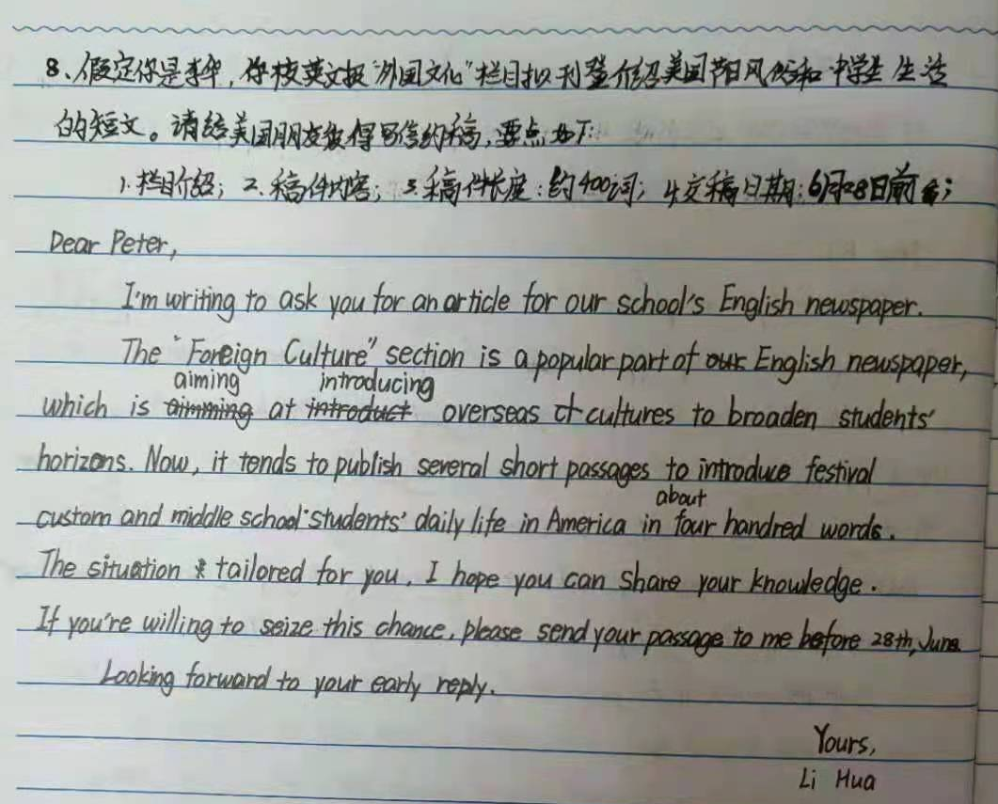
准确性方面：
学生的语言表达虽有个别错误，但学生的整体水平还不错。
aimed
with
is

Slide 20
点评：
从内容上看，该生审题较好，内容没有缺少；语言除个别错误外，基本正确。这是优点，值得表扬。
从语言上来说，丰富性和多样性虽有，但稍显欠缺。约稿部分语言不够地道，缺少贴切性和交际性。建议从读者角度出发，换位思考。
从结构上课看，除了“Now,”外，没有其它衔接词，基本是句号到底。建议变化句式，增加句式的多样性，多运用地道语言和交际性语言。
该生的作文得分为9分左右。
建议该生练练书写，给阅卷老师留下好印象。
Knowing that you are proficient in writing articles, especially school life, I’m writing to you to ask for some articles.
栏目的好处过于单一，可适当增加，如 which offers a platform where not only can students gain a deeper insight into foreign culture , but also can broaden their horizons, promoting mutual understanding. 修改后不仅内容详实，语言的丰富性和多样性就有了。（倒装+非谓语）
约稿部分语言生硬，不够委婉，建议改成:Would you please write something about it? And we welcome articles about the American festivals, such as the Christmas Day or the Thanksgiving Day, and the school life in your country. By the way, your article might as well have a title made up by yourself. About 400 words would be fine. Could I have your article before June,28th? 修改之后的文章不仅衔接自然，而且语气委婉，容易让人接受。易于约稿成功。
建议改成
Given your prominent/outstanding ability, I firmly hold the belief that everyone will like your article. Looking forward to your reply at your earliest convenience.
换位思考，替对方考虑

Slide 21
One possible version 1
Dear Peter， I’d like to ask you to write an article for our school’s English newspaper.
To start with, the “Foreign Cultures“ section in our newspaper is very popular among the students. It publishes articles written by foreign friends considering the cultures of their countries.Would you please write something with reference to the culture in your country？What’s more, we would especially prefer the articles about how Americans spend their holidays and festivals and the life of American high school students. Could you write anything relevant so long as it’s fascinating and informative with a vocabulary of 400 words or so．Could we have your article before June 28?
Your prompt reply will be highly appreciated! Yours, Li Hua

Slide 22
One possible version 2
Dear Peter,
How are you doing? Recently, in order to cultivate our interests, broaden our horizons and enrich our afterschool life, our school newspaper will start a column related to western life and culture. Therefore, I am writing to ask you to write an article on it.
Here are some details about it. To begin with, you may talk about your life in your middle school so that we Chinese students can know more about it. In addition, you can introduce a western festival, such as the Christmas Day or the Thanksgiving Day, which is not only meaningful but also interesting. What’s more, your article should be at least 400 words or so. Eventually, would you be so kind as to send it before June 28 with the purpose that it can be published in time? Hopefully, you could do me the favor. I have the confidence that everyone will like your article. Thanks for reading my letter in such a hot summer. I’m looking forward to your reply and your article.
Yours,
Li Hua

Slide 23
学生反思
我的优点
人称/时态
词汇
要点
衔接
审题
我的不足
我需要改进的方面：

Slide 24
教师助
力
六
月
高
考
学生折取
梦想
桂冠

