Slide 1
感恩遇见，相互成就，本课件资料仅供您个人参考、教学使用，严禁自行在网络传播，违者依知识产权法追究法律责任。
更多教学资源请关注
公众号：溯恩高中英语
知识产权声明

Slide 2
B2U3 Listening & Talking
Choose the best app
Shang Jie

Slide 3
Warming Up
Commonly Used Apps In Daily Life
Q1: What apps will you use if you want to chat online? For social networking?
Q2: How about online shopping? Online payment?
Q3: What if you want to stream the movies or music?
Q4: If you want to ask questions or improve your study, you may use ________ ?

Slide 4
Listening -- Activity 1 P31 Ex1
Laura and Xiao Bo are talking about apps.
Listen to their conversation and fill in the blanks.
What apps does Xiao Bo/Laura want? Why?
Personal Purposes
Xiao Bo is trying to ____________, so he is looking for an _________ app.
Laura wishes there were an app for ___________, because she wants to _____________________________. She also needs an app to _____________________.

Slide 5
Listening -- Activity 1 P31 Ex1
Laura and Xiao Bo are talking about apps.
Listen to their conversation and fill in the blanks.
What apps does Xiao Bo/Laura want? Why?
Personal Purposes
Xiao Bo is trying to ____________, so he is looking for an _________ app.
Laura wishes there were an app for ___________, because she wants to _____________________________. She also needs an app to _____________________.
get in shape
exercise
getting rich
add some oink to her piggy bank
money to her savings
make her grades better

Slide 6
Listening -- Activity 2
Listen again and fill in the blanks.
What apps are found for Xiao Bo/Laura?
What functions do these apps have?
Apps | Functions
App1 | There’s an app that __________________________________.
App2 | It keeps track of ____________________________________, and also helps you make _____________.
App3 | It helps you find _________ and ____________.
App4 | Every time you pay for something, it puts a little money _________________.

Slide 7
Listening -- Activity 2
Listen again and fill in the blanks.
What apps are found for Xiao Bo/Laura?
What functions do these apps have?
Apps | Functions
App1 | There’s an app that __________________________________.
App2 | It keeps track of ____________________________________, and also helps you make _____________.
App3 | It helps you find _________ and ____________.
App4 | Every time you pay for something, it puts a little money _________________.
counts every step you take during the day
how much you exercise and what you eat
a fitness plan
discounts
the best price
into a bank account

Slide 8
Listening -- Activity 3
Here are some predictions/guesses/beliefs.
Underline key expressions used to express predictions, guesses, and beliefs.
Predictions, guesses, and beliefs
It might help me walk more.
My guess is that it wouldn’t work.
I imagine this app would help me get fit faster.
I suppose that would be good.
I guess you could save a little with this app.
I suppose there would be some problems, too.
I believe this app could help me get thinner.
It might
My guess is
wouldn’t
I imagine
would
I suppose
would
I guess
could
I suppose
would
I believe
could

Slide 9
Listening -- Activity 3 P31 Ex3
Listen once more. Put the sentence you hear into the form.
Underline key expressions used to express predictions, guesses, and beliefs.
What does Xiao Bo/Laura think of these apps?
Apps | Expectations (Predictions/Guesses/Beliefs)
App1
App2
App3
App4
Predictions, guesses, and beliefs
It might help me walk more.
My guess is that it wouldn’t work.
I imagine this app would help me get fit faster.
I suppose that would be good.
I guess you could save a little with this app.
I suppose there would be some problems, too.
I believe this app could help me get thinner.

Slide 10
Listening -- Activity 3 P31 Ex3
Listen once more. Put the sentence you hear into the form.
Underline key expressions used to express predictions, guesses, and beliefs.
What does Xiao Bo/Laura think of these apps?
Apps | Expectations (Predictions/Guesses/Beliefs)
App1
App2
App3
App4
It might help me walk more.
C. I imagine this app would help me get fit faster.
D. I suppose that would be good.
E. I guess you could save a little with this app.

Slide 11
Listening -- Tips for Talking
So when choosing the best app, please consider ...
Personal Purposes
Why do you need this app?
App’s Functions
What can this app do for you?
Your Expectations
Your predictions/ guesses/ beliefs ...
It might ... / My guess is ...
I imagine ... / I suppose ... I guess ... / I believe ... / ...

Slide 12
Talking -- Activity 1
According to the conversation, discuss ...
Which app will Xiao Bo/Laura probably choose? Why?
Xiao Bo/Laura will probably choose App___, because ______.
Apps | Expectations (Predictions/Guesses/Beliefs)
App1
App2
App3
App4
“But I don’t think it would be enough.”
It might help me walk more.
C. I imagine this app would help me get fit faster.
“But I need an app that adds some oink to my piggy bank.”
D. I suppose that would be good.
E. I guess you could save a little with this app.

Slide 13
Talking -- Activity 2
Here is a post from Susan, who is going to study in China this year ...
Hi, there! I’m Susan. I am going to be an exchange student in China this Sep.
I am excited but worried!!! I’ve heard that life in China heavily depends on the Internet. So can you share any popular apps used there?
I hope these apps can help me fit in China quickly!
#Studyinchina #popularapps
25 10 5
Which apps would you like to recommend to her? Why?
Discuss your choices in groups.

Slide 14
Talking -- Activity 2
In your discussion, please consider ...
Susan’s Purposes
Example:
I think Wechat would be really helpful, which is like Whatsapp abroad.
I believe this app would make it more convenient for you to get in touch with others in China.
For study? For entertainment? ...
App’s Functions
To keep track of .../ To make a plan.../...
Your Expectations
Your predictions/ guesses/ beliefs ...
It might ... / My guess is ...
I imagine ... / I suppose ... I guess ... / I believe ... / ...

Slide 15
Talking -- Activity 2 Discuss in groups
Which apps would you like to recommend to her? Why?
Susan’s Purposes
For study? For entertainment? ...
App’s Functions
To keep track of .../ To make a plan.../...
Your Expectations
Your predictions/ guesses/ beliefs ...
It might ... / My guess is ...
I imagine ... / I suppose ... I guess ... / I believe ... / ...

Slide 16
Homework
Write down your recommendations to Susan;
Recommend an English learning app to your deskmate;
Discussion: Should we control the use of apps? (Reference: Video Time* in Unit 3)

Slide 17
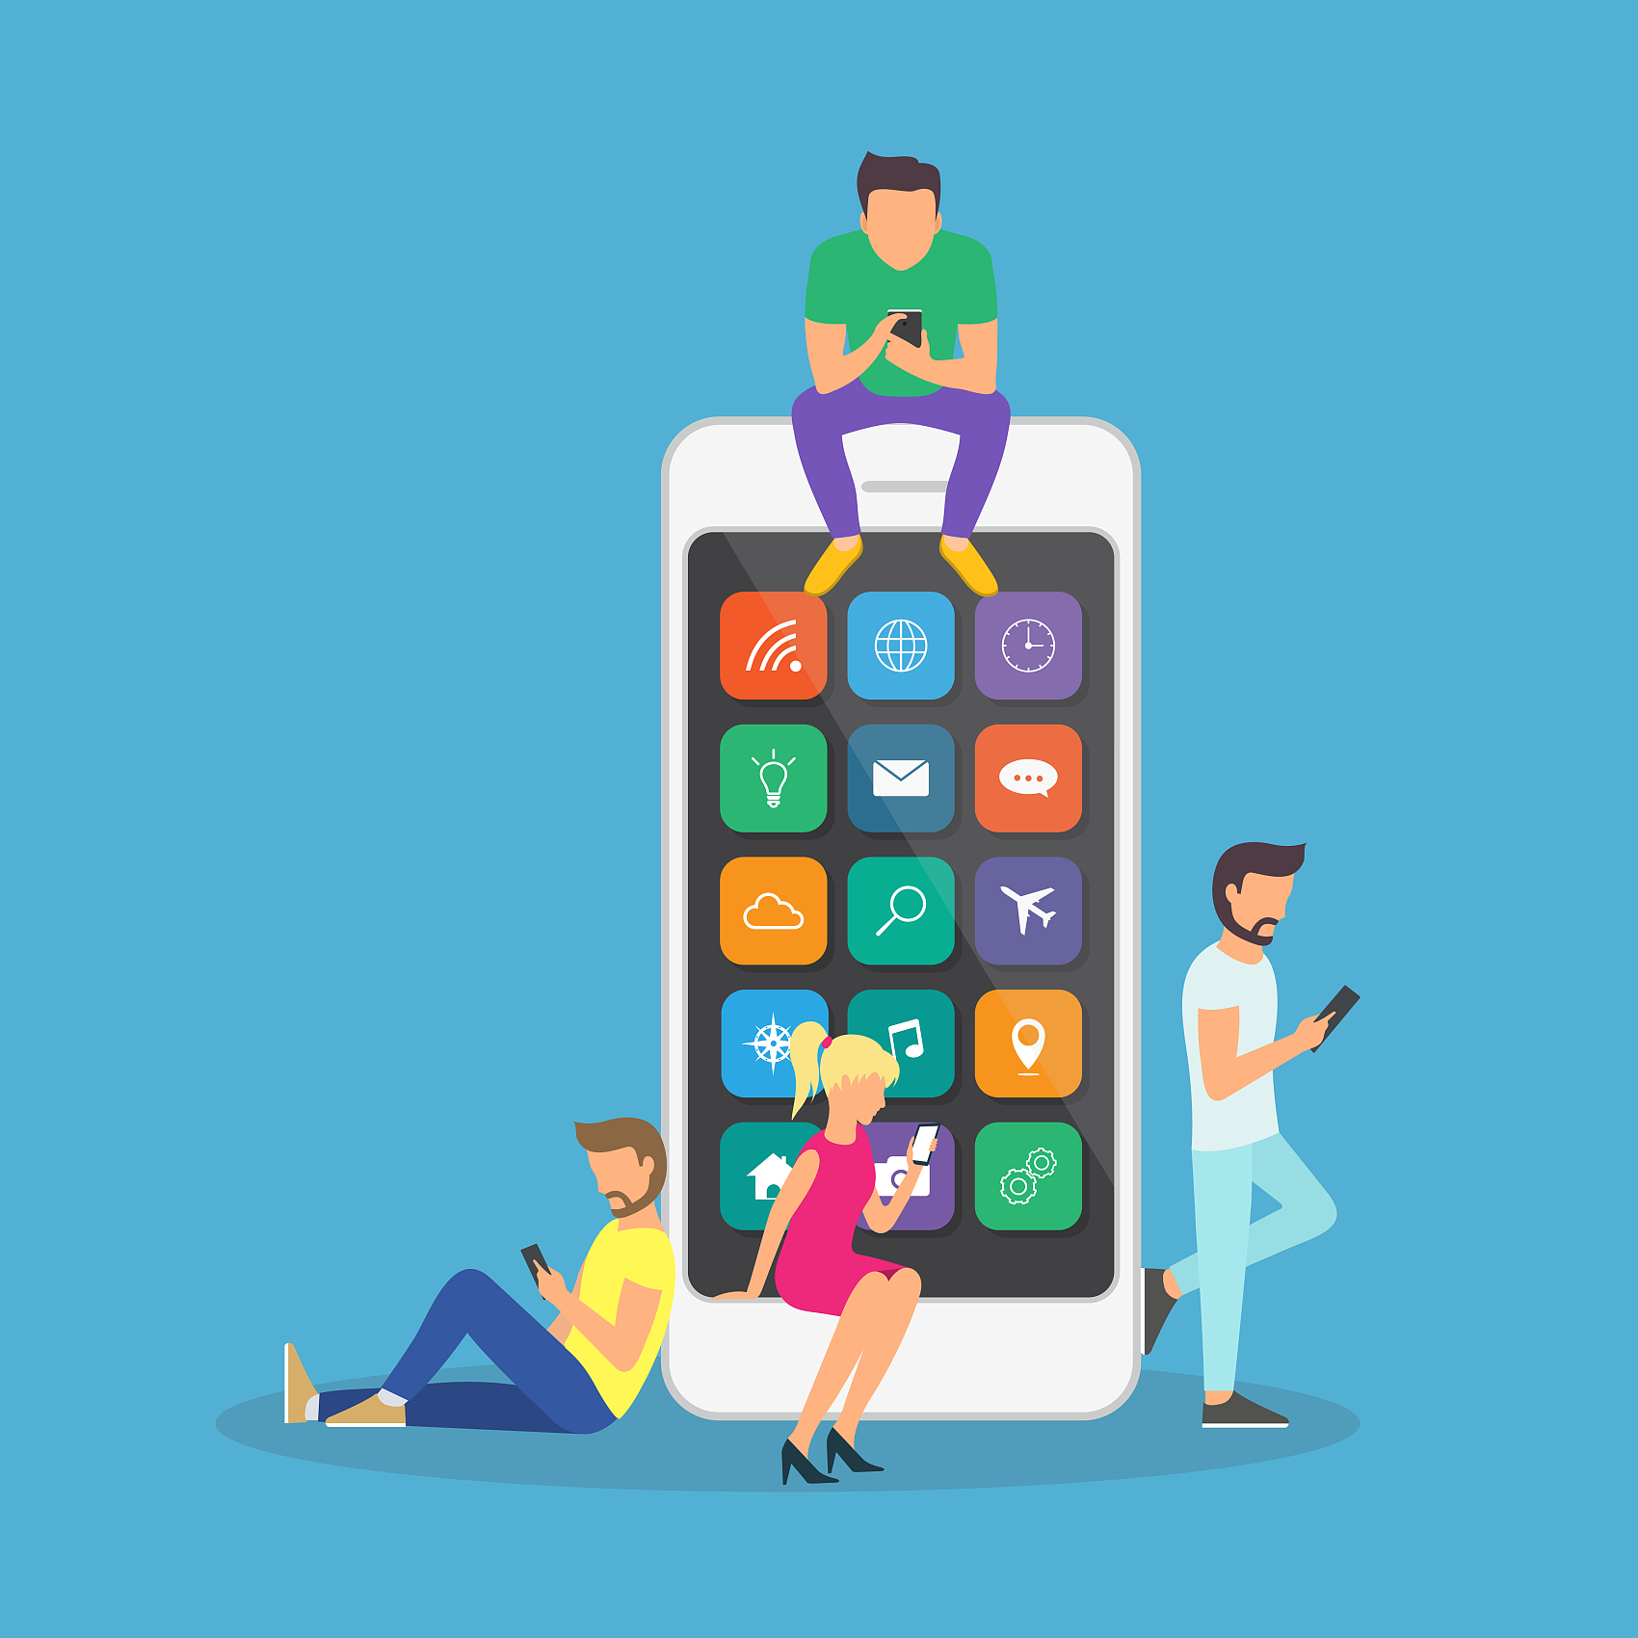
Choose Carefully
Use Wisely
THANK YOU!

