Slide 1

感恩遇见，相互成就，本课件资料仅供您个人参考、教学使用，严禁自行在网络传播，违者依知识产权法追究法律责任。
更多教学资源请关注
公众号：溯恩高中英语
知识产权声明

Slide 2


语法复习
之
定语从句
(The Attributive Clause)

Slide 3
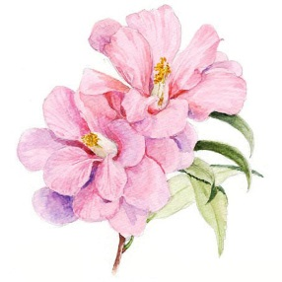

1
    定语从句概念
目 录
2
    定语从句考点
3
    定语从句作用
CONTENTS
4
    定语从句应用
延迟符

Slide 4
1
    定语从句概念
什么是定语从句：
在复合句中，修饰名词或代词的从句。
什么是先行词：
被定语从句所修饰的名词或代词（在非限制性定语从句 中也可指整个主句 ）。
限制性定语从句
定语从句种类：
非限制性定语从句

Slide 5
常用关系词：
that/who/whom
人（主/宾）
关系
代词
that/which
物（主/宾）
whose
人/物：……的（定）
关系词
when
where
why
关系
副词
= 介词+which
(状语)

Slide 6
关系词的作用：
连接作用，连接主从句；
指代先行词，甚至整个主句；
在从句中充当句子成分。
主语
Li Lanjuan is a famous expert who is working against the novel coronavirus at the front line.

Slide 7
2
    定语从句考点
关系代词 that 、which、 whose的用法比较；
关系代词和关系副词的用法比较；
介词加关系代词引导的定语从句。

Slide 8
下列情况中，只能用 that，不用 which
①当先行词是不定代词（如， all, a lot, (a) little, (a) few, much, none, anything, something, everything, nothing 等）时；
Eg. Some elderly women donated all that they had to Wuhan.
②当先行词被不定代词（如，all, any, no, much, little, few, every 等）所修饰时；
Eg. There is no other country that has the power to lock down such a large city as Wuhan.
③当先行词是形容词最高级或被形容词最高级所修饰时；
Eg. COVID-19 is the most contagious disease that
has claimed thousands of lives.

Slide 9
下列情况中，只能用 that，不用 which
④当先行词是序数词或被序数词所修饰时；
Eg. Zhejiang is the first province that activated LevelⅠpublic health emergency response to COVID-19.
⑤当先行词被 the very, the only, the next, the last等所修饰时;
This is the last mask that I have.
⑥当先行词为指人和指物的两个并列名词词组时；
Eg. The medical supplies and workers that were sent to Wuhan have made a big difference to the patients there.
⑦当主句是以 which 开头的特殊疑问句时。
Eg. Which is the country that you like best?

Slide 10
下列情况中，只能用 which，不用that
①关系代词前有介词；
The outbreak of the COVID-19 is a special crisis from which we are supposed to learn a lesson that man should live in harmony with nature.
②在非限制性定语从句中。
Wuhan, capital of Hubei province, is the worst-hit city by the epidemic, which is under tremendous strain.

Slide 11
几点补充
①先行词是those，指人，关系代词用who；
②如果 the way 在定语从句中作状语，其中的关系词有三种不同的表达方式：
a. the way + in which
b. the way + that
c. the way + /
The WHO commends the way (that/in which) Chinese government fights against the epidemic.

Slide 12
关于whose(……的)
①关系词whose实际上是先行词的所有格(…的)；
②“whose +名词中心词”这一结构在定语从句中既能作主语，又能作宾语。
③Whose… 人=the …of whom/of whom the…
物= the …of which/of which the…
Volunteers offer help to the elderly man whose family are quarantined. Volunteers offer help to the elderly man the family of whom are quarantined.
Voluntary donations are flooded into Wuhan whose people are suffering most. Voluntary donations are flooded into Wuhan the people of which are suffering most.

Slide 13
关系代词和关系副词的用法比较
①关系副词在意义上都相当于介词 + which结构：
when = on (in, at, during…) + which;
where = in (at, on…) + which;
why = for which.
②使用关系代词还是关系副词，一定要注意分析从句的结构。如果缺少主语或宾语，用关系代词；如果缺少时间状语、地点状语、原因状语，则分别用when, where, why。
I’ll never forget the days when we’re faced with the coronavirus.
I’ll never forget the days which/that we spent together at home.

Slide 14
介词加关系代词引导的定语从句
①关系代词作介词宾语，不论是在限制性定语从句中，还
是在非限制性定语从句中，当介词前置时，只能用 whom
指人，which 指物；但如果介词后置，则不受这种限制，关
系代词还可以省去，特别是在口语中。如：
Do you know the boy to whom she was talking?
Do you know the boy (that/who/whom) she was talking to?
②关系代词前用什么介词，需看其与从句中谓语动词或先行词的搭配关系来确定。

Slide 15
3
    定语从句作用
借助定语从句，完善所要表达的内容；
借助定语从句，体现表达的多样性、丰富性；
借助定语从句，实现句子结构紧凑，前后衔接一致；
I wish all of you a speedy recovery.
I wish all of you who are unwell a speedy recovery.

Slide 16
结构紧凑，前后一致
Is the passage coherent?
Pollution presents a very serious problem. Too many vehicles give off poisonous fumes to pollute the air. And there are a great number of ships and boats that leak oil to contaminate the harbour and kill marine lives. Laziness is also a bad point. People here seem to depend too much on machinery to do their work.

Slide 17
结构紧凑，前后一致
Topic sentence
Pollution presents a very serious problem. Too many vehicles give off poisonous fumes to pollute the air. And there are a great number of ships and boats that leak oil to contaminate the harbour and kill marine lives. Laziness is also a bad point. People here seem to depend too much on machinery to do their work.
lives. Laziness is also a bad point. People here seem to depend too much on machinery to do their work.
lives. Also, lazy people who depend too much on machinery produce numerous wastes to damage the environment.

Slide 18
4
    定语从句应用
教材中的应用
高考中的应用
时文中的应用

Slide 19
教材中的应用（新必修一，P68）
I became interested in learning more languages aside from English. Then I saw an advertisement that offered a wonderful summer course in German, and that was the class I decided to take on a new language. The building where we met for classes was quite small, but there was a whole world of language to explore. Our teacher was Mrs Haus: a tall, thin, quiet, grey-haired lady. I’ll never forget the first day when she introduced herself to us. She never once raised her voice, but as soon as she began to speak, the room fell silent. What was the reason? Because Mrs Haus LOVE German language and culture—and everybody who was in her classes couldn’t help but love the language, too. We all loved the way she talked about German food and traditions. And I realised what makes a good teacher. A good teacher is someone who is in love with what she or he is teaching.

Slide 20
教材中的应用（新必修一，P68）
I became interested in learning more languages aside from English. Then I saw an advertisement that offered a wonderful summer course in German, and that was the class I decided to take on a new language. The building where we met for classes was quite small, but there was a whole world of language to explore. Our teacher was Mrs Haus: a tall, thin, quiet, grey-haired lady. I’ll never forget the first day when she introduced herself to us. She never once raised her voice, but as soon as she began to speak, the room fell silent. What was the reason? Because Mrs Haus LOVE German language and culture—and everybody who was in her classes couldn’t help but love the language, too. We all loved the way she talked about German food and traditions. And I realised what makes a good teacher. A good teacher is someone who is in love with what she or he is teaching.

Slide 21
高考中的应用
历年考题（2016.10——2020.1）
年份 | 2016.10 | 2017.6 | 2017.11 | 2018.6 | 2018.11 | 2019.6 | 2020.1
题号 | / | 64 | 57 | 57 | / | 58 | /

Slide 22
swept
(2017.6) Pahlsson and her husband now think the ring probably got 63 (sweep) into a pile of kitchen rubbish and was spread over the garden, 64 it remained until the carrot’s leafy top accidentally sprouted (生长) through it.
where
(2017.11) It’s not all that hard to build an advanced and large vocabulary. Like many things in life, it’s 56 ongoing process, and the best part of the process is that there’s enough room for improvement, 57 means you’ll just keep getting better and better.
an
which

Slide 23
who/that
(2018.6) Many westerners 57 come to China cook much less than in their own countries once they realize how cheap 58 can be to eat out.
it
which/that
(2019.6) On the edge of the jacket, there is a piece of cloth 58 gives off light in the dark.

Slide 24
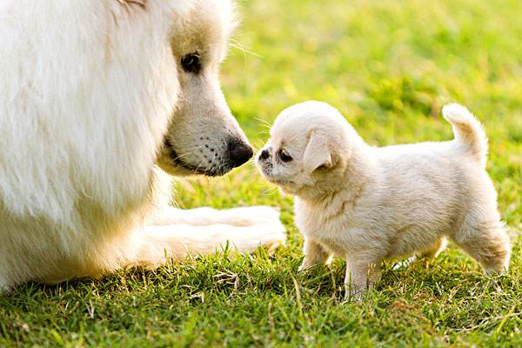
写作中的应用（2020.1浙江续写）
The fluffy little dog jumped out of the box, waged his tail furiously, and then reached out his front paws to hug Poppy, who started to bark full of excitement. It wasn’t long before the two dogs chased each other in the house, happy barks lingering around, which made the parents beam proudly.
Hearing the footsteps, Poppy leaped up and rushed to the boy, who crouched to hug his old friend and kissed her.

Slide 25

写作中的应用（2019.6浙江概写）
Parents everywhere praise their kids. Jenn Berman, author of The A to Z Guide to Raising Happy and Confident Kids, says, “We’ve gone to the opposite extreme of a few decades ago when parents tended to be more strict.” By giving kids a lot of praise, parents think they’re building their children’s confidence, when, in fact, it may be just the opposite. Too much praise can backfire and, when given in a way that's insincere, make kids afraid to try new things or take a risk for fear of not being able to stay on top where their parents’ praise has put them.

Slide 26
写作中的应用（2019.6浙江概写）
Parents everywhere praise their kids. Jenn Berman, author of The A to Z Guide to Raising Happy and Confident Kids, says, “We’ve gone to the opposite extreme of a few decades ago when parents tended to be more strict.” By giving kids a lot of praise, parents think they’re building their children’s confidence, when, in fact, it may be just the opposite. Too much praise can backfire and, when given in a way that's insincere, make kids afraid to try new things or take a risk for fear of not being able to stay on top where their parents’ praise has put them.
Nowadays, parents tend to praise children too much, which will have bad effects.

Slide 27
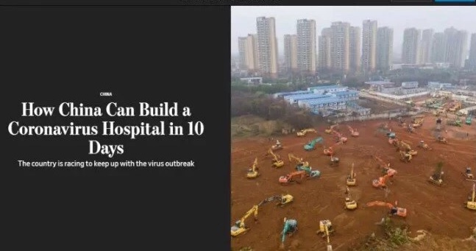

时文中的应用
that
There is no other country ______ can do anything that fast.

Slide 28
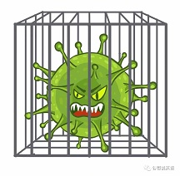
时文阅读
In December 2019, there was a cluster of pneumonia(肺炎) cases in China, which were caused by a previously unknown virus named novel coronavirus(冠状病毒).
Coronaviruses are a large group of viruses. They have the appearance of a crown, which is called corona in Latin. That’s how these viruses get their name. There are some types of coronaviruses that can cause severe diseases, including SARS in China in 2003 and MERS(中东呼吸综合症) in Saudi Arabia(沙特阿拉伯) in 2012.

Slide 29
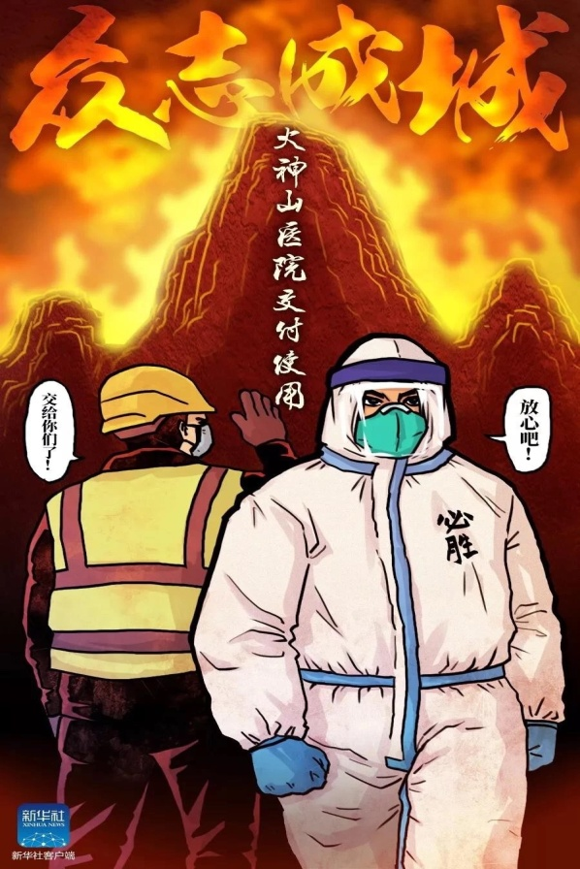
时文阅读
COVID-19, named by the WHO, initially occurred in a group of people who’d been associated with a seafood market in Wuhan, which has been the worst-hit city by the disease. Shortly it spread from those who were unwell to others and then the number of infected people increased rapidly. Fortunately, the Chinese government has been taking the most comprehensive and rigorous prevention and control measures with a high sense of responsibility for people’s health. For the sake of curbing further spread, Wuhan was locked down late last month. Then in order to ease the shortage of beds for patients, a 1,000-bed hospital, named Huoshenshan Hospital was completed in less than 10 days, which makes the whole world marvel at. Meanwhile, experts as well as millions of medical staff across China have been working tirelessly to respond to the outbreak.

Slide 30
时文阅读
In order to prevent transmission, various localities restrict transportation, movement and even business for a period of time combined with the voluntary dutiful cooperation of the 1.4 billion citizens who are in the majority quietly staying at home these weeks to let the virus pass.
We all believe in a couple of weeks or months, this nasty(可恶的) coronavirus will begin declining and the joy of spring will arrive.

Slide 31
牛刀小试之语法填空
Compared with SARS, the 2019-nCov is more contagious(传染性的). The incubation period(潜伏期) is around 14 days, during __1__ the virus is transmissible. So how to keep yourself safe __2__ it ? Zhong Nanshan, __3__ 83-year-old doctor, __4__ is the head of a high-level expert team organized by the National Health Commission(国家卫健委), supplied practical __5__(tip).
First of all, it is important to wear masks when outside and wash hands frequently and __6__(proper). Make sure that animal products __7__(cook) thoroughly before they are consumed. Most importantly, avoid close contact with those __8__ have flu symptoms. He also urged people__9__(stay) put during the Spring Festival holiday. But if you're ___10___(feel) unwell, seek prompt medical care as early as possible.

Slide 32
牛刀小试之语法填空
Compared with SARS, the 2019-nCov is more contagious(传染性的). The incubation period(潜伏期) is around 14 days, during __1__ the virus is transmissible. So how to keep yourself safe __2__ it ? Zhong Nanshan, __3__ 83-year-old doctor, __4__ is the head of a high-level expert team organized by the National Health Commission(国家卫健委), supplied practical __5__(tip).
First of all, it is important to wear masks when outside and wash hands frequently and __6__(proper). Make sure that animal products __7__(cook) thoroughly before they are consumed. Most importantly, avoid close contact with those __8__ have flu symptoms. He also urged people__9__(stay) put during the Spring Festival holiday. But if you're ___10___(feel) unwell, seek prompt medical care as early as possible.
which
from
an
who
tips
properly
are cooked
who
to stay
feeling

Slide 33
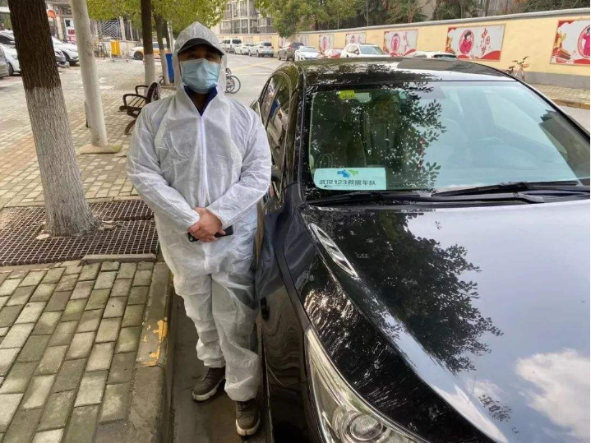
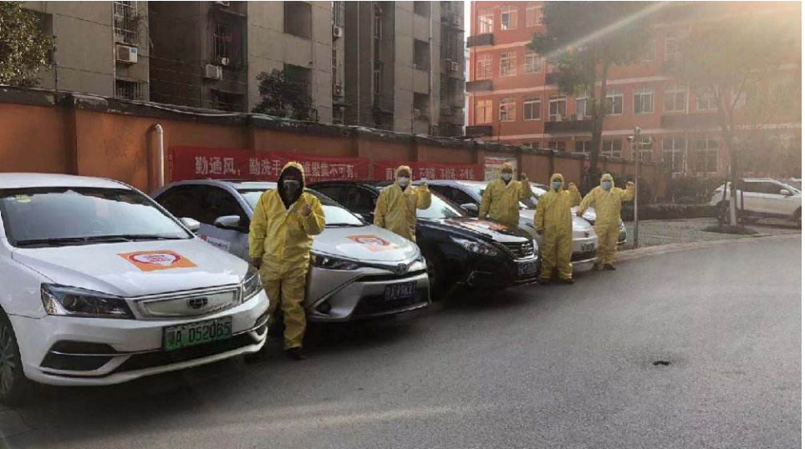

牛刀小试之语段翻译
在这次的疫情中心城市武汉，34岁的韩斌是一名出租车司机。在当地政府封城后，韩斌便加入了数千名志愿者的队伍，和他们一起接送当地居民。大部分乘客是一些贫弱老人，他们要么没有子女，要么在外的家人因封城隔离无法回到武汉。这些免费接送服务均由社区居委会安排，后者是联系居民和当地政府的桥梁。这些志愿者司机奉献他们的时间和精力去帮助当地居民，广受赞誉。

Slide 34
One possible version
在这次的疫情中心城市武汉，34岁的韩斌是一名出租车司机。在当地政府封城后，韩斌便加入了数千名志愿者的队伍，和他们一起接送当地居民。大部分乘客是一些贫弱老人，他们要么没有子女，要么在外的家人因封城隔离无法回到武汉。这些免费接送服务均由社区居委会安排，后者是联系居民和当地政府的桥梁。这些志愿者司机奉献他们的时间和精力去帮助当地居民，广受赞誉。
Han Bin, 34, is a taxi driver in Wuhan, which is the epicenter of the outbreak. After the local government locked down the city, Mr. Han became one of the thousands of people who have volunteered to ferrying local residents. Most of his passengers are poor, elderly residents who don’t have children or whose family is outside Wuhan and can’t come home because of the quarantine. The free rides are arranged by neighborhood committees, which serve as a go-between for residents and the local government. These volunteer drivers win much praise for donating their time and energy to help out their fellow residents.

Slide 35




