Slide 1


感恩遇见，相互成就，本课件资料仅供您个人参考、教学使用，严禁自行在网络传播，违者依知识产权法追究法律责任。
更多教学资源请关注
公众号：溯恩高中英语
知识产权声明

Slide 2




台州市2021届高三一模考试
读后续写讲评
The Rockers Build a Soccer Field

Slide 3
Reading
Maria was practicing with her soccer mates in a tiny school yard. They were all from
River Edge Rockers, a soccer team of their community. Suddenly, the ball flew into a deep hole at the edge of the yard. It was the third time that they had lost their ball this month. Without the ball Maria had to wave goodbye to her mates and went home, depressed. "If only there were a regulation soccer field! "she thought.
That evening, seeing her in low spirits, her father asked, " What was the matter, dear?”
“I was just thinking about playing in a brand new soccer field !"Maria answered.
Her father smiled and said, "Tomorrow, a Town Council meeting is to be held to discuss about the use of that vacant(空着的) lot next to the pet store, Home for Pets, Why not take this opportunity to convince them we need a better field?”
The next day, with the company of her father, Maria and her teammates went to the meeting hall. On their arrival they saw Councilwoman Jill and some citizens already there. They took their seats. After Jill announced the start of the discussion, Maria stood up and spoke first. "Up till now there is no soccer field in our community, which certainly affects our physical health. Our team currently have to practice in a tiny school yard, and only when it's not already booked.”

Slide 4
Reading
Mrs. Lorries, owner of the pet store, commented, "I couldn't agree more. Kids do need such a field. “ The Rockers applauded excitedly and the other citizens all agreed it would be a way out.
A soccer field would be a good use for that lot with overgrown weeds and some large rocks, but to build such one would need a small sum of money and maybe you even need to do all the work on your own.” Councilwoman Jill smiled, “Can you manage it？”
Thinking for a while, Maria nodded with a determined look on her face, " The Rockers can do it! “We will tum it into a soccer field. “ The teammates all cheered.
Para1:The following day, the team got together to share ideas for raising money. ___ _____________________________________________________________________
Para2: A week later, the team gathered at the lot, carrying tools purchased with their earnings.______________________________________________________________

Slide 5
Understanding the story
Maria was practising soccer with her teammates in a tiny school yard ______ the ball fell into a hole at the edge of the yard, which made Maria __________and ___________ for a soccer field of their own.
Back home, Hearing daughter’s complaint, Maria’s father suggested that they go to the City Council meeting the next day, trying to ________ the government to let them have the ___________, which was next to the pet store ________ by Mrs. Lorries, for their soccer field.
Widely _________ by the citizens in the community, Maria and her teammates finally managed to get the permission on one ________: they needed to work on their own to turn the __________________ lot into a soccer field of their own.
when
depressed
desperate
convince
vacant lot
owned
supported
condition
abandoned/deserted

Slide 6
Language learning
1.在院子的边上
2.向挥手告别
3.情绪低落/不高
4.崭新的足球场
5.那块空地
6.宠物店
7.趁这个机会
8.说服某人作某事
9.在爸爸的陪伴下
10.一到那里
11.一个解决方案
12.脸上带着坚定的表情
1. at the edge of the yard
2. wave goodbye to
3. be in low spirits
4. a brand new soccer field
5. that vacant lot
6. pet store
7. take the chance/opportunity
8. persuade/convince sb. to do sth.
9. with the company of Dad
10.On/ Upon arrival
11. a way out, a solution
12. with a determined look on her face

Slide 7







Design the plot: Underlined words
$$√$$
Maria and her teammates worked together to raise enough money and managed to turn the abandoned lot into a soccer field.
Their constant efforts finally paid off and a brand new soccer field was on the way!
They offered to work at the pet store, feeing, walking and washing the pet dogs to earn money for the field.
Looking at the brand new soccer before their eyes, they exploded with pride, imagining practising, passing the ball through the air and into the net.
Looking back, they were delighted that they did manage to make a soccer field of their own.
Maria
teammates
soccer field
pet store
2. convince
practice
comment
manage
3. excitedly
determined
$$√$$
$$√$$
$$√$$
$$√$$
$$√$$
$$√$$
Tip 1:
With the underlined words as possible hints, we can picture the scenes that follow.

Slide 8
Design the plot: First sentence
The following day, the team got together to share ideas for raising money. _________
A week later, the team gathered at the lot, carrying tools purchased with their earnings. _______
1. What were their ideas?
2. How did they put the idea(s) into action and raise/earn money?
Maria and her teammates manage to raise enough for the soccer field,
1. How did they turn the vacant lot into a soccer field with the tools they carried?
2. How did they feel when they saw the work completed and their dream come true?

Slide 9
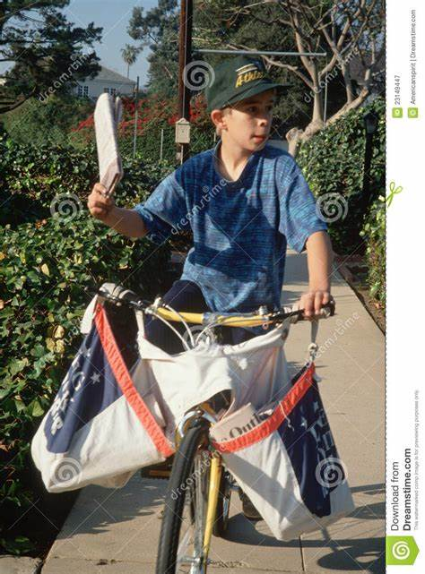
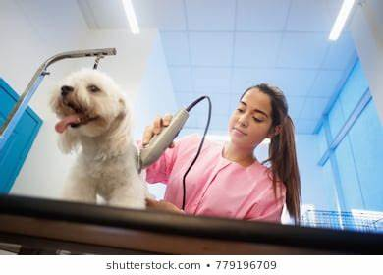
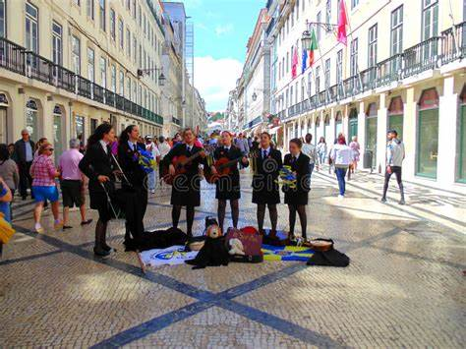
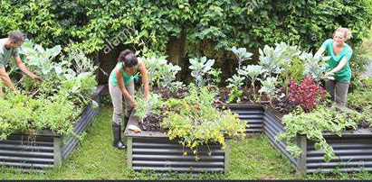
Design the plot:
The following day, the team got together to share ideas for raising money
deliver newspapers/milk
work part-time at shops
take care of gardens for busy neighbours
donation performance

Slide 10
How to handle these ideas:
Tip 1:
Many ideas are suggested, but they only adopt a practical one. So they work together on one idea.
Tip 2:
All the ideas will work, so they organize them in time order, and carry them out one by one.
Tip 3:
All the ideas help, so the divide the team into smaller groups and each is assigned to a particular task.

Slide 11
How to handle these ideas:
Tip 1:
Many ideas are suggested, but they only adopt a practical one. So they work together on one idea.
Example:
Performances, car wash and even a candy sale were suggested but none seemed practical. Suddenly Maria cried excitedly, "Maybe we can convince Mrs. Lorries to offer us some jobs in the pet shop.”

Slide 12
How to handle these ideas:
Tip 2:
All the ideas will work, so they organize them in time order, and carry them out one by one.
Example:
One idea after another popped up, all of which sounded practical. So in the very early morning, they undertook the newspaper-delivering in the neighborhood. After breakfast, the bright sunlight saw the group taking care of the gardens for the busy neighbors. In the afternoon, they worked part-time at the pet store, where they would feed, walk and wash the dogs.

Slide 13
How to handle these ideas:
Tip 3:
All the ideas help, so the divide the team into smaller groups and each is assigned to a particular task.
Example:
One idea after another popped up, all of which sounded practical. So they divided themselves into several groups and were each assigned to one particular task. One undertook the newspaper-delivering in the neighborhood, and one group were up to taking care of the gardens for the busy neighbors. Amazingly, Maria managed to find a job at the pet store, where she would feed, walk and wash the dogs.

Slide 14
Design the plot:
A week later, the team gathered at the lot, carrying tools purchased with their earnings.
钉耙 rake/ pitchfork
锄头 hoe
铁锹 spade/ shovel
除草机 lawn mower
卡车 truck
take … somewhere else
turn the soil in a garden
cut grass
put the metal part into the earth with one foot for digging
make an area of soil or remove weeds from the ground
Tip : As the names for the tools are unknown to most students, just focus on the verbs without referring to the tools.

Slide 15
Design the plot:
A week later, the team gathered at the lot, carrying tools purchased with their earnings.
How to turn the abandoned lot into a soccer field?
Remove the weeds with a lawn mover or by burning
Dig up the rocks with a spade/shovel
Smooth the ground with soil
Plant grass

Slide 16
Describe the scene of building the field:
First they removed the overgrown weeds and dug out the large rocks from the lot. Then they smoothed the field with the soil. Finally they planted grass on it.
Vividly described?
With the dream of a soccer field in mind, they immediately set out to work. The next few days witnessed the group removing the overgrown weeds and digging out the large rocks from the lot and having them taken away.
After smoothing the field with the soil brought somewhere else, they took one step further by planting grass on it. With all the work done, a soccer field of their own was finally born.
总—分–-总结构
无灵主语
把一个动作置于从句中
高级结构
Tip : 为了避免写动作链时的单调，可以采用无灵主语、动作从句化、表达高级化等策略丰富你的表达。

Slide 17
参考范文：
The following day, the team got together to share ideas for raising money. Performances, car wash and even a candy sale were suggested but none seemed practical. Suddenly Maria cried excitedly, "Maybe we can convince Mrs. Lorries to offer us some jobs in the pet shop. All her teammates agreed it was a great idea as it would not only raise enough money but could afford them good time with cute dogs. Things turned out as they had expected. The following days witnessed their efforts feeding, washing and walking dogs and they were handsomely rewarded. (82)
A week later, the team gathered at the lot, carrying tools purchased with their earnings. Seeing the field covered with dirt, rubble, and weeds, Maria kicked into action with her teammates, scooping up debris and depositing it in a rented truck. Then they removed the large rocks together from the field and filled the holes left by the rocks with enough soil. After they planted grass on it, they were enthralled by the new field. "We made it. Together we turned a rough lot into our dream soccer field. " Maria exclaimed, bursting with pride. (79)

Slide 18
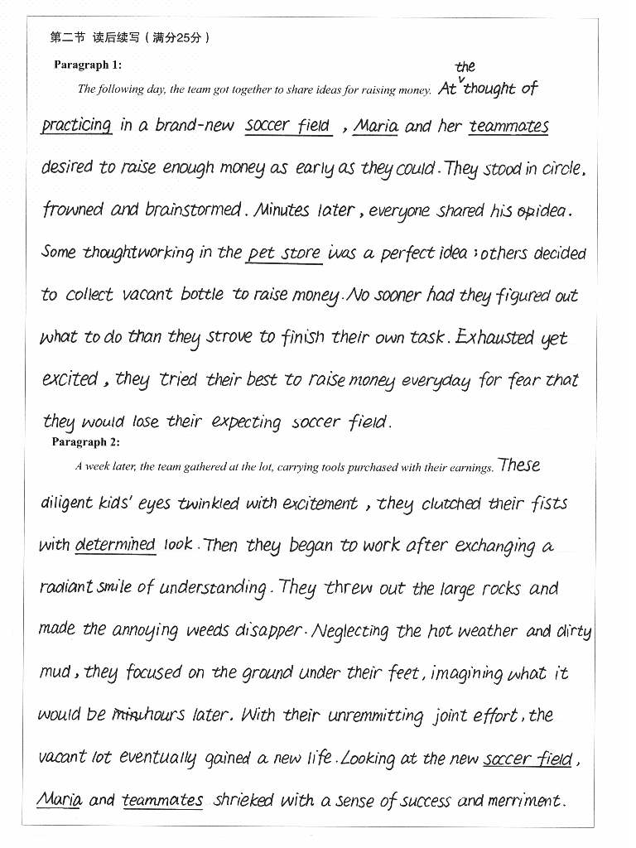
考场作文：
点评：
1.本段情节简练，人物设置简单，让读者马上进入故事情景中。
2.语言表达丰富，像stand in a circle, no sooner… than…,等给读者以画面感的体验，也非常符合故事里角色的定位。。
3.运用了分词结构作状语、句子副词置于句首等，辅之以心理活动、身体动作、情绪描写等手段，使整篇文章简洁而不简单。

Slide 19
下水作文：
The following day, the team got together to share ideas for raising money. One idea after another popped up, all of which sounded practical. So they divided themselves into several groups and were each assigned to one particular task. One undertook the newspaper-delivering in the neighborhood, and one group were up to taking care of the gardens for the busy neighbors. Amazingly, Maria managed to find a job at the pet store, where she would feed, walk and wash the dogs. Money seemed to roll in, but it was still far from enough. To make up for the difference, the Rockers organized a charity performance in the community, asking for donations to the soccer field. Their efforts finally paid off and a soccer field of their own was on the way. (118）

Slide 20
下水作文：
A week later, the team gathered at the lot, carrying tools purchased with their earnings. Overgrown weeds and large rocks were really a challenge for these soccer enthusiasts, but with the dream of a soccer field in mind, they immediately set out to work. The next few days witnessed the group removing the overgrown weeds and digging out the large rocks from the lot and having them taken away. After smoothing the field with the soil brought somewhere else, they took one step further by planting grass on it. With all the work done, a soccer field of their own was finally born. Looking at the field, the teammates exchanged an understanding smile, imagining themselves sending the ball through the air, and toward the goal! (110）

Slide 21
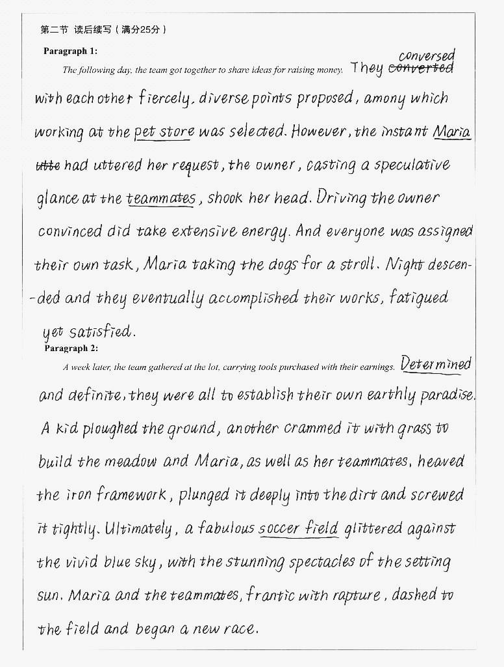
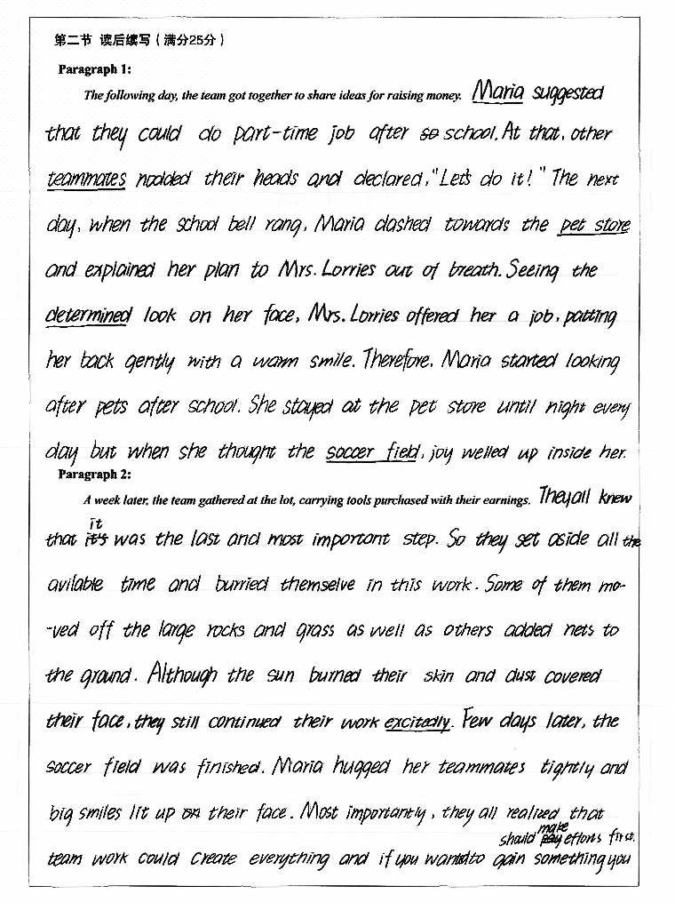

Slide 22


