Slide 1
感恩遇见，相互成就，本课件资料仅供您个人参考、教学使用，严禁自行在网络传播，违者依知识产权法追究法律责任。
更多教学资源请关注
公众号：溯恩高中英语
知识产权声明

Slide 2
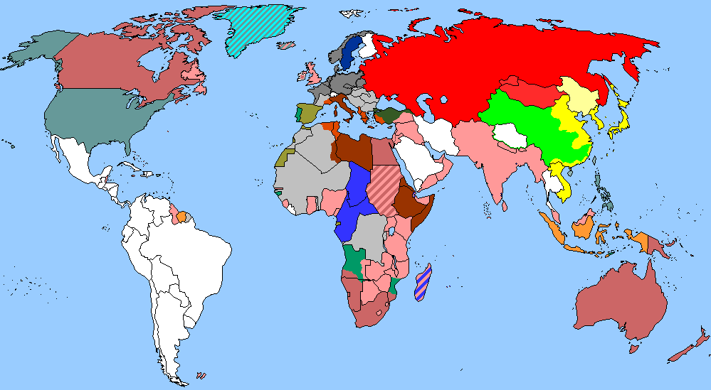
The World
December 1st-15th, 2023

Slide 3
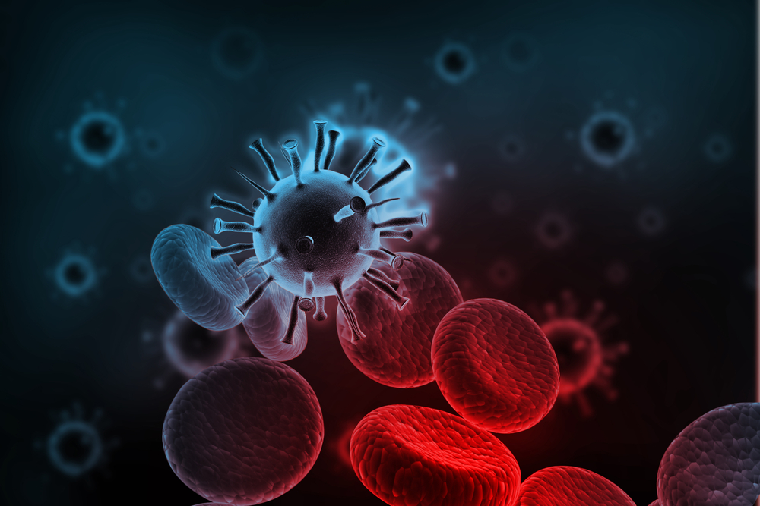
1. Hospitals ban visitors as norovirus spreads
由于诺如病毒的传播，医院禁止访客

Slide 4
Text Completion
Daily Express (9th December 2023 Page 10)
from
Visitors have been stopped ______ seeing loved ones in some hospitals hit by an outbreak of winter vomiting bug norovirus.
Cases have jumped 15% in a week and already this season there have been double the number of people ________ (need) hospital care. A total of 498 NHS beds have been occupied by norovirus patients or closed as part of infection control measures around England. Wards have also been closed to new __________ (admit) in North Wales. The measures have been introduced in an attempt _________ (control) the spread of the ______ (high) infectious illness that causes diarrhoea and vomiting.
Sufferers usually recover within a few days ____ a spike in cases can put extra pressure on hospitals __________ are also caring for patients with winter flu, Covid and other seasonal illnesses. NHS England figures have revealed that cases of flu have soared ____ more than 50% in a week, with an average of 234 people in hospital with the illness every day last week. Health chiefs also fear new Covid variant JN1 could spark a wave of infection. Three wards ___________ (close) yesterday at the James Cook University hospital in Middles-brough and visiting hours axed at Cheshire’s Ellesmere Port Hospital and the Countess Of Chester Hospital. Southampton General Hospital closed a ward after a five-fold increase in patients within a week, and wards have also been closed and visiting restricted at Wrexham Maelor Hospital in North Wales.
Professor Julian Redhead, NHS chief for urgent and emergency care, said: “As we experience more spells of cold weather and people gathering indoors, we expect to see a ______________________________________ (continue) increase in winter viruses.”
needing
admissions
to control
highly
but
that/which
by
were closed
continued/ continual/ continuing/ continuous

Slide 5
Vocabulary
1. spike: a sudden large increase in sth 猛增；急升
If price spikes continue, people will not afford the new houses they want. 如果价格继续飙升，人们将买不起他们想要的新房。
2. axe: to get rid of a service, system, etc. or to reduce the money spent on it by a large amount 精简（机构等）；大量削减（经费等）
Other less profitable services are to be axed later this year. 其他盈利较少的服务项目预定今年稍晚将大量削减。
Translation
在过去的六个月里，失业率急剧上升。
In the last six months, there has been a spike in unemployment.
Translation
该公司宣布计划裁员300人。
The company announced plans to axe 300 jobs.

Slide 6
Translation
Cases have jumped 15% in a week and already this season there have been double the number of people needing hospital care. A total of 498 NHS beds have been occupied by norovirus patients or closed as part of infection control measures around England.
一周内病例增加了15%，本季度需要住院治疗的人数已经翻了一番。共有498张NHS床位被诺如病毒患者占用，或者被关闭作为英格兰各地感染控制措施的一部分。
Sufferers usually recover within a few days but a spike in cases can put extra pressure on hospitals that are also caring for patients with winter flu, Covid and other seasonal illnesses.
患者通常会在几天内康复，但病例的激增可能会给医院带来额外的压力，这些医院也在照顾冬季流感、新冠和其他季节性疾病患者。

Slide 7
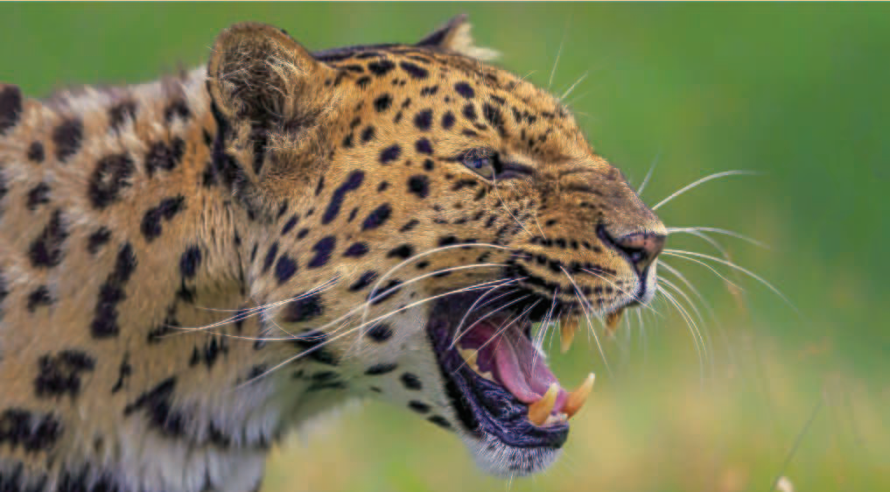
2. Climate change puts Amur leopard at risk
东北豹深受气候变化之害

Slide 8
Text Completion
Science (1st December 2023 Page 1007)
to
The Amur leopard is a leopard subspecies that has adapted ___ the East Asian environment near the Amur River, which runs through eastern Russia and along the northern border of China. Because of human activities such as mining, logging, road building, population growth, ____ poaching, the Amur leopard population dropped ___________ (substantial) in the 1970s. In the years since, conservation efforts ______________(increase) the population to be around 40 individuals in China and 70 in Russia. ________, the effects of climate change are exacerbating the threats that this Critically Endangered species faces.
Amur leopards live in coniferous-deciduous forests, ______ they rarely share territory and hunt alone for small animals. _____________________ much of their habitat is now designated as national parks in southwestern Primorye Province of Russia and the neighboring Jilin and Heilongjiang provinces of China, rising temperatures and dry conditions _______ (drive) by climate change have led to increased fires that combined with human activities and landscape fragmentation have reduced the leopards’ territory and increased cub mortality.The spread of wildfires and increased temperatures have increased deforestation.Together with increased hunting of deer and wild boar by _______ (human) , this ecosystem degradation has led to reduced ungulate prey and more ___________ (compete) between Amur leopards and Amur tigers. As a result, the predators invade villages and prey upon livestock, increasing human-wildlife conflict and the likelihood that leopards will be killed or injured.
and
substantially
have increased
However
where
Although/Though/While
driven
humans
competition

Slide 9
Vocabulary
1. exacerbate: to make sth worse, especially a disease or problem 使恶化；使加剧；使加重
Longstanding poverty has been exacerbated by racial divisions. 由来已久的贫穷因种族分裂而更加恶化了。
2. designate: to say officially that sth has a particular character or name; to describe sth in a particular way 命名；指定
There are efforts under way to designate the bridge a historic landmark. 在努力把这座桥定为历史地标。
Translation
这些症状可能会因为某些药物而加重。
The symptoms may be exacerbated by certain drugs.
Translation
这楼层已定为无烟区。
This floor has been designated a no-smoking area.

Slide 10
Translation
In the years since, conservation efforts have increased the population to be around 40 individuals in China and 70 in Russia. However, the effects of climate change are exacerbating the threats that this Critically Endangered species faces.
从那以后的几年里，保护工作使中国的大熊猫数量增加到40只左右，俄罗斯增加到70只左右。然而，气候变化的影响正在加剧这种极度濒危物种面临的威胁。
Although much of their habitat is now designated as national parks in southwestern Primorye Province of Russia and the neighboring Jilin and Heilongjiang provinces of China, rising temperatures and dry conditions driven by climate change have led to increased fires that combined with human activities and landscape fragmentation have reduced the leopards’ territory and increased cub mortality.
尽管它们现在在俄罗斯西南部的滨海地区以及邻近的中国吉林和黑龙江省的大部分栖息地被指定为国家公园，但气候变化导致的气温上升和干旱条件导致火灾增加，再加上人类活动和景观破碎化，减少了豹子的领地，增加了幼崽的死亡率。

Slide 11
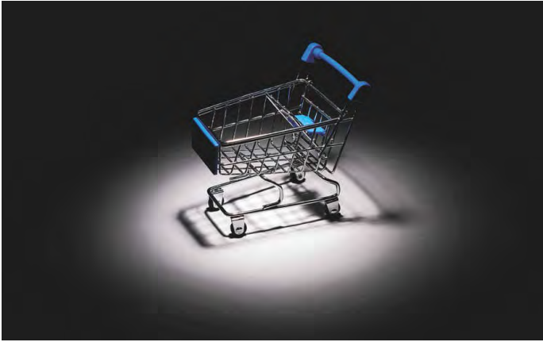
3. Is it true that shopping carts are full of germs? 购物车里真的充满了细菌吗?

Slide 12
Text Completion
The Wall Street Journal (5th December 2023 E5 )
With the holiday shopping season upon us, keep in mind that, yes, shopping carts, ____________ (particular) the handles and seats, can harbor a lot of germs.
In a 2012 study, researchers ________ (swab) 85 grocery carts for certain digestive tract germs. About 72 percent tested positive for some form of fecal bacteria. Bacteria — as well as _______ (virus) —can stay viable on certain surfaces from hours to weeks.
Shopping carts are noteworthy partly because of ____ number of hands that touch them and partly because of the amount of time a shopper __________ (expose) to them. Unlike a 3-second swipe of a doorknob or toilet handle, a shopping cart is a longer-term relationship — with more opportunity to come into contact with pathogens as you push it ________ the store.
The good news is _____ experts do not believe shopping carts represent a major health risk because, in most cases, the dose of germ exposure will not be high enough ________ (cause) illness.
Experts advise washing your hands or _______(use) hand sanitizer before shopping so that you don’t contribute __________ (addition) germs. Use disinfecting wipes, which are available in many stores, to wipe down the shopping cart, particularly the handle and seat.
particularly
swabbed
viruses
the
is exposed
through
that
to cause
using
additional

Slide 13
Vocabulary
1. harbor: to give shelter or refuge to;to be the home or habitat of... 为…提供庇护或避难所;成为…的家或栖息地。
One thing I like about Jane is she doesn’t harbor resentment.
简让我喜欢的一点是，她不会心怀怨恨。
2. swab: to clean or wash a floor, surface, etc. using water and a cloth, etc. 擦洗，擦拭（地板等）
Swab neck skin with Betadine where thyroid area is.
在颈部甲状腺皮肤上用棉签涂抹碘伏。
Translation
我不会再庇护任何不健康的思想。
I will not harbor unhealthy thoughts anymore.
Translation
船员们奉命擦洗甲板。
The crew were orderd to swab down the decks.

Slide 14
Translation
Shopping carts are noteworthy partly because of the number of hands that touch them and partly because of the amount of time a shopper is exposed to them.
购物车之所以值得注意，部分原因在于触摸它们的手的数量，部分原因在于购物者接触它们的时间。
The good news is that experts do not believe shopping carts represent a major health risk because, in most cases, the dose of germ exposure will not be high enough to cause illness.
好消息是，专家们并不认为购物车会带来重大的健康风险，因为在大多数情况下，接触细菌的剂量不会高到足以致病。

Slide 15
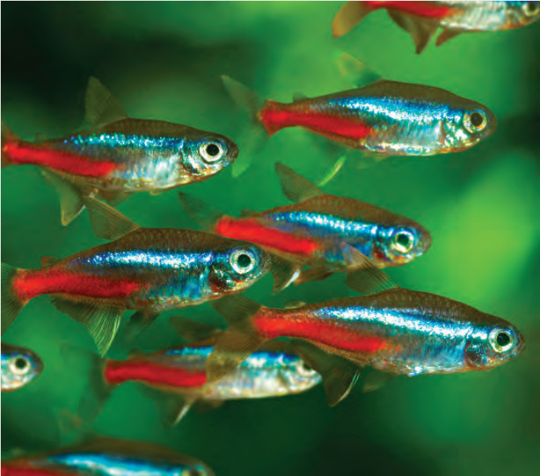
4. New Angle on Manners 会排队的鱼

Slide 16
Text Completion
National Geographic (December 2023 BREAKTHROUGHS)
A species of tiny freshwater fish ______ (find) in the Amazon Basin and in home aquariums around the world was discovered to possess something ____ a surprising number of people appear to lack: the ability _______ (wait) their turn. In a new study published in Scientific Reports, researchers ushered schools of neon tetras (Paracheirodon innesi) through __ narrow opening in their tank and found that the fish used queuing to navigate the close quarters _______ clogging up and impeding passage. The “courteous” creatures, which are only about an inch long, did not collide into one another as they swam near the opening. _____________________ the dexterity to exit without bottlenecking has been observed in ants, no other animal __________ (know) to have the skill. The study’s authors believe that the neon tetras’ _________ (seem) polite behavior might have evolved to help them pass between rocks in their river habitat. These findings, the authors say, could be used to improve traffic-control _________ (strategy) for ___________ (autonomy) cars–and perhaps for crowds of people too.
found
that
to wait
a
without
Though/Although/While
was known
seemingly
strategies
autonomous

Slide 17
Vocabulary
1. usher: to take or show sb where they should go 把……引往；引导；引领
The secretary ushered me into his office.
秘书把我领进他的办公室。
2. impede: to delay or stop the progress of sth 阻碍；阻止
Fallen rock is impeding the progress of rescue workers.
坠落的石头阻滞了救援人员的救援进程。
Translation
我领他去办公室。
I ushered him into the office.
Translation
楼房的施工因天气恶劣而停了下来。
Work on the building was impeded by severe weather.

Slide 18
Translation
A species of tiny freshwater fish found in the Amazon Basin and in home aquariums around the world was discovered to possess something that a surprising number of people appear to lack: the ability to wait their turn.
在亚马逊河流域和世界各地的家庭水族箱中有一种小型淡水鱼，它们拥有一种令人惊讶的能力，而某些人似乎缺乏这种能力，即排队等候。
While the dexterity to exit without bottlenecking has been observed in ants, no other animal was known to have the skill. The study’s authors believe that the neon tetras’ seemingly polite behavior might have evolved to help them pass between rocks in their river habitat.
虽然在蚁群中已经观察到它们能灵活进出而不拥堵，但还没有发现其他动物具有这种技能。该研究的作者认为，霓虹灯鱼看似礼貌的行为可能是为了帮助它们在河流栖息地的岩石之间穿行而进化出来的。

Slide 19
5. Newsweek 12/05/2023

Slide 20
Dictation
A shooting in Dallas, Texas, _______ the lives of four people and left a 15-year-old girl hospitalized, according to local police. A _______ is not in custody, the Dallas Police Department (DPD) said in a statement. “At this time, this is believed to be an _______ incident and there is no ______ to the public,” Dallas police said. Around 4:20 p.m. on Sunday, police were called about a shooting in the 9700 block of Royce Drive in the Rylie neighborhood of Dallas, Texas, DPD said. When officers arrived on the scene, they found five people suffering from _____________. Three adults died at the scene, and two juvenile ______, a 15-year-old female and a one-year-old boy, were transported to a nearby hospital, the DPD said. The little boy succumbed to his injuries. The teen who was wounded was last listed ________________, DPD said. Additional details about the victims were ___________ at the time of publication. The ______ for the mass shooting was unknown as of Sunday night. The investigation is _______, DPD said. Newsweek reached out via email on Sunday to DPD for an update on the incident.
claimed
suspect
isolated
threat
gunshot wounds
victims
in stable condition
not available
motive
ongoing

Slide 21
Vocabulary
1. custody: the state of being in prison, especially while waiting for trial
（尤指在候审时的）拘留，拘押，羁押
After the riot, 32 people were taken into police custody.
那场暴乱之后，有32人被警方拘留。
2. succumb: (to sth) to not be able to fight an attack, an illness, a temptation. etc.
屈服；屈从；抵挡不住（攻击、疾病、诱惑等）
I was determined not to succumb to the virus.
我坚决不向病毒屈服。
Translation
她那天后来被拘留了。
She was taken into custody later that day.
Translation
他最终为Lucy的魅力所倾倒。
He finally succumbed to Lucy’s charms.

Slide 22
Translation
When officers arrived on the scene, they found five people suffering from gunshot wounds. Three adults died at the scene, and two juvenile victims, a 15-year-old female and a one-year-old boy, were transported to a nearby hospital, the DPD said. The little boy succumbed to his injuries.
当警察到达现场时，他们发现有五人受了枪伤。达拉斯警方称，三名成年人当场死亡，两名青少年受害者、一名15岁的女性和一名1岁的男孩被送往附近的医院。小男孩伤重不治。
Additional details about the victims were not available at the time of publication. The motive for the mass shooting was unknown as of Sunday night. The investigation is onging, DPD said.
在本文发表时，还无法获得有关受害者的更多细节。截至周日晚上，大规模枪击事件的动机尚不清楚。达拉斯警方表示，调查仍在进行中。

