Slide 1


感恩遇见，相互成就，本课件资料仅供您个人参考、教学使用，严禁自行在网络传播，违者依知识产权法追究法律责任。
更多教学资源请关注
公众号：溯恩高中英语
知识产权声明

Slide 2
2020学年第一学期
衢州五校期中联考
Continuation writing——A Rose for Elizabeth
致伊丽莎白的玫瑰
浙江省常山一中
吴俊峰

Slide 3
故事背景 setting 人物性格 personal character
冲突 conflict 铺垫 foreshadowing
悬念 suspense 首尾呼应 inclusio
implant
理顺叙事元素， 顺理协同成章
叙事元素
components
composition

Slide 4

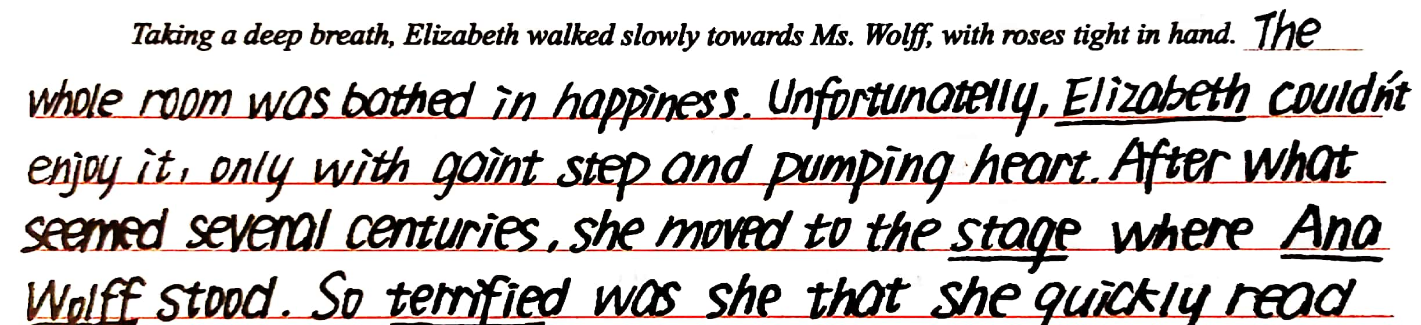
Continuation writing—conflict（冲突）
Elizabeth walked into the yard, carrying a bunch of roses.
“Beautiful flowers for...or..., I'll never get it right!” she cried, throwing the roses on the ground.
Elizabeth had been practising her speech for a week. She'd presented flowers to the dog, the cat, and the statue in the garden.
Part of her couldn't wait. This Saturday, the great Ana Wolff, famous pianist, would perform at the concert hall in town. For four years, Elizabeth had taken piano lessons. She'd listened to Ms. Wolff's recordings over and over again loving the way the notes tumbled like a rushing mountain stream.
Part of Elizabeth was terrified. Her music teacher at school, Mr. Leaf, had asked Elizabeth to present the flowers to Ms. Wolff after the performance. Why did he have to choose her? Elizabeth hated talking in front of people.
Each night, Elizabeth dreamt about music, spotlights, and shining grand piano. Sometimes she tripped（绊倒） and fell. Other times she forgot the words. Once the dream ended with Ms. Wolff rushing offstage before Elizabeth could say anything!
Despite all these, Elizabeth kept practicing. “Beautiful flowers for a beautiful performance...” After all, it was an honor to share the stage with Ana Wolff.
Then, finally, the big day came. “All set, Elizabeth?” Mr. Leaf asked. “Her stomach tightened, but Elizabeth nodded at him.”
The lights dimmed, and Ms. Wolff walked onto the stage wearing a black gown. Smiling, she bowed. The audience clapped loudly. Ms. Wolff made her graceful way to the piano, took her seat and then began to play. Her fingers danced across the keys. She swayed and nodded, and her shiny black ponytail bobbed （跳跃）. Back and forth she raced her feet among the pedals.
Drawn into the music, Elizabeth forgot for a moment about the six words she had to say. Soon it was Ana Wolff's last piece before she knew it. And a burst of thunderous applause suddenly brought Elizabeth to reality. The frightening moment was almost there.
components→→implant→→composition
胡雨轩

Slide 5
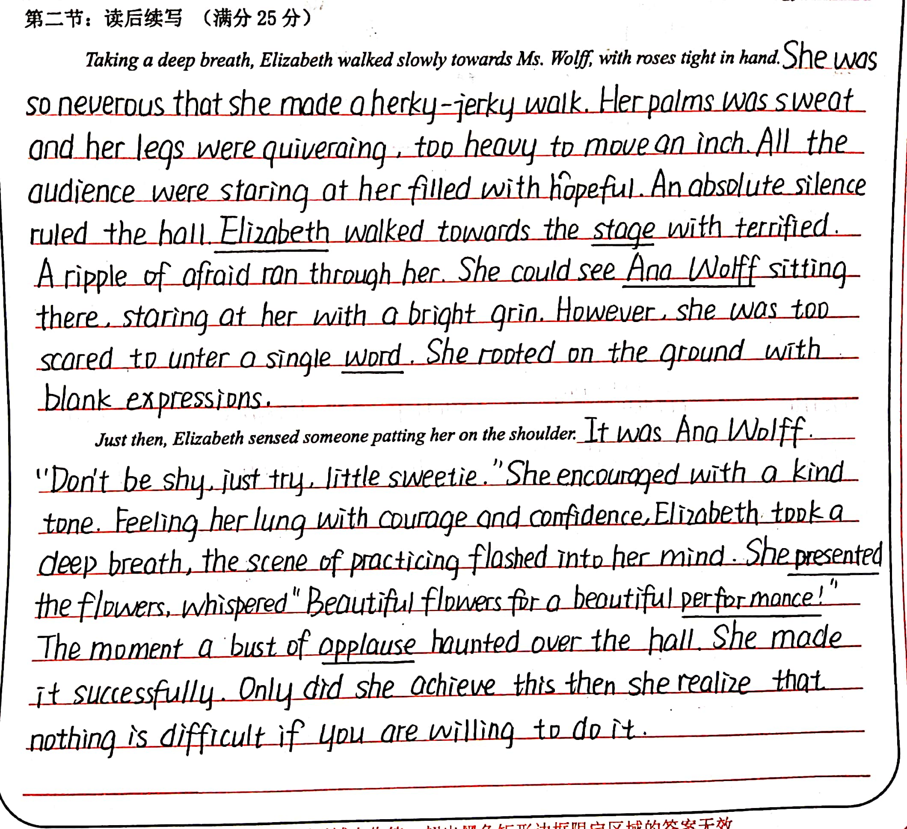
Continuation writing—foreshadowing（铺垫）
Elizabeth walked into the yard, carrying a bunch of roses.
“Beautiful flowers for...or..., I'll never get it right!” she cried, throwing the roses on the ground.
Elizabeth had been practising her speech for a week. She'd presented flowers to the dog, the cat, and the statue in the garden.
Part of her couldn't wait. This Saturday, the great Ana Wolff, famous pianist, would perform at the concert hall in town. For four years, Elizabeth had taken piano lessons. She'd listened to Ms. Wolff's recordings over and over again loving the way the notes tumbled like a rushing mountain stream.
Part of Elizabeth was terrified. Her music teacher at school, Mr. Leaf, had asked Elizabeth to present the flowers to Ms. Wolff after the performance. Why did he have to choose her? Elizabeth hated talking in front of people.
Each night, Elizabeth dreamt about music, spotlights, and shining grand piano. Sometimes she tripped（绊倒） and fell. Other times she forgot the words. Once the dream ended with Ms. Wolff rushing offstage before Elizabeth could say anything!
Despite all these, Elizabeth kept practicing. “Beautiful flowers for a beautiful performance...” After all, it was an honor to share the stage with Ana Wolff.
Then, finally, the big day came. “All set, Elizabeth?” Mr. Leaf asked. “Her stomach tightened, but Elizabeth nodded at him.”
The lights dimmed, and Ms. Wolff walked onto the stage wearing a black gown. Smiling, she bowed. The audience clapped loudly. Ms. Wolff made her graceful way to the piano, took her seat and then began to play. Her fingers danced across the keys. She swayed and nodded, and her shiny black ponytail bobbed （跳跃）. Back and forth she raced her feet among the pedals.
Drawn into the music, Elizabeth forgot for a moment about the six words she had to say. Soon it was Ana Wolff's last piece before she knew it. And a burst of thunderous applause suddenly brought Elizabeth to reality. The frightening moment was almost there.
components→→implant→→composition
郑楠

Slide 6
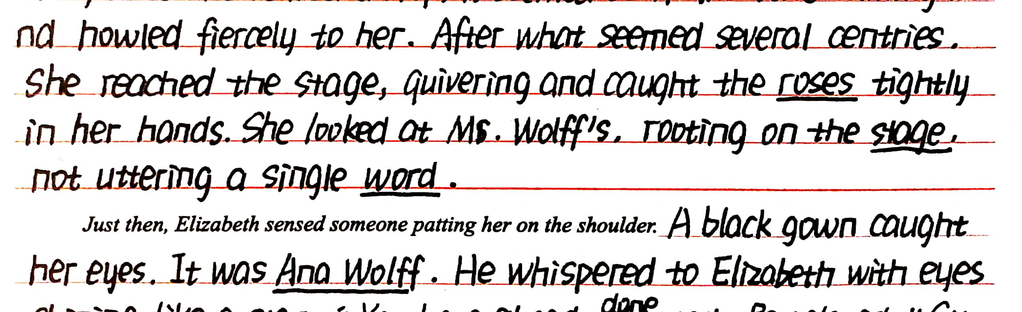
Continuation writing—foreshadowing（铺垫）
Elizabeth walked into the yard, carrying a bunch of roses.
“Beautiful flowers for...or..., I'll never get it right!” she cried, throwing the roses on the ground.
Elizabeth had been practising her speech for a week. She'd presented flowers to the dog, the cat, and the statue in the garden.
Part of her couldn't wait. This Saturday, the great Ana Wolff, famous pianist, would perform at the concert hall in town. For four years, Elizabeth had taken piano lessons. She'd listened to Ms. Wolff's recordings over and over again loving the way the notes tumbled like a rushing mountain stream.
Part of Elizabeth was terrified. Her music teacher at school, Mr. Leaf, had asked Elizabeth to present the flowers to Ms. Wolff after the performance. Why did he have to choose her? Elizabeth hated talking in front of people.
Each night, Elizabeth dreamt about music, spotlights, and shining grand piano. Sometimes she tripped（绊倒） and fell. Other times she forgot the words. Once the dream ended with Ms. Wolff rushing offstage before Elizabeth could say anything!
Despite all these, Elizabeth kept practicing. “Beautiful flowers for a beautiful performance...” After all, it was an honor to share the stage with Ana Wolff.
Then, finally, the big day came. “All set, Elizabeth?” Mr. Leaf asked. “Her stomach tightened, but Elizabeth nodded at him.”
The lights dimmed, and Ms. Wolff walked onto the stage wearing a black gown. Smiling, she bowed. The audience clapped loudly. Ms. Wolff made her graceful way to the piano, took her seat and then began to play. Her fingers danced across the keys. She swayed and nodded, and her shiny black ponytail bobbed （跳跃）. Back and forth she raced her feet among the pedals.
Drawn into the music, Elizabeth forgot for a moment about the six words she had to say. Soon it was Ana Wolff's last piece before she knew it. And a burst of thunderous applause suddenly brought Elizabeth to reality. The frightening moment was almost there.
components→→implant→→composition
徐依雯

Slide 7
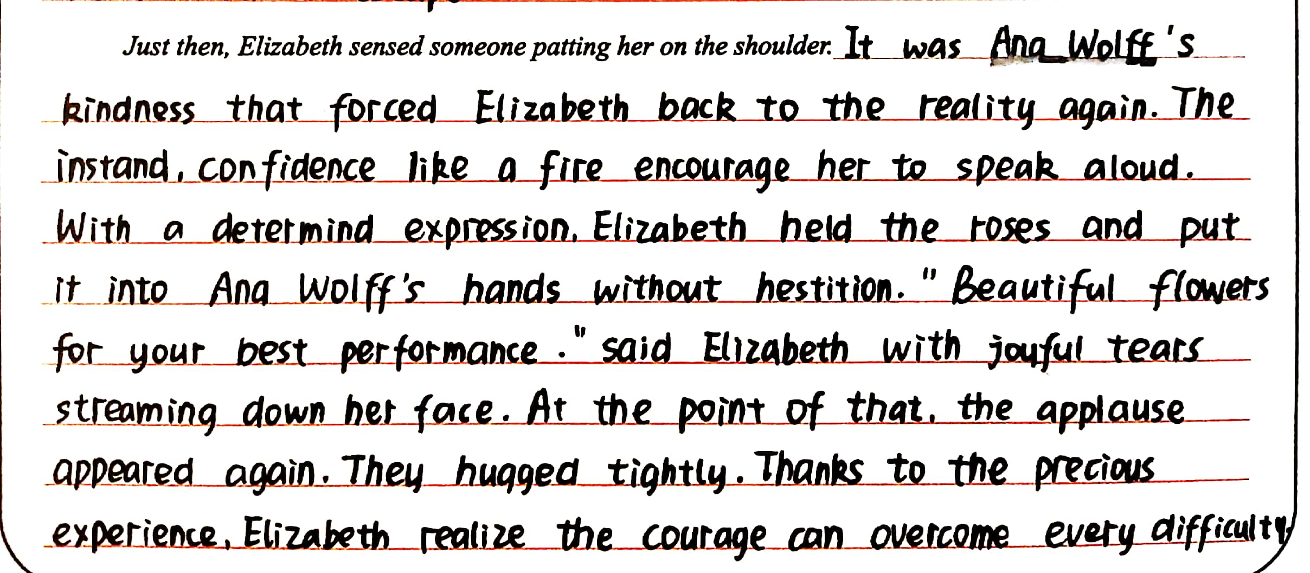
Continuation writing——suspense（悬念）
Elizabeth walked into the yard, carrying a bunch of roses.
“Beautiful flowers for...or..., I'll never get it right!” she cried, throwing the roses on the ground.
Elizabeth had been practising her speech for a week. She'd presented flowers to the dog, the cat, and the statue in the garden.
Part of her couldn't wait. This Saturday, the great Ana Wolff, famous pianist, would perform at the concert hall in town. For four years, Elizabeth had taken piano lessons. She'd listened to Ms. Wolff's recordings over and over again loving the way the notes tumbled like a rushing mountain stream.
Part of Elizabeth was terrified. Her music teacher at school, Mr. Leaf, had asked Elizabeth to present the flowers to Ms. Wolff after the performance. Why did he have to choose her? Elizabeth hated talking in front of people.
Each night, Elizabeth dreamt about music, spotlights, and shining grand piano. Sometimes she tripped（绊倒） and fell. Other times she forgot the words. Once the dream ended with Ms. Wolff rushing offstage before Elizabeth could say anything!
Despite all these, Elizabeth kept practicing. “Beautiful flowers for a beautiful performance...” After all, it was an honor to share the stage with Ana Wolff.
Then, finally, the big day came. “All set, Elizabeth?” Mr. Leaf asked. “Her stomach tightened, but Elizabeth nodded at him.”
The lights dimmed, and Ms. Wolff walked onto the stage wearing a black gown. Smiling, she bowed. The audience clapped loudly. Ms. Wolff made her graceful way to the piano, took her seat and then began to play. Her fingers danced across the keys. She swayed and nodded, and her shiny black ponytail bobbed （跳跃）. Back and forth she raced her feet among the pedals.
Drawn into the music, Elizabeth forgot for a moment about the six words she had to say. Soon it was Ana Wolff's last piece before she knew it. And a burst of thunderous applause suddenly brought Elizabeth to reality. The frightening moment was almost there.
components→→implant→→composition
余星瑶

Slide 8
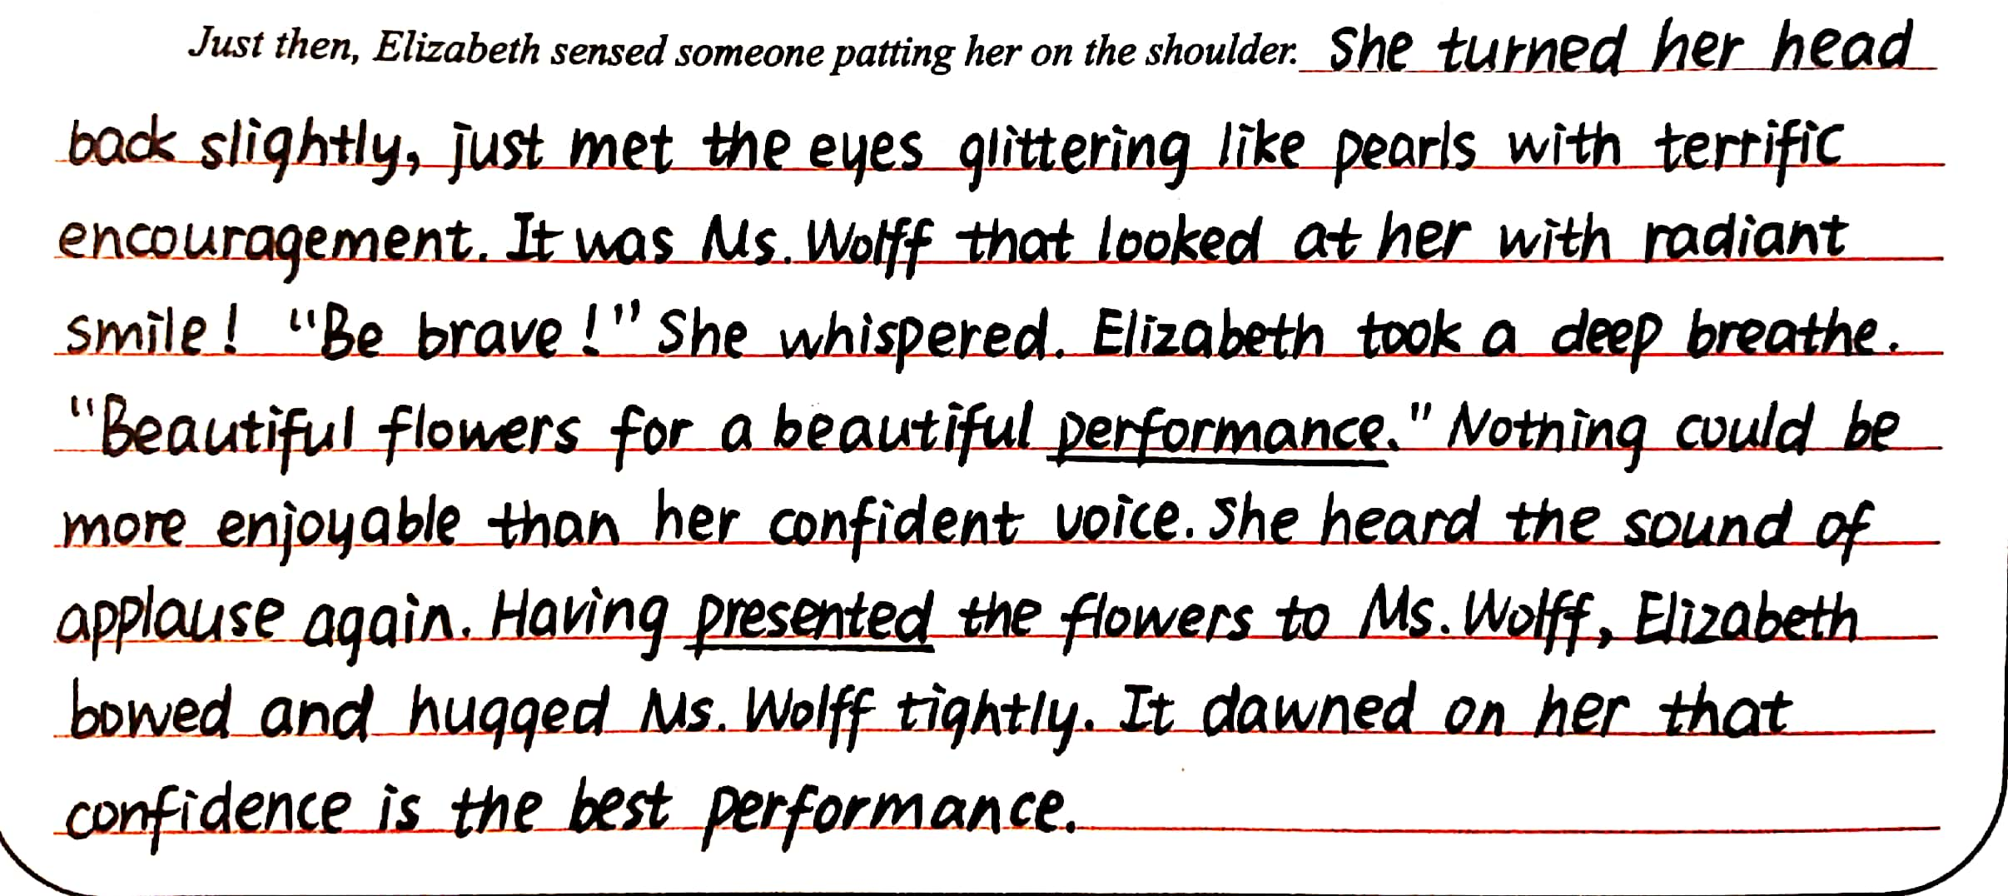
Continuation writing——inclusio（首尾呼应）
Elizabeth walked into the yard, carrying a bunch of roses.
“Beautiful flowers for...or..., I'll never get it right!” she cried, throwing the roses on the ground.
Elizabeth had been practising her speech for a week. She'd presented flowers to the dog, the cat, and the statue in the garden.
Part of her couldn't wait. This Saturday, the great Ana Wolff, famous pianist, would perform at the concert hall in town. For four years, Elizabeth had taken piano lessons. She'd listened to Ms. Wolff's recordings over and over again loving the way the notes tumbled like a rushing mountain stream.
Each night, Elizabeth dreamt about music, spotlights, and shining grand piano. Sometimes she tripped（绊倒） and fell. Other times she forgot the words. Once the dream ended with Ms. Wolff rushing offstage before Elizabeth could say anything!
Despite all these, Elizabeth kept practicing. “Beautiful flowers for a beautiful performance...” After all, it was an honor to share the stage with Ana Wolff.
Then, finally, the big day came. “All set, Elizabeth?” Mr. Leaf asked. “Her stomach tightened, but Elizabeth nodded at him.”
The lights dimmed, and Ms. Wolff walked onto the stage wearing a black gown. Smiling, she bowed. The audience clapped loudly. Ms. Wolff made her graceful way to the piano, took her seat and then began to play. Her fingers danced across the keys. She swayed and nodded, and her shiny black ponytail bobbed （跳跃）. Back and forth she raced her feet among the pedals.
Drawn into the music, Elizabeth forgot for a moment about the six words she had to say. Soon it was Ana Wolff's last piece before she knew it. And a burst of thunderous applause suddenly brought Elizabeth to reality. The frightening moment was almost there.
components→→implant→→composition
郑玉含

Slide 9
学生主动参与评价，推进写作素养提升

Slide 10
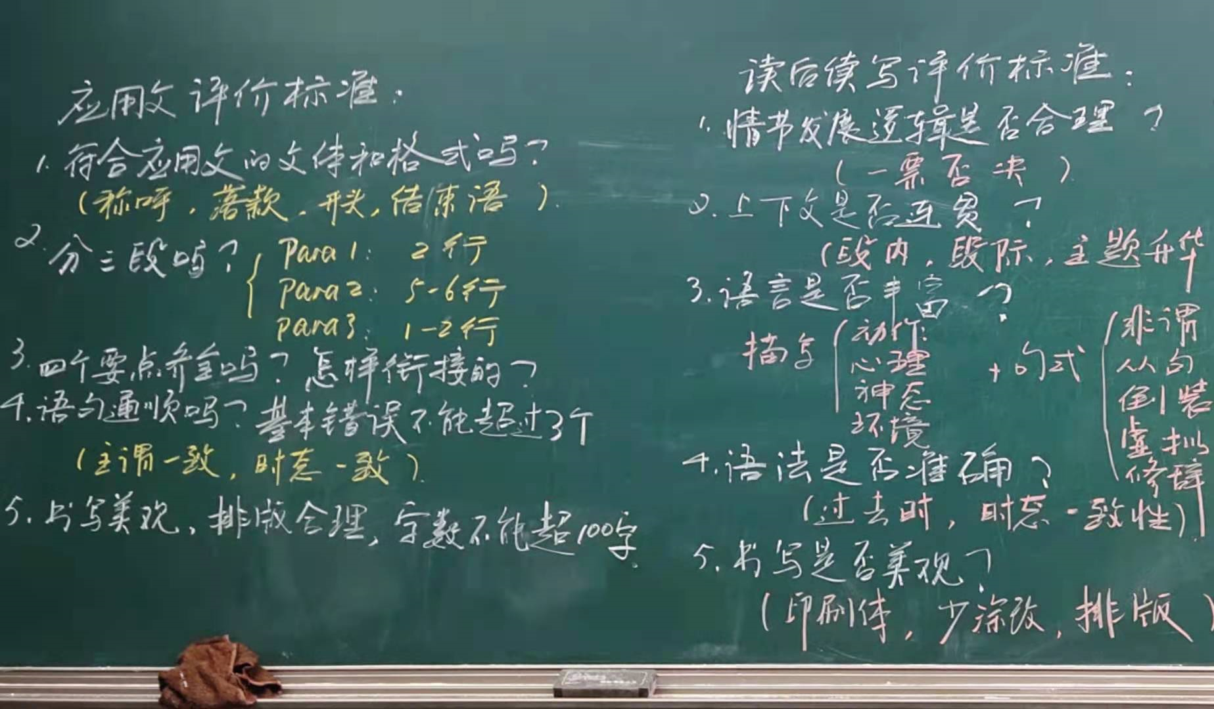
Criteria set by Mr. Wu
自我评价(Self-assessment)
同伴评价(Peer assessment)

Slide 11
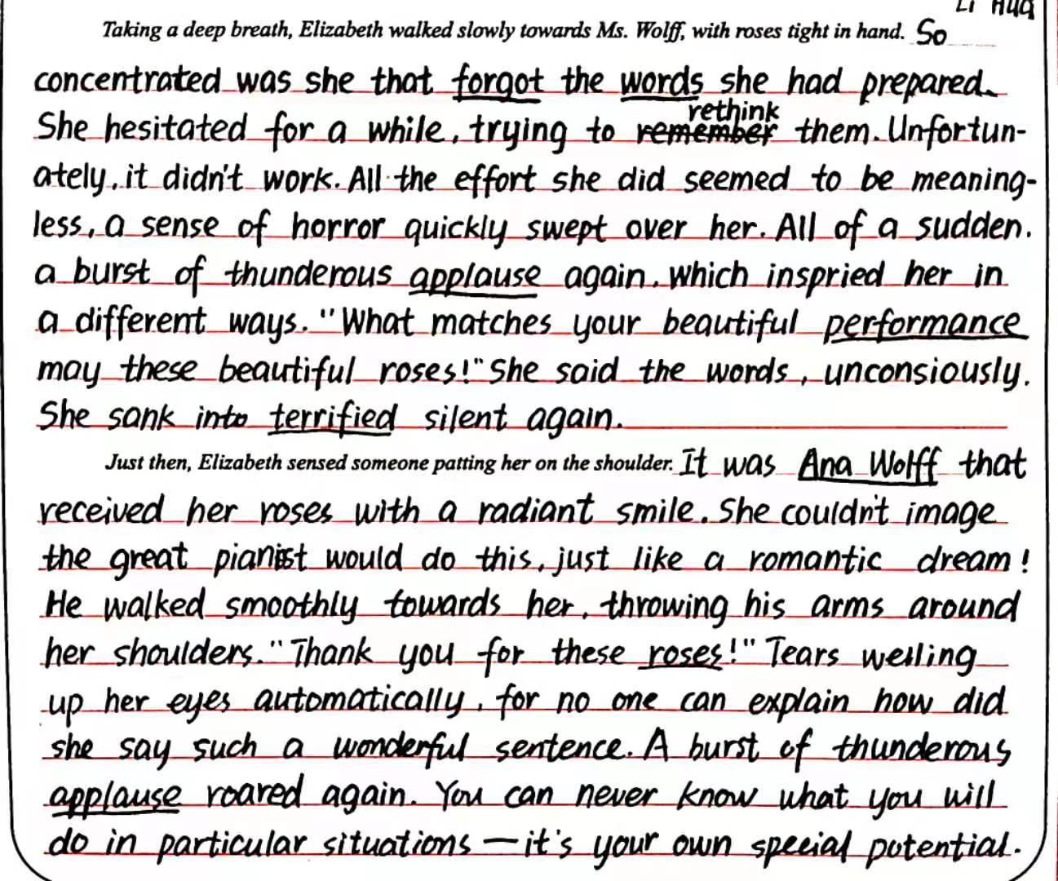
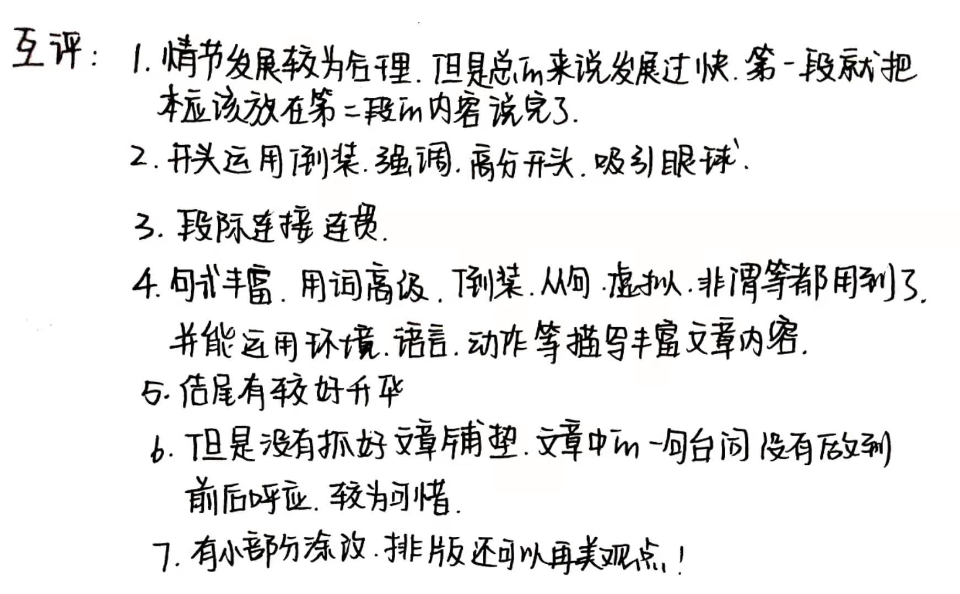
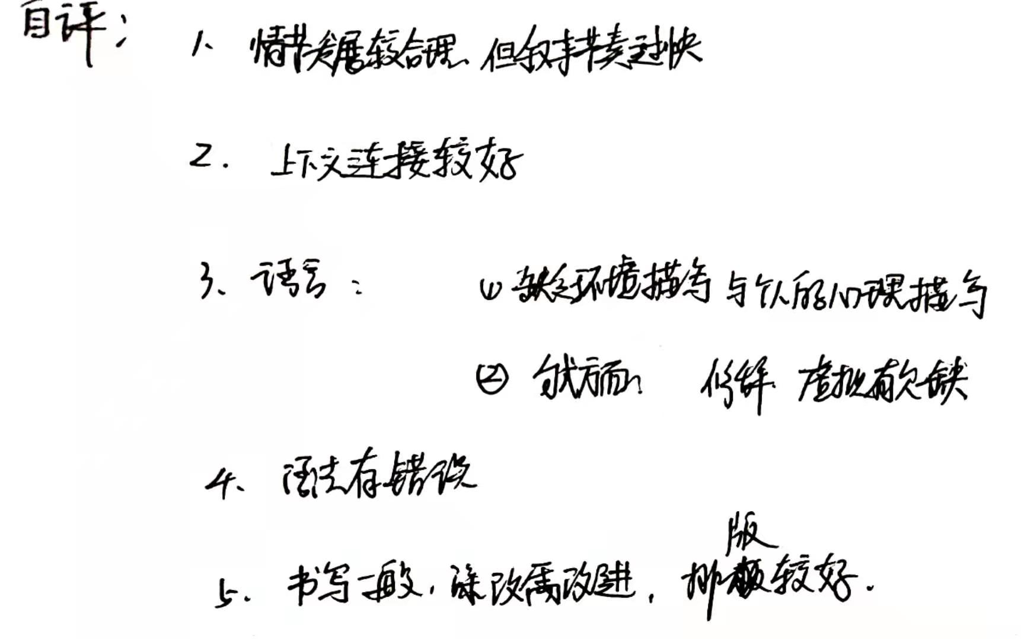
评讲反馈
情节逻辑是基点，语言丰富是看点，情感主线是亮点
Can you comment on this composition?

Slide 12
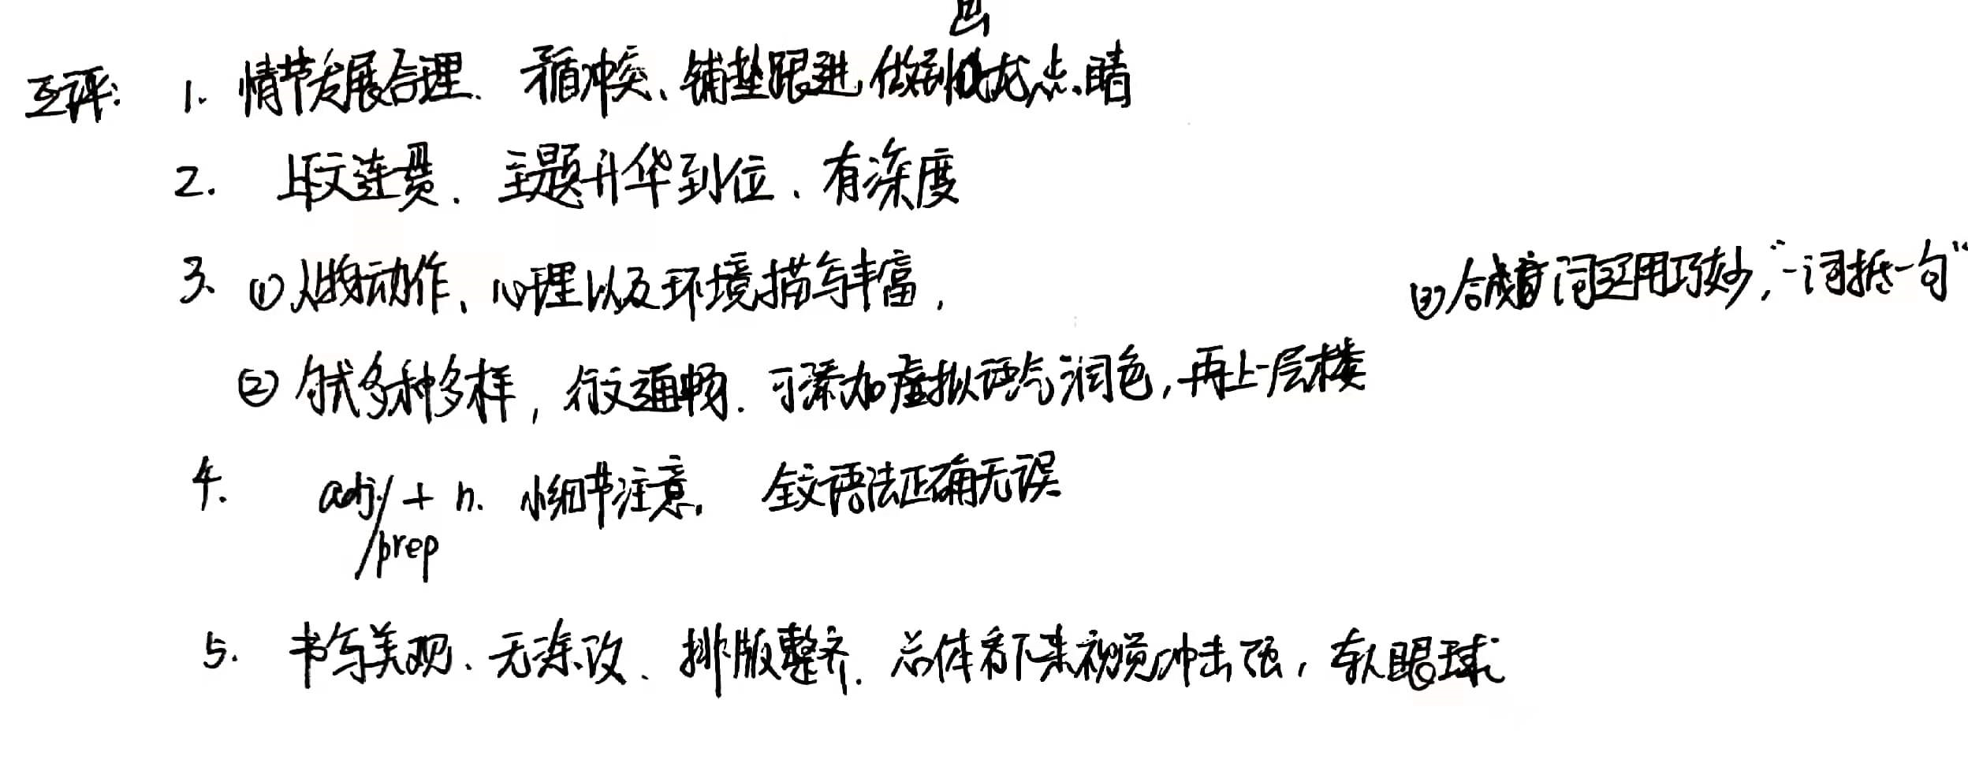
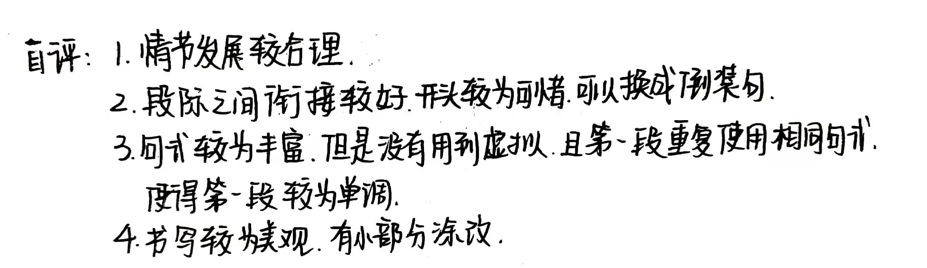
评讲反馈
情节逻辑是基点，语言丰富是看点，情感主线是亮点
Can you comment on this composition?

Slide 13
整合学生好作品，落实读写微技能

Slide 14
读写微技能
读写微技能-1 重视语言赏析用，积累真实语料库
读写微技能-2 理顺叙事元素
读写微技能-3 顺理协同成章
读写微技能-4 善用形容词、副词、doing/done、介词短
语，做伴随状语，在关键处驻足，避免流水
账，细化动作延缓过程，立体动感show出鲜
活
读写微技能-5 高分开头，吸引眼球
读写微技能-6 抓住文章中心词，首尾呼应，主题升华
Writing Microskills

Slide 15
读写微技能-1 重视语言赏析用，积累真实语料库
1.The lights dimmed, and Ms. Wolff walked onto the stage wearing a black gown. Smiling, she bowed_{环境+外貌+神态+动作描写}. 灯光暗了下来，沃尔夫穿着一件黑色礼服走上舞台。她笑着鞠躬。
2.Ms. Wolff made her graceful way to the piano, took her seat and then began to play_{三个并列谓语动词表一连串动作，说明舞台经验丰富，台风稳健}. Her fingers danced_{拟人} across the keys. She swayed and nodded, and her shiny black ponytail bobbed. Back and forth she raced her feet among the pedals_{弹钢琴的动作描写细腻真实，生动形象}. 沃尔夫女士优雅地走向钢琴，坐到座位上，然后开始弹奏。她的手指在琴键上翩翩起舞。她时而摇摆, 时而点头, 乌黑发亮的马尾辫跟着起伏摆动。她的双脚在踏板间来回穿梭。
3.A burst of thunderous applause_{无灵主语} suddenly brought Elizabeth to reality. 一阵雷鸣般的掌声突然使伊丽莎白清醒过来。

Slide 16
读写微技能-2 理顺叙事元素
叙事元素和结构 | 故事背景 setting
 | 人物性格 personal character
 | 冲突 conflict
 | 铺垫 foreshadowing
 | 悬念 suspense
 | 首尾呼应 inclusio

Slide 17
读写微技能-3 顺理协同成章
Elizabeth; Ana Wolff,
stage
roses; performance; words
terrified
present; forgot; applause
Did she make it to present flowers and express appreciation to Ms. Wolff?
What happened to Elizabeth? Was she in an awkward situation?
Who patted Elizabeth and what did he/she do?
How did Elizabeth turn around the situation? What is the internal or external cause ?
“Beautiful flowers for a beautiful performance...”

Slide 18
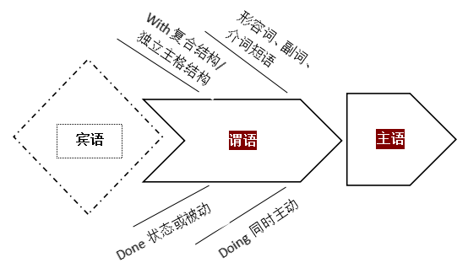
读写微技能-4 善用形容词、副词、doing/done、介词短语，做伴随状语，在关键处驻足，避免流水账，细化动作延缓过程，立体动感show出鲜活
1. Clutching the roses_{现在分词做伴随状语}, Elizabeth_{主语} walked_{谓语} slowly towards Ms. Wolff，the stage lights blazing hot and beads of perspiration trickling down Elizabeth's face_{两个独立主格结构}.
伊丽莎白手里拿着玫瑰花，慢慢走向沃尔夫，舞台灯光灼热，汗珠顺着伊丽莎白的脸上滴下来。

Slide 19
读写微技能-4 善用形容词、副词、doing/done、介词短语，做伴随状语，在关键处驻足，避免流水账，细化动作延缓过程，立体动感show出鲜活
2. Ana Wolff came to her with a radiant smile_{介词短语}.“Do you want to give me the roses?”with a gentle voice, smooth and mollified_{形容词/done做伴随状语}. The voice blew away the fear hovering over her head_{拟人修辞}. “Yes, lady. Beautiful flowers for your beautiful performance.” Elizabeth answered promptly_{副词}, a surge of excitement sweeping over her_{独立主格结构}. In the blink of an eye, all of audience were boiling_{比喻修辞}.
安娜·沃尔夫容光焕发地朝她走来。“你想送我玫瑰吗?”她的声音很温和，很平静。这声音驱散了盘旋在她头上的恐惧。“是的，女士”。伊丽莎白立刻回答道。“美丽的花朵，感谢您美丽的表演。”一阵激动的情绪席卷了她的全身。瞬间，台下的观众沸腾了。(14班 汪亦可 同学)

Slide 20
读写微技能-5 高分开头，吸引眼球
1（倒装句开头）Taking a deep breath, Elizabeth walked slowly towards Ms. Wolf, with roses tight in hand. So nervous was she that she was tripped and fell, with the roses on the stage. Everyone was shocked.The silence in the concert hall was deafening.
她因太紧张而被绊倒，玫瑰花洒落在舞台上。每个人都很震惊。音乐厅里的寂静得可怕。(14班 刘雨洁 同学)
2（介词短语开头）Just then, Elizabeth sensed someone patting her on the shoulder. With blurry eyes, she slowly swung around. It was Ana Wolff!
眼睛模糊，她慢慢地转过身来。是安娜·沃尔夫！(14班 刘雨洁 同学)

Slide 21
读写微技能-6 抓住文章中心词，首尾呼应，主题升华
“You swallow that fear and go out there anyway,” said Ms. Wolff, smiling. “Just the way you did tonight.” Then the great Ana Wolff gently drew a single red rose from her bouquet and gave it to Elizabeth.
“你最终还是咽下恐惧，大胆走出。”沃尔夫笑着说，“就像你今晚做的那样。”伟大的安娜·沃尔夫从花束中抽出一朵红玫瑰，送给伊丽莎白。
（由事及理，虽然伊丽莎白道贺时，仍是紧张万分，但是她还是得到了沃尔夫女士的肯定。最终，她不但得到了偶像的拥抱，还得到了一朵象征勇气的玫瑰，并呼应前文。）

Slide 22
读写微技能-6 抓住文章中心词，首尾呼应，主题升华
To her great astonishment, Ana Wolff threw her arms around her tightly, “Nothing matters, sweetie When I was at your age, I share the same experience with you. It’s called ‘stage fright’.” Ana Wolff smiled in a gentle tone. Not until then did Elizabeth realize that everyone has an embarrassed experience, but the most important thing is to overcome it, and you will find yourself fragrant like the most beautiful rose!
令她惊讶的是，安娜·沃尔夫紧紧地搂着她说: “亲爱的，没什么，我像你这么大的时候，也有同样的经历叫做“怯场”。” 安娜·沃尔夫温柔地笑了笑。直到那时，伊丽莎白才意识到每个人都有尴尬的经历，但最重要的是克服它，你会发现自己像最美丽的玫瑰一样芬芳! ( 14班 刘雨洁 同学 )
（由点到面，呼应前文，并使主题的境界得到提升“成长经历人生轨迹和前辈鼓励终生受益”。）

Slide 23
Sample and appreciation
Taking a deep breath, Elizabeth w alked slow ly towards Ms. Wolff , w ith roses tight in hand . The stage lights felt blazing hot. Beads of sweat trickled down her face. Finally she struggled to the spot where Ms. Wolff was standing. Elizabeth opened her mouth. She mouthed the words, but no sound came out. Murmurs and scattered coughs came from the front row. Elizabeth tried again but the words felt stuck in her windpipe. She lowered her head, trying to block out the sadness erupting inside.
Just then, Elizabeth sensed someone patting her on the shoulder. She raised her head and saw Ms. Wolff looking at her with a warm smile. Ms. Wolff ruffled Elizabeth's hair and whispered in her ear, “Now you know how I feel every time I am on the stage! ” “You mean…you get terrified, too” asked Elizabeth. “I do. Just swallow that fear and smile,” soothed Ms. Wolf. Hearing that, Elizabeth gathered up her courage and said, “Beaut… Beautiful flowers for a beautiful performance! ” She handed the roses to Ana Wolff. The audience cheered. Ms. Wolff wrapped Elizabeth in a big hug. Scents of roses and Ms. Wolff's flowery perfume mingled.
Homework
Find out the writing microskills in this composition.

Slide 24
THANK YOU

