Slide 1
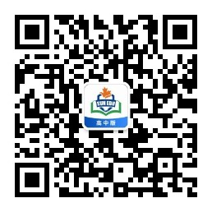
感恩遇见，相互成就，本课件资料仅供您个人参考、教学使用，严禁自行在网络传播，违者依知识产权法追究法律责任。
更多教学资源请关注
公众号：溯恩高中英语
知识产权声明

Slide 2
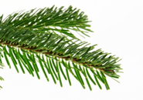
Continuation Writing

Slide 3

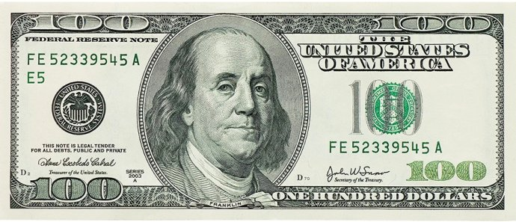
100 dollars

Slide 4

Characters
Megan
, mom
(real character)
a tall man,
niece,
grandma
(imaginary character)
Structure
pick up
_________
the bill on the way to school
the bill at school
Part1
Part2
Part3
(para1):
(para2):
(para3-5):
check
______
guess/ imagine
_______________
the owner of the bill on the way home on the school bus
Part4(para6-7)
deal with
_________the bill at home, in thesupermarket

Slide 5
Part 4 (para6-7) deal with the bill
struggle
think carefully
Walking slowly towards her house, she debated
whether to tell her mom of her new-found treasure.
struggle ，feeling , action， dialogue, decision...
uneasy/ nervous, guilty , relieved
The next day was Saturday and Megan and her mom arrived at the supermarket early.
action, feeling, ending ...

Slide 6
(para6) Walking slowly towards her house, she debated whether to tell her mom of her new-found treasure.
struggle , feeling( nervousness/ uneasiness，guilty，relieved) , action， dialogue, decision ...

Slide 7
Struggle
1 Struggling/ Torn between keeping the secret and talking to mom , Megan was at a loss, so she pulled out the bill, straightening and crumpling it again and again.（徐心瑶）
2 Treats, toys and new skirts that she had always dreamed of flooded into her mind. Meanwhile , mom’s words of being an honest girl were echoing.
in her head.(杨易铮)
3 The devil in her mind tried to persuade her in the sweetest voice while another strong voice kept telling her of to be honest.(周逸飏)
4 Suddenly a demon popped out from her heart, whispering , “ Don’t be guilty. The Bill belongs to you.” But the second moment she thought of her mother’s constant reminder: Always be an honest girl. 邱(俊渊)

Slide 8
feeling (nervousness/ uneasiness)
1. 心跳加快
Megan’s little heart fluttered/beat/ pounded/hammered wildly.
Megan's heart raced.
2. 心跳到嗓子眼了
Megan's heart nearly jumped /leapt/bumped into her mouth.
3. 她心跳陡然停了一下
Her heart missed/skipped a beat.
4. Her throat tightened.
Her palms sweated.
Her legs/body trembled /shook/shivered/quivered.
Her eyebrows knitted/tightened.
She bit her lower lip tightly.
(/violently).

Slide 9
decision
1 Magan returned the bill to the owner , so the next day Magan was taken to the market to be rewarded with some toys .
2 Magan handed the bill to the police , so the next day Magan was taken to the market to be rewarded with some toys .
3 The family being very poor , Mom kept the 100- dollar bill, so the next day they went to the market to buy some necessities .
4 Magan and her mom decided to go to the supermarket to buy some necessity for some poeple in need with the bill .
Tip 1 : The story should be logical and positive with the theme highlighted.

Slide 10
(para7) The next day was Saturday and Megan and her mom arrived at the supermarket early.
action, （helped） people’s reaction， feeling, ending...

Slide 11
Action
Grabbing the bill tightly in her tiny hand , Magan ___________ to the market and quickly her eyes were to the toys. However, thinking of what Mom said last night, Megan started to________presents for the children in need. All done, Megan wrapped them up and them with a red ribbon.
rushed/dashed
glued
choose
tied/decorated
Tip 2 : A series of actions can make the plot more vivid.

Slide 12
Ending
1. On the way home , Megan thought :“ Honesty is the best policy.诚实至上.”
2. “Though I haven’t got my favorite toys, I have harvested something more valuable.” Megan said to her mom.
Tip 3：The tone of the character should be consistent with his personality .

Slide 13
Ending
1 The joy of sharing and spreading kindness filled Megan 's mind. （叶俣含）
2 On the way home, breeze gently brushed Magan's hair and the sun shone on her face warmly. (陈昱臻)
3 Mom hugged Megan tightly in her arms, saying “ My sweetie, I am really proud of you.” (张卢尹)
4 As they walked back to the car,Megan took her mother's hand, smiling happily.
1-->主题升华结尾
2-->环境描写结尾
3-->画面定格结尾
4-->自然式结尾

Slide 14
Walking slowly towards her house she debated whether to tell her mom of her new-found treasure. She was torn between keeping the secret and talking to mom, her heart beating wildly. Once in her room, she closed the door. Carefully she straightened the bill that didn’t belong to her, and the things she dreamed of started running through her mind: a bike, an iPod, new toys ... Then it was dinner time. Noticing Megan toying with her supper, mom asked with concern ，“My sweet, is everything OK?” Not until then did Megan pour out what had been disturbing her the whole day. Over the dinner, mom and Megan discussed how to deal with the bill for a long time and finally they came up with an idea.
struggle
feeling
action
dialogue

Slide 15
The next day was Saturday and Megan and her mom arrived at the supermarket early. Megan anxiously rushed into the supermarket, where various kinds of toys came into her sight, all adorable and inviting. Megan chose carefully, putting them into her basket. In the basket were her long dreamed favorite toys, however, she determined to give them to the chidren in the orphanage as presents , since the imaginary figure of that little girl continully appeared in her mind. Then, she went to the cashier, proudly took out the ＄100 bill from her pocket and handed it to the clerk. Seeing what Megan had done, Mom wore an approving smile on her face.
(鱼米)
定语从句
独立主格
现在分词（状语）
倒装句
since引导的从句
并列动词
现在分词（状语）

Slide 16
Walking slowly towards her house she debated whether to tell her mom of her new-found treasure. She was torn between keeping the bill to herself and talking to mom, her heart beating wildly. Once in her room, she closed the door. Carefully she straightened the bill that didn't belong to her, and the things she dreamed of started running through her mind: a bike, an iPod, new toys ... Then it was dinner time. Noticing Megan toying with her supper, mom asked with concern ，“My sweet, is everything OK?” Not until then did Megan pour out what had been disturbing her the whole day. Over the dinner, mom and Megan discussed how to deal with the bill for a long time and finally they came up with an idea.
The next day was Saturday and Megan and her mom arrived at the supermarket early. Megan anxiously rushed into the supermarket, where various kinds of toys came into her sight, all adorable and inviting. Megan chose carefully, putting them into her basket. In the basket were her long dreamed favorite toys, however, she determined to give them to the chidren in the orphanage as presents , since the imaginary figure of that little girl continully appeared in her mind. Then, she went to the cashier, proudly took out the ＄100 bill from her pocket and handed it to the clerk. Seeing what Megan had done, Mom wore an approving smile on her face.
“ Christmas is coming,” mom thought .

Slide 17
Christmas Is Coming
（ true meaning of Christmas）
"To give up one's very self, to think of others, and how to bring the greatest happiness to others ."
Roses given ； fragrance in hand .

Slide 18
Thank you!

