Slide 1
感恩遇见，相互成就，本课件资料仅供您个人参考、教学使用，严禁自行在网络传播，违者依知识产权法追究法律责任。
更多教学资源请关注
公众号：溯恩英语
知识产权声明

Slide 2
活用教材词汇，靶向高考写作
B1U1单词拓展
武汉开发区汉阳三中：廖英

Slide 3
teenage/ˈti:neɪdʒ/ adj.十几岁的;青少年的
teenager/ˈti:neɪdʒə(r)/ n.(13至19岁之间的)青少年
1.我十几岁的儿子乔丹总是抱怨他必须比他所有的朋友都早回家。（续）
My teenage son, Jordan, always complained about having to be
home earlier than all his friends.
2.作为《青春》杂志的忠实读者，我一直沉迷于青少年专栏，从中我可以得到鼓舞人心的故事，并从激动人心的新闻中获得很多乐趣。2021年新高考I卷应用文“youth英语报创刊十周年短文征稿” （应）
As a loyal reader of YOUTH, I am always absorbed in columns on teenagers from which I can get inspiring stories and gain much
pleasure from exciting news.

Slide 4
teenage/ˈti:neɪdʒ/ adj.十几岁的;青少年的
teenager/ˈti:neɪdʒə(r)/ n.(13至19岁之间的)青少年
3.然而，越来越多的人担心，像吃垃圾食品、缺乏锻炼和沉迷于网络游戏等问题仍然存在于我们青少年中。（应）
However, there is a growing concern that problems like eating junk food, lacking exercise and being addicted to online games still exist among us teenagers.
4.青少年吸烟的主要原因之一是同伴压力。年轻人强烈渴望在同龄人中获得地位和认可。（应）
One of the leading causes of cigarette smoking among teens is
peer pressure. Young people have a strong desire for status and
approval within their peer groups.

Slide 5
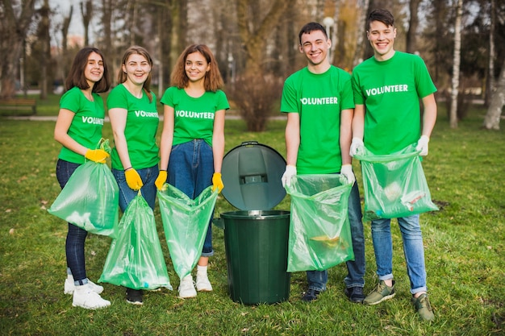
volunteer/ˌvɒlənˈtɪə(r)/ n.志愿者
1.我很高兴得知当地美术馆要举办一场国画展览，需要学生志愿者。现在我写信申请这个职位。^{2019年全国卷应用文“伦敦美术馆志愿者申请信”} （应）
I’m delighted to learn that volunteer students are wanted for a Chinese painting exhibition to be held in the local art gallery. Now I’m writing to apply for the position.
2.为了创造一个更宜居的社区，我们真诚地呼吁您以志愿者的身份参与进来。你的参与和承诺很重要! （应）
To create a more livable community, we sincerely appeal to you for your involvement as volunteers. Your participation and commitment count!
3.她关于社区服务的真挚演讲给观众留下了深刻的印象，激发了许多人参与有意义的志愿活动。（应）
Her heartfelt speech about community service left a lasting impression
on the audience, inspiring many to volunteer for meaningful causes.
4.此外,积极参加海洋组织开展的志愿者活动。
^{2022年全国甲卷应用文“世界海洋日征文投稿”} （应）
In addition, take an active part in
the voluntary activities launched by the ocean organizations.

Slide 6
debate/dɪˈbeɪt/ n.辩论;争论 vt.&vi.辩论
1.上周五下午，学校辩论社在大讲堂举行了关于保护莫高窟的辩论。（应）
Last Friday afternoon witnessed a School Debate Club’s debate about
protecting the Mogao Caves in the lecture hall.
2.支持者认为优先保护莫高窟是值得的，这是一个集建筑、雕塑和绘画于一体的世界文化遗产。另一组/反对者认为保护莫高窟将是对时间和金钱的巨大浪费，这些时间和金钱应该更好地用于帮助国家的经济发展。（应）
The supporters think it is worthwhile to give priority protection to the Mogao Caves, a world cultural heritage site with a mix of architecture, sculpture, and painting. The other group/Opponents argue that
preserving the Mogao Caves will be a huge waste of time and money,
which should be better spent to help the country economic development.

Slide 7
debate/dɪˈbeɪt/ n.辩论;争论 vt.&vi.辩论
3.不出所料，这场辩论不仅培养了参与辩论的同学们的团队合作能力，也让其他同学在逻辑思维和语言智慧上得到了精神上的享受。（应）
This debate, as was expected, not only cultivated the teamwork ability of the students involved in it, but also feasted the other
students spiritually on logical thinking as well as the wisdom in
language.
4.辩手们以其引人入胜的口才和广博的知识面你争我夺，给我们带来了一场赏心悦目的盛宴。（应）
With spellbinding eloquence and a wide range of knowledge,
the debaters clashed with each other, bringing us an impressive
feast for our eyes and ears.

Slide 8
prefer/prɪˈfɜ:(r)/ vt.较喜欢
prefer...to.../prɪˈfɜ:(r) tə/ 喜欢……多于……
1.为了获得更多的点击量，你们最好告诉我你们西方人更喜欢哪种中国文化。^{2021年全国甲卷应用文“中国传统文化主题班会内容征求信”} （应）
To get more clicks, you’d better tell me which Chinese culture
you westerners prefer.
2.每当感到沮丧时，我更喜欢读小说专栏，里面有很多富有想象力的故事。2021年新高考I卷应用文“youth英语报创刊十周年短文征稿” （应）
Whenever feeling depressed, I prefer reading/to read the Novel Column which includes a lot of imaginative stories.
3.我宁愿呆在家里也不愿出去散步。（应、续）
I prefer staying at home to strolling outside.

Slide 9
prefer/prɪˈfɜ:(r)/ vt.较喜欢
prefer...to.../prɪˈfɜ:(r) tə/ 喜欢……多于……
5.大多数学生，65%的人喜欢英语歌曲，一半的学生喜欢看英语电影。2022全国乙卷图表类应用文“针对课外英语学习调查结果的短文投稿” （应）
Most students,65% have a preference for English songs, with half of the students keen on watching English movies.
6.你和我以后有可能见面吗?如果可以，请回复我您的首选日期。（应）
Is it possible for you and me to have a future meeting afterwards? If so, please send me a reply about your preferable date.

Slide 10
content/'kɒntent/ n.内容;[pl.]目录
1.她的钱包掉在地上，里面的东西掉了出来。（应、续）
She dropped her purse and the contents fell out on the floor.
2. 我相信这些行动将维护书的内容的真实性。（应）
I believe these actions would uphold the authenticity of the book’s content.
3.他让人们在沮丧的时候开怀大笑，这样他们就能对自己的生活感到更满意。（应、续）
He made people laugh at a time when they felt depressed, so they could
feel more content with their lives.
4.我们不应只满足于书本知识，而应把理论应用于实践。（应、续）
We should never content ourselves with book knowledge only
and should apply theory to practice.
5.学会拥抱当下，保持正念可以带来平静和满足感。（应、续）
Learning to embrace the present moment and be mindful
can bring a sense of peace and contentment.
6.他脸上带着不满的表情，一怒之下冲出了房间。（续）
He wore a discontented/dissatisfied expression on his face,
rushing out of the room in a burst of anger.

Slide 11
movement/ˈmu:vmənt/ n.动作;运动;活动
1.卢卡斯扭伤了脚踝，只要稍微动一下，他的腿就会一阵剧痛。（续）
Lucas twisted his ankle, and the slightest movement sent sharp pains shooting through his leg.
2.太极拳是一种古老的中国武术，以其缓慢、流畅的动作和深呼吸技巧而闻名。
^{2024年浙江1月高考应用文“校园课间体育项目推荐征文投稿”} （应）
Tai Chi is an ancient Chinese martial art known for its
slow, flowing movements and deep-breathing techniques.
3.我正要离开，这时蜂鸟出现了。一阵移动引起了我的注意。
我转过身，看到同样的蜂鸟在空中盘旋。^{2023年1月浙江高考读后续写“蜂鸟情”}
I was about to leave when the hummingbird appeared.
A flash of movement caught my attention. I turned around the see
the same hummingbird hovering in the air.
4.当Chet看到鲨鱼闪闪发光的鱼鳍在水里慢慢游动时，他紧张的双腿发软。（续）
Chet’s inside turned to jelly when he saw the shark’s shining fin moving slowly
through the water.
5.一瞬间，他把花给了我妻子，祝我们圣诞快乐，然后离开了。（续）
In one quick motion, he gave my wife the flower, wished us Merry Christmas, and left.

Slide 12
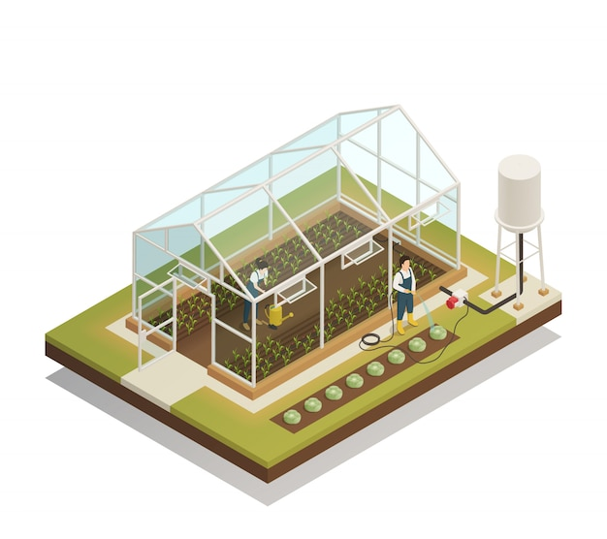
greenhouse/ˈgri:nhaʊs/ n.温室;暖房
1.在温室里种植植物可以保护植物免受极端天气、害虫和疾病的侵害，延长季节，提高作物产量。（应）
Growing plants in a greenhouse provides protection from extreme weather, pests, and diseases, allowing for extended seasons and improved crop yields.
2.然而，人为的温室效应现在已经成为一个大问题。当人们燃烧化石燃料产生大量额外的温室气体时，更多的热能被困在大气中，导致地球表面温度迅速上升。（应）
However, the"man-made" greenhouse effect has now become a big
problem. When people produce huge amounts of extra greenhouse
gases by burning fossil fuels, more heat energy is trapped in the
atmosphere and causes Earth’s surface temperature to rise quickly.

Slide 13
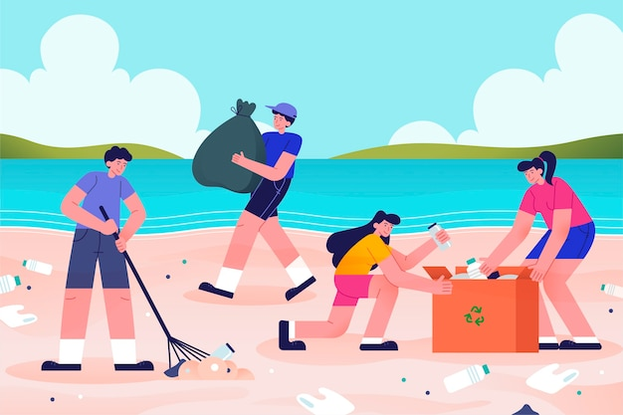
clean up/kli:n ʌp/ 打扫(或清除)干净
1.当双胞胎失望地环顾四周时，他们的父亲出现了。“别慌!”他递给每个人一条干净的毛巾，帮助他们迅速清理混乱。^{2021年全国卷I读后续写“母亲节惊喜”}（续）
As the twins looked around them in disappointmet, their father
appeared. “Don’t panic!” he handed each one a clean towel,
helping them to clean up the mess quickly.
2.更让玛丽亚和彼得吃惊的是，社区里有许多人受到他们努力的鼓舞，主动提出加入他们的清理工作。越来越多的人来到海滩收集塑料袋，他们也呼吁其他人不要扔塑料袋或使用塑料袋。（续）
What amazed Maria and Peter more was that numerous people in their community, encouraged by their efforts, offered to join in their clean-up. More and more people came to the beach to collect plastic bags and they also appealed to others to avoid throwing or using plastic bags.

Slide 14
suitable/ˈsu:təbl/ adj.合适的;适用的
suitable for/ˈsu:təbl fə(r)/ 对……适合的
1.这是一项包容性的运动，适合不同的健身水平，可以很容易地调整为高难度或低难度水平。^{2024年浙江1月高考应用文“校园课间体育项目推荐征文投稿”} （应）
It's an inclusive exercise, suitable for different fitness levels, and can be easily adjusted to be more or less challenging.
2.太极的柔和运动可以适应所有的健身水平，使每个人都能使用。
^{2024年浙江1月高考应用文“校园课间体育项目推荐征文投稿”} （应）
The gentle movement of tai chi can be adapted to suit all fitness levels, making it accessible to everyone.
3.当你被积极的人包围时，你更有可能效仿他们，变成一个乐观主义者。（应、续）
When you are surrounded by people who are positive, you are more likely to follow suit and turn into an optimist.

Slide 15
actually/ˈæktʃuəli/ adv.事实上;的确
1.事实上，他们并不富裕，但伸出援助之手的想法非常强烈。（续）
Actually they were not well off, but the urge to lend a supporting hand was stronger. （用于开始新话题，其实）
2.其实还有更好的选择。例如，做运动或与朋友交谈不仅可以缓解压力，还可以拉近彼此的距离。2024广州12月联考“解压方式讨论调查结果的短文投稿”图表作文（应）
There are actually better options. For example, doing exercise or talking with friends not only relieve stress but also bring us closer to each other. (表示强调)
3.你在晚会上玩得开心吗?嗯，实际上很无聊。（应、续）
Did you have fun at the party? Well, actually it was rather boring.
(用来展示人们想法或观点的对立面)
4.最后一块巧克力你吃了吗，山姆?事实上，是的，我做了。（续）
Did you eat the last chocolate, Sam? Actually,yes, I did. (承认或坦白)
5.实际结果与预测的完全不同。（应、续）
The actual result are totally different from those predicted.

Slide 16
challenge/ˈtʃæləndʒ/ n.挑战;艰巨任务 vt.怀疑
1.然而，在线学习也给我们学习者带来了自律和时间管理方面的挑战。
2021年全国乙卷应用文“Be smart online learners演讲稿” （应）
However, online learning also presents us learners with challenges
in terms of self-discipline and time management.
2.通过这种方式，学生们可以和水平相近的同龄人一起练习，并且可以
互相挑战以提高水平。^{2023年全国卷I应用文“外教随机分组反馈信”} （应）
This way, students can practice with peers who are at a similar level and
can challenge each other to improve.
3.这项工作耗费了我太多的精力，以至于一种挑战的感觉完全压倒了我。
^{2022年浙江1月高考读后续写“傲娇学霸与迷糊学渣”} （续）
The work consumed me so much that there was a sense of challenge that
completely overtook me.
4.起初，我发现掌握笔法和墨水控制的技术是具有挑战性的。但是，在
老师的指导和实践下，我逐渐进步了。^{2023全国乙卷应用文“暑假新技能学习征文投稿”} （应）
At first, I found it challenging to master the techniques of brushwork and ink control.
However, with the guidance of my teacher and practice, I gradually improved.

Slide 17
title/ˈtaɪtl/ n.(书、诗歌等)名称;标题
1.我很荣幸做此演讲。演讲题为《做聪明的在线学习者》。2021年全国乙卷应用文“Be smart online learners演讲稿” （应）
It has a great honor for me to deliver a speech
with the title of Be Smart Online Learners.
2.这位名叫张桂梅的老师被誉为“时代榜样”，她无私的奉献和不断的努力改变了许多女孩的命运。（应）
The teacher, Zhang Guimei, who became titled as “Role
Model of the Times” changed many girls’ destinies with her
selfless devotion and continuous efforts.

Slide 18
topic/ˈtɒpɪk/ n.话题;标题
1.例如，设定时间限制或分配特定主题，以确保平等参与。
^{2023年全国卷I应用文“外教随机分组反馈信”} （应）
For example, setting a time limit or assigning specific topics to ensure equal participation.
2.令我惊讶的是，我的视频很快就得到了无数的赞。我的大红鼻子
和肿下巴成了网友们最喜欢的话题。^{2021年浙江1月高考读后续写 “万圣节南瓜趣事”} （续）
To my surprise, soon my video was followed by a sea of likes. My big
red nose and my sore chin became netizens' favorite topic.
3.你也可以安排关于可持续生活、循环利用和可再生能源等主题的
讲座或研讨会。^{2023北京夏季高考应用文“绿色北京主题社团活动策划建议信”} （应）
You could also arrange for talks or workshops on topics such as
sustainable living, recycling, and renewable energy.
4.听说我们学校要开一次班会，主题是中国传统习俗。
^{2021年全国甲卷应用文“中国传统文化主题班会内容征求信”} （应）
Word came that our school is going to hold a class meeting
whose topic is related to Chinese traditional customs.

Slide 19
confusion/kənˈfju:zɪŋ/ adj.难以理解的;不清楚的
confuse/kənˈfju:z/ vt.使糊涂;使迷惑
confused/kənˈfju:zd/ adj.糊涂的;迷惑的
1.他困惑地看着我，没有回答我的问题。（应、续）
He looked at me in confusion, not answering my question.
2.当我看到自己的名字出现在一等奖名单顶端的那一刻，惊喜和
喜悦占据了我的脑海。尽管路上有障碍和混乱，“这匹马”最终还是
坚定地到达了目的地。^{2023新高考I卷读后续写“参加写作比赛”} （续）
The moment I saw my name on the top of the first prize list, surprise
and joy occupied my mind. Despite the obstacle and confusion on the road,
the horse eventually reached his destination with determination.
3.他们对所发生的事情的说法相互矛盾，使我感到困惑。
（应、续）
They confused me with conflicting accounts of what happened.

Slide 20
confusion/kənˈfju:zɪŋ/ adj.难以理解的;不清楚的
confuse/kənˈfju:z/ vt.使糊涂;使迷惑
confused/kənˈfju:zd/ adj.糊涂的;迷惑的
4.人们经常混淆我和我的双胞胎妹妹。（应、续）
People often confuse me with/and my twin sister.
5.他写得很混乱，很难弄清楚他想表达什么。（应、续）
His writing is so confusing that it is difficult to make out
what he is trying to express.
6.双胞胎把早餐端上楼，叫醒了母亲。看到他们含笑的眼睛，
妈妈感到很困惑，直到他们端上早餐，说“母亲节快乐”。
^{2021年全国卷I读后续写“母亲节惊喜”} （续）
The twins carried the breakfast upstairs and woke their mother up.
Meeting their smiling eyes, Mother felt confused until they presented
the breakfast and said “Happy Mother’s Day”.

Slide 21
fluent/ˈflu:ənt/ adj.(外语)流利的;熟练的
1.同样重要的是，我的汉语和英语都很流利，所以我在与他人
交流时没有任何困难。^{2019年全国卷应用文“伦敦美术馆志愿者申请信”} （应）
Equally important, I am fluent in both Chinese and English, so I
have no difficulty in communicating with others.
2.让自己沉浸在这门语言中，与母语人士交谈，持续练习是
流利掌握一门新语言的有效方法。（应）
Immersing yourself in the language, speaking with native
speakers, and practicing consistently are effective ways to
become fluent in a new language.

Slide 22
fluent/ˈflu:ənt/ adj.(外语)流利的;熟练的
3.你和当地人用汉语交流得越多，你就会说得越流利。（应）
The more you communicate with the natives in Chinese,
the more fluently you will speak it.
4.根据内容、流利度、发音和表现，由专业英语评委
选出前五名，代表我校继续参加全国比赛。（应）
Based on content, fluency, pronunciation, and performance,
the top five students will be selected by professional English
judges and represent our school to continuing completing in
the national competition.

Slide 23
graduate/ˈgrædʒuət/ vi.&vt.毕业 n.毕业生
1.现在，我将从中学毕业。我非常感激我的妈妈，因为她所做的一切对我来说很重要。（应）
Now, I’ll graduate from middle school. I am very grateful to my mom because she has done much for me.
2.许多大学毕业生出国深造。（应）
Many college graduates go abroad for further study.
3.首先，我想对你祝贺我高中毕业表示感谢。
^{2021年6月天津卷书面表达“高考后暑假安排咨询信”} （应）
To begin with, I’d like to express my gratitude for your
congratulating me on my graduation from high school.

Slide 24
recommend/ˌrekəˈmend/ vt.建议;推荐;介绍
1.你是不是整天被办公桌困住了?你是否总是感到困倦和疲惫?为什么不站起来伸展一下身体呢?我写这封信是为了给学生们推荐一种非常棒的运动:跳绳。^{2024年浙江1月高考应用文“校园课间体育项目推荐征文投稿”} （应）
Are you trapped by your desk all day? Do you always feel sleepy and worn out? Why not stand up and stretch your bodies? I am writing to recommend a fantastic exercise for students to engage in during
breaks: Jump Rope.
2.除了旗袍，中国结也是非常值得推荐的，因为它在中国文化中代表着团结和依恋，是表达你对母亲深深的爱和强烈情感纽带的合适礼物。（应）
Besides Qipao, the Chinese knot also comes highly recommended because it represents unity and attachment in the Chinese culture, a proper gift to convey your deep love and strong emotional bond
towards your mother.

Slide 25
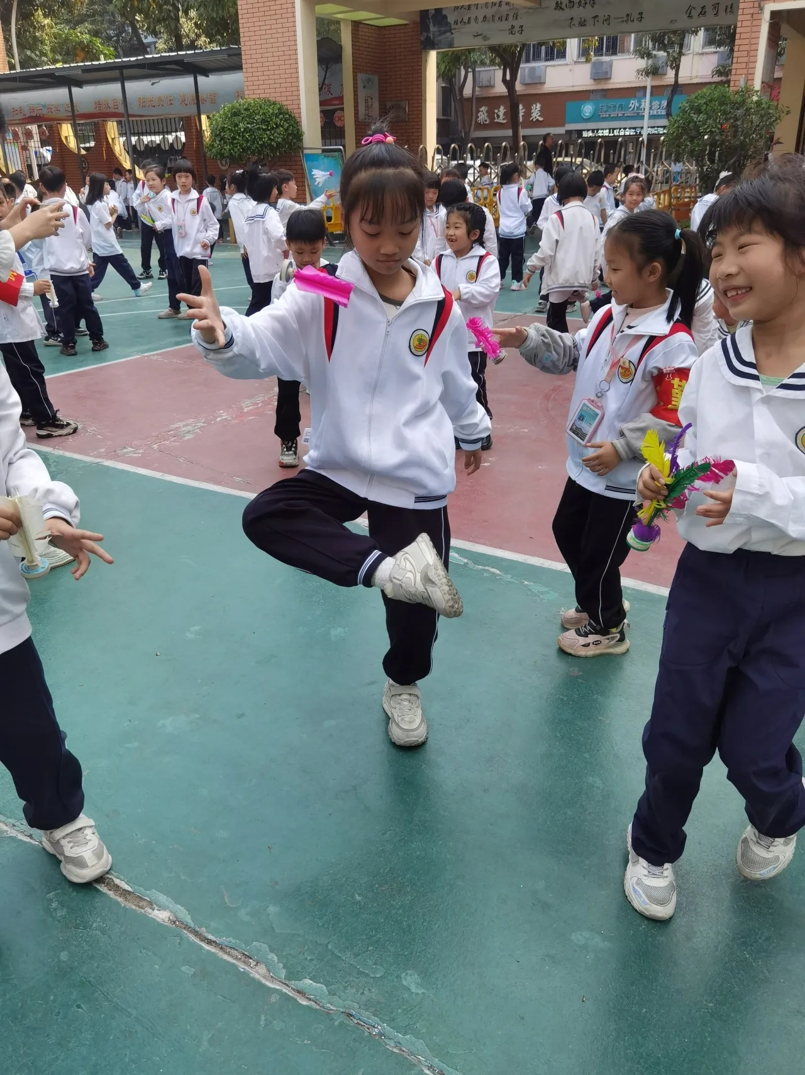
recommend/ˌrekəˈmend/ vt.建议;推荐;介绍
3.我强烈建议把踢毽子纳入学校的课间活动。
^{2024年浙江1月高考应用文“校园课间体育项目推荐征文投稿”} （应）
I strongly recommend that kick shuttlecock
(should) be integrated into school recess activities.
4.我写这封信是为了感谢您推荐的一些科学家的
励志故事，我从中受益良多。（应）
I’m writing to express my thanks for your
recommendation of some scientists‘inspiring stories,
from which I have benefited a lot.

Slide 26
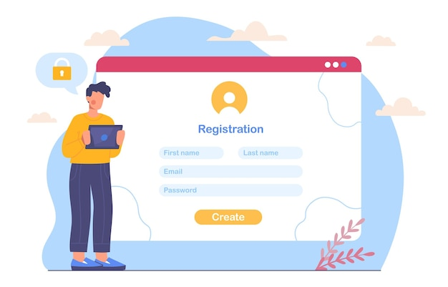
sign up for sth/saɪn ʌp fə(r) ˈsʌmθɪŋ/ 报名参加课程
1.如果你感兴趣,请在下周四下午5点前到办公室报名,以便于我们做些必要的安排。（应）
If you are interested, please sign up at the office before 5:00 p.m. Next Thursday so that we will make necessary arrangements.
2.我的指导老师建议我选修高级文学,因为我喜欢英语
而且成绩不错。（应）
My adviser recommended that I should
sign up for advanced literature because I like English
and I’m good at it.
3.自从我进入高中以来，我就被篮球所吸引，所以我报名参加了篮球俱乐部的活动。（应）
Since I entered senior high school, I have been attracted to basketball, so I signed up for the basketball club activities.

Slide 27
advanced/ədˈvɑ:nst/ adj.高级的;高等的;先进的
advance/ədˈvɑ:ns/ n.&vi.&vt.前进;发展;促进
1.然而，随着我们越来越依赖AI这项技术，一些人感到它的进步威胁到了我们。（应）
Nevertheless, as we become increasingly dependent on this technologyAI, some people feel threatened by its advances.
2.随着夜幕降临，乌云密布，布满了整个天空。（续）
As the night advanced, the clouds closed in and densely overspread the whole sky.
3.首先，随机配对将使水平高的学生主导对话，而其他学生需要提高将处于劣势。^{2023年全国卷I应用文“外教随机分组反馈信”} （应）
To begin with, randomly pairing up will make the more advanced students dominate the conversation while the other students to be improved will be at a disadvantage.

Slide 28
advanced/ədˈvɑ:nst/ adj.高级的;高等的;先进的
advance/ədˈvɑ:ns/ n.&vi.&vt.前进;发展;促进
4.你最好提前练习使用筷子，或者提前让他们知道你需要叉子或勺子。^{2018年全国I卷书面表达“中国做客习俗咨询信”} （应）
And you’d better practice using chopsticks in advance or let them know ahead of time that you need a fork or spoon.
5.这部发人深省的科学纪录片完全吸引了我的注意力，激发了我对科学进步的更多探索。（应）
The thought-provoking science documentary absorbed my
attention completely, inspiring me to explore more about
scientific advancements.

Slide 29
literature/ˈlɪtrətʃə(r)/ n.文学;文学作品
1.《三国演义》基于一些历史事实,是中国的四大名著之一。（应）
Based on some historical facts, The Romance of Three Kingdoms is
one of the four classic novels of Chinese literature.
2.李白是谁?他是中国文学史上的一个传奇，一个偶像，一个光辉的灯塔。^{2023全国甲卷应用文“介绍中国历史人物征文稿”} （应）
Who is Li Bai?He is a legend, an icon and a beacon of poetic brilliance
in the annals of Chinese literature.

Slide 30
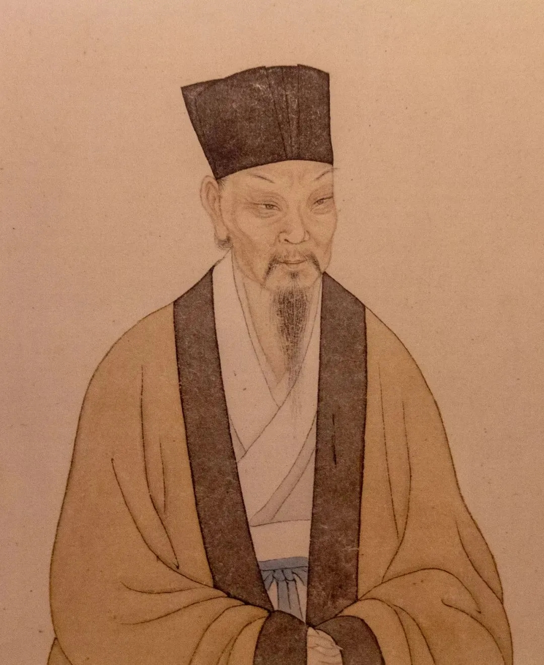
literature/ˈlɪtrətʃə(r)/ n.文学;文学作品
3.我最近得知，为了增加学生学习的乐趣和多样性，我们学校在选修课上提出了一些新的想法，包括“财务管理”和“古代文学”。（应）
I’ve been recently informed that our school, in the hope of adding
fun and diversity to students’ study, has put forward some fresh ideas
on optional courses, including “Financial Management”and “ Ancient Literature”.
4.苏轼的遗产不仅限于他的文学成就。他是一个非常正直和勇敢的人，他不害怕公开反对不公正。^{2023全国甲卷应用文“介绍中国历史人物征文稿”} （应）
Su Shi’s legacy extends beyond his literary achievements. He was a man of great integrity and courage, who was not afraid to speak out
against injustice.

Slide 31
extra-curricular/ˈekstrə kəˈrɪkjələ(r)/ adj.课外的;课程以外的
extra/ˈekstrə/ adj.额外的;附加的
1.我认为报名参加一个俱乐部，参加更多的课外活动对你很有用。（应）
I think it useful for you to sign up for a club and take part in more extra-curricular activities.
2.电影配乐与电影的氛围和情绪完美契合，为故事增添了额外的深度。（应）
The soundtrack perfectly complements the mood and tone of the
movie, adding an extra layer of depth to the storytelling.
3.有时候你做了一些好事，但并不求回报，因此，当某人回报这
份帮助时，你会觉得它是一份额外的收获。（应、续）
Sometimes, you do something good but don’ t expect anything in return.
Therefore, when someone returns the favor, it becomes an extra bonus.
4. 萨拉是一个敬业的员工，总是加倍努力在规定日期前完成任务。（应、续）
Sarah is a dedicated worker, always going the extra mile to meet deadlines.

Slide 32
obviously/ˈɒbviəsli/ adv.显然;明显地
1.2009年6月8日被联合国正式命名为世界海洋日。显然，中国非常重视海洋保护。_{2022年全国甲卷应用文“世界海洋日征文投稿”}（应）
June 8th was officially named by the UN in 2009 as World Oceans Day. Obviously, it attaches great importance to ocean protection.
2.该书在介绍中国文物时发现了一些明显的错误，这让人感到震惊。（应）
It comes as a shock that some obvious errors in the introduction of
Chinese artifacts are found in the book.
3.很明显，计算机正日益成为教育过程中被接受的一部分。（应）
It is obvious that computers are increasingly becoming an accepted
part of the education process.

Slide 33
obviously/ˈɒbviəsli/ adv.显然;明显地
4. 如图所示,很显然，高达75%的受访学生用智能手机看视频来消磨时间。2021年全国乙卷应用文“Be smart online learners演讲稿”（应）
As is apparently/clearly/evidently demonstrated in the chart, up to 75% of the students surveyed use the
smart phone to watch videos to kill time.
5.厨房里有一股明显的烧焦气味。（应、续）
There is a distinct smell of something burnt in the kitchen.

Slide 34
quit/kwɪt/ vi.&vt.停止;戒掉;离开
1.养成这种习惯很容易，但要戒掉却很难。（应、续）
Sliding into the habit was easy, but it was difficult to quit the habit.
2.他不顾家人的反对，辞去了教师工作，成为一名兼职演员。（应、续）
Despite opposition from his family, he quit teaching and became
a part-time actor.
3.马在黑夜中疾驰时在想什么呢?他累了吗?有疑问吗?他想放弃吗?我立刻表示感同身受。^{2023新高考I卷读后续写“参加写作比赛”} （续）
What did the horse think, as he sped through the night? Did he get
tired? Have doubts? Did he want to quit? I sympathized immediately.
4.放弃者永远不会成功，成功者永远不会放弃。（应、续）
Quitters never win, and winners never quit.

Slide 35
responsible/rɪˈspɒnsəbl/ adj.负责的;有责任的
responsibility/rɪˌspɒnsəˈbɪləti/ n.责任;义务
be responsible for/bi rɪˈspɒnsəbl fə(r)/ 对……负责
1.我认为我能胜任这个职位。首先，我是一个善于交际、有责任心的人，我会认真对待这份工作，能够灵活应对突发事件。^{2019年全国卷应用文“伦敦美术馆志愿者申请信”} （应）
I think I am qualified for this position. First, being a sociable and responsible person, I will take this job seriously and be able to deal with any emergencies flexibly.
2.首先，政府有责任制定法律和政策来改善渔业管理、废物处理以及沿海土地和海洋栖息地的恢复。^{2022年全国甲卷应用文“世界海洋日征文投稿”} （应）
Firstly, governments are responsible for making laws and policies to improve fishery
management, waste treatment, and restoration of coastal lands and ocean habitats.
3.总之，我的责任感会使我成为一名合格的志愿者。如果您能
考虑我的申请，我将不胜感激。^{2019年全国卷应用文“伦敦美术馆志愿者申请信”} （应）
All in all, my sense of responsibility will make me
a qualified volunteer. I’d appreciate it if you could take my
application into consideration.

Slide 36
responsible/rɪˈspɒnsəbl/ adj.负责的;有责任的
responsibility/rɪˌspɒnsəˈbɪləti/ n.责任;义务
be responsible for/bi rɪˈspɒnsəbl fə(r)/ 对……负责
4.在我看来，减少垃圾污染是每个人的责任。只有通过我们的共同努力，
我们才能生活在一个更好的环境。（应）
In my opinion, it is everyone’s responsibility to reduce garbage pollution.
Only with our joint efforts can we live in a better environment.
5.我们不应该逃避责任，应该承担新的责任。（应、续）
We must not shrink/avoid from our responsibilities and are supposed to shoulder/assume/undertake new responsibilities.
6.相比之下，乱扔垃圾、浪费能源和随地吐痰都是不负责任的行为，
会对地方和全球的环境产生负面影响。（应）
Littering, wasting energy and spitting on the ground, in contrast, are
examples of irresponsible actions that can have a negative impact on
the environment at both local and global level.

Slide 37
solution/səˈlu:ʃn/ n.解决办法;答案
1.最后，那个能说一口流利英语的自信女孩想出了一个解决问题的
办法。（应、续）
At last, the confident girl who can speak English fluently came up with
a solution to the problem.
2.尽管他很努力，但他觉得自己无法解决这个复杂的问题。（应、续）
Despite his efforts, he felt incapable of solving the complex problem on his own.
3.面对挑战可以帮助我们走出舒适区，教会我们新的技能，建立我们的适应力和解决问题的能力，从而帮助我们成长。（应、续）
Facing challenges can help us grow by pushing us out of our comfort
zone, teaching us new skills, and building our resilience and
problem-solving abilities.

Slide 38
schedule/ˈʃedju:l/ n.工作计划 vt.安排;预定
1. 要做一个聪明的在线学习者，关键是要制定严格的计划和合理的
时间表。2021年全国乙卷应用文“Be smart online learners演讲稿” （应）
To be smart online learners, the key is to make strict plans and
reasonable schedules.
2. 仅仅安排有规律的锻炼来约束自己是不够的，同样重要的是找到一个可以让我们保持动力的伙伴来一起锻炼。（应）
It is not enough to simply schedule regular workouts to discipline ourselves.Of equal importance is to find a partner to exercise with, who can keep us motivated.
3. 会议时间安排为中国时间下午2点至5点，即中国和新西兰的白天时间。所以，不要担心时差。（应）
The session is scheduled from 2:00 p.m. to 5:00 p.m., Chinese time, which is daytime for both China and New Zealand. So, don't worry about jet lag.

Slide 39
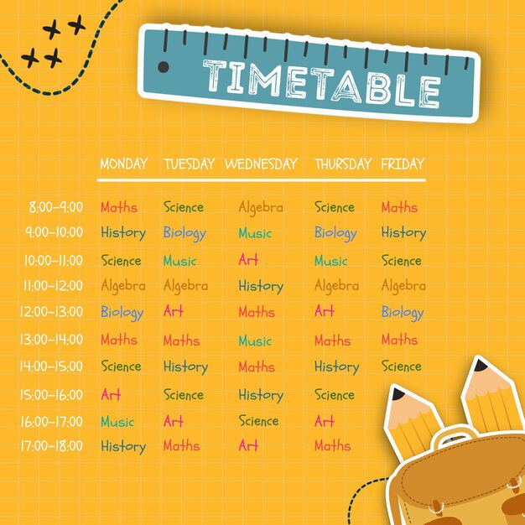
schedule/ˈʃedju:l/ n.工作计划 vt.安排;预定
4. 非常抱歉，我不得不取消去贵国的旅行计划，很遗憾，我将不能如期拜访您。因此，我写这封信是为了向你道歉。（应）
I am terribly sorry that I have to cancel my travel plan to your country and, to my regret, I will not be able to visit you as scheduled. Thus, I am writing to extend my apology to you.
5. 她提前完成了项目，证明了她在软件开发方面的能力。（应）
She demonstrated competence in software development by
completing the project ahead of schedule.

Slide 40
adventure/ədˈventʃə(r)/ n.冒险;奇遇
1.李明在他的背包里带了一个指南针和一个帐篷，我带了一个手电筒，一张地图，一把刀，一个急救箱，一些火柴，蜡烛，食物和衣服，这些都是冒险不可缺少的。（续）
Li Ming brought a compass and a tent as well along in his backpack,
and I was carrying a flashlight, a map, a knife, a first-aid kit,
some matches, candles, food, and clothing that were all indispensable
for the adventure.
2.我们参与了各种各样的活动，有认识一些可爱的卡通人物，也有
体验杰克船长的冒险寻宝，还有发现未来精彩的驾驶世界。（应）
We involve ourselves in a variety of activities, ranging from meeting some adorable cartoon characters, experiencing Captain Jack’s adventurous treasure hunt, to discover the wonderful driving world of the future.

Slide 41
youth/ju:θ/ n.青年时期;青春
1. 年轻人需要继续成为全球文化大使。接触世界上其他的年轻人，了解他们的语言、文化和生活。（应）
The youth need to continue to be global cultural ambassadors. Reach out to
other youths in the world, learn about their language, culture, and life.
2. 总之，中国青年节是一个提醒，激励和鼓舞中国青年过有意义的生活，为社会做出贡献。（应）
In a word, Chinese Youth Day acts as a reminder to motivate and
inspire Chinese youth to live a meaningful life and make contributions
to the society.
3. 选手们精神抖擞，用流利的英语表达自己的观点，自信地与
评委交流，充分展现了他们的青春活力。（应）
With great spirit, the contestants expressed their opinions in
fluent English, and communicated with the judges confidently,
which fully showed their youthful vigor.

Slide 42
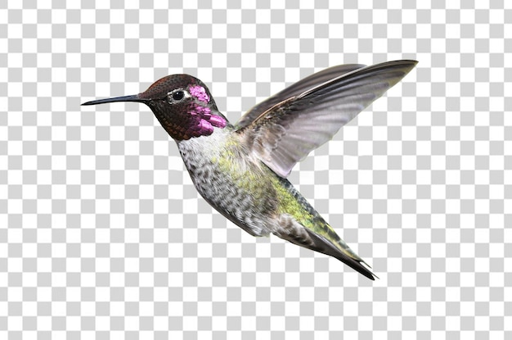
survival n.生存；幸存；幸存事物
1. 接下来的日子充满了准备。他们阅读关于生存的书籍，学习导航用的星星，在小树林里测试他们的勇气。不可动摇的决心和冒险的承诺将他们团结在一起，这些可能永远改变他们生活。（续）
The days that followed were filled with preparation. They read books on survival, learned about the stars for navigation, and tested their courage
in smaller woods. The boys were united by their unshakable resolve and
the promise of an adventure that could change their lives forever.
2. 窗子上原来的那个洞已经找不到了，这使人感到极大的安慰。离开家时，我不禁想知道现在过得怎么样了。它是设法找到回家的路，还是仍然在某个地方挣扎着生存？^{2023年1月浙江高考读后续写“蜂鸟情”} （续）
It was a great comfort that the original hole in the window was nowhere to be found. Leaving the house, I couldn’t help wondering how it was getting on now. Had it managed to find its way back home or was it still out there somewhere struggling to survive.

Slide 43
expert/ˈekspɜ:t/ n.专家;行家 adj.熟练的
1.我们将邀请一位专家为我们讲授中国书画的基本知识和技巧。（应）
An expert will be invited to give a lecture of basic knowledge and
techniques of Chinese calligraphy and painting.
2.然而，我还没有达到预期的结果。因此，我想知道您作为英语教学
专家是否可以提供给我一些实用的策略。（应）
However, I have yet to achieve the desired results. Thus, I wonder
whether you, as an expert in English teaching, could provide me with some practical strategies.
3.我相信，以您的专业母语知识，您修改后的申请一定会脱颖而出。
^{2016全国卷I应用文“请求外教修改简历的请求信”} （应）
I believe with your expertise as a native English speaker, my polished
application revised by you can stand out.
4.为了解决这些问题，我建议咨询专家进行全面审查。如果出版商
能够主动召回当前版本以进行必要的更新，那将是有益的。（应）
To address these issues, I recommend consulting with specialists for
a comprehensive review. It would be beneficial if the publishers could
initiate a recall of the current edition for necessary updates.

Slide 44
behaviour/bɪˈheɪvjə(r)/ n.行为;举止
1.遗憾的是，我注意到有几个学生在考试中有不诚实的行为，比如交换答案和使用电子设备。在我看来，这种作弊行为有可能影响考试的整体公平性。（应）
Regrettably, I noticed several students engage in dishonest behavior during the exam, such as exchanging answers and using electronic devices. In my opinion, this cheating behavior has the potential to impact the overall fairness of the exam.
2. 虽然我姐姐只比我大两岁，但她总是表现得好像她能把
一切安排得井井有条。（应、续）
Although my elder sister is only senior to me by two years,
she always behaves as if she could organize everything properly.
3. 作为学生，我们应该遵守学校的规则，在学校里守规矩。
服从老师和父母对我们有好处。此外，我们必须严格要求自己。（应）
As students, we should follow the school rules to behave ourselves at school. It’s good for us to obey the teachers
and parents. Also, we must be strict with ourselves.

Slide 45
generation/ˌdʒenəˈreɪʃn/ n.一代(人)
1.总之，李白的诗是永恒的提醒，继续激励着一代又一代的读者，包括我自己。^{2023全国甲卷应用文“介绍中国历史人物征文稿”} （应）
In a word, Li Bai’s poetry serve as a timeless reminder, continuing to inspire generations of readers, including myself.
2.位于武汉的户部巷以令人垂涎的小吃而闻名。有些食品摊位甚至已经存在了好几代，在此期间，食物的制作方法和秘密配料一直保持不变。（应）
Located in Wuhan, Hubu Alley is wide known for mouth-watering snacks. Some food stalls have even been there for several generations, during which the methods of food preparation together with the secret ingredients have remained unchanged.
3.老一辈人比年轻一代更不愿意接受新技术。（应、续）
The older generation are more reluctant to embrace new technology
than the younger (generation).

Slide 46
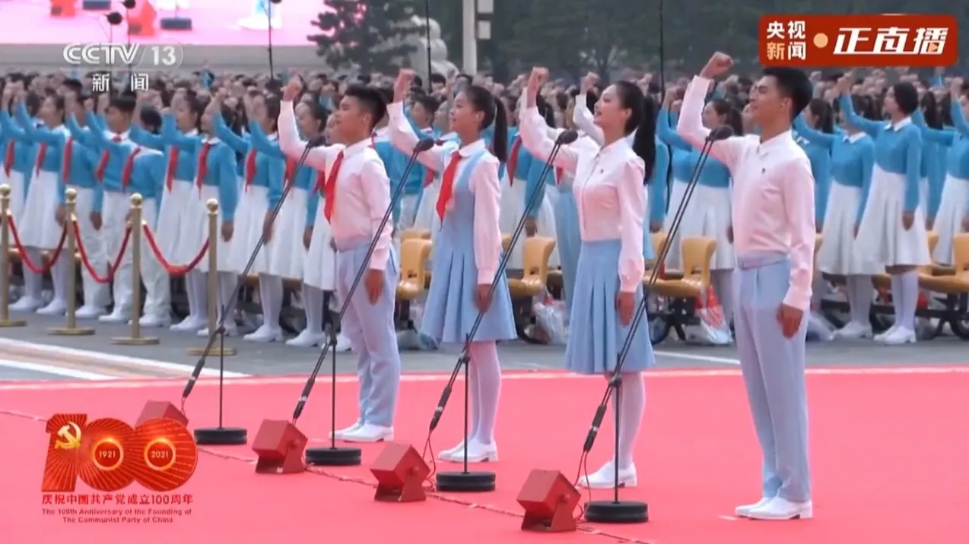
generation/ˌdʒenəˈreɪʃn/ n.一代(人)
4.认识到代沟还可以使孩子们对于不同年代间的差异持一种更包容的态度。若不认识到代沟，他们可能会指责父母未能理解他们。（应）
Recognizing the generation gap can also enable children who might
otherwise have blamed their parents for failing to understand them to
become more tolerant of the generational differences between them.
5.通过更好地了解世界及其人民，我们可以最大限度地获得和平
的全球环境和向我们开放的机会，并成功地实现今天这一代人
的使命。（应）
By better understanding the world and its people,
we maximize our chance of a peaceful global environment, the
opportunities that will open to us, and successfully deliver
today’s generational mission.

Slide 47
attract/əˈtrækt/ vt.吸引;引起…注意(兴趣)
be attracted to/bi əˈtræktid tə/ 喜爱
1.您能告诉我您最喜欢的是什么，以便我们的会议取得圆满成功吗? ^{2021年全国甲卷应用文“中国传统文化主题班会内容征求信”} （应）
Would you be so kind to tell me which attracts you most so that
our meeting can gain great success?
2.对于你们这一代的青少年来说，被电脑游戏和网络世界所吸引是很正常的。（应）
It is not unusual for teenagers of your generation to be attracted to computer games and the online world.
3.走在自然保护区，你会发现自己被那令人惊叹的景色所吸引。（应、续）
Walking in the nature reserve, you’ll find yourself attracted by the amazing scenery.

Slide 48
attract/əˈtrækt/ vt.吸引;引起…注意(兴趣)
be attracted to/bi əˈtræktid tə/ 喜爱
4.拉斐尔带着自信的微笑和我们打招呼，用一种迷人的声音分享他的故事，这让我惊呆了。（续）
Greeting us with a confident smile, Rafael shared his story with an attractive voice, which left me stunned.
5.中国有着悠久的历史和丰富的文化。对于那些热衷于任何中国事物的人来说,它一直具有吸引力。（应）
China enjoys a long history and rich culture. It has always been an attraction for those who are keen on anything that is Chinese.
6.然而，它的缺点也不能忽视，其中之一是容易分散那些缺乏自制力的人的注意力，比如电脑游戏、电视节目等。
2021年全国乙卷应用文“Be smart online learners演讲稿” （应）
However, its disadvantages cannot be ignored, one of which is easy to
distract those who lacks self-control to things like computer games,
TV shows and so on.

Slide 49
同义表达“吸引”
1.设计必须吸引所有年龄和社会群体。（应、续）
The design has to appeal to all ages and social groups.
2.这部电影以其令人惊叹的视觉效果和扣人心弦的情节吸引了观众。（应）
The movie fascinated audiences with its stunning visuals and gripping plot.
3.网红可以在短时间内迅速吸引人们的注意。（应、续）
Internet celebrities can grab people’s attention within a short time.
4.最大的吸引力源于游戏里的竞争十分刺激，但游戏也是一种社交体验。（应）
The main draw is the excitement of competing, but gaming is also a social experience.
5.她的讲故事技巧总是能够吸引观众，让他们迫不及待地想要听更多。（应、续）
Her storytelling skills never fail to captivate the audience, leaving them eager for more.
6. 这座城市集友善、美食、步行便利和历史于一身，令我着迷。（应、续）
The city’s combination of kindness, cuisine, walkability and history enchanted me.

Slide 50
同义表达“吸引”
7. 老师的讲故事技巧非常吸引人，激发了她的学生的好奇心。（应、续）
The teacher’s storytelling skills were so engaging that they evoked curiosity in her students.
8.创新的机器人比赛吸引了学生的注意力，鼓励他们探索令人兴奋的科技世界。（应）
The innovative robotics competition absorbed the students’ attention completely,
encouraging them to explore the exciting world of technology.
9.引人注目的广告会诱使我们购买我们实际上并不需要的东西。（应）
The eye-catching advertisements will trap us into buying things that we actually don’t need.
10.我不仅被爱尔兰的自然之美和音乐之美所吸引，它有许多音乐风格和
各种音乐节，我还被它的字面魅力所吸引，这个国家产生了许多杰出的
作家和诗人。2022年浙江1月高考应用文“中国—爱尔兰文化节活动中结交好友回国联络信” （应）
Not only was I struck by Ireland’s natural and musical beauty, with many
musical styles and various music festivals available, I was also spellbound
by its literal charm, a country producing many outstanding writers and poets.

Slide 51
focus/ˈfəʊkəs/ vi.&vt.集中精力等 n.焦点
focus on/ˈfəʊkəs ɒn/ 集中;特别关注
1.体操不仅能增强体质，还能培养自律和专注力。
^{2024年浙江1月高考应用文“校园课间体育项目推荐征文投稿”} （应）
Gymanstics not only enhances physical fitness but also
cultivates discipline and focus.
2.头发打结,南瓜肉盖着鼻子,我成了在网上收看视频的那些
人关注的焦点。^{2021年浙江1月高考读后续写 “万圣节南瓜趣事”} （续）
Hair in Knots and nose covered by pumpkin pulp. I became the
focus of attention of those who viewed the video posted online.
3.这一次，当她在巨大的教学楼里找路时，她没有感到头痛。
相反，她更注重每层楼不同地方的特色和独特设计。
^{2024年浙江1月高考读后续写“运用心理策略解决路盲问题”} （续）
This time, she did not feel a headache when finding her way
in the huge school building. Instead, she focused more on special features
and unique designs of different places on each floor.

Slide 52
focus/ˈfəʊkəs/ vi.&vt.集中精力等 n.焦点
focus on/ˈfəʊkəs ɒn/ 集中;特别关注
4.此外，在网络课堂上紧密跟随老师是明智的，这样我们就可以变得更加投入，专注和积极。
2021年全国乙卷应用文“Be smart online learners演讲稿” （应）
Besides, it’s wise to follow the teachers closely in online class so that we can become more involved, focused and motivated.
5. 在那纯洁而阳光明媚的脸上，只有一双眼睛，有些空洞，没有焦点。“他是个瞎子!” （续）
In the pure and sunny face were just a pair of eyes, somewhat hollow and focusless."He was blind!"

Slide 53
同义表达“专注于”
1.她上课很专心，从不遗漏任何细节。（应、续）
She is very attentive during class and never misses any details.
2.她全神贯注地看书，没有注意到时间的流逝。（应、续）
She was absorbed in her book and didn’t notice the time passing.
3.他专注于解决这道数学难题。（应、续）
He was engaged in solving the difficult math problem.
4.孩子们完全沉浸在游戏中，没有听到我们叫他们吃饭。（续）
The children were completely immersed in the game and didn’t
hear us calling them for dinner.
5.她专注于写书的创造过程中。（应、续）
She buried herself in writing a book.

Slide 54
同义表达“专注于”
6.她太专注于他自己的思想，没有注意到有什么不对。（应、续）
She was too preoccupied with his own thoughts to notice anything wrong.
7.保持专注!别让外面的音乐打扰你。（应、续）
Stay on track! Don’t let the music outside annoy you.
8.他的眼睛正盯着终点线，突然有两个人影从他身边呼啸
而过，吓了他一跳。（续）
His eyes were fixed on the finish line when suddenly tow figures
whizzed past, starling him.
9.爱丽丝坐在那里，眼睛紧盯着电视屏幕。（应、续）
Alice sat there with her eyes glued to the television screen.

Slide 55
addicted/əˈdɪktɪd/ adj.有瘾的;上瘾的;入迷的
addict/ˈædɪkt/n. 对…入迷的人;吸毒成瘾者
addicted to/əˈdɪktɪd tə/ 对……很入迷
1.得知你酷爱乒乓球,我写信诚邀你加入我们学校的乒乓球队。（应）
Learning that you are addicted to table tennis, I am writing to sincerely invite you to join the table tennis team in our school.
2.她的弟弟，一个小小手机迷，很难把他的注意力集中在学习上。（应、续）
It’s really hard for her brother,a young phone addict,to give his undivided attention to his study.
3.他对电脑游戏的沉迷使他的父母很担心，但我发现要他戒掉真的很难。（应、续）
His addiction to computer games got his parents anxious, but I found it really challenging for him to quit.
4.玩电子游戏是一种上瘾的行为，这已经影响到了青少年和大学生。（应）
Playing video games is an addictive behavior, which has affected teenagers
and college students.

Slide 56
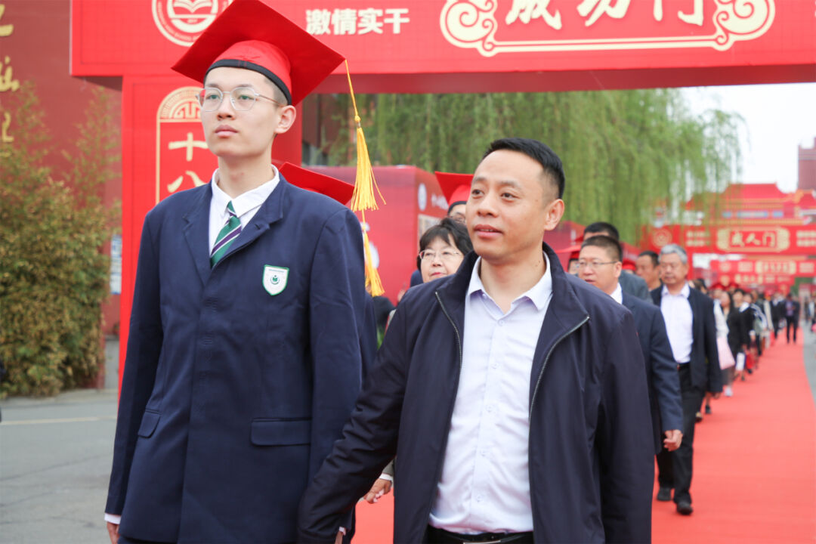
adult/ˈædʌlt/ n.成年人 adj.成年的
1.他们同意在即将到来的春假期间开始搜寻，但他们的计划对成年人保密，因为成年人无疑会反对这种危险的冒险。（续）
They agreed to start this search during the up-and-coming spring break,
keeping their plans a secret from the adults who would undoubtedly
discourage such a dangerous adventure.
2. 校长以一个振奋人心的演讲开始了这个仪式，他谈到了我们未来的责任和人生的新阶段，然后是一系列的传统仪式，标志着我们进入成年期。（应）
Our principal initiated the ceremony with an uplifting speech about our future responsibilities and the new stage of life that lies ahead, followed by a series of traditional ceremonies marking the transition into adulthood.

Slide 57
rel.sunedu.com
Thank You!

