Slide 1


感恩遇见，相互成就，本课件资料仅供您个人参考、教学使用，严禁自行在网络传播，违者依知识产权法追究法律责任。
更多教学资源请关注
公众号：溯恩英语
知识产权声明

Slide 2
Spelling Bee
分享信——2025届3月全国天域名校协作体高三
Kwok

Slide 3
目录
01
审题与能力分析
02
范例中学习写法
03
要点和语料输入
04
范文学习与拓展

Slide 4
原题呈现
假定你是李华，在学校刚刚举行的年度Spelling Bee (英语单词拼写大赛) 决赛中，你获得了一等奖，请给英国好友David写一封邮件分享你的喜悦，内容包括：
1．赛事简介；
2．你的感想。
注意：
1．写作词数应为 80个左右；
2．请按如下格式在答题卡的相应位置作答。
需平衡事实性信息（比赛细节）
与反思性内容（对经历的语言表达）
内容：是否完整覆盖两个要点并体现逻辑递进
语用：是否符合友人邮件的情境亲密度
语言：能否准确使用与"学术竞赛/情感表达"相关的语块

Slide 5
审题分析
维度 | 2025届3月天域名校协作体高三应用文
主题语境 | 个人成就分享与跨文化交流（英语学习成果的国际友人见证）
写信背景
体裁 | 非正式电子邮件（兼具信息传递与情感交流功能）
时态框架 | 赛事描述：一般过去时（决赛事件） 感想表达：一般现在时（当前感受）
逻辑层次 | 1. 赛事基本信息（性质/规模/结果） 2. 情感维度（个人成长/文化认同）→认知维度（语言学习启示）
高频词
潜在升华点 | 从拼写技巧到跨文化沟通能力的隐喻延伸 （如：每个正确拼写的单词都是文化解码的胜利）
Sharing with a foreign friend about winning a school English competition
academic accomplishment/cultural bridge/perseverance

Slide 6
范例中学习写法
Dear James,
Last month, my school organized a month-long reading activity named "Classics for English". I am writing to share it with you.
Aimed at improving students' English reading skills and developing their thinking quality, a wealth of events are designed, ranging from voting on the top ten must-read classics from students, to recommendation of classics from teachers, followed by sharing and exchanging reading experience as well as reading skills. Not only has this activity inspired my interest in English reading, it has also broadened my horizons, giving me a further insight into the culture and customs of foreign countries.
Does your school have similar activities? Looking forward to your sharing.
Yours,
Li Hua
假如你是李华，上个月你校组织了“读名著、学英语”活动。请你写信与你的英国笔友James分享此事，内容包括：
1.活动过程；
2.你的感想。
注意：
1．词数80左右；
2．可适当增加细节，以使行文连贯。
分享的目的阐发
分享的具体内容
感想体会

Slide 7
范例中学习写法
Last week, our school organized an event to celebrate Chinese Youth Day. Themed on "Spreading Positive Energy Among Youth", the event consisted of a series of activities including an award-winning film highlighting the spirit of Chinese youth, and a volunteer program for cleaning up the local community.
I felt inspired and energized by the activities, for they helped me better understand the significance of Chinese Youth Day and offered an opportunity to connect with other like-minded individuals and work together towards creating a better future for our country. I feel honored to have been a part of it.
上周你参加了学校组织的五四青年节活动。请你为自己的英文博客写一篇文章，内容包括：
1．活动的主题和内容；
2．你的想法和感受。
注意：
1．写作词应为80词左右；
2．可以适当增加细节，以使行文连贯；
分享的具体内容
感想体会

Slide 8

Summary
Greeting
→ State the purpose of writing
Opening
Briefly describe the event’s nature, scale, and process(if required)
→ Express feelings and lessons learned
A Letter of
Sharing
Main Body
Closing
Transition to recipient’s affairs
→ Friendly inquiry
Example: How have you been lately? I'd love to hear about your recent experiences too!

Slide 9
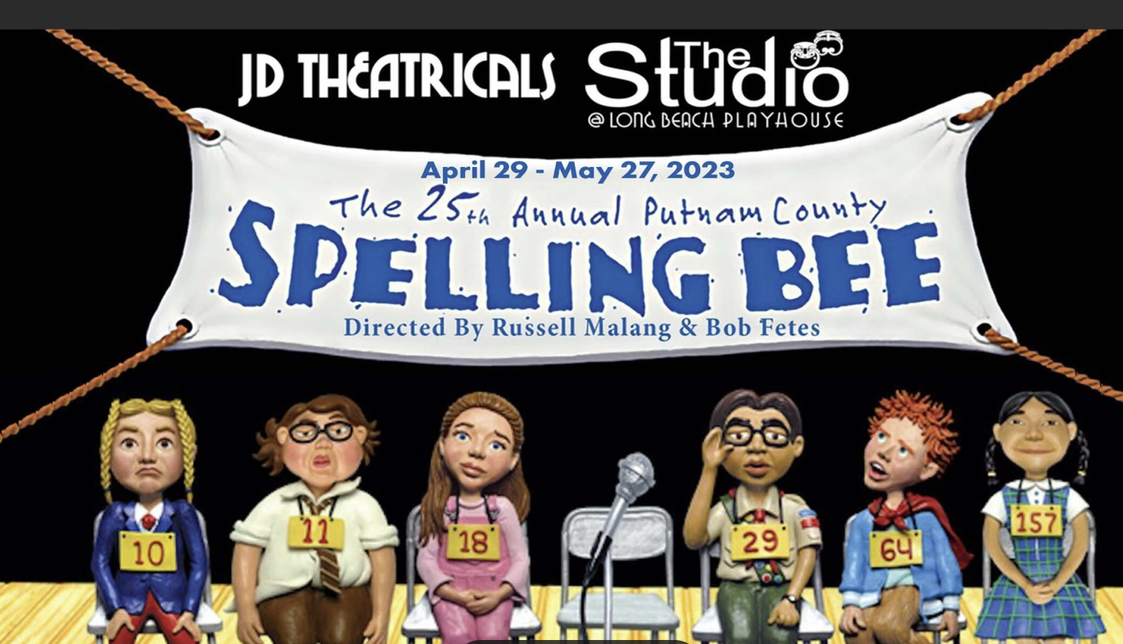
What is Spelling Bee?
A Spelling Bee is a competitive English-language contest where participants spell words aloud, traditionally popular in the U.S. and other Anglophone countries. It tests students' mastery of vocabulary, etymology, and phonetics. Contestants, typically aged 9–14, face progressively challenging words in elimination rounds until one champion remains. Beyond spelling accuracy, it evaluates composure under pressure and linguistic problem-solving—contestants may request definitions, sentences, or word origins.
Symbolizing academic rigor, it promotes literacy, discipline, and cross-cultural language appreciation, often inspiring lifelong linguistic curiosity.

Slide 10
赛事简介——概略化
官方范文
A Spelling Bee is a competitive English-language contest where participants spell words aloud, . It tests students' mastery of vocabulary, etymology, and phonetics. Contestants, typically aged 9–14, face progressively challenging words in elimination rounds until one champion remains. Beyond spelling accuracy, it evaluates composure under pressure and linguistic problem-solving—contestants may request definitions, sentences, or word origins.
Symbolizing academic rigor, it promotes literacy, discipline, and cross-cultural language appreciation, often inspiring lifelong linguistic curiosity.
A Spelling Bee is an English competition where contestants spell increasingly complex words aloud, testing vocabulary and phonetic mastery.
It evaluates composure, linguistic problem-solving skills, and fosters academic discipline.

Slide 11
赛事简介——具象化
维度1： 赛事构成（Composition）
The competition consisted of multiple rounds, starting with a written test and progressing to oral spelling challenges on stage.
维度2： 赛事要求（Requirement）
Contestants had to spell words orally without writing, face instant elimination for a single error, and tackle homophone traps(同音字陷阱) like 'stationary' vs. 'stationery'.

Slide 12
你的感想——“感”
Emotional Response
Holding the trophy, I felt an overwhelming mix of exhilaration and disbelief – all those late-night study sessions finally paid off!
I owe much to Ms. Zhang, who drilled me in Latin/Greek roots, and to classmates who mock-tested me – this victory belongs to our collective effort.
This achievement has given me a newfound confidence in my English skills and my ability to perform under pressure.

Slide 13
你的感想——“想”
Personal Growth
This journey taught me that perseverance matters more than natural talent; even “impossible” words become manageable through systematic breakdown.
Overcoming Challenges
When faced with 'mnemonic' in the final round, I almost panicked, but recalling its Greek root ' saved me – proof that calmness under pressure is half the battle!
Broader Significance
Beyond the glory, the Bee reaffirmed how languages connect cultures – every word I spelled carried centuries of human history and global exchange!
人文社会价值

Slide 14
你的感想——场景拓展
假定你是李华，上周末你们全家去户外露营。请你给英国朋友Chris写一封邮件分享这次经历，内容包括：(1) 露营过程；(2) 你的感想。
This trip allowed me to unwind from the pressures of school and strengthened my bond with my family. Being close to nature did bring me a deep sense of peace.
The raw emotion and creativity displayed during these performances were truly awe-inspiring. It was fascinating to see how English, a language that many of us learn as a second language, could be so powerfully used to express deep feelings and innovative ideas. This experience not only enhanced my appreciation for the art of poetry but also deepened my love for the English language.
你校英文报就最近举办的“当英语遇上艺术” (When English Meets The Arts) 系列活动开展征文。请你写一篇英文短文，分享其中让你印象深刻的一项活动，内容包括：1.活动介绍；2. 你的感想.

Slide 15
范文学习与拓展
Dear David,
I’m so excited to write to you! I won the first prize in the annual Spelling Bee final at my school. The Spelling Bee is a very interesting and intense event where all the participants need to spell various words accurately and quickly. Not only was it a test of vocabulary but also it was a battle of nerves. But I made thorough preparations and dedicated myself completely in the competition.
I feel overjoyed and incredibly proud of myself. This victory is of great significance for me, making me believe that hard work pays off. Moreover, I’ve realized that confidence and calmness are crucial during such competitions. How thrilling and rewarding this event was!
Looking forward to your reply. Best wishes!
Yours,
Li Hua

Slide 16
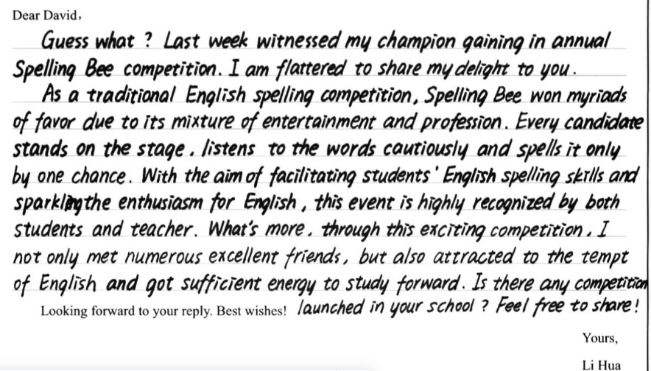
学生习作
Find out some mistakes or some expressions that are not idiomatic enough.

Slide 17

Some expressions……
Guess what? Last week, I won the championship in our school’s annual Spelling Bee competition! I’m so excited to share this news with you.
The Spelling Bee is a traditional English spelling contest that combines fun and learning.

Slide 18
THANKS

