Slide 1


感恩遇见，相互成就，本课件资料仅供您个人参考、教学使用，严禁自行在网络传播，违者依知识产权法追究法律责任。
更多教学资源请关注
公众号：溯恩高中英语
知识产权声明

Slide 2

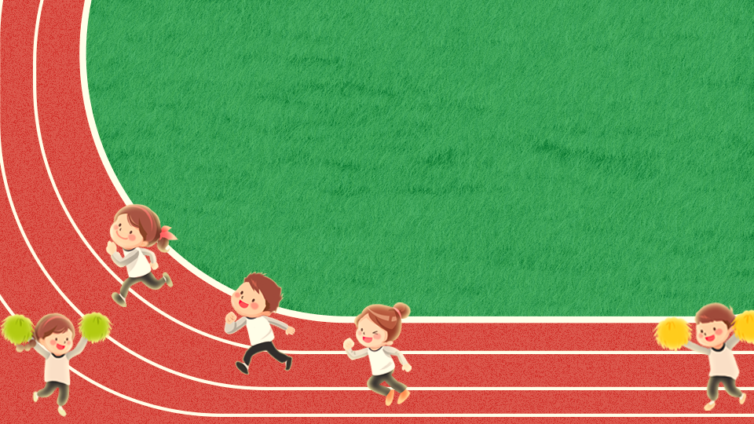
溯恩英语
GOING POSITVIE
张钊

Slide 3
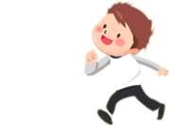

What
problems did Kayla have in the past?

Slide 4



1
worried about her weight
Kayla' problem
2
almost went bananas
3
compared herself with actresses & models

Slide 5
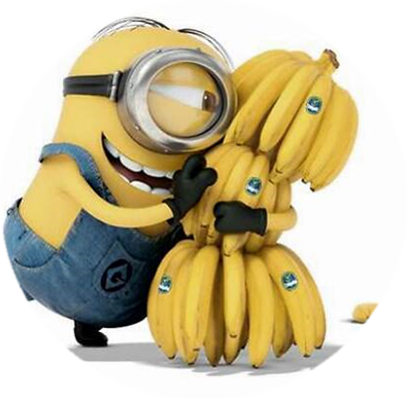
banana
go bananas
top banana
second banana
banana skin
embarrassing
situation
go crazy
big boss
substitute

Slide 6

What made her change her mind?
She read an article telling her to ask “Am I fit?” instead of
“Am I fat?”
The Past
The Present
Am I fat?
Am I fit?
研究成果
an article

Slide 7
Complete the outline with words and phrases from the text.
The Present
The Present
think about _________
rather than
__________
made a list of things________
_____________
fitness
I liked
about myself
weight
The Past
The Past
worried about _________
and tried __________
__________
compared myself with
__________________________
my weight
every diet I read about
actresses
and models

Slide 8
Analyze the change of Kayla's emotion
Worried
01
I wanted to look slim.
I worried about my weight.
I almost went bananas.
Reasonable
02
I thought about fitness rather than weight.
I added healthy foods to my meals.
Positive
03
I made a list of things I liked about myself.
Being positive about myself and my body, I became both happier and healthier.

Slide 9
Underline the words and phrases to show similarities and differences:
I always wanted to look like the slim girls on TV even though I knew that it was impossible. I worried about my weight and tried every new diet I read about online. I tried no-fat, low-fat, 5: 2, only bananas, no bananas—I almost went bananas, too.
Then I read an article that said instead of asking “Am I fat?” I should be asking “Am I fit?” I had no idea a letter could make such a difference! Once I started thinking about fitness rather than weight, things began to change. Instead of saying “I want to lose three kilos”, I would say “I want to run two kilometres in eight minutes” or “I want to be able to do 30 push-ups”. Rather than cutting out the foods I enjoyed, I added healthy foods to my meals. I could still have a burger now and then, but I would add a salad or an apple.
Finally, I stopped comparing myself with actresses and models and looking for things that were wrong with my face or body. Instead, I made a list of the things I liked about myself. By being positive about myself and my body, I became both happier and healthier.
1
differences
2
similarities

Slide 10
Express the same meaning with the given words below.
Many people's problems are like mine.
similar
Many people's problems are similar to mine.
same
Many people have the same problems as mine.
alike
Many people and I have problems alike.
have...in common
Many people have problems in common with me.

Slide 11
Express the same meaning with the given words below.
I put more vegetables than meat in my diet .
instead of
I put more vegetables instead of meat in my diet .
rather than
I put more vegetables rather than meat in my diet.
not...but
I do not put much meat but more vegetables in my diet.
The difference is
The difference is that there are more vegetables than meat in my diet.

Slide 12
书面表达
假定你是高中生李华，你校的英语俱乐部举行了一次演讲比赛，内容是介绍自己如何通过适当的锻炼和饮食获得健康了的体魄。请你根据以下要点写一篇演讲稿：
1
Start with a general statement about the topic and your situaition.
2
Tell the reader about how and why you changed or want to change.
3
Describe the changes and compare the possible results.
4
Tell the reader how the changeds have improved or will improve your life.

Slide 13

1
Start with a general statement about the topic and your situation.
Hello, guys, I'm Lihua. I'm honored to have the chance to share my story of keeping fit with you. I believe many students may have similar experience with me.
Since I entered senior high school, I have so much homework to do and I was always feeling sleepy and exhausted in class. My weight kept going up all the time until someone called me “Fatty” .

Slide 14
2
Tell the reader about how and why you changed or want to change.
I couldn't help feeling worried about myself. So I went to my head teacher to ask for his advice. He suggested that I take a jogging for half an hour after class every afternoon. What surprised me was that he even organized a group with several of my classmates who had the same problem as mine. We keep jogging every afternoon and we enjoy each other's commpany and encouragement. We cut down the fat in our diet and added more fruit and vegetables to it. Most importantly, we drink water instead of sodas.

Slide 15
3
Describe the changes and compare the possible results.
Our efforts are not spent in vain. We stopped putting on weight and, even began to lose it. We feel more energetic and less sleepy in class. What a cheerful turn!

Slide 16
4
Tell the reader how the changes have improved or will improve your life.
Now I feel a lot more confident.I even won a prize in the school's sports meet. This inspires me to determine to make jogging my life-time hobby. Time permitting, I'll try more forms of sports in the future.
So guys, try some sports and you'll fall in love with them.

Slide 17
Try to write a speech draft with the sample above.
Hello, guys, I'm _______. I'm honored to have the chance to share my story of keeping fit with you. I believe many students may have similar experience with me.
Since I entered senior high school,(problem 1) and I was always (problem 2). (Problem 3).
I couldn't help feeling worried about myself. So (solutions). (Detail 1). (Detail 2). (Detail 3).
Our efforts are not spent in vain. We stopped _______________ and even began to _____________________. We feel more ____________ and less _____________________. What a cheerful turn!
Now,I (result 1).(Result 2).(Result 3).Time permitting, I'll try more forms of sports in the future.
So guys, try some sports and you'll fall in love with them.

Slide 18
溯恩英语
Move Joy Fit
张钊

